Slide 1
Whole Home Media Access Over Mixed Topologies
Tim Looney
Strategic Alliance Manager
Consumer Hardware Alliances
Advanced Micro Devices

Slide 2

Digital Media In The Home
Mobile
Communications
Home Theater
Internet
Content
Cable/Satellite
Content
Media Sharing
Music
Photography
User Content
HD Video

Slide 3

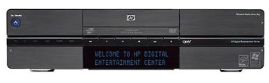

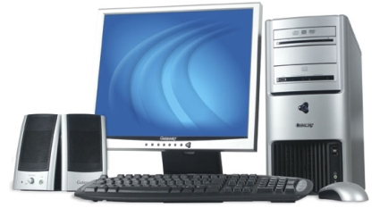

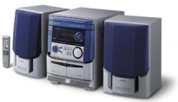


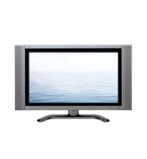

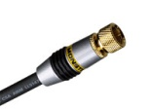
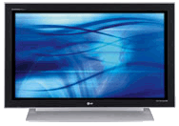


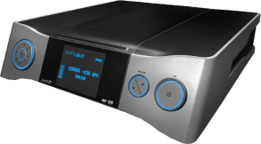
Digital Media In The Home
AC power
coaxial
cat5
Closet
Wi-Fi
Bedroom
Office
AMD LIVE!™ Home Media Server
AMD LIVE! Extended PC
cable or
satellite
Kitchen
Living Room
AMD LIVE!™ Digital Home Cinema
AMD LIVE! Extended PC

Slide 4
Whole Home Media Access The Digital Media Landscape
Today’s consumer…
Is being inundated with increasing amounts of high-quality digital media
Wants consistent, secure, anytime access to it all – from everywhere in their home
Needs high performance, interoperability, ease of use
But…
Many inhibitors are holding back this vision from becoming reality

Slide 5
Digital Media Requirements
MPEG-2 (DVD Quality)
~2-10Mbps / stream
HD Video
Uncompressed (e.g., 24 bpp RGB, HDMI)
1.2 Gbps (720p) – 3 Gbps (1080p)
Typical Compressed (e.g., H.264/AVC HiP)
~10-30+ Mbps / stream
“Trickplay” can double/triple streaming bandwidth requirements
3 simultaneous compressed HD trickplay-enabled streams can easily require end-to-end 200 Mbps+

Slide 6
Networking Choices
“Reliable” Bandwidth
Most transports advertise unrealistic performance
Peak, raw, and physical layer performances are not real-world
Realistic throughputs are often less than half max
Example: IEEE802.11b: 11mbs versus ~5mbps real-world
All networks share bandwidth
Reliability and performance are that of weakest link
There are no guarantees in shared wireless fabrics

Slide 7
Real World Bandwidth
600
Wireless
Wired
500
400
Mbps
300
200
100
0
802.11b
802.11a/g
WUSB
MoCA
802.11draft-n
Fast Ethernet
Powerline TCP
Worst case
Bluetooth 2+EDR
Gigabit Ethernet
Powerline UDP
Best case
Theory Max
Note: Values are estimates and vary due to many conditions!

Slide 8
Network Reliability
Asynchronous (e.g., IP)
Packet-based, dynamic routing, variable latency
IP is not “reliable.” Reliability is added by TCP, custom UDP datagram handling, or error correction
IP AV apps such as IPTV or VoIP need constant bitrate, and do not fare well with TCP congestion avoidance algorithms, out-of-order packets, etc.
Typically rely upon priority based schemes
802.11p/q, 802.11e, Wi-Fi WMM
Isochronous (e.g., isochronous USB)
Typically rely upon reservation/slot systems
Static, synchronous routing for the entire stream

Slide 9
Mixed Topologies
Paradigms for networking and services
Unification
Services and content run over the same physical network using common protocols
Co-existence
Services and content run over the same physical network but each uses different protocols
Separation
Services and content each run over their own physical network

Slide 10
Mixed Topologies
Wireless is necessary for mobile and handheld devices
Wireless LAN (i.e., Wi-Fi) is insufficient to meet all needs of all homes by itself
Quality inconsistent over space / time
Stone/steel construction (e.g. Europe)
Wired backbones will complement wireless
Ethernet – 100Mbps, Gigabit, 10Gig
Coaxial – MoCA, UWB on coax, 1394 on coax
Powerline – HomePlug AV, UPA, HDPLC
Phoneline – HomePNA

Slide 11





Mixed Topologies
Wired Backbone + Wireless PAN or LAN
Wireless LAN
Wired
Backbone

Slide 12
UWB Flavors
Radio convergence,
protocol divergence
IP over BT
over WiMedia
IP
over 1394
over WiMedia
IP
over WiMedia
(WiNet)
IP
over other
UWB
USB
P-to-P
Device Classes
1394
Isoch Protocols
BT
Profiles
other UWB
Bulk
Isoch
IP
IP
Wireless USB
Bluetooth
IEEE1394
(FireWire)
IP
IP
WiMedia Compliant MAC
Other
UWB
MAC/PHY
WiMedia Compliant PHY
IP (packet-based)
Non-IP (isoch)
Non-IP

Slide 13
Content Protection And DRM
Premium content has to be addressed with consideration of the source
One size does NOT currently fit all
To license premium content, one must use the system that the content provider specifies
No interoperability between current DRM systems
As a result of their goal to prevent unauthorized viewing, systems are designed to prohibit interoperability by default
Some schemes will never be allowed to operate over some transports

Slide 14
Content Protection And DRM
Popular CP/DRM technologies/systems
Microsoft® Windows® Media DRM
WMDRM-ND (Cardea), WMDRM-PD (Janus)
Approved output for Cable, 5C, 4C, AACS, DLNA v1.5
Apple FairPlay
4C – CPRM/CPPM
5C – DTCP – DTLA
Approved by HANA, CableLabs for IEEE1394
IP version specified by DLNA v1.5, not approved for Cable
HDCP, AACS, CSS – DVI/HDMI, HD-DVD/Blu-ray, DVD
Industry groups currently tackling CP/DRM
Coral Consortium
DLNA – Digital Living Network Alliance
HANA – HD Audio Video Network Alliance
OMA – Open Mobile Alliance
CableLabs
DVB CPCM

Slide 15

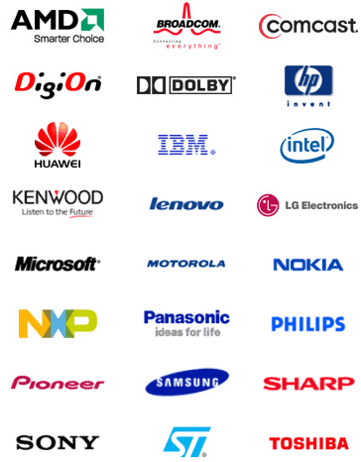
DLNA Digital Living Network Alliance
DLNA Promoters
200+ Member companies
An industry consortium targeting a wired and wireless interoperable network of PCs, consumer electronics, and mobile devices in the home
Architecture Guidelines
Media Format Guidelines
Link Layer Guidelines
Test tools, logos, plugfests, marketing initiatives

Slide 16

DLNA Versions and features
Link Layer
Network Security
Remote
User Interfaces
Electronic
Program Guide
New Media
Formats
DLNA v2.0 Phase 1
More Functions
Publish: 2007?
Scheduled
Recording
Services
Content
Synchronization
Link Protection
DLNA v1.5
New device classes
Published 5/2006
Smart Phones
Media Renderers
Playlists
Mobile Friendly Media Formats
Smart Remotes
Media Controllers
Download
RPT
QoS
PDAs
Printers
Upload
Bluetooth
DLNA v1.0
Framework for sharing content Published 2004
JPEG, LPCM, MPEG2
UPnP AV 1.0
UPnP Device Architecture 1.0
HTTP 1.0/1.1
IPv4 Protocol Suite
Wired: 802.3i, 802.3u; Wireless: 802.11a/b/g

Slide 17
Microsoft Windows Rally
Link Layer Topology Discovery (LLTD)
Allows apps to quickly discover devices at the data link layer
Network Map: (Windows Vista) a centralized, graphical web view
Enables quality media streaming through QoS extensions
Windows Connect Now (WCN)
Allows transfer of wireless settings from PC to wireless devices
Wi-Fi Protected Setup (Simple Config)
Web Services on Devices (WSD)
Devices Profile for Web Services (DPWS)
Uses web services for security, discovery, addressing, eventing
Network devices implement to gain discovery and events
Plug and Play Extensions (PnP‑X)
Supplements UPnP or WSD, for USB-like discovery on IP
Use UPnP for AV use cases, PnP-X for anything else

Slide 18
Whole Home Media Access
Many Significant Inhibitors
Multiple “standard” and proprietary protocols
Varying data rates, latencies, asynch versus isoch
Home construction, layout, existing wires
Bandwidth requirements of HD video
Spatial and temporal degradation of wireless
Inconsistent support for QoS
Media format and codec support
Content protection / Digital Rights Management
Network security, authentication, authorization
Ease of setup, integration, use
Etc.

Slide 19
Call To Action
Test your products over mixed topologies
Support QoS
Microsoft Rally LLTD Extensions
Choose standards-based, and Windows Vista-certified technologies
All roads lead to IP
DLNA, UPnP AV
Wi-Fi Alliance, WiMedia, MoCA, HomePlug AV, etc.
Microsoft Rally, Certified for Windows Vista
Use Operating System components for network plumbing where possible

Slide 20
Additional Resources
AMD LIVE! http://www.amdlive.com
Bluetooth Special Interest Group http://www.bluetooth.org
Coral Consortium http://www.coral-interop.org
DLNA: Digital Living Network Alliance http://www.dlna.org
Microsoft Rally http://www.microsoft.com/whdc/rally
MoCA: Multimedia over Coax Alliance http://www.mocalliance.org
OMA: Open Mobile Alliance http://www.openmobilealliance.org
Powerline
HomePlug AV http://www.homeplug.org
UPA: Universal Powerline Association http://upaplc.com
HD-PLC: (Panasonic) http://www.hd-plc.org
UPnP Forum http://www.upnp.org
Wi-Fi Alliance http://www.wi-fi.org
WiMedia Alliance http://www.wimedia.org
Wireless USB http://www.usb.org/developers/wusb
Contact: winhec2007 @ amd.com

Slide 21
ATTRIBUTION
AMD, the AMD Arrow logo, AMD LIVE!, and combinations thereof are trademarks of Advanced Micro Devices, Inc. Other names are for informational purposes only and may be trademarks of their respective owners. Microsoft, Windows, and Windows Vista are registered trademarks or trademarks of Microsoft Corporation in the United States and/or other countries

