Slide 1
Home Media Transports
Dr. Anton Monk
CTO
Multimedia over Coax Alliance

Slide 2
Agenda
Introduction to Multi-room DVR
Home Networking Requirements
MoCA as Industry Standard
MoCA Field Trial Data
MoCA Features

Slide 3
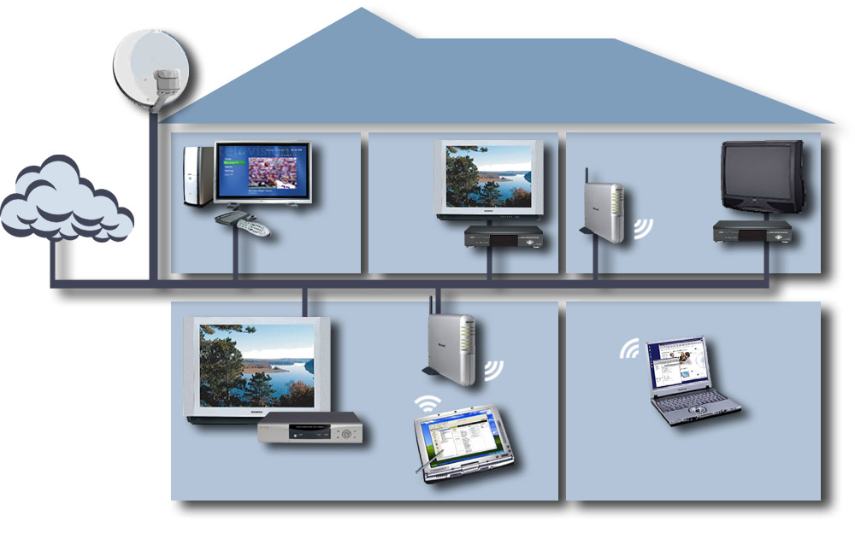
Multi-Room DVR – The “Killer App”
DBS
Office/Den
Master Bedroom
Kids Bedroom
802.11
Bridge
Cable, Telco
Media Center PC
Client STB
Client STB
Coax
Coax
Broadband Multimedia
802.11 Wireless
AP
WebPad
Home Server - DVR
Family Room
Kitchen

Slide 4
Home Networking Requirements (1 Of 3)
Reliable and ubiquitous
  Works where your TV and STB works
  Clean, dedicated, shielded medium with open frequency band
Simple to install
  No new wires (or splitters)
  Retail or non-truck roll solution
High performance: >95% solution
  With reasonable remediation for remaining <5%
  Net Throughput > 100 Mbps
  Packet Error Rate < 1e – 5
    Delay < 10 msec; Jitter < 1 msec

Slide 5
Home Networking Requirements (2 Of 3)
Delivers “no excuses” HDTV and DVD quality
  Supports and coexists with:
    Cable, DBS, Terrestrial
    Telco, CE, PC
  Supports content protection, key protocols,
  high data rates
  Consistent with DLNA, DTCP-IP, CableHome, UPnP

Slide 6
Home Networking Requirements (3 Of 3)
Meets all key market requirements
  Enables cost-effective multi-room DVR
    Including HDTV
  Satisfies any-room access to all home media:
    Video, audio, voice
    Data, gaming, control
  Saves installation and deployment costs
  Future-proof support of >1 Gbps home network

Slide 7
Industry Standard (1 Of 3)
Open, industry-driven alliance, promoting:
  Networking of digital video
  and entertainment
  Through existing coaxial cable in the home
Only alliance with board-of-directors representation from:
  Telco, Cable, DBS, and Retail
Field tested and deployed…
43 members and counting…

Slide 8
Industry Standard (2 Of 3)
Field tests of 250 homes
  >110 Mbps net throughput
  …in 97 percent of all outlets
Completed 4 certification waves with
17 certified products
MoCA MAC/PHY 1.0 approved
  Distributed to members in January 2006
Deployed in well over 200,000 homes
  In U.S., to date

Slide 9









































Industry Standard (3 Of 3)
Promoter Members Associate and Affiliate Members

Slide 10
MoCA Field Trial Data Rate Results (1 Of 2)
250 homes, 15 cities, 120 zip codes, 5K+ person-hours
>110Mbps net/usable > 97% of outlets without remediation
Performance: Percent of Paths versus Bit Rate
100
90
80
70
100 Mbps
60
% Paths
50
40
30
20
10
0
0
50
100
Mbps
150
200
250
PHY Rate
Throughtput (MAC) Rate

Slide 11
MoCA Field Trial Data Rate
Results (2 Of 2)
Packet Error Rate less than 10-6
Latency less than 5ms
Net usable (MAC) data rates:
  With no changes to home coax system:
    97% of all paths in all homes achieved ≥ 110 Mbps
  With simple remediation to installed coax cable system:
    100% of homes achieved ≥ 95 Mbps on every path in the home
Validated in mass deployment by Verizon FiOS service

Slide 12
MoCA Features (1 Of 2)
Physical Layer
  Automatically pre-equalizes modulation
  to path frequency response
  Each path independently and
  continuously optimized
  Up to 270 Mbps PHY
  PER < 10-6 (no retransmissions, low latency)

Slide 13
MoCA Features (2 Of 2)
MAC Layer
  Fully scheduled protocol (no collisions)
  Automatically selected and mobile
  network coordinator
  Support for admission control and parameterized QoS
  Privacy
  >100Mbps net (UDP) throughput

Slide 14
MoCA Frequency
Coexistence (1 Of 2)
Coax and splitters support reliable communications above 860 MHz
Coexistence with existing services
(next slide)
MoCA is the only solution which…
  …meets the strict requirements of a multimedia home network
  …including coexistence with all service providers’ frequency plans

Slide 15
MoCA Frequency
Coexistence (2 Of 2)
Coexistence with existing services
  CATV Cable Modem upstream (5 to 42 MHz)
  UHV/VHF video and Cable Modem downstream
  to 806/860 MHz
  DBS services from 950 to 2150 MHz
1
5-42
Upstream
CM
54-806/860
Off-Air/CATV
MoCA
MoCA
…
MoCA
5-42
Upstream
CM
54-806/860
Off-Air/CATV
MoCA
950-2150
Satellite L-Band
2

Slide 16
Summary (1 Of 2)
Home usage model
  Room-to-room, peer-to-peer, full mesh connectivity
  >100 Mbps net throughput
  No-excuses, glitch-free video
  Consumer- or Service-provider enabled
Medium for whole home reliable,
maintainable coverage
  Connections collocated with TVs and other video devices
  Coexists with existing services and devices
  Medium used “as is” – no new cables, splitter replacements

Slide 17
Summary (2 Of 2)
Real world validation
  >110Mbps in 97% of all connections
    Reasonable remediation for other connections
  Mass deployment by Verizon FiOS service
  Deployment expected by other operators 2H07
MoCA meets all requirements for home networking digital entertainment without compromise

Slide 18

Additional Resources
Web Resources
  MoCA Alliance: http://mocalliance.org
  Whitepapers: http://www.mocalliance.org/en/industry/
  whitepapers.asp
Contact
anton.monk@mocalliance.org

