Slide 1
Home Media Transports: HomePlug AV
Andreas Melder
Senior Vice President
Intellon Corporation

Slide 2
Agenda
A Market Look at Tomorrow’s Digital Home
Wired and Wireless architectures
The HomePlug Powerline Alliance Ecosystem
Elements of HomePlug AV Architecture
HomePlug AV in Action
Usage models
The Future of HomePlug

Slide 3
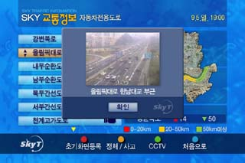

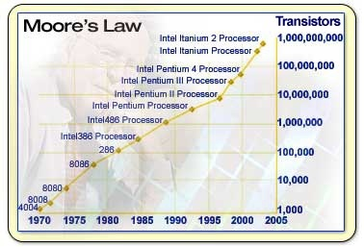

Global Forces
Broadband Access Ramps
All Content Going Digital
Movies
Video Chat
Watch and Chat
Real-Time Traffic
Interactive Sports
Personal Content
Source: Instat*
Displays → High res, larger
Moore’s Law Driving New Apps
CE Devices can connect seamlessly with the PC ecosystem
Even Utilities are innovating!
* Other names and brands may be claimed as the property of others.
Source: Isuppli* Q4’04

Slide 4


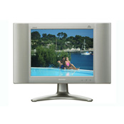



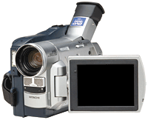

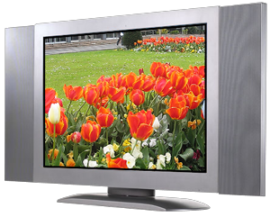

New Devices And Usage
Net Connected
Internet Movies
Online Gaming
Video and Chat
Web Browsing
Voice/Video over Internet
PC/CE Get Connected
Access Photos/ video directly
Access point to Digital Home
Internet Protocol TV, DSTBs, and Connected PCs
Outside Devices Now Connected
Access photos, music, and video
Internet Movies Networked PVR
Alerts – Caller ID, e-mail
Automatic Meters
Connected Electric Grid
Home Automation
HomePlug Will Connect Them All!

Slide 5
Why Is Powerline On The Verge Of Ubiquity?
95% of the world’s households have electricity
That means they already have a home network!
No need to install Ethernet cables, no “truck-rolls”
Several electrical outlets in every room
Services everywhere in the home
Meets quality of service requirements for video, audio, data
Consistent performance everywhere in the house
Goes “through” walls, up floors, down floors and everywhere else
Plug and Play technology – simple to use
A single technology that can be used in BPL, in-home networking, and command and control applications
Powerline is the “Dark Wire” that is about to be “lit”!

Slide 6
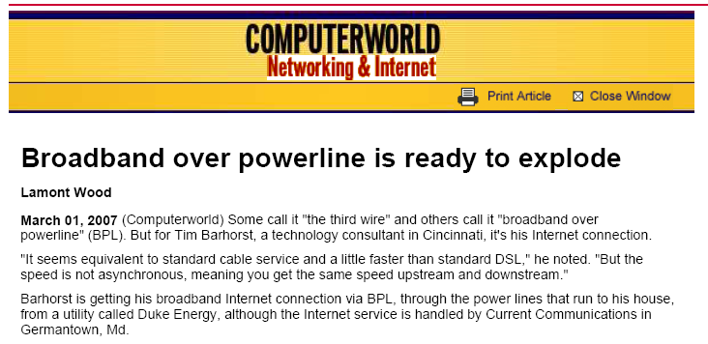
Significant Global Powerline Growth
Worldwide Unit Shipments for Broadband
Powerline Equipment Surpassed 2 Million
Research and Markets has announced the addition of Broadband
Powerline Networking Gets a Jolt from IPTV to their offering. Powerline networking offers a solution with some advantages
over coax and twisted-pair cabling for in-home deployment,
especially in regions with little existing coax or phone line jacks,
such as in EMEA, China, and many Asia-Pacific countries.
At this time, we do not believe that there will be one clear technology
winner in the networking interface race between coax, phone line, and
powerline; however, our current analysis points toward powerline as
winning on a worldwide scale.
InStat - Broadband Powerline
Networking Gets a Jolt from IPTV
Powerline networking offers a solution with some advantages over coax and twisted-pair cabling for in-home deployment, especially in regions with little existing coax or phone line jacks, such as in EMEA, China, and many Asia-Pacific countries. At this time, we do not believe that there will be one clear technology winner in the networking interface race between coax, phone line, and powerline; however, our current analysis points toward powerline as winning on a worldwide scale. In 2005, worldwide unit shipments of broadband powerline equipment surpassed 2 million, and the market has reached an inflection point this year that points only upward.
Broadband Powerline Networking
Will Win in Residential Networking
Broadband powerline networking, a wired technology
that does not require new cabling to be installed,
is poised to emerge as a winner in the residential
networking interface race on a worldwide basis, reports
In-Stat. Powerline networking has advantages over coax
and twisted-pair cabling for in-home deployment.
This is especially true in regions with few existing
coax or phone jacks, such as in EMEA, Asia, and Pacific
Rim countries, the high-tech market research firm says.
Internet TV Use Expected to Soar
The number of subscribers to Internet television worldwide is expected
to increase twelve fold by 2010, bringing with it a host of new services
for consumers, a market research firm said Thursday. The number of
IPTV subscribers is expected to increase at a compound annual growth
rate of 92.1 percent to 63.1 million in 2010 from 2.4 million last year,
iSuppli Corp. said. The number of subscribers is expected to reach 5.3 million this year

Slide 7
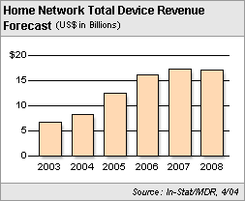
Significant APAC Home Networking Growth
In-Stat Asia/Pacific Survey
“Asia will eclipse North America for the region with the most home networks by 2008, rising from 27% of all home networks worldwide in 2004 to 36% in 2008, with North America dropping from 46% to 34% in the same time span”
Home Networking = $17 Billion (US$) Market

Slide 8




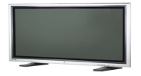






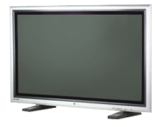







Emerging Home Network
Content Sharing
Comm Services
Other
DVD/VCR
Automation
Monitoring
Security
STB
Stereo
Misc Bridge
Misc Bridge
ePC
Local Cluster Bridge
BB
Modem
Home Network Back Bone
RG
AP
Media
Server
IPTV
Stereo
Games
STB
Wired Backbone
Entertainment Services
WLAN
Wired or Wireless
Today’s Home Networks
HomePlug Will Connect Them All!

Slide 9
HomePlug Powerline Alliance Overview

Slide 10










HomePlug Organization
Implementer’s Forum BOD
New Since
Aug. ’05
Mgmt
(GI)
Legal
(SCLS)
Marketing Working Group
Japan Working Group
Strategy Working Group
AV/1.0 Technical
Working Group
Access/BPL
Technical Working Group
Command & Control
Technical Working Group
TWG
Compliance & Interoperability Working Group
Regulatory Working Group
Policy Creation and Management Working Group
BPL Specification Working Group
CC Specification Working Group
Marketing Liaisons
AV Specification Working Group
AV Field Test Working Group

Slide 11

HomePlug Enablement

Slide 12

Membership Statistics
HomePlug Ecosystem Thriving
3M units in Oct ’05
9+M units currently
~11M units by Oct ’07
Volumes now at >1M units/qtr
HomePlug Alliance Membership
HomePlug Seminar ’07: ~100 Members (projected)
HomePlug Seminar ’06: 70 Members
HomePlug Seminar ‘05: 47 Members
Driving Factors for Growth
Open standard
Compliance program
Interoperability
Coexists with millions of products in market
Technology used in multiple applications
HomePlug AV
HomePlug BPL
HomePlug C&C
HomePlug is the Leading Powerline Standard

Slide 13

HomePlug Ecosystem
HomePlug is the global leader in PLC standards
Major industry players are backing HomePlug
Over 70 members worldwide and growing fast
Only true PLC standard, with complete global ecosystem, multiple IC providers, and strong compliance testing
HomePlug Alliance Sponsor/Board Members

Slide 14
Candidate Wired Options
Medium | Standard | Actual Thru-put | QoS | No new wires | Multi- sourced | Whole House Coverage
CAT-5 | Ethernet | ✓ | - | ✗ | ✓ | ✓
Phoneline or Coax | HomePNA 3.0 | ✓ | ✓ | - /✗ | ✗ | ✓
Coax | MoCA | ✓ | ✓ | - /✗ | ✗ | ✓
Powerline | HomePlug AV | ✓ | ✓ | ✓ | ✓ | ✓
HomePlug AV – Best Suited for Global Wired Use in the Digital Home

Slide 15
Agenda
A Look at Tomorrow’s Digital Home
Wired architectures
Wireless architectures
The HomePlug Powerline Alliance Ecosystem
Elements of HomePlug AV Architecture
Windows Vista – Block Diagram with HomePlug AV
Features of HomePlug AV Architecture
PHY Functional Description
MAC Functional Description
Frame Formats
Management Messages
Service Access Points; Convergence Layer Functions
HomePlug AV in Action
Usage models
The Future of HomePlug

Slide 16
Vista LLTD, qWave, WCN

Slide 17
HPAV System Architecture Overview

Slide 18
PHY Layer
Windowed OFDM – 917 channels from 2–28 MHz
Easy, efficient, configurable creation of nulls to satisfy regulations
Well suited to frequency selectivity of powerline channel (see next slide)
Power Spectral Density Versus Frequency
Nulls created simply through configuration. Spectral nulls required to avoid interference with amateur bands. Different rules in different countries

Slide 19
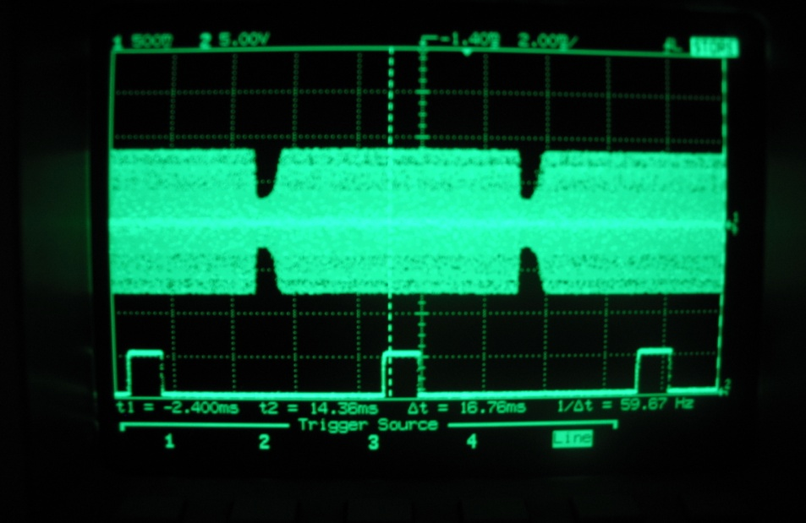
PHY Layer
Each tone (a.k.a. OFDM channel) loaded with 2,3,4,6,8, or 10 bits
Includes Robust Modes (ROBO) for broadcasting
Up to 200 Mbps channel and 150 Mbps information rate (after FEC)
Turbo FEC for near-capacity performance
Time Selective Channel
Frequency Selective Channel

Slide 20
MAC
Centrally managed network (CCo)
Beacon period synchronous with AC Line
Persistent and non-persistent allocation
Provides reliable QoS on noisy PL medium
Contention free (connection oriented) and CSMA/CA periods (connectionless traffic)
Neighbor network coordination
Sharing channel with other AV networks (MDUs)

Slide 21
MAC
Networking timing and synchronization
Channel adaptation and recovery procedure
Partial ACK for broadcast and multicast
Bridging
Segmentation and reassembly
Packet bursts
ARQ, SACK and retransmissions
Encryption – 128 bit AES
Jitter control

Slide 22
QoS
Connections
Parameter Based QoS (TDMA)
Priority Based QoS (CSMA)
Higher Layer Entities (HLEs)
Connection Specification (CSPEC) and Control
QoS Management and Control
Connection Manager (CM)
Connection Management and Monitoring
CCo
Bandwidth Management and Scheduling
Convergence Layer (CL)
Packet classification, QoS Monitoring, etc.

Slide 23
Security
Encryption
Mechanisms
128 bit DES encryption
SHA 256 hash algorithm
Uses
NMK: Network access authenticated by Network Membership Key
NEK: Encryption of “all” data and MMEs with Network Encryption Key
DAK: Device Access Key to securely distribute NMK to a station
Three “security” modes
Unprotected: Default NMK for simplified “out-of-the-box” operation
User Confirm: Simple button push separation of your network from your neighbor’s
Secure: Security as strong as the password
Strong encryption keys generated by the machine or from user-entered passwords

Slide 24
HomePlug AV In Action Self-contained HomePlug AV
Uses
DMS to DMR
IPTV to DMR
PC to PC
PC to Gateway
PC
HD TV
Media
Server
Games
Internet
Printer
IPTV
Internet
STB
Stereo
RG –HPAV
Bridge
PC
HomePlug AV
Wired or Wireless

Slide 25
HomePlug AV In Action HomePlug AV with wireless network endpoints
Uses
AV Backbone
WLAN/WPAN cluster in every room
HPAV-AP
Bridge
Stereo
HPAV-WPAN
Bridge
HD TV
PC
DVD/VCR
Printer
HPAV-AP
Bridge
IPTV
Internet
HPAV-AP
Bridge
IP Telephone
STB
Media
Server
PC
RG –HPAV
Bridge
HomePlug AV
WLAN
Wired or Wireless

Slide 26
HomePlug AV In Action Hybrid networks
Networks
HP AV
WLAN/WPAN
HP v1.0
HD TV
DVD/VCR
Stereo
HPAV-AP
Bridge
PC
HPv1.0–HPAV
Bridge
IP Telephone
IP Telephone
Printer
Internet
HPAV-AP
Bridge
Games
STB
Stereo
IPTV
Media
Server
HomePlug AV
PC
RG –HPAV
Bridge
HomePlug 1.0
WLAN
Wired or Wireless

Slide 27

Summary
Hybrid Wireless and Wired Networks are the Dominant In-Home Solutions
HomePlug AV Provides the Most Ubiquitous Wired Networking Solution for AV Content
HomePlug AV is complimentary to wireless networks
Physical Layer Designed for Robust Operation
MAC Layer Designed for Highly Efficient Operation
Industry Leading Security Measures (modeled after WiFi)
Carrier-class QoS

Slide 28
Call To Action
HomePlug AV is quickly becoming the de-facto powerline standard for powerline communications and distribution
Whole-house coverage
Ease-of-Use (looks like Ethernet)
Stability
Low-cost
Simple WiFi model of operation (WCN)
Secure
Endpoint H/W developers should recognize that HPAV will support all internal Windows Vista comm utilities
HPAV should be viewed as a 1st-class citizen on Windows Vista platforms

Slide 29
The Future Of Homeplug
Significant work being done on future-proofing HomePlug
The HomePlug Alliance is dedicated to driving performance well beyond its current 200bps level
Standards-based approach is the main backdrop to driving performance
Killer-apps are fueling the need for increased speeds
IPTV, HD content, Social Networking, increased access-based technologies (GPON, VDSL)

Slide 30
Additional Resources
Web Resources
HomePlug: http://www.homeplug.org
Intellon: http://www.intellon.com
Related Sessions
Thursday, 9:45 A.M. “Whole Home Media Access Over Mixed Topologies” – Tim Looney, AMD
Visit booth #528
HomePlug Powerline Alliance

Slide 31

© 2007 Microsoft Corporation. All rights reserved. Microsoft, Windows, Windows Vista and other product names are or may be registered trademarks and/or trademarks in the U.S. and/or other countries.
The information herein is for informational purposes only and represents the current view of Microsoft Corporation as of the date of this presentation. Because Microsoft must respond to changing market conditions, it should not be interpreted to be a commitment on the part of Microsoft, and Microsoft cannot guarantee the accuracy of any information provided after the date of this presentation. MICROSOFT MAKES NO WARRANTIES, EXPRESS, IMPLIED OR STATUTORY, AS TO THE INFORMATION IN THIS PRESENTATION.

