Slide 1
Windows Driver Foundation
KMDF and UMDF
Peter Wieland and Eliyas Yakub
Development Leads
Microsoft Corporation

Slide 2
Agenda
Windows Driver Framework
  What’s new to both KMDF and UMDF
Kernel-Mode Driver Framework
  Adoption
  What’s New in KMDF 1.7
  New Samples and Tools
User-Mode Driver Framework
  What’s new in UMDF 1.7
  New and Updated Samples and Techniques
Future Direction of WDF
Sample Index, Resources, and Call to Action

Slide 3
Session Goals
Tell you what’s changed with WDF in the last year
Point out new and updated samples in the WDK
Provide view into our thoughts about the future
Elicit feedback about what you need from WDF to achieve your goals
Additional Information
  We have Chalk Talks for KMDF and UMDF this afternoon to follow on this presentation
  See the “Additional Materials” section at the end of the slide deck for more details on some areas

Slide 4
Windows Driver Framework

Slide 5
Framework Releases
There have been a lot of WDF releases in the last two years
Next release is 1.7 with
Windows Server codenamed “Longhorn”
Version |  | Windows 2000 | WindowsXP | Windows Server 2003 | WindowsVista | LH Server | Release Date
1.0 | KMDF |  | Yes | Yes |  |  | Nov 2005
 | UMDF |  | Yes (SP2) |  |  |  | Oct 2006 (with WMP 11)
1.1 | KMDF | Yes | Yes | Yes |  |  | April 2006
1.5 | KMDF | Yes | Yes | Yes | Yes |  | Nov 2006 (with Windows Vista)
 | UMDF |  | Yes (SP2) |  | Yes
1.7 | KMDF | Yes | Yes | Yes | Yes (SP1) | Yes | With LHS
 | UMDF |  | Yes | Yes | Yes (SP1) | Yes

Slide 6
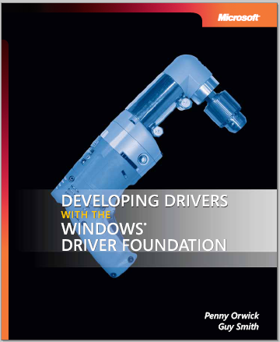
New WDF Book From MSPress
The first book on WDF
Designed to get reader up to speed with WDF
  Covers KMDF and UMDF
Introductory material
for those unfamiliar
with drivers
Provides practical suggestions to get the most from WDF
www.microsoft.com/MSPress/books/10512.aspx

Slide 7

Book
Should I read the documentation or the book first?
Book | Documentation
Unified presentation of framework (KMDF and UMDF) model Advance Insight Expert Advice Practical Examples Code analysis | Provides design guide for every object Reference section on DDI gives more in-depth information Sample code snippet for every DDI Easier to get into the details on any subject by following the link Updates are published quarterly through MSDN
The answer is read both
  If you are a beginner, read the book first

Slide 8
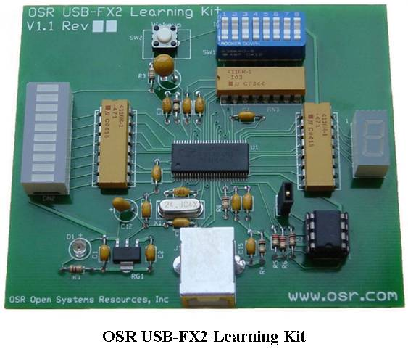
OSR USB-FX2 Learning Kit
WDF Book relies on WDK samples, many of which are based on this device from OSR
  USB device with control, interrupt and bulk endpoints
  Has switches, lights, and loopback on bulk endpoints
To use samples
  Buy device from OSR
  (see resources)
  Use the Fx2 simulator in the LHS WDK

Slide 9
WDF Verifier
GUI tool to manage verifier and debugger settings for your WDF drivers
  Manages UMDF and KMDF settings
  Manages settings on local and remote systems
Included and documented in the Windows Server Longhorn WDK
See “Additional Material” for more details

Slide 10
Kernel-Mode Driver Framework

Slide 11
KMDF Adoption
Windows Vista contains over 20 inbox drivers
  Bus Drivers: HD Audio, UMBUS
  Function Drivers: Processor, SD storage, WinUSB, Media Center IR Remote, Tablet PC Digitizer
  Filter Drivers: Monitor, UMPass
  Non PnP Drivers: PEAuth
Microsoft Partner teams have written several drivers
  Virtual PC – VMBus
  MS Hardware – keyboard, mouse
  Xbox Common Controller
Third party drivers – 50+ and growing every day
  Motorola, Synaptics, AD Instruments, Alps Electric, etc

Slide 12
What's New In KMDF For 1.7
New wait-wake policy between parent and children
New samples
  Smartcard driver
  HID minidriver
  USB WiFi Device miniport
Two test tool
  Preliminary version of WdfTester
Bug fixes and minor changes

Slide 13
Wait Wake Support
Allow parent bus to arm for wake from Sx only if its children are armed for wake
typedef struct _WDF_DEVICE_POWER_POLICY_WAKE_SETTINGS {
….
BOOLEAN ArmForWakeIfChildrenAreArmedForWake;
BOOLEAN IndicateChildWakeOnParentWake;
}
typedef NTSTATUS
(EVT_WDF_DEVICE_ARM_WAKE_FROM_SX_WITH_REASON)(
WDFDEVICE Device,
BOOLEAN DeviceWakeEnabled,
BOOLEAN ChildrenArmedForWake
);
Propagate which device caused the system to wake from Sx
Allow parent bus to propagate the wake status to its children on return to S0

Slide 14
Minor Fixes
WdfWorkItemEnqueue – can be called before previous instance is executed
  Just like a DPC
WdfDeviceEnqueueRequest – can be called at DISPATCH_LEVEL
Can forward request to another driver from EvtIoInProcessContextCallback
Fixed several bugs to handle edge cases

Slide 15
Sample
HID minidriver
Sample is called HIDUSBFX2
Maps non-HID compliant OSR USB-FX2 device to HID
Maps USB FX2 device’s switch pack to HID controls
Maps 7-segment display, and bar graph display as HID features
See “Additional Material” for more information on the design

Slide 16
Sample
Smartcard drivers
Smartcard drivers are WDM drivers
  Use SMCLIB helper library to help with
    Smartcard IOCTL processing
    Controlling the hardware
  Driver handles PnP, Power, WMI, etc…
  SMCLIB handles IOCTLs and completes them

Slide 17
KMDF Smartcard Driver
Uses KMDF and SMCLIB
  KMDF handles PnP, Power, and WMI
  Sends I/O operations through SMCLIB for handling
Works around SMCLIB’s request completion
  Uses extra stack location and completion routine to catch SMCLIB’s completion of IRPs
SCM PCMCIA smartcard driver is ported to KMDF
See “Additional Material” for code snippets

Slide 18
KMDF Native Wi-Fi USB Sample
NDIS 6.0 sample for USB
Wi-Fi device
  Based on the current RTLNWiFi PCI sample
  Takes advantage of NDIS-WDM
  Conforms to the Microsoft Native Wi-Fi miniport driver specification
Abstracts bus dependent and independent parts
  Easily adaptable for other busses
Uses KMDF USB I/O target
  Continuous reader reads packets from input endpoint and indicates to NDIS
NDIS
802.11 Intermediate Driver
802.11 Miniport Driver
KMDF USB Targets
Core USB Stack

Slide 19
Tools
KMDF testers
A set of tools that helps you to test and debug KMDF drivers
Currently consists of two tools
  DDI Fault Injection Tester (WdfFiTester)
  Driver Call Tracer (WdfCallTracer)
See “Additional Material” for more details and screen shots

Slide 20
KMDF Directions
Looking at improvements like
  Performance improvements
  Guaranteed forward progress
  Allow request forward from PDO queue to parent queue
  Simplify synchronization model
  Passive timer callbacks
  New object to manage ring buffers
  More samples

Slide 21
User-Mode Driver Framework

Slide 22
UMDF 1.5 Adoption
Within Windows
  Windows Portable Devices API (WPD)
  Media Player Sync
  Windows Sideshow
  Windows Mobile Sync
External Adoption
  Nokia Phone Sync

Slide 23
UMDF 1.7
Minor update for UMDF
  No significant new functionality
  Bug fixes
  Sample updates
  Downlevel support for
    Windows XP SP2
    Windows Professional 2003 (AMD64)
    New: Windows Server 2003 (x86, amd64 and ia64)
    Included in Windows Server Longhorn
    timeframe [“LHS”]

Slide 24
UMDF 1.7 Samples
Sample Changes
  Demonstrate use of WinUsbCoinstaller
  (see “Additional Materials”)
  Idle and Wake support in Fx2 driver
New Fx2 driver sample
  Uses impersonation to open app specified file
  Demonstrates cancellation for synchronous request
New Echo driver
  Socket based driver and device “server”
  Shows use of ATL in a UMDF driver

Slide 25
Samples
Impersonation
UMDF\USB\Fx2_Driver\Impersonation
Adds a new PLAY_FILE I/O control
  Takes a file name as input
  Impersonates the caller to open the file
  Reads the file and displays the characters on the seven-segment display
PLAY_FILE I/O control is synchronous but cancellable
  Works around lack of IsCanceled property in UMDF
Code snippets in “Additional Materials” at the end of this deck

Slide 26
Samples
Sync request cancellation
Cancelling file playback operation is difficult
  Device-level locking complicates use of cancellation callbacks
  UMDF 1.7 has no way for driver to ask if a request has been cancelled
Solution uses two manual queues
  Stop the queue the request came from (if it’s a sequential queue)
  Forward request to first queue and remove it
  Forward request to second queue and remove it
  If forward or removal fails, the request has been cancelled and completed
  Restart the sequential queue
See “Additional Materials” for code walkthrough

Slide 27
Samples
Socket echo
New sample demonstrates how to communicate with a network connected device
Simple network-connected loopback “device”
  SocketEchoServer.exe acts as the device
  Driver needs to be configured with the device’s address
Also demonstrates use of ATL in a UMDF driver
  Minimal set of ATL – base COM class and smart pointers

Slide 28
UMDF Debugger Improvements
New debugger extensions to dump object
Category | Name | Description
I/O Targets | WdfTarget | Shows target state and outstanding/pending requests
USB | WdfUSBTarget | WdfTarget + WinUSB info and number of interfaces (!wdfobject shows interfaces as children)
 | WdfUSBInterface | Interface descriptor info (!wdfobject shows pipes as children)
 | WdfUSBPipe | WdfTarget + pipe type and parameters
Files | WdfFileHandleTarget | WdfTarget + file handle and IWdfFile object
 | UmFile | File name, IWdfFile interfaces for file, state and queued IRP list
 | WdfFile | UmFile + framework state for that driver’s file interface

Slide 29
UMDF Directions
Looking at three areas
  DDI improvements and better alignment with KMDF
  Larger infrastructure improvements
  Improved device class and transport support
Need partner feedback
  To validate list and prioritize

Slide 30
UMDF Directions
DDI improvements
  USB continuous reader
  Request reuse
  Idle device detection
Infrastructure Improvements
  Improvements to host security
  Memory mapping buffers for direct I/O
  Wake and selective suspend support
  Direct hardware access
  Bus driver support
  Customized marshalling for device classes

Slide 31
UMDF Directions
Want to increase applicability of UMDF
  Support more device classes
  Support more transports
We have some initial targets under investigation
  Need input to prioritize
  Need to know what is missing from this list
Device Classes
Virtual “ports” (COM/LPT)
Input drivers (filters, HID drivers, etc…)
AV Streaming devices
Smartcards & security devices
Bluetooth Profiles
NFC
Transports
TCP/IP (Socket I/O target)
Bluetooth Profiles (over L2CAP)
1394
SDIO
NFC

Slide 32
Unified Framework
The KMDF and UMDF teams have merged into a single frameworks team
Short term this helps provide new features for both frameworks at once
Long term goal is to have a “unified framework” that supports user and kernel mode
  There will always be kernel-only or
  user-only features
  But the common pieces should be as common
  as possible

Slide 33
Call To Action
Read the WDF Book
Test your UMDF and KMDF drivers with 1.7 immediately
  Test your UMDF drivers on Windows Server 2003
Start using the new samples and debugging tools
Write your next driver with UMDF or KMDF
  Keep telling us what stops you from doing that
  Your input does affect our future plans
Send us your feedback
  Kmdffdbk @ microsoft.com for KMDF
  Umdffdbk @ microsoft.com for UMDF

Slide 34
Sample And Tools Index
New samples and tools from this talk can be found in the “LHS” WDK
Name | WDK Location
WDF Verifier | Tools\WDF
KMDF HID Minidriver | Src\KMDF\HidUsbFx2
KMDF Smartcard Driver | TBD
KMDF WiFi Driver | Src\Network\NDIS\USBNWiFi
WdfTester | TBD
UMDF Fx2 with Impersonation | Src\UMDF\USB\Fx2Driver\Impersonation
UMDF Socket Echo | Src\UMDF\SocketEcho
OSR-FX2 Simulator | TBD

Slide 35
Additional Resources
Web Resources
  Whitepapers: http://www.microsoft.com/whdc/driver/wdf/default.mspx
    “How to use WinUsb to communicate with a USB device” - http://go.microsoft.com/fwlink/?LinkId=88294
  Blogs
    http://blogs.msdn.com/doronh/default.aspx (A Hole In My Head)
    http://blogs.msdn.com/peterwie/default.aspx (Pointless Blathering)
    http://blogs.msdn.com/iliast/default.aspx (driver writing != bus driving)
  Related Sessions
    KMDF: How to Develop Framework Drivers – DVR-C379
    UMDF: How to Develop Framework Drivers – DVR-C380
    KMDF (DVR-V484) and UMDF (DVR-V483) self-guided labs
  Newsgroups and Lists
    Microsoft.public.device.development.drivers
    OSR NTDev Mailing List
WDF Book
  http://www.microsoft.com/MSPress/books/10512.aspx
  OSR Device: http://www.osronline.com/article.cfm?article=382

Slide 36


FACT: “Certified for
Windows Vista” means:
Superior Performance,
Reliability, Ease of Use

Slide 37

© 2007 Microsoft Corporation. All rights reserved. Microsoft, Windows, Windows Vista and other product names are or may be registered trademarks and/or trademarks in the U.S. and/or other countries.
The information herein is for informational purposes only and represents the current view of Microsoft Corporation as of the date of this presentation. Because Microsoft must respond to changing market conditions, it should not be interpreted to be a commitment on the part of Microsoft, and Microsoft cannot guarantee the accuracy of any information provided after the date of this presentation.
MICROSOFT MAKES NO WARRANTIES, EXPRESS, IMPLIED OR STATUTORY, AS TO THE INFORMATION IN THIS PRESENTATION.

Slide 38
Additional Material

Slide 39
WDF Version Policy
WDF Version numbers are in the form Major.Minor
(e.g., 1.5)
  Driver builds against a particular version and installs it during device installation
Major Version Number
  Changed for significant API or behavioral change that we cannot make compatible with the previous version
  Major versions of WDF can live side-by-side
    1.0 and 2.0 drivers can both be on the same machine
Minor Version Number
  Changed when we add new features or for bug-fixes
  Backwards compatible with previous releases of that major version
  Newer minor version upgrades older one
    1.7 will upgrade 1.5, but 2.7 would not upgrade 1.5

Slide 40
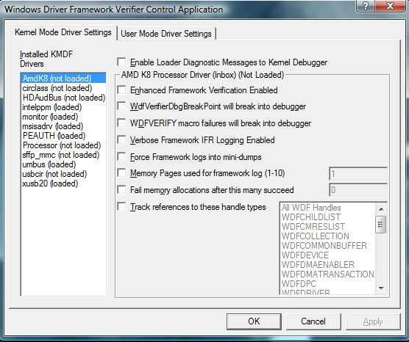
WDF Verifier KMDF Settings
All drivers on local machine listed
Loader diagnostics can be turned on and off
Each driver’s verifier settings can be viewed and altered
Settings consistency and validity is enforced
  Tracks dependencies between options and enables require set

Slide 41

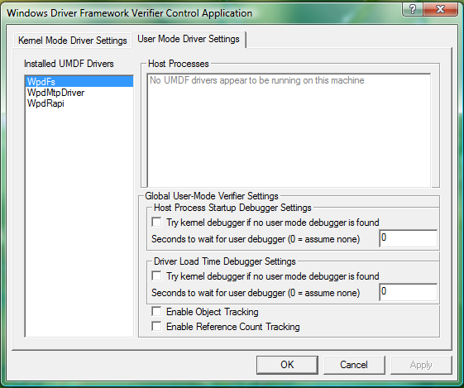
WDF Verifier UMDF Settings
Lists drivers installed on the target machine
Provides access to debugger attachment settings (these are global to all UMDF drivers)
When run directly on the target machine, PIDs for all UMDF host processes are listed to aid in user-mode debugger attachment

Slide 42

HID Minidriver Architecture
KMDF does not support HID minidrivers natively due to conflicting KMDF and HID architecture requirements
Solution is to use a
WDM driver that acts as pass-through between
HID and KMDF
Pass-through driver registers with HIDClass and forwards requests to the attached KMDF driver
System Control Device
Consumer Control Device
Vendor-defined Device
HIDClass
WDM pass-through driver
(HID minidriver)
KMDF driver (FDO)
USB bus driver (PDO)

Slide 43
KMDF Smartcard Driver
Three steps to this approach
  EvtDeviceAdd
    Increase StackSize to have one extra location in the IRPs
  EvtIoDeviceControl
    Get IRP from WDFREQUEST and forward it SMCLIB with a completion routine
  CompletionRoutine
    Get WDFREQUEST from IRP and complete the request

Slide 44
Sample
Smartcard driver
// See sample for definitions of [GET|SET]_REQUEST_IN_IRP
DeviceAdd() {
WdfDeviceWdmGetDeviceObject(DeviceExtension->Device)->StackSize++;
}
VOID PscrEvtIoDeviceControl(Queue, Request, OutLength, InLength, IoCtlCode){
irp = WdfRequestWdmGetIrp(Request);
SET_REQUEST_IN_IRP(irp, Request);
IoCopyCurrentIrpStackLocationToNext(irp);
IoSetCompletionRoutine (irp, PscrSmcLibComplete, Request,…);
(VOID) SmartcardDeviceControl(SmartcardExtension, irp);
return;
}
NTSTATUS PscrSmcLibComplete (DeviceObject, Irp, Context) {
WdfRequestComplete((WDFREQUEST)Context, Irp->IoStatus.Status);
return STATUS_MORE_PROCESSING_REQUIRED;
}

Slide 45
WdfFiTester
DDI fault injection tester
Used for injecting DDI call failures in KMDF drivers
Test the capability of driver in handling DDI failures gracefully
Can be configured to fail any KMDF DDI that returns NTSTATUS code
Tool provides WMI interface for configuring fault injection and writing test scenarios

Slide 46
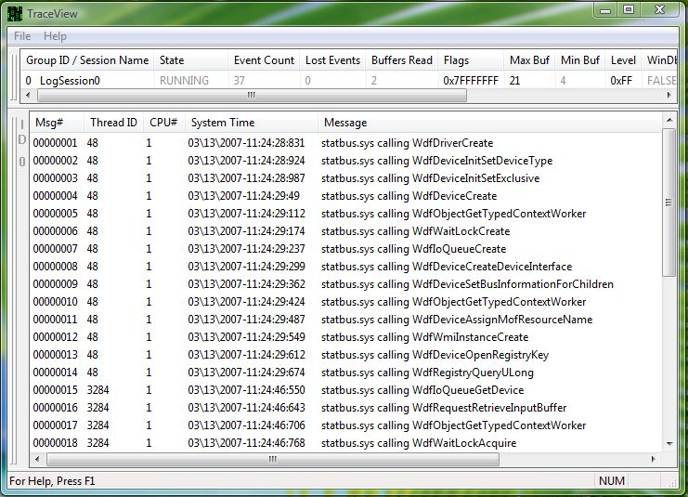
WdfCallTracer
Driver call tracer
Trace driver communication with framework

Slide 47
UMDF 1.7 Fixes
Fixes focus in a few key areas
  Host failures in low-memory conditions
  Power management bugs
  Driver impersonation for async I/O
  Hardening against arithmetic overflow
  Reflector fixes to improve stability

Slide 48
Samples
WinUsb coinstaller
Windows Vista WDK did not show proper use of the WinUSB coinstaller
  Driver packages would not install on Windows XP
WDK samples have been updated
  Four modifications needed to the Windows XP samples
Additional info
  See “Additional Material” for INF snippets
  “How to Use WinUsb to Communicate with a USB Device” white-paper from WHDC

Slide 49
Samples
WinUSB coinstaller
Invoke WINUSB.INF sections from your INF
  On Vista this installs the WinUSB driver package into the system
  On Windows XP it is benign
UMDF\Samples\USB\Echo_Driver\WUDFOsrUsbDriver.inx
[OsrUsb_Install.NT]
CopyFiles = UMDriverCopy
Include = WINUSB.INF
Needs = WINUSB.NT

Slide 50
Samples
WinUSB coinstaller
Copy and Invoke WinUSB coinstaller in your INF
  On Windows XP this installs the WinUSB driver package
  On Windows Vista this is benign
UMDF\Samples\USB\Echo_Driver\WUDFOsrUsbDriver.inx
[SourceDisksFiles]
WUDFOsrUsbDriver.dll=1
WudfUpdate_$UMDFCOINSTALLERVERSION$.dll=1
WdfCoInstaller01005.dll=1
WinUsbCoinstaller.dll=1
[CoInstallers_CopyFiles]
WudfUpdate_$UMDFCOINSTALLERVERSION$.dll
WdfCoInstaller01005.dll
WinUsbCoinstaller.dll
[CoInstallers_AddReg]
HKR,,CoInstallers32,0x00010000, "WudfUpdate_$UMDFCOINSTALLERVERSION$.dll",
"WinUsbCoinstaller.dll",
"WdfCoInstaller01005.dll,WdfCoInstaller"

Slide 51

Samples
WinUSB coinstaller
Set the correct KMDF version in the INF
  This was a bug in the Windows Vista samples
UMDF\Samples\USB\Echo_Driver\WUDFOsrUsbDriver.inx
[WinUsb_Install]
KmdfLibraryVersion = 1.5 # was 1.0
Include WinUsbCoinstaller.dll in your driver package
  Along with UMDF and KMDF coinstallers

Slide 52
Samples
Impersonation
Invoking the impersonate method
HRESULT CMyDevice::PlaybackFile(PlayInfo) {
PLAYBACK_IMPERSONATION_CONTEXT context = {PlayInfo, NULL, S_OK};
// Impersonate and open the playback file.
hr = FxRequest->Impersonate( SecurityImpersonation,
this->QueryIImpersonateCallback(),
&context );
this->Release();
…
hr = context.Hr;
…
}

Slide 53
Samples
Impersonation
OnImpersonate callback uses the context to
  Get the name of the file to open
  Store the file handle and status of CreateFile
VOID CMyDevice::OnImpersonate( Context )
{
PPLAYBACK_IMPERSONATION_CONTEXT context = (…) Context;
context->FileHandle = CreateFile(context->PlaybackInfo->Path, …);
if (context->FileHandle == INVALID_HANDLE_VALUE) {
content->Hr = HRESULT_FROM_WIN32(GetLastError());
} else {
content->Hr = S_OK;
}
return;
}

Slide 54
Samples
Sync Request cancellation
Sample encapsulates the cancellation logic into the reusable CCancelChecker class
class CCancelChecker
{
HRESULT Initialize( __in IWDFDevice* Device,
__in IUnknown* DummyCallbackInterface );
VOID Cleanup( VOID );
bool IsSynchronousRequestCancelled( __in IWDFIoRequest* Request );
};

Slide 55
Samples
Sync Request cancellation
HRESULT CMyDevice::PlaybackFile( Req ) {
// Instantiate the cancel checker object
CCancelChecker cancelChecker;
…
// Initialize the cancel checker using this object’s Iunknown as
// the dummy interface pointer
IUnknown *pQueueCallbackInterface = this->QueryIUnknown();
hr = cancelChecker.Initialize(m_FxDevice, pQueueCallbackInterface);
pQueueCallbackInterface->Release();
…
do { // Check for cancellation.
cancelled = cancelChecker.IsSynchronousRequestCancelled(Req));
if (cancelled) hr = HRESULT_FROM_WIN32(ERROR_CANCELLED);
else { /* Do Work */ …}
} while(SUCCEEDED(hr));
…
// Only complete the request if it wasn’t cancelled
if (cancelled == false) FxRequest->CompleteWithInformation(hr, 0);
…
// Cleanup the cancelChecker’s resources
cancelChecker.Cleanup();
return hr;
}

