Slide 1
Static Analysis And Verification Of Drivers
Jakob Lichtenberg
Software Development Engineer
Microsoft Corporation

Slide 2
Session Outline
Motivation
Static Analysis Tools
PREfast for Drivers (PFD)
Static Driver Verifier (SDV)
Conclusions and Next Steps

Slide 3
Catch Bugs, Catch Them Early
$
A defect that costs $1 to fix on the programmer’s desktop costs $100 to fix once it is incorporated into a complete program and many thousands of dollars if it is identified only after the software has been deployed in the field.
(Building a Better Bug Trap – The Economist June 2003)
$
$
Static Analysis can reduce defects by up to a factor of six!
(Capers Jones, Software Productivity Group)

Slide 4

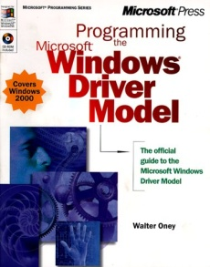

Development
Writing Drivers is hard:
Many rules to obey
Writing drivers requires insight
Testing drivers is hard:
Finding the root cause is hard
Ensuring path coverage is hard
Testing
Source Code

Slide 5
Rules
Development
Testing
Static Analysis
Read for
understanding
Automate
testing
DDI Usage Rules
Defects
Verification
Engine
100% path
coverage
Source Code

Slide 6
What Is Static Analysis
Compile-time analysis of the source program
  like code inspection, but performed by a tool
Looks for violations of well-defined constraints
  procedure contracts or DDI contracts
Examples of bugs to be found by Static Analysis
  IoCompleteRequest(p) requires p to be non-NULL:
      p = NULL ; … ; IoCompleteRequest(p);
  Completing the same Irp twice:
  IoCompleteRequest (Irp);
  …
  IoCompleteRequest (Irp);

Slide 7
Finding The Root Cause Is Hard
The driver causes a crash. What driver is to blame?
Under what scenario? On which path? Why?
I/O
Mgr
Driver
DLL
??
??
??
Is this DLL involved?
??
X

Slide 8
Driver Verifier And A Lucky Test ...
Now, you know the type of the bug. Yet, the path is cloudy.
Debug, debug, debug …
I/O
Mgr
Driver
DLL
DriverIoCtl ( Irp )
??
ClassIoCtl ( Irp )
IoCompleteRequest(…)
??
??
IoCompleteRequest(…)
IoCompleteRequest(…)
??
X

Slide 9
Static Analysis Does Two Things:
Finds a defect - without testing
Reveals the path - without debugging
I/O
Mgr
Driver
DLL
DriverIoCtl ( Irp )
switch ( … )
{
ClassIoCtl ( Irp )
if (status != …) {
IoCompleteRequest( Irp );
}
}
IoCompleteRequest( Irp );
X

Slide 10
Ensuring Path Coverage
One test case covers only one path in the driver
The path remains unrevealed if no defect found
100 test cases cover < 100 paths?
More test cases -> more duplication
I/O
Mgr
X

Slide 11
Path Coverage: Testing in progress…
X
X
weeks
X

Slide 12
Path Coverage: Far from complete…
Failure paths
X
X
Corner cases
“Impossible” paths
weeks
X

Slide 13
Path Coverage: Incomplete, unknown
Failure paths
How many paths remain untested?
How long would it take to test all of them?
When are you done?
Longer than you can afford!
Time to market?
X
X
Corner cases
“Impossible” paths
weeks
X

Slide 14
Static Analysis: 100% coverage
X
In minutes or hours, not weeks or months
Employing Computer, not a Test Engineer
Targeting a large set of potential violations
X
X
X
X
X

Slide 15
Benefits
Encode the insights of the experts as rules
Path Coverage: 100%, at no cost (let a computer do it), at little time (hours versus weeks)
Root Cause: Defect Reports are easy to use: a direct reference to the defective path (or point) in the source code reveals the root cause and reduces cost of debugging
Push-button technology, allows you to catch your bugs easily and repeatedly
Defects are discovered early, before designing test cases, often while still coding, even before the hardware is available

Slide 16
Limitations
Principal limitation: Algorithms are based on source code abstraction and heuristics (which results in both false positives and false negatives)
Targets violations of a given set of well-defined constraints. Does not know about every possible error
  Static Analysis is a complementary technology.
  Not a replacement for traditional testing

Slide 17
Static Analysis Tools For Drivers
Two complementary technologies provided in the WDK
  PREfast for Drivers: Look inside every procedure for possible violations
  Static Driver Verifier: Look along paths, cross inter-procedural boundaries
ReadFoo ( PIRP Irp )
{
PIRP p = NULL;
...
if (status) {
IoCompleteRequest(p);
}
}
ReadFoo ( PIRP Irp )
{
...
status = Bar (Irp);
if (status) {
IoCompleteRequest(Irp);
}
}
X
X
Bar ( PIRP Irp )
{
...
IoCompleteRequest(Irp);
return STATUS_SUCCESS;
}

Slide 18
Static Analysis Tools For Drivers
PREfast for Drivers (PFD)
  Lightweight and fast (runs in minutes)
  Easy to use early in development – start early
  Use on any code that compiles
  Limited to a procedure scope, each procedure analyzed independently.
  Annotations improve precision
  Works on any code, C and C++
  Finds many local violations
Static Driver Verifier (SDV)
  Extremely deep analysis (runs in hours)
  More useful in the later stages of development
  Requires complete driver
  Works over the whole driver, along every path, crossing inter-procedural boundaries
  Annotations not necessary
  Limited to WDM or KMDF and to C
  Finds a few deep bugs

Slide 19
Tools For Verifying Drivers
Static Tools (as early as possible)
  PFD (As soon as the driver compiles)
  SDV (When fundamental of driver is in place)
Dynamic Tools (When hardware is available)
  Checked build of Windows
  Driver Verifier
Other tools
  Verifying other aspects (for example, inf files)
  Model specific tools (for example, NDISTest)
Notes:
19

Slide 20
Tools For Verifying Drivers
Ease Of Use
Reproducibility
Driver
Verifier
PREfast for Drivers
Static Driver
Verifier
Depth

Slide 21
PREfast For Drivers
What it does:
  Analysis of driver, one function at a time
  Fast (2-5x compile time, usually)
  Finds a lot of “inadvertent” errors and some “hard” ones
  Works on code that compiles; doesn’t need to run
Some things it can find:
  Null pointer, uninitialized variable (along an unusual path)
  Local leaks (memory, resource)
  Mismatched parameters
  Forgot to check result
  Format/list mismatch
  Misuse of IRQLs (some)
  Various special cases that are easily missed (Cancel IRQL, e.g.)
  Proper use of callback/function pointers

Slide 22
PFD: Driver Specific Resource Leak
void LeakSample(BOOLEAN Option1)
{
NTSTATUS Status;
KIRQL OldIrql;
BufInfo *pBufInfo;
KeAcquireSpinLock(MyLock,&OldIrql);
//...
if (Option1) {
pBufInfo = ExAllocatePoolWithTag(NonPagedPool,
sizeof(BufInfo), 'fuB_');
if (NULL==pBufInfo) {
return STATUS_NO_MEMORY;
}
//...
  KeReleaseSpinLock(MyLock, OldIrql);
  return STATUS_SUCCESS;
  }
  //...

Slide 23
PFD: Driver Specific Resource Leak
void LeakSample(BOOLEAN Option1)
{
NTSTATUS Status;
KIRQL OldIrql;
BufInfo *pBufInfo;
KeAcquireSpinLock(MyLock,&OldIrql);
//...
if (Option1) {
pBufInfo = ExAllocatePoolWithTag(NonPagedPool,
sizeof(BufInfo), 'fuB_');
if (NULL==pBufInfo) {
return STATUS_NO_MEMORY;
}
//...
  KeReleaseSpinLock(MyLock, OldIrql);
  return STATUS_SUCCESS;
  }
  //...
warning 8103: Leaking the resource stored in 'SpinLock:MyLock'.

Slide 24
PFD: Driver Specific Resource Leak
void LeakSample(BOOLEAN Option1)
{
NTSTATUS Status;
KIRQL OldIrql;
BufInfo *pBufInfo;
KeAcquireSpinLock(MyLock,&OldIrql);
//...
if (Option1) {
pBufInfo = ExAllocatePoolWithTag(NonPagedPool,
sizeof(BufInfo), 'fuB_');
if (NULL==pBufInfo) {
KeReleaseSpinLock(MyLock, OldIrql);
return STATUS_NO_MEMORY;
}
//...
  KeReleaseSpinLock(MyLock, OldIrql);
  return STATUS_SUCCESS;
  }
  //...

Slide 25
PREfast For Drivers At WinHEC
  Technical Session:
  PREfast for Drivers – Annotations
  Chalk Talk:
  PREfast for Drivers
  Self Paced Lab:
  PREfast for Drivers Lab

Slide 26
Static Driver Verifier
Introduction
Example
Concepts
  Rules
  OS Model
  Verification Engine
Experience

Slide 27
Static Driver Verifier
What Static Driver Verifier does
  Global analysis of entire driver
  Looks for violations of DDI constraints
SDV for WDM
    68 rules covering aspects such as IRPs, IRQL, PnP, and synchronization rules
New: SDV for KMDF
  52 rules covering aspects such as DDI ordering, device initialization, request completion and request cancellation
  Availability: From Windows Longhorn Server WDK
Limitations
  Only pure C drivers
  Up to 50 K lines of code

Slide 28
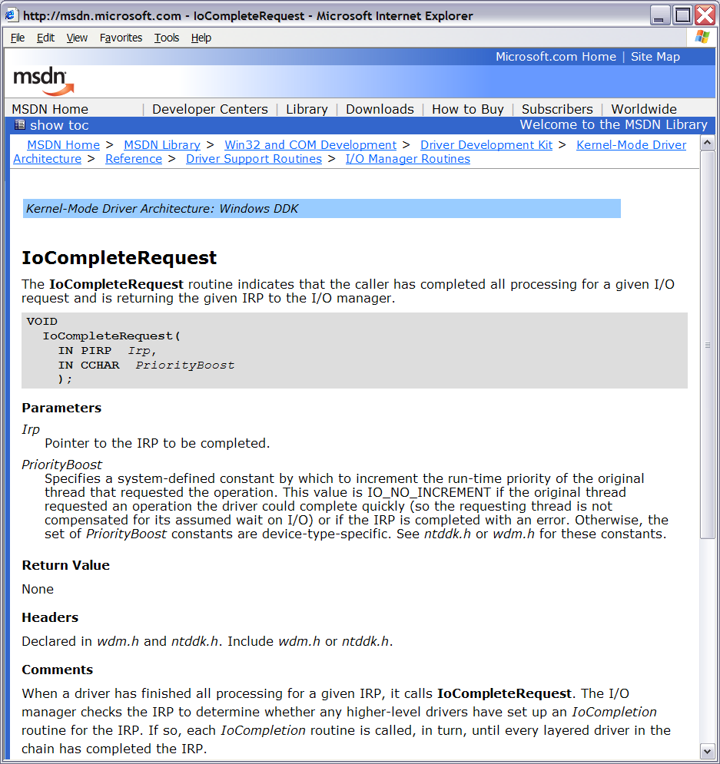
Example
I/O System
Irp
Driver
Dispatch routine
Irp
Irp
IoCompleteRequest
Device Driver
Interface

Slide 29
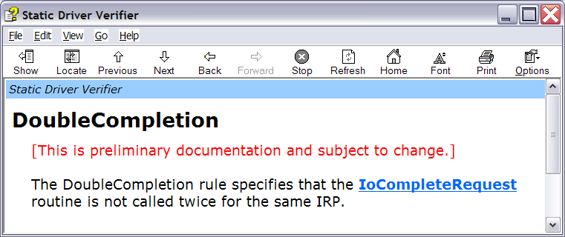
Example
I/O System
Irp
Driver
Dispatch routine
X
Irp
Irp
IoCompleteRequest
Device Driver
Interface

Slide 30
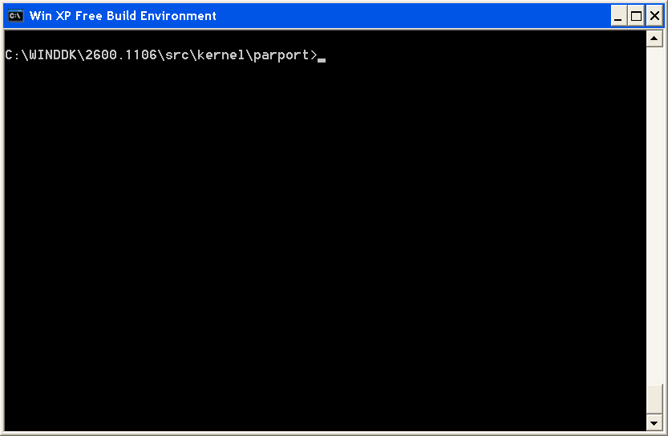
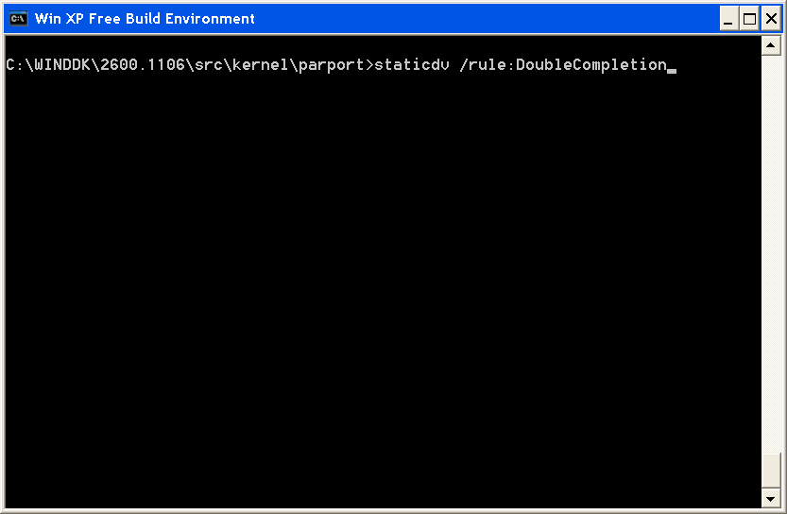
Example
  Parport driver sample in Win XP SP1 DDK

Slide 31
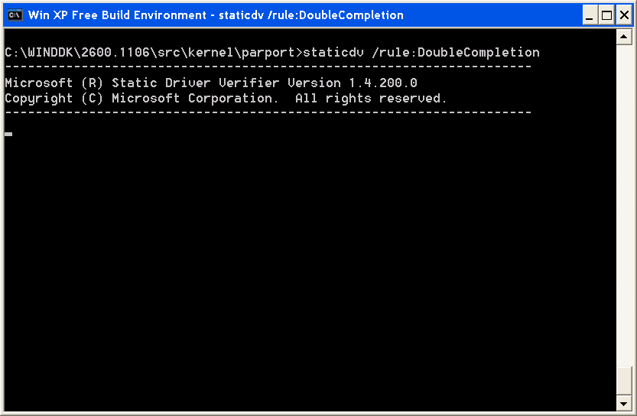
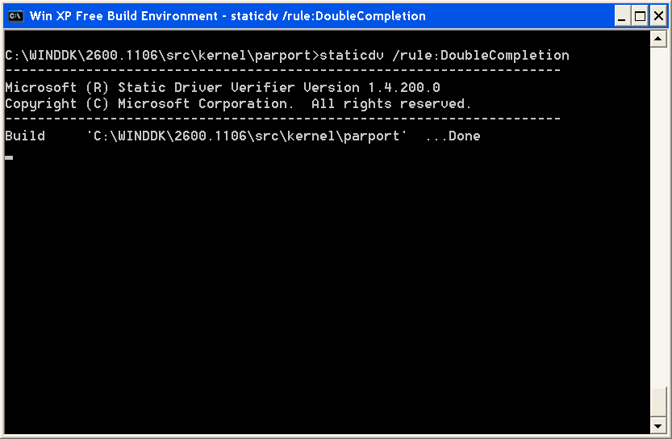
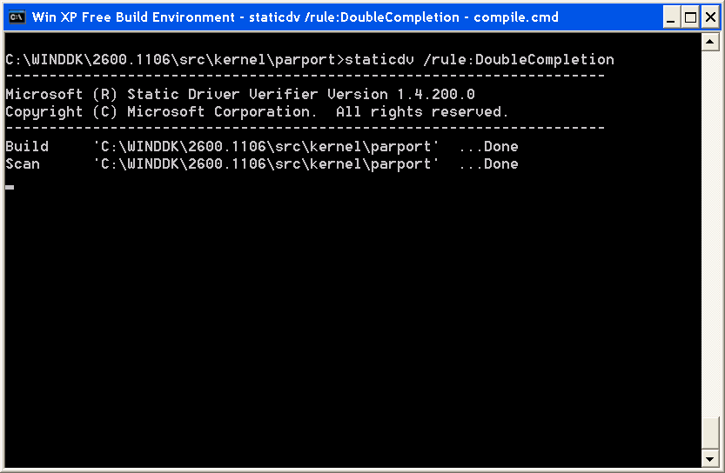
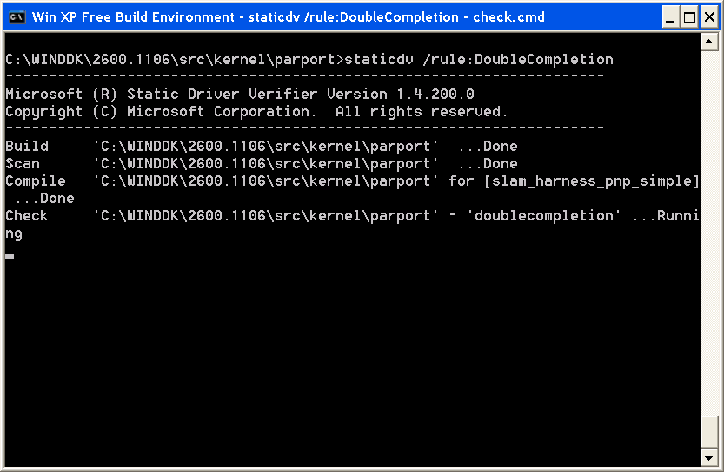
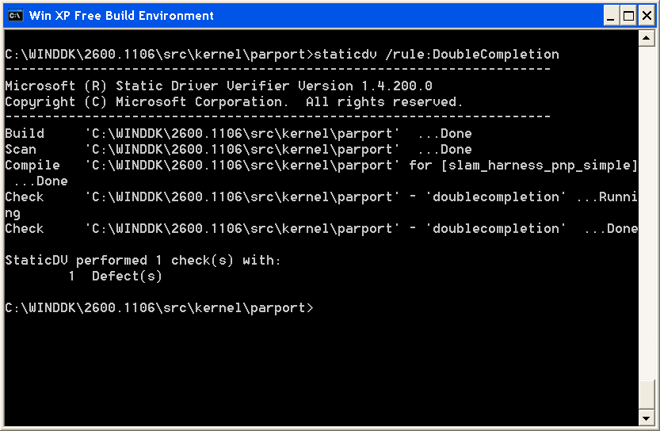
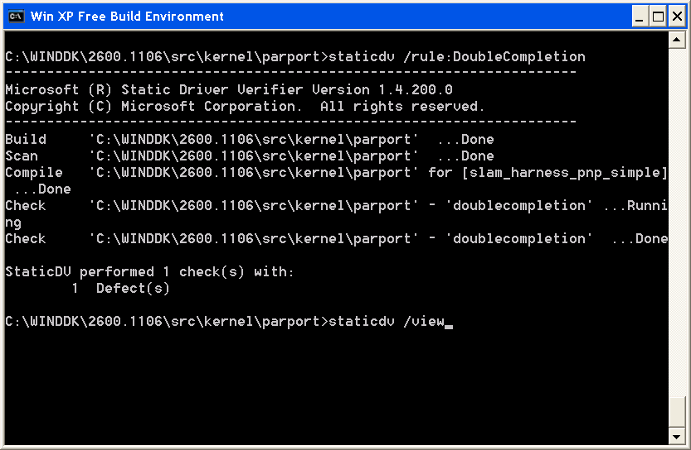
Example
X
  One defect found

Slide 32
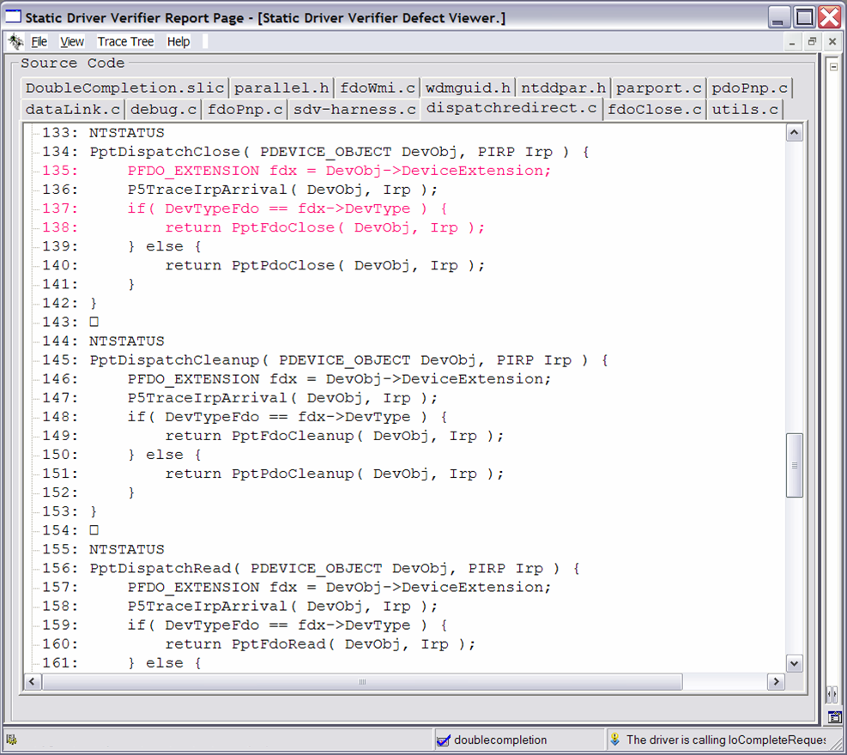
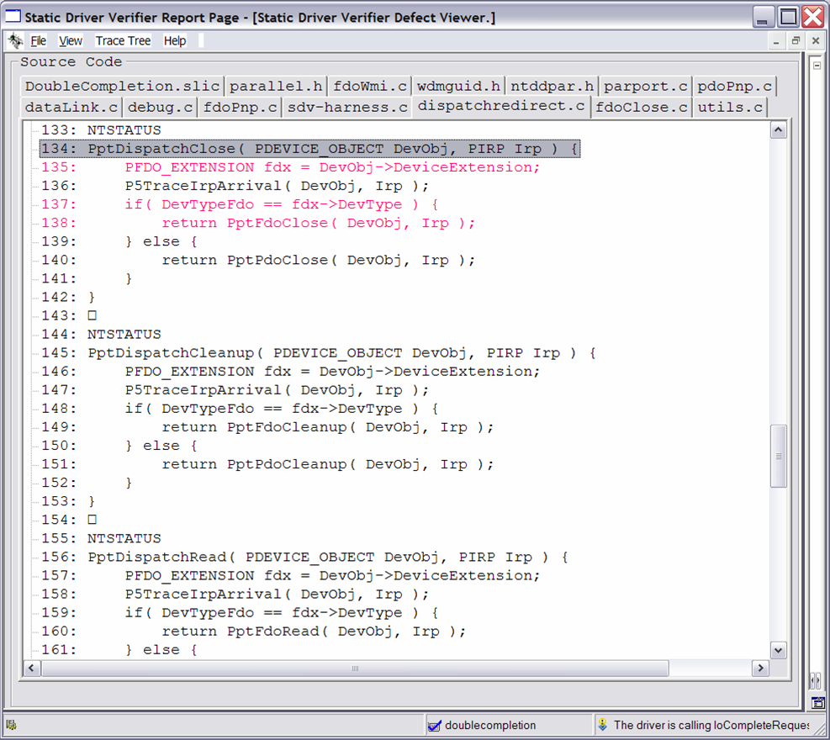
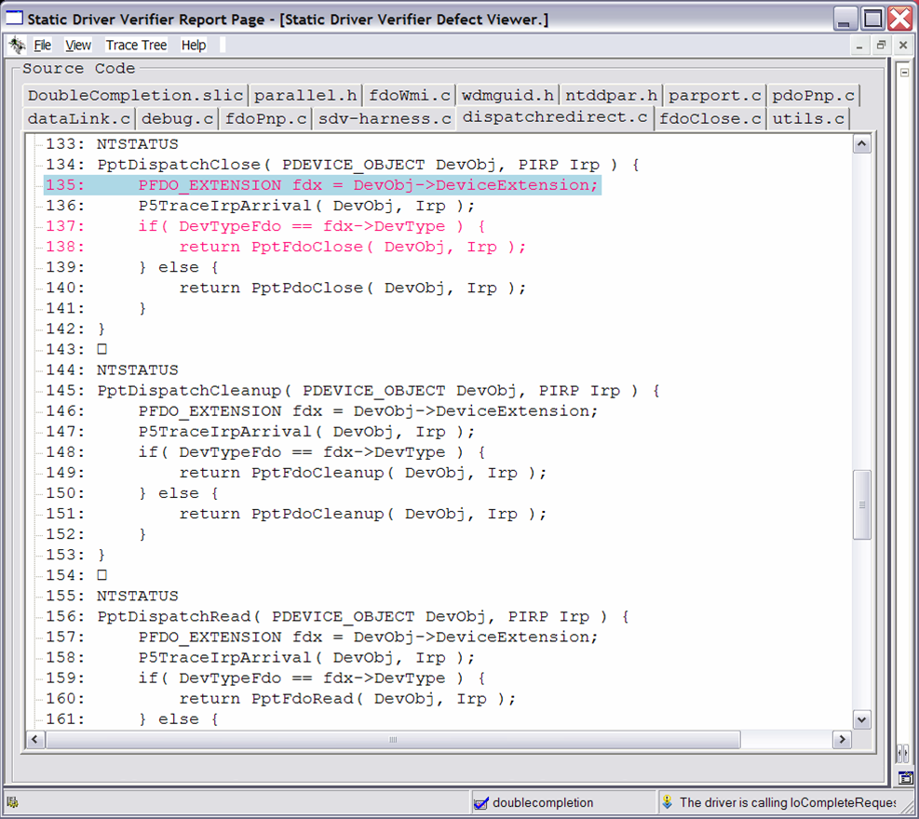
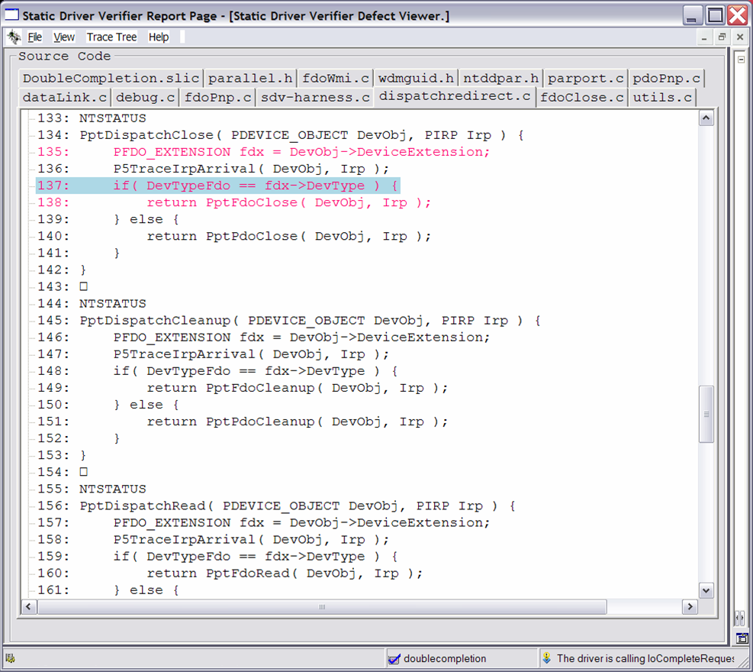
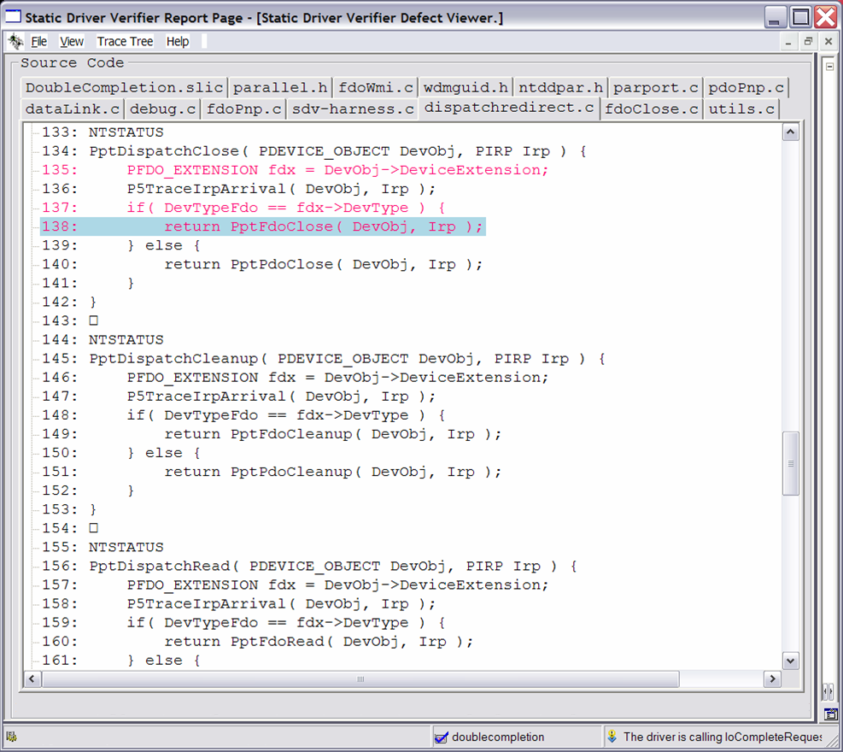
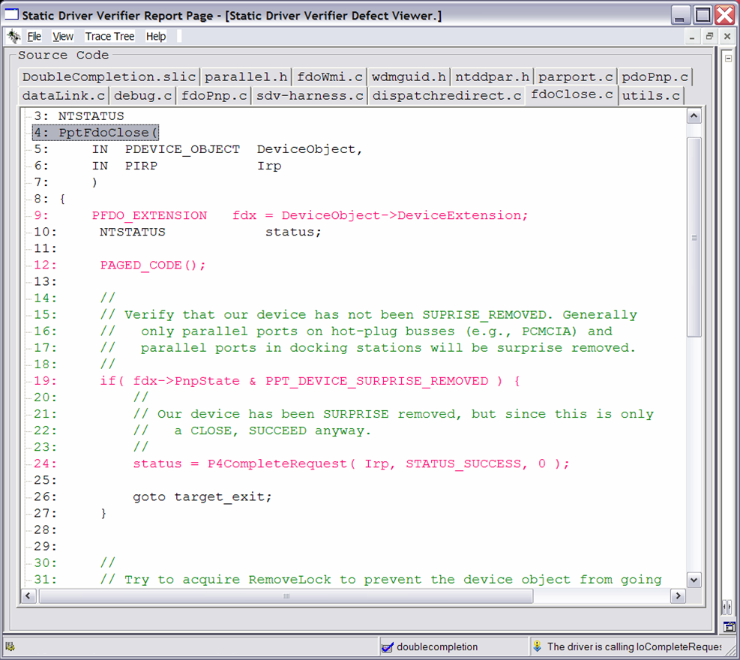
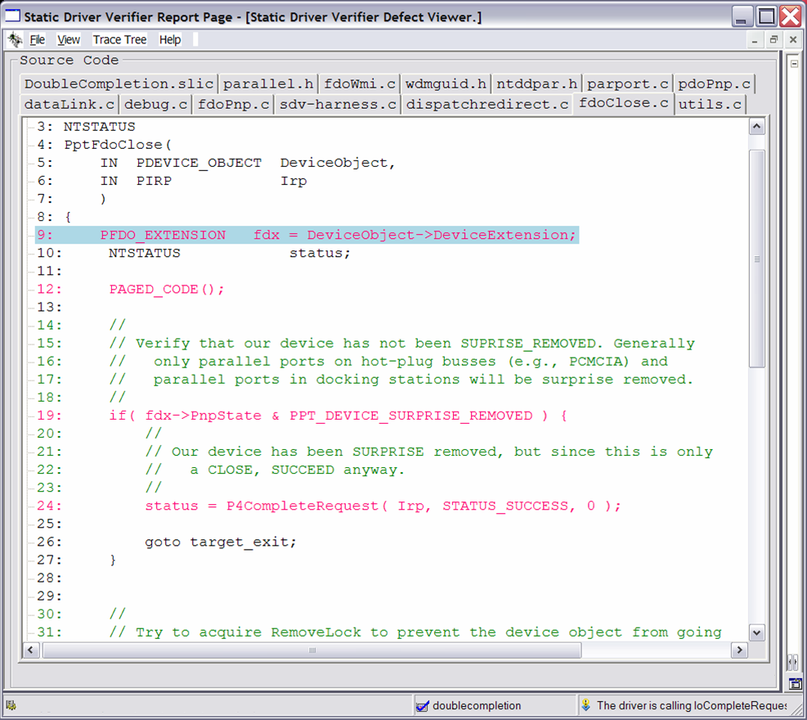
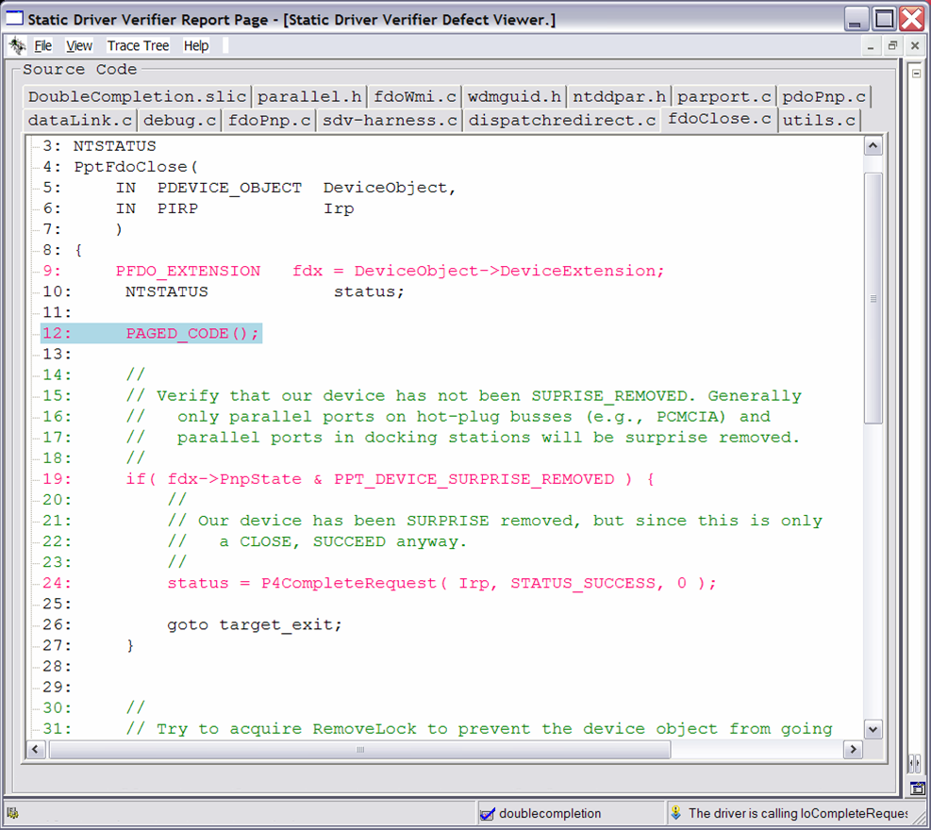
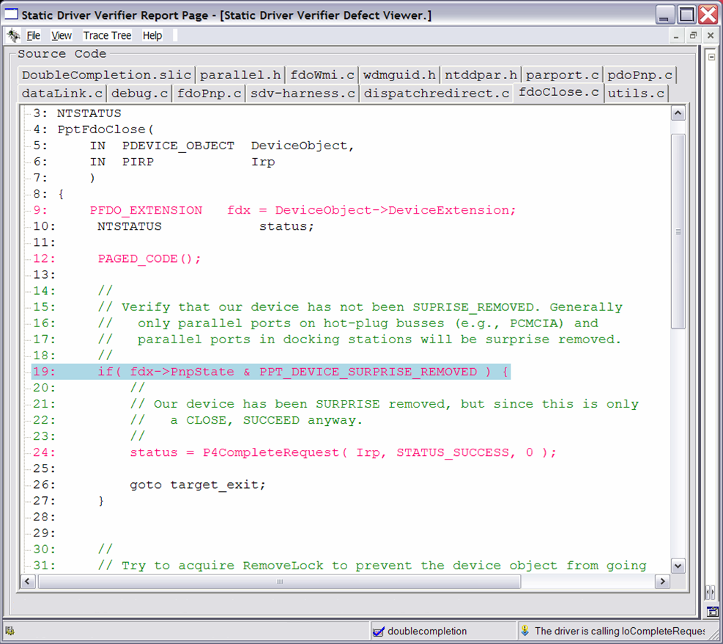
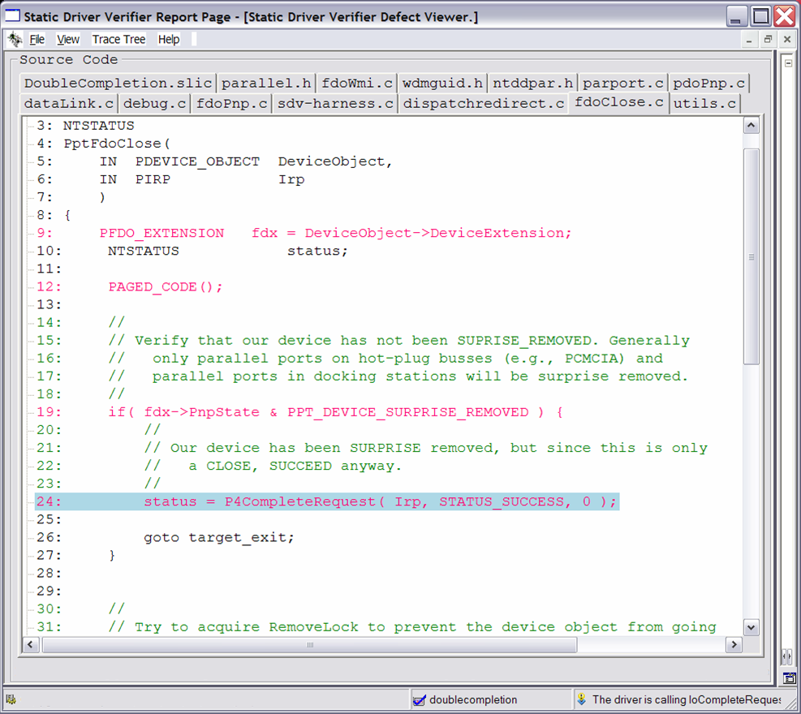
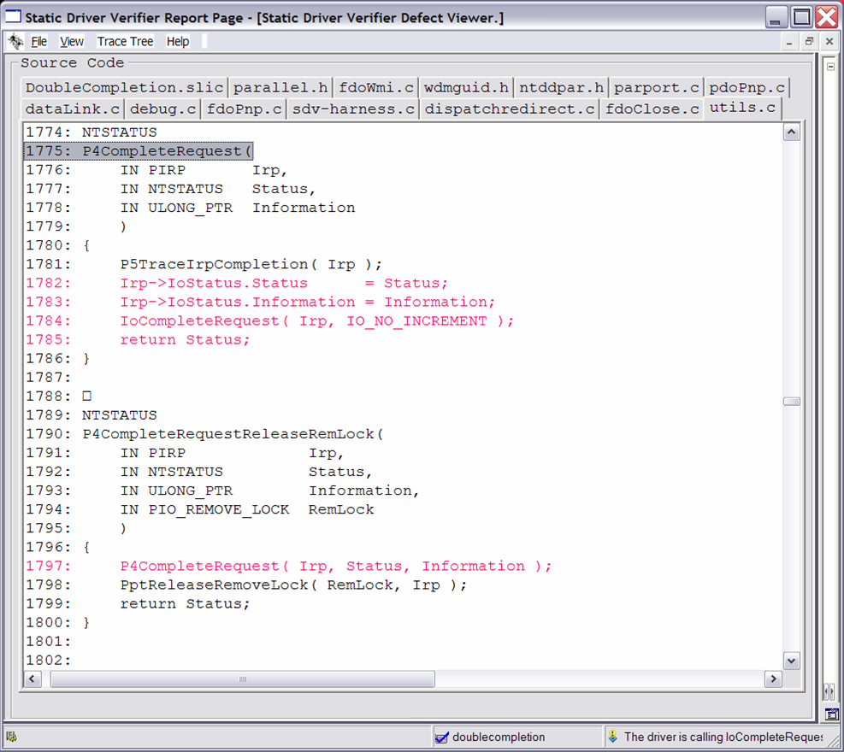
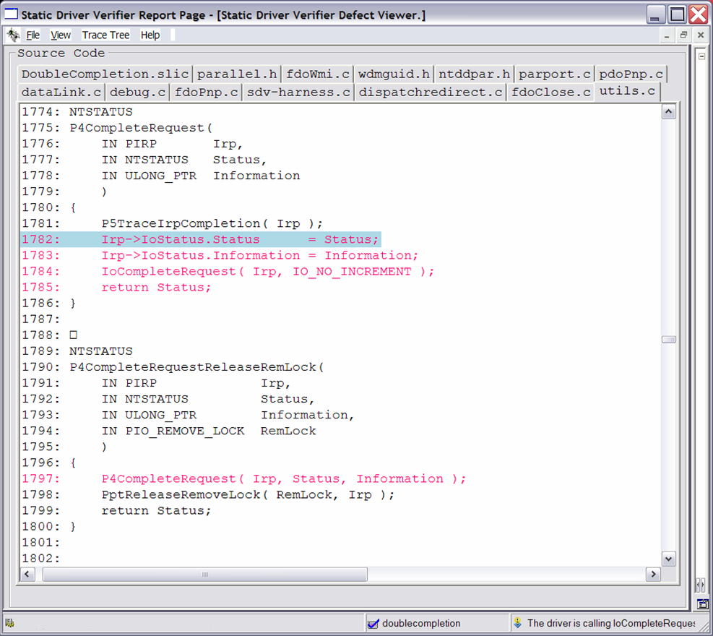
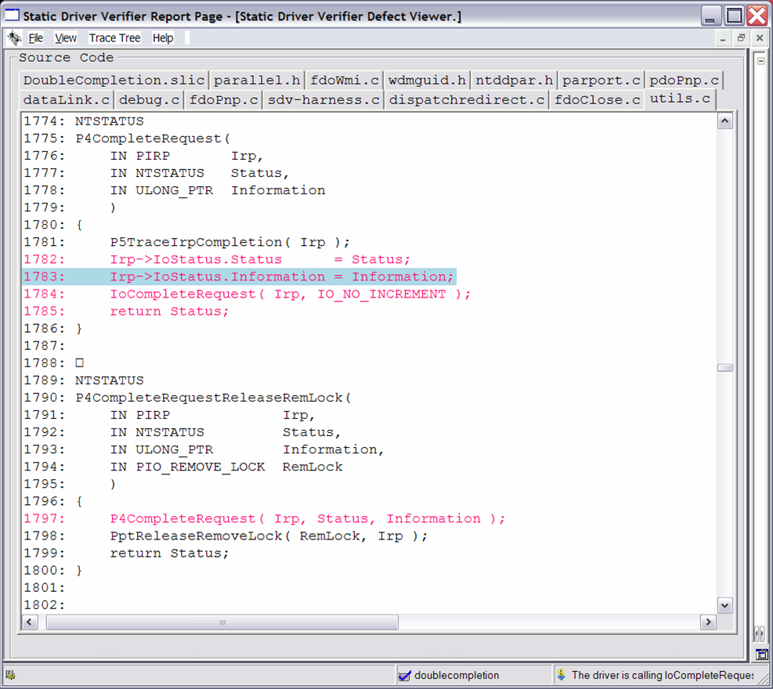
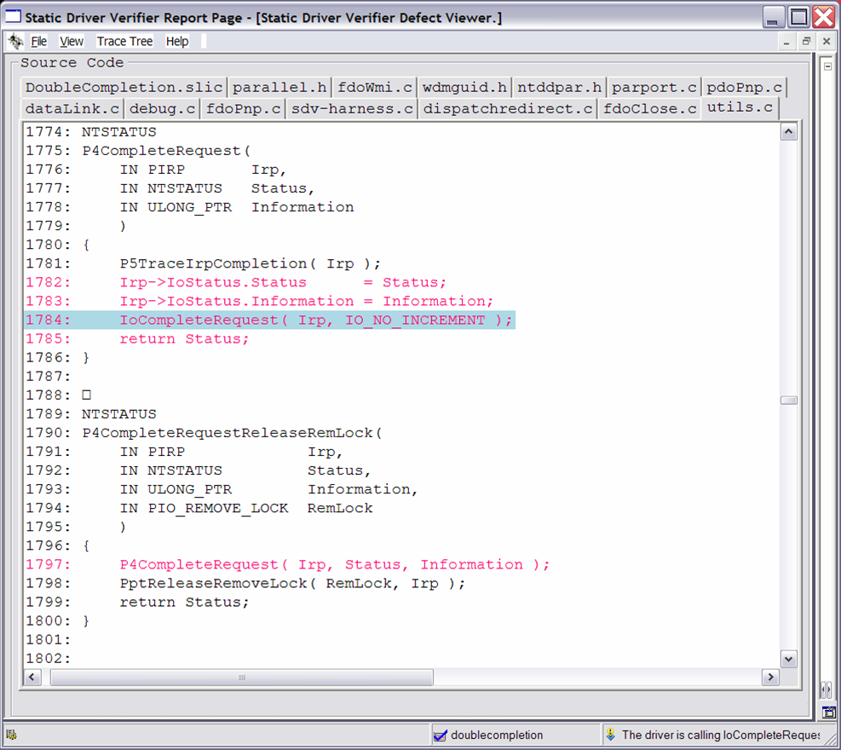
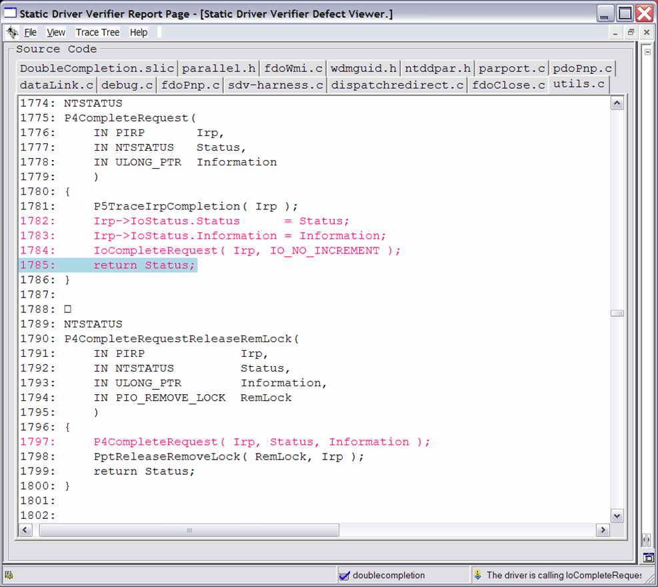

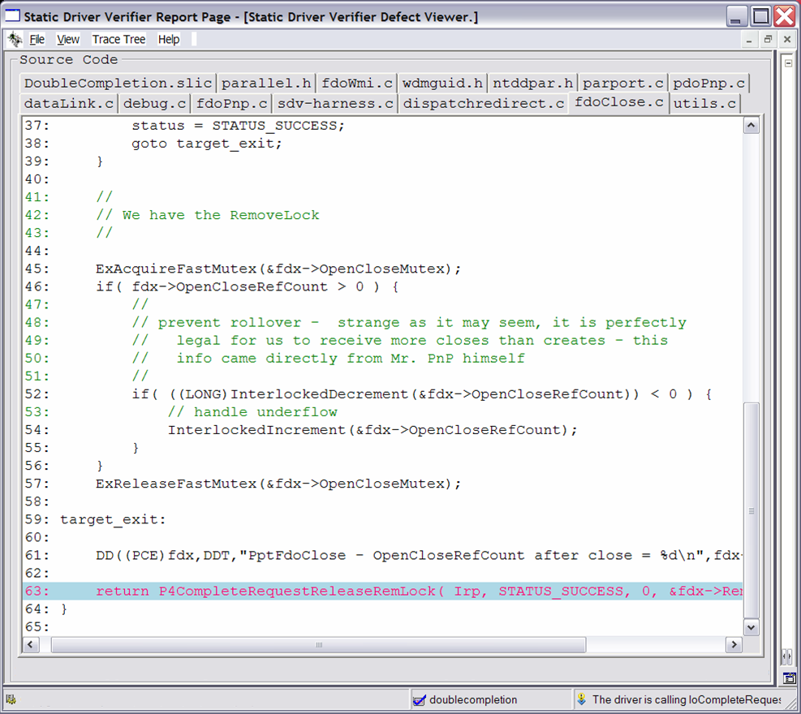
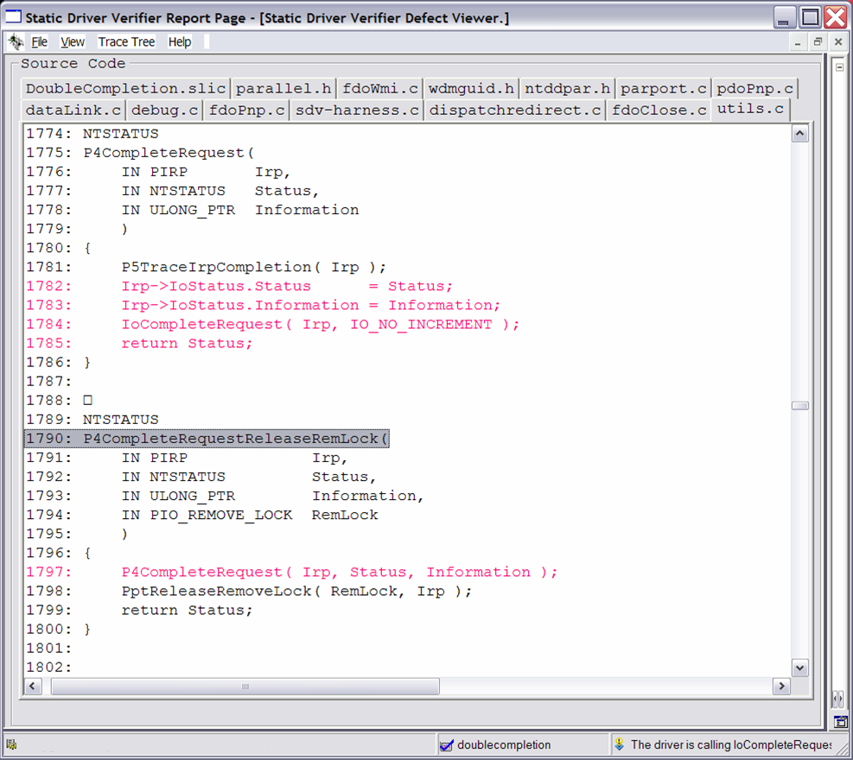
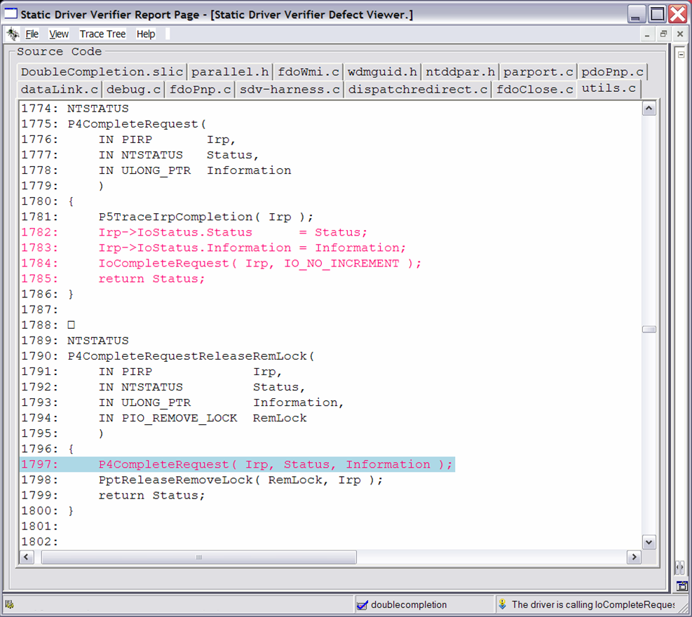




Double Completion
First Completion

Slide 33
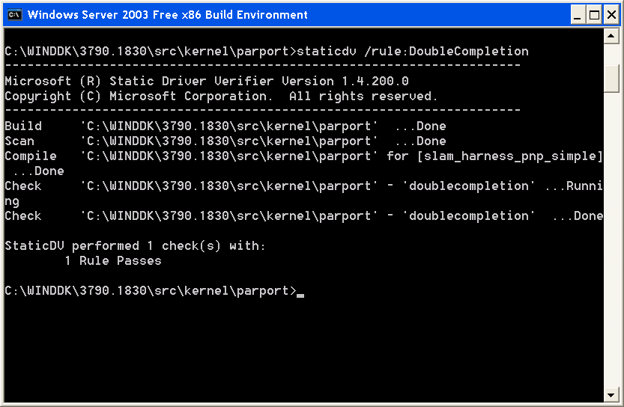
Example
  Server 2003 SP1 DDK
ü
  Rule Passes

Slide 34
Example
IO
Mngr
PptDispatchClose ( Irp )
P4CompleteRequest ( Irp )
IoCompleteRequest( Irp );
X
PptFdoClose( Irp )
P4CompleteRequestReleaseRemLoc ( Irp )

Slide 35
Concepts
SDV
library.c
more_code.c
ü
driver.c
X

Slide 36
Concepts
SDV
library.c
Rules
more_code.c
ü
driver.c
Verification Engine
X
OS Model

Slide 37
Rules
SDV
Rules
library.c
more_code.c
ü
driver.c
Verification Engine
X
OS Model

Slide 38
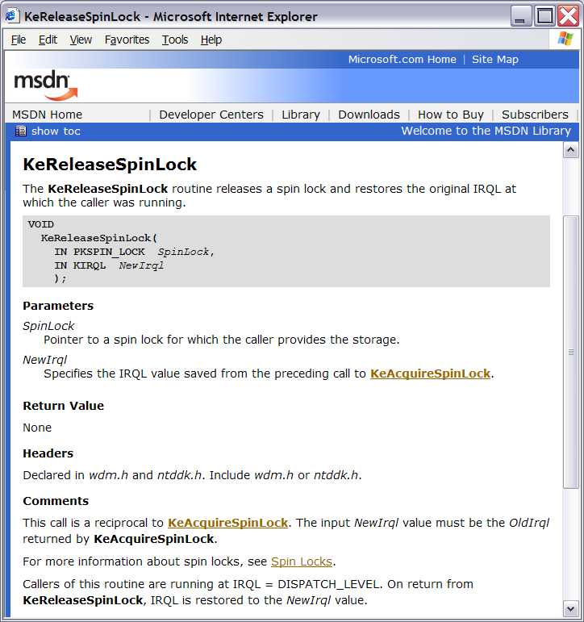
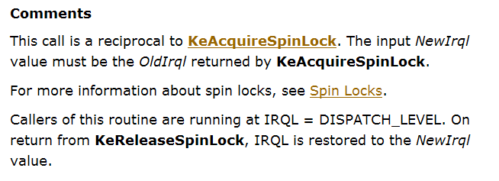
A DDI Constraint Is… A Rule
Rule 1

Slide 39
…One More Rule…
Rule 2

Slide 40
…And Yet Another Rule
Rule 3

Slide 41
Rules
SDV comes with
  68 WDM rules
  52 KMDF rules
Each rule captures an aspect of an interface requirements
Rules are written in a C like language and defines
  State declarations in form of C style variables
  Events that are associated with DDI functions

Slide 42
SpinLock Rule
I/O System
Driver
Entry Point
Device Driver
Interface
KeAcquire SpinLock
KeRelease
SpinLock

Slide 43
SpinLock Rule
state {
enum {unlocked, locked} s = unlocked;
}
I/O System
Driver called
Driver returns
Driver
Entry Point
Unlocked
Release
Acquire
Abort
Release
Device Driver
Interface
KeAcquire SpinLock
KeRelease
SpinLock
Locked
Acquire
Driver returns

Slide 44
SpinLock Rule
state {
enum {unlocked, locked} s = unlocked;
}
I/O System
RunDispatchFunction.exit
{
if (s != unlocked) abort;
}
KeAcquireSpinLock.entry
{
if (s != unlocked) abort;
else s = locked;
}
KeReleaseSpinLock.entry
{
if (s != locked) abort;
else s = unlocked;
}
Driver
Entry Point
Device Driver
Interface
KeAcquire SpinLock
KeRelease
SpinLock

Slide 45
Operating System Model
SDV
library.c
Rules
more_code.c
ü
driver.c
Verification Engine
X
OS Model

Slide 46

Operating System Model
I/O System
Exercises the driver
  Calls DriverEntry
  Calls Dispatch functions
  Calls ISRs
Models certain aspects of the OS state
  Like the current Interrupt Request Level (IRQL)
Models Device Driver Interface functions
  Like the IoCallDriver DDI
Driver
Device Driver
Interface

Slide 47
Operating System Model
I/O System
void main() {
int choice, status; …
status = DriverEntry(…); …
status = AddDevice(…); …
…
switch (choice) {
case 0:
status = DriverRead(…);
break;
case 1:
status = DriverWrite(…);
break;
…
case 28:
status = DriverCreate(…);
break;
default:
status = DriverClose(…);
break;
}
}
…
Driver
Read
Write
Create
Close
DriverEntry
AddDevice
…
Device Driver
Interface

Slide 48
Operating System Model
I/O System
NTSTATUS IoCallDriver( …, PIRP Irp ) {
int choice;
…
switch (choice) {
case 0:
…
Irp->PendingReturned = 0;
return STATUS_SUCCESS;
case 1:
…
Irp->PendingReturned = 0;
return STATUS_UNSUCCESSFUL;
default:
…
Irp->PendingReturned = 1;
return STATUS_PENDING;;
}
}
Driver
UNSUCCESSFUL
SUCCESS
PENDING
…
Device Driver
Interface
IoCallDriver

Slide 49
Verification Engine
SDV
library.c
Rules
more_code.c
ü
Verification Engine
driver.c
X
OS Model

Slide 50
Verification Engine - Example
I/O System
Executes
  Your driver in the context of the OS Model
  While keeping track of the rule state
  While looking for rule violations
Checks each and every path of the driver
Implements worst case behavior
Symbolic model checker
  Strategy: Throw away many irrelevant details through aggressive, but correct, abstraction
…
Driver
Read
Write
Create
Close
DriverEntry
AddDevice
UNSUCCESSFUL
SUCCESS
PENDING
…
Device Driver
Interface
IoCallDriver

Slide 51
Verification Engine - Example
I/O System
…
 | Read | Write | Create | Close | …
SUCCESS | ü | ü | ü | ü | …
UNSUCCESFUL | ü | ü | ü |  | …
PENDING | ü | ü | ü | ü | …
… | … | … | … | … | …
Driver
Read
Write
Create
Close
X
DriverEntry
AddDevice
UNSUCCESSFUL
SUCCESS
PENDING
…
Device Driver
Interface
IoCallDriver

Slide 52
Quality
Comprehensive Path Coverage
  Driver is exercised in a hostile environment
  Verifies all possible paths in the drivers
  Verifies cross function calls
  Verifies driver together with supporting libraries
But there are places where SDV is imprecise
  Only one driver (not the entire driver stack)
  OS Model imperfect
  The verification engine is not precise

Slide 53
Experience
Finds deep bugs not found by testing
  1 bug on average for a sample driver in Server 2003 DDK-3677
  Well tested drivers are often clean
  A dozen true bugs in a fresh driver
Low Noise level
  Less than 1 false bug reported per driver
  2 real bugs for 1 false bug on DDK-3677 samples
Performance
  WDM: Runs in a few hours, but may need to run overnight
  KMDF: Much, much faster
  New: SDV will take advantage of all available CPU cores

Slide 54
Static Driver Verifier At WinHEC
  Chalk Talk:
    Static Driver Verifier: How to Analyze KMDF Drivers
  Self Paced Lab:
    Static Driver Verifier for WDM Lab
    Static Driver Verifier for KMDF Lab

Slide 55
Static Analysis Can…
The business case
  Reduce risk of expensive after-deployment bugs
  Reduce time to market
  Reduce cost of code review and testing
  Improve code quality
  Achieve higher test coverage
The development case
  Find/prevent bugs earlier
  more directly and obviously
  Find/prevent “hard to test” bugs
  Make you more efficient

Slide 56
Use Static Analysis... Wisely
It doesn’t know about all possible errors
It doesn’t make testing unnecessary
Both false positives and false negatives can be misleading
Static Analysis Tools complement testing

Slide 57

Static Analysis Tools For Drivers
 | PREfast for Drivers | Static Driver Verifier
Driver Models | Any | WDM KMDF
Applicability | C and C++ | C only
Issues found | Local defects Easy to fix… High volume… | Global defects Harder to fix… Low volume…
Development Cycle | Apply early: “When the driver compiles” Run often… | Apply later: “When the basic structure of the driver is in place” Run ad hoc or overnight…

Slide 58
Additional Resources
Static Analysis at WinHEC
  2:00 pm: Technical Session: PFD Annotations (DVR-T382)
  3:15 pm: Chalk Talk: SDV: How to Analyze KMDF Drivers (DVR-C383)
  4:30 pm: Chalk Talk: PFD Annotations (DVR-C447)
  Anytime: Three self-paced labs: PFD, SDV for WDM, SDV for KMDF
Learn more
  KMDF Book, chapters both on PFD and SDV
  PREfast for Drivers: http://www.microsoft.com/whdc/devtools/tools/PREfast.mspx
  Static Driver Verifier: http://www.microsoft.com/whdc/devtools/tools/SDV.mspx
Send us feedback and questions
  PREfast for Drivers: pftfdbk@microsoft.com
  Static Driver Verifier: sdvfdbk@microsoft.com

Slide 59

© 2007 Microsoft Corporation. All rights reserved. Microsoft, Windows, Windows Vista and other product names are or may be registered trademarks and/or trademarks in the U.S. and/or other countries.
The information herein is for informational purposes only and represents the current view of Microsoft Corporation as of the date of this presentation. Because Microsoft must respond to changing market conditions, it should not be interpreted to be a commitment on the part of Microsoft, and Microsoft cannot guarantee the accuracy of any information provided after the date of this presentation.
MICROSOFT MAKES NO WARRANTIES, EXPRESS, IMPLIED OR STATUTORY, AS TO THE INFORMATION IN THIS PRESENTATION.

