Slide 1
Static Analysis Tools
PREfast for Drivers
Donn Terry
Software Design Engineer
Microsoft Corporation

Slide 2
Key Takeaways
Be a leader in advancing 64-bit computing
Adopt best practices and new tools
Let’s partner on new hardware directions
Using PFD and annotations in drivers

Slide 3

Agenda
Motivation
Costs and Benefits
Introduction to basic annotations
Sample cases for drivers
Presentation Objectives
Intuition on what annotations are and why use them
General explanation of common/typical annotations
“Introduce” the documentation
Non-goal: Going over any annotation in depth or covering all of them. Far too much for a 1-hour talk

Slide 4
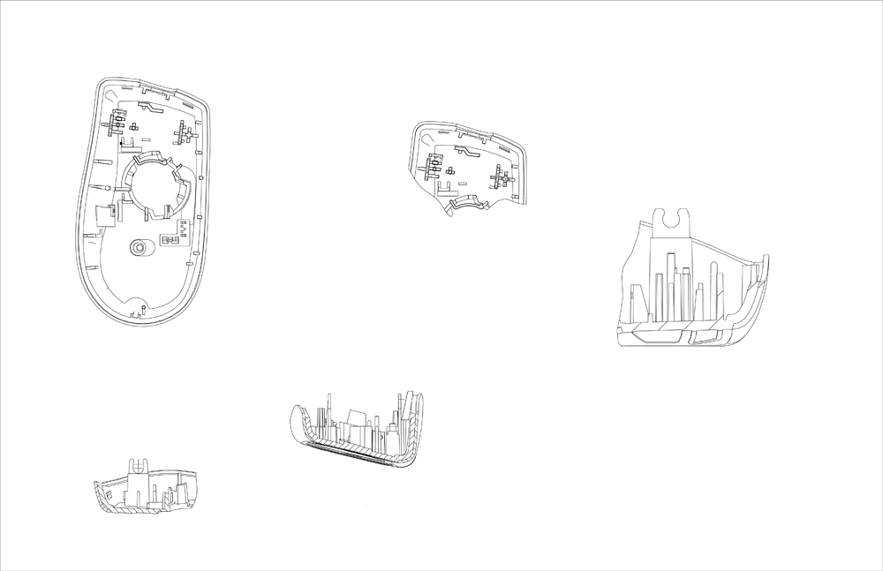

Slide 5
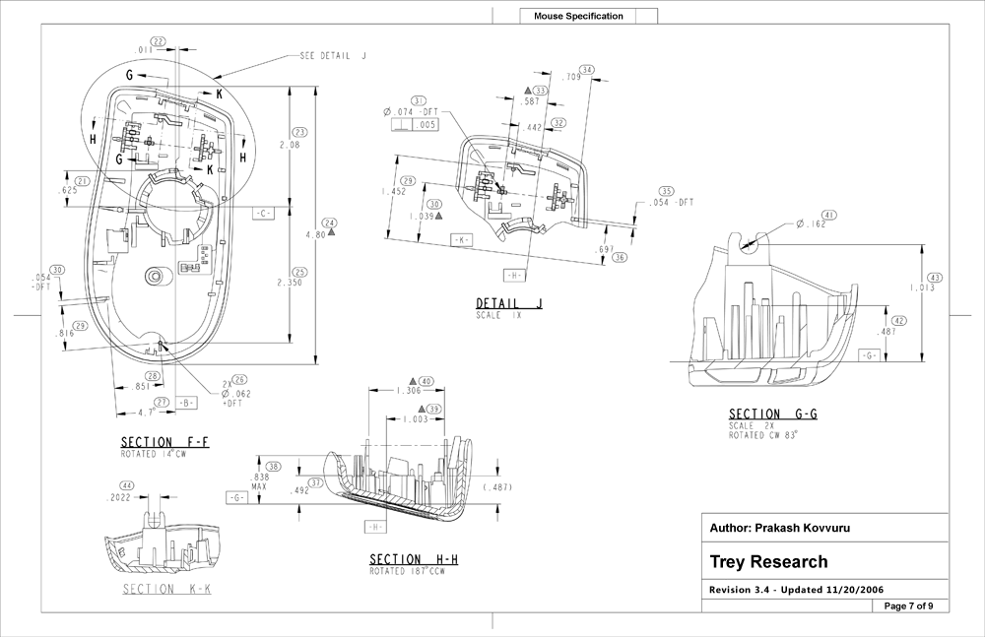

Slide 6
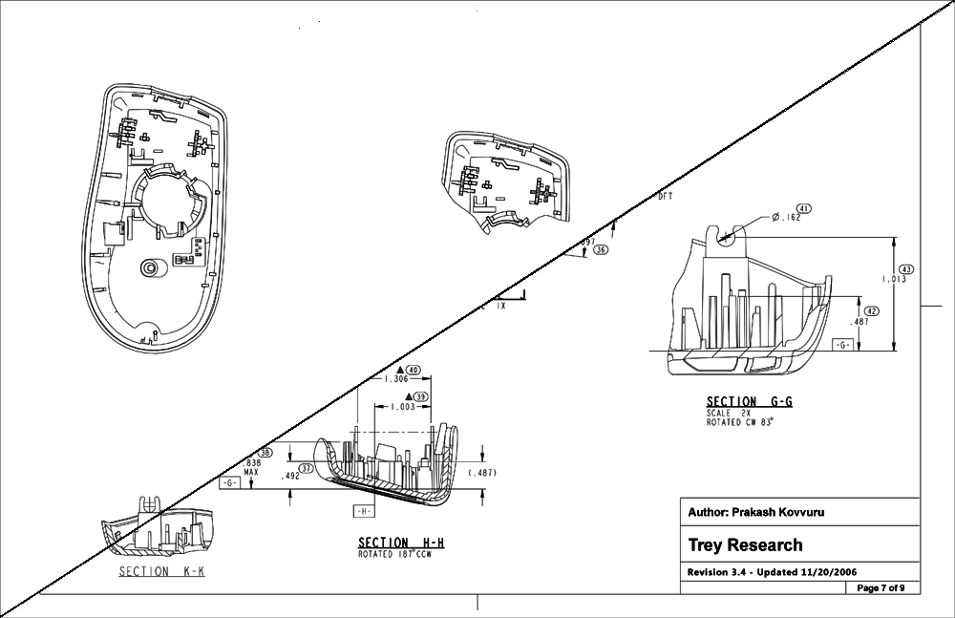
Why Annotate?
Good engineering practice
Precisely describe the “part” you’re building and the contract that represents
Enable automatic checking
Effective (and checked) documentation
  Programmers don’t have to guess/experiment
  Code and documentation don’t drift apart
  Comments are nice, but…

Slide 7
Costs And Benefits
When writing new code
Author already knows the required contract – express as annotations
Annotation discipline forces thought about correct and complete implementation
Annotation problems expose
hard-to-use interfaces
Users know exactly what to expect for their new code – less “go ask” time

Slide 8
Costs And Benefits
When retrofitting
Does take time to determine what the function does, but it should be
“the last time”
Forces thought about correctness and completeness, often exposes bugs even before running the tools

Slide 9
Costs And Benefits
The big benefit
Automatic checking
That is, “cheap” bugs
  The sooner a bug is found, the less expensive it is
  Annotated code finds many more bugs (with less noise) than un-annotated code
  Code that enters test with fewer “easy” bugs makes testing far more efficient – less wasted time for find/fix on easy bugs

Slide 10
Costs And Benefits
Cost: Writing the annotations
Just like any new feature
  Learning curve
  Occasional errors
Side issues
  Resistance / “Do I have to?”
  “Artistic” issues
    This is engineering, not art
Annotations on blueprints have their cost

Slide 11
On Examples
Small “case studies” of how to annotate
Don’t begin to try to cover all the details
Chapter 23 of Developing Drivers for the Windows Driver Foundation covers all of this in detail. That’s the best tutorial and reference

Slide 12
Annotation Mechanics
Annotations are macros
They are #defined to nothing except when Static Tools are running
(safe to use in any context)
wdm.h and ntddk.h already #include driverspecs.h
You can #include driverspecs.h for files that need it

Slide 13
Basic Annotations
Direction of data flow
  __in/__out/__inout
  This is the most basic annotation, and should be used everywhere
  C/C++ don’t help much here, and “const” isn’t always what you need
Optionality
  __in_opt, __out_opt, __inout_opt
Specify intent: No more uninitialized variables

Slide 14
Example
Basics
NTKERNELAPI
PIRP
IoBuildDeviceIoControlRequest(
__in ULONG IoControlCode,
__in PDEVICE_OBJECT DeviceObject,
__in_opt PVOID InputBuffer,
__in ULONG InputBufferLength,
__out_opt PVOID OutputBuffer,
__in ULONG OutputBufferLength,
__in BOOLEAN InternalDeviceIoControl,
__in PKEVENT Event,
__out PIO_STATUS_BLOCK IoStatusBlock
);
Examples are usually familiar APIs from wdm.h, but might not be completely annotated for clarity. Annotate your own functions similarly (but completely). Bold annotations are the ones being discussed, ordinary font is “background”

Slide 15
Tip
Annotate for the Success Case
You want a function call that will never succeed to be caught statically
  “Optional” means it will do something useful if the parameter is absent
  Checking for null and returning an error is very good defensive coding practice, but doesn’t make the parameter optional
  The same general idea applies to other annotations we’ll see later

Slide 16
Problem
Buffer overruns
Buffer overruns are always a risk
  Reliability
  Security
PFD can check that the size you expect is the size you used
You can specify the size in bytes or elements

Slide 17
Example
Buffer annotations
NTKERNELAPI
PIRP
IoBuildDeviceIoControlRequest(
__in ULONG IoControlCode,
__in PDEVICE_OBJECT DeviceObject,
__in_opt_bcount(InputBufferLength) PVOID InputBuffer,
__in ULONG InputBufferLength,
__out_opt_bcount(OutputBufferLength) PVOID OutputBuffer,
__in ULONG OutputBufferLength,
__in BOOLEAN InternalDeviceIoControl,
__in PKEVENT Event,
__out PIO_STATUS_BLOCK IoStatusBlock
);
Fewer buffer overruns

Slide 18
Problem
Ignoring errors
Some functions can fail, but it’s easy to forget to check. PFD can remind you
Use on functions that return NULL when they fail. You must actually test the result
__checkReturn
NTSTATUS
KeSaveFloatingPointState(
__out PKFLOATING_SAVE FloatSave
);
Never forget to check for success again

Slide 19
Driver Annotations
These appear in Windows Vista Beta 3
The “basic” annotations are a single token with “in”-ness or “out”-ness as part of the name
Driver annotations are too rich for that to scale
Use __drv_in(<annotation>) (etc) instead
We’ll see examples along the way

Slide 20
Problem
‘Kinds’ of Code
Not all driver code is kernel mode
Not all kernel code is driver code
Choose the proper mode of analysis
  __kernel_driver; For kernel-mode driver code. This is the default for PFD
  __kernel_code; For non-driver kernel-mode code
  __user_driver; For user-mode driver code
  __user_code; For non-driver user-mode code
Place anywhere as a declaration after driverspecs.h is included

Slide 21
Tip
Implied annotations
Typedefs can be annotated
The annotation applies to objects of that type
Contrast with
The first is a C “string”, the second is a buffer. The difference is the annotation
More than “saves typing”, it documents intent and allows PFD to check the intent is fulfilled
typedef __nullterminated wchar_t *LPWSTR;
typedef wchar_t *LPWCH;

Slide 22
Problem
Correct callbacks
For callbacks, the API is defined by the caller. The called function must conform
C only helps a little
Function Typedefs: The API designer defines the callback API in a typedef
Callbacks use that typedef get correct interface
This is standard C/C++
Also known as “Role Types”

Slide 23
Example-Callback
typedef
VOID
DRIVER_CANCEL (
__in struct _DEVICE_OBJECT *DeviceObject,
__in struct _IRP *Irp
);
typedef DRIVER_CANCEL *PDRIVER_CANCEL;
wdm.h
DRIVER_CANCEL MyCancel;
Driver.h
VOID
MyCancel (
struct _DEVICE_OBJECT *DeviceObject,
struct _IRP *Irp
) { … }
Driver.c
Always correct callbacks

Slide 24
Problem
Typos
PFD can check for many simple, but common errors
  Passing an incorrect enum value
  Passing an incorrect pointer to a PVOID
  Constants where variables are needed
  Variables where constants are needed
  Illegal values and combinations

Slide 25
Example
Enums
NTSTATUS KeWaitForMultipleObjects(
__in ULONG Count,
__in PVOID Object[],
__in
__drv_strictTypeMatch(__drv_typeConst)
WAIT_TYPE WaitType,
__in
__drv_strictTypeMatch(__drv_typeConst)
KWAIT_REASON WaitReason,
__in
__drv_strictType(KPROCESSOR_MODE/enum _MODE,
__drv_typeCond)
KPROCESSOR_MODE WaitMode,
__in BOOLEAN Alertable,
__in_opt PLARGE_INTEGER Timeout,
__in_opt PKWAIT_BLOCK WaitBlockArray);
Never confuse WaitType, WaitReason, and WaitMode again
.

Slide 26
Example
Pointers
NTSTATUS
KeWaitForSingleObject(
__in __drv_isObjectPointer PVOID Object,
__in
__drv_strictTypeMatch(__drv_typeConst)
KWAIT_REASON WaitReason,
__in
__drv_strictType(KPROCESSOR_MODE/enum _MODE,
__drv_typeCond)
KPROCESSOR_MODE WaitMode,
__in BOOLEAN Alertable,
__in_opt PLARGE_INTEGER Timeout
);
Never pass &p when you meant p again

Slide 27
Examples
Constants
UCHAR
READ_PORT_UCHAR(
__in __drv_nonConstant PUCHAR Port
);
LONG
KeSetEvent(
__in PRKEVENT Event,
__in KPRIORITY Increment,
__in __drv_constant BOOLEAN Wait
);
Avoid unjustified assumptions

Slide 28
Example
Checking for errors
__checkReturn
__drv_when((PoolType&0x1f)==2 || (PoolType&0x1f)==6,
__drv_reportError("Must succeed pool allocations are"
"forbidden. Allocation failures cause a system crash"))
PVOID
ExAllocatePoolWithTag(
__in POOL_TYPE PoolType,
__in SIZE_T NumberOfBytes,
__in ULONG Tag
);
Avoid illegal parameters and combinations

Slide 29
Problem
Floating point
If your driver uses floating point you must be very careful to protect the hardware
It’s easy to forget that you used it
Very hard to find in test, typically not repeatable, and blue-screen is the preferable symptom
Can span multiple functions

Slide 30
Example
Floating point
long
intSqrt(long i)
{
return (long) sqrt((double)i);
}

Slide 31
Example
Floating point
long
intSqrt(long i)
{
return (long) sqrt((double)i);
}
…
if (KeSaveFloatingPointState(b))
{
… intSqrt(…) …
KeRestoreFloatingPointState(b);
}
else // deal with error
…
intSqrt(…) …
…

Slide 32
Example
Floating point
__drv_floatUsed
long
intSqrt(long i)
{
return (long) sqrt((double)i);
}
…
if (KeSaveFloatingPointState(b))
{
… intSqrt(…) …
KeRestoreFloatingPointState(b);
}
else // deal with error
…
intSqrt(…) …
…

Slide 33
Tip
Transitivity
Utility functions with side effects
  PFD’s single function scope seems a problem
  But PFD checks both sides of the contract
  Correctly stated contracts solve the problem
Applies to wrappers as well

Slide 34
Problem
Memory leaks
PFD has always checked, but sometimes is noisy
Checks for using freed memory as well

Slide 35
Example
Memory allocation
NTKERNELAPI
NTSTATUS
IoCreateDevice(
__in PDRIVER_OBJECT DriverObject,
__in ULONG DeviceExtensionSize,
__in_opt PUNICODE_STRING DeviceName,
__in DEVICE_TYPE DeviceType,
__in ULONG DeviceCharacteristics,
__in BOOLEAN Exclusive,
__out __drv_out(__acquiresMem(Memory)) // see the book
PDEVICE_OBJECT *DeviceObject
);
Detect many leaks

Slide 36
Example
Aliasing memory
PDEVICE_OBJECT
__checkReturn
IoAttachDeviceToDeviceStack(
__in PDEVICE_OBJECT SourceDevice,
__in
__drv_in(__drv_mustHold(Memory)
__drv_when(return!=0, __drv_aliasesMem))
PDEVICE_OBJECT TargetDevice
);
Reduce false positives

Slide 37
Example
Freeing memory
NTKERNELAPI
VOID
IoDeleteDevice(
__in __drv_freesMem(Memory)
PDEVICE_OBJECT DeviceObject
);
Don’t access freed memory

Slide 38
Problem
Leaked locks
Non-memory objects can leak, too
Sometimes you must, or can’t, hold one

Slide 39
Example
Spin lock
VOID
KeAcquireSpinLock(
__inout
__drv_deref(__drv_acquiresResource(SpinLock))
PKSPIN_LOCK pSpinLock,
__out PKIRQL OldIrql
);
VOID
KeReleaseSpinLock(
__inout
__drv_deref(__drv_releasesResource(SpinLock))
PKSPIN_LOCK pSpinLock,
__in KIRQL NewIrql
);
Don’t leak locks

Slide 40
Example
Holding locks
__drv_mustHoldCriticalRegion
BOOLEAN
ExAcquireResourceExclusiveLite(
__in PERESOURCE Resource,
__in BOOLEAN Wait
);
__drv_neverHold(SpinLock)
VOID
IoCompleteRequest(
__in PIRP Irp,
__in CCHAR PriorityBoost
);
Get the context right

Slide 41
Example
Spin lock wrapper
VOID
GetMySpinLock(
__inout
__drv_deref(__drv_acquiresResource(SpinLock))
PKSPIN_LOCK pSpinLock,
); // Calls KeAcquireSpinLock
VOID
ReleaseMySpinLock(
__inout
__drv_deref(__drv_releasesResource(SpinLock))
PKSPIN_LOCK pSpinLock,
); // Calls KeReleaseSpinLock
Transitive annotations empower checks

Slide 42
Problem
Wrong IRQL
Some functions can only be called at raised IRQL. Some may never be
Some functions can change the IRQL. Some can never do so
Some functions can temporarily change the IRQL, some shouldn’t
How high is safe?
Tracking the combinations can be hard

Slide 43
Example
Changing IRQL
__drv_maxIRQL(HIGH_PRIORITY)
VOID
KeRaiseIrql(
__in __drv_in(__drv_raiseIRQL) KIRQL NewIrql,
__out __drv_out_deref(__drv_savesIRQL) PKIRQL OldIrql
);
__drv_requiresIRQL(DISPATCH_LEVEL)
NTKERNELAPI
VOID
IoReleaseCancelSpinLock(
__in __drv_restoresIRQL __drv_nonConstant KIRQL Irql
);
Track IRQL Changes

Slide 44
Example
Callbacks
typedef
__drv_maxFunctionIRQL(3)
__drv_sameIRQL
__drv_clearDoInit(yes)
__drv_functionClass(DRIVER_ADD_DEVICE)
NTSTATUS
DRIVER_ADD_DEVICE (
__in struct _DRIVER_OBJECT *DriverObject,
__in struct _DEVICE_OBJECT *PhysicalDeviceObject
);
typedef DRIVER_ADD_DEVICE *PDRIVER_ADD_DEVICE;
Check for correct implementation

Slide 45
Problem
Paged functions
PAGED_CODE must be used with #pragma alloc_text
Frequently one or the other is missed
Not quite an annotation, but a lot like one
Predates PFD
Sets __drv_maxFunctionIRQL
PAGED_CODE_LOCKED needed in some special cases
Works with (dynamic) Driver Verifier

Slide 46
Tip
Things to remember
Always use the macros – that’s what will be supported
Stick to the predefined macros
Annotate for the success case
Annotate to the design,
not the implementation

Slide 47
Strategies For Annotation
Proactive – best, but most work
Reactive – gets rid of noise, improves code
Just run PFD – better than nothing

Slide 48
Call To Action
Run PFD
Annotate your drivers
Let us know how it goes

Slide 49
Additional Resources
Chapter 23: PREfast for Drivers Whitepapers on WHDC web site
Chapter 23 in Developing Drivers for the Windows Driver Foundation
  http://go.microsoft.com/fwlinl/?LinkId=80911
PREfast step-by-step
  http://www.microsoft.com/whdc/DevTools/tools/PREfast_steps.mspx
PREfast annotations
  http://www.microsoft.com/whdc/DevTools/tools/annotations.mspx
Using function typedefs with C++
  http://go.microsoft.com/fwlink/?LinkId=87238
E-mail:
Blog: http://blogs.msdn.com/staticdrivertools/default.aspx
Related sessions
  PFD Chalk Talk – DVR-C447
  Static Analysis Chalk Talk – DVR-C383
  Static Analysis Talk – DVR-T381
  Static Analysis Tools Labs
  DVR-V482, DVR-V469,DVR-V501
Pfdfdbk @ microsoft.com

Slide 50

© 2007 Microsoft Corporation. All rights reserved. Microsoft, Windows, Windows Vista and other product names are or may be registered trademarks and/or trademarks in the U.S. and/or other countries.
The information herein is for informational purposes only and represents the current view of Microsoft Corporation as of the date of this presentation. Because Microsoft must respond to changing market conditions, it should not be interpreted to be a commitment on the part of Microsoft, and Microsoft cannot guarantee the accuracy of any information provided after the date of this presentation.
MICROSOFT MAKES NO WARRANTIES, EXPRESS, IMPLIED OR STATUTORY, AS TO THE INFORMATION IN THIS PRESENTATION.

