Slide 1
Building Deployable Device Driver Packages
Eugene Lin
Lead Program Manager
Microsoft Corporation

Slide 2
Key Takeaways
Conference overall
  Be a leader in advancing 64-bit computing
  Adopt best practices and new tools
  Let’s partner on new hardware directions
This session
  Create driver packages that can be deployed via any Windows-supported mechanism
  Deploy multiple driver packages for
  multifunction devices
  Understand the implications of distributing device-related applications with driver packages

Slide 3
Agenda
What is “deployable?”
Driver packages
Multifunction devices
Device-related applications

Slide 4
What Is "Deployable?"
In short, it means your driver package is compatible with the myriad deployment mechanisms provided by Microsoft and third-parties

Slide 5
Why Is This Hard?
Driver package copied to Driver Store
Time passes. The world changes
Driver package installed on device
This is the hard part!

Slide 6
What Is “Deployable?"
End-user
  On-demand install from Windows Update
  Browse to location
  Insert CD/DVD when prompted
  User-initiated Windows Update install
  Device Manager Update
  AutoUpdate push install
IT Pro
  WSUS
  Network share
OEM
  Unattend
  Package Manager

Slide 7
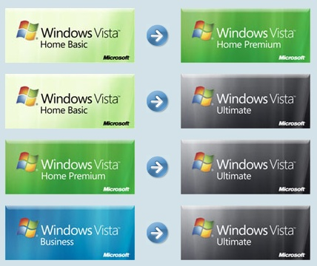
Scenario Example
Anytime Upgrade
  Driver package is saved
  Driver package is copied to new OS image pre-boot
  OS image boots
  Driver package is installed by PnP

Slide 8
Driver Packages
Driver package
Foo.inf
The INF defines the contents of a driver package
All files that are necessary to install all drivers in the package must be referenced in the INF by both CopyFiles and SourceDisksFiles
The INF is the only way that Windows knows which files are important to the driver
Foo.sys
Foo.dll
Bar.dll

Slide 9
Driver Packages
Driver package
Foo.inf
These files will be lost!
Configuration file
Foo.sys
Localized UI
Foo.dll
Bar.dll
Application files
Incorrect

Slide 10
Driver Packages
Driver package
Foo.inf
Configuration file
Foo.sys
Localized UI
Foo.dll
Bar.dll
Application files
Correct

Slide 11
Driver Packages
Driver package
Foo.inf
Missing files
Foo.sys
French Resources
Foo.dll
Bar.dll
Incorrect

Slide 12
Driver Packages
Foo.inf
How Windows will use the INF
Programmatic
  SetupCopyOemInf
  DiInstallDriver
  DIFx tools
User
  Found New Hardware Wizard
  Windows Update on-demand
  Windows Update manual
  AutoUpdate
Foo.sys
Foo.dll
Bar.dll
Configuration file
Localized UI
Application files
Driver Store

Slide 13

Driver Packages
Foo.inf
Windows uses the INF to build a list of files in the package
Foo.sys
Foo.dll
Bar.dll
Configuration file
Localized UI
Application files
Driver Store

Slide 14
Driver Packages
Foo.inf
Windows uses the INF to build a list of files in the package
Foo.sys
Foo.dll
Bar.dll
Configuration file
Localized UI
Application files
Driver Store

Slide 15
Driver Packages
Foo.inf
Windows uses the INF to build a list of files in the package
Windows copies those files into the Driver Store
Media goes away
Foo.inf
Foo.sys
Foo.sys
Foo.dll
Foo.dll
Bar.dll
Bar.dll
Configuration file
!!!
Localized UI
Application files
Foo.inf
Foo.sys
Foo.dll
Bar.dll
Driver Store

Slide 16

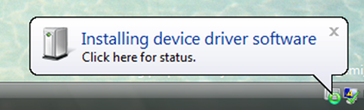
Driver Packages
Configuration file
Localized UI
Foo.inf
Application files
Foo.sys
Foo.dll
Bar.dll
Driver Store
Your device
Your device
Foo.inf
Foo.inf
Foo.sys
Foo.sys
Foo.dll
Foo.dll
Bar.dll
Bar.dll

Slide 17
Driver Packages
Foo.inf
Remember
List all your files in your INF
Don’t assume source media will be present during installation
Configuration file
Foo.sys
Localized UI
Foo.dll
Bar.dll
Application files
Correct
Foo.inf
Driver Store
Configuration file
Foo.sys
Localized UI
Foo.dll
Bar.dll
Application files
Incorrect

Slide 18
Multifunction Devices
Definition
  A device that enumerates as
  multiple devnodes
Problem
  Need to install multiple drivers without prompting users multiple times
Solution
  CopyInf
Driver package
Driver package
Driver package

Slide 19
Multifunction Devices
CopyInf directive
  Links multiple INFs together, so when one gets copied into the Driver Store, the other gets copied as well
  Parsed by Windows when a driver package is copied to the Driver Store
  If a driver package referenced in a CopyINF directive is already in the Driver Store, then Windows will not attempt to re-copy the package
…
[DDInstall]
CopyINF=filename1.inf[,filename2.inf]...
…

Slide 20
Multifunction Devices
CopyInf directive
  Example
  Myprinter.inf and myscanner.inf will be copied into the Driver Store when this driver package is copied into the Driver Store
…
[MyDDInstall]
CopyInf = myprinter.inf, myscanner.inf
…

Slide 21
Multifunction Devices
Parent device uses your driver
Parent.inf
CopyINF = child1.inf, child2.inf
Parent device
Child1.inf
Child2.inf
Child device #1
Child device #2

Slide 22
Multifunction Devices
Parent device uses inbox driver
Usb.inf
(inbox)
Since you don’t know
which child will enumerate first, put the matching CopyINF entries in each child driver package
Parent device
CopyINF = child2.inf
CopyINF = child1.inf
Child1.inf
Child2.inf
Child device #1
Child device #2

Slide 23
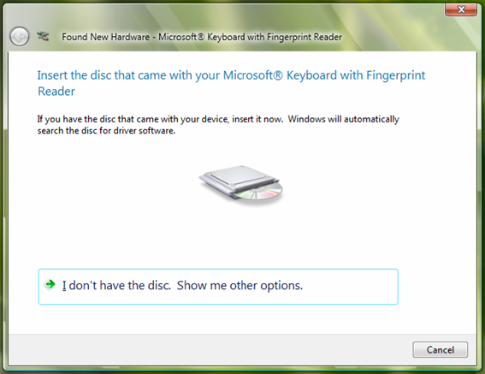
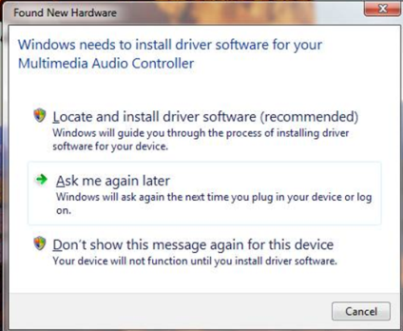
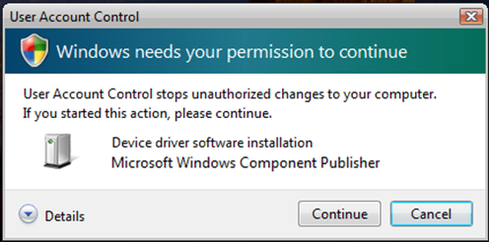
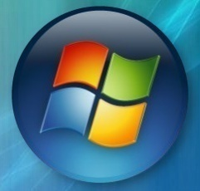

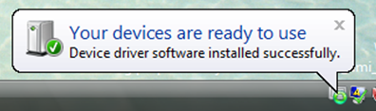
Multifunction Devices
Usb.inf
(inbox)
Child1.inf
Child2.inf
CopyINF=Child2.inf
CopyINF=Child1.inf
Usbccgp.sys
File1
File4
Parent device
Parent device
Windows Update
DevicePath
File2
File5
File3
File6
Found New Hardware Wizard
Driver Store
File1
Usb.inf
(inbox)
Usb.inf
(inbox)
Usbccgp.sys
Child device #1
Usbccgp.sys
Child device #1
File1
Child1.inf
Child1.inf
Child2.inf
Child2.inf
File5
Child device #2
File5
Child device #2
CopyINF=Child2.inf
CopyINF=

Slide 24
Device Applications
How do I install an application with my driver package?
Answer depends on target customer
  Home users: Maximize ease-of-use
  IT Pros/OEMs: Maximize flexibility

Slide 25
Device Applications
Target: Home user retail install
Use a finish-install action to trigger an app install when the device is installed
Whitepaper on how to do this at:
http://www.microsoft.com/whdc/driver/install/app_drv.mspx

Slide 26
Device Applications
Driver package
Include all files necessary for the app installer inside the driver package
App too big? Include an installer stub only that knows how to acquire the app from media or the web
Foo.inf
Foo.sys
Coinst1.dll
Foo.dll
Setup.exe
Bar.dll
App.cab

Slide 27

Device Applications
Windows Vista system
%programfiles%\mycompany
myappsetup
myapp
Setup.exe
Setup.exe
Appfile1
App.cab
Appfile2
Appfile3
Appfile4
Appfile5
Driver Store
I have a Finish Install Action!
Foo.inf
%windir%\system32\drivers
Foo.inf
Coinst1.dll
Foo.sys
Coinst1.dll
Foo.sys
Setup.exe
Foo.dll
Setup.exe
Foo.dll
App.cab
Coinst1.dll
App.cab
Coinst1.dll
Bar.dll
OK! I’ll elevate and call you back
Bar.dll
Foo.dll
Foo.sys
Bar.dll

Slide 28
Device Applications
Target: IT Pro/OEM
Separate your driver package and your application installer
Allow the customer to decide how best to deploy the combination

Slide 29
Call To Action
Make your driver packages deployable by including everything in the INF
For multifunction devices, use CopyInf to link multiple driver packages together
For home users, integrate your application setup into your driver package
For IT Pro and OEM users, keep your application setup separate from your
driver package

Slide 30
Additional Resources
Web Resources
  Specs
    CopyInf directive:
    http://msdn2.microsoft.com/en-us/library/ms794507.aspx
    Writing a co-installer:
    http://msdn2.microsoft.com/en-us/library/ms790151.aspx
  Whitepapers
    How to Install Windows Drivers with Software Applications:
    http://www.microsoft.com/whdc/driver/install/app_drv.mspx
Related Sessions
  DVR-T394 Extending Device Driver Installation with Co-Installers
  DVR-T395 Deploying Device Drivers for Windows Vista
  DVR-T396 Common Device Driver Installation Errors
  DVR-T502 Debugging Device Installation on Windows Vista

Slide 31

© 2007 Microsoft Corporation. All rights reserved. Microsoft, Windows, Windows Vista and other product names are or may be registered trademarks and/or trademarks in the U.S. and/or other countries.
The information herein is for informational purposes only and represents the current view of Microsoft Corporation as of the date of this presentation. Because Microsoft must respond to changing market conditions, it should not be interpreted to be a commitment on the part of Microsoft, and Microsoft cannot guarantee the accuracy of any information provided after the date of this presentation.
MICROSOFT MAKES NO WARRANTIES, EXPRESS, IMPLIED OR STATUTORY, AS TO THE INFORMATION IN THIS PRESENTATION.

