Slide 1
Extending Device Installation With Co-Installers
Jim Cavalaris
Lead Software Design Engineer
Microsoft Corporation

Slide 2
Agenda
Types of installers
Co-installer and class installer operation
How to register installers
Best practices
Finish-install wizard UI and actions
Debugging co-installers and class installers during device installation

Slide 3

What Is A Co-installer?
co·in·stall·er, (noun)
    A user-mode Win32 DLL that assists in device installation.
    A co-installer typically writes additional configuration information to the registry, or performs other installation tasks requiring information that cannot be handled by the INF file.

Slide 4
What Can A Co-Installer Do?
A co-installer can be used to
  Modify default device settings during installation based on run-time information
  Provide “finish install” actions for the user
    User-supplied machine settings for the device
    Offer to install device-specific applications
  Provide device property pages
    Custom Device Manager UI to change advanced device settings

Slide 5
What Else Can A Co-Installer Do?
Technically, just about anything
  Just a Win32 DLL, invoked for specific events
Extreme flexibility is often abused
  Tasks not limited to device configuration
    Boundary between drivers and apps is blurred
  Scenarios and environments not considered
    Deployment scenarios are often affected

Slide 6
Types Of Installers
Three types of “installers”, all optional
  Device Co-Installer (most common)
    Additional handling for a specific device instance
  Class Installer
    Handles all devices in a class
  Class Co-Installer
    Additional handling for all devices in a class
      Device-specific co-installer or class installer are usually better choices

Slide 7
Class And Co-Installer Operation
Class
Co-installers(s)
SetupDiCallClassInstaller(DIF_c,…)
SetupDiCallClassInstaller(DIF_a,…)
SetupDiCallClassInstaller(DIF_b,…)
Device
Installation
Action
new device arrival, user-initiated action
Device Installation Components
Co-installer n
Device-specific
Co-installers(s)
SetupAPI
Class
Installer
“post-processing” required
SetupAPI Default Action

Slide 8
Class And Co-Installer Operation
May be called in different contexts
  Interactive and Non-interactive
  Standard User, Administrator, and LocalSystem security contexts
Only show UI at appropriate times
  Check DI_QUIETINSTALL for all DIF codes
  Use only system-provided UI infrastructure during device installation
    Finish-install Wizards, Finish-install Actions
      More on these later…

Slide 9
Class And Co-Installer Operation
What's a "DIF code"?
Device Installation Function code
  Describe phases of device installation
    DIF_REGISTER_COINSTALLERS
        New co-installers from INF will be registered
    DIF_INSTALLDEVICEFILES
        Driver files will be copied
    DIF_INSTALLDEVICE
        New device settings will be applied
  Other device operations
    DIF_ADDPROPERTYPAGE_ADVANCED
        Supply custom property pages
    DIF_REMOVE
        Uninstall device (note, driver is not removed from system)

Slide 10
Processing DIF_ codes
What should an installer do?
As little as possible
DIF codes have a “default” implementation
  e.g. DIF_INSTALLDEVICE → SetupDiInstallDevice
  Called automatically during normal operation
  Sufficient for nearly all scenarios
“Default” export must not be called directly
  Never from outside the installer chain!
    Direct call bypasses all class and co-installer handling
      Your installer will not be called!
  Exported for use by class installers only, under specific conditions
    More on this later…

Slide 11
Class Installer Interface
Function prototype
Export must use the following prototype
  Note __stdcall calling convention
  Function parameters describe:
    Operation being performed
    Device operation is targeted at
    No context, called just once per operation
typedef DWORD
(CALLBACK* CLASS_INSTALL_PROC) (
__in DI_FUNCTION InstallFunction,
__in HDEVINFO DeviceInfoSet,
__in_opt PSP_DEVINFO_DATA DeviceInfoData
);

Slide 12
Class Installer Interface
Return codes
ERROR_DI_DO_DEFAULT
    Expected result (not an error)
    Indicates SetupAPI should perform the default action
      e.g., DIF_INSTALLDEVICE → SetupDiInstallDevice
    Must be returned for all unrecognized operations
NO_ERROR
    Indicates class installer has called default action function itself
    Use only if class installer “post-processing” is required
Other Win32 or SetupAPI error code
    Fails the entire sequence of operations
best practice

Slide 13
Class Installer Registration
Provided by class “owner”
Only one may exist for a class
Registered by INF when class is installed
Make sure to include SourceDisksFiles, SourceDisksNames
[DestinationDirs]
MyClass_Install_CopyFiles = 11
[ClassInstall32]
CopyFiles = MyClass_Install_CopyFiles
Addreg = MyClass_Install_AddReg
[MyClass_Install_CopyFiles]
MyClassInstall0103.dll
[MyClass_Install_AddReg]
; include other class settings
HKR,,Installer32,,“MyClassInstall0103.dll,\
MyClassInstallEntryPoint“
Best Practice:
Use versioned binary names to avoid file-in-use issues during driver update

Slide 14
Co-Installer Interface
Function prototype
Export must use the following prototype
  Different from class-installer interface!
  Per-operation context
      Distinguishes “pre-” and “post-” processing phases
      On Post-processing, status of operation
      Per-operation data stored during pre-processing
typedef DWORD
(CALLBACK* COINSTALLER_PROC) (
__in DI_FUNCTION InstallFunction,
__in HDEVINFO DeviceInfoSet,
__in_opt PSP_DEVINFO_DATA DeviceInfoData,
__inout PCOINSTALLER_CONTEXT_DATA Context
);

Slide 15
Co-Installer Interface
Return codes
NO_ERROR
    Success, continue operation
    Must be returned for unrecognized operations
ERROR_DI_POSTPROCESSING_REQUIRED
    Call this co-installer again after class installer
    Use context for per-operation data, check status
Other Win32 or SetupAPI error code
    Fails the entire sequence of operations!
Note: co-installers do not return ERROR_DI_DO_DEFAULT!
best practice

Slide 16
Device Co-Installer Registration
Provided by driver package author
Multiple device co-installers may exist
Registered by INF when device is installed
[DestinationDirs]
MyDevice_CoInstaller_CopyFiles = 11
[MyDevice.OS-platform.CoInstallers]
CopyFiles = MyDevice_CoInstaller_CopyFiles
AddReg = MyDevice_CoInstaller_AddReg
[MyDevice_CoInstaller_CopyFiles]
MyCoInstall0102.dll
ImportDll0102.dll
[MyDevice_CoInstaller_AddReg]
HKR,,CoInstallers32,0x00010000,“MyCoInstall0102.dll,\
MyCoInstallEntryPoint”
Copy all binaries required by installer module(s) in the appropriate CopyFiles section

Slide 17
Class And Co-Installer Operation
64-bit Considerations
DLLs are Loaded “in-process” of caller
Must match native architecture of the OS
  E.g., x86, x64, ia64
Non-native host processes not supported for installation and management tasks
Tip:
Common 32-bit application process can launch a separate, native process for management tasks

Slide 18
Class And Co-Installer Operation
Off line Deployment Considerations
Kernel driver binaries can be loaded for device before installers are invoked
  Boot-critical, WinPE scenarios
Avoid dependencies on run-time file and registry operations of custom installers
  E.g. File copy / rename, registry operations not specified in INF
Tip:
Implement “safe” driver defaults for initial driver operation

Slide 19
Co-Installer SetupAPI Logging
Co-installers and class installers can log to the SetupAPI device installation log too!
  %windir%\inf\setupapi.dev.log
Use public logging APIs in your own DLLs on Windows Vista
  SetupGetThreadLogToken()
  SetupWriteTextLogError()
Exports are not available downlevel, dynamically locate to retain downlevel compatibility
See MSDN SetupAPI logging reference for
more info
best practice

Slide 20
Finish-Install Items

Slide 21
Finish-Install Items
Provided by class installers and co-installers
  Obtain device parameters
  Ask if device-specific applications should be installed
Shown after device is installed (and started)
  May be many reboots, logons, after initial installation
Interactive administrator user required
  Interactive user will be prompted for user creds

Slide 22
Finish-Install Wizard Pages
Installation UI in a shell “wizard” format
Installers handle DIF_NEWDEVICEWIZARD_FINISHINSTALL
  System may send even when non-interactive
    Used to discover if any pages need to be shown
    Create pages even when DI_QUIETINSTALL is set
  Create wizard pages, do not display!
    If pages exist, system will call again in an interactive Administrator context to display them

Slide 23
Finish-Install Wizard Pages
Operation
DIF_NEWDEVICEWIZARD_FINISHINSTALL
  // get the class install parameters by calling
  // SetupDiGetClassInstallParams
  // check whether NumDynamicPages has reached the max
  // fill in the PROPSHEETPAGE structure
  // add the page and increment the NumDynamicPages counter
  NewDevWizardData.DynamicPages[NewDevWizardData.NumDynamicPages++] =
  CreatePropertySheetPage(&Page);
  // apply the modified params by calling
  // SetupDiSetClassInstallParams

Slide 24
Finish-Install Action
Custom post-installation processing
  May not have UI
Installers handle DIF_NEWDEVICEWIZARD_FINISHINSTALL
  Same as for “finish-install” wizard, but…
    Set DI_FLAGSEX_FINISHINSTALL_ACTION
    No need to create wizard pages
    If an action exists, system will call again in an interactive Administrator context
    Will send DIF_FINISHINSTALL_ACTION

Slide 25
Finish-Install Actions
Operation
DIF_NEWDEVICEWIZARD_FINISHINSTALL
  case DIF_NEWDEVICEWIZARD_FINISHINSTALL:
  //
  // Processing for finish-install wizard pages
  //
  // Processing for finish-install actions
  if (FinishInstallActionsNeeded()) {
  // Obtain the device install parameters for the device
  // and set the DI_FLAGSEX_FINISHINSTALL_ACTION flag
  DeviceInstallParams.cbSize = sizeof(DeviceInstallParams);
  if (SetupDiGetDeviceInstallParams(DeviceInfoSet,
  DeviceInfoData,
  &DeviceInstallParams)) {
  DeviceInstallParams.FlagsEx |= DI_FLAGSEX_FINISHINSTALL_ACTION;
  SetupDiSetDeviceInstallParams(DeviceInfoSet,
  DeviceInfoData,
  &DeviceInstallParams);
  }
  }
  break;

Slide 26
Finish-Install Actions
Operation
DIF_FINISHINSTALL_ACTION
  case DIF_FINISHINSTALL_ACTION:
  if (FinishInstallActionsNeeded()) {
  //
  // Perform the finish-install actions,
  // notify the user that finish install actions
  // are in progress and wait for
  // the finish-install actions to complete
  //
  }
  break;

Slide 27
Debugging Co-Installers And Class Installers

Slide 28
Debugging Device Installation
Enable debugging support
User Mode debugging
Finding Class/Co-installer entry points
Kernel Mode debugging
Tips for debugging finish-install items

Slide 29
Debugging Installers
Core device installation in session 0
  Non-interactive context
Host process for installation is drvinst.exe
  Same for hardware-initiated and user initiated

Slide 30
Debugging Device Installation
Registry control over debugging
Controls core device installation
process (drvinst.exe)
  Affects every device installation
  For every user, every session
HKEY_LOCAL_MACHINE\SOFTWARE\
Microsoft\Windows\CurrentVersion\Device Installer
DebugInstall : REG_DWORD : <value>

Slide 31
Debugging Device Installation
Supported registry values
  DebugInstall = 0 (or not present)
    No debugging (default behavior)
  DebugInstall = 1
    Enable support for kernel debugger (KD)
  DebugInstall = 2
    Enable support for user-mode debuggers

Slide 32
Debugging Device Installation
User-Mode Debuggers
DebugInstall = 2
  User-mode debugger on local machine
    WinDBG, ntsd.exe, cdb.exe, Visual Studio, others
  Core device install process (drvinst.exe) waits for debugger to be attached

Slide 33
Debugging Device Installation
User-Mode Debuggers
DebugInstall = 2
  5 minute timeout in effect when no
  debugger is attached
  Timeout not enforced while user-mode debugger is attached
    Enforced once debugger is detached
  Remember to clear value when finished! With no debugger attached, no device installations will complete

Slide 34
Debugging Device Installation
User-Mode Debuggers
WinDBG Debugger Tips
  Attach to device installation process
    windbg.exe –g –pn drvinst.exe
    (also nstd.exe, cdb.exe)
  Set unresolved bps, remain set after unload
    bu mycoinst!MyEntryPoint
  Can break on co-installer DLL load
    sx e ld mycoinst.dll; g
    .reload
    bp mycoinst!CoInstEntryPoint

Slide 35

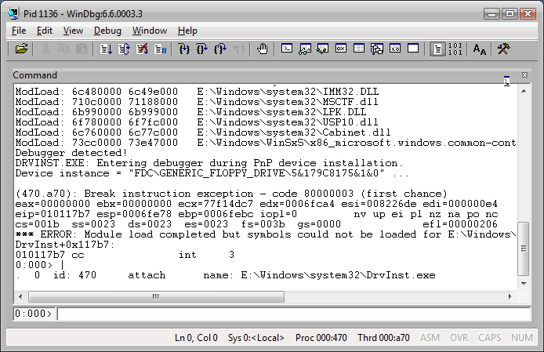
WinDbg Debug Session
demo

Slide 36



Slide 37
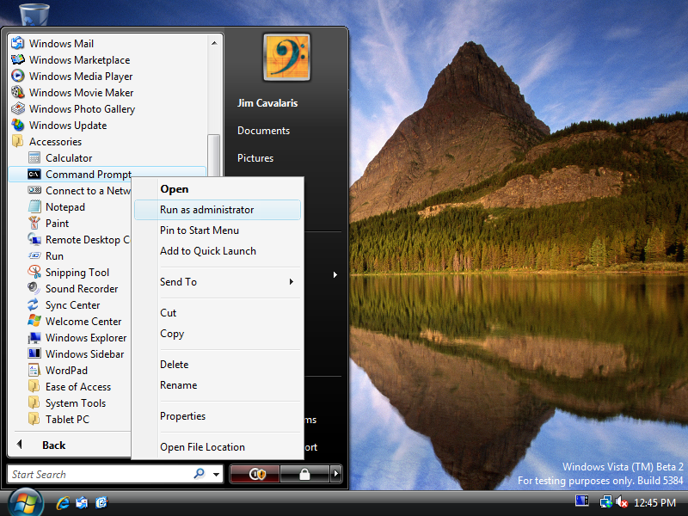

Slide 38
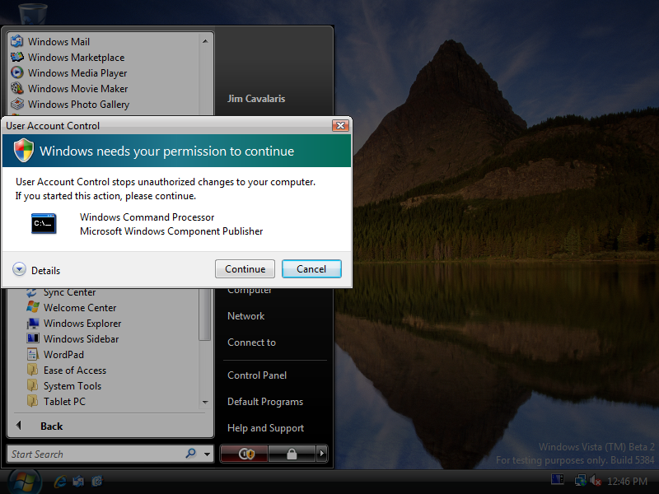

Slide 39
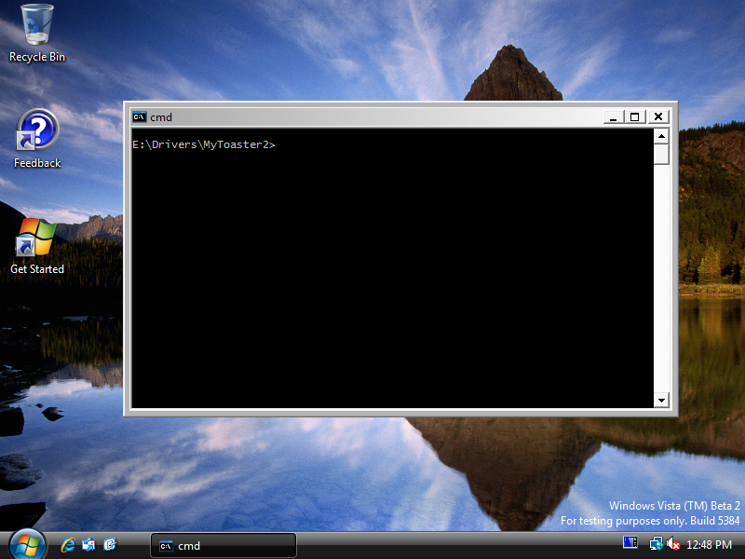

Slide 40


Slide 41
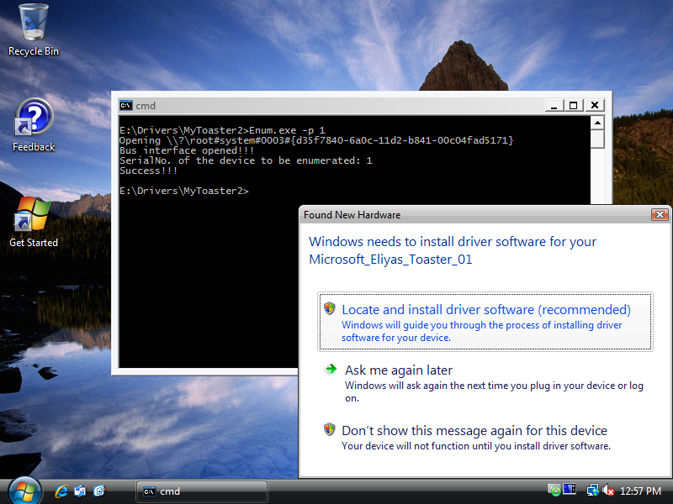

Slide 42
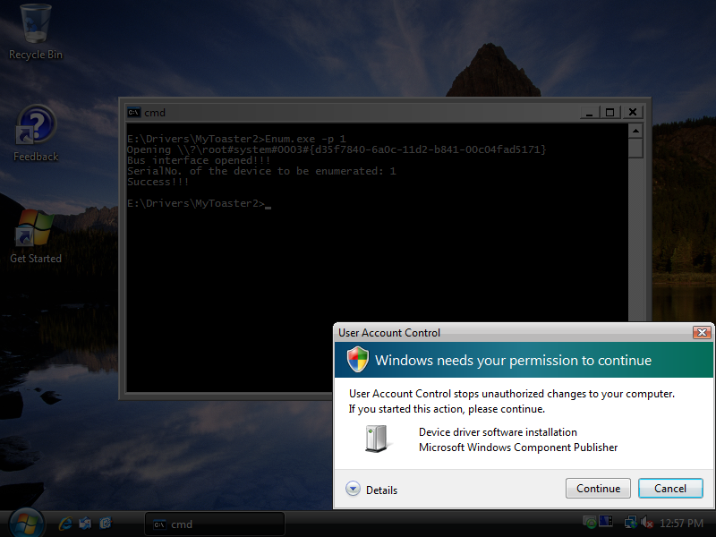

Slide 43
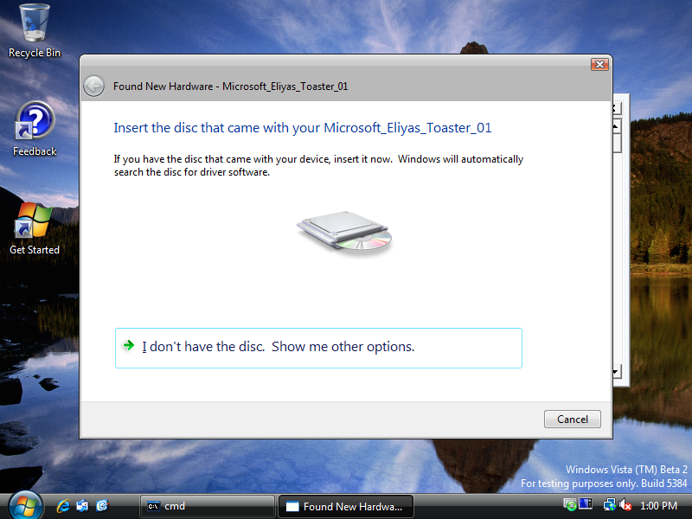


Slide 44
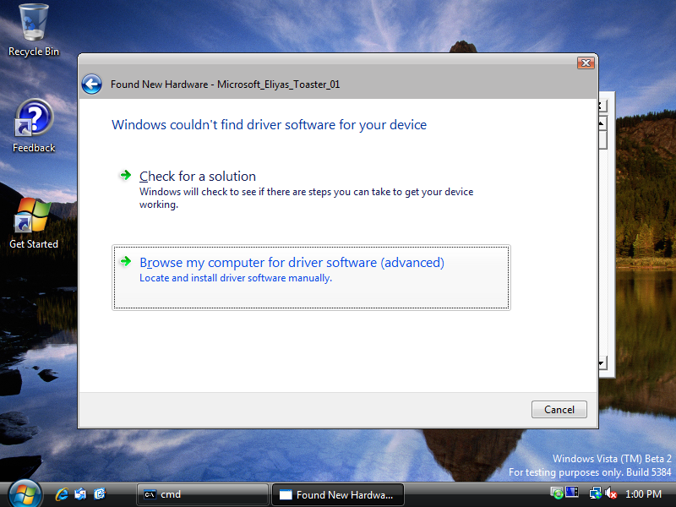

Slide 45
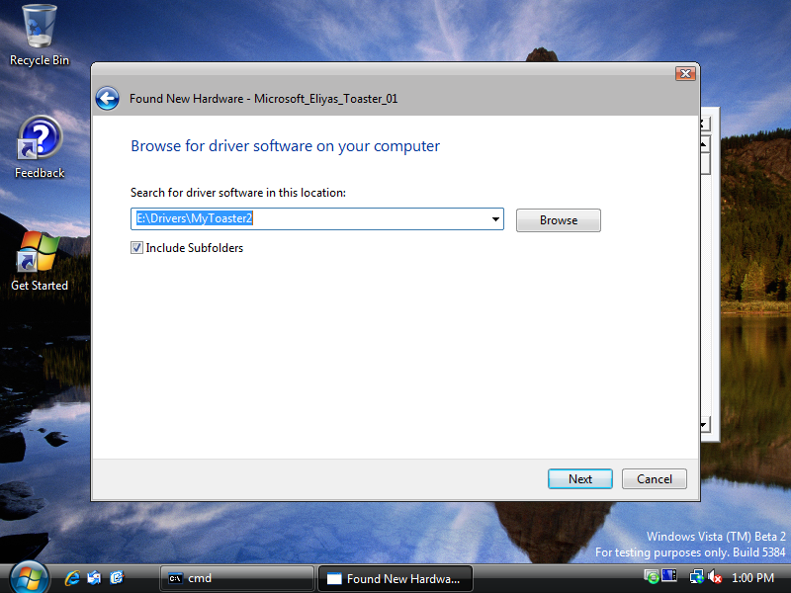

Slide 46
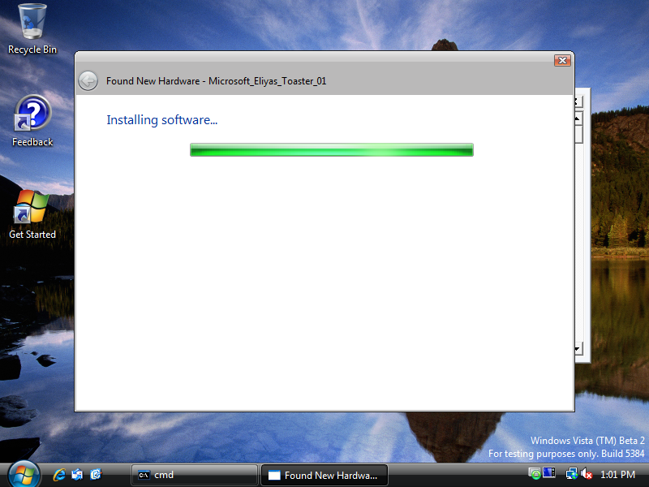

Slide 47


Slide 48


Slide 49
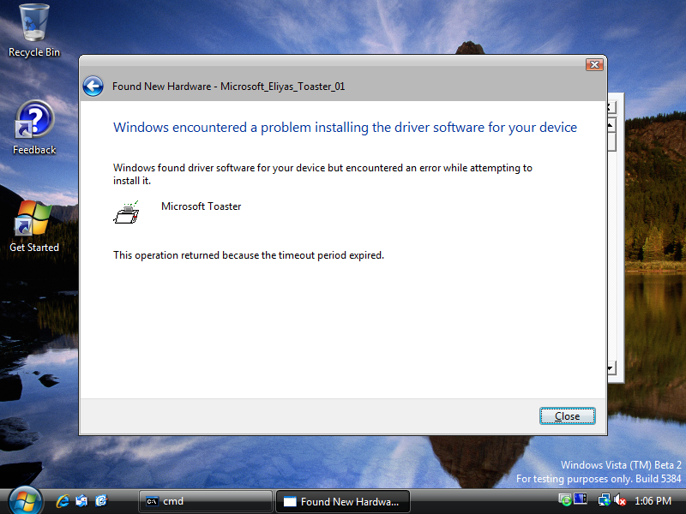

Slide 50


Slide 51
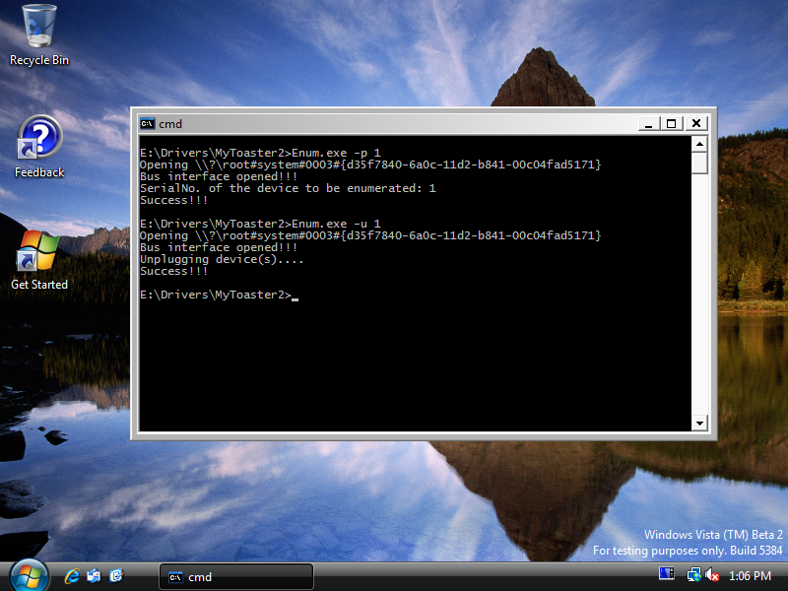

Slide 52


Slide 53
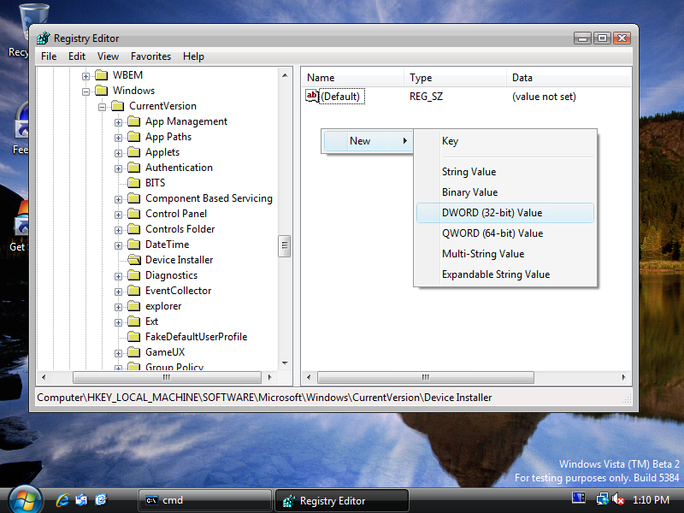

Slide 54
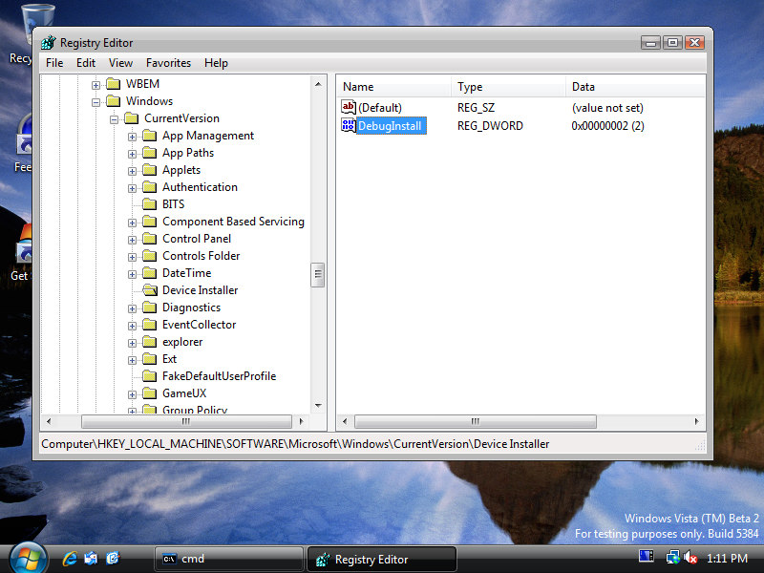

Slide 55
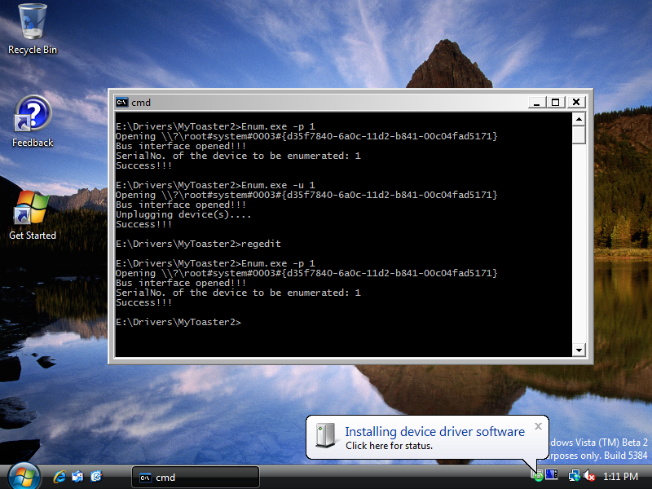


Slide 56


Slide 57
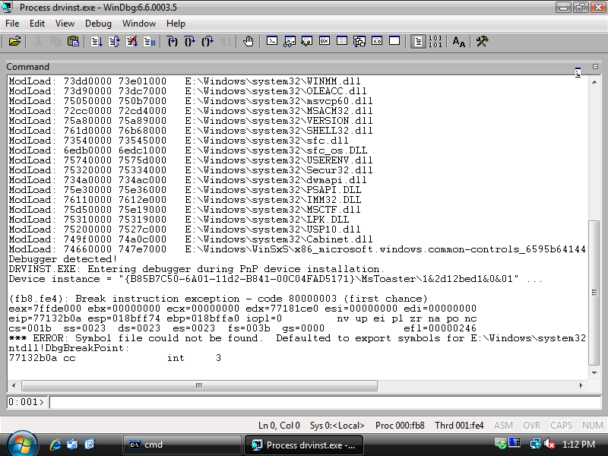

Slide 58
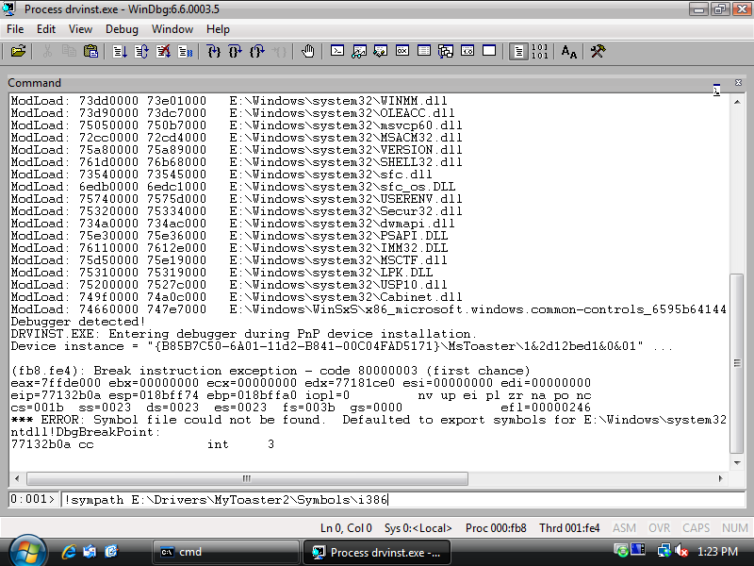

Slide 59
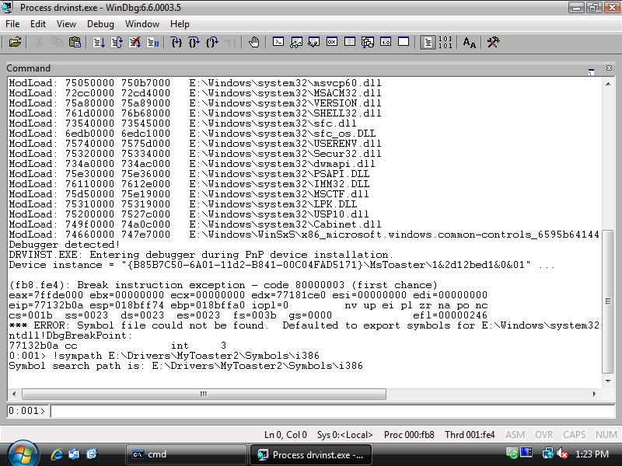

Slide 60
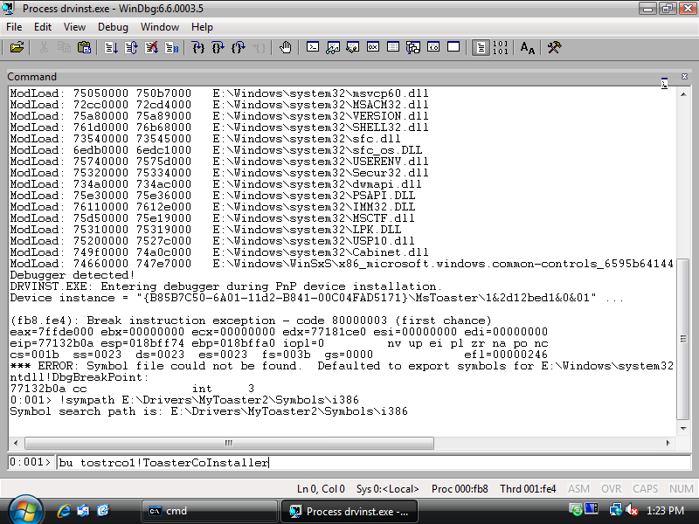

Slide 61
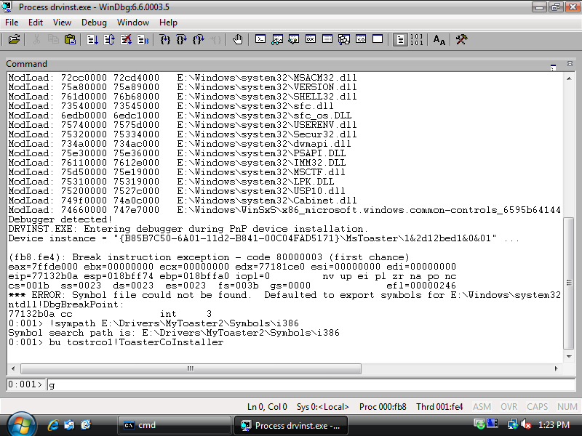

Slide 62
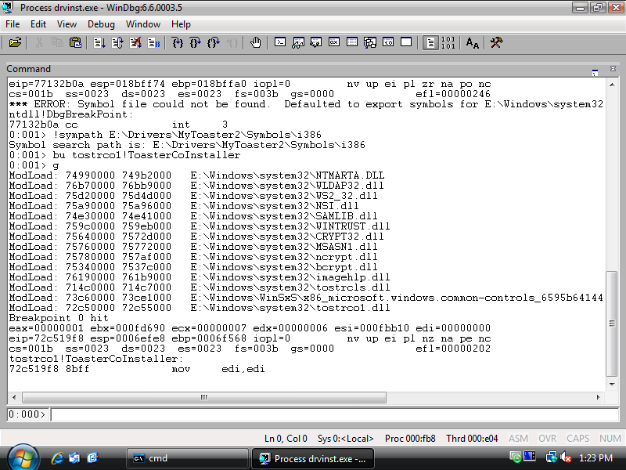


Slide 63
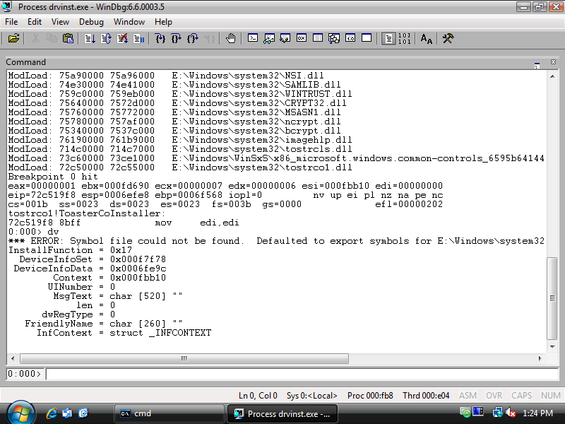
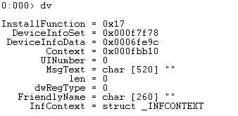

Slide 64
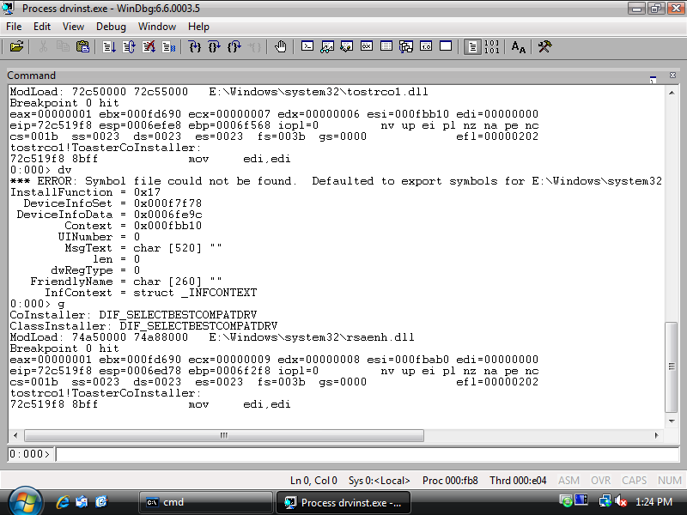
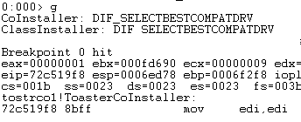

Slide 65
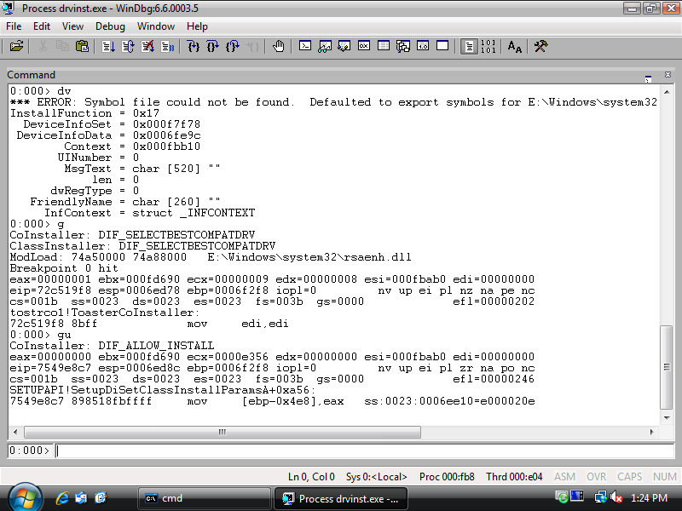
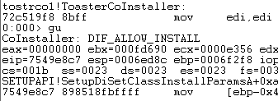

Slide 66
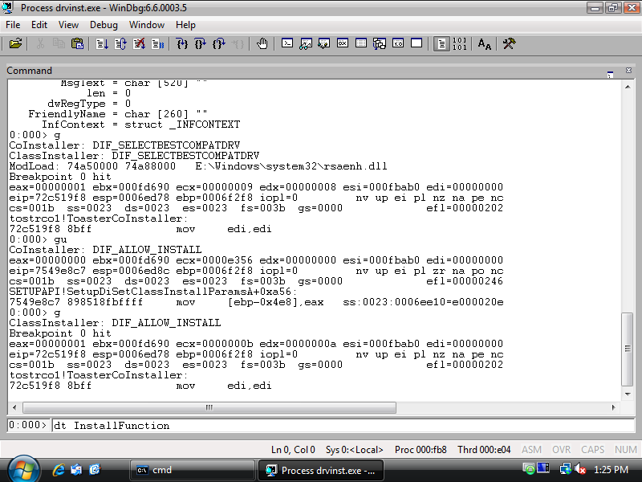

Slide 67
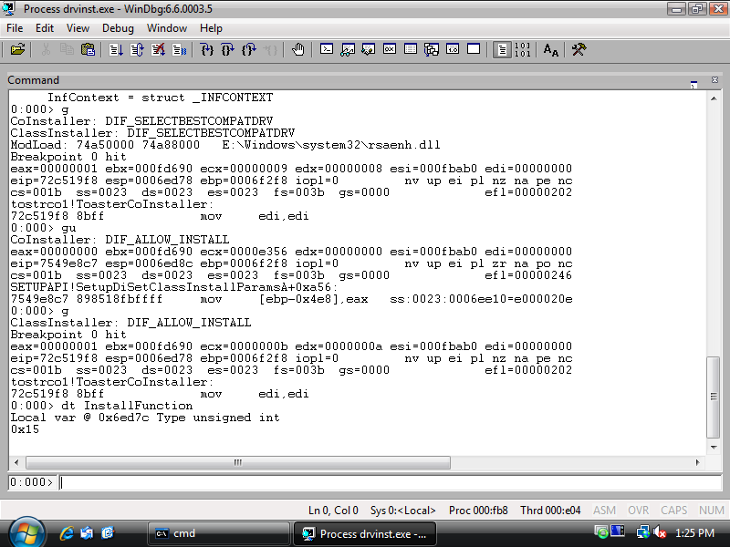


Slide 68
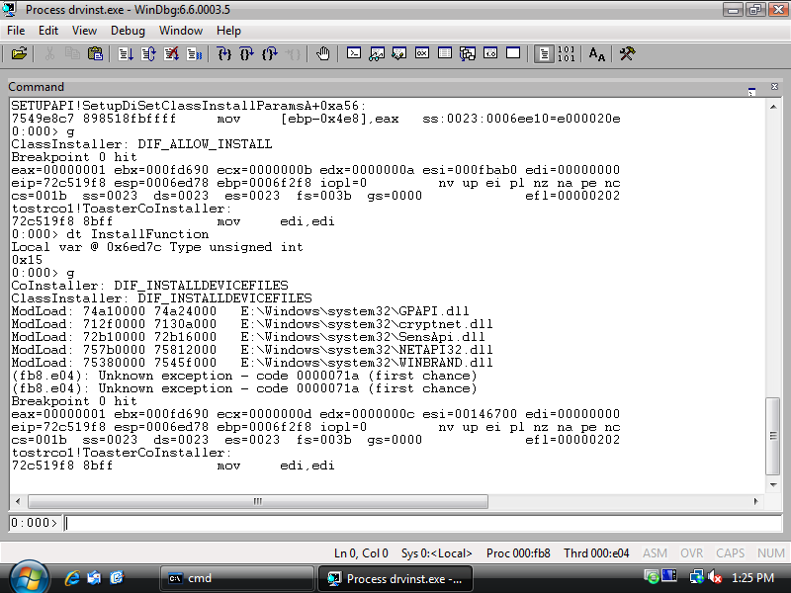

Slide 69
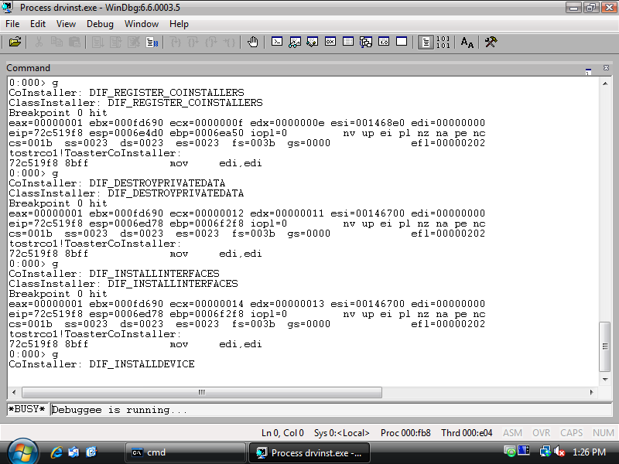

Slide 70

CTRL+BREAK

Slide 71
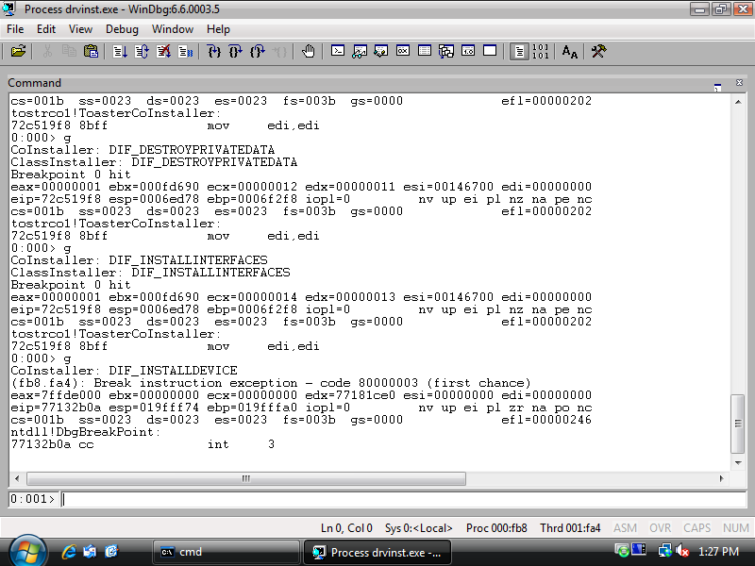


Slide 72


Slide 73
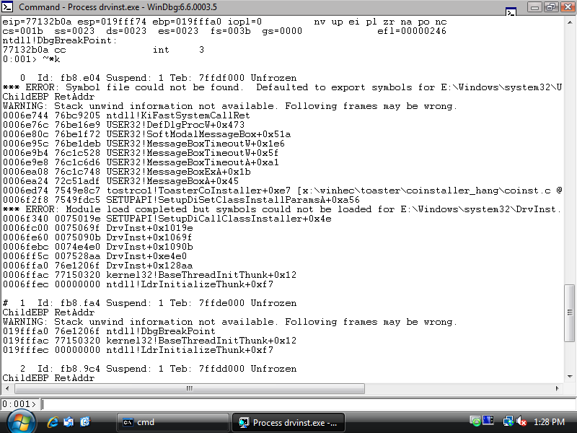

Slide 74


Slide 75
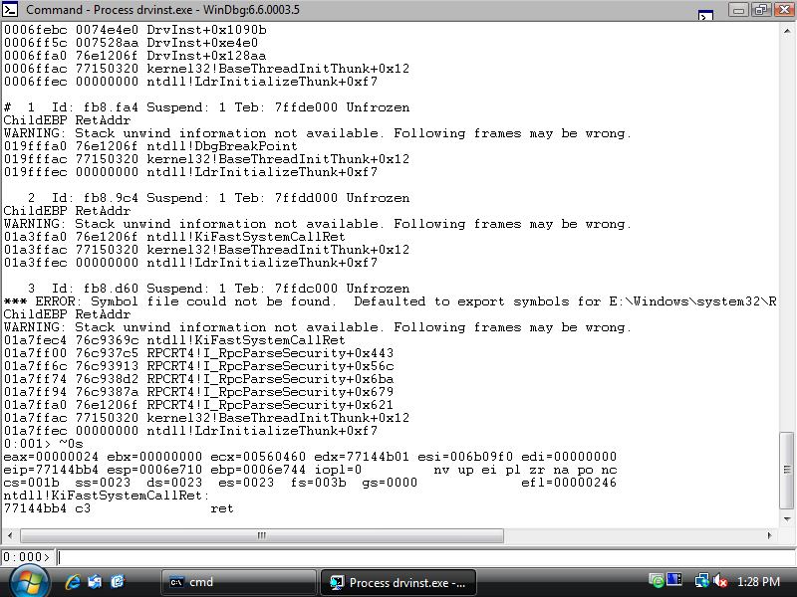


Slide 76
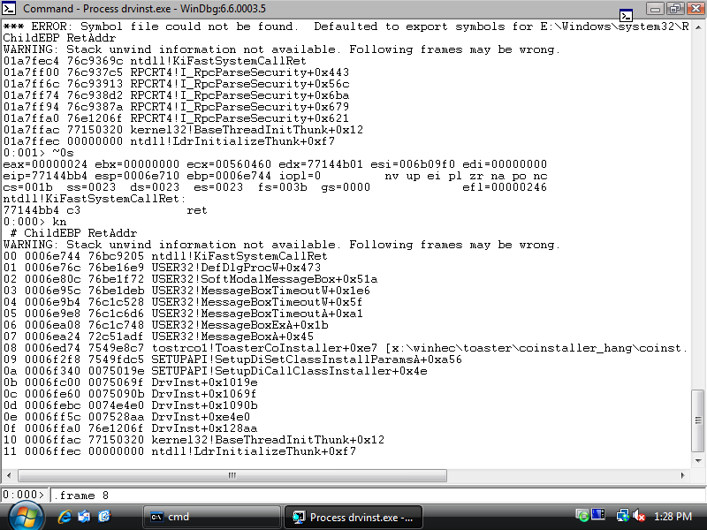

Slide 77
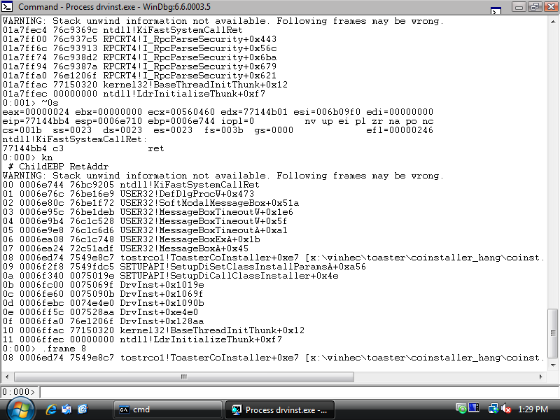

Slide 78
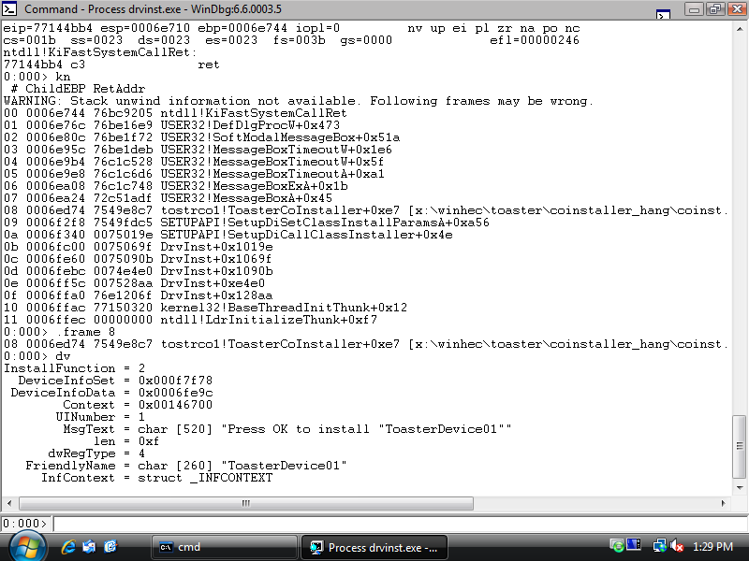

Slide 79
Debugging Device Installation
Kernel Debugger
DebugInstall = 1
  Requires kernel debugger (KD)
  Core device install process breaks into debugger before installation begins
  5 minute timeout for installation is enforced

Slide 80
Class/Co-Installer Debugging
Kernel Debugger
Can set breakpoints in user modules already loaded into current process
  (e.g. public exports from SetupAPI, Kernel32, etc.)
  .reload /user
  bp /p @$proc setupapi!Xxx

Slide 81
Class/Co-Installer Debugging
Kernel Debugger
Otherwise, mostly for kernel
  Set debugger context
  !process, .process, .thread
  Break on kernel module load, set bps
  sx e ld mydriver.sys
  Plug and Play kernel debugging
  !devnode, !devobj

Slide 82
Debugging Finish-Install Items
Run as the interactive user
“Hardware First” scenarios
  rundll32.exe
  newdev.exe (User Access Control scenarios)
“Software First” scenarios
  mmc.exe (device manager)
  Application process
  newdev.exe (User Access Control scenarios)
Use “Image File Execution Options” registry key to start processes under Debugger

Slide 83
Call To Action
Use co-installers to extend default installation tasks (not replace)
Limit use to machine-wide device configuration tasks
Test packages with co-installers and class installers
  Hardware-first, Software-first scenarios
  First-time installation, Update Driver, Uninstall/Re-install
Use custom SetupAPI Logging in
co-installers and class installers to help debug issues

Slide 84
Additional Resources
Web Resources
  Device Installation Design Guide
    http://msdn.microsoft.com/en-us/library/ms790231.aspx
  Writing a Co-installer
    http://msdn2.microsoft.com/en-us/library/ms790151.aspx
  Finish-Install Wizard Pages
    http://msdn2.microsoft.com/en-us/library/aa477003.aspx
  Finish-Install Actions (Windows Vista)
    http://msdn2.microsoft.com/en-us/library/aa477001.aspx
  Debugging Device Installation in Windows Vista
    http://www.microsoft.com/whdc/driver/install/diagnose.mspx
  SetupAPI Logging Reference (Windows Vista)
    http://msdn2.microsoft.com/en-us/library/Aa477450.aspx \
Related Sessions
  DVR-T393: Building Deployable Driver Packages
  DVR-T396: Common Driver Install Errors
  DVR-T502: Debugging Device Installation on Windows Vista

