Slide 1
Driver Verifier Advances and best practices
Daniel Mihai
Software Design Engineer
Microsoft Corporation

Slide 2
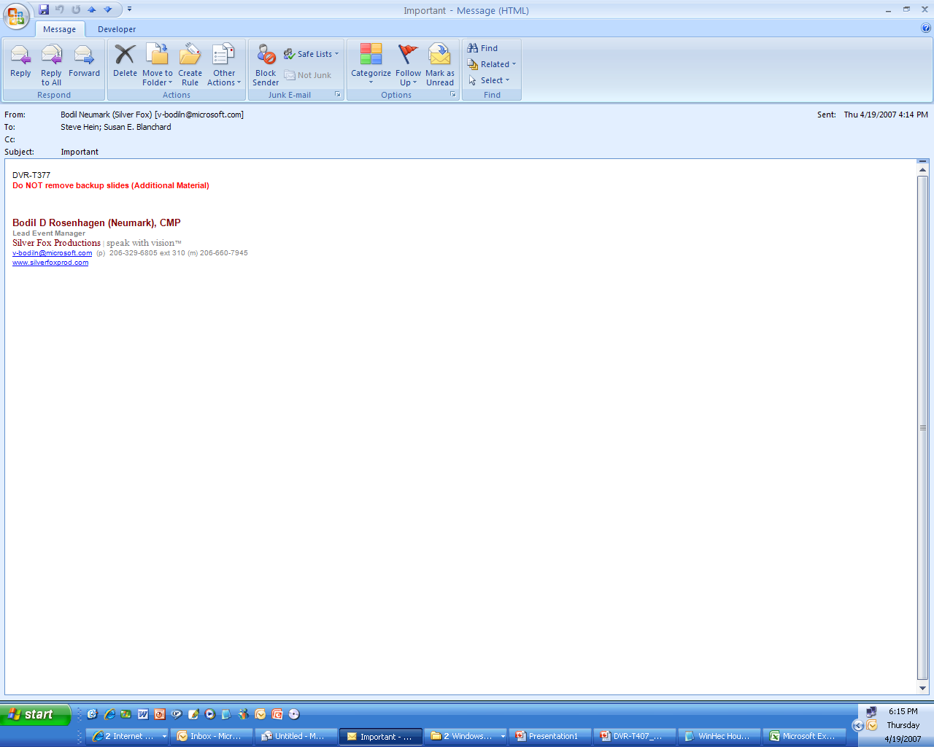
When Drivers Crash…
SHARON
Thursday, April 12, 2007 7:14 AM
Microsoft OCA Support
Our computer wants us to tell you about a crash
Hi Microsoft,
I don’t know how to get you the info our computer wants us to send you about our computer crash. I hope this will help.
Thanks for being there.
Sharon
…we hear from customers

Slide 3
Agenda
New features in Windows Vista and Windows Server codenamed “Longhorn”
Call to action/best practices
Future versions
Additional resources
Questions and Answers

Slide 4
Pre-Windows Vista Options
Special Pool
Pool Tracking
Force IRQL Checking
I/O Verification
Enhanced I/O Verification
Deadlock Detection
DMA Checking
Low Resources Simulation

Slide 5
New Options In Windows Vista
Security Checks
Force Pending I/O Requests
Miscellaneous Checks
Additional Automatic Checks
New features for older options
Performance improvements
Enable/disable without reboot
AutoVerifier

Slide 6
Security Checks (1/2)
Included in Standard Settings (“verifier.exe /standard /driver foo.sys”)
UserMode -> KernelMode processor mode transition is a security boundary
Typically when calling a kernel Zw API
Zw APIs parameters have to be “trusted”
No user mode addresses
Data coming from application already captured and validated

Slide 7
Security Checks (2/2)
No malformed UNICODE_STRINGs
Valid OBJECT_ATTRIBUTES structure fields
If Irp->RequestorMode == KernelMode, Irp->UserBuffer then Irp-> AssociatedIrp.SystemBuffer can be trusted
Verifier.exe /flags 0x100 /driver foo.sys

Slide 8
Force Pending I/O Requests (1/3)
Started from numerous crashes on customer systems, in 2005
KEVENT event;
IO_STATUS_BLOCK ioStatus;
KeInitializeEvent (&event, NotificationEvent, FALSE);
irp = IoBuildSynchronousFsdRequest ( IRP_MJ_WRITE,TopOfDeviceStack, WriteBuffer, NumBytes, &startingOffset, &event, &ioStatus);
if (irp == NULL) return STATUS_INSUFFICIENT_RESOURCES;
status = IoCallDriver (TopOfDeviceStack, irp);
if (status == STATUS_PENDING) {
KeWaitForSingleObject (
&event, Executive, KernelMode, FALSE, NULL);
status = ioStatus.Status;
}

Slide 9
Force Pending I/O Requests (2/3)
If driver doesn’t wait correctly, event and ioStatus on the stack will get corrupted at IoCompleteRequest time
If drivers receiving the IRP don’t return STATUS_PENDING -> hard to test the PENDING code paths
Verifier forces IoCallDriver to return STATUS_PENDING
Also delays completion, allowing enough time for a possible buggy caller of IoCallDriver to return and unwind the stack

Slide 10
Force Pending I/O Requests (3/3)
Log of IRPs forced pending recently
!verifier 40
========================================================
IRP: 8f84ef00 - forced pending from stack trace:
817b21e4 nt!IovpLocalCompletionRoutine+0xb2
81422478 nt!IopfCompleteRequest+0x15c
817b2838 nt!IovCompleteRequest+0x9c
84d747df acpi!ACPIBusIrpDeviceUsageNotification+0xf5
84d2d36c acpi!ACPIDispatchIrp+0xe8
817b258f nt!IovCallDriver+0x19d
8142218e nt!IofCallDriver+0x1c
817c6a9d nt!ViFilterDispatchPnp+0xe9
817b258f nt!IovCallDriver+0x19d
8142218e nt!IofCallDriver+0x1c
84fed489 pci!PciCallDownIrpStack+0xbf
84fde1cb pci!PciDispatchPnpPower+0xdf
…

Slide 11
Miscellaneous Checks
Challenging for performance:
Active Work Items in freed memory
Active ERESOURCEs in freed memory
Active Lookaside Lists in freed memory
Driver unloading but didn’t unregister WMI callback or ETW provider
Deleting device objects that were not unregistered yet from WMI
Unregistering providers that were already unregistered
Handle tracing enabled for System process - see !htrace in debugger.chm

Slide 12
Automatic Checks (1/3)
Calling IoCallDriver with interrupts disabled or above DISPATCH_LEVEL
Return from dispatch routine with interrupts disabled, changed IRQL or APCs disabled
MmProbeAndLockPages for a memory descriptor list (MDL) having incorrect flags
MmProbeAndLockPages for MDL setup by MmBuildMdlForNonPagedPool

Slide 13
Automatic Checks (2/3)
MmMapLockedPages for MDL having incorrect flags
MDL already mapped to a System Address
MDL wasn’t Probed and Locked
MmUnlockPages or MmUnmapLockedPages for partial MDL
MmUnmapLockedPages for MDL that is not mapped to a System Address
Log stack traces for recent ExAllocatePool and ExFreePool calls

Slide 14
Automatic Checks (3/3)
1: kd> !verifier 80 8461b000
Parsing 00010000 array entries,
searching for address 8461b000.
==================================
Pool block 8461b000, Size 00001004,
Thread 85f86030
81ec75d9 nt!VerifierExAllocatePoolWithTag+0x59
82c8d2a6 Ntfs!NtfsCreateMdlAndBuffer+0x48
82c8de06 Ntfs!NtfsAllocateCompressionBuffer+0x78
82c8def3 Ntfs!NtfsPrepareSimpleBuffers+0xc3
82c8f15b Ntfs!NtfsPrepareBuffers+0x93
82c90258 Ntfs!NtfsNonCachedIo+0x232
82cac86a Ntfs!NtfsNonCachedUsaWrite+0x138
82caea62 Ntfs!NtfsCommonWrite+0x1b84
82caf558 Ntfs!NtfsFsdWrite+0x2fe
81ec6655 nt!IovCallDriver+0x275
8182594f nt!IofCallDriver+0x1d
818281db nt!IoCallDriverStackSafe+0x59
82f087c0 fltmgr!FltpLegacyProcessingAfterPreCallback

Slide 15
Improved Low Resources Simulation
Custom parameters
Probability that a given allocation will fail
Pool tags injected with faults
Name of applications affected
Boot grace period length
Verifier /faults 1000 "Tag1 Fred" foo.exe 5
Support for IoAllocateIrp, IoAllocateWorkItem, IoAllocateMdl, MmAllocateContiguousMemory, MmAllocatePagesForMdl, IoAllocateErrorLogEntry
STATUS_ALERTED from Alertable Wait

Slide 16
More New Features For Older Options
Pool Tracking enables TrackLockedPages (PROCESS_HAS_LOCKED_PAGES 0x76)
Force IRQL Checking: Synchronization objects must be non-paged
I/O Verification
Hang Verifier – log IRP operations that take too long time (e.g. cancellation) – displayed by !verifier 20
Detect incorrect Remove Lock usage

Slide 17
Activating/Changing Settings Without Reboot
Windows Server 2003 and earlier
Can change options without reboot but only if Verifier was already enabled at boot time
Can start verifying another driver as long as the driver was not loaded already
Cannot stop verification if driver was loaded
Windows Vista: 90% of Verifier can be enabled/disabled without reboot, even for drivers that are loaded
Made possible by the Memory Management dynamic kernel address space
Verifier.exe /volatile

Slide 18
AutoVerifier
Allow end-users to use the same tool driver developers are using – Driver Verifier
Deployed for large and unsolved Online Crash Analysis (OCA) buckets
Windows Error Reporting suggests enabling diagnostic tool, after an unsolved system crash
If customer accepts, Verifier gets enabled without rebooting – it goes away after a reboot
May-June 2006 – exposed 85 bad driver bugs from Windows Vista Beta customers

Slide 19
Call To Action
Test drivers you own with Driver Verifier enabled, investigate and fix all breaks
All drivers should pass testing at least with Standard Settings enabled
verifier.exe /standard /driver foo.sys
Try Enhanced I/O Verifier too because it is catching lots of other very interesting driver bugs
Improve code coverage by using Force Pending I/O Requests, Low Resources Simulation

Slide 20
Future Versions
Detect additional memory corruptions and leaks
Unified I/O Verification
More powerful Low Resources Simulation
Etc

Slide 21
Additional Resources
WinHEC: Lab - Debugging Bugs Exposed by Driver Verifier, Chalk-Talk - Internals Discussion
WDK documentation http://www.microsoft.com/whdc/DevTools/tools/DrvVerifier.mspx
New features for Windows Vista: http://www.microsoft.com/whdc/DevTools/tools/vistaverifier.mspx
Hang Verifier http://download.microsoft.com/download/9/c/5/9c5b2167-8017-4bae-9fde-d599bac8184a/DriverHangVerification.doc
Feedback:
Verifier @ microsoft.com

Slide 22

© 2007 Microsoft Corporation. All rights reserved. Microsoft, Windows, Windows Vista and other product names are or may be registered trademarks and/or trademarks in the U.S. and/or other countries.
The information herein is for informational purposes only and represents the current view of Microsoft Corporation as of the date of this presentation. Because Microsoft must respond to changing market conditions, it should not be interpreted to be a commitment on the part of Microsoft, and Microsoft cannot guarantee the accuracy of any information provided after the date of this presentation. MICROSOFT MAKES NO WARRANTIES, EXPRESS, IMPLIED OR STATUTORY, AS TO THE INFORMATION IN THIS PRESENTATION.

