Slide 1
Driver Test Manager Best Practices and Directions
Craig Rowland
Program Manager
Windows Logo Kit
Microsoft Corporation

Slide 2
Goals
Give you some ideas on how to better utilize the Driver Test Manger (DTM)
Share with you the roadmap for the Windows Logo Kit

Slide 3
Agenda
DTM Best Practices: AMD Case Study
Windows Logo Kit Roadmap

Slide 4

DTM Best Practices AMD Case Study
partner
Max Kiehn
Staff Engineer
Test Infrastructure
AMD
Greg Robertson
Manager
WHQL
AMD

Slide 5
Overview
DTM and Windows Vista @ AMD
DTM introduction
General DTM tips
DTM deployment scenarios
Advanced DTM features

Slide 6
AMD Case Study Success with Windows Vista and DTM
The first company to certify Windows Vista graphics, chipset, and capture device drivers
Public commitment to 12 Windows Logo’d web postings annually
AMD uses DTM in all phases of software qualification
DTM helped roll out a common set of tools to all product areas

Slide 7
DTM Introduction Delta between HCT/DCT testing and DTM testing
Expanded intent
DTM is not just for Logo anymore…
DTM is not standalone and is more complex
Logo mode constraints are important
Shift Mindset
Tester mindset – DTM is enterprise, client-server
Dev mindset – jobs bring benefits but are not as portable as tests in the HCT. Often needs more support from testers
Account teams – knowing what to ask for from customer contacts and how to repro issues

Slide 8
General DTM Tips DTM controller
DTM controller should be treated as a production server with appropriate maintenance, security and patch procedures
Two 'philosophies' for DTM controllers
Either treat them as disposable and extract all your results after a testing period
Or treat them as fixed and keep them around for long term
In both cases a well-defined or automated deployment procedure is a must

Slide 9
General DTM Tips DTM controller
Specs
Large Lab (20+): Enterprise Class Server
Small/Medium Lab(<20): Dual-Core system, 2-3Gig System RAM
Maintenance
Clean up: SQL logs, DTM logs, test logs, machine pools
Planned updates: Operating System (OS) Updates, DTM QFEs
Network: reliable Gigabit Ethernet backbone throughout

Slide 10
DTM Deployment Scenarios
Production Test Lab
Frequent or continuous logo and non-logo testing
Software Developer Test
Graphics and Chipset Driver Testing at developer level
Enterprise Harness

Slide 11
Production Test Lab
Lab Configuration
IT managed DTM controllers if possible
Automated DTM client and controller deployment procedures
AMD automation wrappers for logo and non-logo testing
Having a test controller is essential especially in the new WLK regular release schedule
Example: during initial AMD TAP involvement with DTM betas not having a test environment significantly slowed down progress

Slide 12
Developer Test
Sell DTM to developers
Find and engage champions
Create a pilot project to use DTM early in the cycle
Evangelize, train and support DTM to developers
Example: during fast-paced Windows Vista adoption with frequent OS, Driver, Test Content, Test Harness changes, AMD engaged developers early in test content and harness evaluation which helped speed up driver development

Slide 13
Developer Test
Provide easy to use testing environment and procedures to developers
Up-to-date dedicated controller with correct security settings, etc.
Do not expect developers to maintain controller or processes
Since test contexts are difficult to export or reproduce we needed manual procedures and a full DTM environment for Development Teams
Main value: reducing the number of unreproducible issues from developers and early identification of logo issues

Slide 14
Large Scale Reporting
Develop custom reports to gather data
For larger scenarios, aggregate the data in a central location
DTM Reports are highly customizable
Example: AMD developed extensive reports for all stages of DTM testing early in the cycle greatly improving internal rate of DTM adoption and Windows Vista driver quality

Slide 15
Large Scale Extensibility
Use WTTCL for basic tasks
Deterministic or time based scheduling
External event scheduling, like smoke test triggered by driver build
Use logo APIs (DSSO) for logo automation including staged scheduling, reruns and even notifications
DSSO can replicate all features of the Device Console

Slide 16
Advanced Functionality
Don’t neglect contexts and mixes – great way to distribute a schedule on one or more machine pools
Customize gatherers – while there is no support for custom gatherers, new dimensions can be created to parse data from standard gatherers into the database for reporting

Slide 17
Windows Logo Kit Roadmap

Slide 18
Lab Size
Number of client in lab
Small = 1-5
Medium = 6-25
Large = 25+
Number of concurrent submissions
Small = 1-3
Medium = 4-10
Large = 10+
Large 15%
Large 11%
Small 40%
Small 48%
Medium 37%
Medium 41%
200 partners surveyed between January 12 February 16 2007 via Connect

Slide 19

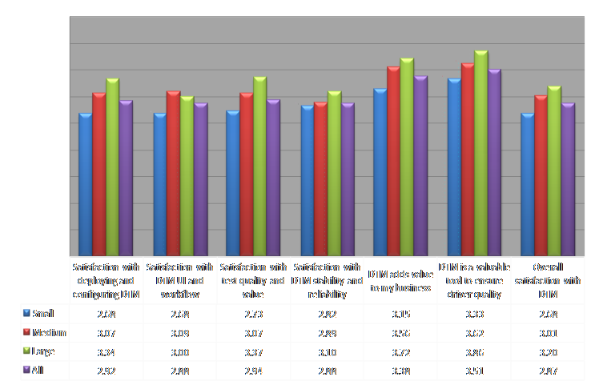
Satisfaction
220 DTM users surveyed between January 12 and February 16 2007 via Connect
Partners were asked to rate their level of satisfaction in each area
1 = dissatisfied or disagree
2 = somewhat dissatisfied or disagree
3 = neutral
4 = somewhat satisfied or agree
5 = satisfied or agree

Slide 20
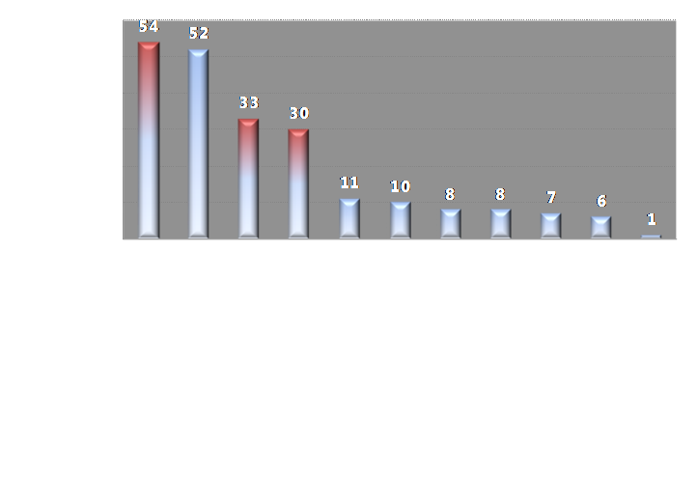
Feature Requests
200 DTM users surveyed between January 12 and February 16 2007 via Connect
Question: What is the one thing Microsoft could do with the DTM that would have the most impact in the Longhorn Server timeframe
Red bars: Also a top feature request from internal Windows team during the RC1 post-mortem review

Slide 21
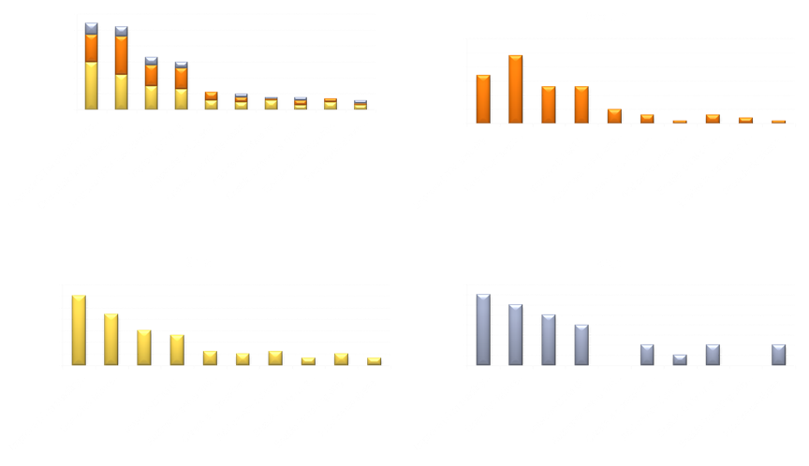
Feature Requests
220 DTM users surveyed between January 12 and February 16 2007 via Connect
Question: What is the one thing Microsoft could do with the DTM that would have the most impact in the Longhorn Server timeframe.

Slide 22
Futures
Fixing the pain points

Slide 23

Stability And Reliability
Test content
Rollup all QFEs from the previous release
Fix all bugs which did not meet the QFE bar
Eliminate as many errata as possible by fixing bugs
Raise the quality bar on tests
Clarify interfaces for tests
DTM
Rollup all QFEs from the previous release
Fix all bugs which did not meet the QFE bar
Move to SQL Express
WTT
Rollup all QFEs from WTT
Take new versions of WTT as they’re available
Improved client-controller connection
Log upload retries

Slide 24
Diagnose-ability
DTM Studio
Logo
Requirements
DTM Infrastructure
DTM
Documentation
Logo Job
Test Log
Test
Documentation

Slide 25
Diagnose-ability
Easy Button
Show failure cause in the UI
One-click takes me to the point of failure; could be in a log, process failed, setup was incorrect
Link Failure to Docs
Failure linked to the logo requirement
Failures linked to test documentation
Automated Log Annotation
AKA auto-triage
Verbose troubleshooting information, for the specific failure, from the test owner

Slide 26
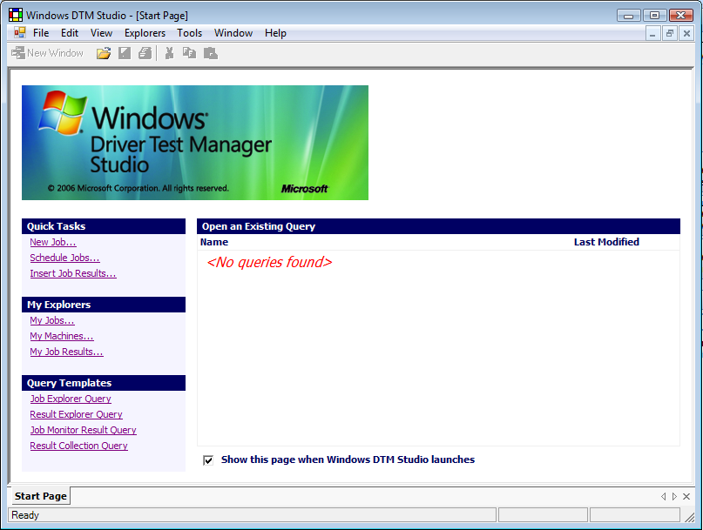
UI And Workflow

Slide 27
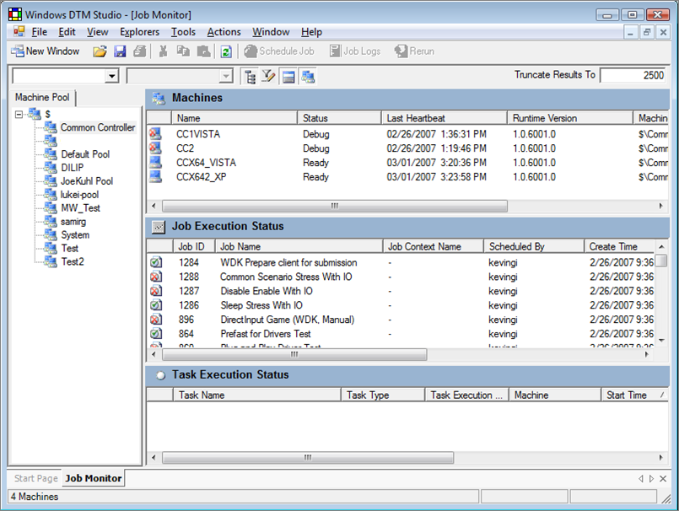
UI And Workflow

Slide 28
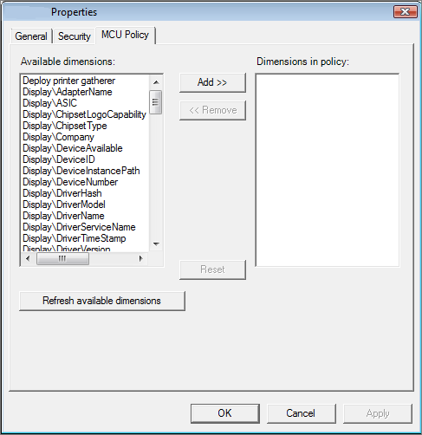
UI And Workflow

Slide 29
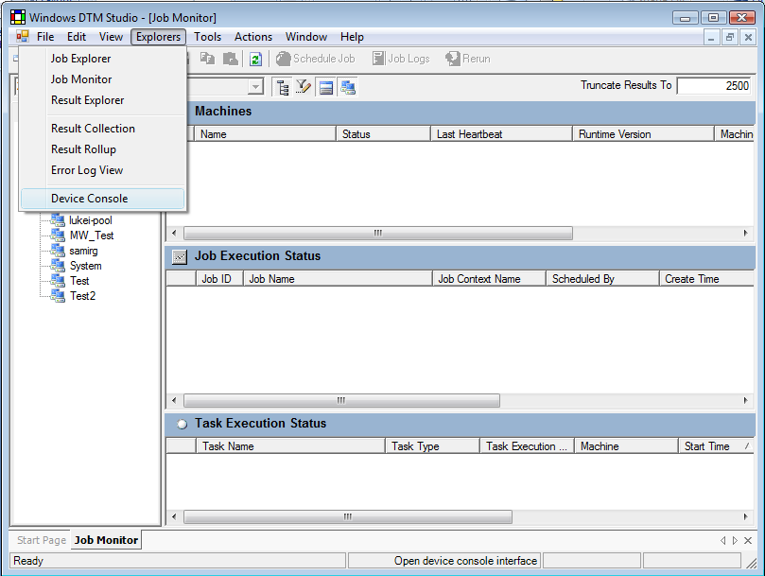
UI And Workflow

Slide 30
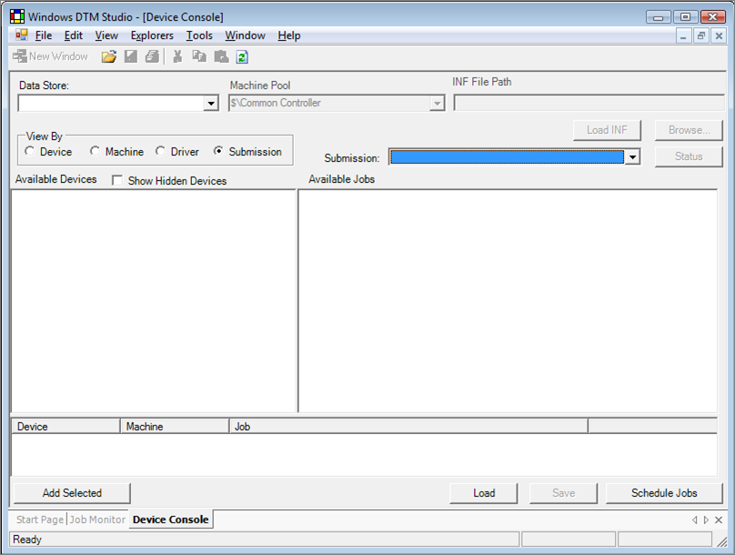
UI And Workflow

Slide 31
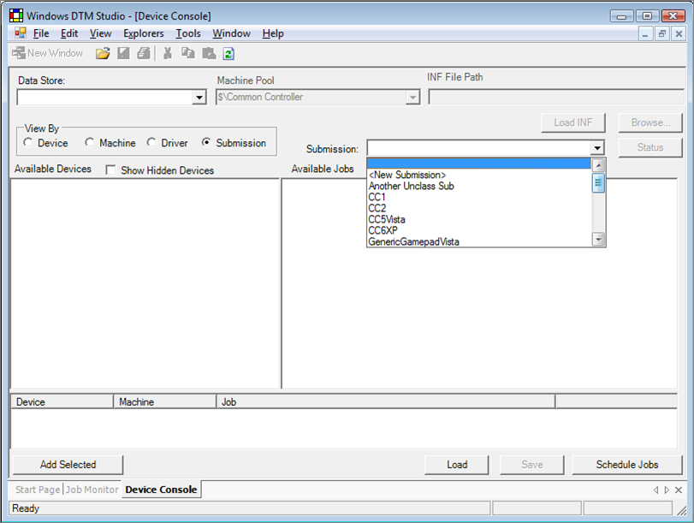
UI And Workflow

Slide 32
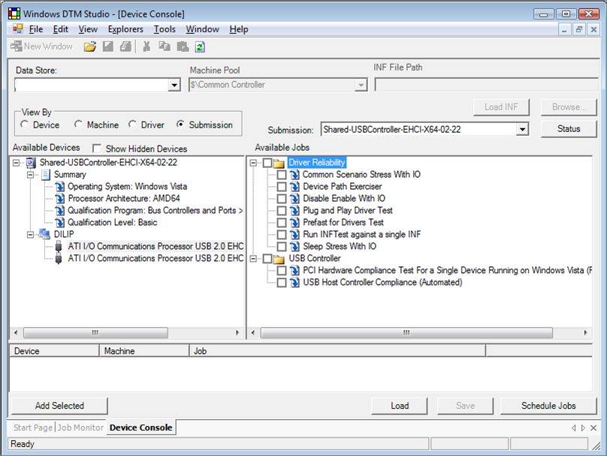
UI And Workflow

Slide 33
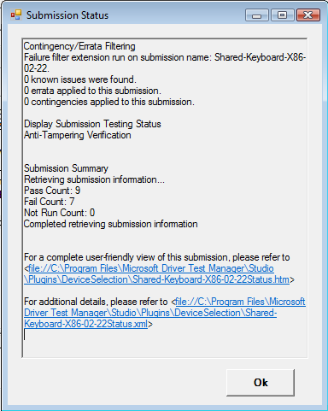
UI And Workflow

Slide 34
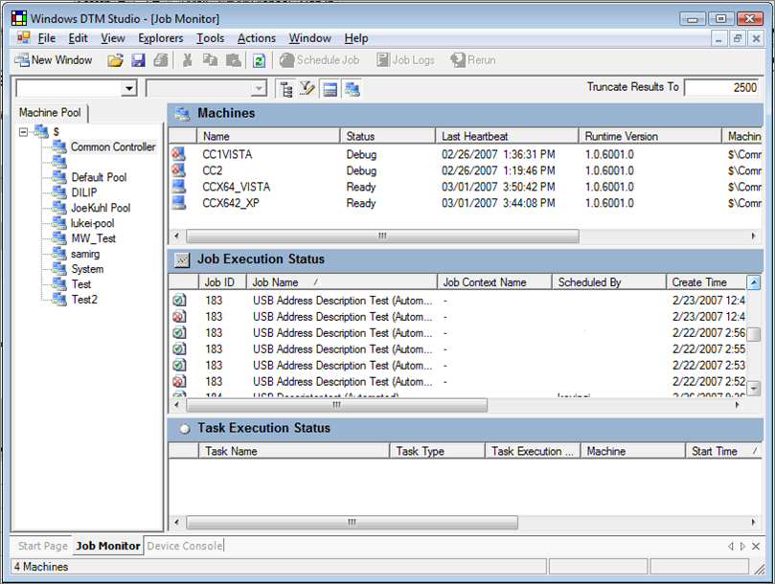
UI And Workflow

Slide 35
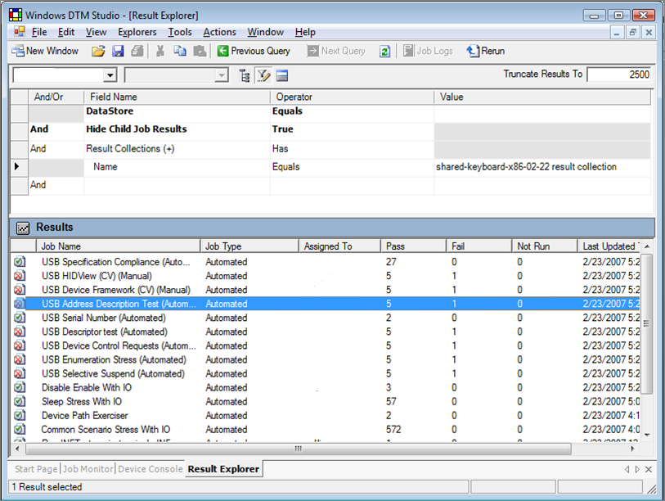
UI And Workflow

Slide 36
UI And Workflow

Slide 37
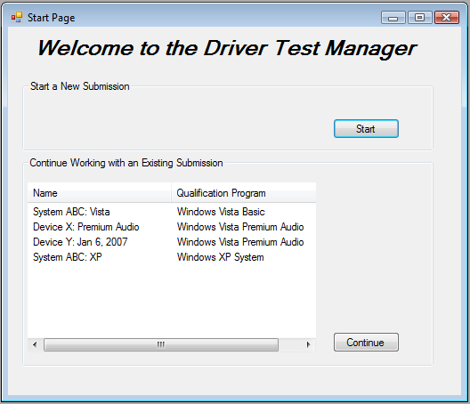
Start Page

Slide 38
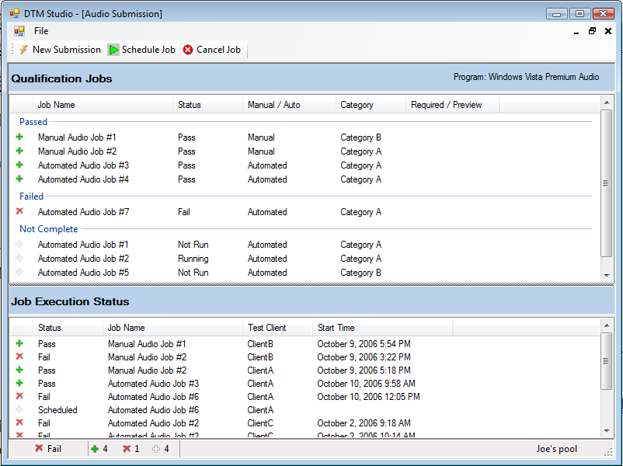
Submission Monitor

Slide 39
Call To Action
Upgrade to WLK 1.0.C in June
Plan for twice annual refreshes to the WLK
Watch WHQL news for beta/TAP announcements

Slide 40
Additional Resources
WHQL News: http://www.microsoft.com/whdc/newsreq.mspx
Web Resources
http://www.microsoft.com/whdc/DevTools/WDK/DTM.mspx
http://winqual.microsoft.com
Related Sessions
DTM Specific
DVR-C387/ DVR-C473 : Driver Test Manager: How to use the DTM
CON-H421: Certification Tests for Portable Devices: Workshop
CLN-467: Audio Testing: DTM Best Practices
SVR-T329: Windows Server Logo Testing: Planning
SVR-C330: Windows Server Logo Testing: Implementation
CLN-T352: Audio Testing for Devices and Systems Using DTM
WNS-C444: Logo Program for Storage: Best Practices
DVR-C451: WDTF Based Logo Tests: An In-Depth Look
Logo Program
CLN-T375: Certified for Windows Vista: Customer Awareness
CLN-C376: Windows Vista Logo Program: Directions
CLN-T495: Windows Logo Program: Strategic Directions
CLN-C404: Windows Logo Program: Best Practices
Other Driver Testing
DVR-T388: Building USB Device Simulations with DSF
DVR-T389: Automating Device Testing: WDTF
DVR-T381: Static Analysis and Verification of Drivers
DVR-T382: Static Analysis Tools: PREfast for Drivers
DVR-T407: Driver Verifier: Advanced and Best Practices
DVR-C408: Driver Verifier: Internals Discussion
DVR-T395: Driver Debugging Basics
Feedback: wlkfb @ microsoft.com

Slide 41
Disclaimer And Attribution
DISCLAIMER
The information presented in this document is for informational purposes only and may contain technical inaccuracies, omissions and typographical errors
The information contained herein is subject to change and may be rendered inaccurate for many reasons, including but not limited to product and roadmap changes, component and motherboard version changes, new model and/or product releases, product differences between differing manufacturers, software changes, BIOS flashes, firmware upgrades, or the like. AMD assumes no obligation to update or otherwise correct or revise this information. However, AMD reserves the right to revise this information and to make changes from time to time to the content hereof without obligation of AMD to notify any person of such revisions or changes
AMD MAKES NO REPRESENTATIONS OR WARRANTIES WITH RESPECT TO THE CONTENTS HEREOF AND ASSUMES NO RESPONSIBILITY FOR ANY INACCURACIES, ERRORS OR OMISSIONS THAT MAY APPEAR IN THIS INFORMATION
AMD SPECIFICALLY DISCLAIMS ANY IMPLIED WARRANTIES OF MERCHANTABILITY OR FITNESS FOR ANY PARTICULAR PURPOSE. IN NO EVENT WILL AMD BE LIABLE TO ANY PERSON FOR ANY DIRECT, INDIRECT, SPECIAL OR OTHER CONSEQUENTIAL DAMAGES ARISING FROM THE USE OF ANY INFORMATION CONTAINED HEREIN, EVEN IF AMD IS EXPRESSLY ADVISED OF THE POSSIBILITY OF SUCH DAMAGES
ATTRIBUTION
© 2007 Advanced Micro Devices, Inc. All rights reserved. AMD, the AMD Arrow logo, ATI, the ATI logo, Avivo, Catalyst, Radeon, and combinations thereof are trademarks of Advanced Micro Devices, Inc. Vista is a trademark, and Microsoft and Windows are registered trademarks, of Microsoft Corporation in the United States and/or other jurisdictions. Other names are for informational purposes only and may be trademarks of their respective owners

Slide 42

© 2007 Microsoft Corporation. All rights reserved. Microsoft, Windows, Windows Vista and other product names are or may be registered trademarks and/or trademarks in the U.S. and/or other countries.
The information herein is for informational purposes only and represents the current view of Microsoft Corporation as of the date of this presentation. Because Microsoft must respond to changing market conditions, it should not be interpreted to be a commitment on the part of Microsoft, and Microsoft cannot guarantee the accuracy of any information provided after the date of this presentation. MICROSOFT MAKES NO WARRANTIES, EXPRESS, IMPLIED OR STATUTORY, AS TO THE INFORMATION IN THIS PRESENTATION.

