Slide 1
Flash Memory Technology Direction
Jim Cooke
Director of Applications Engineering
Memory Products Group
Micron Technology, Inc.
Jcooke @ Micron.com

Slide 2
Agenda
Mass Storage
HDD, HHD, SSD
How Flash can Benefit Drives
Hybrid, ReadyBoost, Robson, SSD
Chipset Adoption
NAND
A Look at the Flash Market
SLC versusMLC
Architectures and Performance
Error Modes
Embedded MMC

Slide 3
Disk Drive Definitions
Hard Disk Drives (HDD)
HDDs utilize ultra-sophisticated magnetic recording and playback technologies. They are used as the primary data storage component in notebooks, desktops, servers, and dedicated storage systems.
Hybrid Hard Drives (HHD)
HHDs are a new type of large-buffer computer hard drive. They are different from standard hard drives in that they employ a large buffer (up to 1 GB) of nonvolatile flash memory used to cache data during normal use. By using this large buffer, the platters of the hard drive are at rest almost at all times, instead of constantly spinning as is the case in HDDs. This feature offers numerous benefits such as: decreased power consumption, improved reliability, and a faster boot process.
Solid State Drives (SSD)
SSDs are data storage devices that use non-volatile memory (flash), and volatile memory (SDRAM), to store data. While not technically "disks", these devices are referred to as such because they are typically used as replacements for HDDs.
Source: Gartner, wikipedia.org

Slide 4
SSD Versus HDD
 | SSD | HDD
Capacity |  | ✓
Performance | ✓
Reliability | ✓
Endurance | ✓ | ✓
Power | ✓
Size | ✓
Weight | ✓
Shock | ✓
Temperature | ✓
Cost per bit |  | ✓
Based on recent advances in NAND lithography, SSD densities reach capacities for mass market appeal
SSD offers many features that lead to improved user experiences
Early shortcomings for reliability and endurance have been overcome
NAND Solid State Storage Devices are ready for deployment in many applications

Slide 5
Why Add NAND To The PC?
Issues in PC architecture today
Long boot times for OS and applications
Unacceptable boot-up times for applications
Hard Disk Drive (HDD) latency falling behind processor performance
HDD maximizes GB, not performance
Industry wants extended notebook battery lifetime
HDD access (and motors) degrade battery life
NAND accesses save power

Slide 6


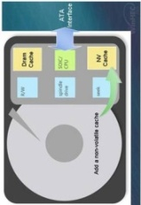
PC Opportunities For NAND
PC chipset/add-in card
Intel “Robson” in future platforms
Card or soldered onto motherboard
Hybrid HDD w/cache
Add NAND to the HDD chipset
Microsoft approach
Solid State Disk (SSD)
Flash replacement of HDD
CPU
System DRAM
Northbridge
Video
(
MCH
)
Connector
Build Option 1
Cache
PC Add
-
in Card
Add
-
in
-
or
-
Card
Soldered to
Motherboard
Southbridge
RS
232
(
ICH
)
PCI E
-
(optionally on MCH)
USB
Parallel
SATA
Build Option 3
Build Option 2
Solid State Disk
Hybrid HDD
With Cache
SSD
NAND

Slide 7

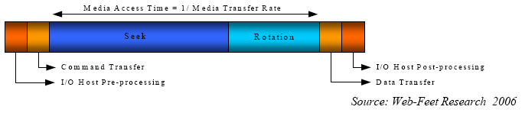
Hard Disk Drive
Rotational Latency
Seek Latency

Slide 8
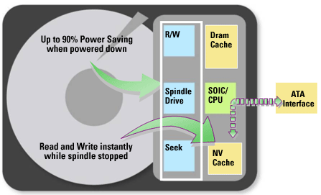
Hybrid Hard Drives Represent An Incremental Upgrade to HDDs
Hybrid Hard Drives have the same basic structure of a standard HDD but with the addition of a non-volatile cache
This feature allows for near instantaneous read/write capability even when the spindle has stopped

Slide 9
Other Ways NAND Flash Can Boost Performance
ReadyBoost
Can be implemented as
Add-on USB Flash disk
Add-on ExpressCard
Add-on SD/MMC card or any other media
User can determine how much of the Flash is used as a performance cache

Slide 10
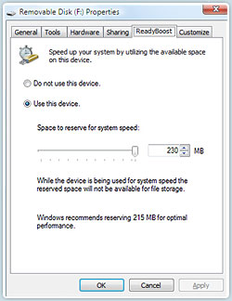
ReadyBoost Setup

Slide 11
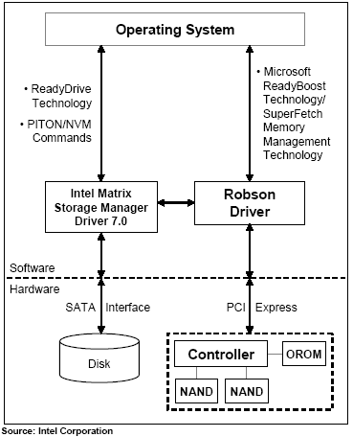
Intel’s Robson
Will first ship with the Santa Rosa notebook chipset platform
Expected to roll out toward the end of 1Q07 and will be implemented with Microsoft's Windows Vista
Initially, they expect the standard Santa Rosa Robson chipset configuration to include 512MB of NAND, but offer 1GB as an option
Source: Gartner,15 December 2006

Slide 12
Attach Rate By Year Of NAND Caching Solutions With Vista-equipped Portable Pcs
Percent of Windows Vista equipped Portable PCs | 2007 | 2008 | 2009 | 2010
Neither NAND Caching Technology | 95% | 77% | 43% | 15%
Hybrid HDD | 5% | 14% | 31% | 41%
Embedded NAND | 1% | 9% | 26% | 43%
Source: IDC 2006

Slide 13
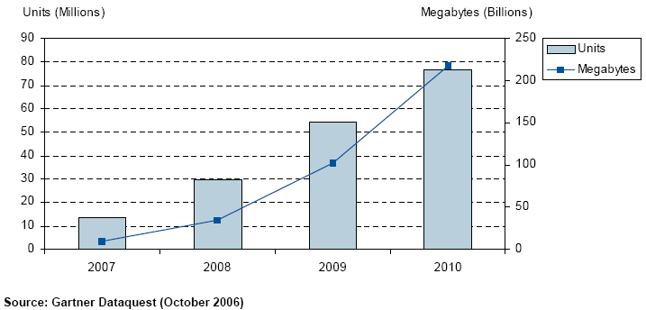
NAND Chipset Adoption In Notebook PCs (2007-2010)

Slide 14
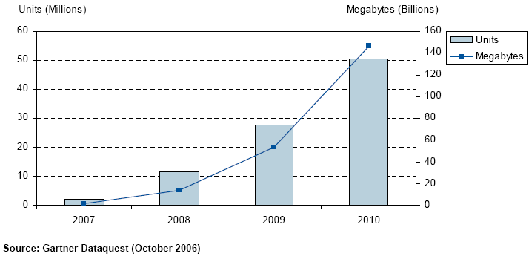
NAND Chipset Adoption In Desktop PCs (2007-2010)

Slide 15
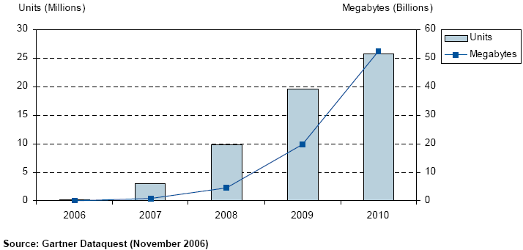
Forecast Of Hybrid HDDs In PCs And Associated NAND Flash Consumption

Slide 16

The Memory To Storage Gap
2

Slide 17
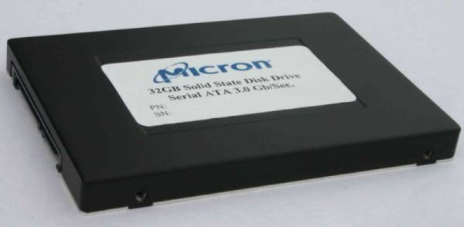
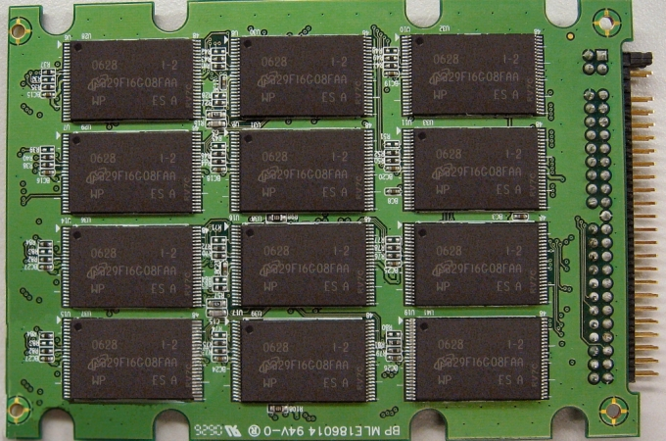
Solid State Drives Are Significantly Different
No moving parts
Lower power (less heat, Longer battery life)
More rugged
Faster

Slide 18
One Of The Biggest Advantages Of Solid State Drives Is Their Ruggedness
Average Specifications | Hard Disk Drive | Solid State Drive | Hard Disk Drive | Hybrid Hard Drive
 | 1.8” HDD | SSD(1.8”/2.5”) | 2.5” HDD | 2.5” HHD
Capacity | 30-80 GB | 4-32GB | 40-160GB | Up to 160GB
Data Rate (max sustain) | 25MB/s | 57MB/s | 44MB/s
Read
Write | 25MB/s | 32MB/s | 44MB/s
Spindle Speed | 4200 RPM | None | 5400 RPM | 5400 RPM
Seek | 15 ms | None | 12 ms | 12.5 ms
Non op shock | 1500 G | 2000 G | 900 G | 900 G
SSD and HHD both provide power savings in various applications, but the exact power savings fluctuate from application to application
In a test of a 32GB SSD drive, the power savings of the SSD was 1 watt better than the closest tested HDD
Source: Web-Feet Research, Seagate, Tom’s Hardware

Slide 19

SSDs Are Forecasted To Grow At A 146% CAGR From 2005 To 2010
Worldwide Disk Drives by Type
(Millions of Units Shipped)
1000
921 M
900
Solid State Drives
792 M
Hybrid Hard Drives
800
Hard Disk Drives
672 M
700
600
552 M
475 M
Units in Millions Shipped
419 M
500
400
300
200
100
0
2005
2006
2007
2008
2009
2010
Source: Web-Feet Research, Gartner

Slide 20
Data Processing Applications Are Expected To Drive A Majority Of SSD Unit Shipments
Worldwide SSD Shipments by Market
(Millions of Units Shipped)
70.00
62.2 M
Military/Aerospace
60.00
Industrial/Medical
Consumer
Data Processing
50.00
41.3 M
40.00
Units in Millions Shipped
30.00
21.6 M
20.00
10.8 M
10.00
4.3 M
480 K
1.5 M
0.00
2005
2006
2007
2008
2009
2010
2011
Source: Web-Feet Research

Slide 21
2.5” Is The ‘Sweet Spot’ Form Factor For SSDs
Worldwide SSD Shipments by Form Factor
(Millions of Units Shipped)
70
62.2 M
1.8" SSD
60
2.5" SSD
3.5" SSD
50
41.3 M
40
Units in Millions Shipped
30
21.6 M
20
10.8 M
10
1.5 M
4.3 M
480 K
0
2005
2006
2007
2008
2009
2010
2011
Source: Web-Feet Research

Slide 22
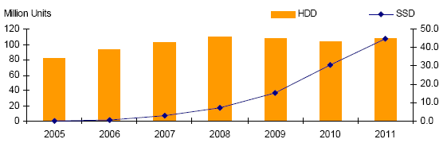
SSDs And HDDs In Portable Computers Unit Demand
Source: Web-Feet Research 2006

Slide 23
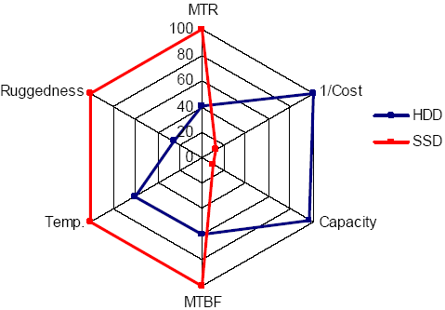
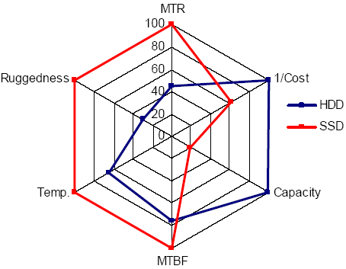
HDD Versus SSD
2006
2011
Source: 2006 Web-feet Research

Slide 24
HDD, NAND Flash Pricing (Log Chart)
$100
$43.39
$15.66
$10
$7.12
$4.68
$3.76
$3.11
$2.05
$1.96
$1.34
$1.08
$1.02
$0.89
$1
$1.30
$1.02
$0.81
$0.58
HDD 0.85in, 1.0in, 1.8in Combined
NAND Flash
Mobile HDD 2.5in (portable PCs)
$0.45
$0.35
$0
$/GB
2005
2006
2007
2008
2009
2010
Source: IDC 2007

Slide 25


Solid-State Drive Meets Or Exceeds HDD Reliability
Hard Disk Drive
Solid State Drive
Application Data
Error Rate 10-15 to 10-14
Application Data
Error Rate ~10-15
Application
Bad Block
Management
Bad Block
Management
Data Management
Channel and
Block Coding
Block Coding
Raw Media
Typical Raw Error Rate >10-4
Typical Raw Error Rate <10-5

Slide 26
Key Takeaways
Hybrid hard drives represent an incremental upgrade to HDDs while solid state drives are significantly different and offer several advantages
As NAND becomes increasingly competitive in densities offered and price, the adoption rate will increase
2.5” is the ‘sweet spot’ form factor for SSDs

Slide 27
ALL SIGNS
point to …
NAND

Slide 28
A Look At The NAND Market
Source: Gartner 3Q06

Slide 29
MLC Versus SLC
Multi­level cell (MLC) NAND Flash will lead in the lowest cost for consumer applications
Media players
MP3/camera phones
Media cards
Professional products, ReadyBoost UFDs, and solid state drives (SSDs) will still demand the higher performance and higher reliability of single­level cell (SLC) NAND Flash

Slide 30
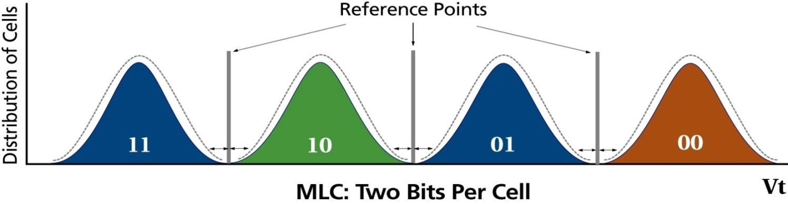
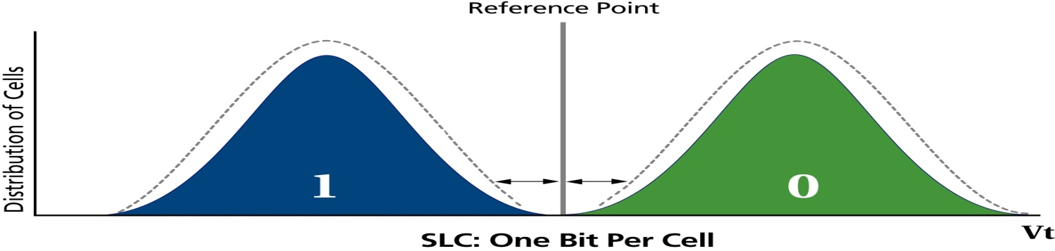

What Is MLC NAND?
MLC stands for multi­level cell NAND
MLC NAND stores 4 states per memory cell and allows 2 bits programmed/read per memory cell
SLC NAND stores 2 states per memory cell and allows 1 bit programmed/read per memory cell

Slide 31
 | MLC versus SLC
Features
Bits per cell | 2 | 1
Voltage | 3.3V | 3.3V, 1.8V
Data width (bits) | x8 | x8, x16
Architecture
Number of planes | 2 | 1 or 2
Page size | 2,112– 4,314 bytes | 2,112 bytes
Pages per block | 128 | 64
Reliability
NOP (partial page programming) | 1 | 4
ECC (per 512 bytes) | 4+ | 1
Endurance (ERASE / PROGRAM cycles) | <10K | <100K
Array Operations
tR (Max) | 50µs | 25µs
tPROG (Typ) | 600–900µs | 200–300µs
tBERS (Typ) | 3ms | 1.5–2ms

Slide 32
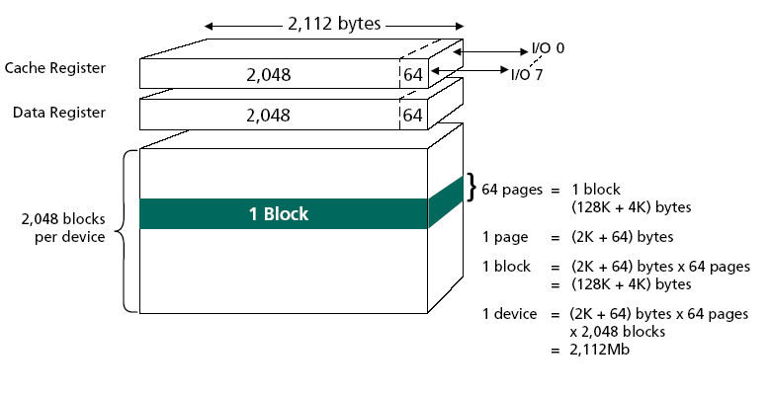
2Gb, 2K Page SLC NAND Architecture

Slide 33
Let’s Get Oriented NAND Architecture
Block Architecture
NAND architecture is based upon independent blocks
Blocks are the smallest erasable units
Pages are the smallest programmable units
Partial pages can be programmed in some devices
I/O
I/O
I/O
I/O
Control
Gate
String
64 pages per block*
Float
Gate
Page
16,896 bits
per page*
* Typical for 4Gb SLC

Slide 34
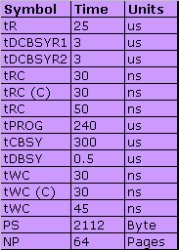
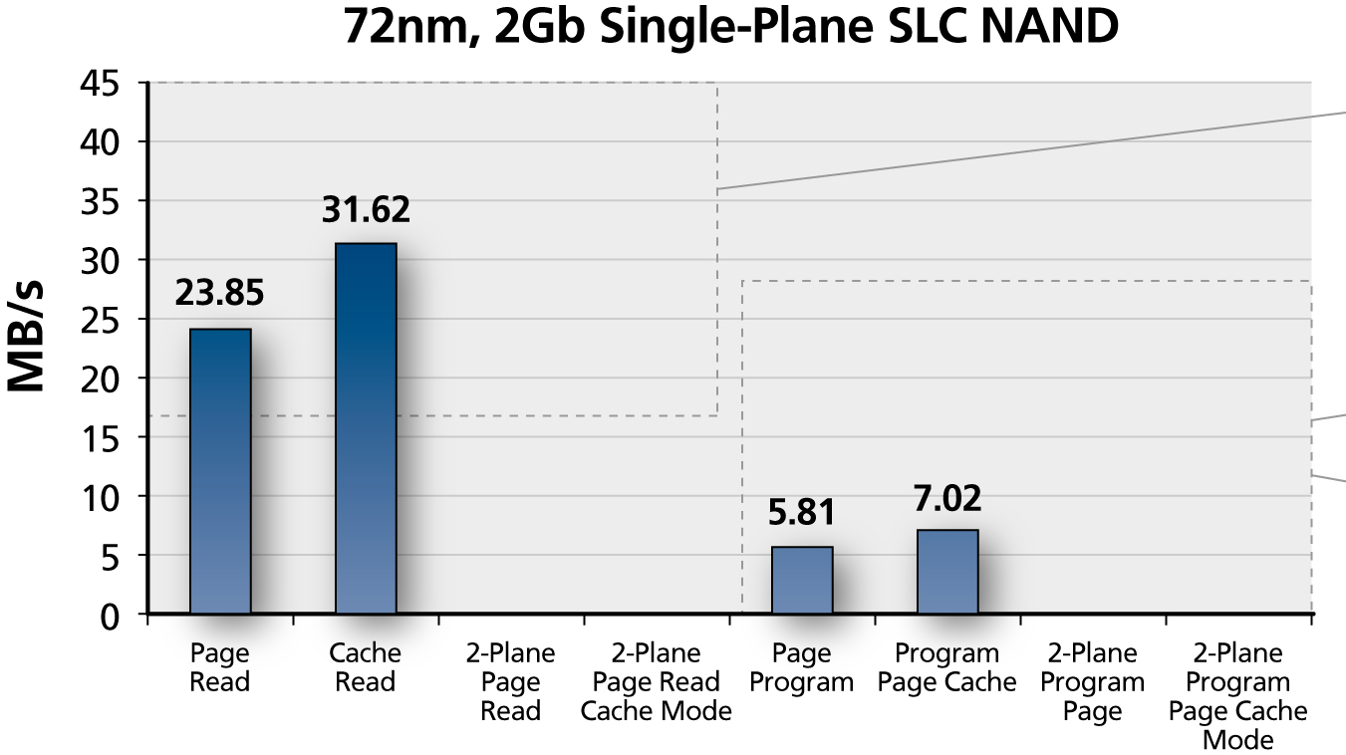
2Gb, SLC 72nm, 2K Page Performance

Slide 35
Two­Plane Features
Device is divided into two physical planes, odd/even blocks
Provides ability to
Concurrently access two pages for read,
Erase two blocks concurrently, or
Program two pages concurrently
The page addresses of blocks from both planes must be the same during two­plane READ / PROGRAM / ERASE operations

Slide 36
4Gb, Two­Plane 2K Page SLC NAND Architecture

Slide 37
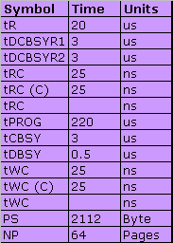
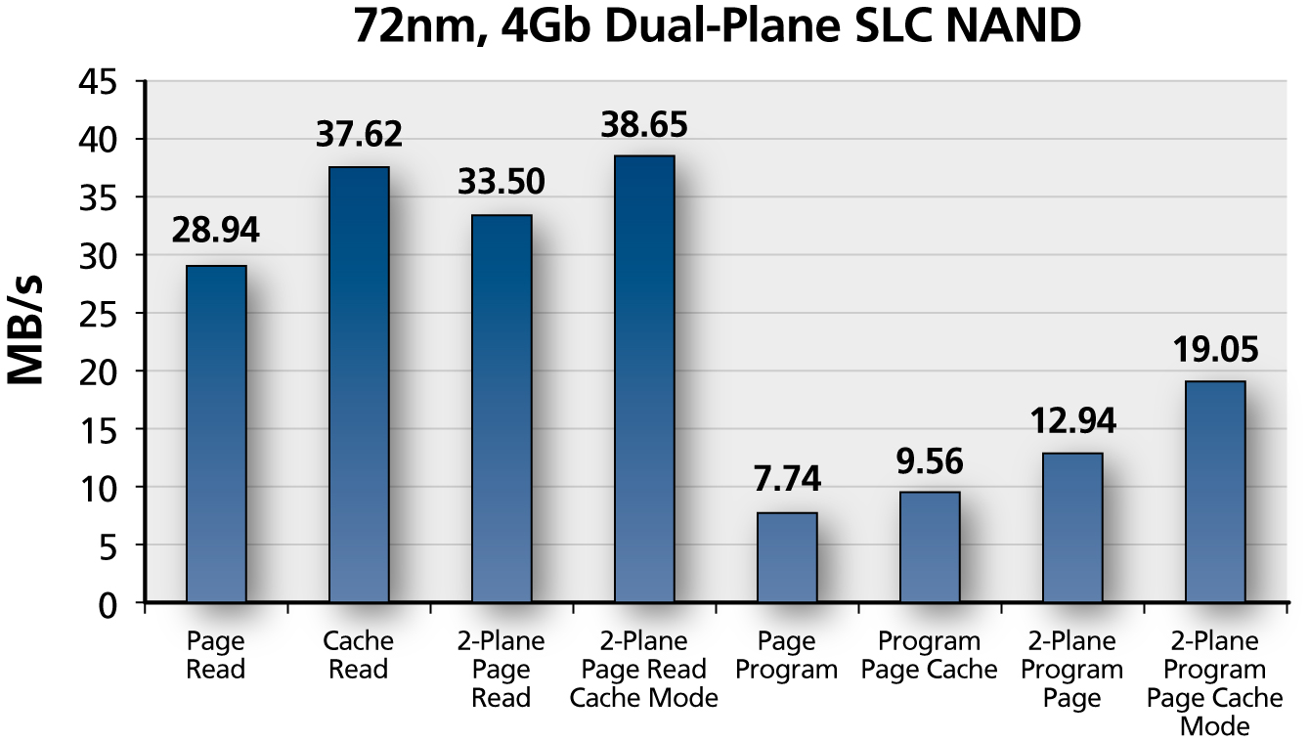
4Gb, 2K Page SLC NAND Performance

Slide 38
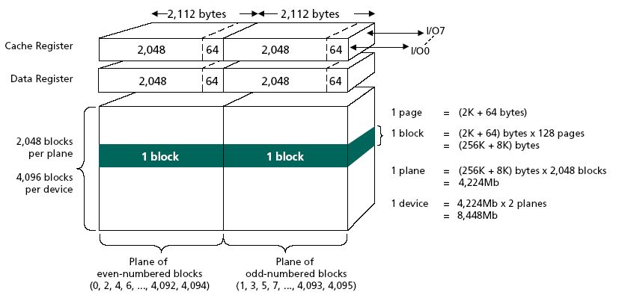
8Gb, Two­Plane 2K Page MLC NAND Architecture

Slide 39
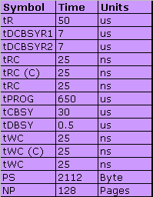
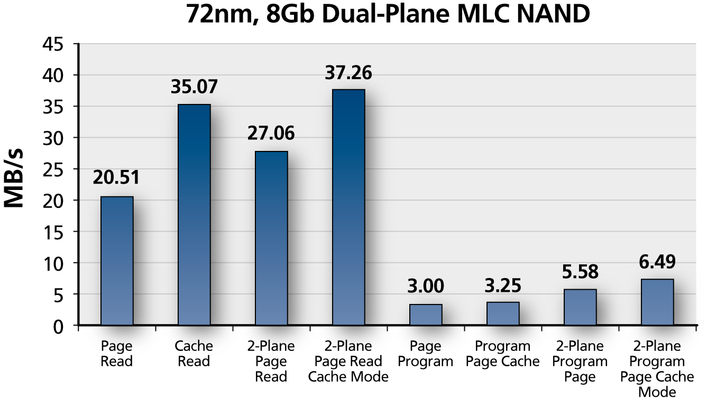
8Gb, 2K Page MLC Performance

Slide 40
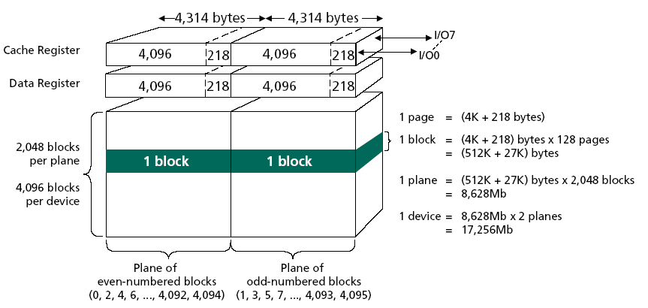
16Gb, Two­Plane 4K Page MLC NAND Architecture

Slide 41
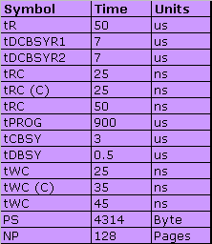
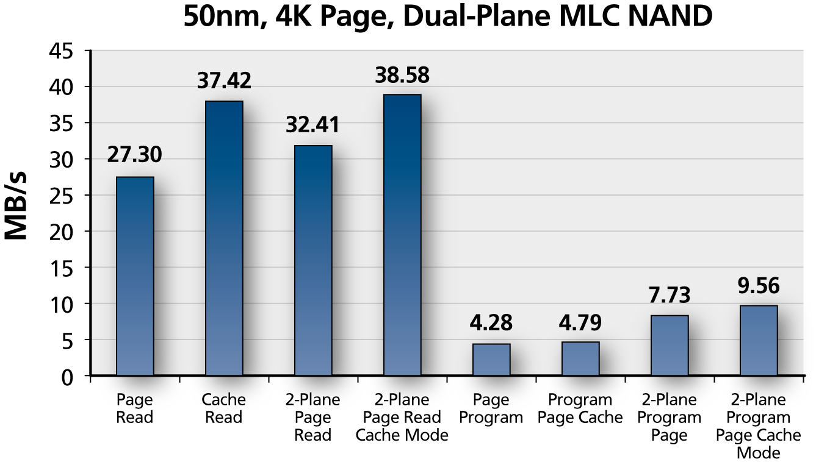
Two­Plane, 4K Page MLC NAND Architecture

Slide 42







Open NAND Flash Interface
Future Micron NAND Flash devices support the Open NAND Flash Interface (ONFI) specification
Micron is a founding member of ONFI
The ONFI 1.0 specification is available at http://www.onfi.org/
ONFI Founders

Slide 43
NAND Error Modes
Program Disturb
Read Disturb
Data Retention
Endurance
All of the above issues are well understood and can be addressed

Slide 44
ECC Can Fix Everything (Well Almost)
You must understand your target data-error rate for your particular system
Understand the use model that you intend for your system
Design the ECC circuit to improve the raw­bit error rate (BER) of the NAND Flash, under your use conditions, to meet the system’s target BER

Slide 45
ECC Code Selection Becoming More Important
1.0E-25
1.0E-23
t = 6
t = 5
t = 4
t = 3
t = 2
t = 1
1.0E-21
1.0E-19
For SLC
A code with correction threshold of 1 is sufficient
1.0E-17
App's Target BER Zone
1.0E-15
1.0E-13
t = 0
Application Bit Error Rate
1.0E-11
t = 4 required (as a minimum) for MLC
1.0E-09
1.0E-07
1.0E-05
1.0E-03
1.0E-01
1.0E-01
1.0E-03
1.0E-05
1.0E-07
1.0E-09
1.0E-11
1.0E-13
1.0E-15
Raw NAND Bit Error Rate
As the raw NAND Flash BER increases, matching the ECC to the application’s target BER becomes more important

Slide 46
Reducing Program Disturb
Program pages in a block sequentially, from page 0 to page 63 (SLC) or 127 (MLC)
Minimize partial­page programming operations (SLC)
It is mandatory to restrict page programming to one single operation (MLC)
Use ECC to recover from program disturb errors

Slide 47
Reducing Read Disturb
“Rule of thumb” for excessive reads per block between ERASE operations
SLC – 1,000,000 READ cycles
MLC – 100,000 READ cycles
If possible, read equally from pages within the block
If exceeding the “rule of thumb” cycle count, then move the block to another location and erase the original block
Erase resets the READ DISTURB cycle count
Use ECC to recover from read disturb errors

Slide 48
Improving Data Retention
Limit PROGRAM/ERASE cycles in blocks that require long retention
Limit reads to reduce read disturb
Example:
Infrequently cycled blocks have longer retention
5 yr
2 yr
0.5 yr
Retention required
(arbitrary time)
Frequently cycled blocks have shorter retention
Block Cycles
(arbitrary cycles)
10 cyc 1,000 cyc 10,000 cyc

Slide 49
Endurance Recommendations
Always check pass/fail status (SR0) for PROGRAM and ERASE operations
Note: READ operations do not set SR0 to fail status
If fail status after program, move all block data to an available block and mark the failed block bad
Use ECC to recover from errors
Write data equally to all good blocks (wear leveling)
Protect block management/metadata in spare area with ECC

Slide 50
Wear Leveling
Wear leveling is a plus on SLC devices where blocks can support up to 100,000 PROGRAM/ERASE cycles
Wear leveling is imperative on MLC devices where blocks can typically support less than 10,000 cycles
If you erased and reprogrammed a block every minute, you would exceed the 10,000 cycling limit in just 7 days!
60 x 24 x 7 = 10,080
Rather than cycling the same block, wear leveling involves distributing the number of blocks that are cycled

Slide 51
Wear Leveling
An 8Gb MLC device contains 4,096 independent blocks
If we took the previous example and distributed the cycles over all 4,096 blocks, each block would have been programmed less than 3 times (vs. the 10,800 cycles when you cycle the same block)
If you provided perfect wear leveling on a 4,096 block device, you could erase and program a block every minute, every day for 77 years!
10,000 X 4,096 40,960,00
--------------------- = ---------- = 28,444 days = 77.9 Years
60 X 24 1,440

Slide 52
Another Option Embedded MMC (eMMC)
Direct NAND interface will always provide the lowest cost solution
The complexities of future MLC require increased attention
For example, ECC algorithm is becoming more and more complex, moving from 4+ bits to 8+ bits in the future
A managed interface addresses the complexities of current and future NAND Flash devices
This means the host does not need to know the details of NAND Flash block sizes, page sizes, planes, new features, process generation, MLC vs. SLC, wear leveling, ECC requirements, etc.
Embedded MMC (eMMC) is the next logical step in the NAND Flash evolution for embedded applications because it turns a program/ erase/read device with bad blocks and bad bits (NAND Flash) into a simple write/read memory

Slide 53
The Need For A Managed Solution
NAND page size, number of planes, and block size are technology dependent
ECC and number of partial page program operations are technology and vendor dependent
Commands and interface inconsistencies between vendors

Slide 54
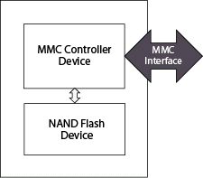
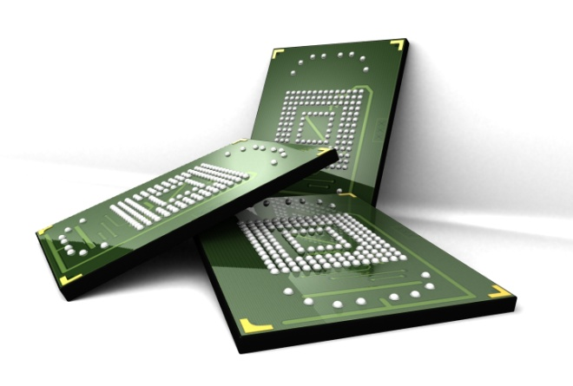
What Is eMMC?
MLC NAND + MMC 4.2 Version Controller Device
High­speed solution
Host selectable x1, x4, and x8 I/Os
52 MHz clock speed (MAX)
Backwards compatible with previous MMC systems
Handles ECC, wear leveling, and block management
12 x 16 x 1.3mm BGA package

Slide 55
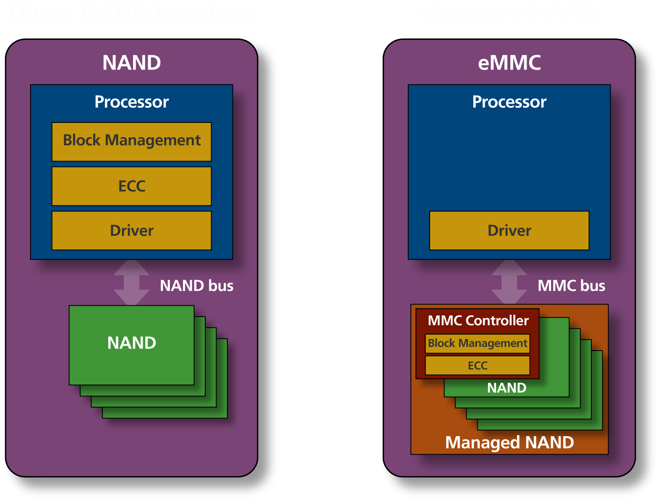
What Is eMMC?

Slide 56
Conclusions
NAND Flash is the lowest cost, non­volatile memory available today
Major applications are SSD and mobile devices
Complexities of MLC NAND require increased hardware and software design
For embedded applications, all of these complexities are addressed through the use of the controller included with eMMC

