Slide 1
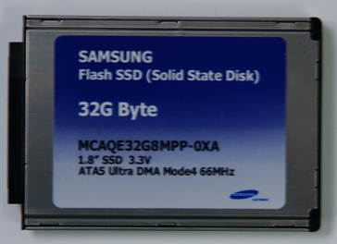
SSD: The Next Wave In NAND Flash
Jim Elliott
Director of Flash Marketing
Samsung Semiconductor, Inc.

Slide 2
Agenda
NAND flash market overview
SSD technology overview
SSD value proposition
SSD versus HDD performance metrics
Tackling SSD perception barriers
Cost
Density
Concluding remarks

Slide 3
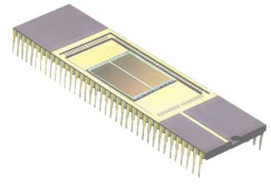
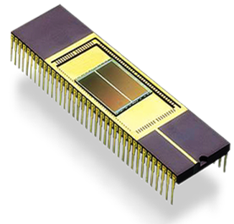
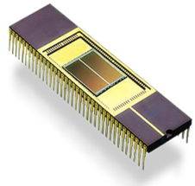

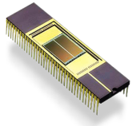


NAND – Scaling Faster Than Moore’s Law
PC Era
256MB ~ 64GB
Major Market Driving Application
Digital Audio Player
128MB ~ 8GB
64Gb
3xnm
USB Flash Drive
64MB ~ 4GB
32Gb
4xnm
Card for Digital Still Camera
32MB ~ 2GB
16Gb
8Gb
50nm
4Gb
60nm
2Gb
70nm
1Gb
90nm
256Mb
512Mb
120nm
150nm
220nm
'00
'01
'02
'03
'04
'05
'06
'07
'08

Slide 4



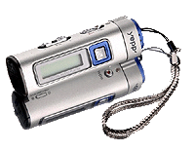
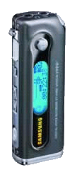

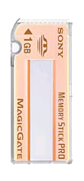

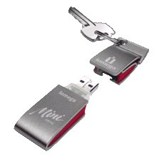
NAND Flash Growth Trends
Flash %
($B)
39%
70
W/W Memory Revenue
38%
37%
36%
36%
SSD
60
Total ’07 Flash Revenue
NAND = $14B
31%
50
Cell Phone
Memory Card
40
MP3 Player
27
30
14%
21
23
20
19
16
USB Drives
12
10
0
`91
`92
`93
`94
`95
`96
`97
`98
`99
`00
`01
`02
`03
`04
`05
`06
`07
`08
* Source: WSTS (`06.10)

Slide 5
NAND Seasonality And Application Trends 1H/2H imbalance due to over-dependence on CE (black friday)
NAND Revenue Growth
NAND Application Trend
M$
Q/Q
4,000
100%
(Source : SEC Marketing)
2000
2001
2002
2003
2004
2005
2006
Others
80%
9%
Card
3,000
Communication
60%
13%
8%
30%
8%
2,000
40%
15%
2006
46%
USB Drive
8%
20%
23%
1,000
13%
0%
MP3 & PMP
27%
PC
0
-20%
2011
Q1
Q4
Q3
Q2
Q1
Q4
Q3
Q2
Q1
Q4
NAND $
Growth
Source: WSTS

Slide 6

Samsung NAND Density Outlook Focus on high density with rapid technology transition
▶ Starting 16Gb Production in Q2 2007
7%
4%
4%
4%
3%
4Gb
9%
8%
5%
12%
19%
19%
29%
30%
28%
47%
8Gb
58%
46%
83%
58%
81%
76%
62%
66%
58%
60%
58%
35%
39%
16Gb
23%
7%
1Q
2005
2Q
3Q
4Q
1Q
2006
2Q
3Q
4Q
1Q
2007
2Q
3Q
4Q
* Source: SEC Marketing

Slide 7
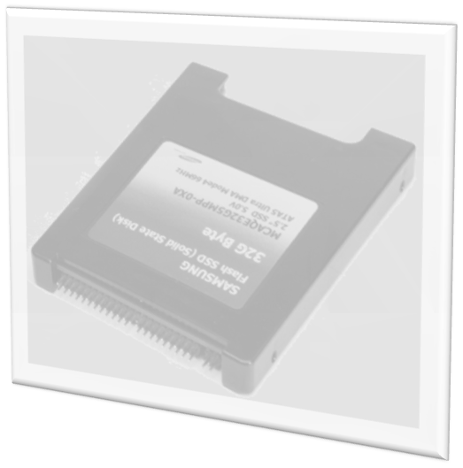
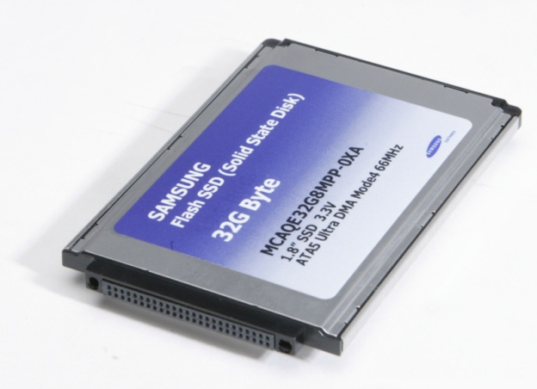
Definition Of SSD
Solid State Drive is a device
that uses memory components to store DIGITAL DATA
Consists of NAND FLASH Memory
Key SSD Advantages…
Extreme Ruggedness
High Performance
High Reliability
Low Power Consumption

Slide 8

SSD Distinguishing Features
Extreme Ruggedness
Substantial resistance against impact: > 1500G
No mechanical parts
Extended operation temperature range: -20°C to 85°C
The lightest storage solution available
Improved Performance
Faster access time and sequential read/write speed
Virtually no latency: > 1msec
Sequential reads: Up to 64MB/sec (8Gb SLC)
Sequential writes: Up to 45MB/sec (8Gb SLC)
Low power consumption
Operation : 0.5W, Sleep: 0.06W, Idle: 0W (PATA)
Virtually no heat generation
No noise: No moving parts

Slide 9
SSD Volume By 2010
SSD Volume Drivers Through 2010:
Corporate laptops, 32GB+
Corporate servers (including read cache)
Retail upgrades (SSD + HDD SKU’s, gamers)
Timing of Adoption (>300K)
2010 Market Size ($M)
Shipments by 2010
(M units, 32GB EQ)
Corporate
$10/GB
2,200
Corporate Laptop
35.6
850
Corporate Server
12.6
550
Corporate High Perf. SAN
8.3
160
Corporate Thin Desktop
2.8
$6/GB
850
10.0
Retail Upgrade
200
Consumer Entertainment Users
3.6
$4/GB
100
Consumer Productivity Users
1.8
100
Other Consumer Laptops
1.9
80
UMPC
Consumer
0.8
$2/GB
2007
2008
2009
2010
Source: Mckinsey

Slide 10
Samsung SSD Long-Term Roadmap
MLC
(Multi Level Cell)
SATA-III 48/64/128/256/512GB
SATA-II
32/48/64/128/256GB
SATA-II
16/32/48/64/96/128GB
SATA-III
56/112/224/336/448GB
SATA-II
28/56/112/168/224GB
SATA-III
32/64/128/192/256GB
SATA-II
14/28/56/84/112GB
Combo
(SLC+MLC)
SATA-II
16/32/64/96/128GB
SATA-I
8/16/32/48/64GB
SATA-II
8/16/32/48/64GB
SLC
(Single Level Cell)
PATA
4/8/16/32GB
R/W Speed:
64/45
57/32
100/80
160/160
800/800
1300/1300
2006
2007
2008
2009
2010

Slide 11
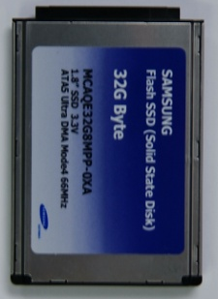
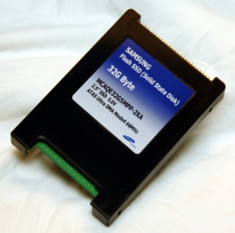
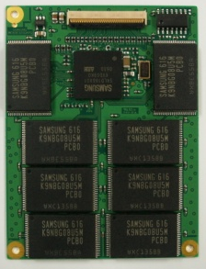
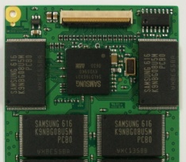
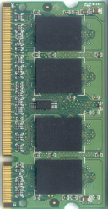
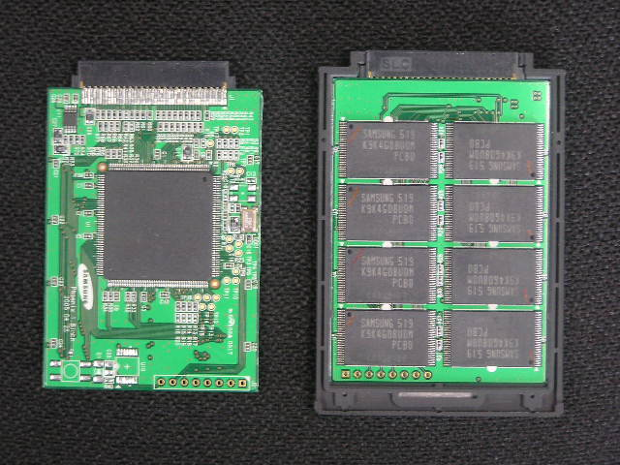
Samsung SSD Form Factors
 | Standard FF |  | Special FF
 | 1.8’’ | 2.5’’ | Slim | Half Slim | So DIMM
Density | 4/8/16/32GB | 4/8/16/32GB | 8/16/32GB | 4/8/16/32GB | 8/16GB
Dimension (H x W x T) | 78.5x54x8.0 | 100.2x70x9.5 | 70.6x53.6x: 3.0: 16/32GB 2.5: 4~8GB | 45.0x53.6x3.8 | 53.6x70.6x3.0
Connector | 50pin | 44pin | ZIF 40pin | ZIF 40pin | 200pin
Weight | 44g | 46g | 20g | TBD | TBD
Market | Notebook | Sub-Note / Tablet | UMPC | Custom | Custom
Availability | Now | Now | Now | ES Jun’07 CS Aug‘07 | Now

Slide 12
SSD Versus HDD Performance
Sequential read/write: SATA1 SSD already comparable to 10K RPM HDD
SATA1 SSD outperforms 5400 NB HDD (business NB)
Random read: SSD far superior to all HDD (read cache for web-servers)
Sequential Read
Sequential Write
[ MB/s ]
SSD SATA2(MLC)
82MB/s
SSD SATA2(MLC)
30MB/s
SSD SATA2(SLC)
100MB/s
SSD SATA2(SLC)
80MB/s
SSD SATA1
64MB/s
SSD SATA1
45MB/s
HDD 10000rpm
83MB/s
HDD 10000rpm
83MB/s
HDD 5400rpm
38MB/s
HDD 5400rpm
38MB/s
Random Read
Random Write
SSD SATA2(MLC)
73MB/s
SSD SATA2(MLC)
1MB/s
SSD SATA2(SLC)
92MB/s
SSD SATA2(SLC)
27MB/s
SSD SATA1
64MB/s
SSD SATA1
3MB/s
HDD 10000rpm
12MB/s
HDD 10000rpm
19MB/s
HDD 5400rpm
8MB/s
HDD 5400rpm
12MB/s
Performance in IOMeter, Chunk size: 128KB

Slide 13
SSD Power Savings Comparison
HDD: Higher RPM = higher power
SSD: Less power saves lifetime energy costs…
Watts used in operation mode
Watts used in idle Mode
HDD RPM
HDD RPM
RPM | Drive
4200 | Hitachi GST Travelstar 4k120
5400 | Toshiba MK1032GSX
7200 | Hitachi GST Travelstar 7k100
10000 | Seagate Savvio 10K.1
15000 | Seagate Cheetah 15K.4
* HDD DATA background

Slide 14
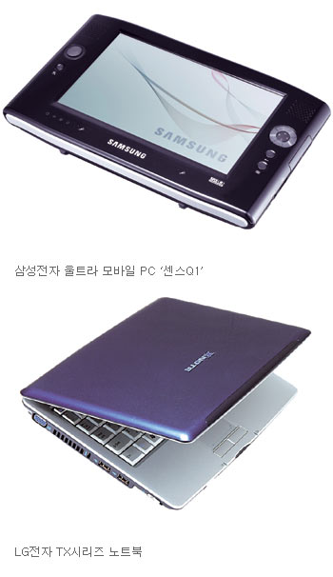

SSD- User Benefits SSD optimizes mobile user experience
Fast Booting/Resume/Application launching
Longer battery life with SSD
(Source: Nikkei Electronics 2006.7)
Windows XP
Boot
1.8” HDD
1.8” HDD
SSD
1.5x
SSD
1.9x
Powerpoint
(17MB,
135 slides)
2.3x
3.5x
Samsung Sens Q1
Sony UMPC UX
Outlook
(650 mails)
4.1x
6.0x
Searching files
including “a”
in C Drive
2.9x
3.8x
0
10
20
30
40
50
60
70
80
90
0
10
20
30
40
50
60
70
80
90
(sec)
(sec)
Battery Life
1.8” HDD
1.8” HDD
SSD
1.3x
SSD
1.2x
0
30
60
90
120
150
180
210
240
270
0
30
60
90
120
150
180
210
240
270
(min)
(min)

Slide 15

SSD: Faster, Lighter, More Mobility…
Item | 1.8” SSD | 1.8” HDD | Customer Benefits
Speed (Vista Launch) | 1’54” | 2’17”
Weight | 859 grams | 898 grams
Mobility | 12 Hours | 11.5 Hours
No seek time and latency reduces application launch time (23 seconds)
Notebook with SSD weighs 39 grams less than HDD
Battery life is 30 Minutes longer due to no moving parts
* Test System: Sony VAIO type G
* source: http://www.jp.sonystyle.com/Business/Vaio/Product/G_vista/closeup.html#c1

Slide 16

SSD Is Ready For Vista
Window Experience Index*
Standard Performance Diagnostic for Vista OS
1.8” SSD Clearly outperformed HDD.
HDD needs higher RPM + Bigger Form Factor to Compete (3.5” 7200rpm HDD)
Primary hard disk score
Test Environment
System: Sony VAIO type G
CPU: Core Solo U1400(1.2 GHz),
OS: Windows Vista Business
SSD: 32GB, HDD: 60GB
1.8” SSD
5.2
1.8” HDD
3.4
1
6.0
Boot Time Comparison
50% Improvement on Windows Front Page Appearance
50% Improvement on All Task Ready Tray
(Source: Itmedia.co.jp)
Window front page show up
All task tray ready
1.8“ SSD
50sec
1min 30sec
1.8“ HDD
1min 40sec
3 min

Slide 17
Counter-Acting SSD FUD Factors
Myth #1:
“SSD Density Points are too Low”
Myth #2:
“SSD Costs to Much”

Slide 18
HDD Capacity Growth HDD MB per platter
100GB
3.5”
2.5”
Increased 35M Times Over 35 years…
Diminishing Marginal Returns?
Who Wants to De-Frag 1TB?
Source: IBM, Intel, Samsung

Slide 19



How Much Storage Is Needed? Percent of HDD capacity used
Why the need for so much capacity?

Slide 20



How Much Storage Is Needed? Percent of HDD capacity used
Why the need for so much capacity?
Video
Photos
Music

Slide 21
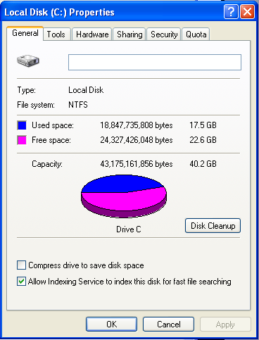
Work Notebook Challenge…
Jim Elliott’s Work Notebook
17.5GB Used Total
Windows XP + Office
6 Years at Samsung
Extensive Presentations
32-64GB SSD is Sufficient for Business Notebooks
CTO’s Prefer
Centralized Data Storage
No Personal Files: Video, Music, Photos, etc.
Source: Jim Elliott - May ‘07

Slide 22
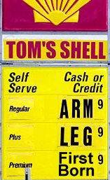

Introducing TCO Concept
Hybrid automobiles…
Acquisition cost is higher
Total cost of ownership value:
Less gas at $4.00 per gallon
Carpool lane → time = money…

Slide 23
Business Notebook TCO Analysis
Laptop lifetime TCO benefit from SSD
Assumptions (3 year lifetime)
HDD Failure Reduction
$60
50x reduction in the incidence of HDD failure rate
20% Improvement in device lifetime productivity due to reliability and performance consistency characteristics (Source: IDC)
Lifetime productivity improvement
180-200
$200
Total Value Benefit
$260
~15 Minutes: average time per day spent waiting for your NB PC to execute commands
(Source SEC)
Typical corporate notebook scenario:
100’s of NB’s deployed for mobile workforce
Efficiency/productivity gains via SSD
Imagine ~5% HDD failure rate over 3 years
Costs: Downtime, MIS, data recovery, etc…
Source:: IDC, Gartner, McKinsey Analysis
3 Year Product Use Basis
(1) Based on 2009 SSD pricing
Source: McKinsey Analysis

Slide 24
Notebook TCO Analysis
3 year breakeven at today’s price

Slide 25
NB SSD Cross-Over Points
2.5” HDD Cost
HDD Typical Cost
HDD Margin
+ Density “Up-Sell”
HDD Fixed Cost
01 02 03 04 05 06 07 08 09

Slide 26
NB SSD Cross-Over Points
2.5” HDD Cost
NAND GB
120
HDD Typical Cost
$60
100
HDD Margin
+ Density “Up-Sell”
80
60
HDD Fixed Cost
40
20
NAND GB Cross-Over (-50% $/GB / Year)
6GB
0
01 02 03 04 05 06 07 08 09

Slide 27
NB SSD Cross-Over Points
2.5” HDD Cost
NAND GB
120
HDD Typical Cost
$60
100
HDD Margin
+ Density “Up-Sell”
80
60
HDD Fixed Cost
32GB
40
20
NAND GB Cross-Over (-50% $/GB / Year)
6GB
0
01 02 03 04 05 06 07 08 09

Slide 28
NB SSD Cross-Over Points
2.5” HDD Cost
NAND GB
2009: 128GB SSD Rivals <150GB HDD
120
HDD Typical Cost
NB + DT
$60
100
HDD Margin
+ Density “Up-Sell”
80
2008: 64GB SSD Rivals 60GB~80GB HDD
Biz + Some Consumer NB
60
HDD Fixed Cost
32GB
40
2007: 32GB SSD Rivals 40~60GB HDD
20
NAND GB Cross-Over (-50% $/GB / Year)
Biz NB
6GB
0
01 02 03 04 05 06 07 08 09

Slide 29
SSD TAM Outlook ~50M notebooks in 2007
Consumer Space: Rich media content (video, etc.,) HDD survives – for now…
SSD breaks in with 128GB+
Total PC Sales Forecast
Business Notebook: (50% of total NB) Little to no media files SSD takes over
2% attachment rate = 1M units in ‘07
249
223
201
174
97
N/B
81
151
65
136
130
135
49
(M units)
118
27
39
95
20
28
31
82
16
14
136
142
152
D/T
110
102
104
112
125
79
98
68
`97
`98
`99
`00
`01
`02
`03
`04
`05
`06
`07
* Source : IDC(`06.08)

Slide 30

SSD Forecast: >100% CAGR
$B
SSD TAM: ~$5B by 2010
Estimates range from $4~7B
SSD to represent ~25% of total NAND TAM by 2010

Slide 31
Concluding Thoughts
High storage demand: NAND flash will cache HDD
System performance improvements
Less power consumption (battery life and energy savings)
Market segments
Mid ~ High consumer desktop and notebook
Server – read cache
Moderate storage demand: NAND conversion is inevitable
Overall system performance improvements
Smaller form factor
TCO benefits
Market segments
Business notebooks in ‘07
Consumer applications as density increases

Slide 32
Final thought: “Better to design up the technology curve than down the cost curve…”

Slide 33


