Slide 1
‘Must Have’ Management Stack Using Industry Standards
Steve Rokov
Director, Marketing
OEM Division
Avocent Corp. – Booth #306

Slide 2
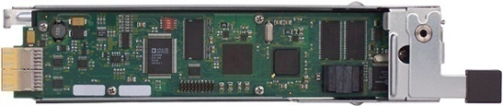

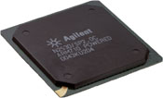

Layer 1: Start ‘Inside’ The Box
Remote presence modular building blocks
Hardware instrumentation, power control and health monitoring: IPMI
Full OS/application and BIOS/OS access: KVM
Remote Virtual Media for remote USB storage: vMedia
Scriptable command line to management features: SMASH
Interoperability access / transport: WS-Management
Analog / Digital KVM
Service Processor
Firmware i.e.,
Integrated Remote Presence
Blade Servers
Telecom Chassis
Rack Servers
Towers

Slide 3

Layers 2 & 3: Extend ‘Up The Stack’
Add appliances / consoles
Support Advanced Services: Translation between layers, standards-based interfaces (SMASH CLP/ WS-MAN), local discovery, staged updates , alert correlation, multicasting …
Enterprise Manager
Systems Management
Software i.e.,
LANDesk
Analog / Digital KVM
Rack Manager i.e. MergePoint
Service Processor
Firmware i.e.,
Integrated Remote Presence
Blade Servers
Telecom Chassis
Rack Servers
Towers

Slide 4
DMTF DASH Management
Lower TCO for Desktop and Mobile Clients
N
E
T
W
O
R
K
DASH -
Managed
Desktop
Avocent
AMD
Mgmt Console
Web Services based management protocol at DMTF
Promotes interoperability between management tools and managed resources
Vendors already adding
WS-Management support

Slide 5


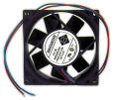




DMTF SMASH
Direct or Gateway
-> show /system1
/system1
cpu0
cpu1
log1
temp3
-> cd temp3
CDT is now /system1/temp3
-> show temp3 -all
Chassis temperature is 30 degrees C
CLP
Managing Supervisor
CLP User
Programmatic
Access /
Application
CLP
Send SMASH Commands
Receive SMASH Responses
Session (e.g., Telnet, SSH …….. WS-MAN)
MAP
CLP
Service / Access
Point
Programmatic
Protocol
Service / Access
Point
Manageability
Access
Point (MAP)
Management Service
Core
MAP
Translate SMASH to native server commands and functions
Managed Element
Access Method
ME
Managed
System
…
ME
SUN, HP, IBM
ME
Managed
Element (ME)
Managed
Element (ME)

Slide 6
Differentiate!
For Silicon and Design Manufacturers
  Outsource standards development to experts
For Hardware Vendors and Integrators
  Design your solutions around a 3-layer stack for ‘Intelligent’ IT Management
  Start with modular building blocks and add rack
  level appliances
For ISVs in Management Markets
  Consider using rack appliances to broaden reach, increase security, consolidate management
All - Support WS-MAN, SMASH and DASH!

