Slide 1
SSD To Solve The I/O Bottleneck
Iri Trashanski
Director, Business Development
SanDisk

Slide 2
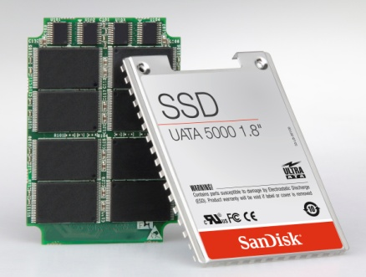

What Is A Solid State Drive?
A Solid State Drive (SSD) is a data storage device that uses flash media to store data, instead of the spinning platters found in mechanical hard disk drives
SSD Benefits
Reliability and Durability
Mobility
Performance
Improved user experience
Gartner, Jo Unsworth
December, 2006

Slide 3
When Random and Sequential
Are Used?
Random
  OS changes and updates
    A single DLL is generally 5 to 6 Disk Locations (min)
      Directory, MFT Entry, and other File System Metadata
      PE Hdr page, .text pages, .data pages, .rsrc pages, etc.
  Applications and documents changes and updates (on-the-go)
  Access user data
Sequential
  Boot
  Hibernate
  Application load (main file)
For example:
When opening an application, the data files will be read in a sequential manner, however, all the associated DLL’s (~100 in average) will be read and loaded in random from 5-6 disk locations per DLL.

Slide 4
HDD Performance Is Not About Transfer Rate But IOPS!
HDD transfer time = Interface transfer + media transfer + mechanical latency (in ms!)
  For a typical 4KB request, the mechanical impact at the HDD level accounts for ~95% of the entire transfer!
  Transfer time accounts for a fraction of actual disk access time
Operating System (OS) transfers
  Random read
  Sequential read
  Random write
  Sequential write
Random read operations accounts for more than
50% of the OS transfers
Major effect on machine behavior

Slide 5
4KB Read is 50% of the read transfers
IOPS

Slide 6
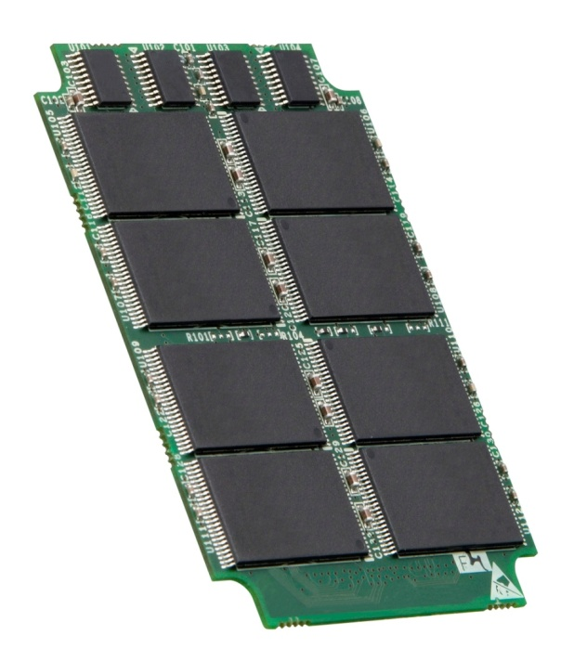
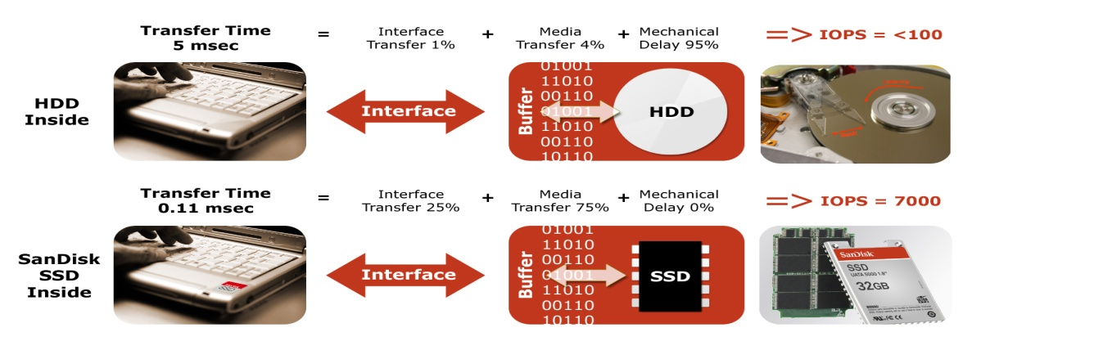
HDD vs. SSD
Seek and Latency
Average Access Time = Ave. Seek Time + Latency Time/2
Average Access Time = 12 msec + 5 msec ~ 17 msec (5400rpm)
Access time is fixed to 0.11ms

Slide 7
HDD Versus SSD
Model | SSD | HDD SATA 2.5’ 80GB
Transfer Rate:
Interface rate | 150 MB/s | 150 MB/s
Maximum Internal* | R : 67 MB/sec* W: 47 MB/sec* | R : 28 – 44 MB/sec* W: 28 – 44 MB/sec*
IOPS | 512B transfer size** R: 7430 | 512B transfer size** R: 68
IOPS | 4KB transfer size** R: 5405 | 4KB transfer size** R: 67
Read Seek Time:
Track-to-track | 0.11ms* | 3ms*
Average | 0.11ms* | 17ms*
Maximum | 0.15ms* | 33ms*
* Based on H2BENCHW 3.6
** Based on IOMETER 2003.12.16
7

Slide 8
SSD vs. HDD IOPS
x80
Based on IOMETER 2003.12.16

Slide 9
User Scenario Benchmarks
Conducted on Dell Latitude D420/D620 notebook

Slide 10

SSD Boot
demo

Slide 11
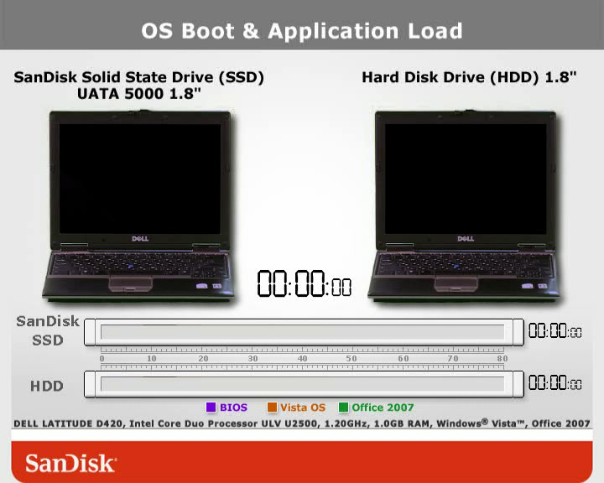
SSD Boot
demo

Slide 12

MLC Meets PC Market Requirements
Lower price point
High performance
  Random Read
    Minimal degradation
    80x better than HDD
Endurance
  Supporting user scenarios
  Exceed PC OEM requirements
  Unlimited read
Field proven – mobile handsets and CE devices
Double Density
High
Performance
High
Endurance

Slide 13
Thank You !

