Slide 1
Windows Server 2008
Iain McDonald
Director of Program Management
Windows Server Division
Microsoft Corporation
iainmc@microsoft.com
http://blogs.msdn.com/iainmcdonald

Slide 2
How We Look at the System
Roles
AD
DHCP
DNS
File
Print
NPS
IIS
Share Point
Terminal Services
Middle
Shell, .NET Framework, MMC, etc.
Base
Server Core

Slide 3

PS C:\> type Power_Management.txt
Balanced power policy on by default
Monitor processor utilization
Manage processor power based on utilization
Adjust power to meet workload requirements
Improved manageability
New, simplified configuration model
Group Policy control of power settings
Rich command line interface
Extensible power policies
Support for custom power settings
Enables devices & applications to participate

Slide 4
PS C:\> type Windows_64-Bit.txt
64-bit only Microsoft solutions
Exchange 2007
Compute Cluster Edition
Windows Server Virtualization
Windows Server Code Name “Cougar” (small business)
Windows Server Code Name “Centro” (mid-sized business)
64-bit only post Windows Server 2008
x64 and IA64 Editions only
Plan the transition to 64-bit
Deploy 64-bit Microsoft solutions
Validate 32-bit applications on 64-bit Windows

Slide 5
PS C:\> type Multicore_Use_Scenarios.txt
Need increased memory and I/O capacity
Network - 10Gb/S and TCP/IP offload
Storage - 10Gb/S iSCSI and 8Gb/S FC
Typical application load will not scale with hardware
Scale-up application loads are low volume
HPC getting more popular
Volume solution is consolidation using virtualization
Application consolidation using Virtualization
About 3 VMs per core today
With 8-core this could grow to ~50 VMs on a 2P
Increased reliability requirements on volume servers

Slide 6
PS C:\> type Reliability_and_Availability.txt
Multicore increase reliability requirements
Many applications on one volume server
Windows Hardware Error Architecture (WHEA)
Discovery of system hardware error capabilities
Windows participation in hardware error processing
Creation of standard hardware error records
Enables hardware health monitoring
Dynamic Hardware Partitioning (DHP)
WHEA enables error prediction
DHP enables seamless replacement of failing parts
Includes processors and memory devices

Slide 7
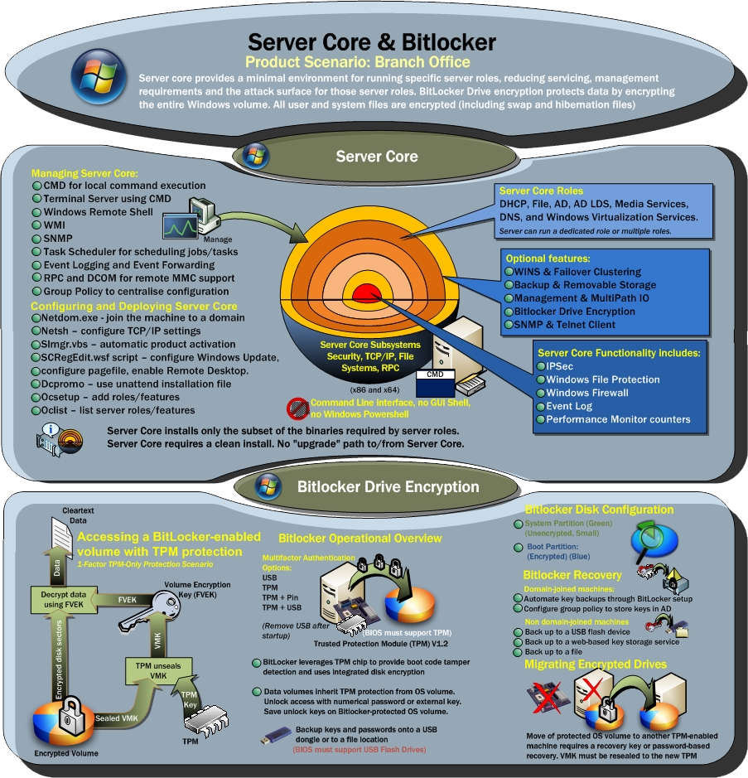
Server Core & BitLocker

Slide 8

Windows Server Core
demo

Slide 9
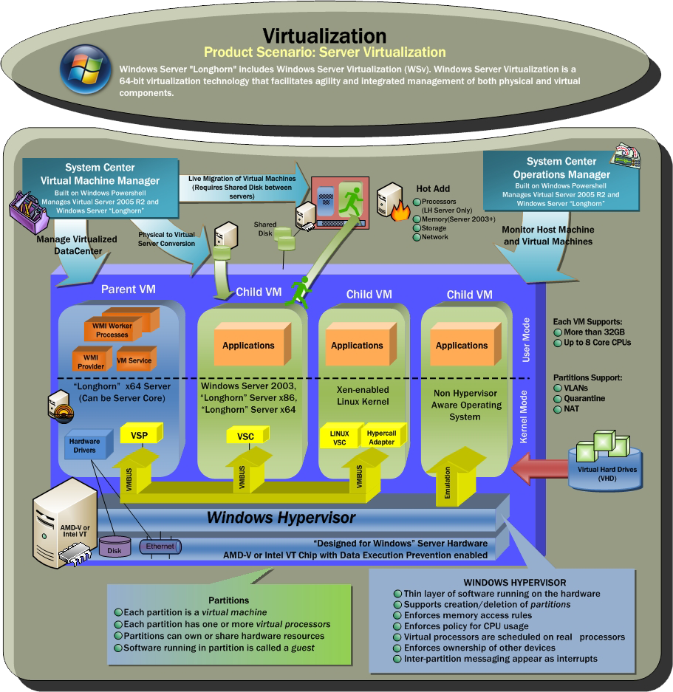
Virtual- ization

Slide 10
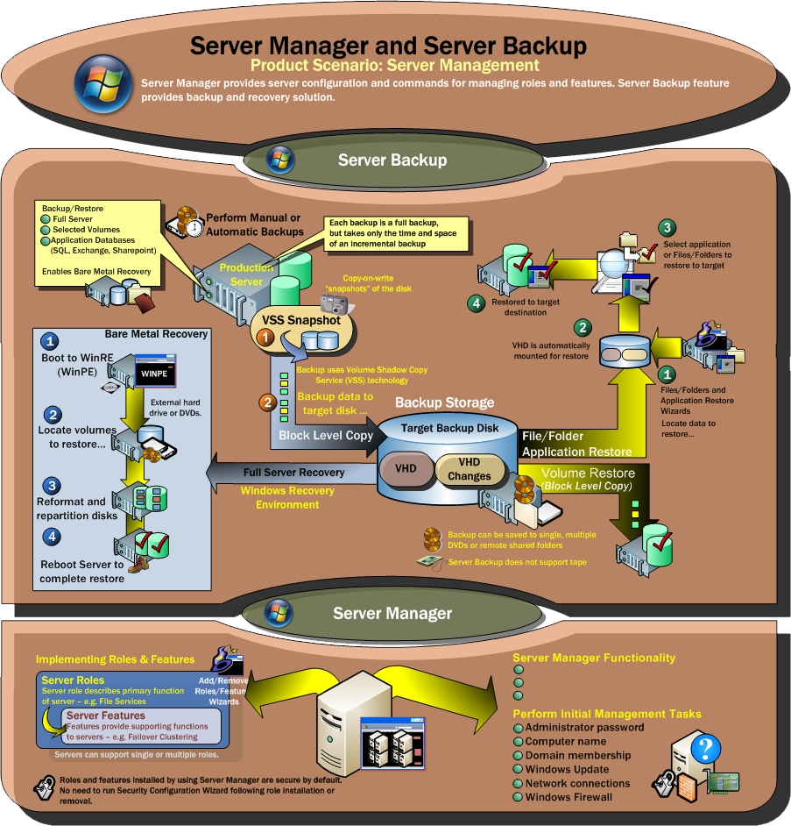
Server Backup & Manager

Slide 11
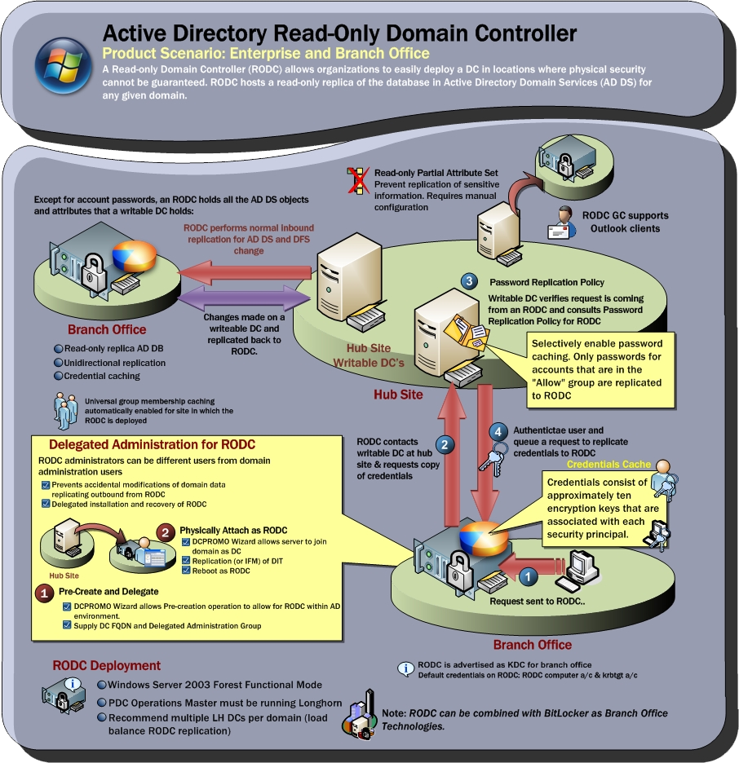
Active Directory Read-Only Domain Controller

Slide 12
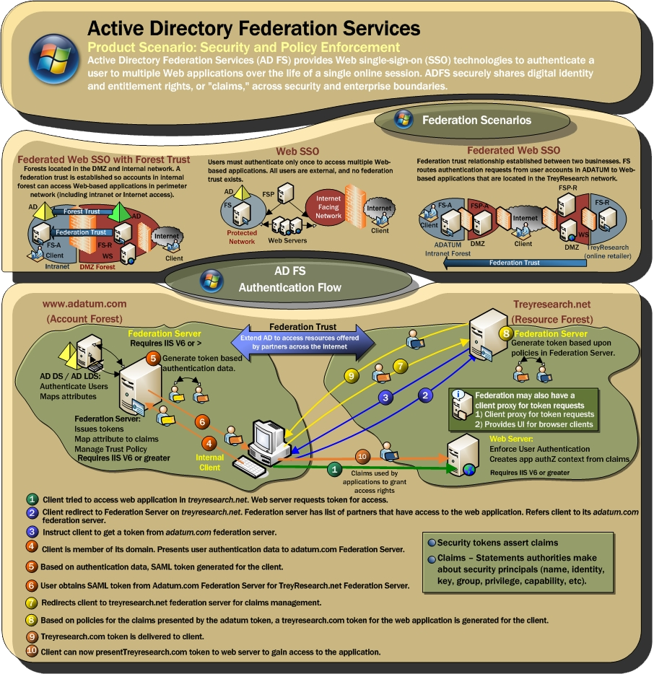
Active Directory Federation Services

Slide 13
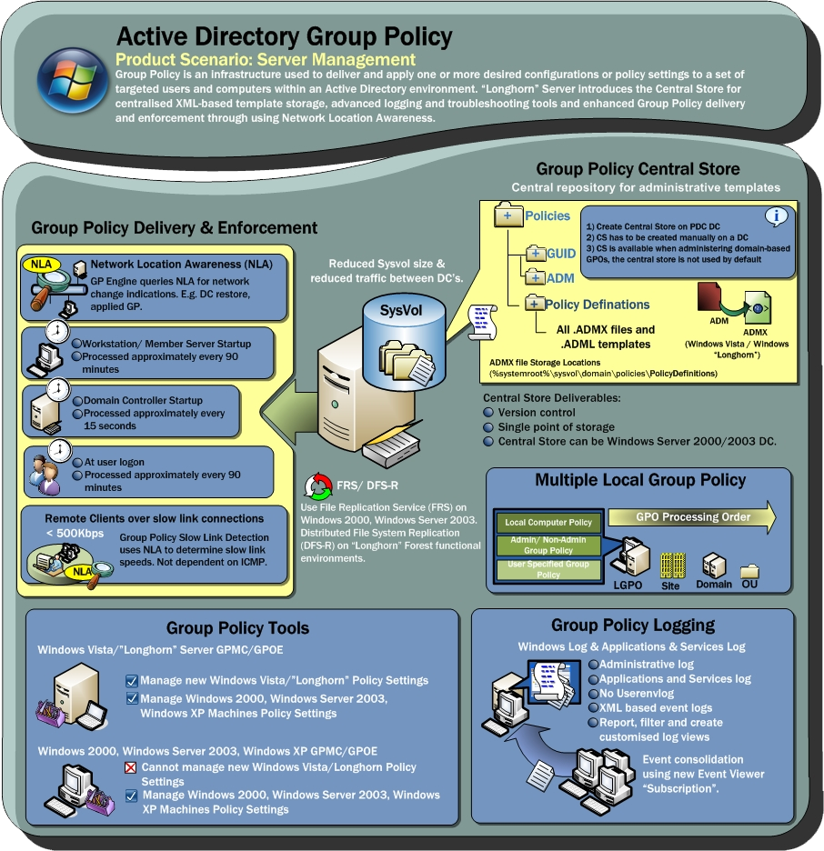
Active Directory Group Policy

Slide 14
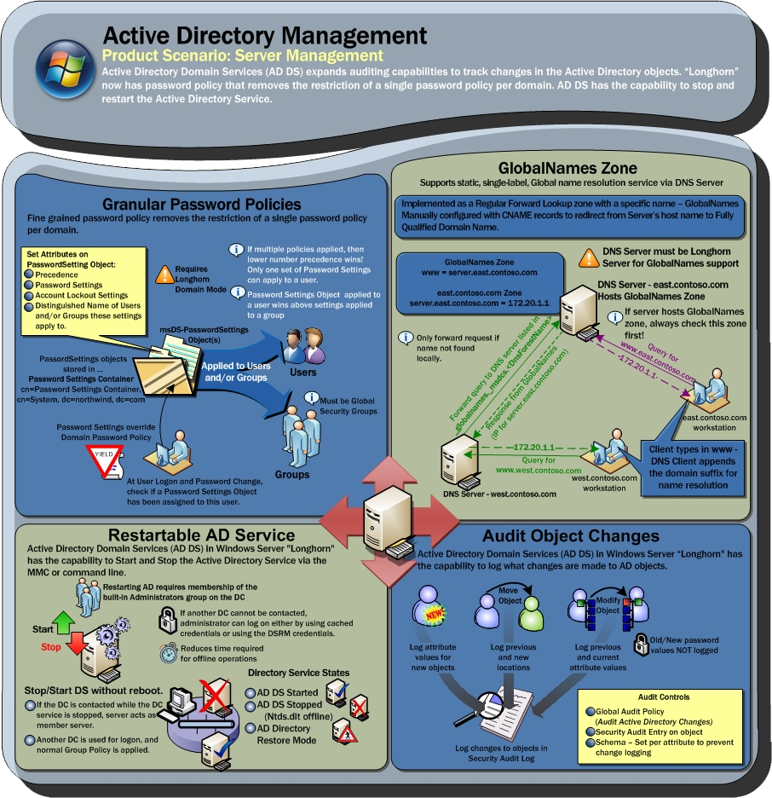
Active Directory Management

Slide 15
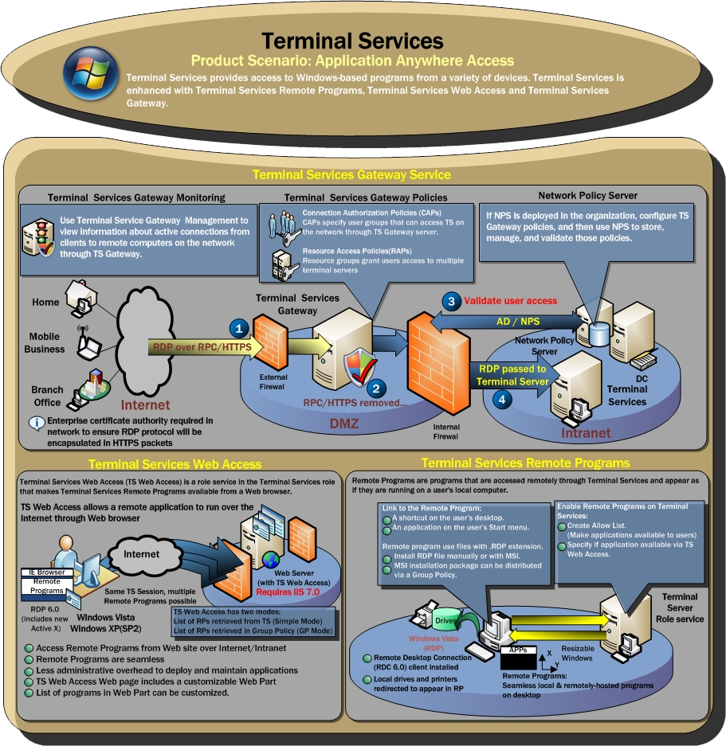
Terminal Services

Slide 16
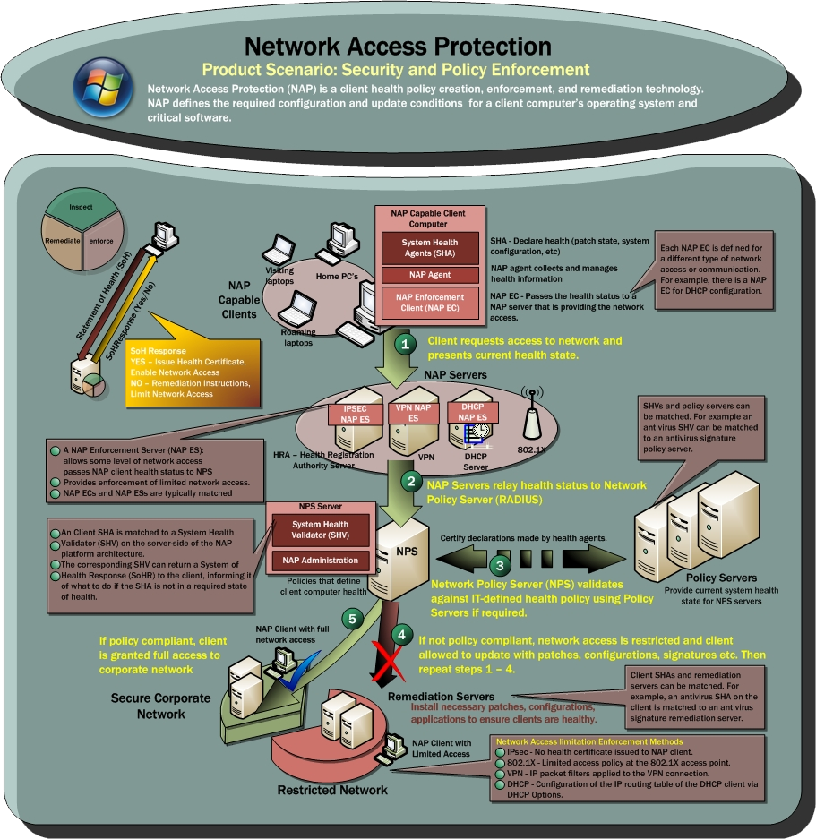
Network Access Protection

Slide 17
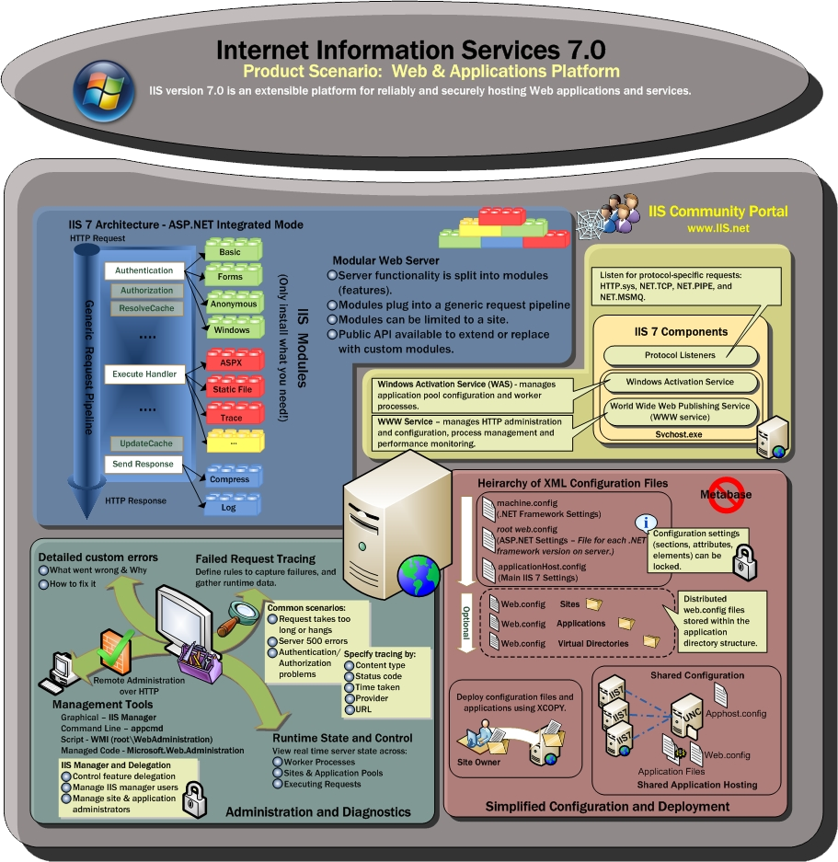
Internet Information Services

Slide 18
PS C:\> type Call_to_Action.txt
Attend Server track sessions at WinHEC this week
Download, evaluate and give feedbacks on:
Windows Server 2008 Beta 3
DTM
Ensure your drivers work on all 64-bit enabled Windows operating systems
Build Windows Server Core into your test plans
Help customers plan and transition to 64-bit computing environments

Slide 19
PS C:\> type Additional_Resources.txt
Windows Server Longhorn http://www.microsoft.com/windowsserver/longhorn/
Windows Server 2008 Beta 3 Download http://www.microsoft.com/windowsserver/longhorn/audsel.mspx
Minimal System Hardware Configuration for Windows Server Core http://www.microsoft.com/windowsserver/longhorn/servercore.mspx

Slide 20
__
/ /\ /\ O ____ ____ ____ ______ ____ _____ ______
/ / \/ \ | | / / / /__) / / ) (__(___ / / ) / /__ / /
/_/ \ |_| (_(__ /_/ \ (_(__/ ____)_) (_(__/ /_/ /_/
Your potential. Our passion.

