Slide 1
Dynamic Partitioning Windows Server
Davis Walker
Software Development Lead
Windows Kernel Team
Microsoft Corporation

Slide 2
Agenda
Dynamic Hardware Partitioning Defined
Windows Server 2008 Support
Hot-Add and Hot-Replace Flows
Platform Support Implications
Driver Support Implications
Tools and Testing
Demo
Call to Action and Resources

Slide 3
What Is Dynamic Hardware Partitioning?
Modification of processor, memory and I/O resources in a system, at runtime
Benefits
  Flexibility and RAS in server management
Primary target is partitionable servers
Creative possibilities like spare cores exist
  Envision massively multi-core world
  Up-sell some cores
  Keep cores available in case of failure

Slide 4
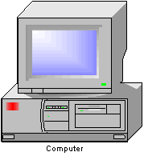
Hardware Partitionable Server
Core
…
Core
Core
…
Core
Memory
Memory
Cache
Cache
…
Core
…
Core
Core
Core
Memory
Cache
Memory
Cache
Service Processor
IO Bridge
IO Bridge
IO Bridge
IO Bridge
. . .
. . .
. . .
. . .
Partition
Manager
PCI Express
Example Hardware Partitionable Server
Partition Manager provides the UI for partition creation and management
Service Processor controls the inter processor and IO connections
Partition Units connect together to create partitions.
Each partition is isolated, and runs a separate
copy of the OS

Slide 5
Why Is This Important?
High-end systems have the support today
Server consolidation increases the importance of uptime and reliability
Multi-core drives RAS requirements into the mainstream
Scenario 1: Capacity on Demand
  Business purchases a low-end server, and can upgrade as the business grows
Scenario 2: Failure management
  Predictive analysis allows replacement before catastrophic failure

Slide 6
Windows Server 2008
Hot-Add
  Processors
  Limited support for I/O APICs
  Memory already supported – this completes the package
Hot-Replace
  Online migration – NOT a remove then add
  Processors and Memory
Limited to x64 Datacenter and Itanium SKUs

Slide 7
Non-Support In Windows Server 2008
Hot-Remove
  Processors: Removal slightly more difficult than add
  Memory: Very hard – physical memory can be reserved by drivers
I/O Migration
  Multi-path, etc, can fill the gap
Management
  We provide interfaces, system builder must provide management application
No plan of record for these

Slide 8
How This Works
Moderate detail on design flow
  Contact us for full technical details
Goal is to prompt the questions
  Is this an interesting feature for my platform?
  How would I build a system to integrate?
  What system-specific software and firmware do I need?
  How does this feature affect my driver?

Slide 9
Hot-Add Processor Flow
Firmware description
“It’s just hot-plug”
  Processors described in ACPI namespace
  Notification of arrival uses standard ACPI mechanisms
OS needs boot-time preparation
  Maximum processor count is important
  NUMA nodes must be described at boot
  Requires MADT and SRAT description

Slide 10
Hot-Add Processor Flow
Initiation
Initiated by the global system partition manager
Partition unit is electrically connected, if necessary
GPE sent to partition
Corresponding _Lxx method
  Adds or changes the state of namespace
  Issues a Notify to report the change

Slide 11
Hot-Add Processor Flow
Discovery and start
Namespace devices found by ACPI driver
APIC ID discovered through _MAT
Proximity domain found through SRAT
Processor reported to the kernel
  IPI sent to start up the processor
  Processor is added as a scheduling target

Slide 12
Hot-Add Processor Flow
Notification
Drivers synchronously pre-notified
Processor started
Drivers synchronously post-notified
Asynchronous PnP notification sent to drivers and applications
Firmware notified of completion

Slide 13
Hot-Add Processor Flow
Load balancing
Modification of process affinity
  System and svchost processes by default
  Others need to opt-in
Device resource rebalance
  Spreads interrupts across all processors

Slide 14
Hot-Replace Flow
Predictive analysis and management
Designed to save hardware experiencing soft errors
WHEA is a great vehicle for this
  Error records from a variety of errors
  Can be captured by management application
  Supports error thresholds
Management application initiates replace
  Not included in Windows Server 2008
  Demo provides an example

Slide 15
Hot-Replace Flow
Description
Partition Unit described in firmware by a module device (ACPI0004)
Replace is of “target” module for “spare”
Spare module includes _DSM
  Identifies it as a spare – not hot-added
Otherwise, description is identical to add
  _MAT, _CRS, etc

Slide 16
Hot-Replace Flow
Spare suitability
Spares assume the role of target
Must be equivalently configured
  Thread/core relationships
  Cache relationships
  NUMA relationships
Superset spares supported
  Modeled as a replace followed by an add

Slide 17
Hot-Replace Flow
Initiation
Similar to add
  Spare is electrically connected (if necessary)
  GPE causes _Lxx to report new namespace
  Spare found, firmware notified of completion
ReplacePartitionUnit called
  Win32 call in the partition
  Remotability not supported (WMI, etc)
  Takes device instances for target and spare modules

Slide 18
Hot-Replace Flow
Identification
Modules queried for processors and memory regions involved
Spare module firmware validation
  Is the spare valid for the target module?
Plug-in driver loaded
  Firmware assist while the system is quiesced
  Abstracts system details – can memory be copied with hardware?

Slide 19
Hot-Replace Flow
Migration
Passive memory migration
System is quiesced
  Devices sent S4 IRPs
  Processors rendezvoused
Processor swap
Migration of memory not copied above
Chipset reconfiguration
  Spare assumes target memory addresses
Un-quiesce

Slide 20
Platform Design Challenges
Physical connection is hard
  There might be chipset routing to be updated
  System not quiesced for a hot-add
  Spare cores can still use the support
Memory replacement must be designed in
  Hardware memory mirroring
  Memory address remap capability
  Processors are much easier

Slide 21
Platform Design Implications
Management solution
  BMC integration
  Management application in-partition
  Windows does not provide this
Flows involve many firmware contracts
  Contact us for complete spec
Dynamic Hardware Partitioning Logo “Attribute”
  System must support the suite of technologies for DHP logo

Slide 22
Driver Issues
Processor Count Awareness
Static processor count assumptions?
  KeNumberProcessors deprecated
  Per-processor data structures
  Array index based on processor number
  Load balancing with thread/DPC affinitization
Solutions
  KeQueryMaximumProcessorCount()
  KeQueryActiveProcessorCount()
  KeRegisterProcessorChangeNotification()
    Failable pre-notification for allocation
    Post-notification before code runs

Slide 23
Driver Issues
PnP and power transitions
Rebalance
  Support and test IRP_MN_STOP_DEVICE
  An old rule, but previously rarely used
S4 power transitions
  New for Itanium
  Tests to exercise exist, even without system support

Slide 24
Driver Issues
Tools and Testing
PnPcpu
  WDK tool for simulating hot-add processor
  Finds processor count dependencies
  Exercises rebalance, notification
Pnpdtest – Rebalance test in WDK tools
Logo tests in the DTM
  Pnpcpu
  Pseudo-S4
Test your device with hibernate

Slide 25
Dynamic Hardware Partitioning And Server Device Drivers
Server-qualified Drivers must meet Logo Requirements related to
  Hot Add CPU
  Resource Rebalance
  Hot Replace “Quiescence/Pseudo S4 “
Reasons
  Dynamic Hardware Partition-capable (DHP) systems will become more common
  Customer may add arbitrary devices to those systems
  This is functionality all drivers should have in any case
Server-qualified Drivers must pass these Logo Tests
  DHP Tests
    Hot Add CPU
    Hot Add RAM
    Hot Replace CPU
    Hot Replace RAM
  Must test w/ Server 2008 “Datacenter”, not Vista
  4 Core, 1 GB system required
  Simulator provided, an actual partitionable system not required

Slide 26

Dynamic Hot Replace
NEC Express5800
demo

Slide 27
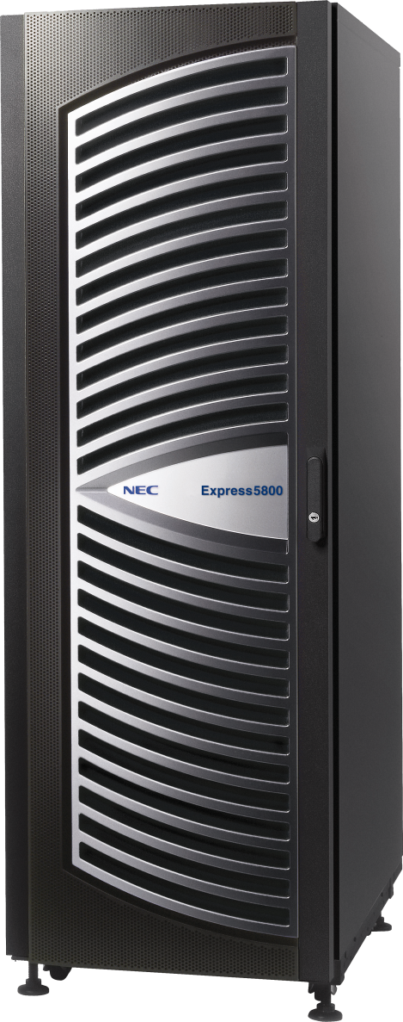
NEC Express5800/1320
Reliability and Performance through the fusion of the NEC A³ chipset and the Dual-Core Intel® Itanium® 2 processor
Supercomputer-class Performance
  Scalable performance powered by the Dual-Core Intel® Itanium® 2 processor
  Very Large Cache Architecture
  Dedicated Cache Coherency Interface
Outstanding Flexibility and Operability
  Investment protection: Easy migration to future processors
  Resource virtualization through floating I/O
  Superb Windows Server support and rich scale-up application lineup
  Superior standard chassis configuration:
  Small footprint and highly scalable I/O

Slide 28
Call To Action
Build systems that take advantage of these features!
Read the detailed flow specification
  Contact us for a copy
Test your driver for compliance
  Tools are available in the WDK
  Logo testing will exercise the behavior
  These scenarios will affect your driver

Slide 29
Additional Resources
Tools and Builds
  Windows Server “Longhorn” Beta 3
  WDK http://www.microsoft.com/whdc/devtools/wdk/default.mspx
Web Resources
  Links http://www.microsoft.com/whdc/system/platform/server/dhp.mspx
  Logo http://www.microsoft.com/whdc/winlogo/hwrequirements.mspx
Related Sessions
  SVR-T326 WHEA Systems: Design and Implementation
    Stay right here
Questions and Comments:
Dpfb @ microsoft.com

Slide 30


© 2007 Microsoft Corporation. All rights reserved. Microsoft, Windows, Windows Vista and other product names are or may be registered trademarks and/or trademarks in the U.S. and/or other countries.
The information herein is for informational purposes only and represents the current view of Microsoft Corporation as of the date of this presentation. Because Microsoft must respond to changing market conditions, it should not be interpreted to be a commitment on the part of Microsoft, and Microsoft cannot guarantee the accuracy of any information provided after the date of this presentation.
MICROSOFT MAKES NO WARRANTIES, EXPRESS, IMPLIED OR STATUTORY, AS TO THE INFORMATION IN THIS PRESENTATION.

