Slide 1
Windows Server Power Management
Stephen Berard
Program Manager Windows Platform Architecture Team

Slide 2
Key Takeaways
Be a leader in advancing 64-bit computing
Adopt best practices and new tools
Let’s partner on new hardware direction
Understand and make use of power management controls in Windows Server

Slide 3
Agenda
Background
Processor power management
Benefits, overview
Enabling support in Windows Server 2003
Changes Windows Server code name “Longhorn”
Device power management
Power management features in Windows Server “Longhorn”
Demo
Questions

Slide 4
Server Power Management Rationale
Increasing density and computing needs in data centers are straining power and cooling capacity
Server power consumption continues to climb
Energy costs are rising
Power generation, consumption has significant environmental impact
Compliance regulation programs targeting server systems
Governmental limits on CO2 emissions

Slide 5
Example Server Power Budget
Processor power management represents the best opportunity today
Source: Intel Server Products Power Budget Analysis Tool
http://www.intel.com/support/motherboards/server/sb/cs-016976.htm

Slide 6
Processor Power Management Benefits
Offers considerable power savings
Negligible impact to server performance, responsiveness
Capable processors are prevalent in the market today
Mature, reliable technology
Significant deployments in mobile, desktop systems

Slide 7
Processor Power Management Benefits
No user intervention required
Managed by the operating system
No 3rd party software or firmware may assume control
Balances power savings with CPU utilization
Scale performance state based on workload
Enter processor sleep states when idle (no thread ready to run)

Slide 8
Processor Power Management Benefits
Fully supported by Windows
Windows Server 2003
Windows Server code name “Longhorn”
Feature parity with Windows client operating systems
For example, full support for:
Deep idle sleep states
ACPI 2.0, 3.0 processor objects, Notify() events
Power policy for tuning Operating System (OS) target state algorithms

Slide 9
Processor Power Management Definition
Defined in the ACPI specification
Performance states (P-states)
Dynamic voltage and frequency scaling
Throttle states (T-states)
Linear scaling of CPU clock
Power states (C-states)
Idle sleep states

Slide 10
Processor Power Management Functional overview
All processor power states are managed by the operating system at run time
Kernel power manager calculates appropriate target states
Based on processor utilization, Windows power policy, thread scheduler, system heuristics
OS initiates processor state transitions
e.g., scales p-state in response to workloads, or
enters low processor power state when idle

Slide 11
Processor Power Management Requirements
Hardware must support PPM capabilities
ACPI namespace must described capabilities and contain processor objects
Windows processor driver required for specific CPU make/model
Most major processors supported in-box
Exception: AMD K8 on Windows Server 2003
Processor driver available from AMD

Slide 12
Enabling Performance States Windows Server 2003
Requires selecting appropriate power policy
Each system power policy includes a processor throttling policy
Determines performance state usage
None – use only the highest performance state
Adaptive – use all performance states based on demand
Constant – use only the lowest performance state

Slide 13
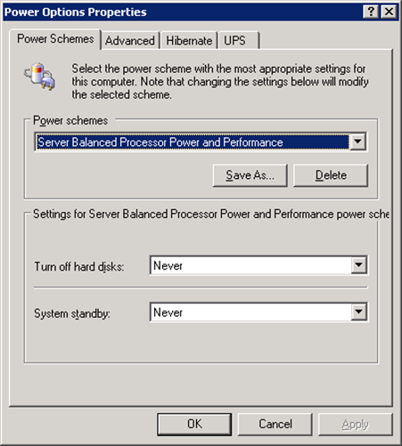
Enabling Performance States Windows Server 2003
To enable demand-based switching, select: “Server Balanced Power and Performance”
Simple, generally appropriate choice

Slide 14
Enabling Performance States Windows Server 2003
Optionally, OEMs or server administrators may create additional power plans
Select processor throttling policy based on desired behavior
User powercfg.exe to view, change processor throttling policy
See Appendix A for details

Slide 15
Processor Power Management Windows Server "Longhorn"
Processor performance states are enabled by default
Power policy allows flexible use of performance states
Values for max, min processor speed
Expressed as a percentage of max processor frequency
Windows will choose the nearest available state
Rounding up if necessary

Slide 16
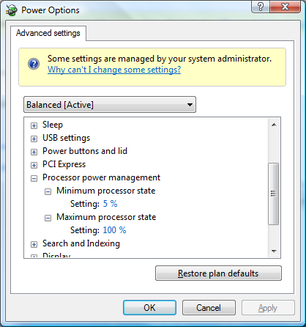
Processor Power Management Windows Server "Longhorn"

Slide 17
Processor Power Management Windows Server "Longhorn"
Power policy will always use “Demand Based Switching” (DBS) between the range defined by max, min frequency
Full range of available states, or
A subset of available states
Will not include linear clock throttle states
Policy may be set to use only one performance state
Max, min, or any intermediate state

Slide 18
Processor Power Management Windows Server "Longhorn"
Example: Processor state power policy
Note: This is the default policy in Windows Server “Longhorn”
State | Freq | % | Type
0 | 2800 | 100 | Performance
1 | 2520 | 90 | Performance
2 | 2142 | 85 | Performance
3 | 1607 | 75 | Performance
4 | 964 | 60 | Performance
5 | 482 | 50 | Performance
Maximum Processor State
Minimum Processor State

Slide 19
Processor Power Management Windows Server "Longhorn"
Example: Processor state power policy
Using a subset of available states
Can use any contiguous range
State | Freq | % | Type
0 | 2800 | 100 | Performance
1 | 2520 | 90 | Performance
2 | 2142 | 85 | Performance
3 | 1607 | 75 | Performance
4 | 964 | 60 | Performance
5 | 482 | 50 | Performance
Maximum Processor State
Minimum Processor State

Slide 20
Processor Power Management Windows Server "Longhorn"
Example: Processor state power policy
Locking processor at one state
Any available state may be selected
State | Freq | % | Type
0 | 2800 | 100 | Performance
1 | 2520 | 90 | Performance
2 | 2142 | 85 | Performance
3 | 1607 | 75 | Performance
4 | 964 | 60 | Performance
5 | 482 | 50 | Performance
Max, Min Processor State

Slide 21
Processor Power Management Windows Server "Longhorn"
Linear clock throttle states
Compared to true performance states, linear states do not save energy
When performing identical work loads
However, throttle states may be useful for some scenarios
Important to understand power policy manager’s rules for use

Slide 22
Processor Power Management Windows Server "Longhorn"
Policy control for use of linear clock throttle states
By default, if performance states are present, throttle states are not enabled
Kernel power manager will not choose a state below the lowest performance state
If no performance states are present, throttle states will be used, but statically – no DBS
Only Maximum Processor State policy value used
To allow throttle states, see Appendix B

Slide 23
Processor Power Management Windows Server "Longhorn"
The kernel power manager will never use “Demand Based Switching” (DBS) with linear throttle states
However, these states may be used statically
When enabled
Default setting is disabled
Power policy applies Maximum Processor State value, ignores Minimum

Slide 24
Processor Power Management Windows Server "Longhorn"
Default use of linear throttle states
State | Freq | % | Type
0 | 2800 | 100 | Performance
1 | 2520 | 90 | Performance
2 | 2380 | 85 | Performance
3 | 2100 | 75 | Performance
4 | 1680 | 60 | Performance
5 | 1400 | 50 | Performance
6 | 1400 | 50 | Throttle
7 | 1120 | 40 | Throttle
8 | 840 | 30 | Throttle
9 | 560 | 20 | Throttle
DBS Allowed
No DBS Allowed

Slide 25
Processor Power Management Windows Server “Longhorn”
Processor power policy includes additional parameters
Influence how kernel power manager chooses target state
Allow OEMs to fine-tune platform behavior
Accommodate differences in hardware implementations
Optimize balance of performance versus power savings

Slide 26
Processor Power Management Tools and support
OS utilization of processor power management can be observed in Windows Performance Monitor
Power test utility provided in the Windows Driver Kit (WDK)
pwrtest.exe
Lists platform power management capabilities discovered by operating system
Logs use of performance, throttle, idle states

Slide 27
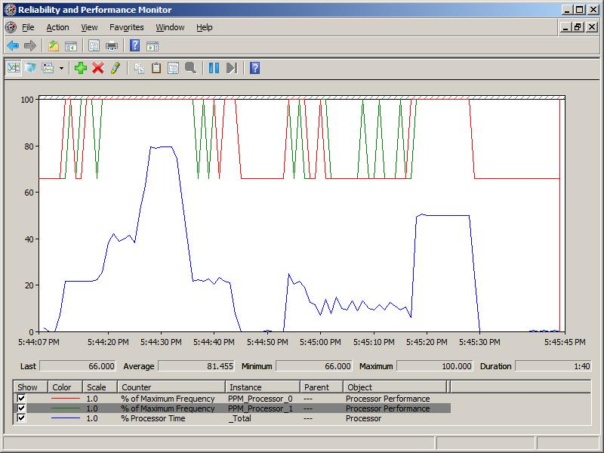
Processor Power Management Performance state utilization

Slide 28
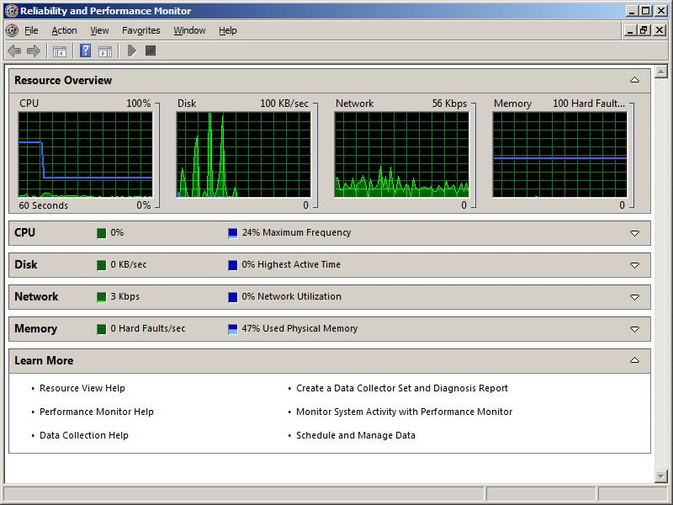
Processor Power Management Processor throttling applied via policy

Slide 29
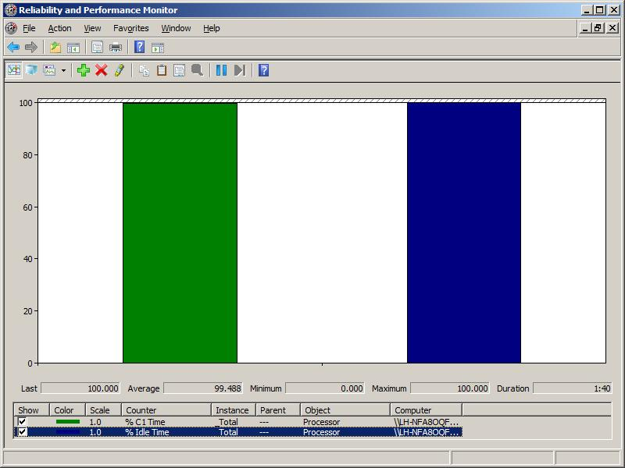
Processor Power Management Performance idle state utilization

Slide 30
Processor Power Management Pwrtest.exe listing power capabilities
C:\Program Files\Microsoft PwrTest>pwrtest /info:ppm
InstanceName: ACPI\GenuineIntel_-_Intel64_Family_6_Model_15\_1_0
Processor Performance States
PerfStates:
Max Transition Latency: 10 us
Number of States: 10
State Speed (Mhz) Type
----- ------------ ----
0 2394 (100%) Performance
1 1596 ( 66%) Performance
2 1596 ( 66%) Throttle
3 1388 ( 57%) Throttle
4 1197 ( 50%) Throttle
5 989 ( 41%) Throttle
6 798 ( 33%) Throttle
7 590 ( 24%) Throttle
8 399 ( 16%) Throttle
9 191 ( 7%) Throttle

Slide 31
Device Power Management Windows Server "Longhorn"
Support for Active State Power Management (ASPM)
In-box power policy for ASPM state
Requires OS control of PCI Express features
See white paper for details

Slide 32
Device Power Management Windows Server "Longhorn"
Extensible power policy infrastructure
Allows easy incorporation of power management-enabled devices
Device power settings integrate with Windows system power policy
Device power settings can appear in Advanced power UI
Rich notification support

Slide 33
Device Power Management Windows Server "Longhorn"
Extensible power policy infrastructure
Allows for true OEM power management innovation and value
Examples
Chipset power management
Network adapter power management

Slide 34
Server Optimized Power Plans Windows Server “Longhorn”
All power plans are defined appropriately for server roles
Idle timers are disabled
Standby, Hibernate, hard disk
Power button actions
Sleep button action is set to Do Nothing
System power button set to Shutdown
Display timeouts remain enabled

Slide 35
Power Management Support Windows Server “Longhorn”
Enables maximum energy savings
New, simplified configuration model
Group Policy control over all power settings
Rich command line interface
Extensive diagnostic and tracing support

Slide 36
Call To Action
Enable processor power management
In OEM server designs
In datacenter server deployments
Leverage Windows Server Longhorn’s extensible power management capabilities
Provide additional OEM value with power management enabled devices

Slide 37
Additional Resources
Web Resources
Microsoft power management white papers: http://www.microsoft.com/whdc/system/pnppwr/powermgmt/default.mspx
PCI Express Active State Power Management in Windows http://www.microsoft.com/whdc/system/bus/PCI/aspm.mspx
ACPI specification: http://www.acpi.info
Related Sessions
SYS-C315 Tuning Processor Power Management
SYS-C316 How to Power Optimize your Windows Platform
For processor power management questions, contact Microsoft at:
For general power questions, contact Microsoft at:
Procpwr @ microsoft.com
Onnow @ microsoft.com

Slide 38

© 2007 Microsoft Corporation. All rights reserved. Microsoft, Windows, Windows Vista and other product names are or may be registered trademarks and/or trademarks in the U.S. and/or other countries.
The information herein is for informational purposes only and represents the current view of Microsoft Corporation as of the date of this presentation. Because Microsoft must respond to changing market conditions, it should not be interpreted to be a commitment on the part of Microsoft, and Microsoft cannot guarantee the accuracy of any information provided after the date of this presentation. MICROSOFT MAKES NO WARRANTIES, EXPRESS, IMPLIED OR STATUTORY, AS TO THE INFORMATION IN THIS PRESENTATION.

Slide 39
Appendix A Windows Server 2003: Using powercfg.exe
Viewing the processor throttling policy
C:\>powercfg /query "Server Balanced Processor Power and Performance"
Field Description Value
----------------- -----
Name Server Balanced Processor Power and Performance
Numerical ID 4
Turn off monitor (AC) Not Supported
Turn off monitor (DC) Not Supported
Turn off hard disks (AC) Never
Turn off hard disks (DC) After 15 mins
System standby (AC) Never
System standby (DC) After 5 mins
System hibernates (AC) Never
System hibernates (DC) Never
Processor Throttle (AC) ADAPTIVE
Processor Throttle (DC) ADAPTIVE

Slide 40
Appendix A Windows Server 2003: Using powercfg.exe
Changing the processor throttling policy
C:\>powercfg /change 4 /processor-throttle-ac constant /n
C:\>powercfg /query "Server Balanced Processor Power and Performance"
Field Description Value
----------------- -----
Name Server Balanced Processor Power and Performance
Numerical ID 4
Turn off monitor (AC) Not Supported
Turn off monitor (DC) Not Supported
Turn off hard disks (AC) Never
Turn off hard disks (DC) After 15 mins
System standby (AC) Never
System standby (DC) After 5 mins
System hibernates (AC) Never
System hibernates (DC) Never
Processor Throttle (AC) CONSTANT
Processor Throttle (DC) ADAPTIVE

Slide 41
Appendix B Windows Server “Longhorn”
Enabling throttle states when p-states are present
Controlled by power policy
This value is hidden by default
Not shown in user interface
User powercfg.exe to view, change setting

Slide 42
Appendix B Windows Server “Longhorn”
View the current Allow Throttle States policy
Copy the policy GUID for use with subsequent commands
C:\>powercfg /qh scheme_current sub_processor
C:\Users\Administrator>powercfg -qh scheme_current sub_processor
Power Scheme GUID: 381b4222-f694-41f0-9685-ff5bb260df2e (Balanced)
Subgroup GUID: 54533251-82be-4824-96c1-47b60b740d00 (Processor power management)
Power Setting GUID: 3b04d4fd-1cc7-4f23-ab1c-d1337819c4bb (Allow Throttle States)
Possible Setting Index: 000
Possible Setting Friendly Name: Off
Possible Setting Index: 001
Possible Setting Friendly Name: On
Current AC Power Setting Index: 0x00000000
Current DC Power Setting Index: 0x00000000

Slide 43
Appendix B Windows Server “Longhorn”
Change the Allow Throttle States policy value
Set this policy value to 1 to enable
powercfg -setacvalueindex scheme_current sub_processor
3b04d4fd-1cc7-4f23-ab1c-d1337819c4bb 1

Slide 44

Appendix B Windows Server "Longhorn"
Verify the change
powercfg -qh scheme_current sub_processor
Power Scheme GUID: 381b4222-f694-41f0-9685-ff5bb260df2e (Balanced)
Subgroup GUID: 54533251-82be-4824-96c1-47b60b740d00 (Processor power management)
Power Setting GUID: 3b04d4fd-1cc7-4f23-ab1c-d1337819c4bb (Allow Throttle States)
Possible Setting Index: 000
Possible Setting Friendly Name: Off
Possible Setting Index: 001
Possible Setting Friendly Name: On
Current AC Power Setting Index: 0x00000001
Current DC Power Setting Index: 0x00000000
Apply the new policy to the running system
powercfg -setactive scheme_current

