Slide 1
Windows Server
Logo Testing: Planning
Sandy Arthur
Program Manager
Microsoft Corporation

Slide 2
Key Takeaways
Understand Windows Server Longhorn Device and Server System Logo and
Test Requirements
Understand Legacy “Supported” Systems Requirements and Tests
Understand Additional Qualifications a Server System may Achieve
High Level Understanding of the Server System Stress Test

Slide 3
Agenda
Logo and Test Goals
Legacy Systems
Device and System Logo Requirements
Device and System Test Requirements
Additional Qualifications
Server System Stress Test

Slide 4
Logo And Test Goals
Improve reliability, availability, and serviceability
of systems running Windows Server code
name “Longhorn”
  Require new technologies to reduce hardware failure rate
  Enhance tools and tests to reduce software failure rate
Address problem areas exposed by OCA, PSS, and other data sources that impact Server customers’ typical scenarios, usages, and configurations
  Multiple processors; large memory footprint; multiple adapters; complex drivers such MPIO, LBFO, TOE; non-hardware elements such as anti-virus, firewall,
  mirroring, backup, remote management, etc.

Slide 5
Legacy Systems

Slide 6
Supported Systems
Supported category for systems will continue to exist
  This is ‘forward compatibility’ from Windows Server 2003
  to Windows Server code
  name “Longhorn”
Testing and submission
  Windows Server 2003 Submission ID
  Windows Server Longhorn Logoed Drivers
  CHKLogo
32-bit only systems, and devices in the system
  Devices need x64 driver version for Logo and Signature
Supported option will not exist for devices
  All devices/drivers must receive logo for Server
Catalog Display

Slide 7
Some Server Model Name and Number
by Some Manufacturer, Inc.

Slide 8
Server Device And System
Logo Requirements

Slide 9
Logo Requirements
Device-specific
Applicable to all Device Categories supported for Server
Devices must be functional in Dynamic Hardware
Partitioning-capable (DHP) systems
  DHP-capable systems will become more broadly available over time
  Customer may add arbitrary devices to their DHP-capable systems
  Customers will need Hot Add for their virtual Windows instances
  This is functionality that all drivers should have in any case
Must meet Logo Requirements that support DHP
  Hot Add CPU
  Resource Rebalance
  Hot Replace Quiescence/Pseudo S4

Slide 10
Logo Requirements
System-specific
Different requirements from Windows Vista, and different reasons for requirements that appear to be same
Security
  BitLocker (If Implemented) – Branch Office scenario
Reliability and Availability
  Watchdog, WDT (If Implemented) – prevent hung system from causing excessive availability impact
  Windows Hardware Error Architecture, WHEA (Required) – help customers diagnose errors
  PCI Express (Required, June 2008) – provides improved availability and can provide advanced error reporting
  Error Correcting Memory, ECC or better (Required) – memory errors are a “Top 20” issue for Windows Server 2003 crashes

Slide 11
Logo Requirements
System-specific
Performance
  High Precision Event Timer, HPET (Required) – significant performance improvement for applications needing high-resolution time stamps
  Gigabit Ethernet or better (Required)
Manageability
  Headless, Remote, Out-Of-Band capability (Required) – specific implementation is up to vendor. Can be Serial, Service Processor, Baseboard Management Controller, or combination
Power
  Processor Power States (If Implemented) – if exist, must be exposed
  to Windows

Slide 12
Server Device And System
Test Requirements

Slide 13
Test Requirements
Device-specific
All Device Categories
  Must test against Windows Server Longhorn
  “Datacenter”-equivalent edition, not Windows Vista
  Minimum requisite system configuration consists of
  4 processor cores and 1 GB memory
  DHP Tests
    Hot Add CPU
    Resource Rebalance
    Hot Replace Quiescence/Pseudo S4
Storage and Networking Devices
  Minimum requisite system configuration consists
  of 4 processor cores and 6 GB memory

Slide 14
Test Requirements
System-specific
CHKLogo validates Windows Server Logo signature attribute
  Client signature will have different attributes than Server
Many/most of the current Windows Vista tests are “If Implemented” for Windows Server Longhorn
  Will not execute or cause ‘false’ failure if the device category does not exist in system
Server-Client Stress Test
Shutdown/Restart
  ~1% of systems fail to shutdown
  Test can detect power off, “dirty” shutdown, WDT, etc.

Slide 15
Additional Qualifications

Slide 16
Additional Qualifications – (AQs)
Definition
There are groups of “If Implemented” requirements in Windows Logo Program 3.x dealing with hardware functionality that are not required for Logo
  If Implemented features that are critical to security or reliability are tested as part of Logo Qualification, if present: BitLocker for security, WDT for reliability
  If Implemented features that provide ‘additional’ functionality beyond what industry standard systems do are tested as AQs: Dynamic Hardware Partitioning, Fault Tolerance, Virtualization
Vendor may select none, some, or all qualification tests for Additional Qualifications (AQs) to
  Qualify systems with respect to these “If Implemented” requirements
  Inform customers of their features in the Server Catalog

Slide 17
Additional Qualifications – (AQs)
“If Implemented” System Logo Requirements
Fault Tolerance (FT)
  None specific to FT – only requirement is to
  pass the FT test
Dynamic Hardware Partitioning
  Partition Isolation
  Configuration Persistence
  Stability after Hot Add and Replace Operations
  Partition Management, Status, and UI
Windows Virtualization
  Windows-compatible Virtualization support

Slide 18
Additional Qualifications – (AQs)
“If Implemented” AQ Tests
Fault Tolerant
  “Standard” Server System Logo test
  Fault Tolerant AQ test - FT system set break and resynchronize with no impact on network-connected
  Stress clients
Dynamic Partitioning
  “Standard” Server System Logo test
  Dynamic Partitioning AQ tests – isolation, persistence, stability, partition management
Windows Virtualization
  “Standard” Server System Logo test
  Virtualization AQ test

Slide 19
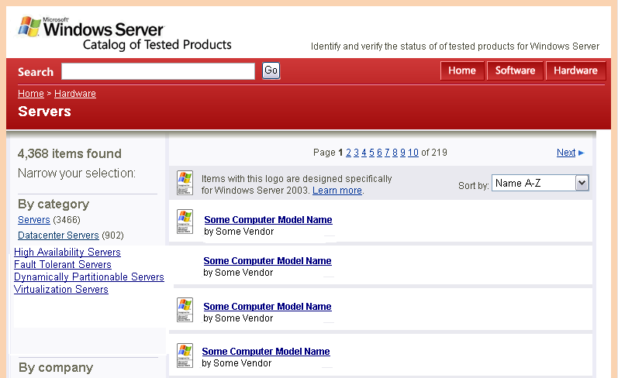
Previewed Server Catalog
Main Page

Slide 20
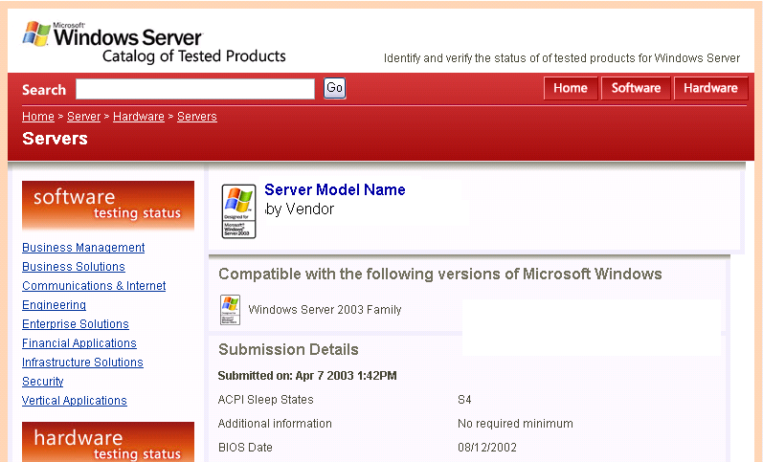
Previewed Server Catalog
Individual system page
High Availability, Dynamic Partitioning, Virtualization, Fault Tolerant

Slide 21
Server System Stress Test

Slide 22
Design Considerations
Customer support history of bugs found that the test could have found, but did not
OEM feedback on past ‘Test’ issues
Lessons learned from previous kits

Slide 23
Design Goals
Replay-Repro failures
more consistently
  Replay log – log is exact, but system state is not
  Vendor can e-mail log to Microsoft to be replayed in lab
Stress load on processor
and memory is ‘appropriate’ to system
  Regardless of CPU count or speed, amount of memory
Support multiple NICs
and HBAs
  Test many configurations
  at once
Dynamically add/replace slave clients
  The test no longer automatically fails when a client fails
Non-Logo mode for vendor use in testing
  Start/stop tests, change stress settings thru GUI or CLI, use
  in combination with
  vendor-written tests

Slide 24
Test Content
CPU, RAM, Paged Pool, and Non-Paged Pool
  Exercises chipset, buses, processors, and memory
Network, WinSock
  Works with TOE or ‘non-TOE’ NICs and drivers
SQL Emulator
  Designed to find
  corruption issues
Local File System
  Multiple HBAs, storage, and physical layers possible
Client-Server
  Using Server Message
  Blocks (SMB)
  Multiple NICs, networks, and physical layers possible

Slide 25
Dynamic Load Generation
Workload automatically scales to the number
of network and storage adapters found in
the system
  Adapters need not be same type, but requires ‘matching’ network clients or storage devices
  Network utilization is ‘managed’ to average ~40% by throttling clients
  Storage stress provided by single instance
  of stress per HBA-HDD(s) ‘pair’
  Target stress level for HBA-HDD pairs is 100%

Slide 26
Dynamic Load Generation
Achieve the same relative amount of stress on the system, regardless of number or type of processors, or amount of memory
  Test spawns as many processor-specific and memory-specific stress threads as are needed in order to achieve a predetermined level of processor and memory utilization
  Test will terminate those stress threads if the utilization level exceeds the predetermined upper range of stress for a period of time
  Target for Processor, RAM, and Pools
  utilization is 70%

Slide 27
Comparison – Old Versus New
Feature | Windows Server 2003 | Windows Server Longhorn
Dynamic Load Balancing | Fixed load generated regardless of the server’s capabilities | Stress tailored to server capabilities
Reproducibility | Re-run and hope | Replay previous test logs
Dynamic Client Replacement | None. Two client machines fail and the server test fails | Uninterrupted testing and easy client addition
Different Modes of Operation | Only one mode | Logo mode for qualification Non-Logo mode for testing Stress mode for single machine testing
Start/Stop Individual Tests | Not possible | User has full control under Non-Logo mode

Slide 28
Test Configuration
Server Under Test (SUT)
Client Master
  Cluster/Server harness install point
  Any Windows Server Longhorn OS Edition
  Typical server hardware
Clients
  8 clients generating
  load against SUT
  Any Windows Server Longhorn OS Edition
  Typical server hardware
Network Switch

Slide 29
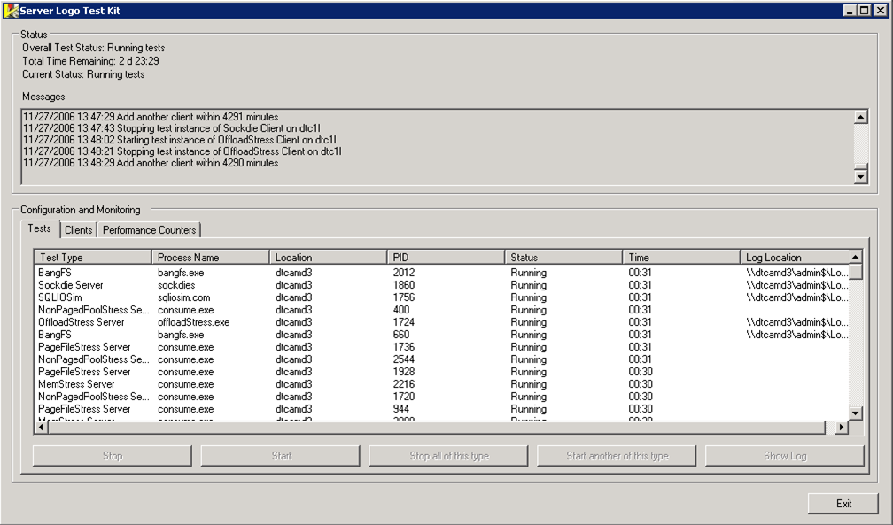
Server Stress – Tests UI
‘history’ of starts and stops of tests
Status of what is happening at the moment

Slide 30
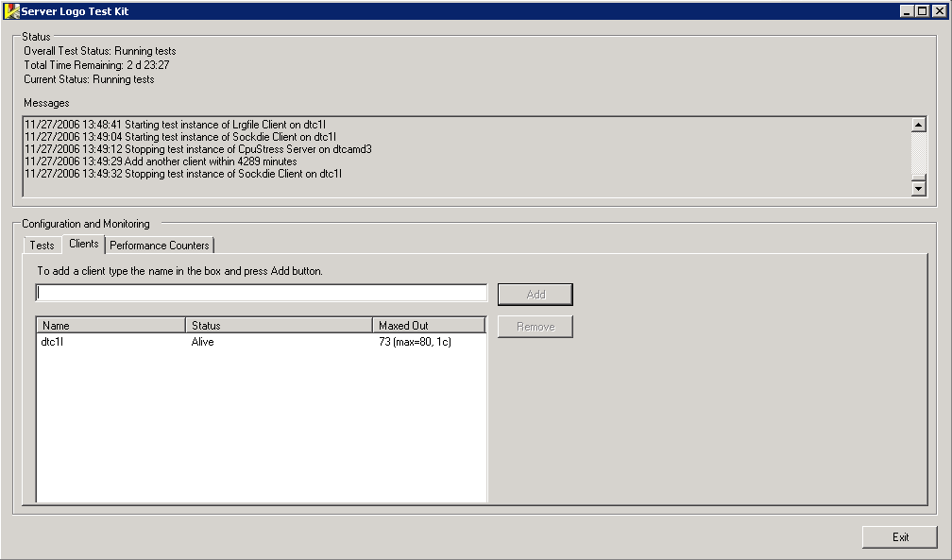
Server Stress – Clients UI

Slide 31
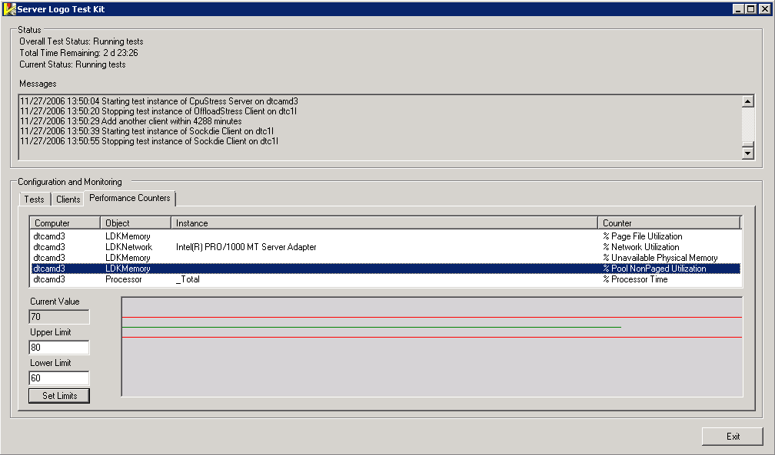
Server Stress – Stress Levels UI

Slide 32
Call To Action
Start testing server devices and systems
File bugs with Microsoft for all related issues
Use Server Device and System tests to find issues in your own products
Fix issues so your products can be qualified by Windows Server Longhorn RC (Devices) or RTM (Systems) milestones without costly delays
Attend the WinHEC Chalk Talk on this topic

Slide 33
Additional Resources
Web Resources
  Other Resources http://www.microsoft.com/whdc/winlogo/WLP30.mspx
  Other Resources http://www.microsoft.com/whdc/system/platform/server/dhp.mspx
  Other Resources http://www.microsoft.com/whdc/system/pnppwr/WHEA/default.mspx
Related Sessions
  DVR-T449 Driver Test Manager: Best Practices and Directions
  SVR-T324 Windows Server Longhorn
  SVR-T325 Dynamic Partition: Windows Server
  SVR-T326 WHEA Systems: Design and Implementation

Slide 34

© 2007 Microsoft Corporation. All rights reserved. Microsoft, Windows, Windows Vista and other product names are or may be registered trademarks and/or trademarks in the U.S. and/or other countries.
The information herein is for informational purposes only and represents the current view of Microsoft Corporation as of the date of this presentation. Because Microsoft must respond to changing market conditions, it should not be interpreted to be a commitment on the part of Microsoft, and Microsoft cannot guarantee the accuracy of any information provided after the date of this presentation.
MICROSOFT MAKES NO WARRANTIES, EXPRESS, IMPLIED OR STATUTORY, AS TO THE INFORMATION IN THIS PRESENTATION.

Slide 35


Dynamic Hardware Partitioning
And Server Device Drivers
Server-qualified Drivers must meet Logo Requirements related to
  Hot Add CPU
  Resource Rebalance
  Hot Replace “Quiescence/Pseudo S4“
Reasons
  Dynamic Hardware Partition-capable (DHP) systems will become more common
  Customer may add arbitrary devices to those systems
  This is functionality all drivers should have in any case
Server-qualified Drivers must pass these Logo Tests
  DHP Tests
    Hot Add CPU
    Hot Add RAM
    Hot Replace CPU
    Hot Replace RAM
  Must test with Windows Server Longhorn “Datacenter”, not Windows Vista
  4 Core, 1GB system required
  Simulator provided, an actual partitionable system not required

