Slide 1
Virtualization In Windows Server Code Name "Longhorn"
Mike Neil
General Manager
Microsoft Corporation

Slide 2




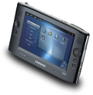
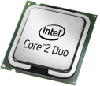




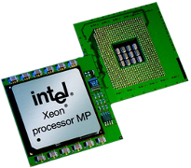

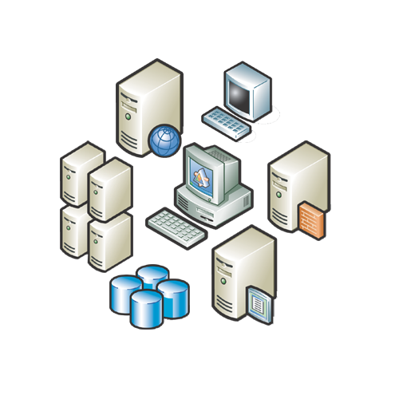






Slide 3










Virtualization Benifits
Server consolidation
Utilization
Business Continuity
Flexibility

Slide 4


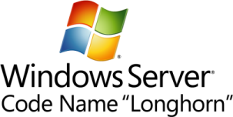

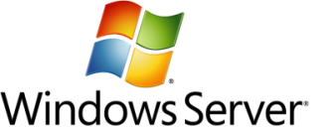









Virtualization Investments
A multiple level approach
Infrastructure
Interoperability
Management
Licensing
Applications
Create agility
Better utilize
server resources
Partner with AMD and Intel
Support
heterogeneity
across the
datacenter
OSP (Open Specification Promise) VHD
Ease consolidation
onto virtual infrastructure
Better utilize
management
resources
Free up IT spend
Deliver
cost-effective, flexible and simplified licensing
Accelerate
deployment
Reduce the cost of supporting
applications
Turn apps into dynamic, real-time services

Slide 5







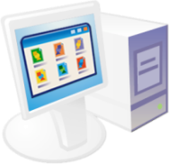







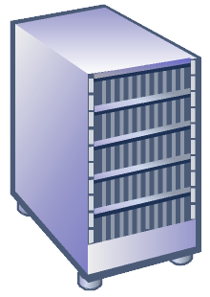








Virtualzied Infrastructure
Management
Presentation
Virtualization
Application
Virtualization
Desktop
Virtualization
Server
Virtualization

Slide 6
Virtual PC
Microsoft Virtual PC 2007
Released February 2007
Over 1 million downloads in first 38 days
Support for Windows Vista as a host
and guest
64-bit host support
Improved performance
Support for Intel VT and AMD-V

Slide 7
Virtual Server
Microsoft Virtual Server 2005 R2 SP1
RC released April 18th
RTM release Q2 CY2007
Support for Intel VT and AMD-V
Support for SLES 10
VSS integration for live backup of running
virtual machines
VHD mounting tool for offline servicing
Improved performance
Improved scalability: 512 VMs on x64 systems

Slide 8
Windows Server Virtualization
Codename "Viridian"
Part of Windows Server code named “Longhorn” wave
Hypervisor based architecture
New virtualization role
  Can be a full role with local UI or
  Production servers can be configured as a minimal footprint Server Core role
Flexible and dynamic virtualization solution
Managed by Microsoft System Center

Slide 9



Usage Scenarios
Test and Development
Automation
Server Consolidation
Dynamic Data Center
Business Continuity

Slide 10














Windows Virtualization
Architecture
Parent Partition
Child Partitions
Provided by:
Virtualization Stack
Applications
Windows
WMI Provider
VM Worker
Processes
Windows
Virtualization
VM
Service
ISV
User Mode
OEM
Virtualization
Service
Clients
(VSCs)
Windows
Kernel
Server Core
Virtualization
Service
Providers
(VSPs)
Windows
Kernel
IHV
Drivers
VMBus
Enlightenments
Kernel Mode
Windows hypervisor
“Designed for Windows” Server Hardware

Slide 11
Windows Server Virtualization
Features
64-bit (x64) and hardware virtualization required
  AMD AMD-V or Intel Virtualization Technology
32-bit (x86) and 64-bit (x64) child partitions
Large memory support within VMs
SMP VMs
High availability and load balancing through clustering
VSS integration for live backups
New hardware sharing architecture (VSP/VSC)
  Disk, networking, input, video
Pass-through high performance disk access for VMs
Robust networking
  VLANs and NLB
DMTF standard for WMI management interface

Slide 12
Interoperablity
VHD (Virtual Hard Disk)
  VHD specification is freely available under Open Specification Promise (OSP)
  VHD TestDrive program
Standards based management APIs
  DMTF defining model for management
Hypervisor hypercall API
  Preliminary documentation available
  Final version will be licensed at RTM

Slide 13
Interoperablity
Linux
  Working with XenSource
    Developing adapter layer to map Xen hypercall API to “Viridian” hypercall API
    Developing disk and networking drivers to integrate with the new I/O architecture
  Working with Novell
    Interoperability and joint support for Windows Server and Novel SUSE Linux Enterprise Server 10
  Support for Linux on “Viridian”

Slide 14
Virtualization Management
System Center Virtual Machine Manager
A new System Center product that allows you to manage your virtualized environment
  Manage Virtual Server – V1
  Manage Windows Server Virtualization – R2
Feature set includes centralized:
  Host Configuration
  Virtual Machine Creation
  Server Consolidation Tools
  Image Library Management
  Virtual Machine Placement and Deployment
  Monitoring and Reporting
  Rapid Recovery

Slide 15





























Virtual Machine Manager Architecture
Client
Web Client
Scripting Client
Administrator Console
Self Service Web Portal
Windows® PowerShell
Windows® PowerShell
Windows® PowerShell
Windows Communication Foundation
Windows Remote Management (WS-MAN)
SCVMM Agent
SCVMM Agent
SCVMM Agent
BITS
BITS
Library
Host
P2V Source

Slide 16
Virtual Machine Manager
Storage integration
Out the box integration with VDS for Fiber Channel and iSCSI based migrations
Working with partners to create an NPIV solution
  Allows a physical port to acquire multiple SAN addresses
    Can be assigned to Virtual Machines to provide unique SAN identities
  Enables SAN best practices: each virtual machine is independently zoned and LUNs are mapped and masked using dedicated World Wide Port Names (WWPNs)
Partners include
  Emulex
  QLogic
  Brocade

Slide 17

Virtualization Manager Roadmap
2008
System Center Virtual Machine Manager R2
Windows® Server Virtualization (within 180 days of the release of “Longhorn”)
2007
System Center Virtual Machine Manager RTM
Now
System Center Virtual Machine Manager Beta 2

Slide 18











Industry Leadership In Licensing
Instance Based Licensing
Will enable new usage models
Windows Server Enterprise/Datacenter
Includes 4/Unlimited virtual instances
Licensing per Virtual Processor
SQL Server, BizTalk Server, etc.
Windows Vista (Software Assurance Customer Benefit)
Allows Vista Enterprise Centralized Desktop deployments
Demo Distribution of Virtual Images

Slide 19
New Computing Models
Vista Enterprise Centralized Desktop (VECD)
Windows Vista/XP running with VMs running on Servers with the presentation delivered to either rich or thin-clients
For licensing count the number of access devices
  Thin-clients: Annual subscription
  PCs: Software assurance + smaller annual subscription
Licensing enables significant deployment flexibility
  VM Pool in the data center
    Unlimited instances of Windows client on any combination of server and storage hardware
  Presentation on the Client
    Up to four (4) running instances per access device
  Architectures
    Both static and dynamic…

Slide 20



















VECD Dynamic Model
2b
Active Directory
Connection Broker
3
6
2a
1
5
7
4
20% Utilization
8
50% Utilization
File Server
9
Execution Servers
70% Utilization
60% Utilization
Customer request to connection broker
Identify customer profile for a specific image and send
request to SCVMM
SCVMM locate the VM and
Identify a suitable server to run the VM
SCVMM provides the server location to connection broker
Connection Broker tells the access device the location of the VM
Device calls the server to activate the VM
Files are provisioned when user click on the icon in VM
Applications are provisioned when user click on the icon in VM

Slide 21
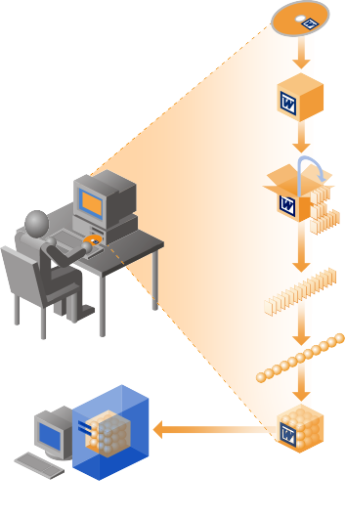
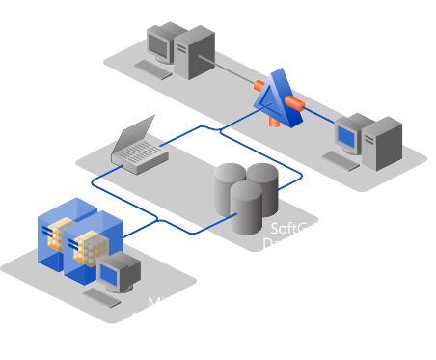
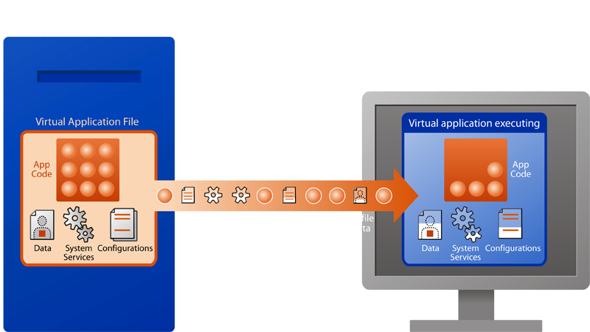
Microsoft SoftGrid Application Virtualization
Dynamically streaming software as a centrally managed service
Rapidly packages applications through active watch technology including execution dependencies.
Applications delivered by highly scalable infrastructure and assigned by Active Directory. Optional application license enforcement.
Delivers launch threshold of application through dynamic streaming protocol and caches for repeat use. Supports disconnected mode.

Slide 23
Call To Action
Check out Virtual PC 2007, Virtual Server 2005 and System Center Virtual Machine Manager today!
Get ready for Windows Server
virtualization (“Viridian”)!

Slide 24
Additional Resources
Microsoft Virtualization Homepage
http://www.microsoft.com/virtualization
Microsoft System Center Homepage
http://www.microsoft.com/systemcenter/
Microsoft System Center Virtual Machine Manager
  Homepage: www.microsoft.com/scvmm
  Datasheet: www.microsoft.com/systemcenter/scvmm/evaluation/default.mspx
  E-mail:
scvmm@microsoft.com

Slide 25

© 2007 Microsoft Corporation. All rights reserved. Microsoft, Windows, Windows Vista and other product names are or may be registered trademarks and/or trademarks in the U.S. and/or other countries.
The information herein is for informational purposes only and represents the current view of Microsoft Corporation as of the date of this presentation. Because Microsoft must respond to changing market conditions, it should not be interpreted to be a commitment on the part of Microsoft, and Microsoft cannot guarantee the accuracy of any information provided after the date of this presentation.
MICROSOFT MAKES NO WARRANTIES, EXPRESS, IMPLIED OR STATUTORY, AS TO THE INFORMATION IN THIS PRESENTATION.

