Slide 1
Windows Server Terminal Services Easy Print
Gaurav Daga
Program Manager
Microsoft Corporation

Slide 2
Key Takeaways
Learn how XML Paper Specification makes TS printing easy
Understand value of XPSDrv printer drivers in TS printing scenarios

Slide 3
Agenda
Scenarios
Architecture
Why XPS?
Why is it Easy?
Client Requirements
TS Printing Policies
Printer Driver Guidance
TS Easy Print Directions

Slide 4
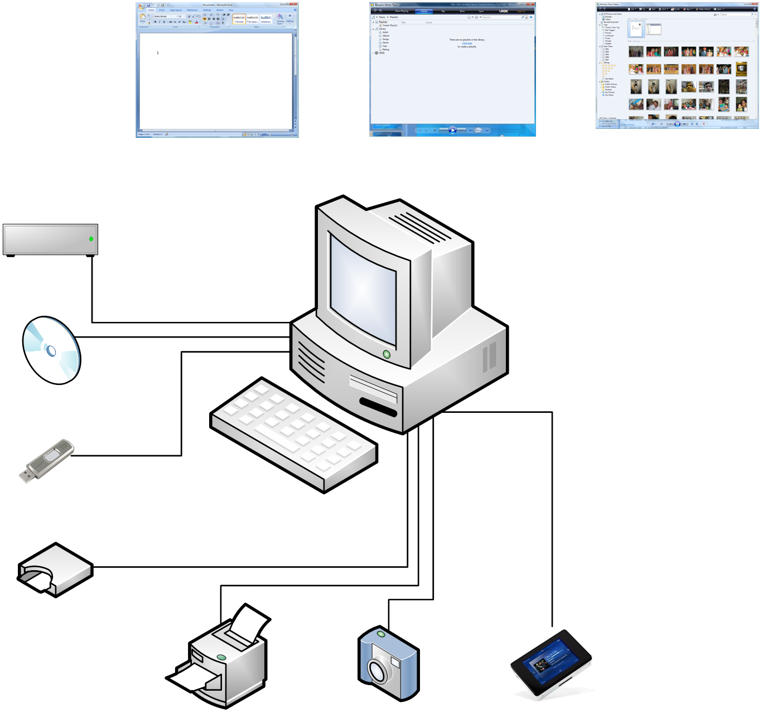
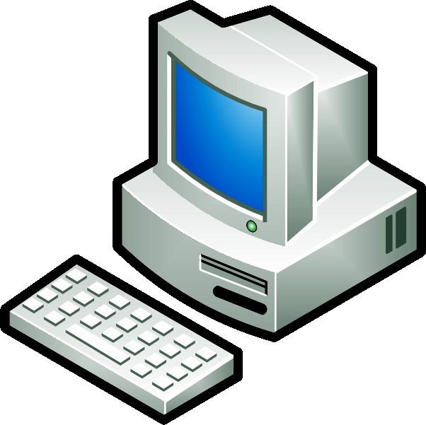
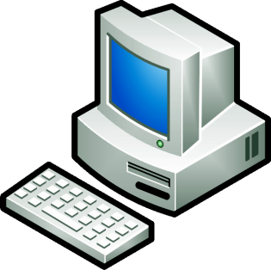
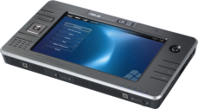



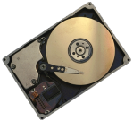



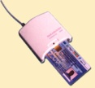
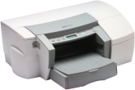
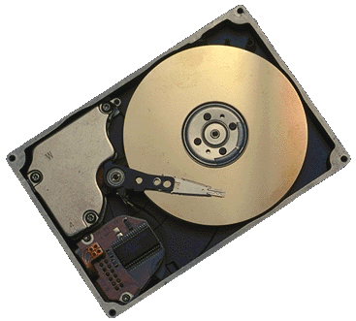
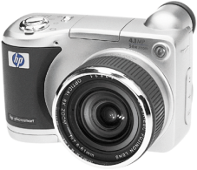


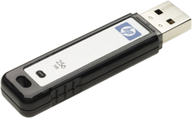
TS Device Redirection
Applications
Local Device Access
Remote Desktop Protocol
Client Computer
Terminal Server

Slide 5
TS Device Redirection
Evolution
Windows Server 2003
  Disk drives
  Smart cards
  Serial ports
  Printers
Windows Vista
  Plug and Play Device Redirection Framework
    Windows Portable Devices based on Media Transfer Protocol
      Digital still cameras
      Audio/Video players
Windows Server 2008
  Point of Service devices using Microsoft POS for .NET 1.11
  TS Easy Print

Slide 6
Why TS Easy Print?
Strong customer feedback on existing TS printer redirection

Slide 7


Slide 8

Local GDI Printing
Architecture
Provided by
Microsoft
WPF App
Win32 App
ISV
IHV
XPS to GDI
Conversion Module
EMF
Print Processor
EMF
Spool
File
GDI Printer Driver
.NET
Framework 3.0 SP1

Slide 9
Local XPS Printing
Architecture
Provided by
Microsoft
Win32 App
WPF App
ISV
IHV
GDI to XPS
Conversion Module
XPS
XPS
Spool
File
XPS Printer Driver

Slide 10
TS Easy Print
Server Side architecture
Provided by
Microsoft
Win32 App
WPF App
ISV
IHV
GDI to XPS
Conversion Module
XPS
XPS
Spool
File
RDP
TS Easy Print XPS Driver

Slide 11
TS Easy Print
Client Side architecture
Provided by
TS Client (MSTSC)
RDP
Microsoft
TS Easy Print
Plug-in
IHV
XPS Printer Driver
.NET
Framework 3.0 SP1
XPS
Spool
File
XPS to GDI
Conversion Module
Print Processor
EMF
Spool
File
GDI Printer Driver

Slide 12
Why XPS?
Public open document format
Portable and printer independent
Flexible document properties handling
Lower bandwidth consumption
  For typical knowledge worker print jobs
  For print jobs with multiple copies

Slide 13
Why Is It Easy?
End User value
Local printers show up in TS session
  TS Easy Print is default driver used
  No other IHV driver required
Why was it an issue?
  Matching IHV driver was required
    Right driver not installed
    No driver for server operating system; especially 64-bit
    Windows Server 2003 Service Pack 1 TS Fallback Printer Driver did not work

Slide 14
Why Is It Easy?
End User value
Local printing preferences honored
  TS Easy Print uses latest saved local printing preferences
Why was it an issue?
  IHV printer driver had factory defaults
    Local printing preferences did not matter

Slide 15
Why Is It Easy?
End User value
All custom IHV printing options available
  TS Easy Print displays printing preferences and device settings directly from client
Why was it an issue?
  Generic lowest common denominator driver used
    E.g. TS Fallback Printer Driver

Slide 16
Why Is It Easy?
End User value
Only current session redirected printers shown
  Default printer remains same for duration of TS session
  Print jobs do not go to wrong printer
  Quicker session logon
Why was it an issue?
  Redirected printers from other sessions were shown
    Administrators saw all sessions printers

Slide 17
Why Is It Easy?
IT Administrator value
No TS administration overhead for printing
  Zero IHV drivers needed
  TS Easy Print comes inbox and is the default
No impact on TS stability
  No incompatible IHV drivers to destabilize spooler

Slide 18
Why Is It Easy?
IT Administrator value
Better printer redirection control depending on TS scalability needs
  TS Easy Print allows default printer redirection only
Per session scoping of redirected printers
also helps TS scalability
TS print jobs do not clog network bandwidth

Slide 19
Client Requirements
Remote Desktop Connection client version 6.1
.NET Framework 3.0 Service Pack 1
IHV printer driver present on client computer

Slide 20
TS Printing Policies
Default: TS Easy Print first, then matching IHV driver
  Matching IHV driver used only if client computer not TS Easy Print ready
Matching IHV driver first, then TS Easy Print
  Set only if all client computers not TS Easy Print ready

Slide 21

TS Easy Print
demo

Slide 22
Printer Driver Guidance
Existing printer drivers work with
TS Easy Print
When developing new printer drivers, use XPSDrv print driver architecture
  Several local printing benefits
  Most efficient TS printing
    At least one less format conversion

Slide 23
TS Easy Print Directions
Thin client support
  Driverless client scenario
Evolution with XPS
  Lower bandwidth consumption for graphics intensive documents
  No .NET Framework dependency on client computer
TS Easy Print tests in Windows Driver Kit
  Inclusion in Device Logo
  Ability to TS certify your printer drivers

Slide 24
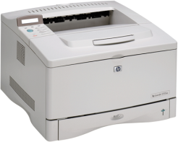


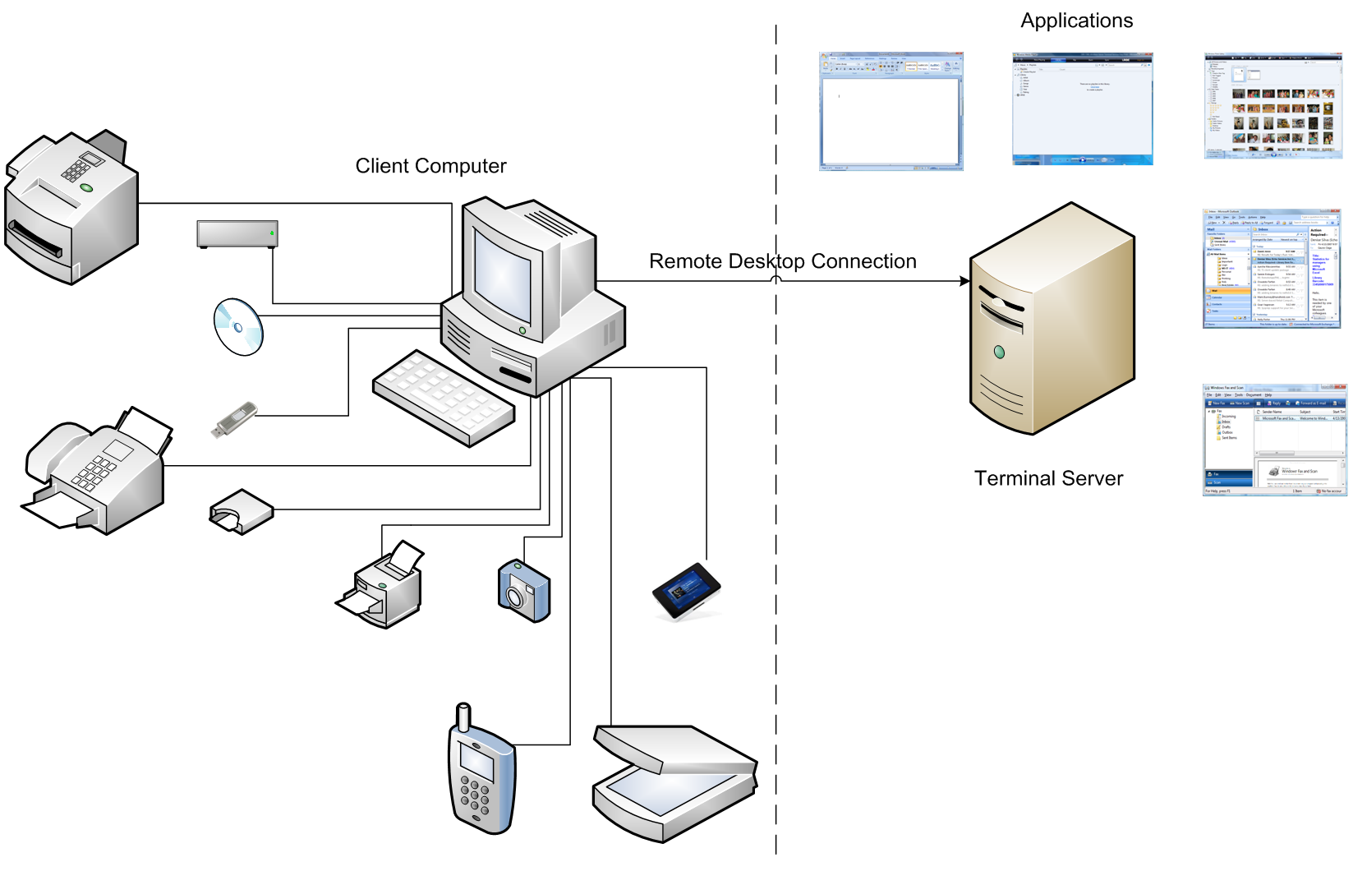


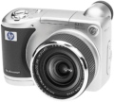



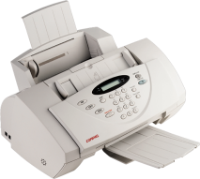
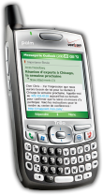
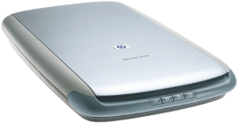
TS Device Redirection Directions
Applications
Client Computer
RDP
Terminal Server

Slide 25
Call To Action
Adopt XPS
TS printing is easy!
  As seamless as local printing
  Tell customers that printer buying decisions not dependent on TS anymore
Printer drivers no longer roadblock in
64-bit server adoption

Slide 26
Additional Resources
TS Blog – http://blogs.msdn.com/ts/
What’s New in Terminal Services for Windows Server codenamed “Longhorn” - http://go.microsoft.com/fwlink/?LinkId=87440
Questions: TS Newsgroup – microsoft.public.windows.terminal_services
How to implement and optimize for XPS and Print?
  CLN-T370 XPSDrv: Best Practices Using Print Verifier
  CLN-C369 Print Verifier and XPSDrv Driver Development
  CLN-T371 Performance Optimization for XPS Documents
  CLN-C372 XPS Document Optimization and Best Practices
  Lab: CLN-V373 XPSDrv Lab: How to Develop and Test Print Drivers and Filters

Slide 27

© 2007 Microsoft Corporation. All rights reserved. Microsoft, Windows, Windows Vista and other product names are or may be registered trademarks and/or trademarks in the U.S. and/or other countries.
The information herein is for informational purposes only and represents the current view of Microsoft Corporation as of the date of this presentation. Because Microsoft must respond to changing market conditions, it should not be interpreted to be a commitment on the part of Microsoft, and Microsoft cannot guarantee the accuracy of any information provided after the date of this presentation.
MICROSOFT MAKES NO WARRANTIES, EXPRESS, IMPLIED OR STATUTORY, AS TO THE INFORMATION IN THIS PRESENTATION.

