Slide 1
Windows Home Server Overview and Opportunity
Charlie Kindel
General Manager
Windows Home Server
Microsoft Corporation

Slide 2
What You Will Learn Today
Windows Home Server is an exciting consumer product with amazing end user value
Windows Home Server is a great platform for 3rd party innovation
3rd parties can start building on the Windows Home Server platform now

Slide 3

Target Market
Multi-PC, Networked Households
Region | 2005 | 2009
USA | 14.7 | 21.6
APAC | 12.3 | 20.3
Western Europe | 12.6 | 20.4
Rest of World | 1.5 | 7.7
Totals | 40.1 | 70.0
19 million U.S.
50 million WW

Slide 4

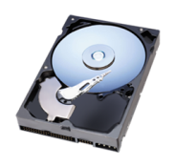
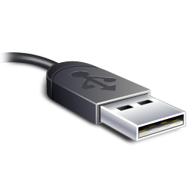
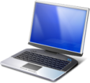
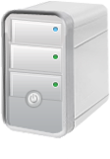
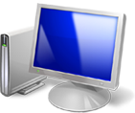
Windows Home Server
Helps families centralize and connect their digital experiences, providing a familiar, easy and reliable way to store, access, share and automatically protect what is most important
Share
Protect
Centralize
Grow

Slide 5
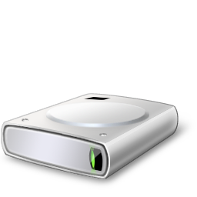
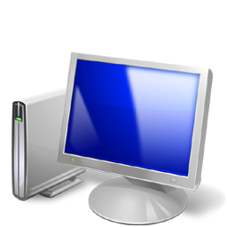


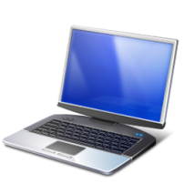
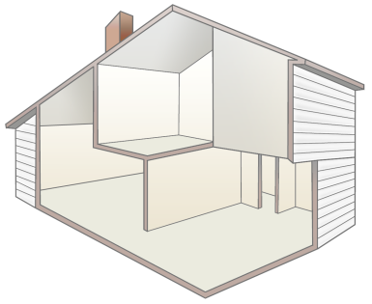



Innovation Areas
Revolutionary simplicity and ease of use
Smart Storage
Automatic Backup
Remote Access
Unrivaled power and robustness

Slide 6
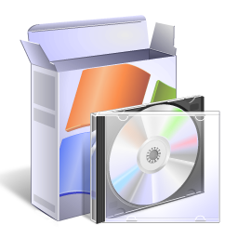
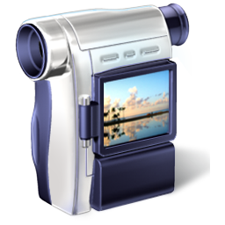
Enabling The Platform For The Home
Windows Home Server
Software
Services
Server Hardware
Devices

Slide 7

Software Opportunities
Windows Client
Client Applications
Add-ins
Windows Home Server SDK
Windows API
Windows Home Server SDK
Windows API
Windows client services
Windows Home Server Services
Windows server services
Internet Services
Internet name and dynamic DNS service

Slide 8
Example Software Opportunities
Music/Video: media servers, cataloging
Productivity: VOIP, video security, video phones
TV/Movies: movie management, TV
Family: photos, calendars, web pages, blogs
Mobility: portability, DLNA
Home Automation: security, lighting, hvac
Data Backup: cloud-based solutions
Security/Privacy: anti-virus, anti-hacking

Slide 9
Services
The home server is an always available node on the home network
Dependable 7/24
Internet domain name and dynamic DNS
Services in the cloud can take advantage of this
Work in the background and push stuff up to the cloud
Reach into the home from the cloud

Slide 10
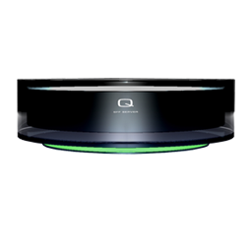
Hardware Concepts
Small form factor
No monitor / display
Low cost x86 CPU
Rear connectors: Power, USB, & GB Ethernet
2 to 4 internal drives
Storage expansion options
Affordable for consumers

Slide 11
OEM Hardware Requirements
Required
1.2 or > GHz equivalent x86 CPU
1 internal Hard Drive (80 GB minimum) with tool-less expansion facilities
512 MB RAM minimum
1 Gigabit Network Card
4 External USB Ports
30 dB or less noise emission
Not allowed
Wireless network adapter
Video connector
Optical drive
Keyboard and Mouse ports
RS-232 and Parallel ports

Slide 12
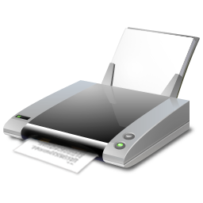
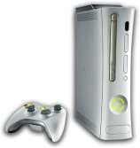
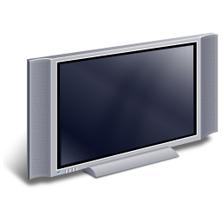

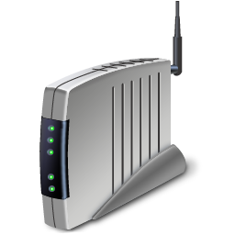
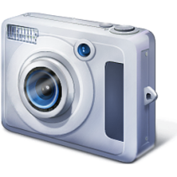


Devices

Slide 13
Recap
Windows Home Server
Software
Services
Server Hardware
Devices

Slide 14




Momentum
Over 60,000 beta participants
Over 40 hardware and software partners
“We think it's a category that can explode in importance.” - Bill Gates
“This could change the game for home computing, making data accessible anywhere, anytime”
-- John Clyman,
PC Magazine , 2/2007
“This is a great product – the only downside is that it’s not coming out next week!”
-- Rob Enderle,
Enderle Group, 11/2006
“Microsoft hits a home run with Windows Home Server”
-- Ed Bott,
ZDNet, 4/26/2007
“People currently using NAS would automatically run to this – it’s so much easier.”
-- Van Baker, Gartner, 11/2006

Slide 15
Call To Action
Sign up for and use the beta
http://connect.microsoft.com/windowshomeserver
Read the Getting Started Guide
Use the Windows Home Server SDK on MSDN
Contact our partner team at whsisv@microsoft.com

Slide 16
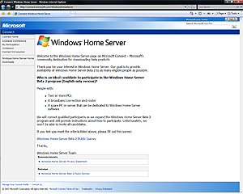
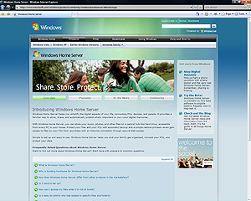
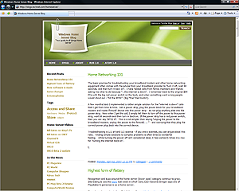
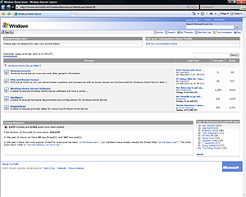
Additional Resources
Windows Home Server Website
http://www.microsoft.com/WindowsHomeServer
Register for Windows Home Server Beta
http://connect.microsoft.com/WindowsHomeServer
Home Server Blog
http://blogs.technet.com/homeserver
Home Server Forums
http://www.serverplayground.com

Slide 17

© 2007 Microsoft Corporation. All rights reserved. Microsoft, Windows, Windows Vista and other product names are or may be registered trademarks and/or trademarks in the U.S. and/or other countries.
The information herein is for informational purposes only and represents the current view of Microsoft Corporation as of the date of this presentation. Because Microsoft must respond to changing market conditions, it should not be interpreted to be a commitment on the part of Microsoft, and Microsoft cannot guarantee the accuracy of any information provided after the date of this presentation. MICROSOFT MAKES NO WARRANTIES, EXPRESS, IMPLIED OR STATUTORY, AS TO THE INFORMATION IN THIS PRESENTATION.

Slide 18
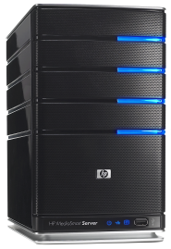
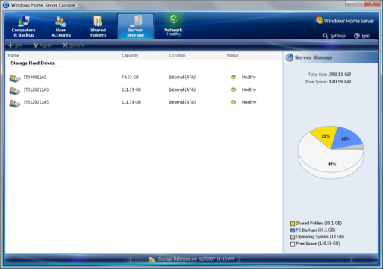
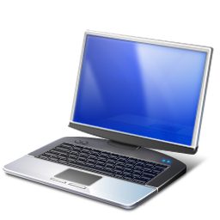
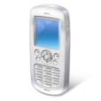


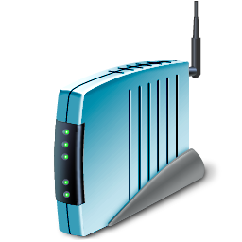
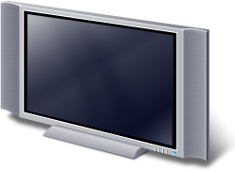
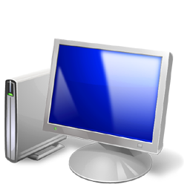


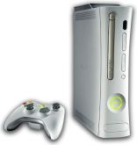
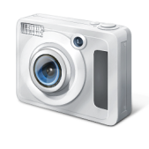
Remote
Laptop PC
Internet
Xbox 360
Media Center PC

Slide 19
Share
Access your files from inside and outside your home
Connect to your home computers from anywhere
Personalized Internet Address for your home
Stream Media to your Xbox 360™ and other devices

Slide 20
Protect
Automated daily PC backup
Simply restore an entire PC or individual files
Monitor the health of PC’s on your network
Your data is stored redundantly protecting against disk failures

Slide 21
Centralize
Expanding storage is as simple as plugging in a new drive
Everything is secure with easy to understand configuration
Centralized storage of all your digital “stuff”

Slide 22
Grow
Expandable storage grows as your needs increase
Works with current and future storage technologies
Works with a rich ecosystem of 3rd party software, services, and devices
Makes owning multiple PC’s easier

