Slide 1
Enterprise Storage Advances In Windows
John Loveall
Director of Program Management
Windows Storage Platform
Microsoft Corporation

Slide 2
Key Takeaways
Provide details of Enterprise Storage Stack Features planned for Windows Server codenamed “Longhorn”
Highlight technology trends for
Enterprise Storage

Slide 3
Agenda
Storage Trends
Microsoft MPIO Support
Server Storage Stack Changes
iSCSI Initiator Integration
Storage Management and APIs
Remote Boot Support
Server Backup
Changes in Online/Offline behavior
Technology Futures

Slide 4
Key Storage Trends For Server
Move toward stateless servers
Security/Key Management
Flash in the system
Broad SAN Adoption
Growing Adoption for Ethernet storage

Slide 5
Microsoft MPIO
Aggregates multiple ports for both block-level fail-over and load balancing
Supports partner provided Device Specific Modules (DSMs)
Microsoft DSM (msdsm) included inbox for storage arrays that support either:
  Active/Active
  Asymmetric logical unit access (ALUA)
Protocol Independent
  Supports SAS, Fibre Channel, iSCSI, Infiniband
Migration from Windows Server 2003 planned for RC1
  Allows upgrade with multiple physical paths in place

Slide 6
Microsoft MPIO
MPCLAIM command line used for Windows “Server Core”
New mechanism included in Windows Server
codenamed “Longhorn” helps ensure that inbox Microsoft MPIO binaries are not overwritten by MPIO binaries in partner provided packages
MPIO Driver Development Kit
  Includes sample source for a common DSM which can be compiled for all platforms (Windows 2000, Server 2003, Windows Server Longhorn)
  Allows partners to ship a single DSM for multiple platforms
  Includes handling persistent reservations (PR) for both Server 2003
  and Windows Server Longhorn to comply with new Windows Server Cluster Longhorn requirements

Slide 7
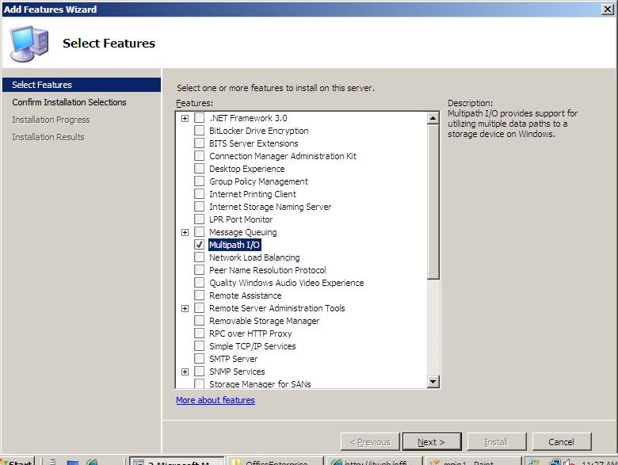
Microsoft MPIO – Installation

Slide 8
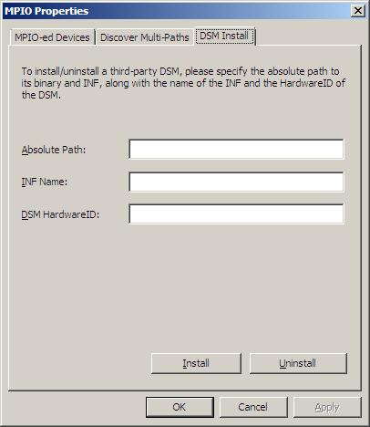
Microsoft MPIO – Configuration
DSM installation
  From control panel configuration utility
  From partner provided integrated installation solutions

Slide 9
Microsoft MPIO Program Change Announcement
MPIO Becomes “Mainstream”
  Program agreement not required for Windows Server codenamed “Longhorn”
  Program Agreement still available for redistributing binaries on Windows Server 2003/Windows 2000 Server
Targeting availability of sample DSM code through standard Windows Server Longhorn development kit

Slide 10
Server Port Driver Stack
Windows Server Longhorn
Storport Hardened for SANs
  IO Timeout modified for BUSY Targets
    Enables Long-Distance LUN Queue Handling
  Full Support of MSI-X Enabled HBAs
  Stabilization of Power Management Handling
Virtual Miniports enabled for SAN Diversity
iSCSI Miniport now a Storport Miniport
Robust Dynamic Device Add/Remove

Slide 11
Server Class Driver Stack
Windows Server Longhorn
ClassPnP
  Improvements for Robust MPIO Deployments
Crashdump
  Removed dependency on NTOS
  Multipathing Support
  Supports crashing to an alternate device connected to any miniport driver
Disk
  Unchanged – Extremely Stable

Slide 12
IP SAN Management Using iSNS
Internet Storage Name Service
Centralized Discovery of iSCSI devices
on an IP Storage network using the
iSNS protocol
Included in Windows Server
codenamed “Longhorn”
  Installs as an optional component

Slide 13
Microsoft iSCSI Software Initiator
Integrated inbox in Windows Server codenamed “Longhorn”
Enables block-based storage for wide area networks and high throughput implementations
  Suitable for applications requiring block level connectivity such as Exchange Server and SQL Server
  High Availability through Microsoft MPIO or MCS (multiple connections
  per session)
  Supports up to 256 Terabyte LUNs through GPT Disks
    Chkdisk times for LUNs still a factor
Connections to iSCSI disks can be configured through:
  Control panel configuration utility
  Command line interface (iSCSICLI)
    iSCSICLI used for “Server Core” Installations
  Storage Explorer

Slide 14
Native Remote Boot Support
Support for stateless servers booting using the Microsoft iSCSI software initiator and standard (enterprise class) NICs
Designed to support all Logoed iSCSI targets
Utilizes iSCSI boot firmware table (iBFT) to hand off parameters from pre-boot to Windows
Support from hardware or PXE vendor required
  Can be implemented in Server Option ROM, NIC Option ROM or
  PXE component
Examples of supported solutions
  IBM HS20 Blade Server
  Intel Pro/1000 PF and PT network adapters
  emBoot Winboot/i

Slide 15
Remote Boot Support
Additional features
Direct install to iSCSI boot LUN
Integration of iSCSI Initiator into setup/WinPE
Support for booting the Windows OS using standard (enterprise class) NICs
Crashdump Support for iSCSI boot through initiator using vendor miniports
Note: Remote boot support using iSCSI HBAs,
Fibre Channel HBAs and other bus types (SAS, etc.) continues to be supported

Slide 16
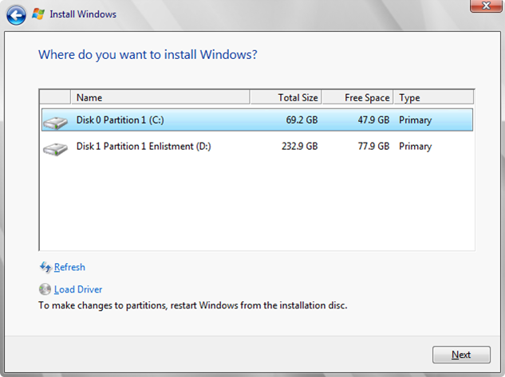
Installation Directly To iSCSI Target

Slide 17
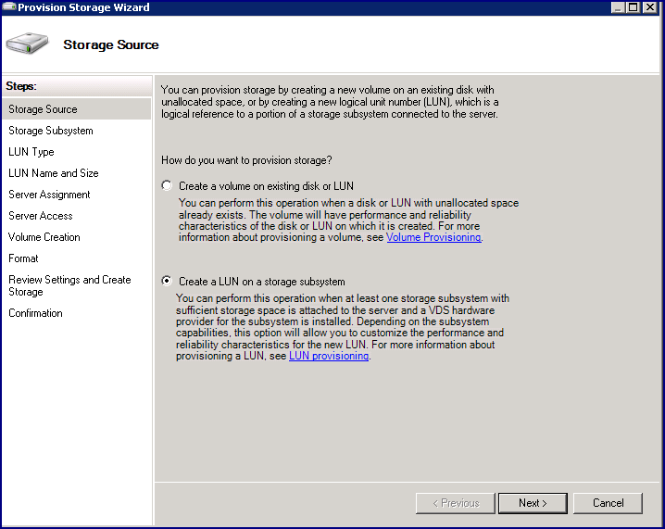
Provision Storage Wizard (1 Of 3)
Simplified, end-to-end storage provisioning experience
Supports LUN creation, assignment of LUNs
to a server, and
volume creation
Used by both Share and Storage Management and Storage Manager for SANs

Slide 18
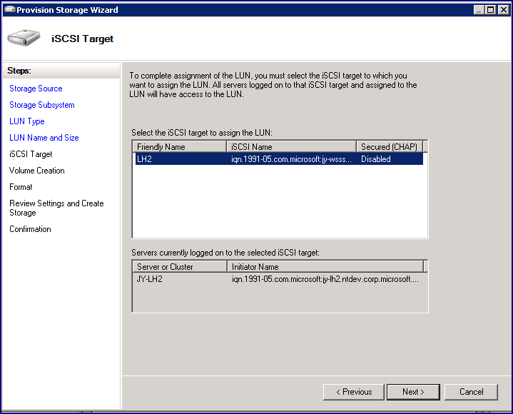
Provision Storage Wizard (2 Of 3)

Slide 19
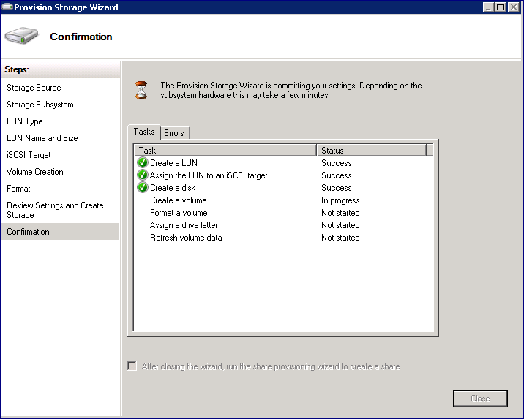
Provision Storage Wizard (3 Of 3)

Slide 20
Storage Explorer
Goals
  Provide visibility into Fibre Channel and iSCSI SANs
  Centralized UI for physical SAN management
Views of Fibre Channel SAN
  Physical view
  Zoning view
Views of iSCSI SAN
  iSCSI view
  Discovery Domains
Server View

Slide 21
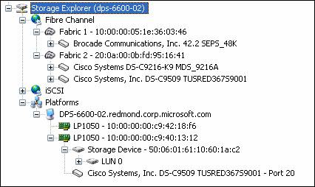
Storage Explorer: User Interface
SAN Visualization
Provides detailed SAN configuration information

Slide 22
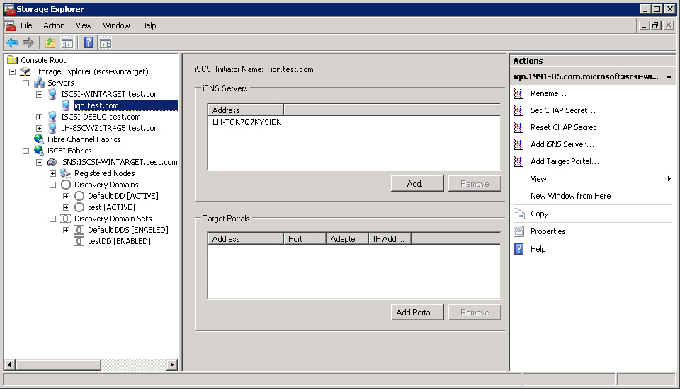
Storage Explorer: User Interface
Device management
Provides access to the management interfaces for individual devices

Slide 23
Protocol Improvements
SMB 2.0
SMB 2.0 greatly increases the restrictive constants for file sharing functionality (users, open files, number of shares, etc.)
Packet compounding within the SMB 2.0 protocol reduces “chattiness”
SMB 2.0 supports durable handles, symbolic links, and simplifies signing algorithms (security)
Performance measured on Windows Server codenamed “Longhorn” Beta 3 at 3326 Mbps
  Currently exceeding original goals for RTM

Slide 24
Protocol Improvements
Transactional File I/O (TxF)
Provides atomic I/O operations throughout the OS (database, Registry, file system, etc.)
Meets the performance and scale-up requirements of larger and more complex data operations
Protocol improvements provide the foundation for advanced storage workload functionality going forward

Slide 25
Volume Shadow Copy Service (VSS)
Diskshadow is a new in-box VSS requestor to create and manage hardware and software shadow copies
  Offers an interactive command line interface and a script mode
  Enables support for hardware transportable scenarios including off-host backups and data mining
Improved support for hardware shadow copy scenarios
  Auto-recovery of transportable hardware shadow copies enabled
  Interoperability with Transactional NTFS(TxF) supported
  Shadow copy imports may be re-tried on failure
  Shadow copies may be imported to multiple machines sequentially
  Fast recovery scenarios with GPT disks are supported

Slide 26
VDS (Virtual Disk Service)
Online/Offline and SAN Policy feature
  Improvement over Windows Server 2003’s “No Automount”
  Full disk (not just volume) is protected in shared environment
New ability to shrink LUNs (LUN Shrink)
  Allows IT departments to optimize LUN sizes based on actual usage
  File system, volume and LUN shrink now
  work compatibly

Slide 27
VDS
Data alignment improvement
  Physical sector size and LBA offset are taken into account for partitions
  Windows Vista has better alignment rules for partitions for basic disks
  Windows Vista SP1 and LHS have better alignment rules for dynamic disks
Hardware providers logoed against prior releases are still supported

Slide 28
Changes To Online/Offline
For Shared Disks
New Modes
  OfflineShared – new disks on a shared bus are protected by being left offline and set as read-only
    The boot disk (shared or not) and all new disks on a non-shared bus are brought online and made writeable
  Offline – all new disks are left offline and made read-only
  Online – all new disks are brought online and made writeable
Online/offline logic in VDS moved to the disk level
SAN policy is introduced to set the default the behavior of newly discovered disks
  The shared busses currently include iSCSI, SCSI, FC, and SAS
SKU Differentiation
  For ADS or DTC, the SAN policy is set to OfflineShared
  For all other SKUs, the SAN policy is set to Online

Slide 29
Online/Offline For Shared Disks
Deprecation of NoAutomount Mode
NoAutomount, although still supported in Windows Server codenamed “Longhorn”, is being deprecated
  At setup time the system will automatically convert to SAN mode Offline if NoAutomount is enabled
  Windows Server 2003 ADS or DTC – the NoAutoMount registry key will be cleared, and the SAN policy will be set to OfflineShared
  Windows Server 2003 Standard SKU – if NoAutoMount was previously enabled, the NoAutoMount registry key will be cleared, and the SAN policy will be set to OfflineShared
  For all other cases, the SAN policy will be set to Online

Slide 30
Server Backup (MMC)
New backup and recovery application that makes it easy to protect Windows Server codenamed “Longhorn” systems and applications from data loss
  Server Backup protects files, folders, volumes, application data, and OS components
  Server Backup supports recovery granularity that ranges from the full system, to applications, or individual files and folders
Supports new wizards that greatly simplify the backup/recovery experience
Utilizes highly efficient block-level, image-based VSS technology
Optimized for disks (local, Fibre Channel, iSCSI), but it also supports DVD optical media and file servers as targets
  Server Backup does not support tape
Note: Tape drivers remain inbox in Windows Server Longhorn for use with 3rd party backup applications and Microsoft Data Protection Manager

Slide 31
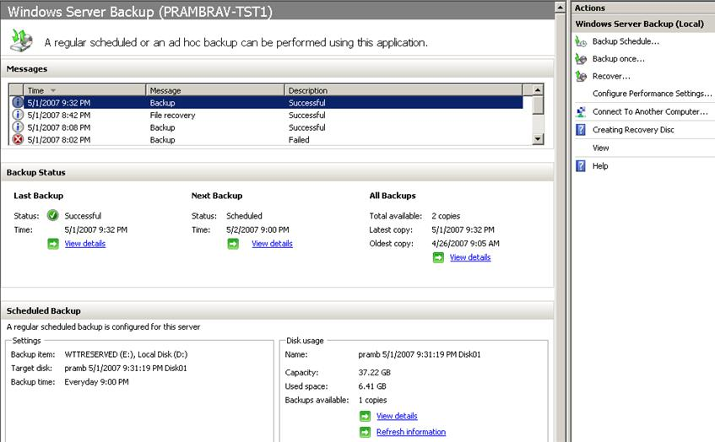
Windows Server Backup

Slide 32
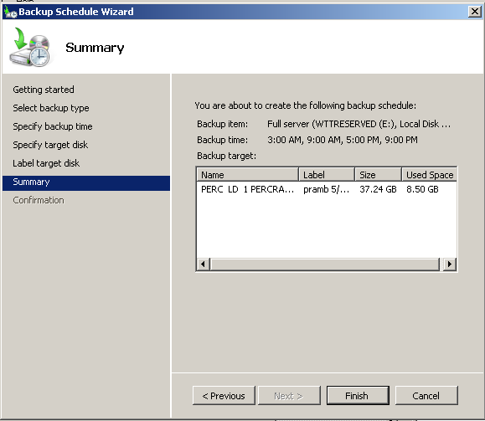
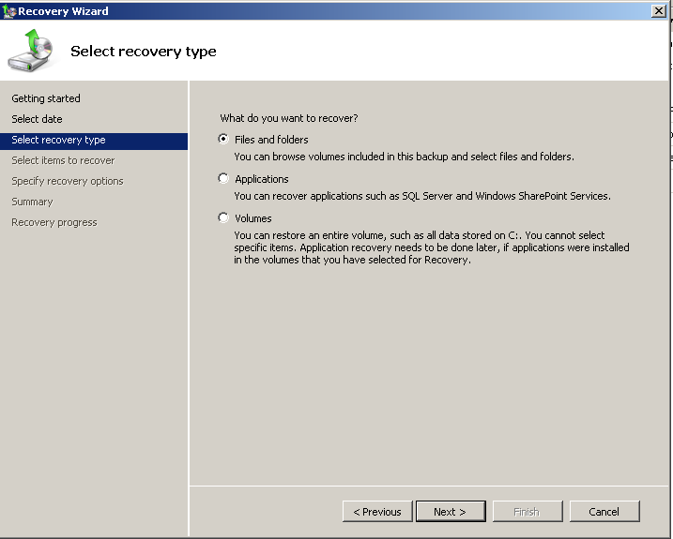
Windows Server Backup

Slide 33

Storage Security Futures
Ñ
Ñ
Full Volume Encryption Options Services
  Opportunities to select from block or file based encryption from Microsoft and partners for combined hardware/software solutions
Industry Standard Storage KMI Platform
  Opportunities for leveraging key
  management standards
Storage Security Management
  Opportunity for centralized, comprehensive management of storage security controls

Slide 34
Storage Technologies
Gaining Traction
Flash
  Integrated system flash
  Solid State Disk Drives
  “Green” Data Center
  “Diskless” Servers
Growing Adoption for Ethernet storage
  Emergence of new standards
  DCE

Slide 35
Calls To Action
Contact Microsoft if you have requirements
related to futures for the enterprise storage stack or emerging technologies
Install and evaluate new enterprise storage features in Windows Server codenamed “Longhorn” Beta 3
Backup Application vendors should review disk online/offline changes to ensure VSS supportability of their applications for Windows Server Longhorn
  hec7stor @ microsoft.com

Slide 36
Questions?

Slide 37

© 2007 Microsoft Corporation. All rights reserved. Microsoft, Windows, Windows Vista and other product names are or may be registered trademarks and/or trademarks in the U.S. and/or other countries.
The information herein is for informational purposes only and represents the current view of Microsoft Corporation as of the date of this presentation. Because Microsoft must respond to changing market conditions, it should not be interpreted to be a commitment on the part of Microsoft, and Microsoft cannot guarantee the accuracy of any information provided after the date of this presentation.
MICROSOFT MAKES NO WARRANTIES, EXPRESS, IMPLIED OR STATUTORY, AS TO THE INFORMATION IN THIS PRESENTATION.

