Slide 1
The Future Of Memory And Storage: Closing The Gap
Dean A. Klein
VP Market Development
Micron Technology, Inc.

Slide 2
Key Takeaways
Understand the CPU-to-memory gap
Understand issues and opportunities to fill the CPU-to-memory gap
Understand the memory to storage gap
Understand issues and opportunities to fill the memory-to-storage gap

Slide 3
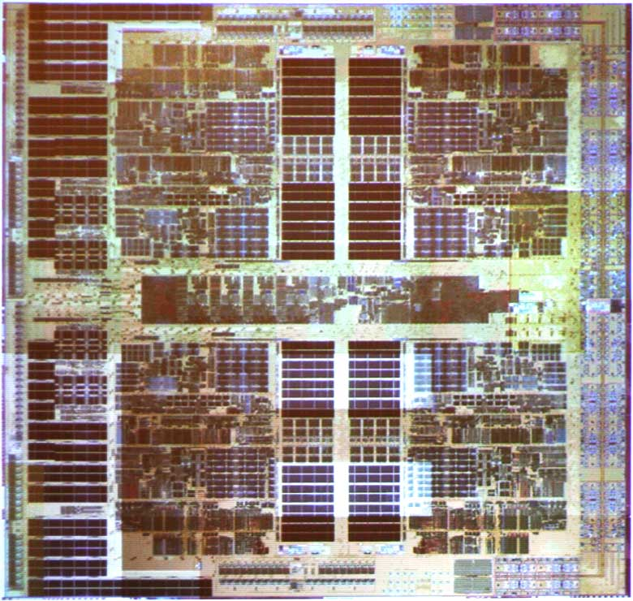
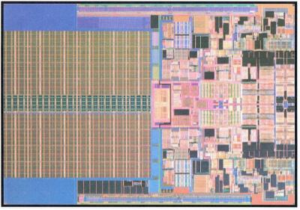
Processor Trends
Increasing core performance
Increasing cores
Increasing bus speed
More memory

Slide 4
Memory Trends
Increasing density
Faster interfaces
Increasing latency
NAND
Memory Transfer Rate chart: Micron research

Slide 5
Growing Gaps
1B
100M
10M
1M
Clocks of Latency
1000
100
10
1
Source: Instat, Micron, Intel

Slide 6
Memory Hierarchy Expansion
Level 1 Cache
Level 2 Cache
Level 3 Cache
Main Memory
Disk
NAND Flash

Slide 7


Slide 8


Processor Trends
AMD “Barcelona”
  Quad core
  2M shared L3 cache
  Dedicated L2 caches
Intel “Penryn”
  Dual/Quad core
  6MB/12MB L2 cache
Intel “Nehalem”
  Quad/8 core

Slide 9
Main Memory Data Rate Trends
DRAM bandwidth typically doubles every 3 years
NGM Diff
NGM SE
DDR
DDR2
SDRAM
DDR3

Slide 10
Memory Trends
But Latency is actually getting WORSE…
And power is a problem…
What drives memory evolution today?
Economics and Physics

Slide 11
Economics Drives Memory
DRAM Market Price-per-bit Decline
(Normalized- Millicent/bit)
1979
1980
Price per Bit (Millicents)
1981
1984
1982
1983
1988
1985
1989
1986
1987
1990
1993
1995
1991
1992
1994
1996
1997
1998
2000
Historical
price-per-bit decline has
averaged 35.5%
(1978 - 2002)
1999
2003
2001
2004F
2006F
2002
2005F
2008F
2007F
1
100
10,000
1,000,000
100,000,000
Cumulative Bit Volume (10¹²)

Slide 12
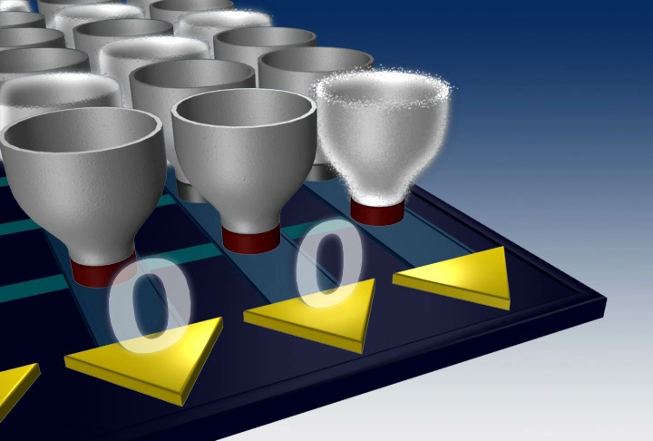
Physics Drives Memory

Slide 13
DRAM Cell Layout: 8F²
2F
4F
Source: CMOS Circuit Design , Layout, and Simulation - Baker

Slide 14
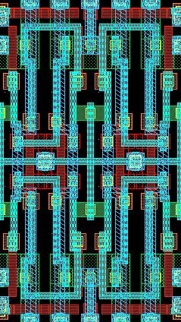
SRAM Cell Layout: 140F²
Source: CMOS Circuit Design , Layout, and Simulation - Baker

Slide 15
Compared
Source: CMOS Circuit Design , Layout, and Simulation - Baker

Slide 16
Cell Sizes Compared
Cell Size (µ²) | Tech Node (nm) | Cell Size(F²)
IBM/Infineon MRAM
1.42 | 180 | 44
Motorola 6T-SRAM
0.69 | 65 | 163
Intel 65nm process 6T-SRAM
0.57 | 65 | 135
Micron 30-series DRAM
0.054 | 95 | 6
Samsung 512Mbit PRAM Device
0.050 | 95 | 5.5
Micron 50-series NAND
0.013 | 53 | 4.5
Source: Micron Market Research

Slide 17
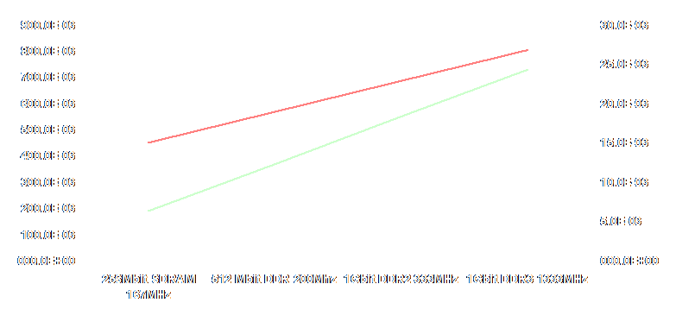
Power Trends
Active
Idle
Active
Idle
X16 devices at nominal Vdd, linear trendlines

Slide 18
Voltage Scaling Trends
7
6
5
4
3
2
1
0
1990
1995
2000
2005
2010

Slide 19

Process Cost Increasing
Cost per Gigabit
Years by quarter

Slide 20
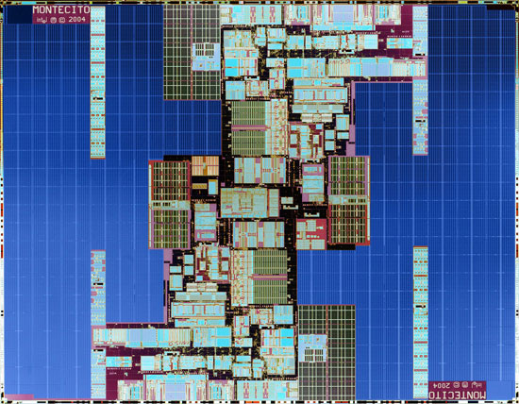
Options For L3 Cache
SRAM L3

Slide 21
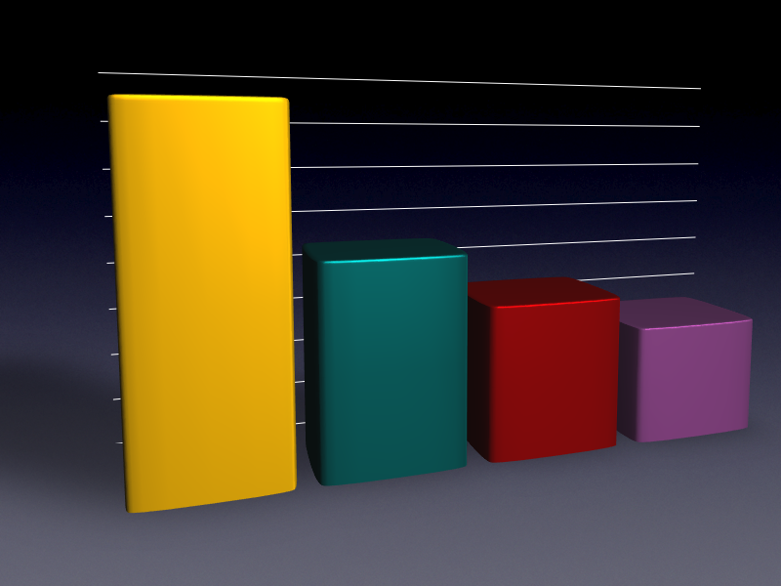
DRAM Can Be Fast
Random 16Byte Transfers Max Envelope
4,000
3,500
3,000
2,500
2,000
Bandwidth per device (MBps / dev)
1,500
1,000
500
DDR2
GDDR3
DDR3
0
RLDRAM
Access pattern: 8 READS followed by 8 WRITES

Slide 22
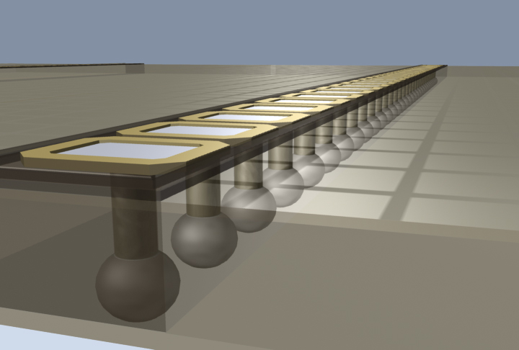
Through-Wafer Interconnect
Reduced parasitic loads
Smaller ESD structures
Greater numbers of interconnects
TWI

Slide 23
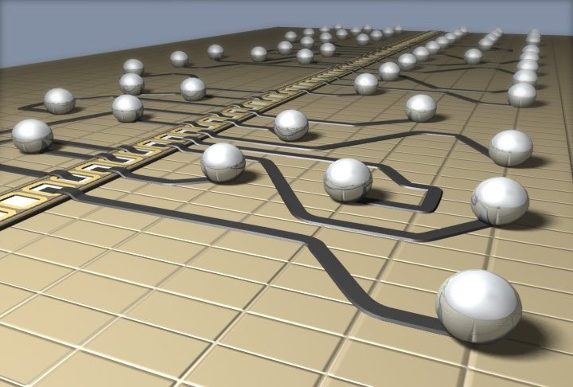
Redistribution Layers
Allow layout flexibility
Reduced parasitic loads
Supports great numbers of interconnects
RDL

Slide 24
Stacked Silicon
Goal of TWI and RDL
Supports N≥2 layers of silicon
Supports processes optimized for device

Slide 25

The Memory To Storage Gap

Slide 26



Storage Demand
161 exabytes of digital data were generated
in 2006
That’s about 168 million terabytes, or roughly equivalent of
1 million copies
of every book in the Library of Congress
36
billion digital movies
43
trillion
digital
songs
Sources: IDC, UC Berkeley, CIA World Fact Book, USA TODAY Research

Slide 27
DRAM To Disk Evolution
“Flash is Disk, Disk is Tape”?
Performance, not capacity, is the issue
Disk will continue as the $/bit leader
NAND pricing is on a steep decline

Slide 28
NAND Density Trends
Beating Moore’s Law
HDD, NAND Flash Pricing (Log Chart)
$100
$43.39
$15.66
$10
$7.12
$3.76
$4.68
$3.11
$2.05
$1.96
$1.34
$1.08
$1.02
$0.89
$1
$1.30
$1.02
$0.81
$0.58
HDD 0.85in, 1.0in, 1.8in Combined
NAND Flash
Mobile HDD 2.5in (portable PCs)
$0.45
$0.35
$0
$/GB
2005
2006
2007
2008
2009
2010
Source: IDC 2007

Slide 29
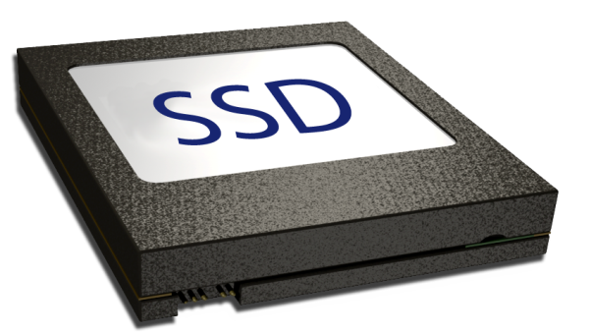





SSDs In The Enterprise
CPU
Relative
Latency
Relative
Cost/bit
1 | L1 Cache | 200
2.5 | L2 Cache | 140
35 | L3 Cache | 120
300 | DRAM | 8
250,000 | SSD | 3
25,000,000 | HDD | 0.7
NAND
NAND Flash Closes the Latency Gap
Cost/bit Data as of Aug ‘06

Slide 30
Datacenter Issues
Power
Reliability
Space
Performance
Table 1: Observed failure rates
System | Source | Type | Part Years | Fails | Fails /Year
TerraServer SAN | Barclay | SCSI 10krpm | 858 | 24 | 2.8%
 |  | controllers | 72 | 2 | 2.8%
 |  | san switch | 9 | 1 | 11.1%
TerraServer Brick | Barclay | SATA 7krpm | 138 | 10 | 7.2%
Web Property 1 | anon | SCSI 10krpm | 15,805 | 972 | 6.0%
 |  | Controllers | 900 | 139 | 15.4%
Web Property 2 | anon | PATA 7krpm | 22,400 | 740 | 3.3%
 |  | motherboard | 3,769 | 66 | 1.7%
Source: Microsoft Research

Slide 31
Management Stack
Application
Flash Translation Layer
Interfaces to traditional HDD File System
Enables sector I/O to Flash
Wear leveling
Bad block management
Automatic reclamation of erased blocks
Power loss protection
Manages multiple NAND devices
Operating System
File System
HDD
SSD
Flash
Translation
Layer (FTL)
Controller
Controller
Manages Physical Protocol
NAND Command encoding
High Speed data transport (DMA/FIFO)
ECC
Controller
ECC
Error Control
Algorithm to control sector-level bit reliability
Implemented in hardware with software control
Algorithm depends upon Flash technology
NAND

Slide 32
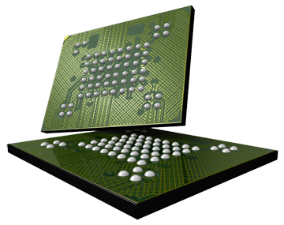
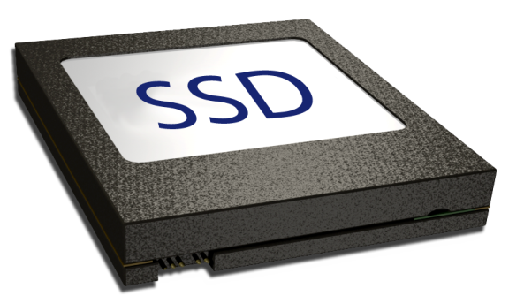
SSD Quality And Reliability
NAND
Extended operation of NAND
On-going production management to
assure reliability
Management
NAND-Validated Error Correction
Static and dynamic Wear Leveling
Garbage collection
Bad block remapping
Other proprietary schemes
Applications
Optimizations based upon Management
and NAND
NAND Specs
100K P/E Cycles
1-Bit ECC
Limited Read Cycles
10 year data retention
SSD Specs
10 Year operating life
10⁻¹⁵ Bit Error Rate
1E+6 hours MTBF

Slide 33
ECC Code Selection Becoming More Important
As the raw NAND Flash BER increases, matching the ECC to the application’s target BER becomes more important
1.0E-25
1.0E-23
t = 6
t = 5
t = 4
t = 3
t = 2
t = 1
1.0E-21
1.0E-19
For SLC
A code with correction threshold of 1 is sufficient
1.0E-17
App's Target BER Zone
1.0E-15
Application Bit Error Rate
t = 0
1.0E-13
1.0E-11
t = 4 required (as a minimum) for MLC
1.0E-09
1.0E-07
1.0E-05
1.0E-03
1.0E-01
1.0E-01
1.0E-03
1.0E-05
1.0E-07
1.0E-09
1.0E-11
1.0E-13
1.0E-15
Raw NAND Bit Error Rate

Slide 34

Endurance: Usage Example
Continuous write at max bus speed of 100MB/s with a 5:1 r/w ratio
30 minutes to fill up disk
50 years before 1M I/O cycle limit is exceeded
250 years before 1M I/O cycle limit is exceeded
Capacity: 32 GB
At 20% utilization
Opportunities for improvement, i.e. new coding, will further extend time to cycle limit
Flash Drives are ready for deployment for various applications

Slide 35
Meaningful Cycling Metrics
Practical, testable solutions are needed
Simply stating that “the drive must meet 1 million complete read and write cycles” is not realistic
1M
100K
Years for
one complete
pass
Cycles
10K
13
1K
Capacity (%)
100%

Slide 36
Cycling For CE Applications
1M
Years for
one complete
pass
0.93
100K
Cycles
10K
1K
5%
20%
75%
Capacity (%)

Slide 37
Cycling For Servers
1M
Years for
one complete
pass
3.02
100K
Cycles
10K
1K
20%
30%
50%
Capacity (%)

Slide 38
Cycling For Enterprise
10M
Years for
one complete
pass
6.78
1M
100K
Cycles
10K
1K
5%
20%
75%
Capacity (%)

Slide 39
Call To Action
Close the Gaps!
Innovation opportunities exist with CPU-coupled DRAM-based caches
Innovation opportunities enabled by rapid NAND scaling for NAND-based storage

Slide 40
Additional Resources
Web Resources
  Specs
  http://www.micron.com/winhec07
  Whitepapers
  http://www.micron.com/winhec07
Related Sessions
  Main Memory Technology Direction
  Flash Memory Technology Direction
E-mail address
daklein @ micron.com

Slide 41

© 2007 Microsoft Corporation. All rights reserved. Microsoft, Windows, Windows Vista and other product names are or may be registered trademarks and/or trademarks in the U.S. and/or other countries.
The information herein is for informational purposes only and represents the current view of Microsoft Corporation as of the date of this presentation. Because Microsoft must respond to changing market conditions, it should not be interpreted to be a commitment on the part of Microsoft, and Microsoft cannot guarantee the accuracy of any information provided after the date of this presentation.
MICROSOFT MAKES NO WARRANTIES, EXPRESS, IMPLIED OR STATUTORY, AS TO THE INFORMATION IN THIS PRESENTATION.

