Slide 1
AMD Virtualization Technology Directions
Andy Kegel, Sr. MTS
Mark Hummel, AMD Fellow
Computer Products Group
AMD

Slide 2
Agenda
Server consolidation
  Virtualization is successful, further advancements
  are needed
  Processor improvements for performance
  I/O virtualization for performance
  Device isolation for improved RAS
Security policy enforcement
  Secure initialization
Emerging technologies
  PCI-SIG IOV
  Torrenza

Slide 3
Server Consolidation Today
Too many servers: Hot and underutilized
Server virtualization consolidates many systems onto one
Successful consolidation of systems
with low-moderate CPU utilization and
low I/O loads

Slide 4
Server Consolidation Tomorrow
Next challenges
  Address systems with high CPU utilization
  Address systems with high I/O loads
  Use hypervisor to improve scalability of workloads
Thin client example
  Virtual clients on servers connected to thin clients,
  smart-phones, or Windows Vista™ enabled traditional client devices
Commercial example
  Virtual CPU rental by the gigabyte-hour
  Virtual storage rental by the gigabyte-month
Resource sharing ⇨ security requirements

Slide 5
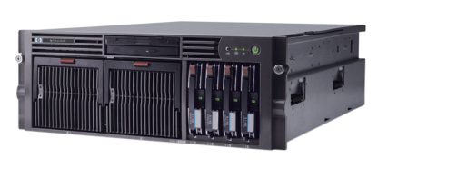
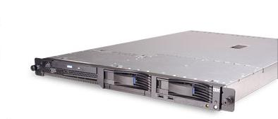
Multiple Cores Mean
Less Hardware
Lots of single-core systems
What about all the I/O that now routes through the single I/O subsystem?
consolidate
CPU improvements drive
system consolidation
I/O demands concentrate
Need significant overhead reductions to allow
continued consolidation

Slide 6
Virtualization Ideal
More changes ahead
Zero
Overhead
video1
Proc+
NPT
SW
I/O+
IOMMU
AMD-V

Slide 7
AMD Virtualization™ Roadmap
Enhancements:
Processor
AMD-V
Multi-core
NPT
World switch
Perf counters
NPT+
World switch+
Hv assists+
World switch++
I/O
System
Timeline
IOMMU
Interrupt+
Virtualized devices
PCI-SIG IOV
2007 →

Slide 8
Enhancements In “Barcelona” Processor
Nested Page Tables (NPT)
  To reduce hypervisor complexity and time
  To improve guest performance (workload)
  Caching of the nested page table
Speed improvements for world switches
  Optimization over time
Performance counters
  For hypervisor tuning and virtualization of guest performance counters

Slide 9
Fewer Intercepts With NPT
Shadow Page Tables Are Costly
Intercepts due to Shadow Page Tables
~80%
Intercepts remaining with Nested Page Tables
~20%

Slide 10
World Switch Times
Measured and simulated values
Note: Future values are based on simulations and models

Slide 11
I/O Virtualization Topology
HT
Device
DRAM
ATC
Tunnel
ATC
PCIe bridge
HT
optional remote ATC
CPU
IOMMU
PCIe bridge
PCI Express™ devices,
switches
PCIe bridge
HT
ATC
CPU
IOMMU
IO Hub
DRAM
ATC = Address Translation Cache
(ATC a.k.a. IOTLB)
HT = HyperTransport™ link
PCIe = PCI Express™ link
PCI, LPC, etc

Slide 12
IOMMU Function Summary
Address translation and memory protection
  Isolation is key to security protections
  Restrict I/O devices to access only allowed memory, preventing “wild” writes and “sneak peeks”
  Direct assignment of I/O device to VM guest increases I/O efficiency
  I/O devices can use same address space as VM guest, reducing hypervisor intervention
  Simplify I/O devices by eliminating scatter/gather logic
Interrupt remapping
  Efficiently route and block interrupts
  Support new PCI-SIG I/O Virtualization
  (IOV) specifications

Slide 13
Overview And Fly-By
Overview IOMMU use models
Fly-by updates and interrupts
  Review at your leisure
  Visit AMD booth or contact authors

Slide 14
IOMMU Role In System
MMU
RAM
Peripheral
Application
Application
Application
Peripheral
IOMMU
System
Software
Peripheral
control

Slide 15
I/O bottleneck illustrated
MMU
RAM
Peripheral
VM Guest 1
VM Guest 2
VM Guest 3
Peripheral
Parent
VM 0
Hypervisor
Peripheral
I/O
requests
control
I/O
requests

Slide 16
I/O Device Assignment
MMU
RAM
Peripheral
VM Guest 1
Process
OS
VM 1
VM Guest 2
Process
VM Guest 3
Peripheral
IOMMU
Parent
VM 0
Hypervisor
Peripheral
control

Slide 17
Device Protection
No virtualization
MMU
RAM
Peripheral
Process 1
Process 2
Process 3
Peripheral
IOMMU
Operating
System
(kernel)
IO
buffers
Peripheral
control

Slide 18
Translation Data Structures Example with level skipping
63
58
57
48
47
39
38
30
29
21
20
0
0000000b
000000000b
Level-4 Page
Table Offset
000000000b
Level-2 Page
Table Offset
Physical Page Offset
Final Level 1
Skipped →2M
Super page
Level-4 Table
Level-2 Table
Levels Skipped¹
2 MB Page
9
9
21
0h
52
52
PDE
2h
PDE
0h
Physical
Address
63
52
51
12
11
9
8
0
Starting
Level
Level 4 Page
Table Address
4h
¹The Virtual Address bits associates with all skipped levels must be zero

Slide 19
IOMMU Revision 1.2
Additions since Revision 1.0
Interrupt remapping defined
System interrupt filtering added
System address controls refined
  IntCtl expanded (interrupts)
  IoCtl expanded (port I/O)
  SysMgt expanded (e.g., VID/FID)
ACPI definitions

Slide 20
IOMMU Interrupt Remapping
Centralize control for interrupt redirection
  Tool for optimizing interrupts to processor that initiated
  I/O operations
Validate all interrupts based on source
  To eliminate performance degradation from classes of device or driver failures
  To prevent denial of service attacks from classes of devices or
  guests gone rogue
Support for future tableless mode of interrupts
  Reduces implementation cost of device by moving HW registers
  to memory
Enables MSI interrupts to be routed to different guests
Intelligent compression of interrupts by hypervisor

Slide 21
IOMMU Interrupt Remapping
Device table entry controls remap
Output vector = f(device ID, input vector)
Remap vector number, destination,
mode
XXXXXb
MSI Data[10:0]
Interrupt
Remapping
Table
11
IRTE
Interrupt
Message
Interrupt Remapping
Table Address
DeviceID
Device Table Entry

Slide 22
IOMMU interrupt controls
Devices
Fixed & Arbitrated Interrupts
INIT
Lint1
SMI
NMI
Lint0
ExtInt
(block/pass)
(block/pass/remap)
IOMMU
INIT
Lint1
Fixed and Arbitrated
NMI
Lint0
ExtInt
Processor(s)

Slide 23
Special Memory Range Controls
Special memory ranges
  E.g., port I/O, VID/FID
Operation controls
  Block access
  Allow original access
  Translate system management address to memory address
  Translate port I/O address to memory address

Slide 24
IOMMU ACPI
Communicate to system software
  IOMMU units present in system
    Feature overrides
  Topology information
    Which IOMMU translates for which devices
  Memory access requirements for I/O
    Exclusion ranges (not translated, e.g., UMA)
    Blackout ranges (not accessible by processor)
    Universal ranges (always accessible, e.g., SMM)

Slide 25
Secure Initialization
Secure initialization ensures
  Processor is in known-good state
  Loaded image conforms to owner’s policy
Platform hardware requirements
  AMD Virtualization™ (Rev. F or better)
  Trusted Computing Group (TCG) Trusted Platform Module (TPM) V1.2
Standards conformant – DRTM
  AMD contributed S.I. specification to TCG
  TCG specification expected later this year

Slide 26


Secure Init Example
Guest OS 1
MMU
RAM
Protected content
  The movie goes through memory - how do you prevent copying?
Secure Initialization
and DRTM
  Chain-of-trust verifies each piece of software
  as it loads
  Protects each piece
  of software
  Can block hyper-rootkit
TPM
Guest OS 2
(playback)
deviceX
IOMMU
Secure
Hypervisor
movie
buffers
video
  Hypervisor and Guest OS 2 run known-good software
  Can use IOMMU to block deviceX

Slide 27
Initialization Sequence
AMD-V™ architecture
TPM
Power
on
Secure Loader (SL), Configuration Verification Modules (CV), and Hypervisor
put into Memory
TPM PCR Updates
SL is copied to TPM by hardware and Hash of SL is calculated and Stored in a TPM PCR
Save State
of environment as needed
Stop active
I/O and
stop other CPUs
SKINIT
Instruction
CV Validates Configuration
HV Init
Reload saved environment
as needed
SL Validates
and loads CV
SL Measures HV

Slide 28
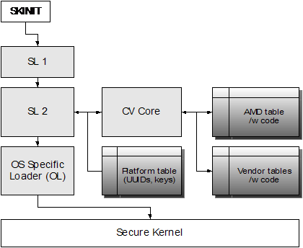
CV Software Components

Slide 29
CV Details
SKINIT instruction
SL1 – secure loader
SL2 – secure loader
CV – configuration verification
OL – OS loader
Secure kernel – a kernel that continues the chain of trust
This software stack is virtualizable

Slide 30
Future directions
PCI-SIG IOV
Address Translation Services (ATS)
  Separates IOMMU table walker from TLB
    Defines remote TLB semantics
    Creates a scalable solution for IO address remapping
Single Root Device Virtualization (SR-IOV)
  Make direct device attachment to Guest OS more cost effective
    Standardizes framework for virtualizing device controllers
    Reduces device implementation cost
    Maintains device driver investment
Multi-root Fabric Virtualization (MR-IOV)
  Creates shared IO fabric for blade servers
    Root port transparency minimizes impact on software
      Multi-plane approach creates per root port virtual view of fabric
    Multi-channel overlays provide isolation between root ports

Slide 31
Device Virtualization
Bottleneck
Every request that initiates DMA must
be validated
  Guest must not be allowed to peek at or modify content of other guest’s memory
Currently done via Hypervisor intercepts/calls and SW emulation
  Reduces throughput
  Increases compute resource overhead

Slide 32
Device Virtualization
Direct device assignment
Key to removing bottleneck
  Eliminate intercepts and emulation
  Per-device DMA address translation and validation
  Per-device interrupt routing
IOMMU is a required element
  SR and MR IOV work presumes the presence of
  an IOMMU
    DMA remapping
    Interrupt remapping

Slide 33

Device Virtualization
HW device virtualization
PF: Physical Function
VF: Virtual Function
VF4
VF3
Device
(virtualized)
VF2
VF1
PF
Device implements many virtual functions
Each function assigned a unique Bus-Device-Function tuple (BDF)
Each Function can be assigned to a separate guest VM
Device tags DMA and interrupt transactions with BDF
Each Function can be isolated and access only the assigned guest VM

Slide 34
Device Virtualization
Role of the IOMMU
Guest
VM
Guest
VM
Guest
VM
I/O
partition
Guest
VM
Guest
VM
Guest
VM
I/O
partition
hypervisor
IOMMU
hypervisor
shared
I/O requests routed direct to device
No hypervisor intervention
IOMMU enforces isolation
All I/O requests are routed through I/O partition and
via hypervisor

Slide 35
Fabric Virtualization
Multi-rooted physical view
CPU
CPU
CPU
CPU
. . . . .
IOMMU
IOMMU
RC
RC
Multi-root Fabric
. . . . . . .
LAN Controller
Storage Controller
Shared multi-planar IO fabric
Dynamic assignment of functions to RC
Multi-channel resources provide isolation between RC

Slide 36
Fabric Virtualization
Multi-rooted logical view
CPU
CPU
Each RC has a distinct and disjoint view of fabric
Each RC only sees devices it is assigned
HW enforces isolation
in fabric
IOMMU enforces isolation within RC
IOMMU
RC
Virtual Switch
LAN Controller
Storage Controller

Slide 37
Future Directions
AMD Torrenza
Framework for connecting discrete accelerators
  Extended hooks into system
  Extensions optimized for BW and Latency
Framework for new class of high
performance devices
  Sophisticated communication and computation
  offload engines
Broad Umbrella
  Embraces both HyperTransport and PCI-Express

Slide 38
Torrenza
Examples
Stream Computing Accelerators
  Lightweight Computational Elements
  High Speed Local Memory (Stream Register File)
  Sophisticated Data Mover
Heterogeneous Multi-processing Accelerators
  Many Lightweight Compute Elements (“many core”)
  Multiple Coherence Domains
  Low Latency Communication/Synchronization
  Shared Virtual Address Space Among Elements/CPU
Communication/Messaging Based Accelerators
  Intelligent protocol offload
  Direct user space I/O

Slide 39
Torrenza
Device-resident IOMMU
CE: Compute Element
Accelerator
CE
CE
CPU/NB
CPU
IOMMU
X
X
MEM
MEM
IOMMU resident on accelerator
Provides translation and protection for all CE accesses

Slide 40

Torrenza
Centralized IOMMU with ATS
CE: Compute Element
ATC: Address Translation Cache
Accelerator
CE
CE
CPU/NB
CPU
ATC
X
IOMMU
X
MEM
MEM
IOMMU/ATC provides translation and protection for all CE accesses
Table walker is external to accelerator
IOTLB resident on accelerator

Slide 41
Torrenza
IOMMU Key Element
Isolation
  Access control for accelerator requests
  Supports multi-context accelerator
Virtualization Support
  Maps accesses from guest to host addresses
  Direct context to Guest OS assignment
Shared virtual address space
  Maps accelerator accesses from guest virtual to host physical address
  Direct accelerator to application communication
  Supports accelerator page faults
    Need for page-pinning eliminated

Slide 42
Jumpstart Development
SimNow!™ Software Simulator
SimNow!™ software is designed to be faster than other x86 simulators
  Its speed comes from using dynamic translation and in not attempting to model fine detail.
SimNow! models the entire PC platform.
  SimNow models specific chipsets and functionality
  An unmodified BIOS and OS boot and run correctly
SimNow! software is configurable, and is designed to emulate about a dozen different AMD Athlon™ 64 and AMD Opteron™ processor-based platforms
  Multi-core processors, IOMMU, and TPM models available
SimNow! is licensed by AMD under specific terms and conditions

Slide 43
Call To Action
Chipsets with AMD IOMMU Revision 1.2
Platforms with AMD IOMMU and TPM
Firmware support for AMD IOMMU
Firmware support for industry-standard secure initialization
Peripheral support for PCI-SIG virtualization and PCI-IOV for direct device-assignment

Slide 44
Additional Resources
Web Resources
  Specs: http://www.amd.com
    IOMMU (search for IOMMU)
    Torrenza:
    http://enterprise.amd.com/us-en/AMD-Business/Technology-Home/Torrenza.aspx
  Developers: http://developer.amd.com
  SimNow!™: http://developer.amd.com/downloads.jsp
  TCG: http://www.TrustedComputingGroup.org
  PCI-SIG: http://www.pcisig.com/home
Related Sessions
  Implementing PCI I/O Virtualization Standards Based Designs
  Interactive Discussion on PCI IOV Usage Models and Implementation Considerations
For Email addresses
  Contact:
Andrew.Kegel @ amd.com, mark.hummel @amd.com

Slide 45
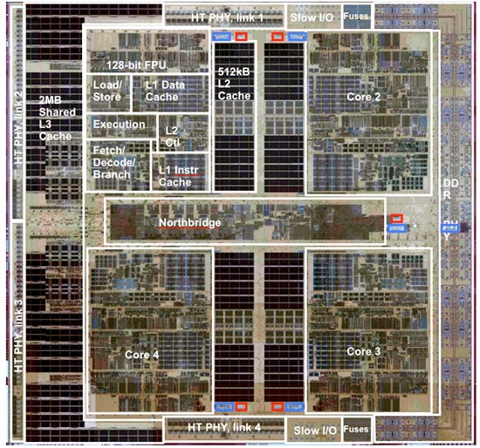
Questions
V1.04

