Slide 1
PCs And Energy
Efficiency Implications for OEMs and IHVs
Tom Bolioli
Terra Novum, LLC
Mike Walker,
Beacon Consultants Network Inc.

Slide 2
Agenda
Demand for Energy Efficient PCs
Energy Star Program Overview
Energy Star Computer Specification v 4.0
Implications for OEMs and IHVs
Monitor and Computer Power Management in Windows Vista

Slide 3
Demand For Energy
Efficient PCs
Growing enterprise focus on IT cost savings opportunities
Sharply higher energy costs
Extending battery life for mobile PCs
Government purchasing guidelines

Slide 4
Demand For Energy
Efficient PCs
Government procurement rules in the USA
  Energy Policy Act of 2005 requires federal agencies to buy ENERGY STAR products
  Executive Order 13423 requires federal agencies to enable ENERGY STAR “sleep” features
    Applies to both monitors and computers
State and local governments are adopting the same requirements
European Union and other international governments have similar requirements

Slide 5
PC Energy Consumption Trends
Avg. monitor power consumption is falling
Percentage of mobile PCs is increasing
Multi-core CPUs instead of increased clock speeds
Energy-efficiency considerations have begun to migrate from mobile to desktop to server

Slide 6
Computer And Monitor
Power Consumption
Source: Lawrence Berkeley National Laboratory, CCAP (Climate Change Action Plan)
Model data, 2006; The Cadmus Group, Inc. unpublished data, 2007

Slide 7

ENERGY STAR Program
National symbol of energy efficiency
  ENERGY STAR-labeled products use less energy, save money and help protect the environment
  Makes it easy for consumers and businesses to identify high-quality, energy-efficient products
Products meet strict energy performance criteria set by EPA or DOE
  Criteria are detailed in “Specifications” (or “Specs.”)
Voluntary program
  Partners with over 7,000 organizations
Primary Message:
“Ask for the ENERGY STAR”

Slide 8
ENERGY STAR
Computer specification
Helps buyers identify most energy-efficient computers
Sets wattage limits for a variety of PC configurations
Requires manufacturers to test and self-certify PC models
Why a new ENERGY STAR spec (version 4.0)?
  Increase in the number of computers and the number of hours in use calls for a more rigorous spec
  Shifts focus from standby power to overall energy use
  Specification offers “guaranteed savings”
Timing
  Tier 1 Requirements - effective July 20, 2007
  Tier 2 Requirements - effective January 2009

Slide 9
ENERGY STAR
Computer Spec. Version 4.0: What’s covered
Covered products
  Desktops
  Workstations
  Mobile PCs
  Desktop-derived servers (small tower form factor)
Products not covered
  Mid-range and large servers
  Thin clients/blade PCs
  Handhelds and PDAs

Slide 10
ENERGY STAR
Computer Spec. Version 4.0: What’s New
Lowers previous power consumption requirements for “sleep” modes
Introduces requirements for active power consumption at “idle”
Sets efficiency requirements for power upplies
Requires power management and wake-on-LAN features to be enabled
Sets labeling and marketing requirements

Slide 11
How Is “Idle” Measured?
System configured as shipped
  Includes OEM software preload
No applications open
Power measured 10 minutes after boot
Test procedure detailed in specification

Slide 12

ENERGY STAR
Categories
Category | Description
Desktops and Desktop-derived Servers
A | Default category
B | Multi-core processor and ≥1GB RAM
C | Multi-core processor AND dedicated non-shared GPU RAM of ≥128 MB AND, at least 2 of these 3 features: ≥ 2GB RAM TV Tuner and/or HD video capture ≥ 2 hard disk drives
Notebooks
A | Default category
B | Dedicated non-shared GPU RAM of ≥128 MB

Slide 13
Power Consumption
Requirements
Category | Idle | Sleep* (S3) | Standby* (S4/S5 off)
Desktops and Desktop-derived Servers
A | ≤ 50 W | ≤ 4 W | ≤ 2 W
B | ≤ 65 W | ≤ 4 W | ≤ 2 W
C | ≤ 95 W | ≤ 4 W | ≤ 2 W
Notebooks
A | ≤ 14 W | ≤ 1.7 W | ≤ 1 W
B | ≤ 22 W | ≤ 1.7 W | ≤ 1 W
* Computers with wake on LAN enabled are allowed an additional 0.7W for sleep and standby modes

Slide 14
Workstation Power
Consumption
Workstation power consumption calculated in TEC
  Weighted average power consumption, based on system state
Weightings (expressed in % of time)
  Off/Standby: 10%
  Sleep: 20%
  Idle: 70%
Workstation TEC must be ≤ 35%

Slide 15
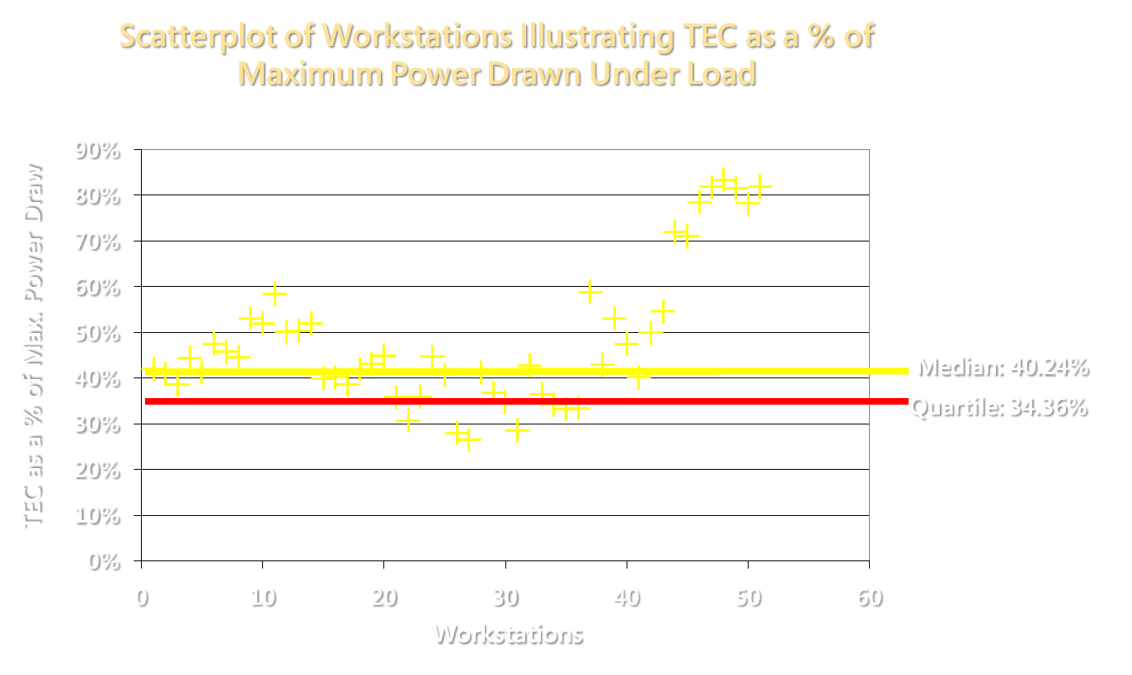
Device And Component Impact
Source: Data submitted to ENERGY STAR for the development of computer spec. version 4.0 by various industry stakeholders

Slide 16
Internal Power Supply Requirements
80% minimum efficiency at the following loads
  20% of rated output
  50% of rated output
  100% of rated output
Minimum power factor of .9 or greater at 100% of rated output
  Typically requires active power factor correction

Slide 17
External Power Supply Requirements
Applies to rated outputs of up to 250W
Minimum average efficiency at 25%, 50%, 75% and 100% of rated current (amperage) output
  ≥ [0.09 * Ln (P^{rated})] + 0.49 for EPS units rated for > 1 to ≤ 49 watts
  ≥ 84% for > 49 Watt rated output EPS
At no load, draws ≤ 0.75 W

Slide 18
Computer Power Management Requirements
Manufacturers must ship desktops, notebooks, and workstations with power management settings enabled
  Display enters low power mode after 15 min of inactivity
  Computer goes into low power mode after 30 min
Why power management features?
  Up to $100 annual savings per computer
  Example: GE is saving $6.5 million
All products shipped through enterprise channels must have wake-on-LAN enabled
Why Wake-on-LAN?
  Allows enterprises that require access to sleeping PCs to
  wake them from sleep states

Slide 19
Labeling And Marketing Requirements
Place ENERGY STAR label on product and packaging, product literature, and internet site
Work with resellers to ensure products remain in compliance
Educate customers about energy savings and environmental benefits
Notes:
19

Slide 20
Sneak Preview
ENERGY STAR Computer Specification Tier 2
The test procedure will likely be based on a benchmark workload called “EEcoMark™”
BAPCo and Ecma are developing the EEcoMark™ benchmark
Idle still likely to play a major role
ENERGY STAR will likely use the performance and energy numbers in some way to set acceptable power levels

Slide 21
What Do We Mean By
“Energy Efficient”?
Use power more efficiently during periods of activity
Use as little power as possible when not active
Components/devices should drop into low power modes as often and as deep as possible
This is what ENERGY STAR Computer Spec. v 4.0
Tiers 1 & 2 will ultimately reward

Slide 22
Implications For OEMs
Review the spec
Use energy-efficient device components
Validate sleep transition reliability and performance
  Pay close attention to resume performance
Test preload with a power meter
Consider adjusting preload software for energy efficiency

Slide 23
System Design Suggestions
Support processor performance (ACPI P) states
Support processor idle (ACPI C) states
  Even on desktop, workstation and server systems
Buy and integrate devices that have best-in-class power management technologies
  Run-time idle
  Device performance specs
  Validate selective suspend functionality for USB devices
ENERGY STAR Computer Spec 4.0 Tier 2 will take active power -- above idle levels -- into account

Slide 24
Implications For IHVs
Test your device with the active/idle requirements
  Pay special attention to low power mode transitions
Use power-efficient hardware components
Implement run-time idle power management
  E.g., disable yourself automatically when there is no device activity
Design and implement performance states to scale power consumption on demand
  E.g., scale graphics power consumption based on current workload environment
Integrate with Windows Vista power policy
  Allows for OEM and user configuration

Slide 25
Examples Of Power-Efficient Design
Optimize power conversion
  Higher AC conversion efficiency drops idle and active power
  DC-DC conversion
  12v -> 3.3v is better than 12v -> 5v -> 3.3v
  Investigate Adaptive Load Voltage Regulators
Integrate
  ASICs can eliminate silicon and increase performance, while dropping energy use

Slide 26
Call To Action
Recognize that demand for energy efficient computers is increasing
Understand how well-designed devices and configurations can save energy
Test using a power meter and the ENERGY STAR Computer Spec v 4.0 test procedure

Slide 27
Additional Resources
Other sessions
  Building power-friendly devices
  Optimizing Windows Vista for energy efficiency
Web resources
  ENERGY STAR Computer Spec v 4.0
    www.energystar.gov/index.cfm?c=revisions.computer_spec
  Computer power management
    www.energystar.gov/powermanagement
  Windows Hardware Developer Central: OnNow Device Power Management
    www.microsoft.com/whdc/system/pnppwr/powermgmt/devicepm.mspx
Contact information
  Katharine Kaplan, EPA/ENERGY STAR
  Tom Bolioli, Terra Novum, LLC
  Mike Walker, Beacon Consultants Network Inc.
kaplan.katharine @ epa.gov
    Tbolioli @ terranovum.com
    Mwalker @ beaconconsultants.com

Slide 28
Appendix
Computer Power Management

Slide 29
Overview Of Windows Power Management Features
Monitor power management (MPM) places active monitors into a low power sleep mode after a period of inactivity
System standby and hibernate features place the computer (CPU, PCI bus, hard drive, fans, etc) into a low power sleep mode
Why activate these settings?
  $10 - $100 annual cost savings opportunity may be sitting on nearly every desk in your organization

Slide 30
CPM Offers A Tremendous ROI
Costs
  Labor costs: Typically in the low thousands
  (Windows XP and Windows 2000)
    Care must be taken to ensure that sleeping computers do not interfere with the distribution of administrative software updates
    Older software applications and some peripheral devices may not conform to the latest ACPI standards: Must be tested for CPM 010compatibility
Benefits
  An org with 6000 PCs can expect to reap 3 year savings in excess of $1 million
  Example: GE is saving nearly $6.5 million

Slide 31
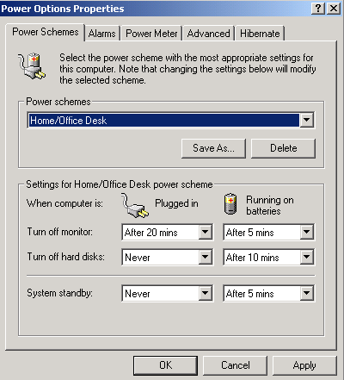
System Standby And Hibernate Maximize Savings
System Standby (S3)
  Drops power to 1-3 W
  Wakes up in seconds
Hibernate (S4)
  Drops power to 1-3 W
  Wakes up in 20+ seconds
  Saves work in the event of power loss
Hard disk spin down
  saves very little
Shutoff (S5)
  Drops power to 1-3 W
  Wakes up in 30+ seconds
  Saves work in the event of power loss

Slide 32
Windows Vista Greatly Improves Power Management Features
Hybrid sleep eliminates confusion and increases reliability
Sleep is default state
Group Policy enhanced
Prevents applications from vetoing sleep transitions

Slide 33

© 2007 Microsoft Corporation. All rights reserved. Microsoft, Windows, Windows Vista and other product names are or may be registered trademarks and/or trademarks in the U.S. and/or other countries.
The information herein is for informational purposes only and represents the current view of Microsoft Corporation as of the date of this presentation. Because Microsoft must respond to changing market conditions, it should not be interpreted to be a commitment on the part of Microsoft, and Microsoft cannot guarantee the accuracy of any information provided after the date of this presentation.
MICROSOFT MAKES NO WARRANTIES, EXPRESS, IMPLIED OR STATUTORY, AS TO THE INFORMATION IN THIS PRESENTATION.

