Slide 1
Silverlight
Scott Guthrie
General Manager
Developer Platform
Microsoft Corporation

Slide 2



Cross Browser
Cross Platform
Plug-In
.NET
Media Experiences
RIA
Notes:
Everything on this slide, the tools, runtimes, and more is available to download today.
Richer Media –
Expression Studio –
Visual Studio –
.NET –
Multiple Languages –
Services –
Broad Reach – runs on more operating systems then windows, 98% of all devices, needs to be small to download and install it 20 seconds or less

Slide 3




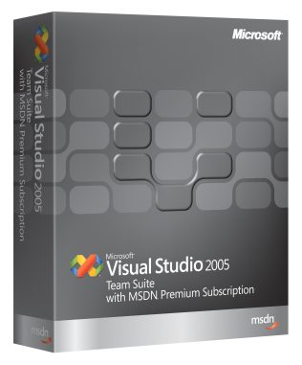





Building Applications With .NET
web
desktop
web
desktop
media & RIA

Slide 4
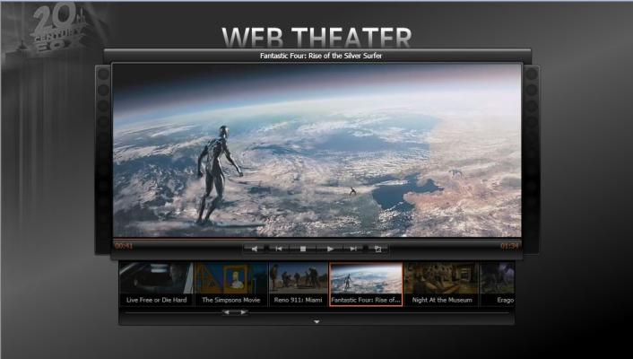
Media Capabilities
Quality
Stunning HD video quality
DVD-like interactivity and overlays
Flexible Development
Integrate w/ existing AJAX frameworks
SMPTE-standard VC-1, WMV and MP3
Delivery
Live Streaming or On-Demand
Performance, scale and cost advantages over other solutions

Slide 5

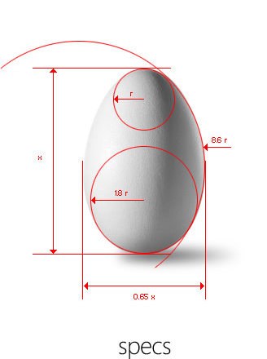
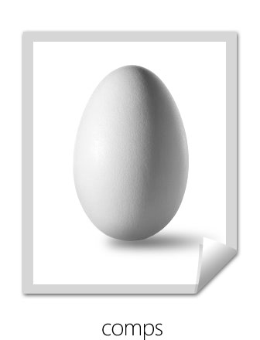

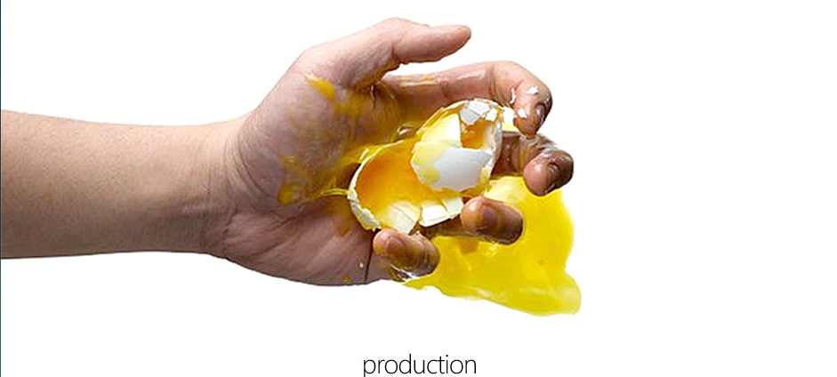
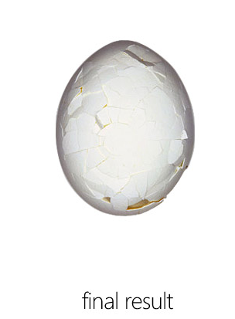
Designer/Developer Collaboration
=

Slide 6
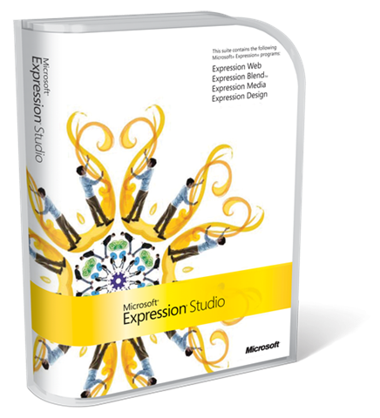









Slide 7
Expression Studio
demo
Notes:
Open Blend
Open an empty super-basic player example
Select a video
F5 to see – it plays!
Create a skin
Open design and export the graphics elements
Import into Blend
Animate them in Blend
Draw some more in Blend
F5 show with skin
Add Play controls
Draw the player controls
Animate them
F5 to show working skin
Add Resize/Fullscreeen
Add a resize or full-screen mode to show HQ video playback
Switch to Encoder
Select a horribly extreme compression format
Do A/B compare
See in preview that Q is horrible and switch to a less agressive compression
Show bug overlay
Show setting markers and generating thumbnails
Show one of the following:
Subtitles
Live encoding
Header/Trailer
Ad triggered by a marker
Select the template we just created and encode
Return to Blend
Demo “Wall of Video” based on the skin created earlier
Demo Video Puzzle based on the skin created earlier

Slide 8




Silverlight Streaming
Provides developers a free, scalability-on-demand solution for Silverlight
http://silverlight.live.com
Notes:
You build the application, we deliver the scale
Free 4GB hosting and streaming service
Rich API programmability
Full control over the user experience
DVD quality streaming
Free Hosting and Streaming
Upload complete Silverlight applications
4GB free storage per Windows Live ID
700kbps DVD-quality video
Advertising supported
You Build it, we scale it
Geoscale distributed network optimized for content delivery
1 terabit / second total network bandwidth
UX
Custom templates with designer in complete control of UX
No third party logo requirements
16:9 or 4:3 aspect ratio
Stereo audio

Slide 9
Silverlight Streaming
demo
Notes:
Open Blend
Open an empty super-basic player example
Select a video
F5 to see – it plays!
Create a skin
Open design and export the graphics elements
Import into Blend
Animate them in Blend
Draw some more in Blend
F5 show with skin
Add Play controls
Draw the player controls
Animate them
F5 to show working skin
Add Resize/Fullscreeen
Add a resize or full-screen mode to show HQ video playback
Switch to Encoder
Select a horribly extreme compression format
Do A/B compare
See in preview that Q is horrible and switch to a less agressive compression
Show bug overlay
Show setting markers and generating thumbnails
Show one of the following:
Subtitles
Live encoding
Header/Trailer
Ad triggered by a marker
Select the template we just created and encode
Return to Blend
Demo “Wall of Video” based on the skin created earlier
Demo Video Puzzle based on the skin created earlier

Slide 10
Silverlight Development Model
JavaScript AJAX
Supported with Silverlight 1.0 and 1.1
Enables JavaScript to program both HTML and JavaScript together
Fully supported with ASP.NET AJAX
.NET
Supported with Silverlight 1.1
Cross platform version of the .NET Framework included with Silverlight
Fully supports VB and C# development in the browser

Slide 11
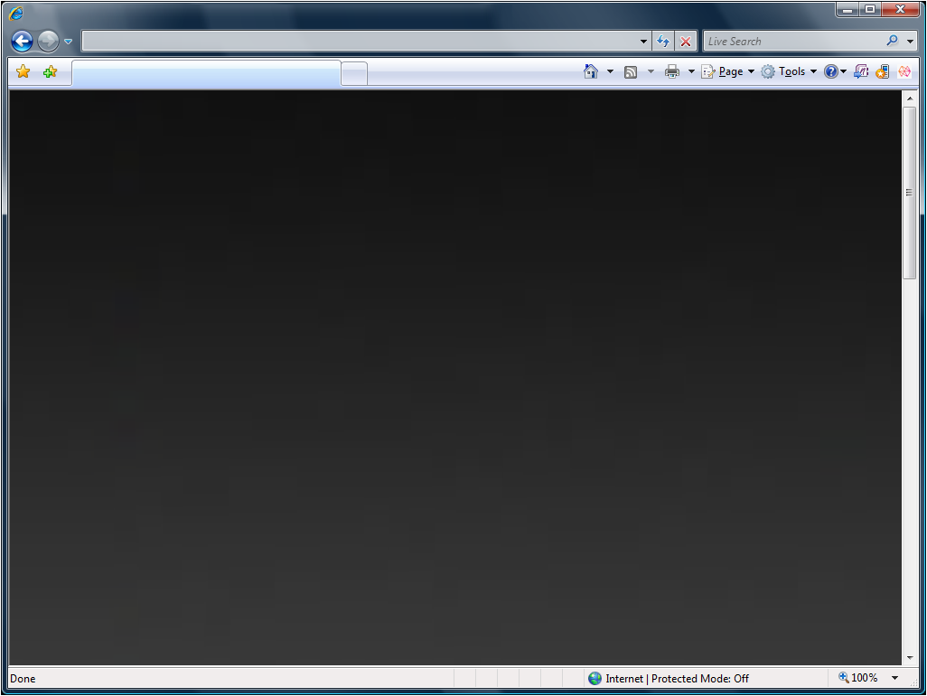
Why use .NET in the browser?
High
Performance
Runtime
Rich UI Controls, Graphics, Media & Interactivity
Multi-Language
Support
HTML DOM
Integration
Robust Networking
Flexible Data Support

Slide 12
Silverlight Developer Overview
demo

Slide 13

demo
Beau Ambur
CEO/Founder
Metaliq
Notes:
Now you have seen how it is possible to build these applications using the full capabilities of Silverlight – I think it is impressive, but the possibilities really go beyond what I can build on stage in 15 minutes. I’d like to invite up Beau Amber, from Metaliq to really show you, with some time what Silverlight is capable of doing.
DEMO: TopBanana with Beau (10 minutes)
Show some code in VS/Blend how it was put together
Talk to productivity, quality, consistency, skills reuse, tooling
Show experience on mac
Integrate with “Bluelight” (probably faked up, just messaging it)
Points to pop:
Holy **@ this is amaznig
Dev/Des integration (easy to do)
Size (40k)
Performance

Slide 14
Geewa
demo
Michal Novak
Head of Sales and Marketing
Notes:
Ruby + Debugging on Mac + Deploy to PHP/Apache

Slide 15

Recap…
Broad Reach
Richer Media
.NET
Multiple Languages
Expression Studio
Visual Studio
Services
Notes:
Everything on this slide, the tools, runtimes, and more is available to download today.
Richer Media –
Expression Studio –
Visual Studio –
.NET –
Multiple Languages –
Services –
Broad Reach – runs on more operating systems then windows, 98% of all devices, needs to be small to download and install it 20 seconds or less

Slide 16
Roadmap
MIX 07
Summer 07
Beyond…
Silverlight 1.0 Beta
Silverlight 1.1 Alpha
Silverlight 1.0
Silverlight 1.1
SilverLight for mobile
Expression Studio
Expression Blend 2 Preview
Expression Media
Encoder
Expression Studio 2
Silverlight Tools Preview for Visual Studio ‘Orcas’
Silverlight Tools for
Visual Studio ‘Orcas’

Slide 17
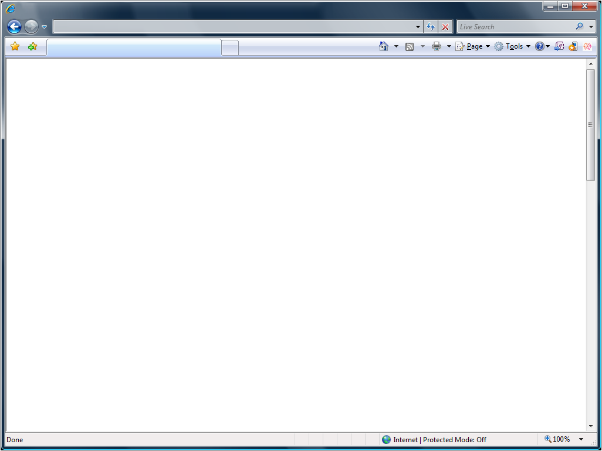
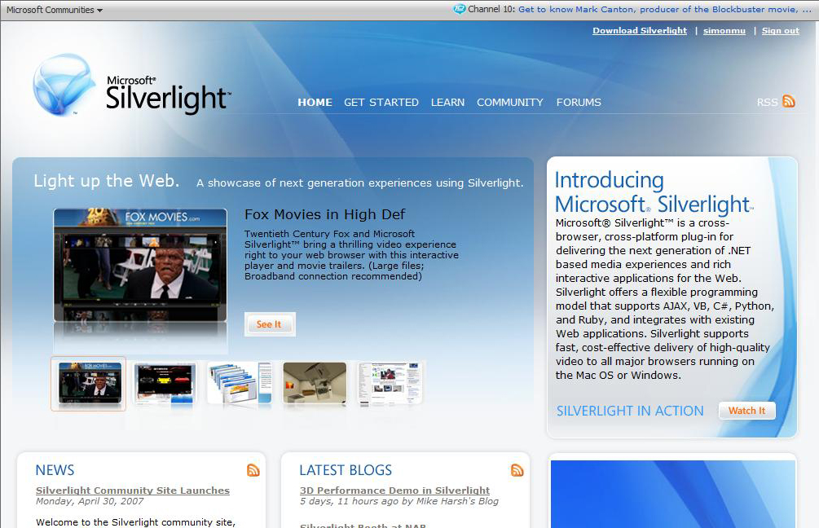
www.silverlight.net
Notes:
Everything on this slide, the tools, runtimes, and more is available to download today.
Richer Media –
Expression Studio –
Visual Studio –
.NET –
Multiple Languages –
Services –
Broad Reach – runs on more operating systems then windows, 98% of all devices, needs to be small to download and install it 20 seconds or less

Slide 18
Learn More:
http://weblogs.asp.net/scottgu

Slide 19
Q&A

Slide 20

© 2007 Microsoft Corporation. All rights reserved. Microsoft, Windows, Windows Vista and other product names are or may be registered trademarks and/or trademarks in the U.S. and/or other countries.
The information herein is for informational purposes only and represents the current view of Microsoft Corporation as of the date of this presentation. Because Microsoft must respond to changing market conditions,
it should not be interpreted to be a commitment on the part of Microsoft, and Microsoft cannot guarantee the accuracy of any information provided after the date of this presentation.
MICROSOFT MAKES NO WARRANTIES, EXPRESS, IMPLIED OR STATUTORY, AS TO THE INFORMATION IN THIS PRESENTATION.

