Slide 1


Manufacturing 2.0 Manufacturing in the Age of Joint Value Creation
Colin Masson - Research Director, Value Chain Strategies
October, 2007

Slide 2
Agenda
Introduction to AMR Research
AMR Research Supply Chain Top 25 - The New Role of Manufacturing
Manufacturing 2.0 - Challenging ERP and MES Paradigms
Joint Value Creation and Co-Innovation - Powered by …? Microsoft!

Slide 3
AMR Research… Deep Impact on Manufacturing Strategy
Advanced
Manufacturing
Research
(AMR) Founded
Coined EMI
(Enterprise
Manufacturing
Intelligence)
acronym
Manufacturing
2.0
Demand-Driven SC Research Identifies $450B Margin
Opportunity
Co-Founded
MESA organization
1986
AMR Supply Chain Top 25 Launched
Co-founded Supply Chain Council
Co-developed SCOR Model
1986
1988
1994
1996
1997
1998
2000
2003
2004
2005
2006
2007
Joins board of
Manufacturing
Institute (NAM)
Coined MES
(Manufacturing
Execution
System)
acronym
Defined Advanced Planning and Scheduling (APS) Marketing
First-ever PLM
research
published
By AMR
Research
Launched Demand-Driven Supply Network (DDSN)
Role of Demand Driven Manufacturing
in DDSN
Identified MES Market Crosses $1B Barrier
Manufacturing
Peer Forum
Launched
Over 700 companies and over 15,000 business and IT executives work with AMR Research, including:
16 of the top 20 consumer products companies
13 of the top 15 life sciences companies
6 of the top 10 chemicals companies
22 of the top 40 retailers
25 of the top 30 technology and service providers
More real-world data and analysis on the supply network and the effective use of enterprise applications to support manufacturing than any other organization
AMR Research Manufacturing Exchange © 2007 AMR Research, Inc. | Page 3
Notes:
3

Slide 4
Agenda
Introduction to AMR Research
AMR Research Supply Chain Top 25 - The New Role of Manufacturing
Manufacturing 2.0 - Challenging ERP and MES Paradigms
Joint Value Creation and Co-Innovation - Powered by …? Microsoft!

Slide 5

The AMR Research Top 25 for 2007
1 Nokia
2 Apple
3 Procter & Gamble
4 IBM
5 Toyota
6 Wal-Mart
7 Anheuser Busch
8 Tesco
9 Best Buy
10 Samsung Electronics
11 Cisco Systems
12 Motorola
13 The Coca Cola Company
14 Johnson & Johnson
15 PepsiCo
16 Johnson Controls
17 Texas Instruments
18 Nike
19 Lowe’s
20 GlaxoSmithKline
21 Hewlett Packard
22 Lockheed Martin
23 Publix Supermarkets
24 Paccar
25 Astra Zeneca

Slide 6
Top 25 Outperforms
More efficient use of assets (3X)
Stronger growth (50% more)
Faster turns (2X)
More profitable (2X)

Slide 7
What Makes the Top 25 Outperform the Rest?
“I Think I Can Sell…”
Demand
attract, sell, service
Supply
plan, source, make, deliver
“Here It Is, Sell It”
…to synchronized
processes…
Product
define, design, promote, supply, support
“Here’s a New
Product – Figure Out How to Make It”
Demand
Supply
…from Silos…
Product

Slide 8
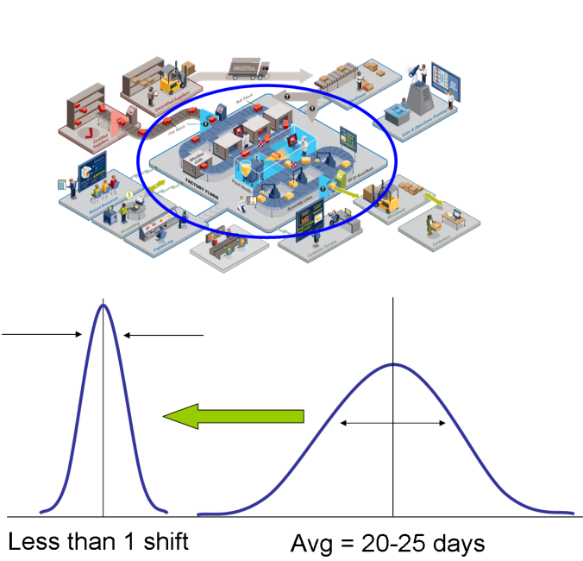
…and Dealing With The New Manufacturing Realities
AMR Research Manufacturing Exchange © 2007 AMR Research, Inc. | Page 8
More Product Variants
Shorter New Product Development and Launch
Increasing Regulatory Compliance
Cost Reduction
Increasing Demand Forecast Error
More Dynamic Supply Networks
Agile Manufacturing Preferred to FG Inventory!
Notes:
8

Slide 9
Manufacturing Operations Ranks #1 for 2006-2007
Customer Management
15%
14%
ERP
15%
19%
Product Lifecycle
Management
8%
7%
Sourcing & Procurement
6%
6%
Supply Chain Management
12%
12%
Manufacturing
Operations
19%
23%
Performance Management
10%
8%
Most Important (n=939)
Largest Dollar (n=939)
Source: AMR Research 2006-2007 IT Spending Survey (US)

Slide 10
Agenda
Introduction to AMR Research
AMR Research Supply Chain Top 25 - The New Role of Manufacturing
Manufacturing 2.0 - Challenging ERP and MES Paradigms
Joint Value Creation and Co-Innovation - Powered by …? Microsoft!

Slide 11
Manufacturing 2.0
“
Manufacturing 2.0 capitalizes on service-based and collaboration-based architectures to let manufacturers dynamically reconfigure sensor and mobile-worker enabled supply networks to make products right first time and on demand.
Manufacturing 2.0: Defining Next-Generation Manufacturing Thursday, July 05, 2007 Colin Masson, Simon Jacobson, Alison Smith http://www.amrresearch.com/Content/View.asp?pmillid=20535
Addressing the Manufacturing Backlog: It's Time for Manufacturing 2.0 Thursday, February 08, 2007 Colin Masson http://www.amrresearch.com/Content/View.asp?pmillid=20193

Slide 12
What’s Wrong With MES/ERP Monolithic Approaches?
Inflexible MES architectures don’t scale for multisite rollouts.
Inflexible ERP business processes don’t mesh with the realities of detail manufacturing operations.
Neither ERP nor MES can cope with constant reconfiguration and requirements to support lean and Six Sigma initiatives.
ERP and MES have functional inadequacies when faced with multiple manufacturing styles with their own characteristic data models.
Deployment of MES applications requires significant and increasingly scarce engineering skills.
Adapting ERP to manufacturing requires domain knowledge that corporate IT business groups don’t have.
The complexity and cost of MES deployments and traditional hard-wired automation approaches have created an “automation threshold”, and it’s been difficult to justify the ROI for manufacturing software investments below it.

Slide 13
Emerging Manufacturing 2.0 Characteristics
User-centric interfaces that not only streamline activities, but take advantage of available shop-floor talent for deployment, reconfiguration, and software maintenance.
Manufacturing architectures that capitalize on existing investments by using manufacturing SOA instead of ripping and replacing them with monolithic applications.
Incorporation of Web 2.0 and Enterprise 2.0 technologies and constructs such as blogs, instant messaging, mashups, search, tagging, wikis, and cool, always-connected mobile devices. This will engage younger generations in manufacturing as well as enhance software usability and collaboration.
Support for low-cost tags, intelligent sensors, pervasive networks, and mobile workers.
Event-driven, supply network collaboration (intra- and inter-enterprise) platforms.
Convergence of product data management and process development models for rapid development of new products and manufacturing processes to accelerate time to market.

Slide 14
RFID/Sensor Enabled Manufacturing
N = 103
US - Current or Planned Use of RFID in Manufacturing
Currently using
Implementing
Evaluating
No activity
Tracking inventory movement
Parts/material replenishment
Improved product identification & verification
Improved cycle times
Data acq from x plant floor sources into ERP systems
Track and trace of WIP
Managing in-process quality
Improving asset availability/asset management
Tracking product genealogy
Repair part tracking and scheduling
Automated/guided execution of production orders
Repair and maintenance of assets
Machine control
Regulatory compliance (eDHR, eBR, RoHS, WEEE)
Kanban
Returnable container tracking
Securing hazardous materials and equipment
0%
10%
20%
30%
40%
50%
60%
70%
80%
90%
100%
% of companies

Slide 15
RFID/Sensor Enabled Supply Networks
N = 95
US - Current or Planned Use of RFID in Supply Chain
Currently using
Implementing
Evaluating
No activity
Bin/material management
Track and trace
Product pedigree
New product introduction and promotion compliance
Electronic proof of delivery
Bulk container tracking
Returnable container tracking
Yard management
Establish a more secure supply chain
Store level replenishment
Leaning out through pull-based replenishment
Vendor managed inventory
Understanding and managing cust/end-user demand
Shipping/outbound logistics
Receiving/Inbound logistics
Transportation Management
Warehouse operations/inventory mgmt
0%
10%
20%
30%
40%
50%
60%
70%
80%
90%
100%
% of companies

Slide 16
Desired Capabilities From Mobility in Mfg Operations
% of Responses: N=76
Q. What capabilities is your company trying to address by using mobile technology in your manufacturing operations?
Managing in-process quality
62%
Data collection from multiple plant floor sources into ERP systems
58%
Information exchange between plant floor applications and ERP
49%
Tracking product genealogy from raw materials through work-in-
47%
process to finished goods
Visibility in the extended supply chain
45%
Automated/guided execution of production orders
43%
Improving asset availability/managing maintenance activities
42%
Acquisition of time series data from the plant floor
42%
Multi-site visibility of production KPIs
36%
Decreasing cost or cycle time for compliance reporting
33%
Optimized finite capacity scheduling based on real-time visibility
25%
of production assets and raw materials
Securing access to hazardous materials and equipment
24%
Enterprise visibility into production sites financial performance
21%
66% of respondents are using/planning mobile technology deployments, and will increase spending 26% in 2008
Other
1%

Slide 17
Rich Mobile Content for Manufacturing Visibility and Execution
% of Responses: N=76
Q. What type of content do you utilize/expect with your mobile technologies in manufacturing?
Sequenced Production orders
47%
Calendars/Task Lists
46%
Production Alerts/Alarms
45%
Recording production quantity, quality and location
43%
Work Instructions for Production Orders
42%
Raw Material/Component Pick lists
40%
Quality Sampling Schedules/Procedures
40%
Recording material/component consumption (including
37%
Serial tracking)
Emergency Shutdown/Work Order Alerts
33%
Safety Inspections Schedules/Procedures
33%
Work Instructions for Maintenance Orders
32%
Sequenced Maintenance Orders
32%
Inventory/Cycle Counting Data Collection
32%
Production Performance Dashboards
30%
Asset/Equipment locations/maps
28%
Asset Performance Dashboards
13%

Slide 18
Time to Leverage MES and ERP With Manufacturing 2.0
Degree of Contract Manufacturing/JVC
Rate of NPDI
Global Coordination
Dynamic
Multi Tier
Collaboration
Manufacturing 2.0
Manufacturing SOA supporting:
Multiple Mfg Styles
Demand-Driven Manufacturing
Multi-Enterprise Collaboration
Orchestration of Multi-Vendor Services
User-Centric Interface
User Implementation
Mobile Workforce
Sensor Networks
Supply Network Dynamism
Dynamic
Single Tier
Collaboration
–
Manufacturing
1.0
(MES)
DDSN Maturity
Multi-site MES
Static
Internal
Collaboration
Local Execution
Product Mix
# of Mfg Styles
MTS
ATO/ETO
Single Site
Multi
-
Site
Multi
-
Site
(Owned)
(Owned)
(Owned & Contracted)
Product/Manufacturing Complexity
AMR Research Manufacturing Exchange © 2007 AMR Research, Inc. | Page 18
Notes:
18

Slide 19
Supply Networks are Driving Convergence of E-SOA and M-SOA
Enterprise
Plant
Manage Risk
Protect Brand Equity
Speed New Product Launch
Demonstrate Compliance
Supply Network Partners
AMR Research Manufacturing Exchange © 2007 AMR Research, Inc. | Page 19

Slide 20




















The High-Tech Value Network
Tier 2 Supplier
Contract Manufacturer 3
Customer
ODM
Tier 2 Supplier
3PL
Contract Manufacturer 1
Returns and Repairs
Customer
OEM
A complex web of global relationships and dependencies
3PL
ODM
3PL
Customer
Tier 1 Supplier
Tier 1 Supplier
Contract Manufacturer 2
Tier 1 Supplier

Slide 21

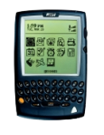


But, Enterprise SOA – Still A Work in Progress…
Governance
User/Role Based
Interaction
Tools, e.g. ECE
Office
Web 2.0
Composite Apps
Product
Demand
Supply
Internal
BPM
Activity
Monitoring
BI
Portal
Enterprise
Content
Service
Registry
Transact
Enrich
Manage
Service Enablement Layer
MDM
ESB
Mfg
Ops
SCM
CRM
ERP
Mfg
Ops
PLM
EDW
Mfg
Ops
Security and Management
AMR Research Manufacturing Exchange © 2007 AMR Research, Inc. | Page 21
Notes:
21

Slide 22
…but Manufacturing SOA is Real!
Governance
Role Based
User Interaction
Tools, e.g. MCE
Office
Web 2.0
Manufacturing
Composite Apps
Right
First Time
Track &
Trace
Schedule
Optimization
MES 2.0
OPM
Event/Activity
Monitoring
OI
Ops Portal
Mfg
Content
Mfg Service
Registry
Ops-Transact
Ops-Enrich
Ops-Manage
Service Enablement Layer
Mfg
MDM
Ops-SB
MES
ODS
Quality
LIMS
EWI
MES
ODS
Quality
LIMS
EWI
MES
ODS
Quality
LIMS
EWI
Enterprise
Apps
Products
Assets
Processes
Etc.
UI
Logic
DB
DCS, PLC, RFID (OPC)
Security and Management
AMR Research Manufacturing Exchange © 2007 AMR Research, Inc. | Page 22
Notes:
22

Slide 23
Supply Networks Application Needs are Emerging
Network:
Quality
Genealogy
Compliance
Performance
P&PLM
Etc.
Enterprise
Plant
AMR Research Manufacturing Exchange © 2007 AMR Research, Inc. | Page 23

Slide 24
Emerging Information Architectures for Global Manufacturing
Supply Chain
Management
Manufacturing 2.0
Manufacturing Composition Environment
Manufacturing SOA
Real-Time Services Bus
4
Demand, Capacity
Planning,
Customer
Requirements
Enterprise 2.0
Enterprise Composition Environment
Enterprise SOA
Enterprise Software Bus
Enterprise
Management
Global Specifications Management
Business Planning and
Logistics Systems
Manufacturing
Management
Production
Orders,
Plant
Schedules
3
Plant
Management
Manufacturing Operations and
Control Systems
Production
Throughput
Production Unit
Management
Production
Processes
2
Data Collection, Operator, and Batch Control Systems
Manufacturing Services
(e.g. ISA-95, OPC DA/HDA/UA)
Multiple manufacturing styles
Multiple vendors
Production
Process
Management
Machine, Material
Execution,
Procedures
Machine
Management
Site Autonomy
Corp Standards
1
Equipment Control Systems
Seconds
Minutes
Hours
Days
Weeks
Months
Machine
Logic
Process
Control
Process
Management
Recipe /
Work Order
Execution
Plant
Operation
Analysis
Production
Scheduling
Capacity
Planning
AMR Research Manufacturing Exchange © 2007 AMR Research, Inc. | Page 24
Notes:
24

Slide 25
Agenda
Introduction to AMR Research
AMR Research Supply Chain Top 25 - The New Role of Manufacturing
Manufacturing 2.0 - Challenging ERP and MES Paradigms
Joint Value Creation and Co-Innovation - Powered By…? Microsoft!

Slide 26
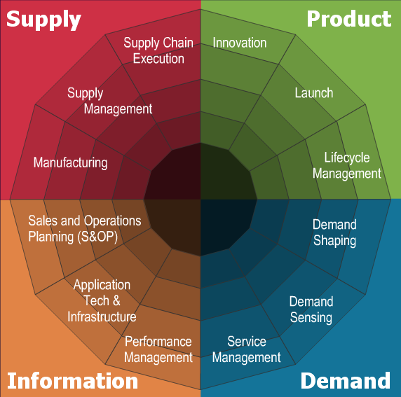
New Standard of Excellence: Joint Value Creation
Orchestrate
Coordinate
Anticipate
React

Slide 27
Network Collaboration and Co-Innovation…
Quadrant | Dimension | From | To
Supply | Supply Chain Execution | Supply disconnected from sales, marketing & product with ltd visibility | Process alignment with real-time, multi-tier visibility
 | Supply Management | Divisional organizations buying at lowest cost with manual settlement | Shared service, network focus, collaborating with suppliers for joint value creation
 | Manufacturing | Autonomous & dedicated production facilities designed for low product mix & economies of scale | Active demand shaping to level load, supply sensing, design for mfg
Product | Innovation | Internal-driven design, focus on optimized engineering, unstructured prioritization of projects | Collaborative, market-driven design and simulation aligned with strategic business initiatives
 | Launch | Serial handoff to mfg & supply chain, minimal part reuse, disconnected with sales & marketing | Process & SC simulation to optimize design for supply tradeoffs, post-launch evaluation, embedded S&OP with NPDL
 | Lifecycle Management | New products introduced in silos, independent of previously launched products | Products/brands introduced as platforms to deliver extended features and services

Slide 28
…and Dynamic Orchestration of Services…
Quadrant | Dimension | From | To
Demand | Demand Shaping | Disconnected marketing, sales & customer service, no measurement of pricing or promotion effectiveness | Cross-functional incentives, market-basket analysis for cross-selling, price optimization scenario modeling
 | Demand Sensing | Demand equals orders, no incentive for forecast accuracy, spreadsheet support | Demand is consumption units, demand signal repository, attribute-based range forecast
 | Service Management | Cost vs profit focus, disconnect between service & new product, no visibility of performance to service levels | Integration of service into product design & dev’t, service parts optimization, dashboards
Information | Performance Management | Inside-out, functional, non-standardized, metrics, unclear ownership, no supporting technology, lack of follow-up corrective action | Outside-in, cross functional, coordinated metrics portfolio with executive ownership, tools for active monitoring & correction of SC health
 | Application Tech & Infrastructure | Wide variety of functional applications, no long-term architecture, no standardization of business process | Ability to compose unique business processes over standard software base, collaborative commerce, benefits realization process
 | Sales & Ops Planning | Tactical, short-term operations plan based on sales history, functional metrics | Shared ownership & metrics, scenario analysis, integrated with strategic business plan, balance risk and complexity

Slide 29
…Requires Manufacturing 2.0
“
Manufacturing 2.0 capitalizes on service-based and collaboration-based architectures to let manufacturers dynamically reconfigure sensor and mobile-worker enabled supply networks to make products right first time and on demand.
Manufacturing 2.0: Defining Next-Generation Manufacturing Thursday, July 05, 2007 Colin Masson, Simon Jacobson, Alison Smith http://www.amrresearch.com/Content/View.asp?pmillid=20535
Addressing the Manufacturing Backlog: It's Time for Manufacturing 2.0 Thursday, February 08, 2007 Colin Masson http://www.amrresearch.com/Content/View.asp?pmillid=20193

Slide 30

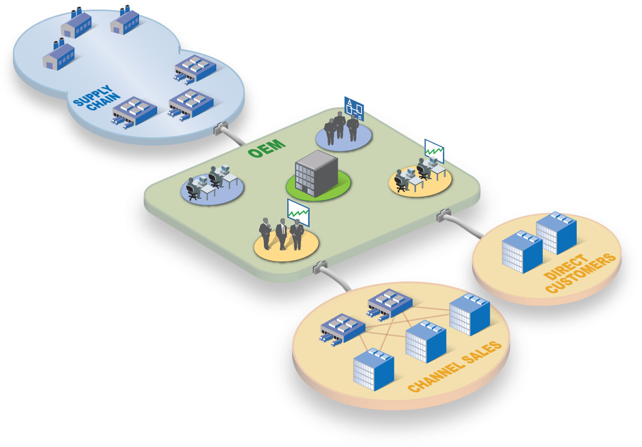



…and Somebody Has to Provide the Platform
Event-driven, supply network collaboration platform
In-House
Manufacturing
Contract
Manufacturers
Operations Event/Activity Monitoring
Component
Manufacturers
Engineering
Service
Operations
Supply
Network Operations
HQ/
Finance
Operations Process Management (OPM)
Sales/
Marketing
Operations Intelligence

Slide 31


Manufacturing 2.0: SOA Convergence…or New Battlegrounds?
Enterprise
Plant
AMR Research Manufacturing Exchange © 2007 AMR Research, Inc. | Page 31

Slide 32

ERP Vendors Driving Applistructure into Manufacturing
Enterprise
Plant
AMR Research Manufacturing Exchange © 2007 AMR Research, Inc. | Page 32

Slide 33




Infrastructure Providers Driving E-SOA Technology Into Manufacturing?
Enterprise
Plant
AMR Research Manufacturing Exchange © 2007 AMR Research, Inc. | Page 33

Slide 34
But Microsoft Holds the Keys to Manufacturing 2.0
Microsoft Common Services
Vista, Windows Mobile
Sharepoint Portal
OBA (MES=“Microsoft Excel Spreadsheet”)
ODS=SQL Server
OI=PerformancePoint
OPM=Biztalk
etc
Microsoft Opportunity
Manufacturing Composition Environment
Manufacturing SOA
Real-Time Services Bus
Enterprise
Plant
Manufacturing Services:
Automation,
MES ISVs
Etc.
AMR Research Manufacturing Exchange © 2007 AMR Research, Inc. | Page 34

Slide 35
Microsoft and Manufacturing 2.0
“
Microsoft’s technologies dominate most manufacturing scenarios either through core technology offerings (like BizTalk server, SQL databases, and the SharePoint portal), Office applications (like Excel and Access), or via partners such as Apriso and Invensys…
… We’re still surprised that the company hasn’t already stepped up to deliver the Manufacturing Composition Environment in AMR Research’s Manufacturing SOA framework. With many manufacturers believing that MES is the acronym for Microsoft Excel Spreadsheet, this is Microsoft’s opportunity to lose.
Manufacturing 2.0: Defining Next-Generation Manufacturing Thursday, July 05, 2007 Colin Masson, Simon Jacobson, Alison Smith http://www.amrresearch.com/Content/View.asp?pmillid=20535

Slide 36

(617) 350-1778
cmasson@amrresearch.com
www.amrresearch.com
Colin Masson
Research Director,
Manufacturing Ops.
AMR Research Manufacturing Exchange © 2007 AMR Research, Inc. | Page 36
Notes:
36

