Slide 1
Module 1:
Database and Instance

Slide 2
Overview
Defining a Database and an Instance
Introduce Microsoft’s and Oracle’s Implementations of a Database and an Instance
Understand Client Interaction
Key Database and Instance Limitations

Slide 3
Concept of Database and Instance
Database Management System (DBMS) encompasses database and instance
A Database is a set of physical files that store application and system data
An instance consists of the hardware resources of the system (primarily memory and CPU utilization) that facilitates data access for the end-user

Slide 4

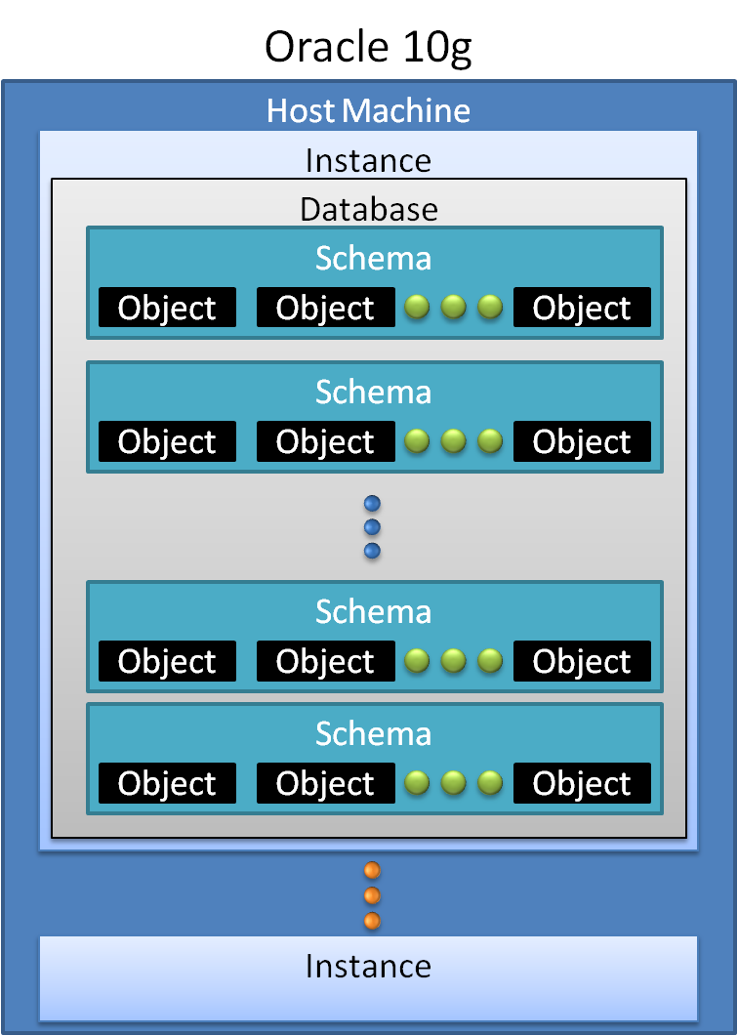
Database and Instance Implementations

Slide 5
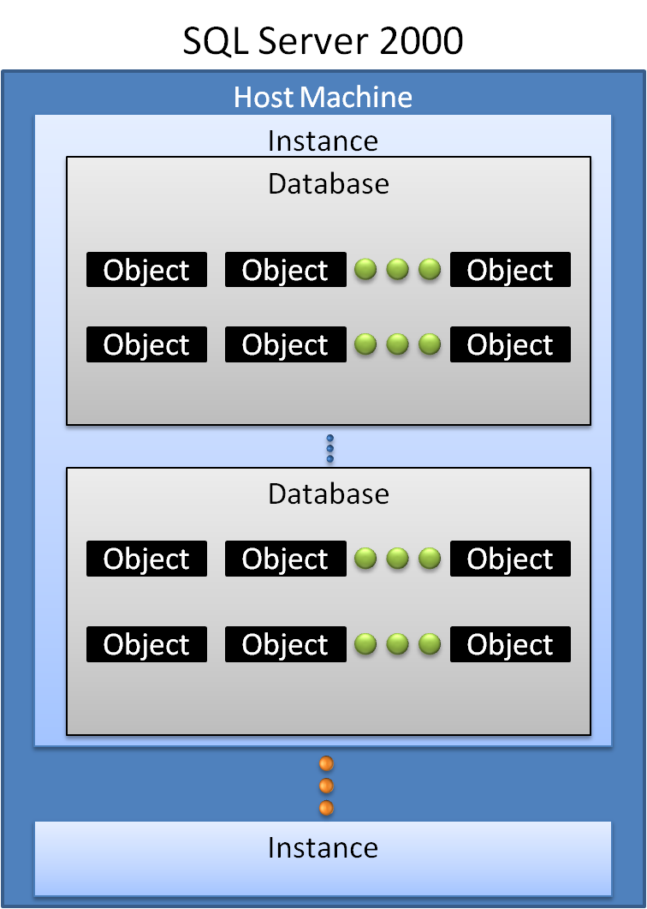
Database and Instance Implementations

Slide 6
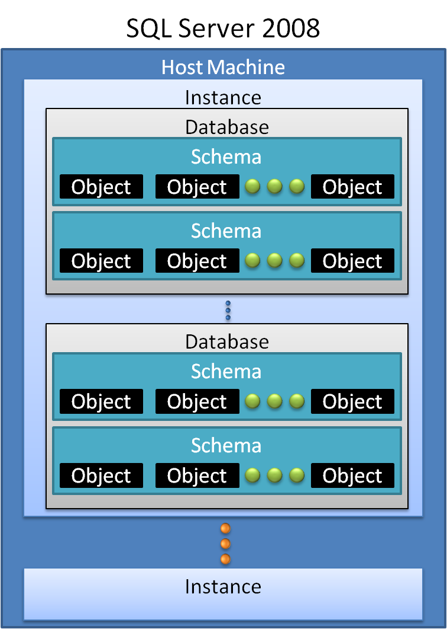
Database and Instance Implementations

Slide 7

Demonstration: Understanding the SQL Server Instance Environment
In this demonstration you will see how to:
Stop and start service using the SQL Server Configuration Manager
Stop and start services using the command prompt
Connect to a database engine
View the properties of an instance in Configuration Manager
Review a database in object explorer
Connect to another database engine
Review associated registry keys for SQL Server installations

Slide 8
Client Interaction with Database and Instance
Database Server
Storage
System
Application Layer
-------------
Oracle Net Foundation Layer
-------------
Oracle Protocol Support Layer
Oracle Instance
--------------
Oracle Net Foundation Layer
------------
Oracle Protocol Support
Layer
Client
Person
Oracle
Connections
Listener (defined by listener.ora,
may implement TNSnames.ora)
Data Storage
Client
System
Application Layer
-------------
SQL Server Network Interface protocol
layer
-------------
SNAC network libraries
Database Server
Engine
Storage
System
Relational Engine
--------------
Tabular Data Stream (TDS) Packet
------------
SQL Server Network Interface (SNI)
Layer
SQL Server
Connections
Client
Person
TDS Endpoint
Data Storage
Client
System
Key components in the interaction of the user (client) with the database environment

Slide 9
Demonstration: Reviewing Network Connections
In this demonstration you will see how to:
Analyze network protocols
Review TCP/IP settings
Analyze client protocols

Slide 10
Database Capacities
Database Capacities on Windows Server 2003 (x86, x64, or IA64) | Oracle 10g | SQL Server 2008
Minimum data block size | 2 KB | 8 KB
Maximum data block size | 16 KB | 8 KB
Maximum file size | 64 GB | 16 TB
Maximum number of files | 65,536 | 32,767
Maximum database size | 4 PB (65,536 * 64 GB) | 524 PB
Maximum control file size | 20,000 data blocks | N/A
Instances per server | Limited by host resources | 50 – Standard and Enterprise Edition 16 or less on other editions
Maximum database extent | 4GB | 64 KB
Maximum number of tablespaces | 65,536 | 32,767 (filegroups – see Module 2)
Maximum log file size | 64 GB | 2 TB
A brief look at Oracle and SQL Server 2008 maximum capacity specifications

Slide 11
Review
Provided a definition for the database and how it is more specialized than normal file system.
Differentiated the instance from the database and looked at the high level components of each DBMS.
Both DBMS systems rely on network protocols, listeners, and client software that allow communications in a database environment.
Each of the DBMS provide large resource capacities for applications using the Microsoft Windows operating system.

