Slide 1

ADO.NET Entity Framework

Slide 2
Agenda
ADO.NET Entity Framework
An Adaptive Framework
An Extensible Framework
An Evolutionary Framework

Slide 3
ADO.NET Entity Framework
Today’s Challenges
Logical Database Schema
Disparate Data Sources
Normalized Data
Developers need to understand the logical database schema in order to program against it
Developers need to know multiple languages and dialects to program against disparate data sources
Developers need to write complex code to work with business object whose data is spread across many tables and rows

Slide 4
ADO.NET Entity Framework
Solutions
Entity Data Model
LINQ and Entity SQL
Entities
Developers can use the Entity Data Model to transform relational data into conceptual entities
Developers can use LINQ and Entity SQL to write data access code in a .NET programming language
Developers can work with entities instead of tables and rows to simplify data access code

Slide 5
Agenda
ADO.NET Entity Framework
An Adaptive Framework
An Extensible Framework
An Evolutionary Framework

Slide 6


An Adaptive Framework
Work with Conceptual Business Objects
Map tables in the data source to entities in the conceptual model
Map multiple tables to a single entity and map many-to-many relationships
dbo.Customer
dbo.CustomerDetails
Customer
Use complex types to represent related objects

Slide 7
An Adaptive Framework
Use Inheritance with Data
Conceptual model that supports inheritance
Developers are familiar with inheritance
The ADO.NET Entity Framework brings inheritance to the conceptual model
The ADO.NET Entity Framework supports three types of inheritance
Table per hierarchy
Table per subclass
Table per concrete type

Slide 8


An Adaptive Framework
Customize Client Views
Customize the automatically generated client views to meet your business requirements
Use a DefiningQuery to specify the required data using the native query language
Use an Entity SQL WHERE clause to return a subset of the data
SELECT P
FROM AW.Production.Product AS P
WHERE p.ProductCategory.Name = 'Road Bikes'
<EntitySet Name="Product" EntityType="AW.Product">
<DefiningQuery>
SELECT p.Name, p.ProductNumber, p.ReorderPoint
FROM Product as p WHERE p.DaysToManufacture > 1
</DefiningQuery>
</EntitySet>

Slide 9
Agenda
ADO.NET Entity Framework
An Adaptive Framework
An Extensible Framework
An Evolutionary Framework

Slide 10
An Extensible Framework
Customize Modeling Files
Use a schema-aware XML editor to add metadata or modify properties in the automatically generated modeling and mapping files
CSDL
<FunctionImport Name="GetOrderDetails"
EntitySet="SalesOrderDetail"
ReturnType="Collection(AdventureWorksModel.SalesOrderDetail)">
<Parameter Name="SalesOrderHeaderId" Type="Int32" Mode="in">
</Parameter>
</FunctionImport>
MSL
<FunctionImportMapping FunctionImportName="GetOrderDetails"
FunctionName="AdventureWorksModel.Store.GetOrderDetails"/>

Slide 11
An Extensible Framework
Customize Generated Code
Add business logic to data access code
Extend the partial classes that the tools generate
Create custom implementations of the partial classes’ base interfaces
[Serializable()]
public partial class Customers : Cust
{
// autogenerated code
}
[Serializable()]
public partial class Customers : Cust
{
// your code
}

Slide 12
Agenda
ADO.NET Entity Framework
An Adaptive Framework
An Extensible Framework
An Evolutionary Framework

Slide 13
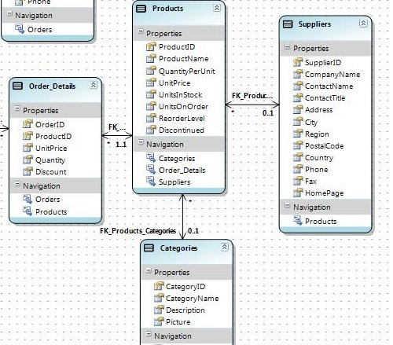
An Evolutionary Framework
Visual Studio 2008 Tools
Microsoft® Visual Studio® 2008 provides Entity Framework Tools to work with models and mappings
Entity Designer to generate and validate models
Entity Mapping Tool to define entities and associations
Entity Model Browser to visualize the model

Slide 14



An Evolutionary Framework
Familiar Data Provider Functionality
Continue to use the ADO.NET data provider model
Use the EntityClient data provider to query against conceptual models

Slide 15
An Evolutionary Framework
Write Better Code
Query and return results as strongly typed CLR data objects
Use IntelliSense®
By using LINQ or Entity SQL
IntelliSense supports strongly typed objects
LINQ
var newPeople = from p in aw.SalesPeople
where p.HireDate > hireDate select p;
foreach(SalesPerson p in newPeople)
{
Console.WriteLine("{0}\t{1}", p.FirstName, p.LastName);
}

Slide 16


An Evolutionary Framework
Simplify Maintenance
When using entities, schema changes do not always result in changes to the application code
Upgrade to more powerful editions of SQL Server™ with minimal changes to code

Slide 17
Summary
Adaptive
Map tables to entities
Map many-to-many relationships
Extensible
Customize modeling files
Evolutionary
Simplify modeling and mapping
Customize generated code
Use inheritance
Build custom data views
Write better code
Simplify application maintenance
Use new functionality in a familiar way

Slide 18

This presentation is for informational purposes only. Microsoft makes no warranties, express or implied, in this summary.

