Slide 1

Your Data Any Place, Any Time
Beyond Relational

Slide 2
Agenda
Overview of Beyond Relational
Applications Today
Beyond Relational Feature Overview
Whirlwind Feature Tour
Q&A

Slide 3














Your Data Any Place, Any Time
Enterprise Data Platform
Services
Reporting
Integration
Analysis
Synch
Entity Data Model
Beyond Relational
FILE
Query
RDBMS
OLAP
Search
XML
Dynamic Development
Mobile and
Desktop
Server
Cloud
Pervasive Insight

Slide 4















Applications Today
Relational Data
Documents & Multimedia
Applications
XML
Spatial

Slide 5


Key Application Challenges
BI Analysis
Application Integration
Compliance
Reporting
Application Tier
Data Model Tier
Search & Indexing
Caching & Synch
Object Mapping
Rich Query Capability
Increasing complexity
Storage Tier
Large Data Sets
Transactions & Security
Reliability and Scale
Referential Integrity
Relational
Data
Documents &
Multimedia
XML
Spatial
Growth of the types of data to be hosted

Slide 6




Beyond Relational Data
Dealing with relational and non-relational data platforms Growth in application complexity & duplicated functionality Compensating for unavailable services
Pain Points
Reduce the cost of managing all types of data Simplify the development of applications which use relational and non-relational data Extend services currently available for relational data to non-relational data
Goals & Strategy

Slide 7
Beyond Relational Feature Overview
SQL Server 2005
SQL Server 2008
XML Data Type and Functions
  XML Upgrades
XML
  Remote BLOB Store API
  FILESTREAM
  Integrated FTS
Documents &
Multimedia
Full Text Indexing
  Fully supported Geometry and Geography data types and Functions
Spatial
Large UDTs
Flexible Columns
Wide Tables
Filtered Indices
HierarchyID
Relational
Data
User Defined Types

Slide 8
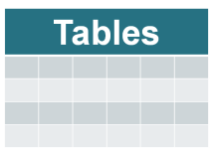

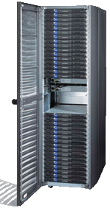
Storing Documents & Multimedia
Documents &
Multimedia
Use File Servers
Dedicated BLOB Store
Store BLOBs in Database
Application
Application
Application
BLOBs
BLOBs
BLOBs
DB
DB
DB
Advantages
Low cost per GB
Streaming Performance
Lower cost per GB at scale
Scalability & Expandability
Integrated management
Data-level consistency
Complex application development & deployment
Integration with structured data
Complex application development & deployment
Separate data management
Enterprise-scales only
Poor data streaming support
File size limitations
Highest cost per GB
Challenges
Windows File Servers
NetApp NetFiler
EMC Centera
Fujitsu Nearline
SQL Server VARBINARY(MAX)
Example

Slide 9

SQL Server 2008 BLOB Storage
Documents &
Multimedia
Use File Servers
Application
BLOB
DB
Store BLOBs in Database
Store BLOBs in DB + File System
Application
Application
Dedicated BLOB Store
BLOB
BLOB
Application
BLOB
DB
DB
DB
Remote BLOB Storage
FILESTREAM Storage
SQL BLOB

Slide 10
FILESTREAM
Documents &
Multimedia
Storage Attribute on VARBINARY(MAX)
Unstructured data stored directly in the file system (requires NTFS)
Dual Programming Model
  TSQL (Same as SQL BLOB)
  Win32 Streaming APIs with T-SQL transactional semantics
Data Consistency
Integrated Manageability
  Back Up / Restore
  Administration
Size limit is the file system volume size
SQL Server Security Stack
Store BLOBs in DB + File System
Application
BLOB
DB

Slide 11
Initial FILESTREAM Limitations
Documents &
Multimedia
In SQL Server 2008
  Remote storage of FILESTREAM data is not supported
  DB Snapshot and DB Mirroring are not supported
  Some Katmai features will not be integrated for FILESTREAM, examples:
    SQL Encryption
    Table Value Parameters

Slide 12
Remote BLOB Store API
Documents &
Multimedia
Applications can transparently support different BLOB stores
Each BLOB Store vendor responsible for delivering their own providers
Applications
Remote BLOB Store API Client Library
Provider
Library
Provider Library
Provider Library
Provider API
Services
Create
Enumerate
Fetch
GC
Delete
SQL Server
BLOB Store 1
BLOB Store 2
Windows File Server

Slide 13
Remote BLOB Store Example
Documents &
Multimedia
Machine Boundary
1
Write BLOB(Photo)
Application
2
Return BlobReference
2
3
Write BlobReference to PhotoRef field
3
RBS Client Library
BLOB Store Provider Library
ClaimID | ClaimDate | PhotoRef
4390 | 6/5/2007 | <xml>
1
BLOB Store
SQL Server

Slide 14
Remote BLOB Store Details
Documents &
Multimedia
Most useful in environments where interoperability is required
No restrictions on back-end store
Back-end can change with no app change
Looser (link level) consistency guarantees
SQL Server handles link consistency and garbage collection

Slide 15


BLOB Storage Vision
Documents &
Multimedia
 | File Stores / BLOB Stores | SQL BLOBs | Remote BLOB Store API | FILESTREAM
Streaming Performance | Depends on external store |  | Depends on external store
Link Level Consistency
Data Level Consistency
Integrated Management
Non-local Windows File Servers | n/a |  |  | Post-2008
Interop with External BLOB Stores | n/a

Slide 16
Full Text Indexing Challenges
Documents &
Multimedia
Indexes stored outside SQL Server lead to manageability challenges
Mixed query performance suffers from having to pull over complete full-text result set
Scaling issues on big boxes

Slide 17
Full Text Indexing Enhancements
Documents &
Multimedia
Full-Text Indexes fully integrated into SQL Server
Make mixed queries perform and scale
  SELECT * FROM candidates
  WHERE CONTAINS(resume,’”SQL Server”’)
  AND ZipCode = ‘98052’

Slide 18
Spatial Data Overview
Spatial
Storage and retrieval of spatial data using standard SQL syntax
  New Spatial Data Types (geometry, geography)
  New Spatial Methods (intersects, buffer, etc.)
  New Spatial Indexes
Offers full set of Open Geospatial Consortium components (OGC/SQL MM, ISO 19125)
Query speed (spatial index)
Integration with Virtual Earth

Slide 19
SQL Server 2008 XML Upgrades
XML
Improved XML Schema Validation
  Full support for storing & validating Office 12 Document formats
  Support for lax validation
  Full xs:dateTime support
    Support for no timezone values
    timezone preservation
  Support for lists and union types
Added support for let-clause in XQuery
Added support insert sql:variable(“@xml”) into /a/b

Slide 20
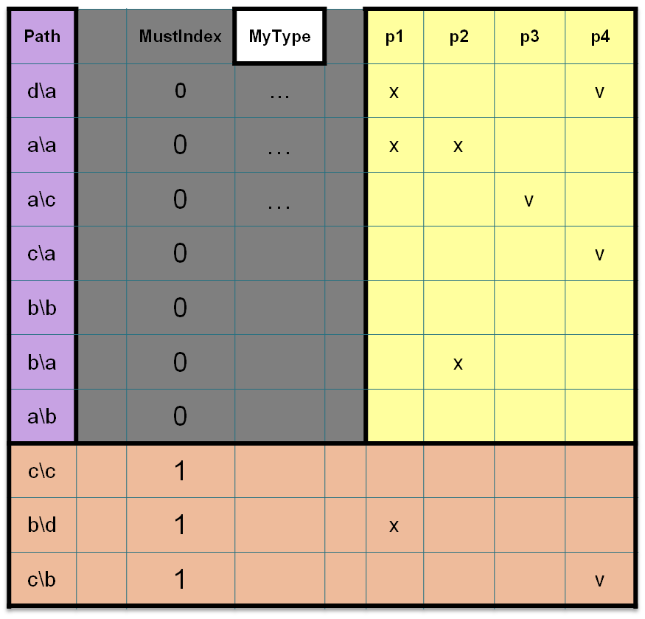
Storing Relational Data
Relational
Data
1
2
3
4
5
1
HierarchyID | Store arbitrary hierarchies of data and efficiently query them
Large UDTs | No more 8K limit on User Defined Types
Sparse Columns | Optimized storage for sparsely populated columns
Wide Tables | Support for hundreds of thousands of sparse columns
Filtered Indices | Define indices over subsets of data in tables
2
3
4
5

Slide 21

© 2004 Microsoft Corporation. All rights reserved.
This presentation is for informational purposes only. Microsoft makes no warranties, express or implied, in this summary.

