Slide 1

Your Data Any Place, Any Time
Manageability

Slide 2
SQL Server 2008
Manageability Challenges
Challenges face database administrators today :
Proactively monitoring and tuning system health
Managing complex and high-value tasks
Scaling management to multiple data centers
Gaining insight into historical trends and real-time activities

Slide 3














SQL Server 2008 Manageability
Productive Administration
Monitor
Troubleshoot
Configure
Tune
Manage by Intent
Monitor with Insight
Scale with Ease
Scale
Audit
Report
Notes:
3

Slide 4







SQL Server 2008
Management Capabilities
Gain Insight into historical trends
Scale for any business size
Monitor system health and optimize performance
Perform Interactive administration
Conform and comply with system configuration policies

Slide 5







Scale and Conform with Policy-based management
Manage to desired intent
Scale management
Intelligent monitoring

Slide 6
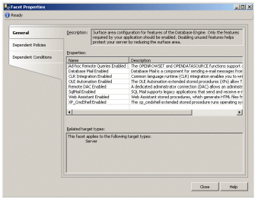
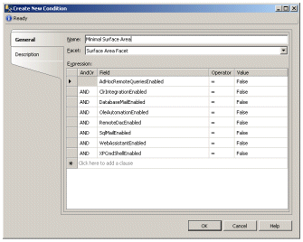
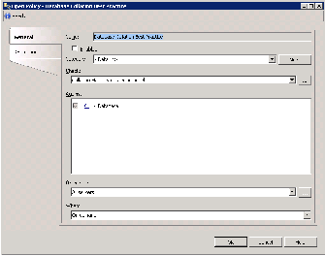

Policy-Based Management
Defining Policies
Facets
Conditions
Policies
Targets
Categories

Slide 7


Manage by Intent
Policy checking & governance
Facets
Define aspects of system configuration
Physical properties that relate to settings
Logical properties that encapsulate business rules
Conditions
Capture the declarative intent (desired state)
Simplify compliance enforcement

Slide 8
Intelligent Monitoring
On Demand
On Schedule, log out-of-compliance
Changes are attempted, prevent out-of-compliance
Changes are attempted, log out-of-compliance
Manual checking by administrator
SQL Server Agent job check periodically and logs non-compliance
DDL Trigger rolls back non-compliant changes
Event Notification logs non-compliant changes

Slide 9

Scale with Policies
Automate policy enforcement across the enterprise
Define policies centrally

Slide 10

Optimize Performance with SQL Server 2008
End-to-End Health Monitoring for optimization
Performance Tuning Tools

Slide 11
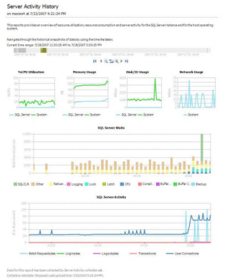


End-to-End System Health Insight
Performance Studio
Low overhead data collection
Centralized data storage
Comprehensive reporting
SQL Trace
Performance Counters
Transact-SQL
Management Data Warehouse
Data providers

Slide 12



Performance Tuning Tools
SQL Server Profiler
Database Tuning Advisor
SQL Server Management Studio Reports
SQL Server Management Pack
For Microsoft System Center Operations Manager
Monitors availability and performance
Available at the server and database levels
Gain insight into indexing and partitions structures of your databases
Capture SQL Server activity
View and play back captured workloads
Correlate with System Monitor
Optimize indexes and partitions for your workload

Slide 13





Maintenance Administrative Tasks
Interactive Administration
Gaining Management Insight
Programmatic Management

Slide 14
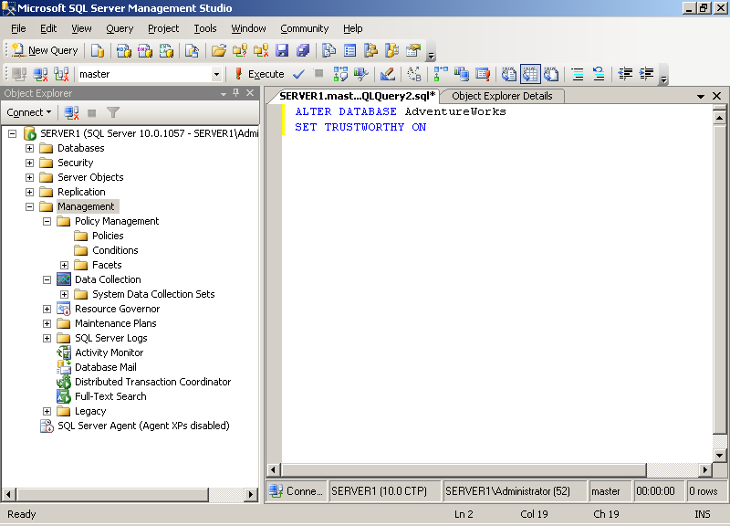
Interactive Administration
Centralized management of all SQL Server instances and services
Intellisense for productive management

Slide 15
Gaining Management Insight
Standard Reports
Custom Reports
Performance Dashboards

Slide 16


Programmatic Management
SQLCMD
Create batch files
Automate multiple scripts
Server Management Objects (SMO)
Create custom .NET management tools
C:\>sqlcmd –I Insert..

Slide 17

© 2004 Microsoft Corporation. All rights reserved.
This presentation is for informational purposes only. Microsoft makes no warranties, express or implied, in this summary.

Slide 18
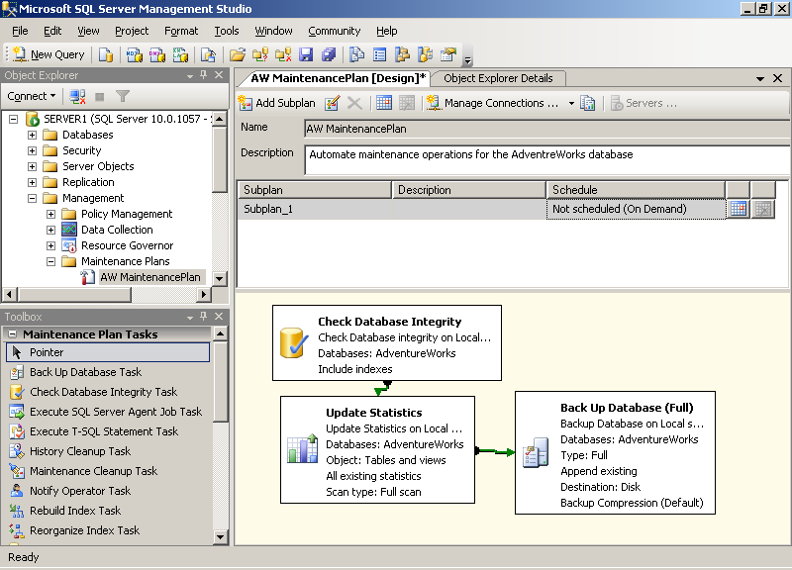
Automated Maintenance
SQL Server Agent
  Jobs, Operators, and Alerts
  Maintenance Plans
  Multi-server management

