Slide 1

Your Data Any Place, Any Time
Performance and Scalability

Slide 2
Performance and Scalability
Challenges
Scaling Up
Optimizing Performance
Scaling Out

Slide 3
























Performance and Scalability
SQL Server 2008
Scalable shared databases
Workload prioritization
Scale-out Analysis Services
TPC benchmarks
Distributed partitioned views
Scale out for the enterprise
Real-world, predictable performance
Tuning and optimization tools
Data dependent routing
Peer-to-peer replication
Improved BI performance
Multi-instance architecture
Query notifications
Scale up with today’s hardware
Service Broker
Enterprise health monitoring
+
64
Hot-add hardware
64-bit technologies
NUMA Support
NUMA

Slide 4





Optimizing Performance
Relational Database Performance
Data Warehouse and Analysis Performance
Reporting Services Performance
Integration Services Performance

Slide 5
Relational Database Performance
Measurable, real-world performance
Performance optimization tools
TPC-C
TPC-E
TPC-H
Cost-based optimization
Read-ahead scans
Partitioning
SQL Server Profiler
Database Engine Tuning Advisor
High performance query processing engine

Slide 6




Relational Database Performance
Resource Governor
SQL Server
Ability to differentiate workloads
  e.g. app_name, login, etc.
Per-request limits
  Max memory %
  Max CPU time
  Grant timeout
  Max Requests
Resource monitoring
Backup
OLTP Activity
Executive Reports
Admin Tasks
Ad-hoc Reports
High
Admin Workload
OLTP Workload
Report Workload
Min Memory 10%
Max Memory 20%
Max CPU 20%
Max CPU 90%
Admin Pool
Application Pool

Slide 7
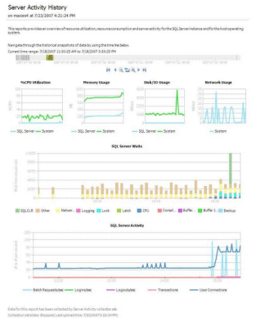
Relational Database Performance
Performance Studio
Low overhead performance data collection
Centralized performance data storage
Comprehensive performance data reporting
SQL Trace
Performance Counters
Transact-SQL
Management Data Warehouse
Data providers

Slide 8
Data Warehouse and Analysis Performance
Data Warehouse Performance
Star schema query optimizations
Partitioning
Advanced indexing
Sparse columns
VARDECIMAL
Analysis Services Performance
Block computations
Writeback to MOLAP

Slide 9


Reporting Performance
On-demand processing
Effective caching and memory management
Re-engineered rendering architecture
Reporting Services

Slide 10
ETL Performance
High performance lookup operations
Change Data Capture

Slide 11
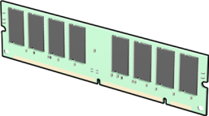
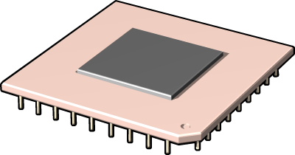




Scaling Up
Hardware Support
Concurrency

Slide 12

Hardware Support
64-bit
Multi-core, multi-processor
Large-scale memory
NUMA hardware
Hot-Add hardware
Memory
Processor

Slide 13
Concurrency
Transaction isolation
Read uncommitted
Read committed
Repeatable read
Serializable
Read committed (with row versioning)
Snapshot
Lock escalation granularity
Row
Page
Partition
Table

Slide 14







Scaling Out
Scalable Shared Databases
Distributed Partitioned Views
Peer-to-Peer Replication
Query Notifications
Scale-Out Analysis Services

Slide 15

Scalable Shared Databases
Read-only database in SAN
Mounted by multiple reporting servers
Applications access a consistent copy from any server

Slide 16

Distributed Partitioned Views
Data is partitioned horizontally across multiple servers
Transact-SQL view retrieves all data with a UNION ALL clause
Requests can be directed by using data dependent routing

Slide 17

Peer-to-Peer Replication
Data is replicated to local servers
Local modifications are propagated throughout the enterprise

Slide 18


Query Notifications
Application notified when queried data changes
Optimal cache refresh behavior

Slide 19




Scale-Out Analysis Services
Centralized, read-only Analysis Services database shared by multiple instances
Client applications connect to a single virtual IP address

Slide 20

© 2004 Microsoft Corporation. All rights reserved.
This presentation is for informational purposes only. Microsoft makes no warranties, express or implied, in this summary.

