Slide 1
Microsoft SQL Server 2008 Reporting Services

Slide 2
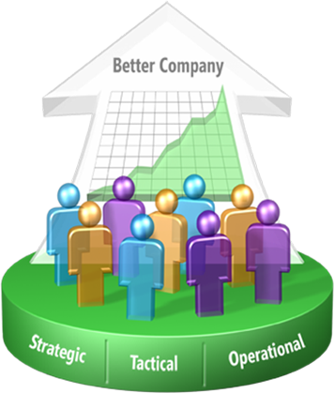



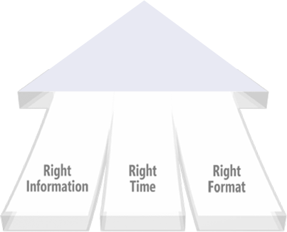
Microsoft Business Intelligence
Improving organizations by providing business insights to all employees leading to better, faster, more relevant decisions
  Complete and integrated BI and Performance Management offering
  Widespread delivery of intelligence through Microsoft Office
  Enterprise grade and affordable

Slide 3




Our End-to-End BI Offering
DELIVERY
COLLABORATION
CONTENT MANAGEMENT
SEARCH
SharePoint Server
Reports
Dashboards
Excel
Workbooks
Analytic
Views
Scorecards
Plans
END USER TOOLS & PERFORMANCE MANAGEMENT APPS
Excel
PerformancePoint Server
BI PLATFORM
SQL Server
Reporting Services
SQL Server
Analysis Services
SQL Server DBMS
SQL Server Integration Services

Slide 4






Intelligent Data Platform
Unlock Your Data
Deliver Relevant Information
Drive Actionable Insights
Personalized data experience
Rich connectivity
Intuitive design environment
Process aligned insights
Universal reach through Office
Interactive data navigation
Scale for thousands of users
Central manageability
Enterprise-class data integration

Slide 5




The Microsoft BI Platform SQL Server 2008
Store
Analyze
Integrate
Report

Slide 6
The Microsoft BI Platform SQL Server 2008
Store
Analyze
Integrate
Report

Slide 7

Reporting Challenges
How Do You Deal With:
Data stored in multiple data sources
Limitations in native report engines
Inefficient report development processes
Requests for multiple output formats
Expensive, 3rd party reporting tools
Multiple Users, Multiple Tools
Scalability and reliable report processing
Delivery of contextual business insight

Slide 8



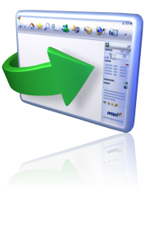


Reporting Services
Reporting Services is a complete server-based platform supporting the authoring, management and delivery of relevant, interactive reports where needed across the entire enterprise
Authoring
Management
Delivery
Embedded Reporting
Web Report
2007 Sales
XML

Slide 9
Reporting Services 2008
Enterprise Reporting Platform
Author Impactful Reports
  Powerful Designers
  Flexible Report Layout
  Rich Visualizations
Manage any Workload
  Enterprise Scale Platform
  Central Deployment
  Strong Manageability
Deliver Personalized Reports
  Interactive Reports
  Rendering in the Format Users Want
  Delivery to Location Users Want
Embed Reporting
Web Report
XML

Slide 10
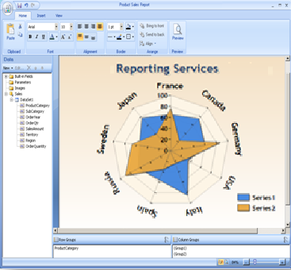
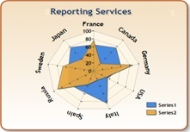



Author Impactful Reports
Powerful Designers
  Audience targeted design environments
  Advanced authoring capabilities
  Design scalability
Flexible Report Layout
  Support for multiple data sources
  Pixel perfect reporting
  Innovative layout capabilities
Rich Visualizations
  Intuitive data experience
  Data enriching charting capabilities
  Fully customizable gauge types
Embed Reporting
Web Report

Slide 11
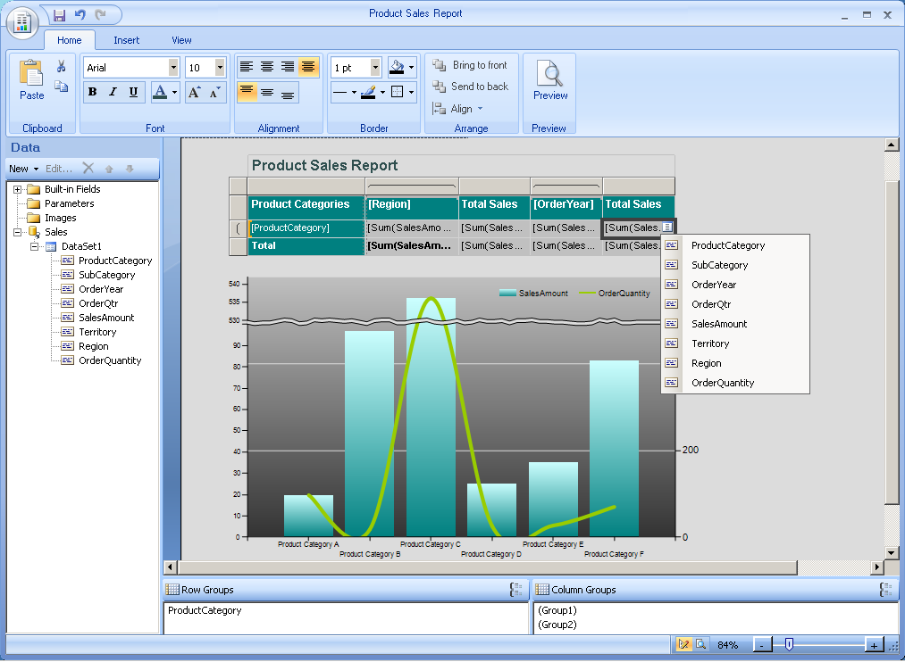
Powerful Designers
Audience targeted design environments
  Familiar, Visual Studio-based authoring environment for developers
  Intuitive, Office-Optimized authoring environment for Business users
Advanced authoring capabilities
  Graphical design experience
  Advanced grouping, sorting, filtering, parameterization
    Drill through for seamless navigation
    Dynamic, expression-based formatting
Design scalability
  Design one, deploy to many
  Standalone Report Designer for broader reach
  Business User customizations of advanced reports
Embed Reporting
Web Report

Slide 12
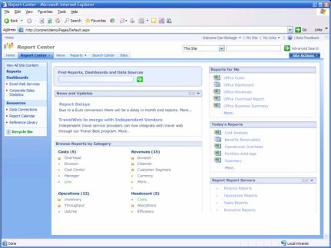
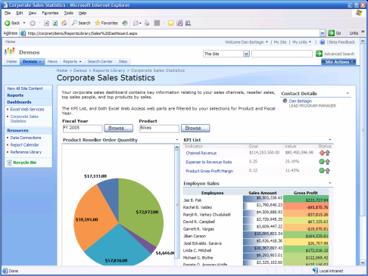
Manage Any Workload
Enterprise Scale Platform
  Comprehensive reporting platform
  Scalable report processing
  High developer productivity
Central Deployment
  Simplified deployment and host processes
  Central deployment to SharePoint
  OR Native Mode
Strong Manageability
  Central manageability of report server content
  Advanced report scheduling
  Sophisticated cache handling
  Extensible security model

Slide 13
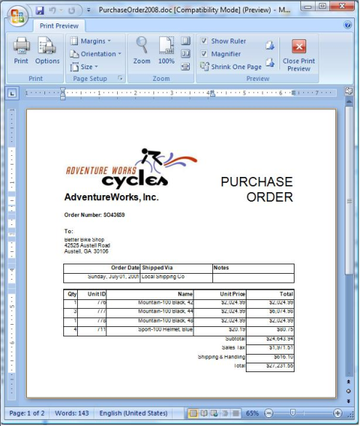



Deliver personalized Reports
Interactive Reports
  Interactive navigation paths
  Parameterization for optimal relevancy
  Ad-hoc report customizations
Rendering in any Format
  Rendering to Microsoft Office
  Rendering in SharePoint
  Rendering HTML, PDF, CSV, XML, and Image
Delivery to any Location
  Pull Model for retrieval of reports when needed
  Push Model for scheduling automatic delivery
  Embed reports for contextual business insight
XML

Slide 14
Demo
Reporting Services 2008 in Action

Slide 15
New with Microsoft SQL Server 2008 Reporting Services
Deliver Relevant Reports
Author
Manage & Scale
Experience
New Report Designer
New Flexible Report Layout
Enhanced Data Visualization
Scalable Report Engine
IIS Agnostic Report Deployment
New Word Rendering
Improved Excel Rendering
New End User Design Experience
SharePoint Integration

Slide 16











Major Reporting Services Customers
5.1 TB Credit Card DW, Relational Query, OLAP, RS
500+ unique reports, 1500+ users, Office BSM
Catering Planning System used in 2,300 hotels
25% time savings in catering forecast generation
Used by 13,000 agents in 220 offices
Built portal with Visual Studio .NET, SSAS
700 restaurants, 30,000 users, 700+ concurrent
OLTP/LOB reporting on inventory & sales data
Reporting on 1.6 TB of data, 35K+ Tx/Min
325 concurrent connections
Consumer Real Estate Division
98% reduction in report management time

