Slide 1

Your Data Any Place, Any Time
Server Consolidation

Slide 2













Rationale for Consolidation
Interoperability
Improve Management
Reduce Servers
Backward
Consolidation
Forward
Consolidation
Reducing the Cost of Running Servers

Slide 3

SQL Server 2008
Server Consolidation
Flexibility
Manageability
Scalability and Performance

Slide 4
Flexibility
Consolidation Options
Migration Technologies
Flexibility
Manageability
Scalability and Performance
Flexibility

Slide 5


Consolidation Options
Single instance, multiple databases
Reduces physical servers
Centralizes database server administration
Supports workload isolation
  through Resource Governor

Slide 6

Consolidation Options
Single server, multiple instances
Reduces physical servers
Centralizes server administration
Supports isolation of:
  Workload
  Security
  Database server administration
  Compatibility
Requires a single license per processor

Slide 7


Consolidation Options
Single physical server, multiple virtual servers
Reduces physical servers
Centralizes server hardware administration
Supports full server isolation
Requires a single license per processor
  For SQL Server 2008 Enterprise Edition

Slide 8



Migration Technologies
SQL Server 2008 data transfer technologies
  SQL Server Integration Services
  Detach and attach
  Backup and restore
Upgrade directly from previous versions

Slide 9
Manageability
Administration
Auditing
Configuration
Monitoring
Flexibility
Manageability
Scalability and Performance
Manageability

Slide 10
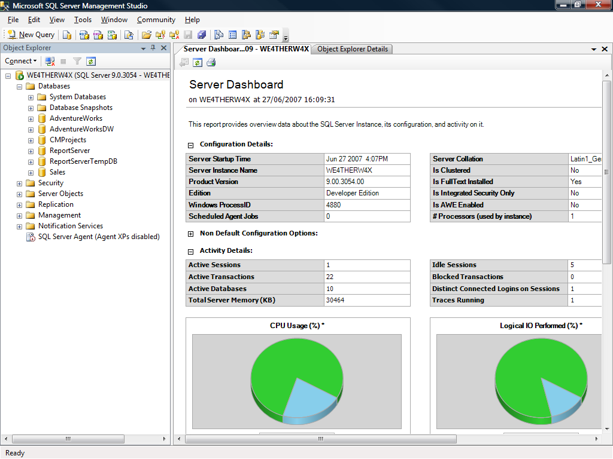
Administration
SQL Server Management Studio
Centralized management of multiple:
  Services
  Instances
  Editions
  Versions

Slide 11



Auditing
Define audit filters on one instance, and apply to many instances
Centralize enterprise wide audit reporting

Slide 12
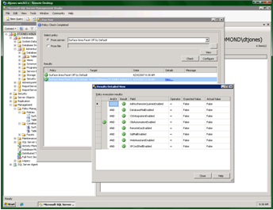

Configuration
Declarative Management Framework
Define policies on one instance, and apply to many instances
Enforce policies:
  Proactively through triggers
  After changes through Service Broker
  On a scheduled basis through SQL Server Agent
  On an ad-hoc basis

Slide 13
Monitoring
Performance Studio
Data Collection Sets
Data Collection
Dashboard (post Katmai)
Performance and Diagnostics Monitoring
Management Data Warehouse
Historical and baseline comparisons
Policy based management
Troubleshooting and Tuning

Slide 14
Manageability
Resource utilization
Scaling up
Flexibility
Manageability
Scalability and Performance
Scalability and Performance

Slide 15


Resource Utilization
Resource Governor
Differentiate workloads
  Based on application, user, etc.
Define resource utilization limits
  CPU
  Memory
Covered Scenarios:
  Preventing runaway queries
  Predictable concurrent execution of different-size workloads
  Workload prioritization

Slide 16
Scaling Up
64-bit scalability
  Take advantage of 64-bit hardware
Hot-add memory and CPU
  Add hardware without downtime
Native data compression
  Reduce storage requirements
  Increase performance for high I/O workloads

Slide 17
Summary
Flexibility
Manageability
Scalability and Performance

Slide 18

© 2004 Microsoft Corporation. All rights reserved.
This presentation is for informational purposes only. Microsoft makes no warranties, express or implied, in this summary.

