Slide 1

Your Data Any Place, Any Time
Delivering Location Intelligence with Spatial Data

Slide 2




The Business Opportunity
Increased user-sophistication
More data sources
More kinds of data
Integrated systems and mash-ups
Ubiquitous geographical technology
GPS
Online mapping services
Availability of geographical data

Slide 3












Spatial Data Scenarios
Customer-base management and development
Environmental-related data impact, analysis, and planning
Financial and economic analysis in communities
Government-based planning and development analysis
Market segmentation and analysis
Scientific research study design and analysis
Real-estate development and analysis

Slide 4
Introduction to SQL Server Spatial
Deliver Location-aware Intelligence
Comprehensive Spatial Support
High Performance Spatial Capabilities
Geospatial Application Extensibility

Slide 5


Comprehensive Spatial Support
Spatial Data Types
geography data type
Geodetic (“Round Earth”) geospatial model
geometry data type
Planar (“Flat Earth”) geospatial model
Define points, lines, and areas with longitude and latitude
Define points, lines, and areas with coordinates
Use for localized areas or non-projected surfaces such as interior spaces
Account for planetary curvature and obtain accurate “great circle” distances

Slide 6
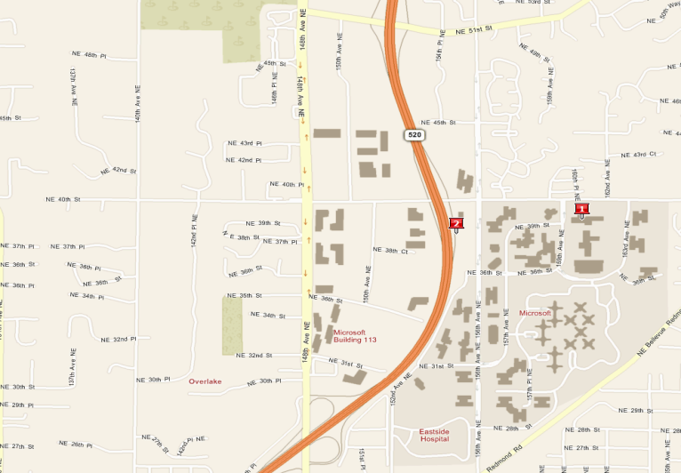
Comprehensive Spatial Support
Performing Spatial Operations
Both types provide static and instance methods
  Calculate distances, find intersections, etc.
Find streets that intersect the Microsoft campus
SELECT StreetName
FROM Streets
WHERE Streets.StreetGeo.STIntersects(@ms) = 1

Slide 7
High Performance Spatial Capabilities
Native Spatial Support
geometry and geography are CLR Types
Increased maximum size in SQL Server 2008 enables highly complex spatial data elements
Integrate spatial data with other business data
No need for a dedicated data store

Slide 8

High Performance Spatial Capabilities
Spatial Indexing
Spatial indexing is built into the query engine
  Grid-based quad-tree index structure
Query optimizer determines cost-based query plans

Slide 9





Application Extensibility
Standard Format Support
Sourcing geographical data
Industry-standard formats for import/export
Well Known Text (WKT)
Well Known Binary (WKB)
Geographic Markup Language (GML)
Integration with GIS and geospatial data solutions

Slide 10





Application Extensibility
Data Programmability
Consume spatial data through ADO.NET
Call spatial data type methods from .NET code
Integrate with external location-aware applications such as Virtual Earth

Slide 11
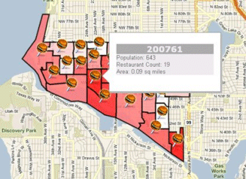
Application Extensibility
Spatial Integration – Example Virtual Earth
Query: Zip codes and Restaurants
Results: Density by color
Benefit: Quickly gain insight

Slide 12
Conclusion
Take advantage of comprehensive spatial support
Build high performance spatial solutions
Extend and integrate geospatial applications
geometry and geography data types
Methods for spatial operations
Store spatial data with business data
Spatial indexing
Industry-standards compatibility
Comprehensive programmatic library

Slide 13

© 2004 Microsoft Corporation. All rights reserved.
This presentation is for informational purposes only. Microsoft makes no warranties, express or implied, in this summary.

