Slide 1



Slide 2
People_Ready Processes
Enabling mainstream adoption of Business Process Management
J.R. Arredondo
Microsoft Corporation

Slide 3
Today's goal
High level overview of BPM
Potential blockers of BPM adoption
Routes of Adoption
What Microsoft and our partners are doing to help customers benefit from BPM
Takeaway:
  Language and framework to understand and communicate the value of BPM

Slide 4
The Satisfaction Gap
The business need happens here
Our response
is here
        The Gap

Slide 5









Application Development Nirvana
MODEL
Business users and IT collaboratively define the end-to-end processes and the need for automation.
They create and modify models based on existing processes or views of ideal processes.
Tools provision these models into executable processes.
PARTICIPATE
People know exactly what to do and things never fall through the cracks.
ANALYZE
Machines help managers see how our processes are doing both in specific instances or in the aggregate.
They can even help us predict how we will be doing next quarter so that we can do something about it now.
EXECUTE
Machines do the work or assign tasks to people when required.

Slide 6
The “clock speed” of business change has increased…
Before After
Predictability and stability
Manageable change
Enough time to react
Long term planning was enough
Rapidly changing needs
Unexpected change
Shorter windows of opportunity
Planning for the unknown
Globalization and regulation

Slide 7
Agility is the new competence for the enterprise
Internal forces
Increased business complexity
Globalization
New initiatives
AGILITY
is the ultimate
enterprise
competence
External forces
Government regulations
Compliance requirements
More competitive environments

Slide 8
Companies are typically not organized around processes
Sales and Marketing
Customer Service
Fulfillment
A/R
Partners
Process A
Process B
Process C
Companies are organized around functions, not around processes.
Cross organizational processes tend to be difficult to manage.
BPM brings visibility, agility, compliance and efficiency to these
end-to-end processes.

Slide 9
BPM: managing processes as assets
BUSINESS PROCESS MANAGEMENT
BPM is a discipline that looks at business process as
organizational assets that need to be managed
THE PROMISE OF BPM
Increase business agility
Optimize processes
Increase productivity
Reduce errors
Be compliant
ROI

Slide 10
Simple view of BPM
MODEL
PARTICIPATE
ANALYZE
EXECUTE

Slide 11
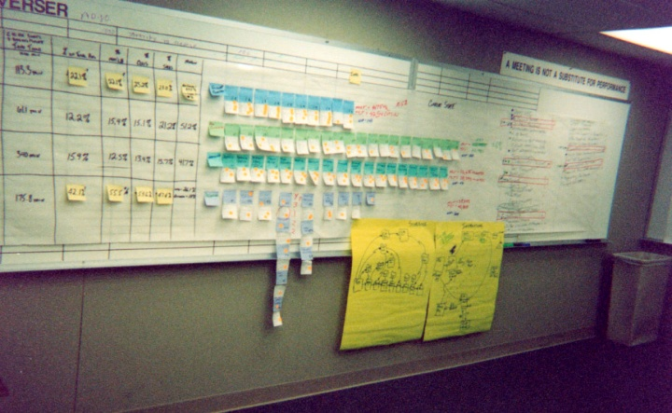

But BPM is a difficult problem
WHY?
Non technical issues: change, alignment, project complexities.
Processes span groups, companies, regulations, countries, channels
No single person knows everything about the process
Many legacy applications need to be integrated
Multiple skills and disciplines required (both in IT and Business)

Slide 12
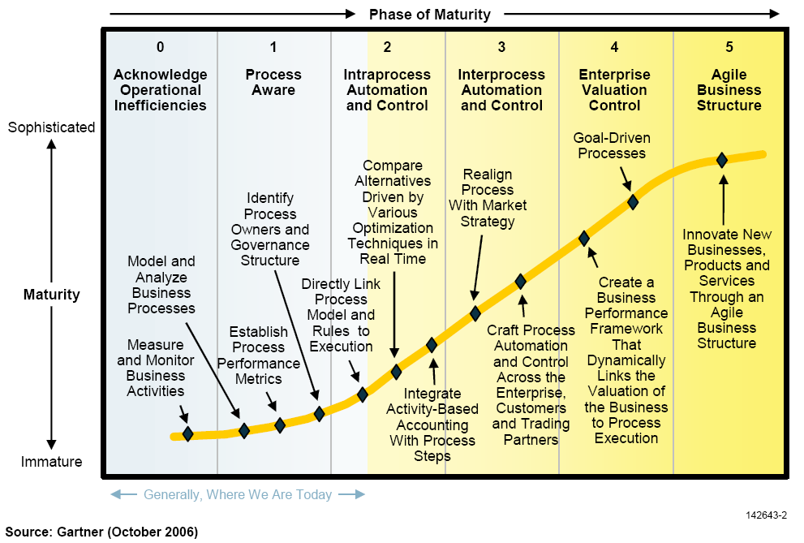
BPM is the right vision, but cost, complexity and risk limit adoption
Complexity, cost, and risk
  High initial cost and TCO
  High risk and time-to-value with proprietary tools
  High specialization and services to software ratios
… lead to low adoption
  Low penetration beyond large enterprise segment
  Low penetration in information worker base per company
Most enterprises are still here

Slide 13
Blockers of BPM adoption
Niche orientation
Requires people to learn new tools
Tool complexity mismatch with user skill
Requiring one suite of tools for everybody
Only “select” people actually using them
Not part of the way people do work
Requiring separate platform investments
Heavy on services and integration
Not as broadly available
Large and complex projects
Top down, “boil the ocean” initiatives

Slide 14
People_Ready Processes
Addressing the blockers of BPM adoption
Niche Orientation
Requiring one suite of tools for everybody
Requiring separate platform investments
Large and complex projects
Relevant to all Information Workers
Solutions are central part of the way people work, available to all and easy to use
Ubiquitous Platform
Platform is broadly available and requires minimal integration
Collaborative Design Tools
People use tools they already know to enrich the process understanding in a collaborative manner
Routes of Adoption
Each initiative is focused on a specific incremental goal

Slide 15
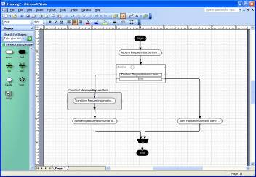
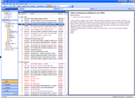
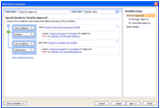
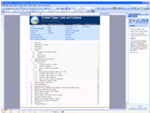
1) Relevant to all information workers
No niche orientation
Deliver value all the way to people’s desktops
Ensure that processes are deeply integrated into the Office experience (design & run-time)
Empower information workers with out of the box benefits
Empower organizations to build sophisticated workflow
Visio: Visually describe and model the business process
Outlook: Receive notifications and
track tasks
SharePoint Designer
Create and customize workflows
Word, PowerPoint,
Excel, InfoPath: Start/participate within SharePoint workflow

Slide 16




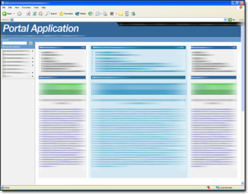


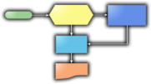







2) Ubiquitous Process Platform
Not separate platforms
Web 2.0
Packaged
Apps
“People-Ready” Process Platform
Portal
Devices
and People
Partner
Business
Process
Legacy
LOB
Embedded
Trading
Partners
Cloud

Slide 17









Microsoft Business Process Platform
Consume
User Directed
Security and Identity
Management and Governance
Design and Development
Compose
User Interaction
Presentation Services
Collaboration Services
Composition Services
Compose
Business Transaction
Business Process Services
Information Integration Services
Messaging
Services
Connectivity Services
Expose
Existing Systems

Slide 18
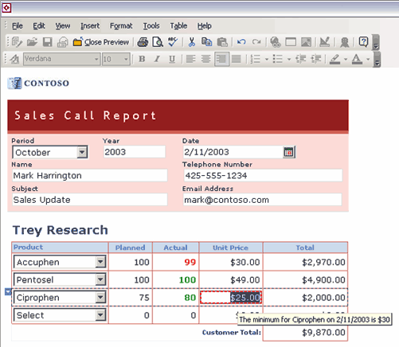





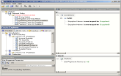
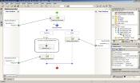

3) Collaborative design tools
Tackling process complexity
Process
Owner
Process
Participants
Business
Analyst
Tackle process complexity with
Use of the right tools
Collaboration across lifecycle
Minimal code (Model driven)
Professional
Developer
Process
Architect
Solution
Architect

Slide 19
4) Routes of adoption
Avoid boiling the ocean
Unknown & undocumented business processes
One-off exceptions and manual procedures
Processes don’t scale economically
Lack of process differentiation
Aware
Document and enrich to understand
Standardized
Workflow for quick improvements
Automated
Integrate for process efficiencies
Optimized
Manage for continuous improvement
Capture
Standardization
Automation
Continuous Improvement

Slide 20
Routes of Adoption
Managing the portfolio of projects
Ad-hoc
Aware
Standardized
Automated
Optimized
Project 1
Project 2
Project 3
Project N

Slide 21












Business Process Alliance
Partner Ecosystem of BPM Solutions
People. Process. Performance.
Microsoft Business Process Alliance
Set of strategic alliances to deliver greater customer choice of end-to-end BPM solutions on the Microsoft process platform

Slide 22
Business Process Alliance
Momentum
Announcement of the Business Process Alliance at the Gartner BPM Summit in February 2007.
Since then…
  360+ new customers
  350+ consulting and delivery partners
  50+ solutions offered
  6 partners appear in Gartner Magic Quadrants for their leadership in BPM and SOA solutions

Slide 23
Business Process Alliance
Momentum - Industries Served
Over 100 vertical templates and solutions for:
  Banking & Financial Services
  Government & Public Sector
  Insurance
  Healthcare & Life Sciences
  Manufacturing
  Media & Entertainment
  Professional Services & Legal
  Retail
  Telecommunications
  Transportation
  Travel & Hospitality

Slide 24
In summary
Address the blockers
Niche Orientation
Requiring one suite of tools for everybody
Requiring separate platform investments
Large and complex projects
Relevant to all Information Workers
Solutions are central part of the way people work, available to all and easy to use
Ubiquitous Platform
Platform is broadly available and requires minimal integration
Collaborative Design Tools
People use tools they already know to enrich the process understanding in a collaborative manner
Routes of Adoption
Each initiative is focused on a specific incremental goal

Slide 25
In summary
Routes of adoption: avoid boiling the ocean
Unknown & undocumented business processes
One-off exceptions and manual procedures
Processes don’t scale economically
Lack of process differentiation
Aware
Document and enrich to understand
Standardized
Workflow for quick improvements
Automated
Integrate for process efficiencies
Optimized
Manage for continuous improvement
Capture
Standardization
Automation
Continuous Improvement

Slide 26
Getting close to Nirvana
MODEL
Business users and IT collaboratively define the end-to-end processes and the need for automation.
They create and modify models based on existing processes or views of ideal processes.
Tools provision these models into executable processes.
PARTICIPATE
People know exactly what to do and things never fall through the cracks.
ANALYZE
Machines help managers see how our processes are doing both in specific instances or in the aggregate.
They can even help us predict how we will be doing next quarter so that we can do something about it now.
EXECUTE
Machines do the work or assign tasks to people when required.

Slide 27
A shorter Satisfaction Gap
The business need happens here
Our response
is now here
        The smaller Gap

Slide 28
Thank you!

Slide 29


