Slide 2
Driver Scalability
Davis Walker
Principal Development Lead
Windows Kernel
dwalker@microsoft.com

Slide 3
Agenda
Locality for Driver Scalability
Case Studies
Storport NUMA I/O
Load Balancing and NDIS Receive-Side Scaling (RSS)
Analysis Tools
Complementary Windows Support
NUMA and locality APIs
Processor Groups

Slide 4
Overview
Systems are getting larger and more parallel
To scale, devices must increase throughput with system size
This requires efficient use of processors, memory, and I/O links
Measurable performance differences are available to drivers that focus on scalability techniques
This talk is targeted to driver writers who need to push a lot of data
Server storage
High-speed networking
And so forth

Slide 5
Hardware Evolution
Industry is moving towards distributed processing complexes
CPUs share internal caches between cores
CPU and memory are a “node”, connected via links to other nodes
I/O is sometimes associated with a node, sometimes not
Accessing “close” hardware vs. “far” hardware is measurably faster
“Close” operations are vastly cheaper
Cache lookups vs. memory lookups
Local node memory lookups vs. remote node memory lookups
Links between units have fixed throughput and can become saturated

Slide 6
P₁
P₂
P₃
P₄
NUMA
Nodes
Cache₁
Cache₂
Cache₃
Cache₄
Node Interconnect
Cache(s)
Mem_{A}
Disk_{A}
Disk_{B}
Mem_{B}

Slide 7
Drivers Can Optimize for This Environment
Optimize for end-to-end processing on “close” hardware
If data travels long distances, scalability is impacted
Define discrete blocks of work that can be processed in parallel
Understand system topology
Understand software components involved in I/O processing
Process these blocks in distinct sections of hardware
Minimize interaction between processing blocks
Locality is important for:
DMA buffers
Buffer copies for data transformation
Processors that execute various phases of driver processing

Slide 8
Case Study 1: Storport NUMA I/O
Improvements to Windows Server 2008 to improve data locality of storage transactions
Includes:
Per-I/O interrupt redirection (with appropriate hardware support)
NUMA-aware control structure allocation
I/O concurrency improvements through lock breakup
Target ~10% reduction in CPU utilization on I/O intensive workloads
Used as an example here
Pointer to implementation details on Resources slide
Different I/O models have different data flows—this case study is designed to demonstrate the analysis and thought process

Slide 9
Storage I/O Sequence of Steps
Application issues a file read or write
Ends up as a storage adapter DMA transaction
Potentially in the application buffer, more likely to an intermediate buffer
Interrupt is generated after the I/O completes
Interrupt source is cleared in the device
Control structures associated with the request are updated
DPC is queued to process the data
DPC performs the bulk of the processing
Flushes DMA adapters (potentially copying data into the user buffer)
Potentially performs data transformation
Each component (adapter, file systems, etc.) processes control structures
Application thread is notified of completion

Slide 10
NUMA I/O Concept
Process requests vertically on the processor initiating the request
ISR/DPC happen on the initiating processor
Optimizes for:
Buffers and control structures allocated on the local node
Control structures accessed both at initiate and complete time
Tries to avoid:
Saturating links by pulling data across boundaries
Interrupting processing that occurs in parallel to this request

Slide 11
Locked out for I/O Initiation
(6)
(2)
Locked out for I/O Initiation
ISR
DPC
(7)
I/O Initiator
Windows Server 2003 Disk Read
P₁
P₂
P₃
P₄
Cache₁
Cache₂
(0)
Cache₃
Cache₄
(6)
(8)
(5)
Node Interconnect
(4)
(3)
(1) I/O Buffer Home
Cache(s)
Mem_{A}
Disk_{A}
Disk_{B}
Mem_{B}
0. Disk_{B} statically affinitized to P₂ when initialized (random)
P₃ selects buffer: Mem_{A}
P₃ starts I/O: fill buffer from Disk_{B}
Disk_{B} DMA triggers Invalidate(s)
Buffer written to Mem_{A} (or Node Cache)
HW Interrupt and ISR: Disk_{B} → P₂
P₂ executes DPC (by default)
Completion processing accesses control state in Cache₃
Data may be pulled into Cache₂
Originating thread alerted (APC or synch I/O): P₂ → P₃
May require InterProc Interrupt
Data must be in Cache₃ to use

Slide 12
I/O Initiator
Windows Server 2008 Disk Read
(NUMA I/O HBA)
ISR
DPC
(3)
ISR
P₁
P₂
(2)
P₃
P₄
Cache₁
Cache₂
Cache₃
Cache₄
Node Interconnect
(3)
(2)
Cache(s)
Mem_{A}
Disk_{A}
Disk_{B}
Mem_{B}
Performance Optimizations:
Concurrent I/O initiation
Interrupt I/O-initiating processor
Execute DPC on I/O-initiating processor
P₃ selects buffer: Mem_{B}
P₃ starts I/O: fill buffer from Disk_{B}
Buffer written to Mem_{B} (or Node Cache)
HW Interrupt and ISR: Disk_{B} → P₃ or P₄
P₃ executes DPC
Control state is hot in Cache₃
Originating thread likely running locally
Data exists in Cache₃ for application use

Slide 13
How NUMA I/O Works: Interrupt Processing
MSI-X hardware has one message pointed at every node (at minimum)
Device supports sending interrupts to requesting processor
Beneficial cache effects
XRB/SRB are accessed by miniport on initiation and in the ISR
Cache residency is generally very good
If thread-initiated asynch I/O, chances are good that it is still running
Less chance of cache pollution of unrelated threads
Means that DPC will also occur on initiating processor

Slide 14
How NUMA I/O Works: DPC Processing
DPC typically contains the bulk of I/O completion work
Control structure and queue processing by a stack of drivers
Data transformation for compressed files, anti-virus, etc
Double-buffering if device cannot DMA to all of memory
Control processing
Tends to be symmetric between initiation and completion
Cache considerations—same memory touched on initiation/completion
Node considerations—drivers may have NUMA-aware buffer allocation
Balancing considerations—components may keep per-node lists
Random completions can cause “sloshing”
Data transformation
Not typically part of high-end I/O flow, but something to keep in mind
Copies across a link increase latency, impact perf of the whole system

Slide 15
Case Study 2: NDIS Receive-Side Scaling (RSS)
Reacting to application locality doesn’t work in all cases
Inbound network traffic
A data queue might contain data for more than one application
Data transformations might occur before the application is known
In this case scalability can be improved by load balancing
Split work into blocks
Process the blocks independently
Locality still matters
Ensure that processing of one block does not interfere with another
Interrupt, DPC, and worker processing can still happen vertically

Slide 16
How RSS Works: Multiple Queues
Hardware divides received packets across multiple receive queues
Each receive queue collects packets for one or more TCP connections
Target queue selection ensures in-order processing of each connection
Packet processing occurs vertically
Each receive queue interrupts a different processor using MSI-X
Most network processing done in a DPC on the interrupting processor
RSS processor selection parameters
Speed of the NIC
The processor topology of the system
The “distance” of the NIC to NUMA nodes (if known)
Administrative settings

Slide 17
How RSS Works: Scalability Improvements
Cache benefits result from accessing:
The same data structures repeatedly on the same processors
The packet header by multiple layers of the stack on the same processor
Partitioning benefits
TCP connections structures are partitioned to match the queues
Processor load is monitored at run time
Adjustments are made to avoid over-utilization of a processor
TCP connections are moved across queues
Processors are changed by re-targeting MSI-X vectors

Slide 18
Locality Counter-Example: Power Management
When a driver enforces locality it can limit flexibility
E.g. the OS’s ability to migrate work for system efficiency
Consider power management
Work consolidation might be best on a lightly loaded system
Use a small set of hardware, allow the rest to idle to sleep
This may provide the best throughput-per-watt and power scalability
Aggressive load balancing by the driver can limit the OS
A balance between these considerations is required

Slide 19
The Balance
Aligning chunks of work to NUMA nodes provides a good balance
Provides OS flexibility within a node, but keeps work partitioned
A good, static default
No resource management facilities exist for migrating work based on system conditions
Load monitoring systems like NDIS are very complicated
Or, react to the apps/drivers sending you requests, so that you move gracefully with system changes around you, as in NUMA I/O

Slide 20
Windows Performance Toolkit— Performance Analyzer
Based on Event Tracing for Windows (ETW) instrumentation
Instrumentation built into the retail Windows operating system
Provides coverage of kernel-level activity
Controlling, decoding, and displaying ETW events in kernel
process lifetime
thread lifetime
image lifetime
sample profile
context switch
DPC
ISR
driver delay
disk I/O
file I/O
registry
hardfault
pagefault
virtual allocation
heap
TCP/UDP

Slide 21
Scalability Analysis Using Performance Analyzer
Can do scalability analysis on a per-driver basis
Total DPC/ISR time per processor
Wait classification (new in Windows 7), showing:
Which functions in the driver cause the calling threads to sleep
Who wakes up sleeping threads
IRP tracing
And much more
The tool can be downloaded—location on Resources slide
MSDN has comprehensive documentation

Slide 22
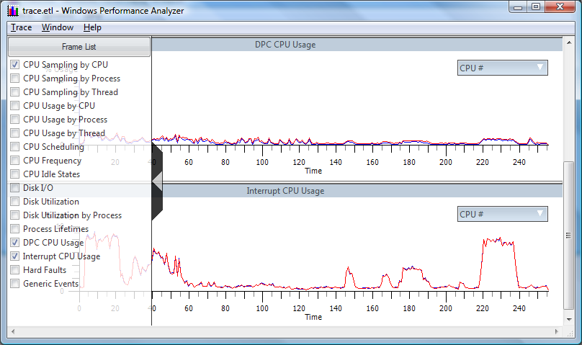
Performance Analyzer Screen Shot—DPC/ISR Time

Slide 23
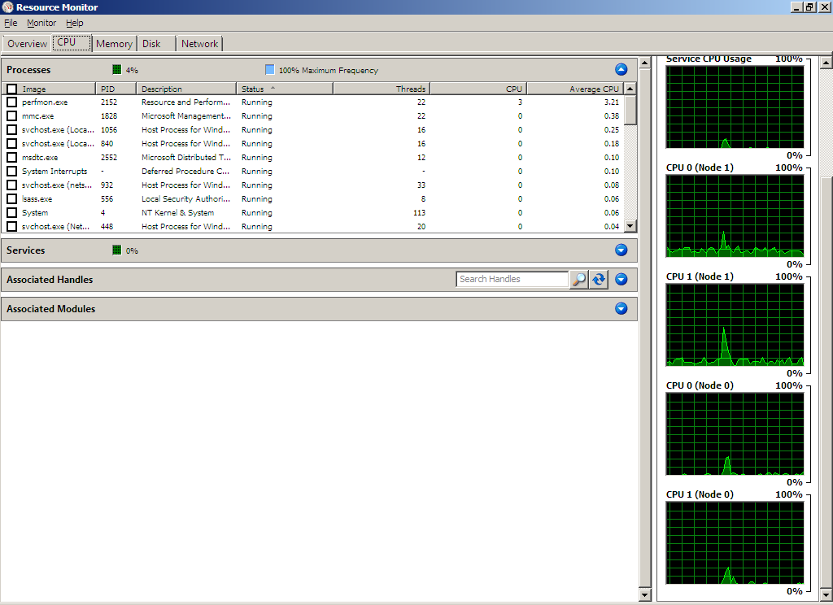
Resource Monitor—Per-Node CPU Activity

Slide 24
Windows 7 Improvements: NUMA and Topology
Understanding topology is necessary for locality optimizations
User-mode NUMA APIs have existed for some time
Symmetric APIs coming for kernel-mode
KeQueryLogicalProcessorRelationship
Cache, Package, Node relationships
“Distances” between nodes
Current node information
KeQueryNodeActiveAffinity
KeGetCurrentNodeNumber
Device proximity
IoGetDeviceNumaNode

Slide 25
Windows 7 Improvements: Processor Groups
KAFFINITY limits a system to 64 processors
KAFFINITY is a bitmap—easy and useful to manipulate
But increasingly a problematic limitation
Extensibility through processor “groups” of up to 64 processors
Groups are static—defined by keeping NUMA nodes together
Within a group, traditional processor management techniques apply
Allows support for arbitrary numbers of processors. A given Windows release will support what can be validated.

Slide 26
Processor Groups: Locality Leads to Scalability
The philosophy: in order to scale to hundreds of processors, work must be partitioned with topology in mind
Most work happens within a single group
Threads are scheduled within a group unless migrated explicitly
Processes run in a single group by default
A single interrupt can only be attached to processors within a group
Other groups can be used intentionally
A process can migrate threads between groups explicitly
MSI-X messages can each be attached to an independent group

Slide 27
Processor Group APIs
Any kernel routine using processor numbers or affinity is changing
New representations:
GROUP_AFFINITY: group number + KAFFINITY
PROCESSOR_NUMBER: group number + group-relative number
Example APIs that are changing
KeGetCurrentProcessorNumber
KeQueryActiveProcessorCount
KeSetSystemAffinityThreadEx
KeSetTargetProcessorDpc
New mechanisms to extend drivers past the first group
Registry key to indicate support for interrupts past first group
Complete details available in white paper

Slide 28
Processor Groups: Do You Need to Care?
Use of per-processor data structures?
Possible functional issues—discussed on the next slide
High performance device
Multiple MSI-X messages to be spread across the system
System-wide load balancing requirements
Likely to be limited to the first group without changes
System management utility
Likely not to comprehend all processors in the system without changes

Slide 29
Processor Groups: Compatibility Risk
Drivers run in the context of many apps
Must accept requests across all processors
Unmodified APIs return per-group information
Example issue:
Per-processor data structure accessed in a DPC
Because it is per-processor, at DISPATCH_LEVEL, it is self-synchronized
Two processors in separate groups now map to the same data structure
Possible list corruption, etc.
Drivers expecting to run on very large systems will need to be updated, and will need to test in this environment
Multi-group testing available on any MP machine

Slide 30
Related Sessions
Session | Day / Time
Implementing Efficient RSS Capable Hardware and Drivers for Windows 7 | Tues. 1:30-2:30
Network Power Management in Windows 7 | Tues. 5:15-6:15
Storport Drivers from the Ground Up | Tues. 8:30-9:30 and Wed. 9:45-10:45
Driver Scalability | Tues. 11-12

Slide 31
Resources
Windows Performance Tools Kit http://www.microsoft.com/whdc/system/sysperf/perftools.mspx
NUMA I/O presentation (WinHEC 2007) http://download.microsoft.com/download/a/f/d/afdfd50d-6eb9-425e-84e1-b4085a80e34e/SVR-T332_WH07.pptx
“Scalable Networking with RSS” on the WHDC Web site http://www.microsoft.com/whdc/device/network/NDIS_RSS.mspx

