Slide 1


Slide 2

PCs and Devices in Windows 7:
What You Need to Know
Cameron Brodeur
Program Manager
Device Foundation Platform
cbrodeur@microsoft.com
Adam Lenart
Software Design Engineer
Device Foundation Platform
alenart@microsoft.com
Ben McGregor
Software Design Engineer - Test
Device Foundation Platform
benmc@microsoft.com

Slide 3

Agenda
Creating a Device-Centric Experience
Metadata for PCs and Devices
Device Actions
Demo

Slide 4
Creating a Device-Centric Experience

Slide 5
What Is a “Device”?
Depends on who is asking the question: the user or the PC?
Further complicated by what the device is capable of doing
Devices can be single-function or multi-function
Almost all devices have more than one devnode
  A devnode is an internal structure that represents a device function tied to a driver
Multifunction devices have more than one devnode

Slide 6

PKEY_Device_Interface = {378DE44C-56EF-11D1-BC8C-00A0C91405DD}
Example: A Simple Device
USB Human Interface Device
PKEY_DeviceInterface_DevicePath = USB#VID_413c&PID_3200#6&2894b41f&0&3#{a5dcbf10-6530-11d2-901f-00c04fb951ed}
HID-compliant mouse
“It’s a mouse!”
USB mouse often thought of as having a single function
  Actually has (at least) 2 devnodes
Windows sees a multifunction device
User thinks of the device as having a single function

Slide 7
The Problem
PCs, applications, and users fundamentally see devices differently
  PCs and applications: strictly functional view where the device is a collection of interfaces and properties
  Users: device is a physical object which provides a set of functionality
Both of these views are correct
Today Windows does not support the user’s concept of a device
How do we support both views of what constitutes a device?

Slide 8
The Solution: ContainerID
New Plug and Play (PnP) device property in Windows 7
Groups devnodes together into a “device container” representing the physical device
  Allows Windows to determine how functionality is related
  Related functionality can be presented to the user as a device
Preserves existing devnode model while providing a more natural representation of a physical device

Slide 9
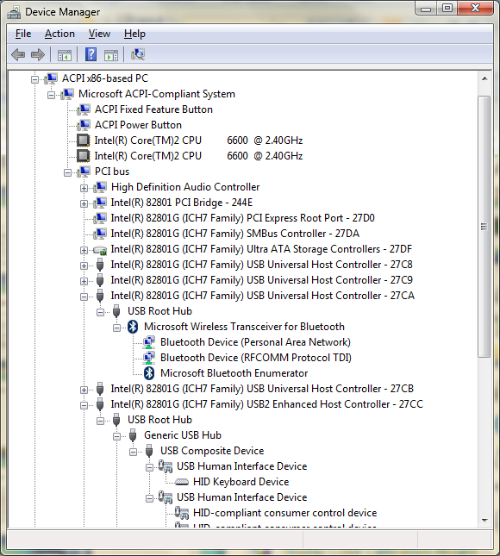
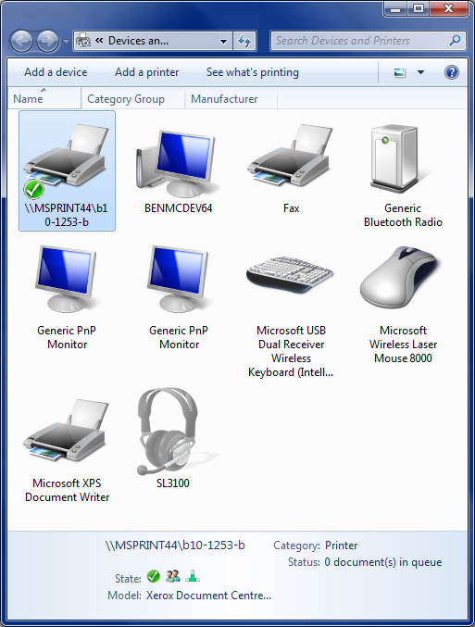
ContainerID Enables a Device-Centric Experience

Slide 10
ContainerID Details
Globally Unique Identifier (GUID) unique to a physical device
All devnodes belonging to a device container on a given bus type must share the same ContainerID
ContainerID is auto-generated by PnP
      Based on devnode topology and DEVICE_CAPABILITIES.Removable capability as reported by the bus driver
Optionally, the bus driver can supply a ContainerID when enumerating a devnode

Slide 11

Which Devnodes Should Bus Drivers Report as Removable?
Declaring that a devnode is Removable indicates to PnP that the devnode is the root of a device container
  Only the root devnode should be reported as Removable
Child devnodes of the root should not be reported as Removable
  Unless they actually represent physically detachable devices
Non-Removable child devnodes will inherit the ContainerID of their parent
Removable
Device
Root
Not Removable
Function
A
Not Removable
Function
B

Slide 12
What About the Computer?
The computer is a device
PnP will create a ContainerID for the computer
  Removable capability is used to group devnodes into a ContainerID for the computer
There should be only one ContainerID for the entire PC
Devices inside the PC need to report themselves as not Removable

Slide 13
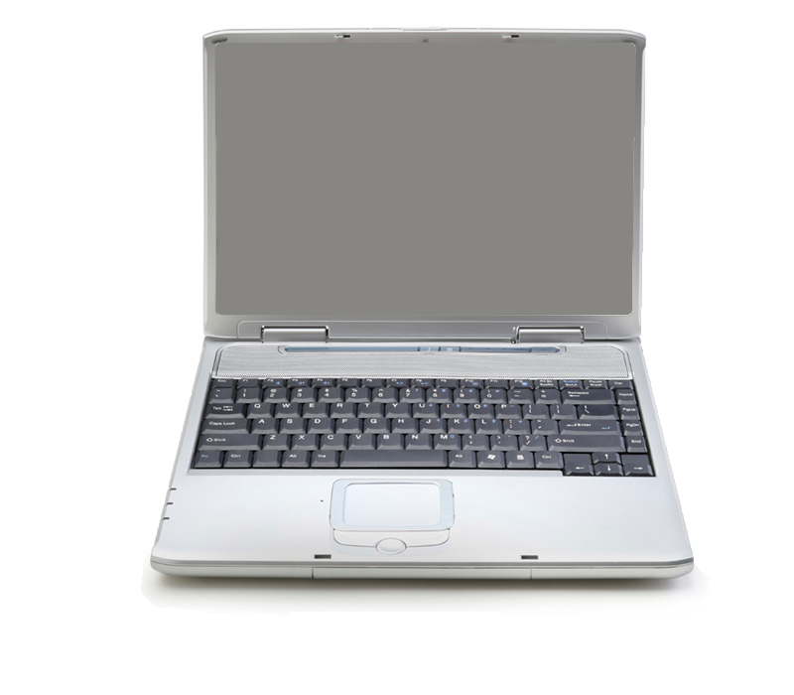
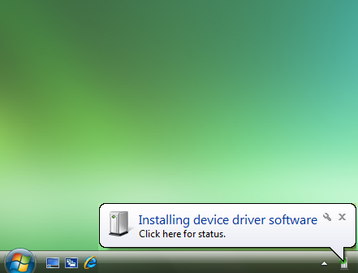

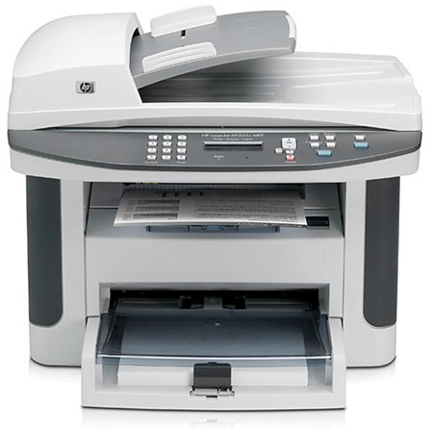

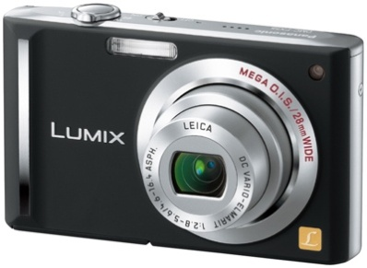
Root
{A}
Device Installation
No ContainerID on Device
USB
Hub
{A}
MFP
{B}
{A}
{B}
Printer
{B}
Scanner
{B}
Removable
USB
Hub
{B}
Not Removable
{C}
{D}
{C}
Camera
{A}
{B}
ContainerID
{C}
{D}
Storage
{D}

Slide 14
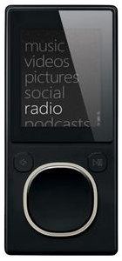
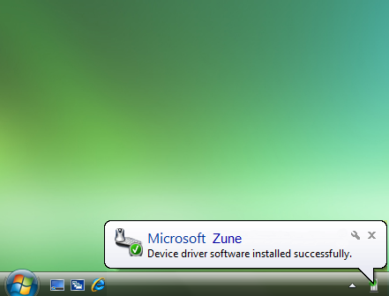

Device Installation
ContainerID on Device
PnP issues minor IRP function code
IRP_MN_QUERY_ID to bus driver
with new query request type
BusQueryContainerID
PnP issues minor IRP function code
IRP_MN_QUERY_ID to bus driver
with new query request type
BusQueryContainerID
If IRP handled, bus driver attempts to
retrieve ContainerID value for device
PnP issues minor IRP function code
IRP_MN_QUERY_ID to bus driver
with new query request type
BusQueryContainerID
If IRP handled, bus driver attempts to
retrieve ContainerID value for device
Bus driver determines best unique
ID available on the device
PnP issues minor IRP function code
IRP_MN_QUERY_ID to bus driver
with new query request type
BusQueryContainerID
If IRP handled, bus driver attempts to
retrieve ContainerID value for device
Bus driver determines best unique
ID available on the device
Bus driver returns ContainerID GUID
to PnP
PnP issues minor IRP function code
IRP_MN_QUERY_ID to bus driver
with new query request type
BusQueryContainerID
If IRP handled, bus driver attempts to
retrieve ContainerID value for device
Bus driver determines best unique
ID available on the device
Bus driver returns ContainerID GUID
to PnP
Devnodes belonging to the same
device container all have the same
ContainerID
  Explicitly reported by bus driver or
  Inherited from parent devnode
My ContainerID is
Retrieving …
What’s your ContainerID?
{140effad-8329-4535-a1fd-0b2685c0ef3e}

Slide 15
Device Installation
ContainerID on Device
PnP issues minor IRP function code
IRP_MN_QUERY_ID to bus driver
with new query request type
BusQueryContainerID
If IRP handled, bus driver attempts to
retrieve ContainerID value for device
Bus driver determines best unique
ID available on the device
Bus driver returns ContainerID GUID
to PnP
Devnodes belonging to the same
device container all have the same
ContainerID
  Explicitly reported by bus driver or
  Inherited from parent devnode

Slide 16
ContainerID for USB Devices
2 ways to retrieve a ContainerID on USB devices
  MS OS ContainerID Descriptor
    Allows ContainerID to be specified for the device
  USB Serial Number
    Serial number (if available) hashed to a ContainerID GUID

Slide 17
ContainerID for Bluetooth Devices
Media Access Control (MAC) address is hashed to a ContainerID GUID
All Bluetooth services and PnP devnodes originating from the Bluetooth device will be assigned this ContainerID

Slide 18
ContainerID for PnP-X Devices
Network devices that implement the following protocols can specify a ContainerID in device metadata
  Device Profile for Web Services (DPWS)
  Universal Plug and Play (UPnP)
New <ContainerID> element defined for each protocol
If <ContainerID> element is not supplied, PnP will create a ContainerID for the device
  UPnP: Device UDN
  DPWS: Hash of endpoint reference address

Slide 19
ContainerID Summary
Common Buses
 | USB | Bluetooth | PnP-X
Primary | MS OS Descriptor | TBD | <ContainerID>
Secondary | Serial Number Hash | MAC Address Hash | UDN/ Endpoint Reference
Default | Removable Capability

Slide 20
ContainerID Action Items
Ensure that your device reports its removable relationship correctly
  This will be used to create the ContainerID when the bus driver does not handle IRP_MN_QUERY_ID/ BusQueryContainerID
Always embed uniqueness information in your devices
  ContainerID if supported by the bus
  Common buses will attempt to create a ContainerID based on unique information from the device
  Do not reuse the same ContainerID value across physical devices
    Each device needs a unique ContainerID to avoid identifier collision

Slide 21
Metadata for PCs and Devices

Slide 22
Metadata for PCs and Devices
Windows 7 enables rich metadata to be associated
with PCs and devices
  Enhances the device-centric user experience
Device metadata provides
  A photorealistic icon of the device in the UI
  Device manufacturer, model, and description
New device-centric UI will use metadata when available
for a device
  Devices and Printers folder

Slide 23
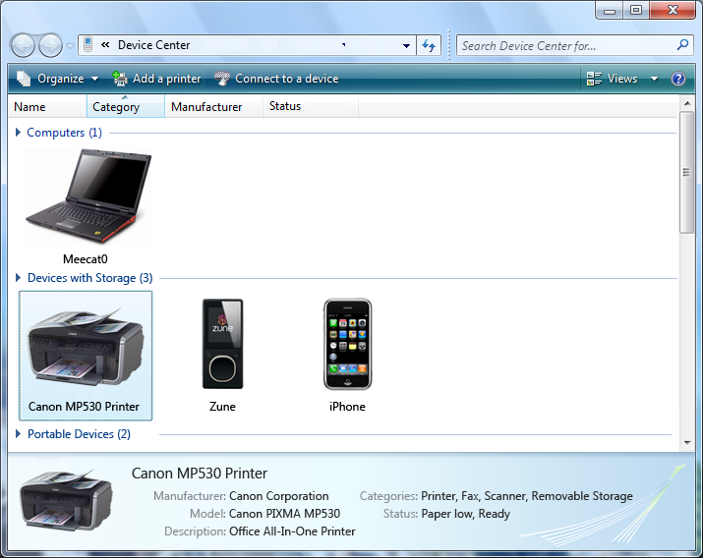

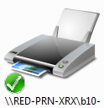

Metadata in the Devices and Printers Folder
METADATA
METADATA
Photorealistic
Icons
Generic
Icons
Music Player
Cell Phone
Generic
Descriptions
Detailed
Descriptions

Slide 24
Metadata Package Overview
A metadata package is authored by an IHV or OEM
The metadata package is then submitted to Windows Quality Online Services (Winqual) for distribution via a Microsoft metadata server
    Metadata can also be distributed by a device or application installation package
Metadata packages will be matched to a device using
  ModelID (New PKEY for Windows 7)
  HardwareID
Metadata packages can be created to match against multiple ModelIDs and HardwareIDs

Slide 25
Metadata Package Overview (continued)
Metadata packages will be easy to create using the Device Center Metadata Wizard
Streamlined metadata package submission process through Winqual
Metadata package documentation and tools will be released at WinHEC 2008
Start creating and submitting device metadata packages early
  Microsoft wants to help you provide a great out-of-box experience for your devices!

Slide 26
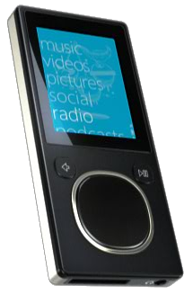
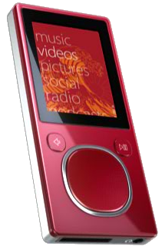
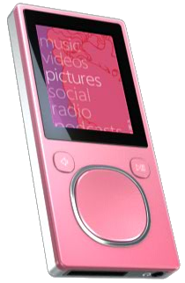
ModelID Details
ModelID is a new device property key in Windows 7
  DEVPKEY_Device_ModelId of type DEVPROP_TYPE_GUID
ModelID allows differentiation between devices which share the same manufacturer and model
  E.g. The same make/model of a device may be available in multiple colors
    Each color has a different ModelID to match the appropriate metadata package
  E.g. The same make/model of cell phone is branded by several OEMs
    Each OEM branded phone has a different ModelID to match the OEM provided metadata package

Slide 27
ModelID for the PC
PC OEMs Take Note!
Windows 7 automatically generates a ModelID for the PC
ModelID is generated by hashing the System Management BIOS (SMBIOS) reported system description and manufacturer
  Ensure these properties are available and unique for each PC model and manufacturer
A tool (ComputerModelID.exe) will be provided to report the ModelID generated for the PC
In the absence of metadata Windows 7 will use the SMBIOS reported enclosure type to display an accurate default icon

Slide 28
Metadata Action Items
Identify devices that would benefit from having metadata
Always include a device specific HardwareID
  Enables devices to be matched to a metadata package
  Ensure HardwareID is specific to the device make and model
  HardwareID should be present even if it will not be used for driver package matching
PC OEMs – Provide accurate information in the SMBIOS
  Information in the SMBIOS will be used to create a ModelID for the PC
Complete information on authoring device metadata packages will be released on http://www.microsoft.com/whdc/ in the WinHEC timeframe

Slide 29
Device Actions

Slide 30
Device Actions Overview
After installing a device, it is not always clear how to manage or use the device
  Start menu > All Programs
  Desktop shortcut
  Control Panel
The Devices and Printers folder provides the capability to associate actions with a device
  Launch point for device experiences

Slide 31
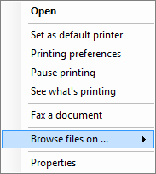

Advantages of Device Actions
Configurable Double-click Action
Additional
Device
Actions
Extensible
Device
Properties

Slide 32
How Actions Are Associated with a Device
Actions can be associated with a device using the following
  ModelID
  HardwareID
  CompatibleID
  Device Interface Class GUID
Actions are registered for a device using the shell standard extensibility model for context menus
  Device actions registered under HKCR\DeviceDisplayObject
Registered actions are exposed in the Devices and Printers folder
Most
Specific
Least
Specific

Slide 33
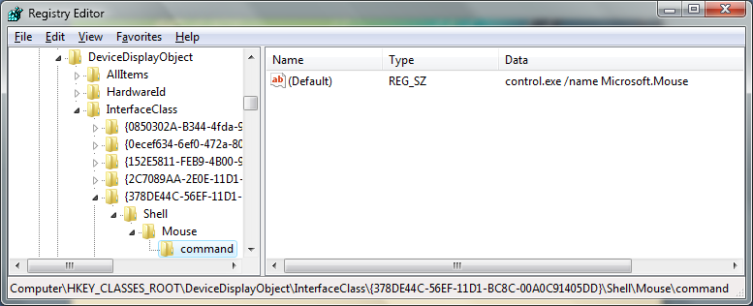
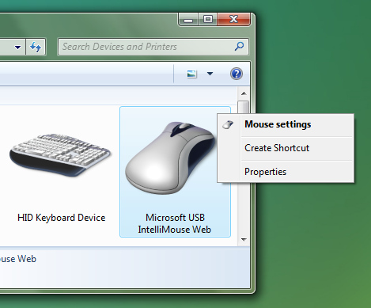
Mouse Context Menu Handler Example
Shell extensibility provides flexibility to specify
Context menu icon
Context menu text
Command to execute for this context menu item
Default context menu handler for mouse
Registered against the mouse interface
class
Device specific action displayed in context menu for device

Slide 34
Demo
The Device-Centric Experience in Windows 7

Slide 35
Action Items
Ensure that your device
  Correctly reports its removable relationship for each devnode
  Embeds a unique identifier (e.g. ContainerID or serial number)
  Appears as one device in the Devices and Printers folder
  Includes a device-specific HardwareID for metadata package matching
Author metadata packages for your device
Expose important device actions in the Devices and Printers folder

Slide 36
Resources
Upcoming white papers for Windows 7 on WHDC Web site
http://www.microsoft.com/whdc
  Multifunction Device Framework
  Using ModelID to Specify Metadata

Slide 37
Questions

