Slide 1


Slide 2
Get Ready For Windows 7
Ben Gray Senior Analyst, Infrastructure & Operations Forrester Research October 6, 2009

Slide 3
Theme
Commercial anticipation for Windows 7 is high;
It’s time to start preparing for your next PC standard

Slide 4
Key points
Windows XP won’t be around forever.
IT professionals should start preparing for Windows 7 now.
Specifically, they should:
  Start / accelerate application compatibility testing against the Windows 7 RTM code
  Plan for rolling out Windows 7 in small batches on new hardware initially
  Weigh the costs / benefits of upgrading existing machines with at least 2 GB of memory
  Start developing training sessions and best practices / tips and tricks guidance
  Prepare for — and embrace — empowered users who want to be early adopters

Slide 5
Agenda
Windows 7 for your business
  Why: Building the business case
  When: Timing the migration
  How: Deployment best practices
Recommendations
Q&A

Slide 6
Agenda
Windows 7 for your business
  Why: Building the business case
  When: Timing the migration
  How: Deployment best practices
Recommendations
Q&A

Slide 7
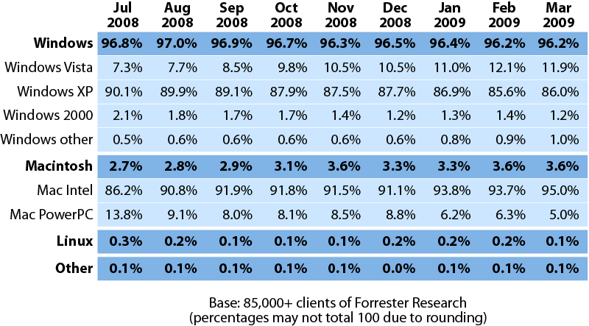
Corporate desktop operating systems trends, Q3 2008 to Q2 2009
Source: July 22, 2009 “Corporate Desktop Operating System Trends, Q3 2008 To Q2 2009”

Slide 8
The state of today’s commercial operating system market
“What percentage of your firm's PCs run the following operating systems?”
Base: 665 PC decision-makers at North American and European enterprises and SMBs
Source: Enterprise And SMB Hardware Survey, North America And Europe, Q3 2009

Slide 9
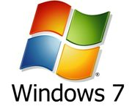
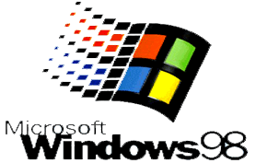



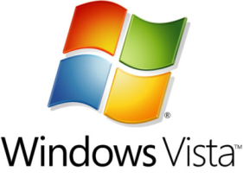
Windows desktop operating system roadmap
SP1
SP1
SP2
SP3
SP1
1998
1999
2000
2001
2002
2003
2004
2005
2006
2007
2008
2009
2010
SP1
SP2
SP3
SP4
SP1
SP2

Slide 10
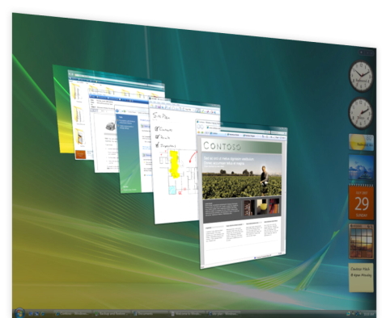
Why one in seven firms upgraded to Windows Vista
Feature/function drivers
  Improved security
    User Account Control, BitLocker Drive Encryption,
    IE7 Protected Mode, Windows Defender, Security
    Development Lifecycle
  End user experience = happier users
    Sleek 3D user interface (Aero)
    Integrated search
    SuperFetch, ReadyBoost, and ReadyDrive
    Faster on, faster off, and faster access to data and applications
  Better reliability
    Windows Vista was evaluated and stress-tested by more users than any previous version of Windows
Stay current with Microsoft’s and ISVs’ support lifecycles

Slide 11
Why most firms remained on Windows XP
Enterprises pulled back their initially aggressive Windows Vista deployment plans for three reasons:
  Application compatibility didn’t look as good as desktop operations had hoped
  Hardware compatibility was hard to get around with PCs older than 12 to 18 months
  Most IT shops were fatigued having just wrapped their project to standardize on Windows XP
Despite these challenges and swirling Windows 7 speculation, the firms that migrated / are migrating to Windows Vista have a clearer and easier upgrade path to Windows 7
With swirling enthusiasm for Windows 7, the time is now to prepare for your eventual migration

Slide 12
With apologies to Mr. Dylan, the times they are a-changin'
With the introduction of SP2 in August 2004, Windows XP has been a venerable OS for organizations worldwide.
It has delivered the compatibility, security, and reliability that enterprises had hoped for and to this day remains the desktop standard for most firms.
Even two-and-a-half years after the general availability of Windows Vista, Windows XP still powers almost 80% of all Windows-based enterprise PCs.
However, some factors are converging that will finally provide businesses with a compelling reason to shake the status quo, which will end Windows XP's corporate reign. These include:
  Businesses are supporting aging infrastructure that must be refreshed
  Windows XP's support is nearing an end
  Windows XP availability will eventually get squeezed
  Firms are finding compelling business reasons for a Windows 7 upgrade
  Client virtualization has matured and can accelerate deployment plans

Slide 13
The key features of Windows 7 to prepare for
The top five Windows 7 features that IT operations professionals need to prepare for are:
  DirectAccess, which promises to simplify connectivity for mobile users
  BranchCache, which promises to improve branch access networking
  BitLocker and BitLocker To Go, which promise to secure the data on hard drives and removable USB thumb drives
  AppLocker, which promises to deliver more granular control of user applications
  Federated search, which promises to simplify access to data across local and remote resources
And many more are coming up in client discussions, including:
  PowerShell, Group Policy, Problem Steps Recorder, Windows Troubleshooting, Deployment Tools, IE8, etc.

Slide 14
Agenda
Windows 7 for your business
  Why: Building the business case
  When: Timing the migration
  How: Deployment best practices
Recommendations
Q&A

Slide 15
Two-thirds of all businesses already expect to migrate to Windows 7 eventually
“What are your firm's plans for deploying Windows 7?”
Base: 653 PC decision-makers at North American and European enterprises and SMBs
Source: Enterprise And SMB Hardware Survey, North America And Europe, Q3 2009

Slide 16
When should your firm start the migration to Windows 7?
The pace of business adoption depends on:
  Availability
    July 22, 2009: Released to manufacturing (RTM)
    September 1, 2009: Availability for customers with volume licensing
    October 22, 2009: General availability
  Readiness
    Application compatibility testing
    Image development
    Application packaging and testing
  PC refresh cycles / hardware requirements
    New PCs
    Existing machines with 2 GB of memory
  Budget plans
    Relative importance of PC/OS upgrades compared with other key IT initiatives (e.g., business continuity/disaster recovery, security, compliance, green IT, etc.)

Slide 17
Within 12 months, Windows 7 will become the new standard for most corporate PCs
“Today, which operating system is installed
most frequently on new end user PCs?”
“Twelve months from now, which operating system
do you expect to be installed most frequently
on new end user PCs?”
Base: 665 PC decision-makers at North American and European enterprises and SMBs
Source: Enterprise And SMB Hardware Survey, North America And Europe, Q3 2009

Slide 18
Agenda
Windows 7 for your business
  Why: Building the business case
  When: Timing the migration
  How: Deployment best practices
Recommendations
Q&A

Slide 19
Sixty-two percent of Windows Vista shops are already planning on deploying Windows 7
“Which of the following best describes your firm's plans to continue using Windows Vista?”
Base: 47 PC decision-makers at North American and European enterprises and SMBs
in which Windows Vista is the most widely deployed operating system today
Source: Enterprise And SMB Hardware Survey, North America And Europe, Q3 2009

Slide 20
Sixty-one percent of Windows XP shops (almost 80% of all businesses) are already planning an upgrade to Windows 7
“Which of the following best describes your firm's plans to continue using Windows XP?”
Base: 596 PC decision-makers at North American and European enterprises and SMBs
in which Windows XP is the most widely deployed operating system today
Source: Enterprise And SMB Hardware Survey, North America And Europe, Q3 2009

Slide 21
Companywide deployments of Windows 7 will take multiple years
“What is your firm's strategy for company-wide deployment of Windows 7?”
Base: 425 PC decision-makers at North American and European enterprises and SMBs
Source: Enterprise And SMB Hardware Survey, North America And Europe, Q3 2009

Slide 22
Prepare for — and embrace — empowered users who want to be early adopters
“Will IT upgrade individual users to Windows 7 if they request it outside of specific upgrade campaigns?”
Base: 425 PC decision-makers at North American and European enterprises and SMBs
Source: Enterprise And SMB Hardware Survey, North America And Europe, Q3 2009

Slide 23
Agenda
Windows 7 for your business
  Why: Building the business case
  When: Timing the migration
  How: Deployment best practices
Recommendations
Q&A

Slide 24
Recommendations
Windows 2000 customers
  Complete migration to Windows Vista as soon as possible (prior to July 13, 2010) or plan on purchasing extended support . . .
  . . . But for firms that haven’t yet begun their migration away, plan on deploying Windows 7
Windows XP customers
  Start testing application compatibility with Windows 7 RTM
  Plan for the start of deployment within 12 to 18 months
  Tie in the upgrade to Windows 7 with the natural PC refresh cycle of the business
  Consider accelerating the Windows 7 deployment by upgrading machines with 2 or more GB of memory already in the field
  Keep in mind the end of extended support for Windows XP on April 8, 2014
Windows Vista customers
  Continue deploying Windows Vista on new machines
  Consider starting your Windows 7 evaluation now with Windows 7 RTM
  Plan for the eventual Windows 7 upgrade on new PCs initially with Windows 7 SP1

Slide 25
Agenda
Windows 7 for your business
  Why: Building the business case
  When: Timing the migration
  How: Deployment best practices
Recommendations
Q&A
  Eve Psalti, Senior Marketing Manager, Microsoft Windows

Slide 26
Thank you
Ben Gray
+1 617.613.6143
bgray@forrester.com
www.forrester.com
Visit these resources for more on Windows 7 and the Windows Optimized Desktop:
Windows 7: www.Windows.com/Enterprise
Windows Optimized Desktop: www.Microsoft.com/OptimizeDesktop
Windows 7 for IT Pros: www.Microsoft.com/Springboard
Microsoft Desktop Optimization Pack: www.Microsoft.com/MDOP

