Slide 1

Business Productivity Online Suite: Screenshots for
Formotus Mobile Business Forms
Formotus, Inc.

Slide 2
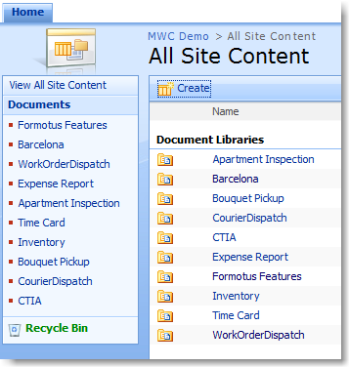
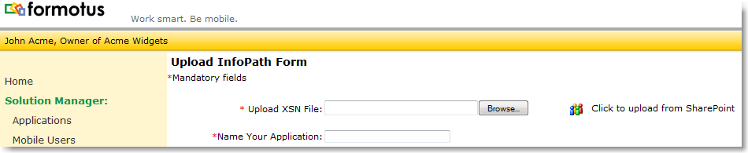
Formotus Mobile Business Forms
Store and manage
your InfoPath
forms with
SharePoint Online.
Formotus can upload
forms from SharePoint
for deployment to
mobile devices.

Slide 3
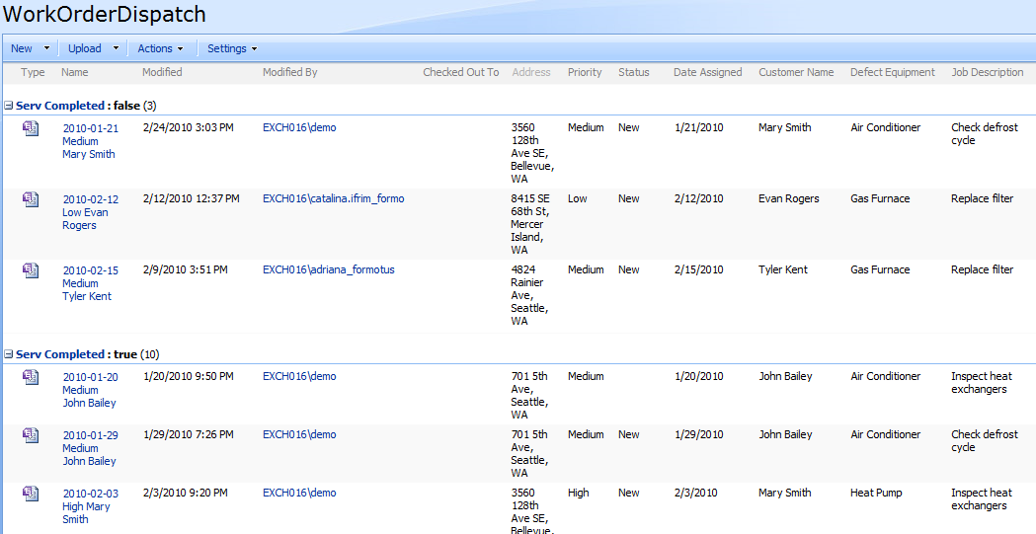
Formotus Mobile Business Forms
Use SharePoint Online as a mobile dispatch center, assigning tasks and locations to mobile workers.

Slide 4
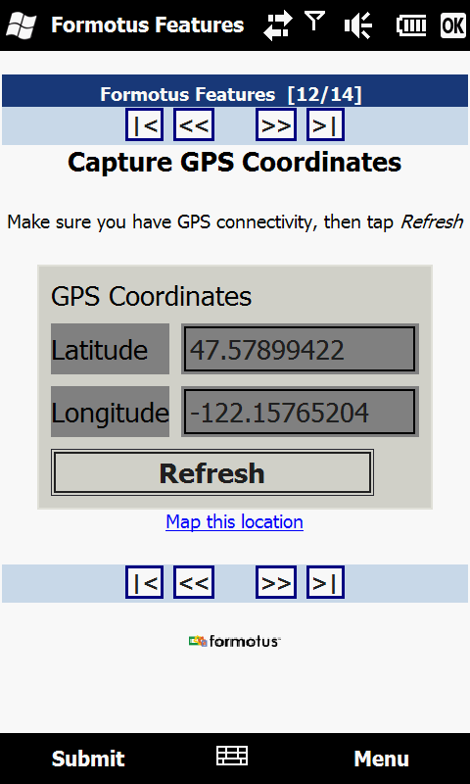
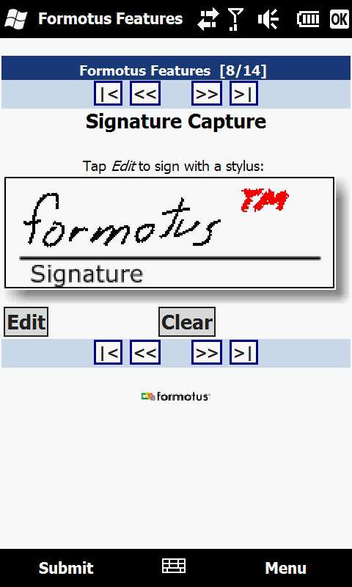
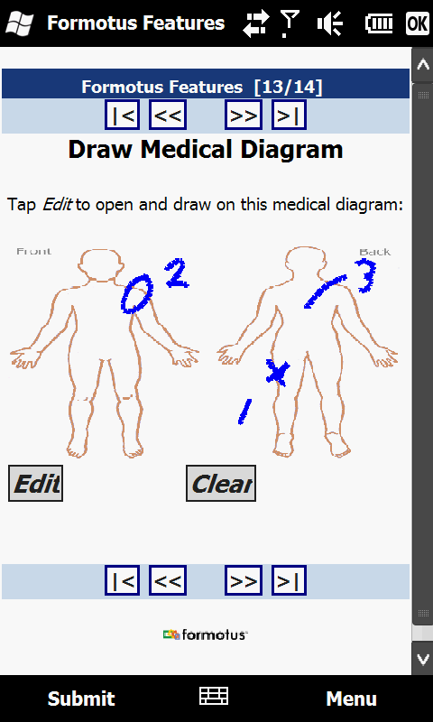
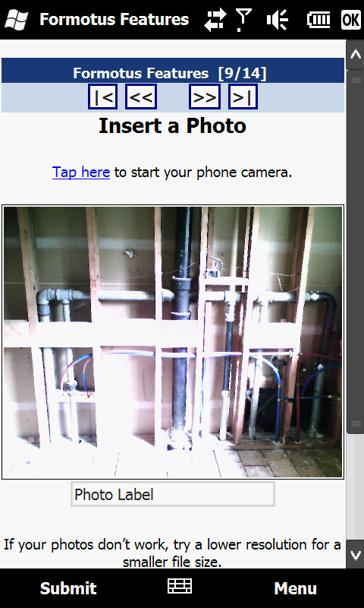
Formotus Mobile Business Forms
Mobile workers can
capture photos, signatures,
GPS and timestamps in forms
that submit back to
SharePoint Online.

Slide 5
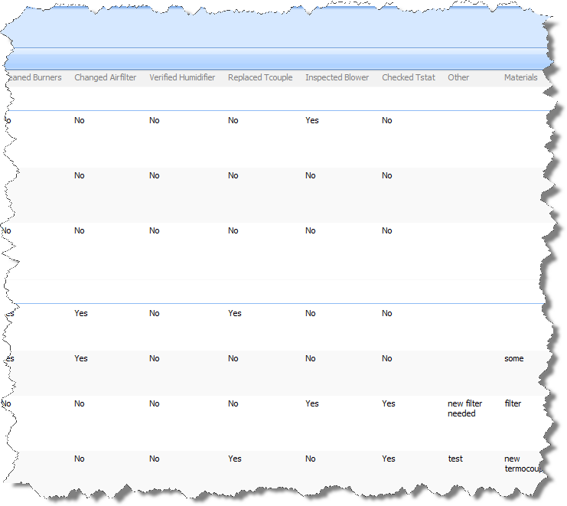
Formotus Mobile Business Forms
Data submitted
from phones is
viewable in
SharePoint
Online.

Slide 6
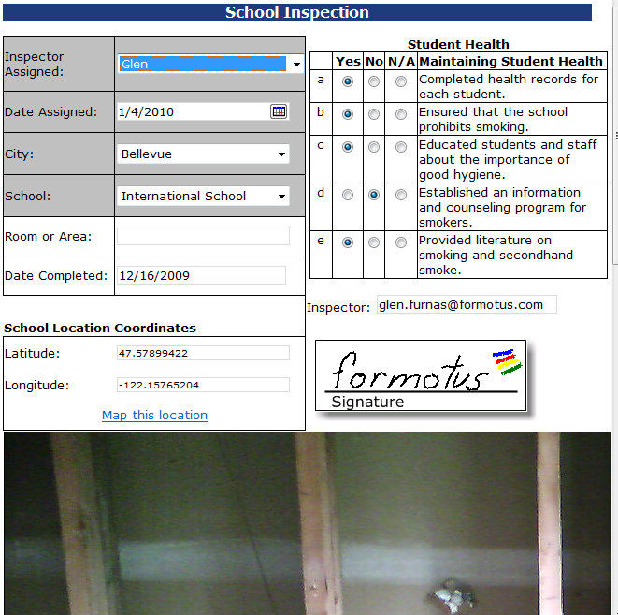
Formotus Mobile Business Forms
Mobile workers and
office workers can
collaborate on the
same form using
SharePoint Online.

Slide 7










Office Workers
Desktop Data
SharePoint
Online
Form Template
upload
Hosted Service
Business Data
Mobile App
Mobile Data
connect
deploy
Mobile User

Slide 8
Formotus Mobile Business Forms
www.formotus.com
Formotus, Inc.
3633 136th Pl SE, Suite 202
Bellevue, WA 98006
Phone: 206-973-5060
Fax: 206-260-7235
info@formotus.com
www.formotus.com

