Slide 1

{ Aplicaciones de Datos de Nueva Generación }
Microsoft Corporation

Slide 2
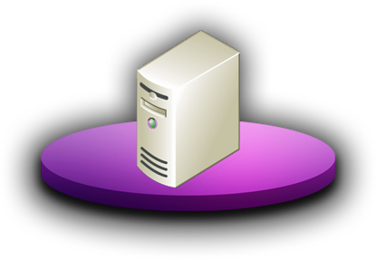









Evolución de la programación de BBDD
Yesterday
Ayer
Hoy
Relational client/server applications
Stationary centralized data
Some services
Aplicaciones relacionales cliente/servidor
Datos estáticos y centralizados
Unos pocos servicios
Datos relacionales y no estructurados
Acceso desde Web y dispositivos móviles
Muchos servicios disponibles
Sincronización de datos
Soporte para aplicaciones antiguas
Complejidad creciente de los datos
Notes:
Database applications today are required to work in a much more complex environment than ever before. We no longer can get away with refusing to deal with anything except simple numbers and strings.
Users are demanding the ability to take their data with them and to synchronize it when they return.
The volume of data is increasing exponentially.

Slide 3







Aplicaciones de Datos de Nueva Generación
Completo
Flexible
Productivo
Datos espaciales
Estructurados
No estructurados
Mejoras en T-SQL
SQL Server Compact
Synchronization Services para ADO.NET
Modelo de Datos de Entidad
ADO.NET Entity Framework
LINQ
ADO.NET Data Services
Desde la Base de Datos a la Plataforma
Notes:
The data programmability vision for SQL Server 2008 is to be the most comprehensive and flexible platform available while allowing developers to be highly productive.
SQL Server 2005 started the journey by providing support for XML data, UDTs up to 8K in size, and storage for large variable-length data, including BLOBs. SQL Server 2008 takes us further down that path by providing direct support for spatial data and for even larger variable-length data while maintaining performance by blending the best of both database and file system access to that data.
We have continued to invest in the T-SQL language to enable developers to write applications using less code. This increases the application-development speed and lowers support costs.
The sync framework provides a simple, supported framework for building systems that support local caching on mobile systems and efficient synchronization with the main database.
The Entity Framework lets businesses code at an object level that more closely reflects business needs while still providing efficient access to corporate data. LINQ simplifies data-access code and can reduce the volume and maintenance costs of that code. ADO.NET Data Services allows access to corporate data via industry standard protocols and formats.

Slide 4

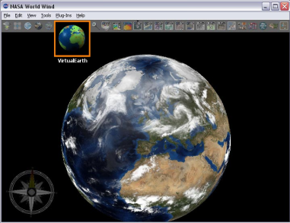
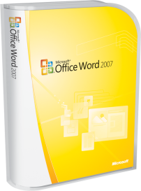


Retos de la Programación
Información espacial
    Tipo de datos Geometry
    Tipo de datos Geography
    Funciones espaciales
    Índices espaciales
La información de localización geográfica cada vez es más importante
Información no estructurada
    FILESTREAM
    Servicios BLOB remotos
    Búsqueda de texto completo integrada
Creciente necesidad de almacenar archivos y documentos
Información relacional
    Columnas ligeras (“Sparse”)
    Índices filtrados
    Jerarquía
    Grandes UDTs
Requisitos de las aplicaciones muy complicados
Notes:
Do not spend much time discussing details of the enhancements at this point. But it is worth spending a few moments on the bulleted items that are not covered in the remainder of the slides, notably:
Remote BLOB services
Integrated full-text search
Sparse columns
Filtered indexes

Slide 5
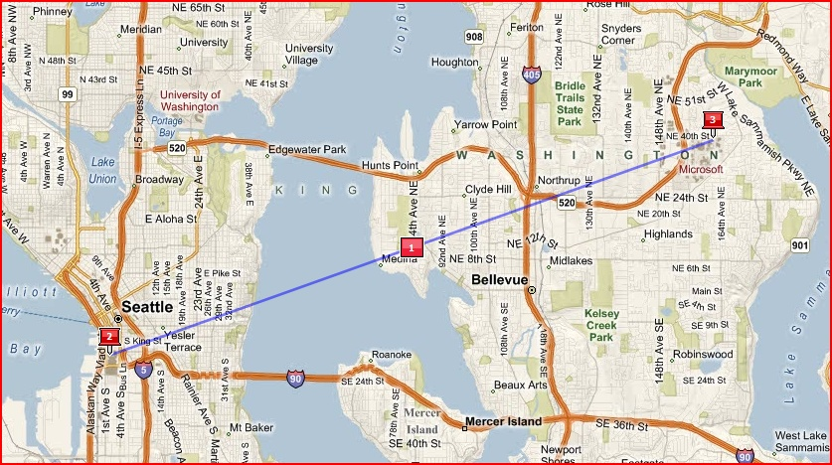
Datos espaciales
Algoritmos planares (tierra plana) y Geodésicos (globo terráqueo)
Visualización de datos espaciales con el Virtual Earth SDK
Intercambio de información espacial utilizando GML XML
Integra los datos espaciales con aplicaciones .NET
Optimiza el rendimiento utilizando índices espaciales
Soporte de los partners para los tipos de datos espaciales
47.6456,
-122.12551
Notes:
Make sure the audience understands the difference between Planar and Geodetic measurement systems. Although you could do all the work with Geodetic systems, for historical reasons (mostly due to the lack of commonly available efficient computing systems), much existing spatial work occurs with flat Earth mappings. Over short distances, the curvature of the Earth isn’t an issue, but it becomes more of an issue with larger distances.
You are able to create mashups with Virtual Earth data and are able to interchange our spatial data with others using standard GML XML.
Spatial calculations are tough. A key differentiator for SQL Server 2008 is the provision of a separate MSI that lets .NET applications make direct use of spatial functions and data types.
Although you could do many of the same things without specific spatial support, performance could quickly become an issue. Imagine trying to find all the streets that intersect a university campus. It might seem simple to do that if the table of streets includes only those in the district. But if the table includes all those in the city, it’s harder. And if the table includes all streets in the country, you start to realize where standard relational approaches would let you down. Spatial indexes let you build high-performing spatial applications.

Slide 6
Tipos de datos espaciales
Tipo de Datos Geography
Modo de uso
Almacena varios tipos:
  Puntos
  Cadenas lineales
  Polígonos
  Combinaciones de los anteriores
Funciones espaciales
  Relaciones espaciales: intersecciones, tangencias, etc.
  Construcciones espaciales: intersección, unión, etc..
  Métrica: distancia, área
Creación de una instancia:
  declare @g geography
  set @g = geography::Parse(‘POINT(47.6456 -122.12551)’)
Crear una tabla:
  create table T(id int, region geography)
Seleccionar datos:
  select * from T where region.STIntersects(@g)
  = 1
Tipo de datos Geometry
Soporta los estándares OGC
Notes:
Make sure the audience understands that the geography data type relates to the flat Earth systems and that the geometry type relates to the round Earth systems. Note that the Earth isn’t spherical. SQL Server 2008 models it as an ellipsoid squashed 1 in 300. Calculating distances and doing calculations on spheres is fairly easy. Doing the same calculations on such an ellipsoid is very complicated. SQL Server 2008 provides that code for you in an easy-to-consume form.
Geography and Geometry are new system CLR types. Mention at this point that there is now a distinction between system and user CLR types. Regardless of your “Enable CLR Integration” setting, these types are available for use.
The OGC standards provide for a large number of spatial functions. SQL Server 2008 implements many of these and certainly all of the most useful ones.

Slide 7
{ Información espacial}
demo
Operación con tipos de datos espaciales
Notes:
SQL Server 2008 introduces spatial data types. This demonstration is structured in two halves. The first part of the demo uses a basic spatial viewer to demonstrate basic queries using the geometry data type. The second part of the demo starts the story of Next Generation Discount Airlines (NGDA). NGDA is a startup discount airline providing services to outback Australia. It has challenges with large distances and lightly populated areas. Transportation costs are significant for those living in these areas. The demo shows an application used to locate the nearest major transport hub for any given city and how far away that hub is. The application is expanded in subsequent demos.
To avoid a dependency on a live Internet connection, a fixed image taken from Virtual Earth is overlaid in the application.

Slide 8

Datos no estructurados
FileStream
Atributo de almacenamiento en VARBINARY(MAX)
Datos no estructurados guardados directamente en sistema de archivos NTFS
Modelo de programación dual:
  T-SQL (como un BLOB SQL)
  API de Streaming de Win32 Streaming APIs con semántica transaccional de T-SQL
Consistencia transaccional
Capacidad de gestión integrada
  Backup/restore
  Seguridad de SQL Server
Tamaño limitado al tamaño del volumen del sistema de archivos
Guarda BLOBs en DB + File System
Aplicación
BLOB
Base de Datos
Notes:
A religious debate has raged in the industry for years on the best way to store BLOBs. They are faster to access via the operating system, but doing so provides transactional consistency issues. It has been easy for the operating system data to become out of sync with the database pointers to that data.
The FileStream data type provides the best of both worlds. Full transactional consistency is maintained. And a dual programming model means you can access the data via T-SQL or in a higher-performing way via Win32 streaming APIs.
An added advantage is the ability to manage the data along with other database objects in terms of backup/restore and security.

Slide 9
Aplicaciones de Datos de Nueva Generación
Completo
Flexible
Productivo
Datos espaciales
Estructurados
No estructurados
Mejoras en T-SQL
SQL Server Compact
Synchronization Services para ADO.NET
Modelo de Datos de Entidad
ADO.NET Entity Framework
LINQ
ADO.NET Data Services
Desde la Base de Datos a la Plataforma
Notes:
The second pillar we will be discussing is how SQL Server 2008 is the most flexible data platform to date.

Slide 10



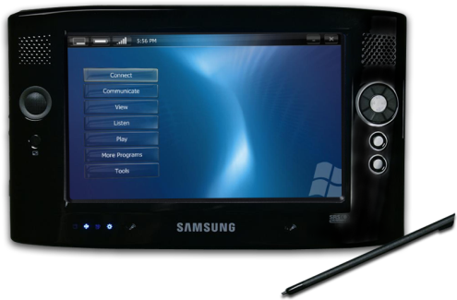
El reto de la flexibilidad
Mejoras en T-SQL
    Fecha/Hora
    Parámetros tabulares
    Dependencias de objetos
    MERGE
    Grouping Sets
    Muchos más...
Creciente complejidad de los datos
Sincronización de datos
    SQL Server Compact
    Microsoft Sync Framework
    Visual Studio 2008
    Control de cambios
Los usuarios necesitan acceso a los datos offline
Notes:
At this point, drive home the need to be able to handle more complex data, for developers and DBAs to achieve more in the same amount of time, and for users to get offline (yet synchronized) access to their data.
Again, do not spend too long on the bulleted points, which are discussed later.

Slide 11
Mejoras en T-SQL
Combina las operaciones INSERT y UPDATE mediante la nueva sentencia MERGE
Se pasan como parámetros estructuras complejas y listas de valores a los procedimientos almacenados mediante los nuevos parámetros tabulares
Se crean nuevas filas de datos sobre la marcha con los nuevos constructores de datos tabulares
Se simplifica la lógica de agregación con los nuevos Grouping Sets
Control exacto de las dependencias de los objetos mediante nuevos DMFs
Notes:
A common programming requirement is to insert data if it isn’t already there but update it if it does exist. The MERGE statement provides this ability in a single automatic operation. A great side benefit is that it does so on full sets of data, not just on individual rows. This can make a huge difference in ETL processes such as in SQL Server Integration Services when maintaining data warehouses or processing data from staging tables.
It is also common to need to pass a list of values to a stored procedure. Most programmers accomplish this via hacks like comma-delimited lists and then have to break the list apart with table-valued UDFs. Alternatively, they have accepted the overhead of passing in XML parameters and then needing to crack those open. Table-valued parameters let you pass complex structures and lists directly into stored procedures and then have them already in a table format ready for processing in the procedure.
The INSERT statement now has the ability to insert multiple rows at once. Table-valued constructors have enabled this. They can also be used in a variety of other statements, such as in the source for a MERGE statement.
CUBE and ROLLUP provide limited aggregation abilities, but the new Grouping Sets provide a standard way to produce summary data.
In SQL Server 2005, sp_depends suffers from a lack of full knowledge about dependencies, mostly due to deferred name resolution. SQL Server 2008 replaces sp_depends with a pair of new dynamic management functions (DMFs) that accurately reflect object dependencies, including partial dependencies when the full information is not yet known.

Slide 12
Mejoras en T-SQL
Nuevos tipos de datos
Aplicaciones con una mejor gestión de fecha/hora gracias a nuevos tipos de datos de alta precisión:
  datetime2
  date
  time
  datetimeoffset
Permite abordar problemas complejos con UDTs y UDAs más grandes
!!!
Notes:
DateTime2 provides a much higher precision DateTime data type. This can be very important when importing data from other systems that support different date ranges.
SQL Server 2008 provides separate date and time data types! This is a woo-hoo moment for SQL Server and delivers on a very common request from users. SQL Server 2008 also provides support for storing and processing time offsets with datetime data. GETDATE() has been enhanced and replaced by SYSDATETIME() and SYSDATETIMEOFFSET().
In SQL Server 2005, user-defined data types and user-defined aggregates are limited to 8K of static data. This restriction has been lifted, and these objects can now be up to 2GB in size. This allows for significantly more powerful types, such as the new system CLR types: geometry, geography, and hierarchyid.

Slide 13

Mejoras en T-SQL
Tipo de datos HierarchyID
Representa una posición en una jerarquía
La representación natural de:
  Organigramas corporativos
  Listas de componentes
  Contabilidad – cuentas/subcuentas
  Gestión de contenidos
  Foros / lista de correo
Almacenamiento compacto y eficiente
Soporte para inserciones y borrados arbitrarios
Potentes métodos de consulta
  GetRoot, GetLevel, IsDescendant, ReParent, etc.
Notes:
Modeling tree-structured data in a relational database has been done in a wide variety of inconsistent and incompatible ways.
HierarchyID is the SQL Server implementation of an ORDPATH type. Applications can be built to support tree structures in a compact, efficient, and consistent way. A powerful set of query methods have been provided.

Slide 14
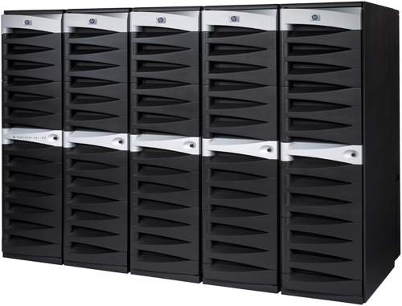

Sincronización de datos
SQL Server Compact
  Base de datos por defecto en Visual Studio 2008
  Orientada a desktops y dispositivos móviles
  Edición reducida de 2 MB de SQL Server
  Soporta la sintaxis de T-SQL y la mayoría de tipos de datos
Gestión de cambios en SQL Server
Synchronization Services for ADO.NET
  Detección y resolución de conflictos
  La detección y resolución se realizan de manera independiente en cada nodo
  Pueden definirse acciones personalizadas para resolver los conflictos
Notes:
SQL Server Compact Edition provides the ideal local cache for partially connected and mobile applications. It has a particularly small footprint and is trivial to deploy. It is supported on both desktop and mobile operating systems. It can be deployed without the need for administrative permissions. It supports a subset of T-SQL syntax and most SQL Server data types.
SQL Server change tracking provides a simple mechanism for detecting changes in underlying tables and, when used in combination with the Sync Framework, makes building local caching applications easy. Conflict detection and resolution are critical for such applications, and the Sync Framework provides support for these out of the box. For even finer-grained control, custom resolution schemes can be implemented.

Slide 15
Next-Generation Data Applications
Comprehensive
Flexible
Productive
Spatial
Unstructured
Structured
T-SQL enhancements
SQL Server Compact
Synchronization Services for ADO.NET
Entity Data Model
ADO.NET Entity Framework
LINQ
ADO.NET Data Services
From Database to Platform
Notes:
The third pillar we are discussing is how SQL Server 2008 is the most productive application platform to date.

Slide 16
Retos de productividad
Hasta un 40% de todo el código de las aplicaciones es código de acceso a datos
Acceso a datos
    Entity Data Model
    ADO.NET Entity Framework
    LINQ
    ADO.NET Data Services
Desconexión entre la programación orientada a objetos y las BD relacionales
Las aplicaciones Web de nueva generación necesitan datos
Notes:
At this point, it’s important to spell out that more than 90% of applications are data-related and that up to 40% of all code in applications is data-access code. This code is highly repetitive and typically involves large amounts of duplication. Reducing this code lets you build applications much faster and to greatly reduce support costs.
Most business applications today are built using object-oriented techniques. Unfortunately, there is a disconnect between the view that these applications need of the corporate data and how the data is stored in a relational database. Additionally, different applications might require different views of the same data.
Newer applications using technologies such as Silverlight and AJAX need access to corporate data in an asynchronous fashion. Today’s Web services are using mechanisms that were designed for presentation layers. Faster and simpler access is needed to the data using protocols optimized for data only.
Again, do not spend much time on the bullet points for the features because they are discussed in later slides.

Slide 17

Modelo de Datos de Entidad
Permite definir un modelo conceptual de una empresa
  Refleja los requisitos corporativos, en vez de aplicar un modelo de base de datos relacional
  Reduce la complejidad de las aplicaciones
  Soporta conceptos no relacionales avanzados, como la herencia
  Captura el conocimiento del dominio mediante programación declarativa y soporte de diseño basado en Visual Studio
1: Modelo de Objeto
2: Modelo conceptual
3: Modelo de BBDD
Notes:
Today, corporate data is most efficiently stored in relational database engines. This relational view, however, does not reflect the view required by business applications. Multiple tables may need to be queried to provide data for a single class. Knowledge about class inheritance tends to live in developers’ brains rather than in any declarative form because the relational database does not store these concepts.
The Entity Data Model allows the creation of entities that reflect business requirements. It then provides a declarative mapping layer (via a conceptual model) that relates this object model to the underlying database model.
This also allows different applications to have different entities modeled off the same underlying corporate data.
Visual Studio-based designers make it easy to create the mapping layer.

Slide 18

ADO.NET Entity Framework
Desvincula el modelo de aplicación del esquema de almacenamiento
  Las consultas se expanden en el cliente, pero se evalúan en el almacén de datos
  Mapeo flexible
    Múltiples entidades en una misma tabla
    Entidades distribuidas entre varias tablas
    Soporte para procedimientos almacenados
  Permite la evolución independiente de las aplicaciones y el esquema
LINQ
To Entities
LINQ
To Datasets
Servicios de Datos
Entities
Datasets
ADO.NET Providers
Notes:
Applications are no longer limited to querying only at the ADO.NET or Dataset layers.
The Entity Framework gives the developer a choice of layers to program to, based on the needs of the application. Queries are expanded at the client before being sent to the data store, where they are then efficiently processed.
Decoupling the application model from the underlying schema insulates applications from changes in the corporate schema. This means that both the application and the corporate data schema can evolve independently while minimizing rework. This can greatly reduce support and maintenance costs.

Slide 19
LINQ
LINQ to SQL and LINQ to Entities
IntelliSense, typed vars, compile-time
error checking
Add logic to insert, update, delete events
LINQ to SQL
  Access SQL Server databases only
  1:1 mapping of SQL Server database to classes
LINQ to Entities
  Enables richer level of abstraction
  Entity Framework provides flexible
  mapping support
Notes:
It has been common for applications to construct statements that are sent to data stores for execution. Until the statement arrives, no knowledge of the correctness of the statements is available. While constructing statements, the developers are given no assistance regarding the correct names of items.
LINQ is a language enhancement that provides advanced querying ability in .NET-based languages. LINQ can be used at a variety of levels in the system, including SQL, Entities, XML, and Datasets.
When used with SQL, LINQ has a close relationship with the underlying SQL Server structure.
When used at the Entity layer, a richer level of abstraction is provided. This allows the developer to work with objects more related to business functions than to relational storage schemas.

Slide 20
ADO.NET Data Services
Exposición de datos más segura en forma de servicios ampliando ADO.NET
Acceso a “recursos” sobre HTTP utilizando URIs
  Uso de verbos (GET y POST)
Soporte para CRUD (create, read, update, delete)
Soporta resultados en formato XML y JSON
Utiliza patrones de acceso basados en REST
Integra la lógica de negocio con los conceptos Web
  Paginación, clasificación, etc.
Expone recursos mediante puntos de entrada HTTP
Notes:
Advanced applications built using technologies such as Silverlight and AJAX access data asynchronously via Web service calls separately to their UI payload. Such calls are using technologies not optimized for pure data access.
ADO.NET Data Services allows corporate data to be securely exposed via standard protocols. A key aim was to avoid inventing any new protocols. Industry standards have been used throughout.
Data is accessed using standard HTTP verbs (GET and POST). Results are returned in XML and JSON formats, optimized for pure data access.
The services use standard REST-based access patterns and allow the incorporation of some business logic such as paging and sorting, along with the data access.
Standard HTTP port entry points are used rather than SQL Server-specific ports.

Slide 21
Resumen
SQL Server 2008 permite trabajar a los desarrolladores de manera más eficiente
  Datos espaciales y no estructurados
  Mejoras en T-SQL
  Nuevos tipos de datos
  Sincronización avanzada
  ADO.NET Entity Framework

Slide 22

FTS en EL PAÍS
Donde se utiliza FTS en EL PAÍS
  Sistema Documental (fotos, infografías, texto)
Porque utilizamos FTS en EL PAÍS
  Historia de la aplicación desde SQL 6.5 a 2005
Como tenemos configurado FTS
  Arquitectura: Cluster de dos servidores x86 con 3 GB RAM y 2 procesadores Intel ( 4 con hyperthreading) con almacenamiento HP EVA
  2 catálogos de FTS ( 4 y 5 millones de registros)
  Actualización incremental y automática
  Tiempo de creación de los catálogos:
    En SQL 2005 5 horas para una tabla con 4 millones de registros, generando un fichero de 3 GB y con 3.386.249 palabras únicas.
    En SQL 2005 3 horas para una tabla con 3 millones de registros, generando un fichero de 2GB para 3.498.643 palabras únicas.
  Acceso desde aplicación para documentalistas y desde la intranet para toda la compañía.

Slide 23
FTS en EL PAÍS
FTS en SQL 2005
  Posibilidad de elegir la sensibilidad a los acentos
  El backup de BD se integra con el catálogo de FTS
  Tres veces más rápido creando los catálogos en comparación con SQL 2000.
Las novedades esperadas en EL PAÍS con SQL 2008
  Filestream
  Integración del motor de búsqueda dentro del motor de SQL
  Ver las tripas del catalogo de FTS
  Dettach\Attach, log shiping con FTS

Slide 24
Recursos
Sobre programación de datos
  http://www.microsoft.com/sql/2008/technologies/dataprogrammability.mspx
Más info sobre datos espaciales
http://www.microsoft.com/sql/2008/technologies/spatial.mspx
Información sobre SQL Server 2008
http://www.microsoft.com/sql/2008/default.mspx
Webcasts, Labs Virtuales y Whitepapers de SQL Server 2008
http://www.microsoft.com/sql/2008/learning/default.mspx
Formación en SQL Server 2008
http://www.microsoft.com/learning/sql/2008/default.mspx
Descarga de CTP de SQL Server
http://www.microsoft.com/sql/2008/prodinfo/download.mspx
Comunidad de SQL PASS
http://www.sqlpass.org
Rincón de SQL a partir de las15:15.

Slide 25
Contactos
Fernando G. Guerrero
  FGuerrero@SolidQ.com
  Solid Quality Mentors
Adriana Rangel Sotter
  arangel@esri-es.com
  Esri España.
Arturo López
  alopez@microsoft.com
  Microsoft España.
Francisco Camina
  franca@microsoft.com
  Microsoft España.

Slide 26

Este es un documento preliminar y puede cambiar notablemente antes de la aparición de la versión comercial del producto descrito en él. La información contenida en este documento representa la visión actual de Microsoft Corporation acerca de los temas analizados en la fecha de publicación. Debido a que Microsoft debe responder a condiciones de mercado cambiantes, no debe interpretarse como un compromiso por parte de Microsoft, y Microsoft no puede garantizar la exactitud de ninguna información aquí mostrada después de la fecha de su publicación. Este documento se publica con fines informativos exclusivamente. MICROSOFT NO OFRECE GARANTIAS, EXPRESAS, IMPLICITAS NI ESTATUTARIAS SOBRE LA INFORMACIÓN CONTENIDA EN ESTE DOCUMENTO.
© 2008 Microsoft Corporation. Todos los derechos reservados. Microsoft, BizTalk Server,.NET Framework, el logo Office, SQL, SharePoint, Visio, Visual Studio, Windows Server y Windows son marcas registradas o marcas comerciales de Microsoft Corporation en Estados Unidos y/o en otros países. Otros nombres de empresas y productos mencionados aquí pueden ser marcas registradas de sus respectivos propietarios

