Slide 1

Introduction
Richard Moore
IW Business Group Lead
Microsoft Ireland

Slide 2

What’s Your Take
On The Economy?

Slide 3





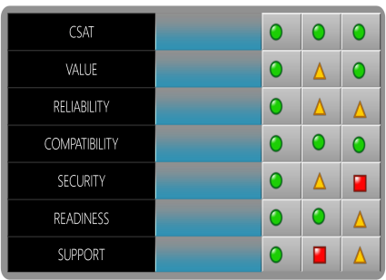




What We Hear From Our Customers:
SAVE ME TIME
INCREASE OUR PRODUCTIVITY
SAVE ME MONEY
HELP US GROW OUR BUSINESS

Slide 4
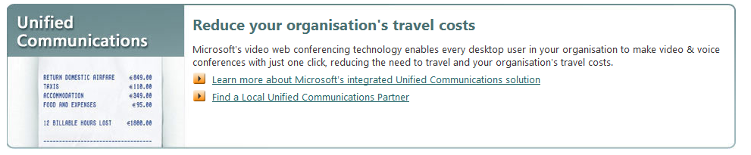
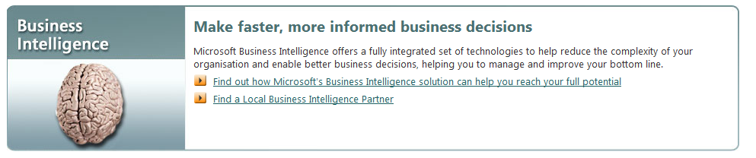
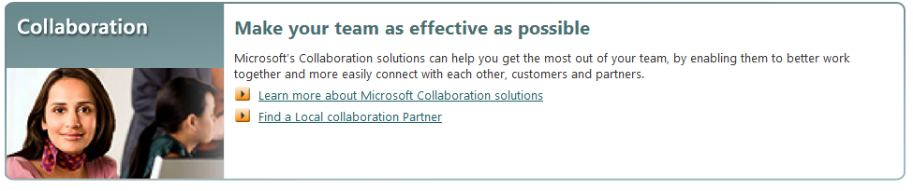

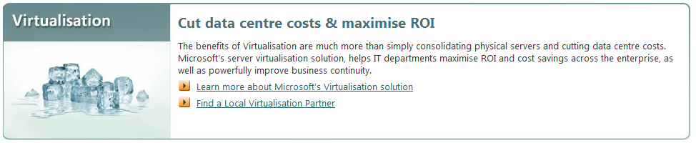
What can I do to address these challenges?

Slide 5
Today’s focus

Slide 6



Products
Business Productivity Infrastructure
Unified Communications And Collaboration
Business Intelligence
Enterprise Content Management
Extended collaboration, mobility desktop
Business productivity server
Business Data Catalog
Open XML File Formats
Website and Security Framework
Workflow
Search
Extensible UI
E-mail, calendar, unified messaging server
Presence, IM, Web conferencing, VoIP server
Secured, Well-Managed Infrastructure
Notes:
6

Slide 7

























UC&C Partners

Slide 8
Next Steps
Check out www.microsoftconnect.ie for presentations, photos, videos from the event
Resources: MOSS Gear-Up side
http://sharepoint.microsoft.com/gearup/Pages/default.aspx
SharePoint Users Group – Dublin & Belfast
Complete your feedback forms
If you would like a consultation indicate on your form

Slide 9
Connect: Other Topic Areas
Coming Soon!
Coming Soon!

