Slide 1
Stop the IT/User Tug-of-War with
Microsoft's Windows Optimized Desktop
Featuring customer baa cio philip langsdale

Slide 2

Today’s Webcast Speakers
Moderator:
  Joseph E. Maglitta - Editorial Director and Market Expert - Ziff Davis Enterprise Market Strategies and Content Services
Customer:
  Philip Langsdale, CIO, BAA
  Tim Matthew, Head of IT Architecture, BAA
Notes:
Add pictures and logos and visuals

Slide 3

Agenda
BAA Profile
Business and Technology Challenges
Appeal of Windows 7 for BAA
Evaluation Criteria
Deployment Strategy & Tangible Benefits
Industry & Customer reaction to Windows 7

Slide 4
Company Profile: BAA
7 UK Airports
Ferrovial Consortium acquired BAA in July ’05
>200m passengers pa
Over 12,000 staff
Rail Link between Heathrow and London
Heathrow Airport flies to over 180 destinations in over 90 countries, with some 90 airlines have made Heathrow their base.
Over the next five years BAA is investing £6.6bn across its seven Airports.
£4.8bn being spent on transforming facilities at Heathrow.

Slide 5

BAA IT Services Technology Scope & Scale
10,000 End Users
15,342 PC’s including FIDS, etc.
185,468 contacts pa
200 Corporate Applications
800 Change Request pa
50,000 Work Orders pa
485 Business Applications
420 TB of live data
1,800 servers
60+ commercial telecom customers
1500 network cabinets
75,000 Data Ports
19,000 phones
5000 mobile phones
500 wireless devices
4 Primary Data Centres
1673 Comms & Server rooms

Slide 6
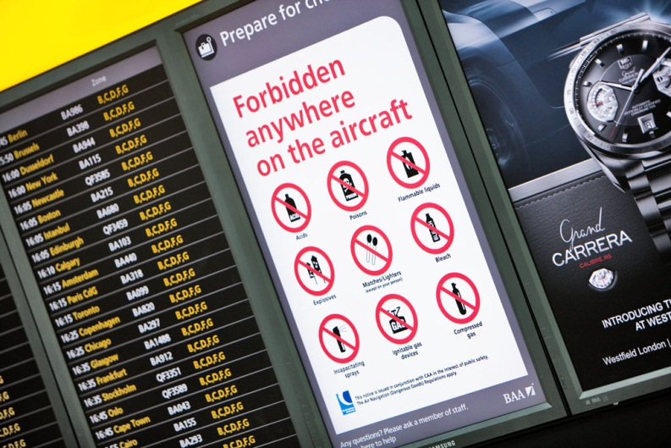
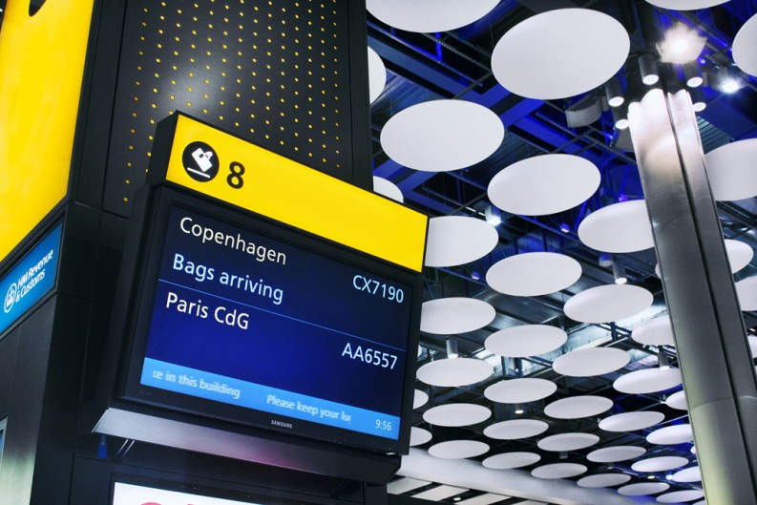
Industry & Business Challenges
Recently, IT has begun to move from a cost centre based function, seen as non-strategic and un-aligned with the business direction, to a critical and business differentiating capability.
The increasing importance of IT to BAA has led to the inclusion of the CIO on the Executive Committee and a stronger focus on strategic investment and service improvement.
The changes introduced are leading to a significantly improved relationship between BAA IT and the business leadership
Grupo Ferrovial have approved a strategy for IT which is seeking to exploit IT synergies and deliver and accrue savings at group level

Slide 7
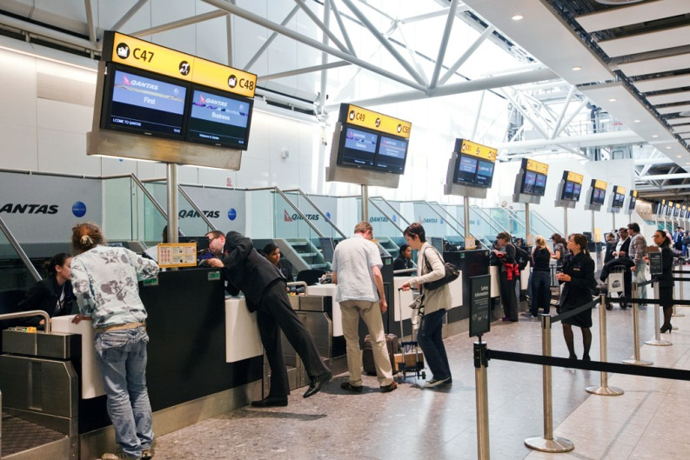
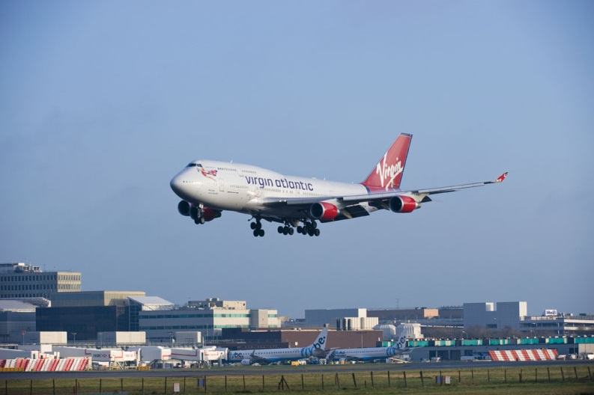
BAA’s Drivers for Change
Increased focus on the Passenger – IT enabling the process from kerb to gate, gate to kerb.
Heathrow strategy to be the European hub of choice.
Delivering the appropriate quality of service for each Airport.
Realisation that a “one size fits all” strategy is not fit for purpose.
A drive to lower costs and simplify the IT within Airports Division.
Process and process compliance to poor.
Pressure to reduce IT Opex by £100m during Q5.
Regulatory demands meaning the business model shifting towards divestment.
Data quality already poor and getting worse.
The complexity of the technology landscape causes increased demand on service quality and cost.

Slide 8

The Strategy for BAA IT
The Strategy for Heathrow will deliver a more cost effective, service differentiating capability for the Airport.
The strategy for Airports Division will deliver a cost effective selection of the architecture at an individual airport level, thereby enabling separation if necessary.
There will be separate systems rolled out for Heathrow and Airports Division (for both the airport operations front office and the back office).
The chosen solutions will meet the differing needs of Heathrow and Airports Division and be aligned to the specific strategy of the respective Airports.

Slide 9
BAA’s Strategic IT Principles
IT will be accountable for all IT investment, opex and resource allocation;
IT architecture will be aligned to the BAA strategy and appropriate to the needs of each airport;
IT will deliver reliable services, agile and flexible infrastructure and support innovation;
IT will manage performance against KPIs which are directly aligned to the needs of the business;
IT infrastructure will be compatible and flexible enough to allow for “plug and play” services;
IT governance, processes and standards will enable the successful delivery of all business/IT programmes;
IT investment will not be shared across Heathrow and Airports Division;
All IT projects will follow a standard BAA Project lifecycle process;
Sourcing will be dictated by operational and strategic importance.

Slide 10




Why did BAA move to Windows 7?
Support the simplification of the technology landscape
To help reduce cost and complexity
Increase the productive of staff working within or away from BAA.
Simplify the security of the desktop
Streamline PC Management

Slide 11
Evaluating Windows 7
BAA evaluated Windows 7 in the following areas:
Ease of deployment and management
Cost to deploy
The ability to simplify the infrastructure to help reduce costs and complexity
Security
Operational support benefits over XP
Windows Vista vs. Windows 7
Tangible benefits with Windows 7
Benefits are deploying alongside Server 2008 R2

Slide 12






Deployment Strategy & Impact
Deployment Strategy:
Deployment strategy will be a phased approach based upon refreshing hardware
Reduce the number of different technologies used within the technology stack—simplify the deployment image.
Benefits:
Ease of deployment and build management
Demonstrating that IT is supporting the business by delivering better ways for them to work and also reducing IT costs to the business
Intuitive UI and navigation
Notes:
Moderator questions:
How have the technologies helped you to identify problems and resolve PC issues? What has been the impact on your IT staff?
Discuss advanced diagnostics and the new Windows Troubleshooting platform
What has helped you to simplify security?
Discuss BitLocker To Go, Group Policy
How was productivity of your employees been impacted?
Discuss DirectAccess and BranchCache in Windows 7 Enterprise; Windows Server® 2008 R2

Slide 13



The Advantages of Windows 7
Windows 7 can help you:
Make People Productive Anywhere
Manage Risks
Through Enhanced Security And Control
Reduce Costs by Streamlining PC Management
Notes:
Make People Productive Anywhere
Provide seamless access to data from anywhere
Give people access to the right applications from anywhere
Everyday tasks are faster and easier
Manage Risks Through Enhanced Security And Control
Protect Desktop and Mobile Resources
Enforce Compliance with corporate policies, government regulations, and software licenses
More secure Web Browsing
Reduce Costs by Streamlining PC Management
Simplify application and desktop lifecycle management
Improve control and automation
Keep PCs running smoothly
Manage physical and virtual assets from one place

Slide 14




Analysts and Editors are Showing Support for Windows 7
“This upgrade is big, and it’s hugely recommended for Microsoft users.” - Brian Chen/Wired
“No one runs an operating system just for the pleasure of the interface; the point is to get work done. And that means getting to your files quickly. But file-handling and search rarely get headlines. With the release of Windows 7, perhaps they should. Windows 7 makes it much easier to organize and find files and folders; this will most likely save you far more time than you might imagine.” – Preston Gralla/ Computerworld
“Windows 7 is damn good and a far cry from what ‘legacy’ Windows operating systems were. I would personally recommend it to anybody - professionally or personally - simply after using it and experiencing the high performance, the responses it gives me, the application compatibility and the general cleanliness of the user experience.” - Zack Whittaker/ZDNet

Slide 15
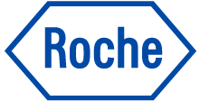


And Early Adopters Are Seeing Value Today…
“Using Windows 7, we’ll be able to better support our strategy as a global company and more easily share information no matter where our employees and consultants reside.”
Petter Wersland, Leader of the Windows Ecosystem at StatoilHydro
“Employees don’t have to worry about manually synchronizing their data—it’s now synchronized automatically, and users have access even when they are disconnected from the network. This is a big win for our users.”
Dieter Reichert, Program Manager of Workplace Solutions, F. Hoffmann-La Roche
“We are able to deploy to different computer devices using the same image file—helping reduce deployment time by 60 percent. What used to take three and a half hours now takes as little as one hour.”
Andreas Viehauser, Head of Client and Software Management, Raiffeisen Informatik
“Windows 7 allows us to deliver greater performance and flexibility to our staff and helps them work more efficiently so that we can better serve our clients.”
Laurence Longe, National Managing Partner, Baker Tilly
Notes:
StatoilHydro is a leading crude oil and gas supplier and its expanding international presence includes 30,000 employees in 40 countries. It had 2008 revenues of NOK 656 billion (U.S.$102 million). StatoilHydro wanted to speed information access at branch offices and improve network connectivity for remote employees. At the same time, the company wanted to enhance IT security. StatOilHydro upgraded its client and server environments, taking advantage of features available in the Windows Server® 2008 R2 operating system together with the Windows® 7 operating system.
Roche employs over about 80,000 people and sells its products in over 150 countries. As a research-focused healthcare company, Roche discovers, develops and provides innovative diagnostic and therapeutic products and services that deliver significant benefits to patients and healthcare professionals – from early detection and prevention of diseases to diagnosis, treatment, and treatment monitoring.
Based in Vienna, Austria, Raiffeisen Informatik is one of the largest IT services providers in Austria with 3,000 employees in 27 worldwide locations. In 2008, the company posted nearly U.S.$1.7 billion in revenue. To prepare for customers who want to upgrade to Windows® 7, the company decided to upgrade to the operating system internally in a pilot deployment. As a result, Raiffeisen Informatik looks forward to streamlined deployment, enhanced security, increased support for mobile employees, and an improved user experience
Baker Tilly is one of the largest firms of chartered accountants and business advisors in the United Kingdom, with 2,200 employees at 25 locations. The firm has a high concen­tra­tion of mobile employees—more than 70 percent of its employees often work from dis­persed locations using portable com­puters.
Companywide, Baker Tilly used the Windows XP® operating system and the Windows® Internet Explorer® 6 browser. Looking for ways to support its dispersed work­force, and to streamline computer management, the firm wanted to upgrade its operating system and implement an up‑to-date Internet browser.
Over a four week period, Baker Tilly deployed Windows 7 Enterprise Edition Release Candidate. It migrated more than 2,200 computers spread across the company’s 25 locations. Working with Dell was crucial to the project, giving Baker Tilly ready access to the expertise necessary for success

Slide 16
Top Resources
Visit these resources for more on Windows 7 and the Windows Optimized Desktop
Windows 7: www.Windows.com/Enterprise
Windows Optimized Desktop: www.Microsoft.com/OptimizeDesktop
Windows 7 for IT Pros: www.Microsoft.com/Springboard
Microsoft Desktop Optimization Pack: www.Microsoft.com/MDOP

Slide 17
QUESTIONS?
Notes:
Questions from the Audience:
What cost savings does BAA anticipate from their Windows 7 deployment?
What are the main advantages of Windows 7 over Windows XP?
How will Windows 7 give you an advantage over your competitors?

