Slide 1
Network Connected devices with Windows SideShow™
Teague Mapes, Lead Developer, tmapes@microsoft.com

Slide 2
What is Windows SideShow?
Enables instant access to important information on a variety of display devices connected to a computer
Enables new two-way remote control scenarios
Provides end-user control of gadgets via Control Panel
Completely extensible architecture
Anyone can write gadgets using the API
Anyone can build devices using the Device Driver Interface
Frees developers from writing device-specific code

Slide 3





10,000-foot View
Gadget running on Windows Vista
Gadget gets data from data source, such as application or Web
Gadget output is device-independent XML
Output is sent to devices via Windows SideShow APIs

Slide 4
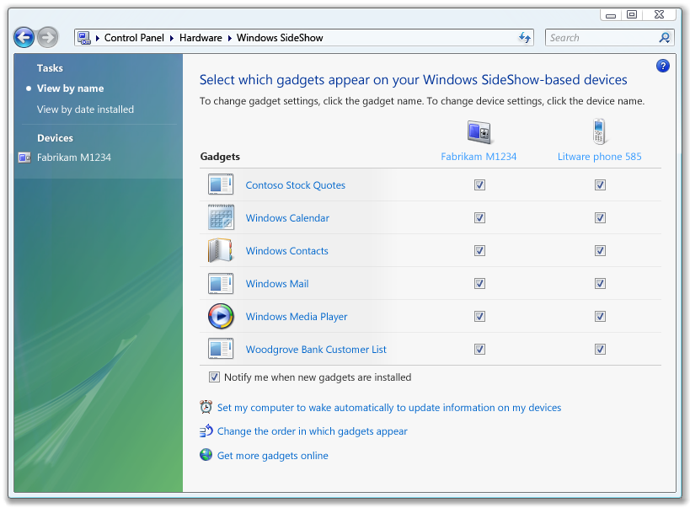


10,000-foot View
Control Panel acts as a switch, routing gadget data to devices
Based on user preferences

Slide 5

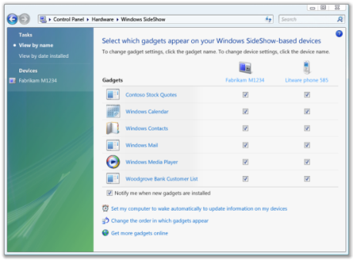
10,000-foot View
Gadget running on Windows Vista
Navigation
Windows SideShow Platform
Content Flow (push)
Device
Device

Slide 6

demo

Slide 7
“Universal” Driver
Reduce barriers to enabling SideShow with custom firmware
No PC code necessary to build a device!
Standard Microsoft-provided driver
USB
Bluetooth
TCP/IP (Uses PnP-X for device discovery)
SSL
Same driver for Windows CE implementation
Windows Update for seamless installation

Slide 8
Standard Wire Protocol
Protocol and driver is licensable for use by anyone
Business Term Sheet available; contact sshowext@microsoft.com for more information
Standard driver uses new wire protocol for SideShow
http://www.microsoft.com/whdc/device/sideshow/Univ-Drv_SideShow.mspx
Passes content/commands directly to device from SideShow DDI
Requires “smart” device implementation

Slide 9
TCP/IP Connectivity
Uses Windows Rally technologies for device discovery
Plug and Play Extensions (PnP-X)
UPnP 1.0: CE5
Devices Profile for Web Services: CE6
Seamless user experience
Device appears in Network Explorer
Double-click → Automatic driver installation
Support for unsecure and secure TCP communication channel

Slide 10
Resources
One stop shop for Windows SideShow development information:
http://www.microsoft.com/whdc/device/sideshow/default.mspx
Windows CE and Windows Mobile contact:
Business contact:
showmobx @ microsoft.com
sshowext @ microsoft.com

Slide 11

© 2006 Microsoft Corporation. All rights reserved. Microsoft, Windows, Windows Vista and other product names are or may be registered trademarks and/or trademarks in the U.S. and/or other countries.
The information herein is for informational purposes only and represents the current view of Microsoft Corporation as of the date of this presentation. Because Microsoft must respond to changing market conditions, it should not be interpreted to be a commitment on the part of Microsoft, and Microsoft cannot guarantee the accuracy of any information provided after the date of this presentation. MICROSOFT MAKES NO WARRANTIES, EXPRESS, IMPLIED OR STATUTORY, AS TO THE INFORMATION IN THIS PRESENTATION.

