Slide 1
Windows™ Rally ®
Overview and Directions
Windows Rally Summit
June 2008
Glenn Ward
Windows Core OS Division
Microsoft
Notes:
6/12/2008 10:15 AM
© 2006 Microsoft Corporation. All rights reserved. Microsoft, Windows, Windows Vista and other product names are or may be registered trademarks and/or trademarks in the U.S. and/or other countries.
The information herein is for informational purposes only and represents the current view of Microsoft Corporation as of the date of this presentation. Because Microsoft must respond to changing market conditions, it should not be interpreted to be a commitment on the part of Microsoft, and Microsoft cannot guarantee the accuracy of any information provided after the date of this presentation. MICROSOFT MAKES NO WARRANTIES, EXPRESS, IMPLIED OR STATUTORY, AS TO THE INFORMATION IN THIS PRESENTATION.
1

Slide 2
Agenda
Introduction
Rally Overview
Device Implementation Details
Demonstration
Future Directions
Notes:
2

Slide 3


What’s brought us here?
Far too many products showcased at CES 2008 were predicated on a stable, fast, and reliable home network infrastructure, along with connected PCs and other devices. Most of these products will fail as the underlying assumptions of consumer infrastructure, needed for success, are incorrect.
Companies that recognize the importance of simplifying the digital consumer electronics experience for consumers and leverage optimized tools for deployment and management will see the most success in 2008.
- Michael Gartenberg, “Consumer Backlash against Digital Technology, Jupiter Research”, 4/25/08
JupiterResearch believes the complexity of consumer technology will only get worse … and that will not be good for any industry initiatives.
Functions must be task centric (e.g., do you want to view your TV when away from home?) as opposed to tech centric (e.g., Do you want to forward ports 8800 and 81000 for remote access?).
Vendors must leverage clear, easy-to-understand wizards for consumers to walk through complex processes… <or risk failure.>
- Michael Gartenberg, “Consumer Backlash against Digital Technology, Jupiter Research”, 4/25/08

Slide 4
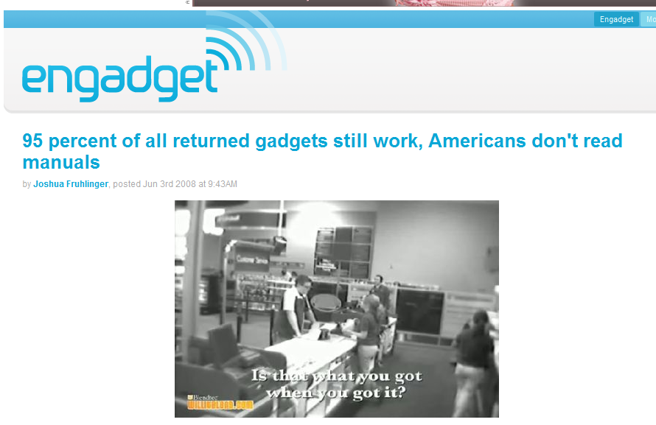
…even worse…

Slide 5
…now Get Ready for .11n …
U.S. Wireless Network Purchases
(New and Upgrades) - MM
Source: Jupiter Research Home Networking Model, Jan 2008

Slide 6

Device Connectivity Challenges
What’s the best installation experience I can have with Windows?
What components or suppliers let me minimize the dev work I have to perform?
How will awareness of these in-box capabilities be driven?
What will .11n mean for digital home applications and scenarios?

Slide 7
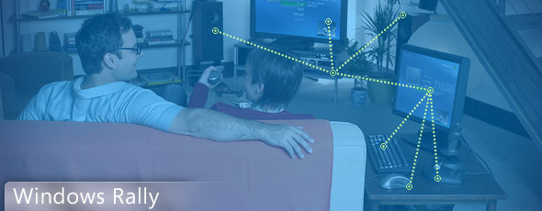
Windows Rally
Device Value
Simple to configure
Reliable, Performant Network Experience
Works well with Windows
Program
PlugFest and Interop
Technology Uptake
Showcase Opportunities

Slide 8
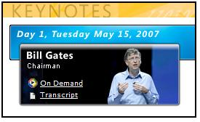
Rally at WinHEC Keynote
“…with this ease of set up we see many of those things coming into the mainstream. So we’ve focused on [developing this] underlying infrastructure, and so partners can take new Rally devices that are very differentiated, and so just the same way that USB came in and was such a fundamental building block, we see now Rally as important as that, and driving a whole new set of devices.”
- Bill Gates, Keynote Address, WinHEC 2007

Slide 9


Device Life Cycle
Discover & Install
Perform
Configure
Diagnose
Discover & Install
SSDP, WS-Discovery
WCN
Perform
LLTD QoS
LLTD, LLTD-QoS
UPnP, DPWS
PnP-X, Application(s)
Configure
Diagnose
PnP-X
LLTD
EAP, WCN
UPnP, DPWS

Slide 10
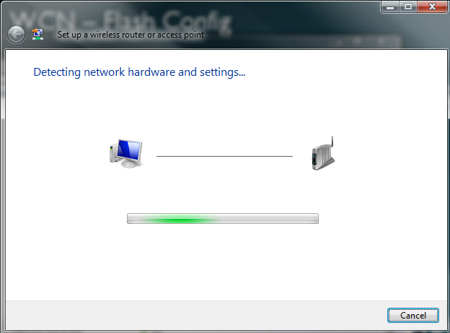
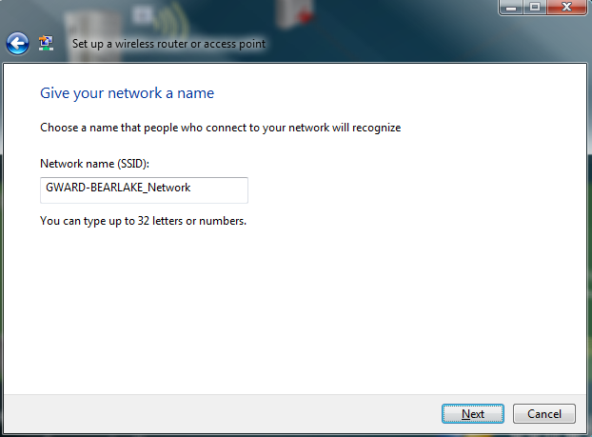
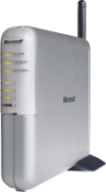
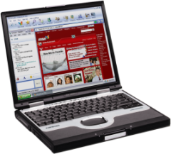
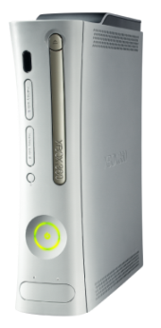

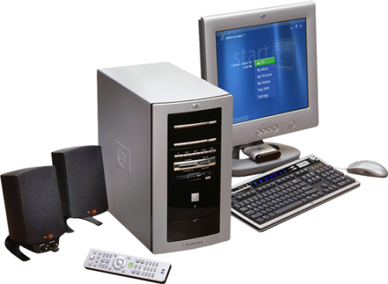
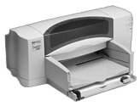
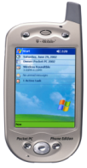
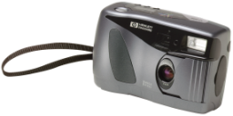
Wi-Fi Protected Setup / WCN
Windows XP & Vista
USB Flash Drive
Windows Vista
Ethernet
Ethernet
USB
Wi-Fi

Slide 11
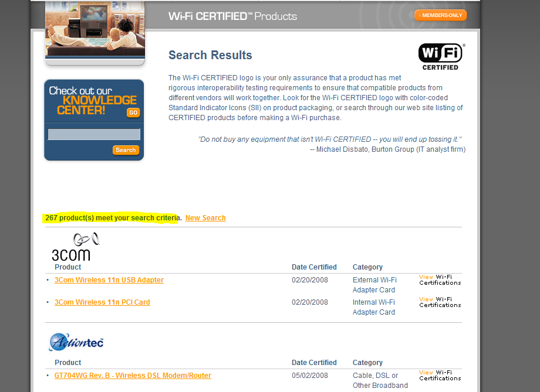
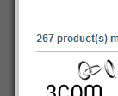

WPS / WCN Momentum
In WLK 1.2, 6 New tests added:
PIN Based Registrar
Missing Attributes
Optional Attributes
Proxy
Push Button
Registrar Discovery

Slide 12
Windows Vista Feature Pack for Wireless
New Functionality – EAP Transport, Push Button Configuration, UI Integration
Wave 1 RTM – 5/2/2008 (5 Languages)
Distribution Vehicles
Wave 1 – OEM Redist
Wave II – OEM & IHV Redist

Slide 13
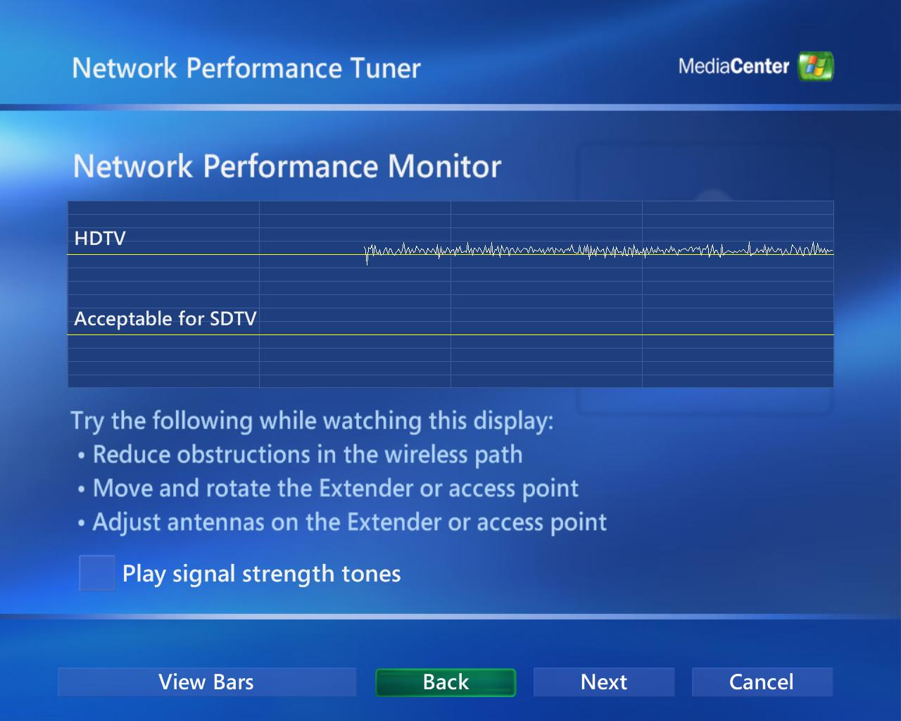
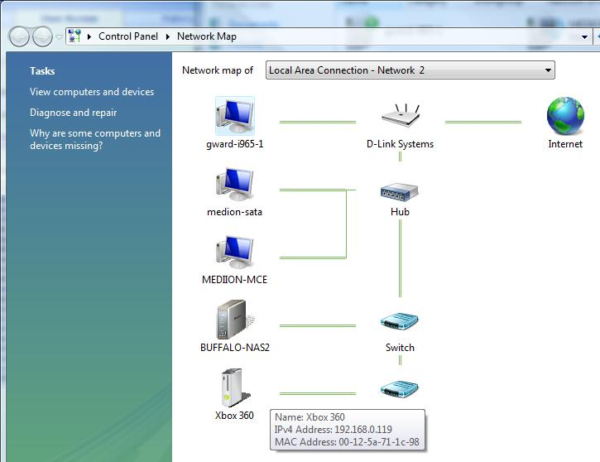
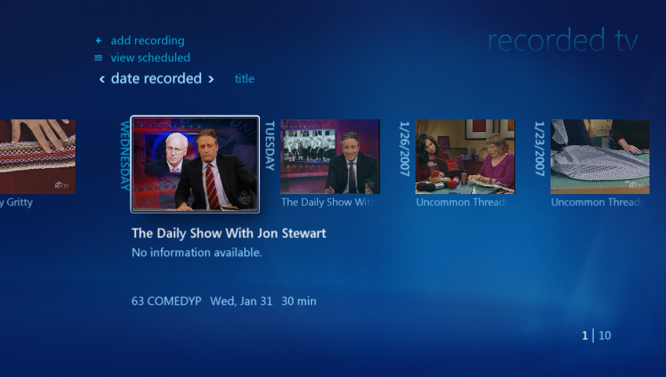
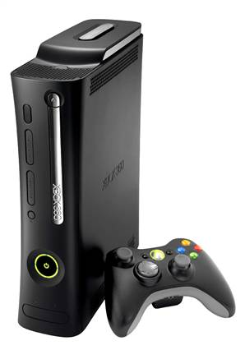
LLTD (Link Layer Topology Discovery)
Attribute | Benefit
Icon Transport | Photorealistic Icon; Device Branding
Topology Diagnostics | Problem resolution, facilitate remediation
Bandwidth Estimation | Graceful transient conditions handling

Slide 14
Web Services: Interop For Browsers
User
HTML
HTTP
TCP
IP

Slide 15
DPWS: Interop For Machines and Devices
Service and Client
WS-*
SOAP
HTTP
UDP
TCP
IP

Slide 16

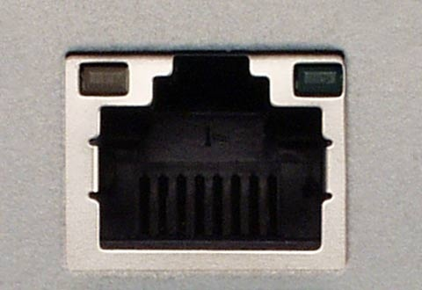
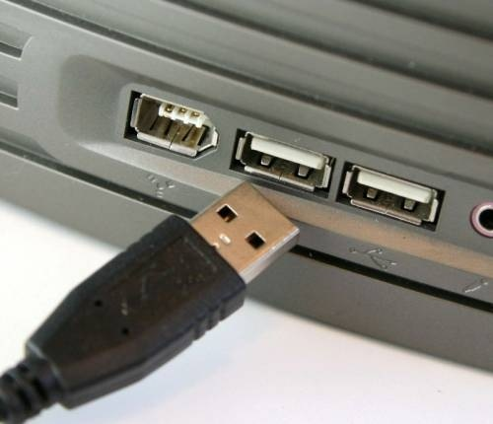
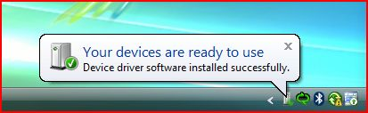
PnP-X Explained
The IP “bus” has been lacking
Problems caused…
No single end-user experience
The device experience depends on the connector selected
Undefined experience when plugging into this port
Well understood experience when plugging into this port
Solution: PnP-X
(PnP Extended)
IP devices limited in adoption
Custom solutions for integrating with Windows
Historically a non-PnP device
Fuels device adoption
Lowers support costs
A PnP device

Slide 17

Synergies and Experiences
Technologies
Applications
Management Interfaces
Device Specific Drivers
Plug and Play Extensions
Quality of Service
LLTD: QoS
Network Map
LLTD: Presence, Topology
Wireless Setup
Windows Connect Now / WPS
Discovery
Function Discovery
UPnP
Legacy Devices
Device Profile for Web Services
New or Rich devices
IP Network
(IPv4, IPv6)
Ethernet/Wireless
Windows Rally Experiences
Windows Rally Technologies

Slide 18
Demonstrations
NAS Shared Storage
Cellular Phone

Slide 19
General Rally Guidelines
Device must implement LLTD protocol per specification
Wireless device must support Wi-Fi Protected Setup / WCN for seamless setup.
Device must implement PnP-X per specification, and use or provide driver for PnP experience
Device must implement a L3 Discovery and Control Protocol and DCP / WSDL (generic if necessary)

Slide 20


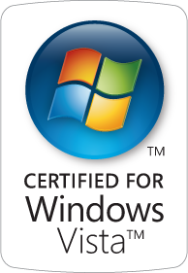



Infrastructure: Drive Quality, Experiences via Vista Logo
Enables Premium Experiences
Wireless Video Streaming: MCE to Extender (360, MCEv2/’Pika’)
5Ghz support ensures minimal traffic contention
“Certified For” (Premium)
Indicates compatibility, reliability, product quality
Ensures Interop with Windows Vista, Xbox Live!
Provides baseline setup, security, diagnostics, performance
“Works With” (Basic)

Slide 21
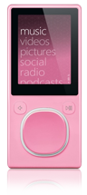
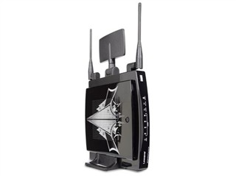
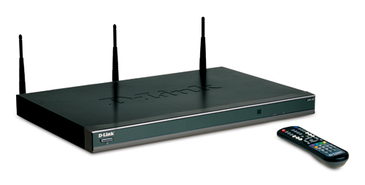
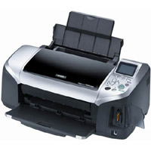
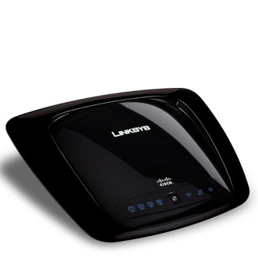
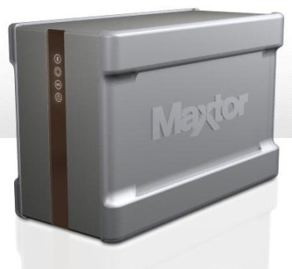
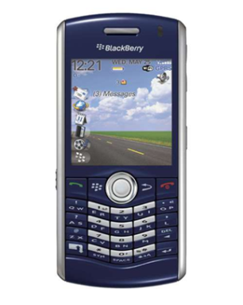
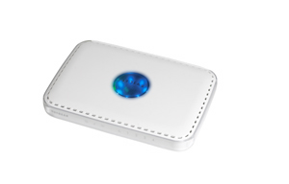
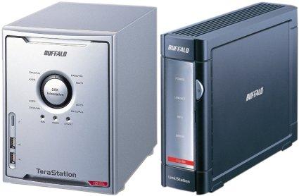
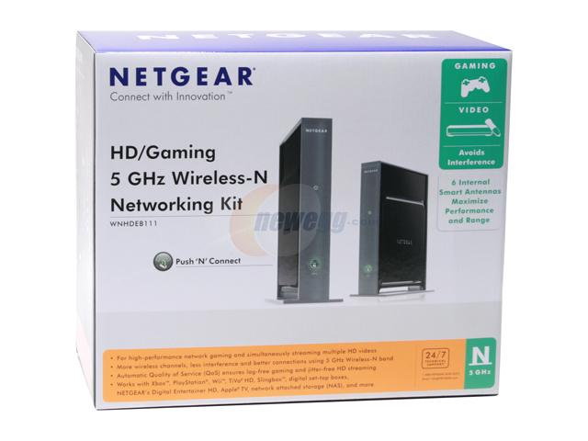
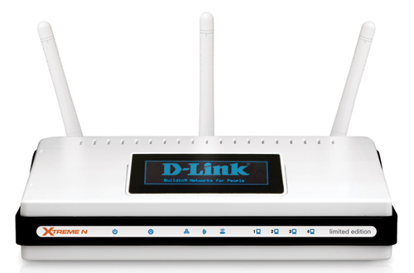
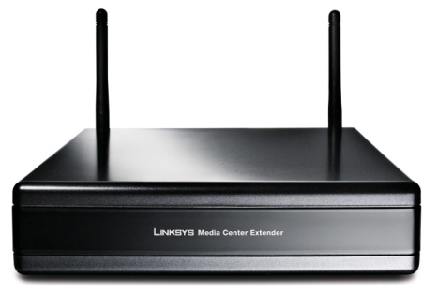
A few implementations…

Slide 22

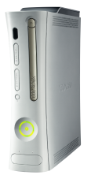


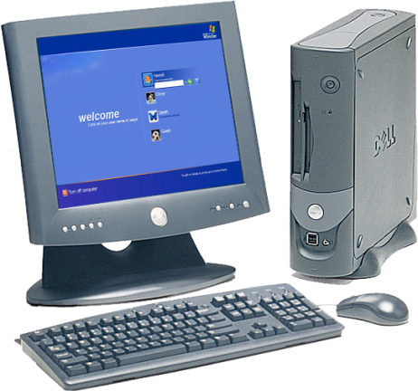
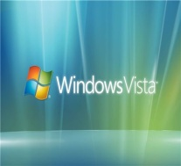



Device Futures Unified model
Unification of IP and directly connected devices
Users should not have to care about the bus
IP Network
Directly Connected

Slide 23
Call to Action
Depend on Continuity of Investment
Leverage Windows Plumbing!
The Rally Stack: Implement, Build on top, Move up!
Attend Circuit City, PnP-X sessions
Partner with Feature Teams for Success in 2008 and 2009

Slide 24

© 2006 Microsoft Corporation. All rights reserved. Microsoft, Windows, Windows Vista and other product names are or may be registered trademarks and/or trademarks in the U.S. and/or other countries.
The information herein is for informational purposes only and represents the current view of Microsoft Corporation as of the date of this presentation. Because Microsoft must respond to changing market conditions, it should not be interpreted to be a commitment on the part of Microsoft, and Microsoft cannot guarantee the accuracy of any information provided after the date of this presentation. MICROSOFT MAKES NO WARRANTIES, EXPRESS, IMPLIED OR STATUTORY, AS TO THE INFORMATION IN THIS PRESENTATION.

