Slide 1
Anteprima di Windows 7
Overview delle nuove funzionalità
Gabriele Castellani
Evangelist Manager
Gabriele.Castellani@microsoft.com
Carlo Mezzanotte
Audience Marketing Manager
Carlo.Mezzanotte@microsoft.com

Slide 2
Agenda
Gli appuntamenti della settimana
Le novità di Windows 7 per i professionisti IT
Le novità di Windows 7 per gli sviluppatori

Slide 3


Le sessioni disponibili
Internet Explorer 8
  Compatibilità applicativa
  Novità nella gestione del client
  Distribuire il nuovo sistema operativo
  Nuove funzionalità di sicurezza
  Supporto nativo e avvio da VHD
  Organizzare e trovare le informazioni
  Developer overview
  Supporto al multicore
  Web service API per applicazioni C++
  Architettura e funzionalità di sicurezza
  Personalizzazione del browser tramite IEAK
  Distribuzione centralizzata in ambito aziendale
  Gestione centralizzata tramite Group Policy
  Web Slices, Accelerators, Visual Search
  Document compatibility e approccio alla compatibilità
  Novità per sviluppatori AJAX
  Developer tools
Non perdete le sessioni interattive

Slide 4
Anteprima di Windows 7
25/2 mercoledì
  14.30 – 15.30 Keynote e pubblicazione sessioni
26/2 giovedì
  14.00 – 15.00 Chat con i relatori
  17.00 – 18.00 Chat con i relatori
27/2 venerdì
  14.00 – 15.00 Chat con i relatori
2/3 lunedì
  14.00 – 15.00 Chat con i relatori
  20.30 – 21.30 Chat con i relatori
3/3 martedì
  14.00 – 15.30 Tavola rotonda conclusiva

Slide 5





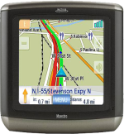
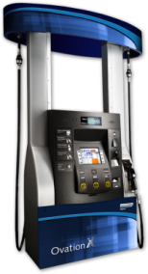
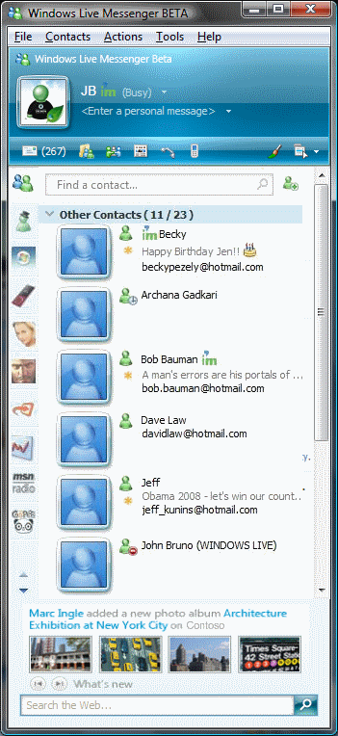

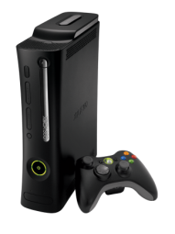
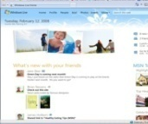

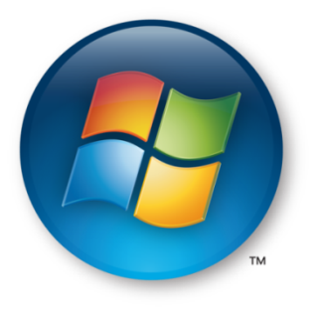
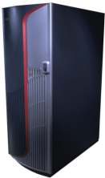
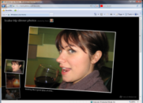
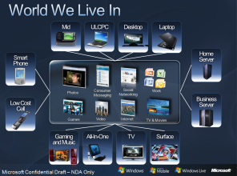


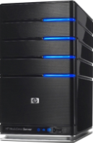


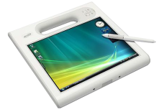
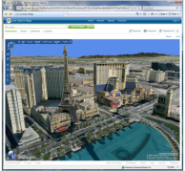
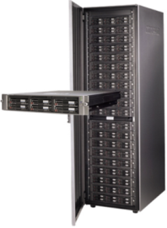
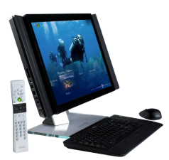

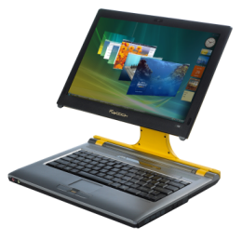


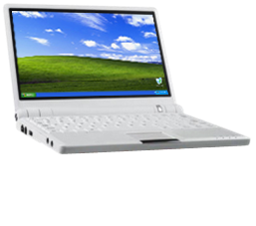


Il mondo in cui viviamo
Surface
Consumer Messaging
Social Networking
Devices
Photos
Work
Games
TV & Movies
Videos
Internet
Servers
PCs
Mobile
Netbooks/Nettops
Notes:
Best of Breed Execution:
World-class experience available on PC + Phone + Web
Cloud to integrate PC and Phone
Access all of my stuff and preferences no matter where I am
Experience Enabling Platform
One model across PC, Phone, and Web
Scalable Business Model
Royalty based client for Phone and PC
Services model that enables offers
New opportunities for differentiation and monetization.

Slide 6



























































Scenari premium
Consumer
Small Business
Enterprise/
Mid-Market
Memories
Data Backup and Security
Optimize Desktop Infrastructure
TV and Movies
Find, Use, Share Information
Sales and Marketing
Gaming
Financial Management
Enable Mobile Workforce
Music
Social Networking
Collaboration
and Mobility
Improve Security and Compliance
Productivity
Notes:
These are the scenarios people care about and that drive purchase behavior of PCs, software, and hardware
Windows 7 values and creates opportunity to align and deliver premium experiences on these scenarios for all your software/Hardware solutions

Slide 7
Gli investimenti in Windows Vista continueranno a dare frutti con Windows 7
  I cambiamenti architetturali in Windows Vista stanno ripagando
  Windows 7 si basa su questi cambiamenti, non li rifà
  Distribuire Windows Vista oggi faciliterà la futura migrazione a Windows 7 – la compatibilità è un obiettivo primario
Profondi cambiamenti
In Windows Vista
Benefici oggi
e in futuro
  User Account Control
  Security Hardening
  Image Format
  Display driver model
  Meno malware sul PC
  Meno vulnerabilità
  Componentizzazione
  Meno esecuzioni in kernel-mode
Notes:
You may be excited about some of the things that you’ve seen in Windows 7, but it is still something that is very much in the future. If you are evaluating whether to deploy Windows Vista or wait until Windows 7—our guidance is very much to deploy Windows Vista now.
You may be concerned that after you’ve upgraded to Windows Vista you are going to have a similar effort to upgrade to Windows 7. As I’ve mentioned, Windows 7 is going to be built on top of the Windows Vista foundation and compatibility with Windows Vista is a goal.
In Windows Vista we made advancements in security, networking, reliability, and user experience that caused application compatibility issues with existing third party and LOB corporate apps.
In security for example we introduced User Account Control and IE 7 protected mode so that applications run with less security privileges. We introduced Windows Resource Protection to help prevent critical system files from being modified or replaced. These were very important changes to make to the Windows Platform—but we don’t see the need to make changes of that scope in Windows 7.
One of the key changes in Windows Vista was the introduction of a new display driver model. This visual interface technology is designed to go beyond just improving the visual design, it is designed to deliver long-term gains in reliability and performance as well.
In Windows Vista, the Display Driver Model has two components, a streamlined kernel mode driver, and a user-mode driver that does most of the calculations. The Display Driver Model architecture elevates most of the driver execution out of the kernel mode, so a driver problem can be contained,.
As the old driver model is phases out, and WDDM is adopted broadly we expect customers will see the reliability benefits in Windows Vista, and continued in Windows 7.
If you’ve invested in upgrading your hardware and software to be compatible with Windows Vista, and you’ve invested in the skills to deploy and administer Windows Vista, you will find a much smoother migration to Windows 7 than if you are moving from any other operating system.
However, if you wait and are still running Windows XP when you move to Windows 7, the compatibility of your software and devices is not going to be higher than it would be today and you will not be able to take advantage of the security, search, and management features of Windows Vista .

Slide 8



Windows 7 è basato su Windows Vista
Deployment, Testing, and Pilots Today Will Continue to Pay Off
Windows 7
  Massima compatibilità: il software che funziona su Windows Vista funzionerà su Windows 7 – possibili eccezioni per il codice a basso livello (AV, Firewall, Imaging, ecc).
  L’hardware che esegue bene Windows Vista eseguirà bene Windows 7.
Pochi cambiamenti: focus su miglioramenti a qualità e affidabilità
Profondi cambiamenti: nuovi modelli per sicurezza, driver, distribuzione e servizi di rete
Notes:
KEY TAKEAWAYS:
We are not going to cause the same level of pain as we did with Windows Vista.
The changes we made in WV caused problems, but the benefits are here now.
The path to Windows 7 should be as smooth as the shift from RTM to SP1.
In Windows 7 we are building on the advances we made in Windows Vista to help address emerging trends and technologies and meet the needs we’ve heard from our customers.
The most important thing we’ve learned is that there is no one-size-fits all solution that’s best for every business. If anything, businesses are becoming more diverse. Some have a large number of mobile workers, some have workers distributed in branch offices around the world.
Windows 7 Enterprise, part of the Microsoft Optimized Desktop, gives you the flexibility to support the diverse needs of your unique business by enabling users to Access Information Anywhere, providing greater levels of Security & Control, and Streamlining PC Management.
We will be building these new capabilities without making significant architectural changes to the Windows platform. We want to make this clear so businesses can have confidence that investments they make to optimize their infrastructure with Windows Vista and MDOP today will put them in the best position to deploy Windows 7 when it‘s available.
Windows 7 will be built on the Windows Vista foundation and will inherit the quality improvements we’ve made in Windows Vista Service Pack 1 and Windows Server 2008.
Compatibility with Windows Vista software, hardware and tools is an important goal of this release. We are not able to make specific statement at this time about system requirements or compatibility levels—but we know that we have engaged with the ecosystem much earlier and are not making the broad types of changes to the kernel, driver, or graphics subsystems that we made in Windows Vista.
In building Windows Vista we made some significant changes to the platform that had an impact on compatibility. Those changes were important and had a measurable improvement on security. Windows Vista is the most secure client version of Windows to date and experienced fewer than half the number of security vulnerabilities that Windows XP experienced in its first year, and fewer than one-fifth the number of security vulnerabilities as the nearest competitive operating system on the market.
Windows 7 also benefits from these important changes, since we are not undoing the changes we made in Windows Vista that resulted in significant security improvements. This also means that customers still using Windows XP when Windows 7 comes out should expect a similar level of compatibility between Windows XP and Windows 7 as there is between Windows XP and Windows Vista.
However, the upgrade from Windows Vista to Windows 7 should be easier, given compatibility between these two products. We recommend customers upgrade to Windows Vista now, then move to Windows 7 because the investments required to test and remediate applications, update deployment tools and processes, upgrade hardware will be similar—and you get the benefits of a more secure, modern operating system for a longer time.
In Windows 7 we are not making significant changes to the componentization, setup model, or kernel. There will of course be limited changes made to fix bugs and additional features in those areas, but these are not the places we are making significant investments in this release.
The client release of Windows 7 will be available in 32 & 64-bit versions.

Slide 9
Miglioramenti nelle funzionalità di base
Overview
Compatibile e affidabile
  Stessa classe di hardware di Vista
  Applicazioni e driver sono retrocompatibili
Stabile e sicuro
  Sicurezza e controllo UAC migliorati
  Windows Filtering Platform
Veloce e reattivo
  Gestione del consumo energetico migliorata
  Service Control Manager
  Windows Troubleshooting Platform
Notes:
[TDM, DEV]
High level summary of Windows 7 Fundamentals – a solid foundation for new possibilities.
Compatibility and Reliability
Windows 7 is designed to run on the same hardware as Windows Vista, and to be compatible with applications and device drivers that work with Windows Vista.
Windows 7 is the most reliable version of Windows yet. Designed on an improved technology foundation, Windows 7 allows users to reliably start up, shut down, or hibernate their computers without having to worry about losing valuable work. Furthermore, Windows 7 makes it easier than ever to back up and restore data to network drives or DVDs. Windows 7 also improves upon print reliability and performance.
Stable and secure
Windows 7 includes new and improved security features that make it easier for developers to improve, use, and manage the security of their applications. It comes with a variety of new security features that not only help protect against threats but also limit the damage that attackers can do if they gain access to a computer.
Enhancements to the Windows Filtering Platform allow developers to create applications that interact with the packet processing in the networking stack of the operating system. Network data can be filtered and also modified before it reaches its destination.
Also, due to changes to the Windows privilege model, system security is more manageable by both developers and their end users. New improvements make it easy to identify critical prompts to ensure that users can access the applications and features they need without compromising their systems.
Responsive and Ready
Windows 7 maximizes hardware energy efficiency and scalability while maintaining high performance. Energy efficiency is improved through reduced background activity and new support for the trigger starting of system services. Windows 7 also offers improvements in the Windows kernel that enable applications and services to scale efficiently between platforms.
Performance of many features and APIs is improved in Windows 7 versus Windows Vista. For example, driver performance on servers is optimized by new user-mode and kernel-mode topology APIs. Graphics rendering is considerably smoother and faster. Accessibility performance is also significantly faster than before

Slide 10
Velocità
Decremento
Incremento
Memory
Reference set, Graphics
Disk I/O
Registry Reads, Indexer
Power
DVD Playback, Panel, Timers
Speed
Faster Boot
Device Ready
Responsiveness
Start menu, Taskbar
Scale
256 processors
Notes:
[TDM. DEV]
[High level overview of the Windows 7 improve performance and main talking points]
Windows 7 maximizes hardware energy efficiency and scalability while maintaining high performance. Energy efficiency is improved through reduced background activity and new support for the trigger starting of system services. Windows 7 also offers improvements in the Windows kernel that enable applications and services to scale efficiently between platforms.
Performance of many features and APIs is improved in Windows 7 versus Windows Vista. For example, driver performance on servers is optimized by new user-mode and kernel-mode topology APIs. Graphics rendering is considerably smoother and faster. Accessibility performance is also significantly faster than before.

Slide 11














Windows 7 per le aziende
Rende più veloce e semplice quello che fate oggi e introduce nuove possibilità
Maggiore produttività, ovunque
Maggiore sicurezza e controllo
Gestione semplificata dei PC
  In ufficio
  In una filiale
  In viaggio
  Proteggere meglio dati e PC
  Basato su Windows Vista foundation
  Migrazione facile
  Manutenzione dei PC
  Virtualizzazione
Notes:
The investments in Windows 7 are shaped by the evolving needs of end users and IT professionals in the enterprise. Users are becoming more computer-savvy, and expect more from the technology they use at work. They expect to be able to work from home, from branch offices, and on-the-road—with the same level of productivity. As user needs have changed, the demands on IT professionals have increased. Today, IT professionals must provide more capability and greater flexibility for users while continuing to minimize cost and security risks.
Make Users Productive Anywhere. Work from home, on the road, or in a branch office and be as productive as if you were at a desk in headquarters.
Enhance Security & Control. Extend the security foundation of Windows Vista with encryption for portable (USB) drives and IT control over which applications can run.
Streamline PC Management. Windows 7 makes it easier to manage and deploy desktops, laptops, and virtual environments while leveraging the same tools and skills you use with Windows Vista.

Slide 12




Maggiore produttività, ovunque
Informazioni senza ostacoli
Velocità e semplicità
  Cercare sul PC e su Internet
  Internet Explorer 8: velocità, accelerators e web slice
  Prestazioni elevate e affidabili
  UI e navigazione intuitive
Accesso alle informazioni ovunque
  Connettività mobile DirectAccess™ (Windows 7 Enterprise)
  BranchCache™ network boost (Windows 7 Enterprise)
Notes:
Make Users Productive Anywhere
Windows 7 enables users to complete their job no matter where they are—at home, in a branch office, or on the road—without reducing productivity. People can work with fewer interruptions, because Windows 7 will deliver solid performance and reliability from day 1. Windows Search can query a SharePoint site on a company intranet as well as files on a user’s PC. With DirectAccess, mobile users can simply and more securely access corporate resources when out of the office. BranchCache can make users in branch offices with slow connections more productive by speeding access to frequently accessed files and Web pages.
Key features:
Fundamentals: Windows 7 is engineered to provide solid performance and reliability on day 1.
DirectAccess™: Give mobile users seamless access to corporate networks without a need to VPN (Windows 7 Enterprise).
BranchCache™: Users in branch office wait less to download files across WAN (Windows 7 Enterprise).
Windows Search with Federation: Consistent experience to find documents on the PC or SharePoint.
Enterprise Search Scopes: Advanced search UI lets IT put links to sites on Start menu and Explorer (Windows 7 Enterprise).
Internet Explorer 8: Faster Web experience, along with Accelerators and WebSlices.
Get Even More Flexibility with MDOP: App-V gives you access to your applications from any PC (optional).

Slide 13
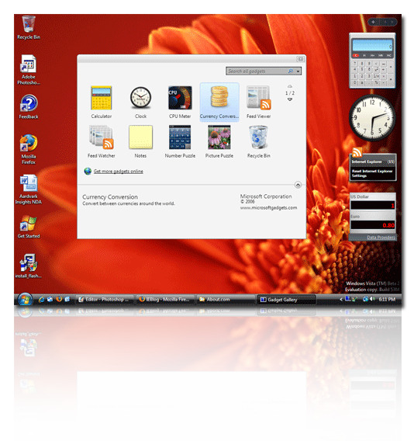
















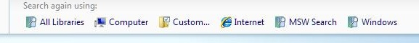
Enterprise Search
Maggiore produttività, ovunque
La situazione attuale
La soluzione con Windows 7
Search Federation
(Windows 7 Enterprise)
  Esperienza coerente per trovare dati da diverse fonti, incluso SharePoint
  L’IT può pre-popolare i link in Menù Avvio e Explorer per i siti preferiti con “Enterprise Search Scopes”
  Le attuali soluzioni di ricerca sul desktop e a livello aziendale sono buone, ma non integrate
  Servono diversi passi per trovare i dati sul PC e sui server
  Le fonti di dati sono difficili da trovare
Notes:
Access Information Anywhere describes a broad set of investments that we are doing in Windows 7 to make users more productive no matter where they are and no matter where the application and data that they need to access resides. One of those investments is in search.
As a result of the investments we’ve made in Desktop Search, leading customers who have deployed Windows Vista and the 2007 Microsoft Office System are experiencing great benefits in more easily and quickly finding information. Improved search capabilities are one of the biggest benefits end users find in using Windows Vista.
Customers are also realizing huge benefits in using search to access information stored in corporate repositories—using solutions such as Microsoft Office SharePoint Server and Microsoft Search Server.
But today these two worlds of enterprise search are separated. We have great solutions for desktop search and server search but they haven’t been brought together.
One of our goals in Windows 7 is to provide a more unified search experience so that from the desktop users can also find information on corporate repositories such as SharePoint or online services.
We are planning to use federation to make search results from online sources accessible within the desktop search experience. We also want to make it easy for IT to customize search defaults and locations to increase usage of intranet portals—maximizing the return organizations get from those investments.
“Enterprise Search Scopes” (Windows 7 Enterprise) enables IT, using Group Policy, to deploy links to appear on the user’s Start menu or in Explorer. This way, you can maximize your investments in SharePoint and Enterprise search by making it easy for users to search those destinations. The screenshot shows an example of how Microsoft could use this feature and how the search options would appear in Windows Explorer. IT could deploy a link to our intranet portal “MSW” for all users, and then on a division level we can deploy links to the portal for that division (e.g., Windows). If the user can’t find what they need on one site, they can easily re-scope their search to another one.

Slide 14







Accesso remoto per gli utenti mobili
Maggiore produttività, ovunque
La situazione attuale
La soluzione con Windows 7
DirectAccess™
(Windows 7 Enterprise)
Ufficio
Casa
Ufficio
Casa
  Difficile per gli utenti accedere alle risorse aziendali da fuori ufficio
  Problematico per l’IT gestire e aggiornare i PC portatili quando sono scollegati dalla rete aziendale
  Un nuovo paradigma di rete permette la stessa esperienza dentro e fuori ufficio
  Utenti mobili più produttivi con l’accesso trasparente alle risorse di rete
  Più facile gestire i PC mobili e distribuire aggiornamenti e policy
Notes:
One of the goals of Windows 7 is to enable users to access the information that they need whether they are in or out of the office.
In the past few years, Microsoft has made getting to email from outside the office easier. First we had Outlook Web Access, so we could access email through the web. Then we introduced RPC over HTTP, which just requires and internet connection to connect to the Exchange server.
But users still have a challenge when accessing resources that are inside the corporate network. For example users cannot open the links to an internal Web site or share included in an email.
The most common method to access these resources is VPN. VPN can be hard to use for users because it takes time and multiple steps to initiate the VPN connection and wait for the PC to be authenticated from the network. Hence, most remote users try to avoid VPN’ing as much as possible and stay disconnected from corporate network for as long as they can. At this point we run into a chicken-egg problem: Since remote users are disconnected, IT cannot manage them while away from work – remote users stay more out of date and it gets harder and harder to access corporate resources…
With the capabilities Windows 7 enables, users who have internet access will be automatically connected to their corporate network. A user who is sitting on a coffee shop can open his laptop, connect to the internet using the wireless access of the coffee shop and start working as if he is in the office. The user in this case will be able to not only use outlook, but also work with intranet sites, open corporate shares, use LOB applications, and basically have full access to corporate resources.
This solution is also very appealing to IT Professionals:
Managing mobile PCs has always been an issue since they could be disconnected from the corporate network for a long time. With this work access solution, as long as they have internet connectivity, users will be on corporate network. Servicing mobile users (such as distributing updates and Group Policy) is easier since they can be accessed more frequently by IT systems.
Deploying Windows 7 will not automatically enable this type of work access connection. You will have the choice to enable it or not and it will require some changes to your backend network infrastructure, including having at least one server running Windows Server 2008 R2 at the edge of your network. The solution takes advantage of Microsoft’s investments in IPSEC and IPv6 to provide secure connectivity even when not on the physical corporate network.

Slide 15










Branch Office Network Performance
Maggiore produttività, ovunque
La situazione attuale
La soluzione con Windows 7
BranchCache™
(Windows 7 Enterprise)
  Nelle filiali l’accesso ad applicazioni e dati via WAN è lento
  Le connessioni lente penalizzazno la produttività
  Migliorare le prestazioni della rete è costoso e di difficile implementazione
  Cache del contenuto scaricato da file e Web server
  Gli utenti nella filiale possono aprire rapidamente i file salvati nella cache
  Libera banda di rete per altri utenti
Notes:
Even inside a single business different departments can have unique needs. For example, Branch Offices have issues and requirements that are different from the main office. Companies are investing in opening more Branch Offices to provide a work environment for mobile employees and reach more customers.
This trend generates new challenges for both the end users and the IT Professionals:
Branch Offices are usually connected to enterprises with a low-bandwidth link. Hence accessing corporate data located in the enterprise is slow for end users.
To resolve customer pain points and increase user productivity IT Professionals are constantly looking for ways to improve network performance.
With Windows 7, Microsoft will offer a software alternative to alleviate the problem—“Branch office caching”. The idea is to cache the corporate data downloaded by users locally in the branch office so it can be quickly accessed by others in the branch. With branch office caching, opening a document can take seconds instead of minutes.
For example: Headquarters posts a large training presentation on a file share and sends an e-mail to all employees worldwide. The first employee who opens the presentation has to wait several minutes for the file to download across the WAN. After the file is downloaded Windows will automatically store that file in the cache for others to use. When the next employee tries to download the file Windows will automatically retrieve that file from the cache in the branch and the user can open it in much less time.
The cache can be hosted on a server in the branch or distributed across a number of PCs. If the cache is distributed, the branch users automatically check the cache pool to see if the data has already been cached. If the cache is hosted on a server, the branch users check the branch server to access data. Each time the users try to access a file, the access rights of the user are authenticated against the server in the data center to make sure that the user has access to the file and is accessing the latest version.
The solution enables users to have fast access to previously downloaded data in the branch and also frees network bandwidth for other uses.
It caches content from Web and file servers running Windows Server 2008 R2, and if you use the hosted cache option in the branch office, that server much be running Windows Server 2008 R2 as well.

Slide 16




Aumentare sicurezza e controllo
Proteggere i dati su PC e dispositivi
  BitLocker To Go™ (Windows 7 Enterprise) protegge i dati sui dischi rimovibili
  BitLocker™ semplifica criptazione e gestione delle chiavi dei dischi
Proteggere utenti e infrastruttura
Basato su Windows Vista Security Foundation
  AppLocker™ (Windows 7 Enterprise) controlla quali applicazioni girano
  Internet Explorer 8 aiuta a proteggere gli utenti online
  User Account Control meno invasivo
  Security Development Lifecycle per la difesa in profondità
Notes:
Enhance Security and Control
Windows 7 builds on the security foundation of Windows Vista, and delivers increased flexibility in helping secure computers and data. Businesses can worry less about sensitive data on lost laptops or USB drives because, in addition to protecting internal hard disks, Windows BitLocker Drive Encryption can now encrypt external thumb drives and hard disks with BitLocker To Go—and provide recovery keys so that the data is accessible when needed. For enterprises that demand the highest levels of compliance, IT professionals can use new application-blocking tools in AppLocker to dictate which applications can run on user computers, providing yet another way to limit the risk of malicious software. User Account Control has been streamlined to provide fewer prompts to users and more configuration options for IT.
Key features:
BitLocker To Go™: Help protect data on any removable drives—such as USB keys.
BitLocker™: Improved in Windows 7 to simplify setup by automatically creating partitions.
AppLocker™: Application control to specify what software is allowed to run on user PCs
Windows Vista Foundation: Security of Windows Vista with enhancements like more flexible UAC prompt behavior.
Get More Control with MDOP: Application Inventory Service lets you know what’s installed. Advanced Group Policy Management provides greater flexibility & control over GP.

Slide 17

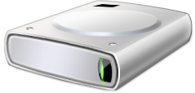






Protezione dei dati
Aumentare sicurezza e controllo
La situazione attuale
La soluzione con Windows 7
BitLocker To Go™
(Windows 7 Enterprise)
+
Worldwide Shipments (000s)
  Protegge i dati su dischi interni e rimovibili
  Forzare l’uso dell’encryption tramite Group Policies
  Dati di recovery in Active Directory per una maggiore gestibilità
  Configurazione di BitLocker semplificata
Gartner “Forecast: USB Flash Drives, Worldwide, 2001-2011” 24 September 2007, Joseph Unsworth
Gartner “Dataquest Insight: PC Forecast Analysis, Worldwide, 1H08” 18 April 2008, Mikako Kitagawa, George Shiffler III
Notes:
Some of the biggest investments we are making to Enhance Security and Control are around Data Protection.
According to an Information Week survey, 87% of consumers said they lost respect for a company that divulged customers' personal information due to loss of theft. The 600K+ lost or stolen laptops a year are one of the more dramatic examples of information leakage that businesses must contend with.
For organizations who have deployed Windows Vista with BitLocker, they know company data, including customer data, is well protected if a laptop is lost or stolen. Additionally, customers who have deployed Windows Vista SP1 with BitLocker gain the ability to easily protect multiple internal disk volumes, not just the primary system volume.
Unfortunately, data leakage is not just a lost laptop issue anymore. The ubiquity of USB Flash Drives provides even greater opportunity for data to fall into the wrong hands. Today, more than twice as many USB Flash Drives enter the marketplace than PC’s. A leading analyst forecasts that, in 2010, the average USB flash drive will hold almost 4 GB of data and cost less than $10. The scary part for an organization: unlike losing a laptop, a user never seems to report, or sometimes even notice, the loss of a USB flash drive!
In a survey conducted in 2007 by a leading analyst, more than half of respondents (52 percent) have lost confidential data through removable media such as USB Flash drives in the past two years.
In Windows Vista, we gave you granular USB port controls so that you could block the utilization of USB removable storage devices.
Unfortunately, blocking removable storage devices does not provide you with all the flexibility and control you need to protect your organization. There are valid business requirements that necessitate the need to store data on removable USB devices (e.g., sharing large files with a trusted partner, taking work home).
Windows 7 extends the data protection mechanisms made available in Windows Vista. In Windows 7, BitLocker To Go better protects data stored on portable media (e.g., USB Flash Drives, USB Portable Hard Drives) by helping ensure that only authorized users can read the data, even if the media is lost, stolen, or misused. New BitLocker policies will allow you to enforce data protection and require that data can only be written to BitLocker-protected removable devices.
Unlike some types of special devices you can purchase that may encrypt hardware, BitLocker can store the recovery information in Active Directory. This allows for field recovery of BitLocker drives in the instance that a user forgets his passphrase.
Finally, we are streamlining the overall setup and administration of BitLocker for all storage devices.

Slide 18
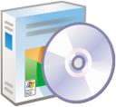











Controllo delle applicazioni
Aumentare sicurezza e controllo
La situazione attuale
La soluzione con Windows 7
AppLocker™
(Windows 7 Enterprise)
  Gli utenti possono installare e usare applicazioni non approvate
  Anche gli utenti standard possono installare alcuni tipi di software
  Tali applicazioni possono:
    Introdurre malware
    Aumentare le chiamate all’helpdesk
    Ridurre la produttività
    Vanificare la compliance
  Eliminare applicazioni indesiderate/sconosciute dalla rete
  Forzare la standardizzazione applicativa in azienda
  Creare e gestire facilmente regole flessibili usando le Group Policy
Notes:
The other big investment we are making to Enhance Security and Control is around Application Control.
The longer a computer has been deployed, the more the software on it drifts away from its desired configuration. These inconsistencies are greatly accelerated by installation and execution of non-standard software within the desktop environment. Users today bring software into the environment by bringing in software from home, Internet downloads (intended and not intended!), and through email. The result is a higher incidence of malware infections, more help desk calls, and difficulty in ensuring that your PCs are running only approved, licensed software.
Coupled with compliance requirements in the enterprise through OCI, SOX, HIPPA and other regulations, enterprises are renewing efforts to lock down their desktops as a means to:
Reduce total cost of ownership (TCO)
Increase security to safeguard against data loss/threat of IT theft and to protect privacy
Support compliance solutions by validating which users can run specific applications
With Windows XP and Windows Vista, we gave IT administrators Software Restriction Policies to enable the definition of application lockdown policies. However, SRP was difficult to implement because the rules were based on application hashes, which meant that they had to be re-created anytime the application was updated.
Windows 7 reenergizes application lockdown policies with a totally revamped set of capabilities. AppLocker provides a flexible mechanism that allows administrators to specify exactly what is allowed to run on their systems and gives users the ability to run applications, installation programs, and scripts that administrators have explicitly granted permission to execute. As a result, IT can enforce application standardization within their organization with minimal TCO implications.
For example, a rule could be written that says “allow all versions greater than 8.1 of the program Photoshop to run if it is signed by the software publisher Adobe.” Such a rule can be associated with existing security groups within an organization, providing controls that allow an organization to support compliance requirements by validating and enforcing which users can run specific applications.

Slide 19





Gestione semplificata dei PC
Keep PCs Running Smoothly
Easier Deployment from Windows Vista
  Compatibilità con hardware, software, tool di Windows Vista
  Nuovi strumento per sveltire creazione delle immagini, migrazione e distribuzione
  Gestione configurazione con PowerShell & Group
  Policy
  Piattaforma di troubleshooting per ridurre i problemi di helpdesk
  Miglior supporto per la virtualizzazione del client
  Supporto multi-monitor e microfono per VDI
  Gli stessi strumenti per gestire immagini VHD & WIM
Notes:
Streamline PC Management
Whether IT professionals manage and deploy desktops, laptops, or virtual environments, Windows 7 makes the job easier while enabling them to leverage the same tools and skills they use with Windows Vista. Advanced image management and deployment tools enable IT professionals to add, remove, and report on drivers, language packs, and updates—and push those system images to computers using less network bandwidth. New scripting and automation capabilities based on Windows PowerShell 2.0 reduce the costs of managing and troubleshooting computers. For enterprises making the leap to client virtualization, Windows 7 helps you more easily maintain virtual machine images and provide a richer user experience over remote connections.
Key features:
Compatibility: Majority of applications that work on Windows Vista will continue to work on Windows 7.
Deployment Tools: Maintain images with enhanced offline servicing, deploy using less bandwidth.
PowerShell 2.0: With graphical editor, easier to automate repetitive tasks.
DirectAccess™: Keep mobile PCs connected and up-to-date with the latest policies and updates.
Troubleshooting Platform: Diagnose and resolve issues with built-in or IT-created troubleshooters.
VDI Enhancements: Improved user experience for VDI with multi-monitor and microphone support.
Simplify Management with MDOP: Diagnostics and Recovery Toolkit gets PCs running again. Desktop Error Monitoring let’s you spot potential support issues early so you can take action. Enterprise Desktop Virtualization enables compatibility for your application on your modern desktop.

Slide 20


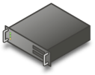





Virtual Desktop Infrastructure
Gestione semplificata dei PC
La situazione attuale
La soluzione con Windows 7
      Esperienza remota più ricca
  Grafica più ricca con supporto multi-monitor
  Uso della voce per telefonia e applicazioni con supporto del microfono
  Stampa migliorata
      Cosa è Virtual Desktop Infrastructure?
Fare di più con VHDs
  Maintain VHD: aggiornamento offline di immagini VHD con gli stessi strumenti usati per WIM
  Boot from VHD: Riuso di VHD files per distribuzione su desktop PC
  Distribuzione dei desktop in macchine virtuali su server
  Gestione centralizzata e sicurezza
  Gli utenti possono accedere a desktop e applicazioni ovunque si trovino
*
  L’uso di Windows per scenari VDI richiede licenze VECD addizionali
Notes:
Today, Microsoft virtualization products and technologies are already helping companies automatically match computing capabilities to business needs. Imagine your employees accessing their personalized desktop, with all of their settings and preferences intact, on any machine, from any location. Or the workloads running on servers in your data center automatically being redeployed to respond to a sudden surge in demand for a specific capability. Or your entire infrastructure restoring itself instantly following a catastrophic power outage.
This is possible through Virtual Desktop Infrastructure technology. However, this is still an emerging area, and there are several challenges, including potential higher costs of running enough servers to support your users and the fact that users don’t have as rich a Windows experience when running a remote session.
Keep in mind that using Windows features for VDI scenarios requires a specific VECD license.
Let’s talk about some of the investments we are making in Windows 7 to make this type of virtualization more cost effective and provide a better experience for users.
Richer Remoting Experience: When connecting to a Windows 7 PC, the user gets a richer experience more like a local Windows Desktop. These are some of the improvements that we are making to the user’s VDI experience:
Graphics: Windows 7 enterprise will provide true Multi-Monitor support, for up to 8 monitors. A scenario where this functionality is critical is a financial trader who needs to view information on multi-monitors, while the organization wants to have the centralized security and administration of VDI. Other graphics improvements include Desktop Window Manager remoting to display Windows Aero and more efficient video remoting with Windows Media Player.
Audio: Bi-directional audio to support microphones for VOIP and speech recognition. Better audio playback over low-latency connections to mitigate A/V synchronization issues when remoting video via bitmaps (Flash, Silverlight) .
Devices: Easy print makes it easy for the user to print to the correct local printer from their client computer. PnP redirection provides support for redirection of Windows Portable Devices – this category of devices includes media players based on the Media Transfer Protocol (MTP) and digital cameras based on the Picture Transfer Protocol (PTP).
Physical Boot from VHD: Some customers who use VDI also have a need to reuse that same image on a physical PC. For example, imagine a call center with 200 users, 100 who work onsite with a traditional desktop and 100 who work remotely. Both sets of users are in a highly managed environment and use technologies such as folder redirection and roaming profiles so that the user’s state is not stored in the image and not tied to the OS image. These highly managed machines are typically remotely reimaged frequently (for example, using PXE with WDS to bring down the image file everyday or whenever there is a problem). In these scenarios, you can take that image you use for the VDI users and deploy it to the managed desktop PCs in the office. This gives you the capability to use and maintain the same image for both deployment scenarios.
Understand that while this technology opens up new deployment scenarios, there will not be 100% parity in the experience between WIM and VHD. This is why we only recommend physical deployment of VHDs to desktops in highly managed environments where the user’s state is not stored on the PC and you have the ability to remotely re-image the OS on the physical PC frequently.
Some of the differences between booting from VHD and WIM are:
VHD deployment is not recommended for mobile PCs because VHD will not support Hibernate/Sleep or BitLocker.
Some features of WDS will not be available in a VHD install
Setup.exe will not support installing Windows into a VHD
VHD files are larger than WIM files so copying the file down will consume more network bandwidth and take longer when compared to a similar WIM.
In Windows 7, our deployment tools, such as WDS, will also support deployment and servicing of VHD files.
Note that the physical VHD boot feature does not use virtualization to accomplish the VHD boot, there is no hypervisor or virtualization involved. We are simply using the VHD file as a container to store the OS image. In Windows 7, you will be able to specify a local VHD file on the hard drive using the Boot Configuration Data (BCD) to boot from.

Slide 21







Automazione
Gestione semplificata dei PC
La situazione attuale
La soluzione con Windows 7
PowerShell v2.0 sul Client
  Gli script permettono di automatizzare le attività ripetitive
  I liguaggi di scripting per Windows erano limitati e difficili da usare
  PowerShell aiuta i professionisti IT ad avere maggior controllo e produttività nella gestione dei server
  Gli stessi potenti strumenti per l’automazione di server e PC
  Nuovo editor grafico che rende più facile imparare e usare lo scripting
  Eseguite le attività automatizzate da remoto nell’intera organizzazione
Notes:
Let me tell you some more details about one of the ways we are Streamlining PC Management in Windows 7—Increasing Automation.
Windows PowerShell is a Windows command line shell and scripting language that helps IT professionals achieve greater control and productivity. There were close to 1 million downloads of PowerShell in its first six months of availability, and PowerShell has been included in server products, including Exchange 2007 & Windows Server 2008.
While PowerShell 1.0 has been available as a separate download for Windows XP and Windows Vista, PowerShell 2.0 will be included natively in Windows 7 so you can easily take advantage of it to automate the management of your clients.
Examples of how PowerShell can help the IT Pro:
-Execute a command on all PCs to check if the Anti-Virus software service is stopped, and automatically restart it if necessary
-Modify the security rights on files or shares
-Open a data file (or OS repository like WMI) and pass the contents into a pre-formatted output file like an HTML page or Excel spreadsheet
-Automate .NET applications that expose its objects for manipulation
-Search and output specific information from Event Logs
With the remote automation capabilities that will be new in v2.0 , an administrator can create a PowerShell script to configure a specific setting or run a complex task – defragment the hard drive, close a firewall port, etc., all from one IT Pro’s workstation, and the script will run immediately on all targeted PCs (provided they are online, of course).
PowerShell will NOT be exclusive to the Enterprise SKU.

Slide 22
Windows 7 for Developers
Costruito su basi solide
Improved fundamentals
Compatibile: con le applicazioni compatibili con Vista
Nuovo PowerShell 2.0
  Interfaccia a caratteri e nuova interfaccia grafica (ISE)
  Esecuzione di comandi su comuputer Remoti
  Transazioni
Nuovo MSI
  Semplicità
  Installazione nel profilo utente
  Setup multipli concatenati
Supporto VHD
  VHD mount
  Boot da VHD
Consumo energetico
Service Control Manager
Supporto all’accessibilità
Applicazioni più ricche
User experience più naturale
  Windows Touch, supporto a gesture, ink e touch per applicazioni Win32 e .Net
  Nuova taskbar, migliore usabilità
  Nuovo Ribbon Facilmente integrabile in applicazioni Win32 esistenti retrocompatibile
  Rich animation framework per integrare transizioni ed animazioni.
  Peer to peer application nuove API e nuove funzionalità
  Nuovi formati
  Gestione dell’ hardware
  Direct 2D/3D v10 e v11
  Supporto Multi-core migliorare la velocità delle applicazioni e la parallelizzazione
  Device Stage abilita la personalizzazione dell’interfaccia di gestione dei dispositivi collegati al PC
Windows & Web
Integrazione
Federated Search Consente di estendere le funzionalità di ricerca all’interno delle applicazioni
Internet Explorer 8, Silverlight and Windows Presentation Foundation (WPF)
Windows Web Services API abilita l’utilizzo di Webservice anche ad applicazioni Win32
Web
Internet Explorer 8 Standard compliant , Web Slices a Accellerators
Built-in dev tools in IE8 è presente una toolbar dedicata agli sviluppatori Web.

Slide 23
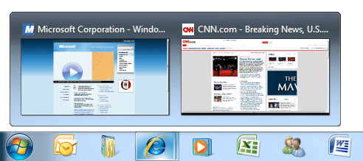
Windows 7 Taskbar
Enhanced user experience
  Semplice e veloce eseguire una applicazione
  Gestione delle finestre semplificata
  L’utente è in controllo
  Pulita e leggera
Windows UX guidelines
Enhanced Taskbar, Jump Lists
Thumbnail Toolbars
Custom Switchers, Icons
Overlay Icons, Progress Bars
Notes:
[TDM, DEV]
[Why - Windows 7 Taskbar overview]
Quick and easy launch of applications
It is easy to get to the programs and destinations you use all the time, with less mouse movement and fewer clicks.
Accessing commonly used programs within a single click required us to enrich Quick Launch by increasing its presence on the taskbar and making more top-level room for pinned items. We began looking into how Quick Launch interacted with the taskband and how launching and switching were sometimes separate and other times duplicative. For example, almost all single-instance programs in Windows interpret an attempt to re-launch them as a switch if they are already running. So, clicking Outlook’s icon in Quick Launch would merely switch to the program if it was already running and present in the taskband. To make room for more items on the taskbar, we knew we had to remove some of the redundancy and free up valuable real-estate.
Easier to managed windows
You can switch to the right window quickly without mistakes and effortlessly position windows the way you want them.
This goal spoke to the very heart of the taskbar—the ability to switch between windows. This challenged us with seeking a more predictable method of surfacing windows on the taskbar, meaningful use of text and a reliable method of helping people consistently switch with confidence. We’ve had text on the taskbar for years and Vista introduced thumbnails, but customer feedback informed us that there was room for improvement. Interestingly, we found inspiration in old features such as Windows XP’s window grouping and Alt-Tab’s visual layout of individual windows
The user is in control
The desktop reflects your style. You get to personalize the experience, choosing what is important to you, including how and when you receive notifications.
By far the biggest target of feedback, the Notification Area had to put control back in the hands of people. It was decided that instead of the opt-out model that required the person to clean up this area, we would start with a clean experience. Only system icons would appear by default and then people can to customize this area to their liking.
Clean and Lightweight
The desktop experience feels organized, lightweight, open and is a pleasure to use. Visuals and animations are delighters the first time and every time.
A successful product is more than the utility it serves—it is also an experience. From the very start we wanted the taskbar, and the desktop as a whole, to draw an emotional response from the person. This required a set of scoped delighters that demoed well and retained their appeal over time. We began to define a personality for the UI using terms such as “glass and energy,” Chi, authenticity and many others. These investigations helped define a visual and animation language that we could then apply to several aspects of Windows 7.

Slide 24

  La nuova interfaccia
Demo

Slide 25
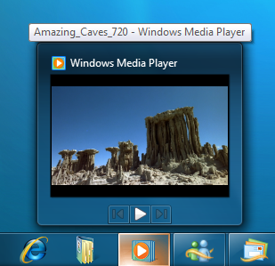
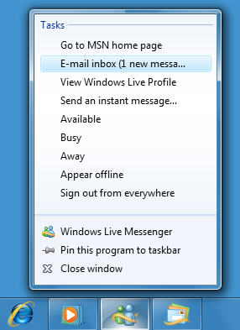
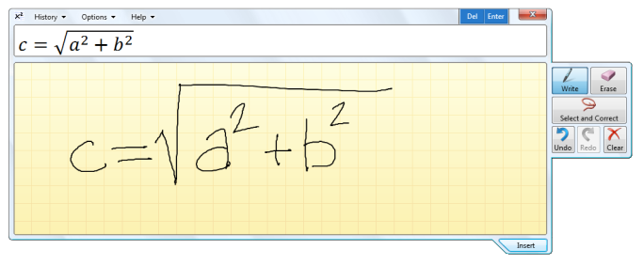
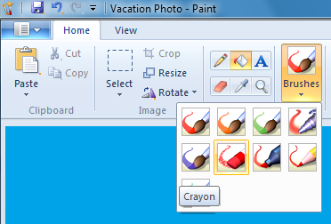
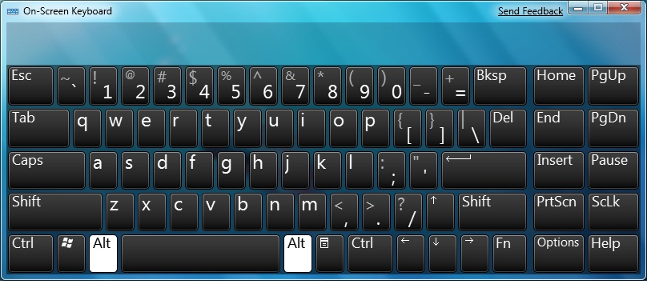
Interazioni più naturali
Multi-touch, Ink, Speech
Jump Lists
Ribbon User Interface
Libraries
Notes:
[DEV, TDM]
[High level overview of enable more natural user interaction]
New methods of desktop integration put application functionality right at the user’s fingertips, and Windows Explorer and Libraries provide easy access to high-value information. The Scenic Ribbon control and animation framework make it easier to build interactive and appealing user interfaces. New touch APIs enable natural interactions through multi-touch and finger-panning, and manipulation and inertia APIs enable impressive visual effects.
Fosters natural user interaction
Multi touch, ink and gesture support along with handwriting recognition allow you to create exciting new input capabilities.
New taskbar, destinations and shell integration enhance discoverability and usability
New controls and APIs for the Ribbon allow easy additions for Ribbon-style controls, menus, and galleries to your application.
An animation framework helps you enhance custom animations.

Slide 26
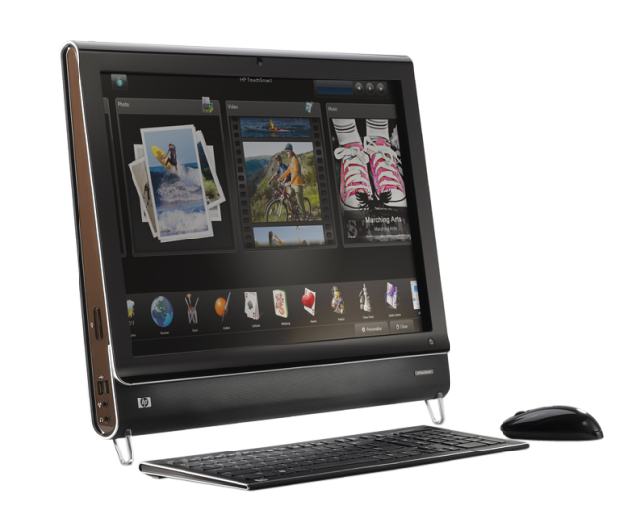
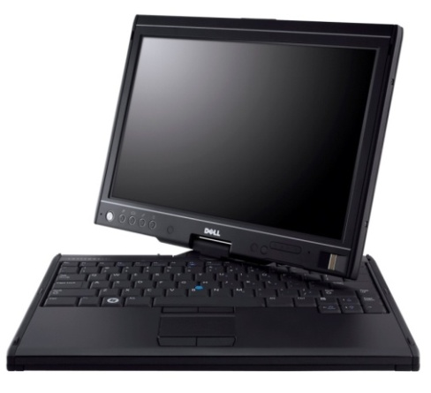
Multi - Touch
Consumers
  Il Multi-touch abilita nuovi scenari applicativi
  Le applicazioni multitouch sono più intuitive per gli utenti
Hardware
  Comupter Multi-touch sono già sul mercato
  Le funzionalità Multi-touch saranno presenti su molte classi di dispositivi
Developers
  Nuove API WIN32
  Nuovi oggetti COM
  Integrato in .Net 3.5 e poi in 4.0
Notes:
[DEV, TDM]
[High level overview of Why Multi Touch]
Multi-touch offers clear differentiation with a high “WOW” factor for consumers
Multi-touch enhances on-the-go use and opens up new scenarios for business
90% of people in focus groups claimed they would pay a 20-30% premium for a PC with multi-touch
Seeing is believing: Consumer purchase intent doubles after hands-on experience

Slide 27
  I nuovi dispositivi
Demo

Slide 28
Internet Explorer 8
CSS 2.1
CSS Certification
Performance
HTML 5
Developer Tools
Activities
WebSlices

Slide 29
IE 8 Developer Tools
Live CSS Editing
Compatibility Testing
JavaScript Debugger
JavaScript Profiler
Tutto built-into IE8

Slide 30
  Internet Explorer 8
Demo

Slide 31
Internet Explorer 8
Internet Explorer 8 Release Candidate
  Windows XP SP3
  Windows Server 2003
  Windows Server 2008
  Windows Vista SP1
In Windows 7 beta 1
  Versione intermedia tra la beta 2 e la RC
  Per il testing Web utilizzare la Release Candidate

Slide 32
Le sessioni disponibili
Internet Explorer 8
  Compatibilità applicativa
  Novità nella gestione del client
  Distribuire il nuovo sistema operativo
  Nuove funzionalità di sicurezza
  Supporto nativo e avvio da VHD
  Organizzare e trovare le informazioni
  Developer overview
  Supporto al multicore
  Web service API per applicazioni C++
  Architettura e funzionalità di sicurezza
  Personalizzazione del browser tramite IEAK
  Distribuzione centralizzata in ambito aziendale
  Gestione centralizzata tramite Group Policy
  Web Slices, Accelerators, Visual Search
  Document compatibility e approccio alla compatibilità
  Novità per sviluppatori AJAX
  Developer tools
Non perdete le sessioni interattive

Slide 33
Grazie

Slide 34
Avvertenza
Tutte le informazioni fornite in questa sessione sono basate su una versione preliminare di Windows 7
Le funzionalità descritte possono cambiare nella versione definitiva di Windows 7 senza alcun preavviso da parte di Microsoft

Slide 35
RenatoFrancesco.Giorgini@microsoft.com
http://blogs.technet.com/italy
© 2009 Microsoft Corporation. All rights reserved.
This presentation is for informational purposes only.
MICROSOFT MAKES NO WARRANTIES, EXPRESS OR IMPLIED, IN THIS SUMMARY.

