Slide 2
Everything you need to know about VDI
Adam Hall
Technology Strategist
Gavin Bennett
Systems Engineer – Citrix NZ
Session Code: SVR309

Slide 3
So, what is VDI?
Lets start with a prize!

Slide 4
Our definitions are …
Delivery of a Windows desktop via a delivery protocol
Delivery of a virtual Windows Client from a centralised platform

Slide 5
Did you know?
The Hands on Labs for TechEd 2009 are all delivered through VDI?

Slide 6

Considerations for VDI
User Profiles
User Data
Patch Management
Anti-virus
Server hardware
Client Hardware
user:image ratio
1:1 ?
1:many ?
Applications ?
Install?
Virtualise?
Stream?
Sound Familiar?
VDI is not a silver bullet for desktop management!

Slide 7
Microsoft VDI

Slide 8
The Microsoft position
Windows 7 as the preferred client
Small and low complexity environments

Slide 9
Citrix XenDesktop

Slide 10




Citrix Today XenDesktop + XenApp
Task Workers
Office Workers
Guest Workers
Remote Workers
hosted desktops on the server
desktop streaming
hosted virtual desktops VMs or blade PCs

Slide 11

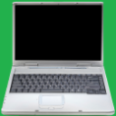

Extending to Mobile Workers
Task Workers
Office Workers
Guest Workers
Remote Workers
Mobile Workers
hosted desktops on the server
desktop streaming
hosted virtual desktops VMs or blade PCs
local virtual desktops

Slide 12

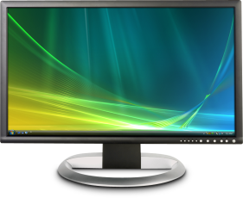
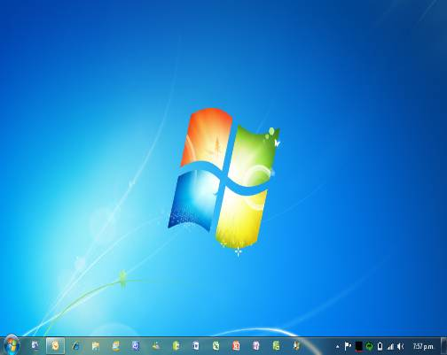




Dynamic Desktop Assembly and Delivery
Virtual Desktop
User Settings
Apps
Desktop Appliance
OS
On-demand assembly
Delivered with best user experience
Dynamically assembled at runtime
Single master of each component
Notes:
12

Slide 13

Desktop Delivery Components
Brokering
1
2
Users login and request their desktop
Operating Systems, Apps, and user Profiles are provisioned on demand
User Settings
User Profiles
Apps
3
App Delivery
Users desktop is delivered
Users
Desktop Provisioning
OS
Virtual Desktop
Virtual Desktop Hosting Infrastructure
Notes:
13

Slide 14
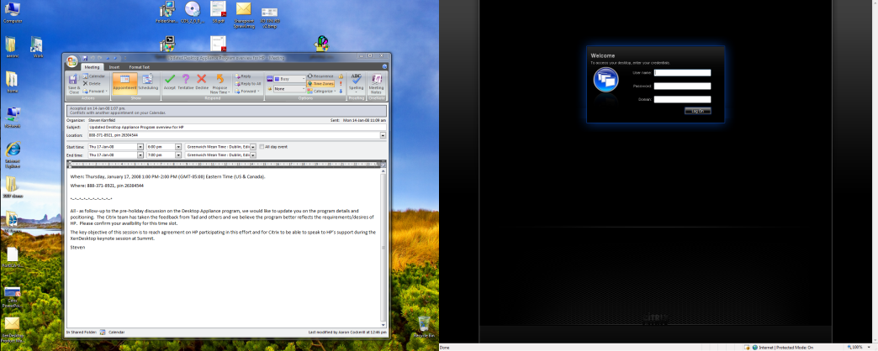
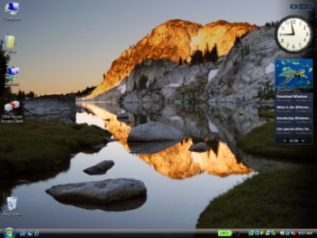
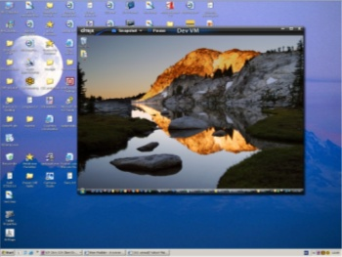
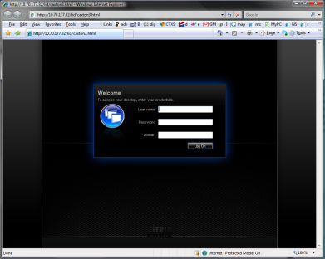
End User Experience
Access Scenarios
Desktop Appliances
login
Full-Screen
unmanaged machines
Web page
Windowed
Full-Screen
Notes:
14

Slide 15
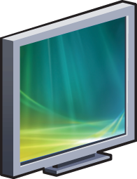
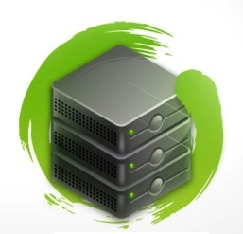




XenDesktop – VM or physical Only solution that can both host and stream desktops
Virtual Delivery Protocol
Hosted Virtual Desktops
Any Network
User Profile
Any Device
Real-time Assembly
Apps
Desktop OS
Desktop Streaming on the LAN
Existing PCs
Notes:
15

Slide 16


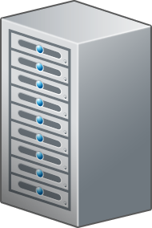




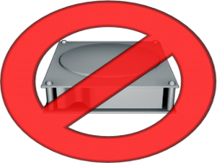


Why install an OS?

Slide 17
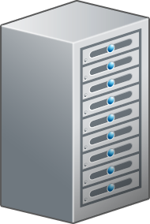
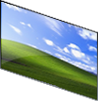

Why install an OS?

Slide 18
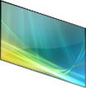
Why install an OS?

Slide 19
Why install an OS?

Slide 20

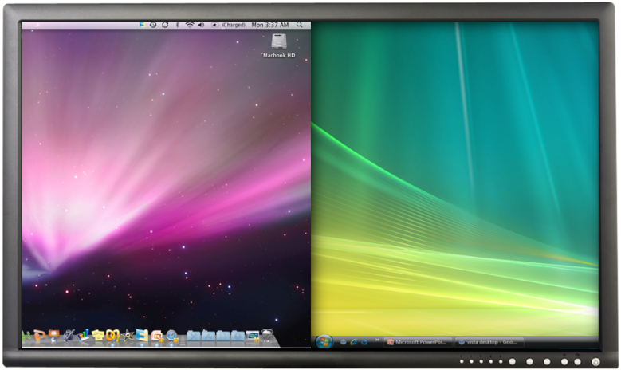
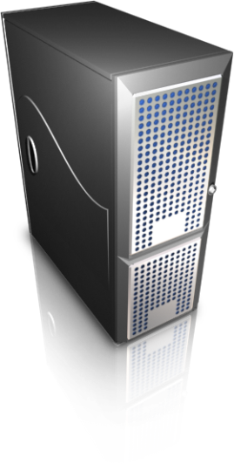




Citrix HDX Technology Leverages the Entire Delivery System
3
2
1
HDX at the Device
HDX on the Network
HDX in the Data Center
SSL 001000111010101 SSL 001000111010101 SSL 001000111010101 SSL 001000111010101 SSL 001000111010101

Slide 21
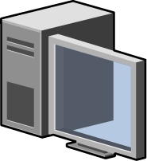
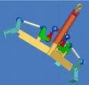
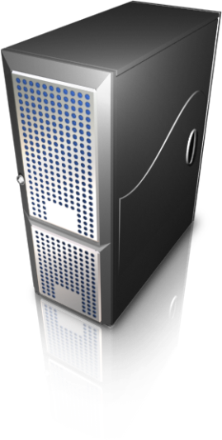
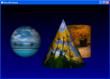
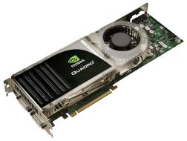
Adaptive Orchestration of HDX Technology
Optimise using HDX Broadcast
If possible, use HDX on the device
Fallback:
use HDX in the data center
2
Inspect Network
3
Inspect Endpoint
1
Optional
h/w acceleration
Inspect Server
Notes:
21

Slide 22
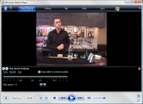
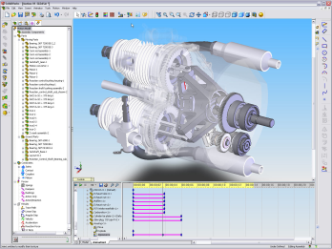
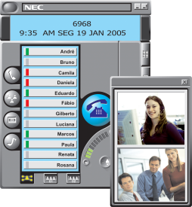
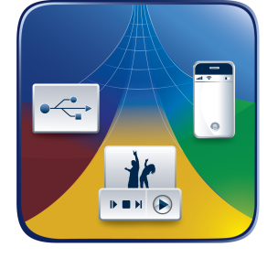
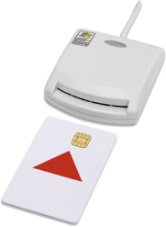
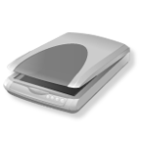

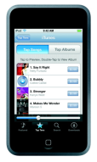
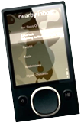
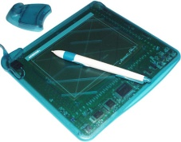
What is user experience?
Multimedia
Collaboration
Connectivity
Network Performance
3D & Next Gen Graphics
WAN Optimization

Slide 23
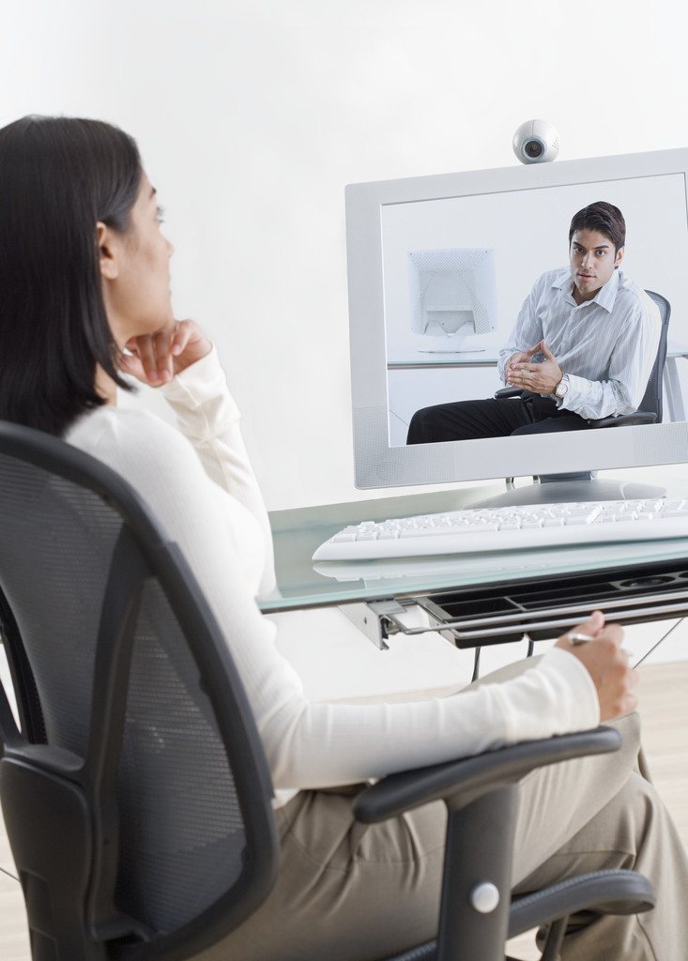
HDX Plug-n-Play Enhancements
Isochronous USB support
Advanced multi-monitor configurations

Slide 24
What about offline?

Slide 25
Types of Client Hypervisor Architectures
Type 1 Hypervisor
Type 2 Hypervisor
personal image
corporate image
corporate image
Type-2 hypervisor
Personal Image
Type-1 hypervisor
hardware
hardware

Slide 26


Collaborating on Citrix XenClient a bare-metal client hypervisor
Delivered by Citrix and Intel OEM partners
First availability beginning December 2009

Slide 27

Next Generation Laptops: Virtualisation “Built-in”
personal desktop
corporate image
Hypervisor from Citrix/Intel
Intel Processors

Slide 28
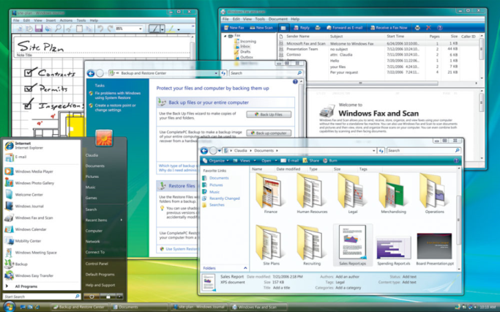
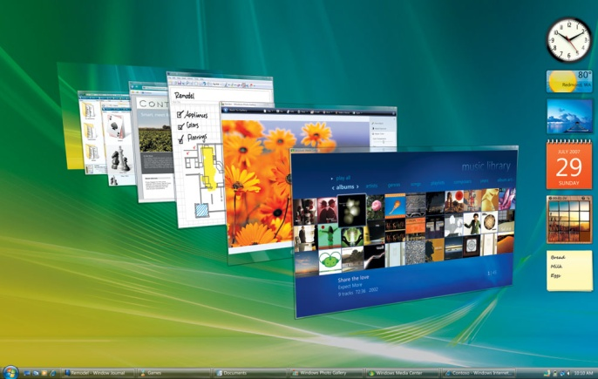
“Business” & “Personal” Environments
Business
Personal
Locked down
No local app installs
Tightly managed
Self-service corp apps
Allows Local App Installs
Minimal Management
Virus Scanner
Security Patches
No SLA
Self-Service Wipe

Slide 29
Desktop Delivery for Mobile Workers
access control policy
User Settings
personaldesktop
corporate image
data
apps
subsequent
OS
initial download
Apps
Δsync
Users
OS
Hypervisor from Citrix/Intel
BYOC
Single image management
Dynamic desktop assembly
Service level assurance

Slide 30
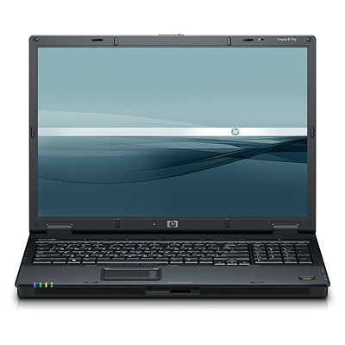

Security Policy in the Platform
Lease policy for corporate images
Check-in every 2 weeks
Kill pill for stolen devices
Corporate image and user data sync
Data movement restrictions
USB devices
Copy & paste
Printing

Slide 31


Self-service “app store” for employees
Simple “storefront” for IT
Saves IT money and time
Gives users broad choice in a fun and familiar way

Slide 32

User-Installed Apps on Dynamic Desktops
User Settings
Personalization
App Delivery
Apps
Users
OS
Virtual Desktop
Desktop Provisioning

Slide 34
© 2009 Microsoft Corporation. All rights reserved. Microsoft, Windows, Windows Vista and other product names are or may be registered trademarks and/or trademarks in the U.S. and/or other countries.
The information herein is for informational purposes only and represents the current view of Microsoft Corporation as of the date of this presentation. Because Microsoft must respond to changing market conditions, it should not be interpreted to be a commitment on the part of Microsoft, and Microsoft cannot guarantee the accuracy of any information provided after the date of this presentation. MICROSOFT MAKES NO WARRANTIES, EXPRESS, IMPLIED OR STATUTORY, AS TO THE INFORMATION IN THIS PRESENTATION.

