Slide 1

OCS 2007 Anywhere Access
Alan Shen
Director
Unify Square
alanshen@UnifySquare.com

Slide 2
Session Objectives And Takeaways
Session Objective(s)
  Overview of Anywhere Access scenarios
  Demo all Anywhere Access scenarios
  Describe deployment considerations
Session Takeaways
  Understand the value of Anywhere Access
  Identify scenarios appropriate for your company
  Plan your topology for anywhere access

Slide 3





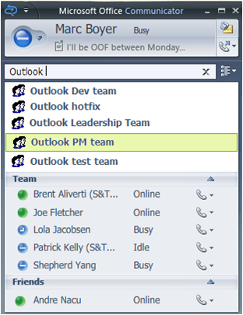
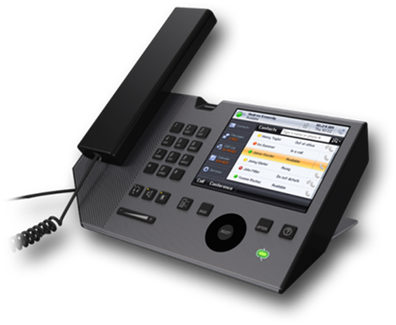
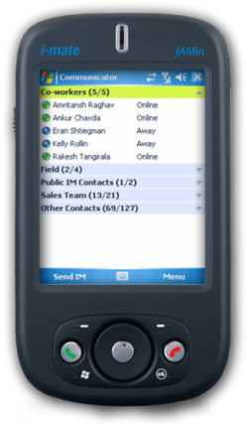
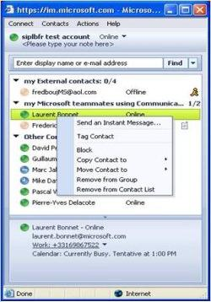
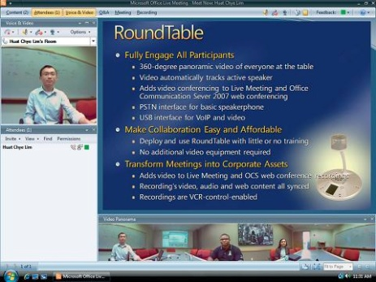
Anywhere Access Scenarios
Application | a.k.a. | Description
Office Communicator | OC MOC | Client application for ad-hoc real time communication | ✓ | ✓ | ✓ | ✓
Communicator Phone Edition | Tanjay | IP phone for OCS 2007 | ✓ |  | ✓
Live Meeting Console | Console | Rich meeting client for structured meetings |  |  | ✓ | ✓ | ✓
Communicator Mobile | CoMo | Windows Mobile client for on the go instant messaging | ✓ | ✓
Communicator Web Access | CWA | Web client for instant messaging on any browser | ✓ | ✓

Slide 4




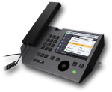



















OCS 2007 Topology
Information Worker (UC endpoints)
Management
Remote
Users
Reverse Proxy
Communicator
Phone Edition
Meeting Console
Communicator
MOM / MMC
Access Edge
Active
Directory
Front End Servers
Back End Servers
Federated
Company
ABS,DL,Content
Web Edge
CDR/Archiving
QOE Monitoring
Registrar, Proxy and
Presence Servers
SQL Database
Device Update
A/V Edge
Existing
PBX Network
Mediation
Server
A/V Conf
Server
Web Conf
Server
Exchange
2007
CWA
Server
PSTN and
Mobile Phones
SIP/PSTN
Gateway
SIP/Media
Translation
Slides, Meeting
Content
Mail & Unified
Messaging
Communicator
Web Server
Audio, Video

Slide 5
Feature Overview
Office Communicator
Rich client for ad-hoc communication
  Presence: Rich presence model with custom permissions
  IM: Share rich content messages
  Voice: Calls another communicator user or a PSTN number
  Video: Use a webcam or Round Table active speaker
Conferencing
  Drag and drop additional users to escalate to a conference
  IM, Voice, Video all support multiparty conferencing
User integration
  Downloads address book for username lookup
  Integrates with local Outlook contacts store
  Looks up distribution list members

Slide 6
Topology – OC Remote Login
Information Worker (UC endpoints)
Management
Remote
Users
Reverse Proxy
Communicator
Phone Edition
Meeting Console
Communicator
MOM / MMC
Access Edge
Active
Directory
Front End Servers
Back End Servers
Federated
Company
ABS,DL,Content
Web Edge
CDR/Archiving
QOE Monitoring
Registrar, Proxy and
Presence Servers
SQL Database
Device Update
A/V Edge
Existing
PBX Network
Mediation
Server
A/V Conf
Server
Web Conf
Server
Exchange
2007
CWA
Server
PSTN and
Mobile Phones
SIP/PSTN
Gateway
SIP/Media
Translation
Slides, Meeting
Content
Mail & Unified
Messaging
Communicator
Web Server
Audio, Video

Slide 7
Topology – OC Remote IM Activity
Information Worker (UC endpoints)
Management
Remote
Users
Reverse Proxy
Communicator
Phone Edition
Meeting Console
Communicator
MOM / MMC
Access Edge
Active
Directory
Front End Servers
Back End Servers
Federated
Company
ABS,DL,Content
Web Edge
CDR/Archiving
QOE Monitoring
Registrar, Proxy and
Presence Servers
SQL Database
Device Update
A/V Edge
Existing
PBX Network
Mediation
Server
A/V Conf
Server
Web Conf
Server
Exchange
2007
CWA
Server
PSTN and
Mobile Phones
SIP/PSTN
Gateway
SIP/Media
Translation
Slides, Meeting
Content
Mail & Unified
Messaging
Communicator
Web Server
Audio, Video

Slide 8
Topology – OC Remote A/V activity
Information Worker (UC endpoints)
Management
Remote
Users
Reverse Proxy
Communicator
Phone Edition
Meeting Console
Communicator
MOM / MMC
Access Edge
Active
Directory
Front End Servers
Back End Servers
Federated
Company
ABS,DL,Content
Web Edge
CDR/Archiving
QOE Monitoring
Registrar, Proxy and
Presence Servers
SQL Database
Device Update
A/V Edge
Existing
PBX Network
Mediation
Server
A/V Conf
Server
Web Conf
Server
Exchange
2007
CWA
Server
PSTN and
Mobile Phones
SIP/PSTN
Gateway
SIP/Media
Translation
Slides, Meeting
Content
Mail & Unified
Messaging
Communicator
Web Server
Audio, Video

Slide 9
Feature Overview
Communicator Phone Edition
Full featured IP Phone
  Presence: Retrieves same users and presences as OC
  One touch calling or use the dial pad
  Voice: Calls another communicator user or a PSTN number
  No video
Conferencing
  Supports multiparty conferencing and full call control
Firmware updates
  Managed using OCS 2007 device update server
  Automatically checks for available build and downloads

Slide 10
Topology – Tanjay Remote Login
Information Worker (UC endpoints)
Management
Remote
Users
Reverse Proxy
Communicator
Phone Edition
Meeting Console
Communicator
MOM / MMC
Access Edge
Active
Directory
Front End Servers
Back End Servers
Federated
Company
ABS,DL,Content
Web Edge
CDR/Archiving
QOE Monitoring
Registrar, Proxy and
Presence Servers
SQL Database
Device Update
A/V Edge
Existing
PBX Network
Mediation
Server
A/V Conf
Server
Web Conf
Server
Exchange
2007
CWA
Server
PSTN and
Mobile Phones
SIP/PSTN
Gateway
SIP/Media
Translation
Slides, Meeting
Content
Mail & Unified
Messaging
Communicator
Web Server
Audio, Video

Slide 11
Topology – Tanjay Remote Audio
Information Worker (UC endpoints)
Management
Remote
Users
Reverse Proxy
Communicator
Phone Edition
Meeting Console
Communicator
MOM / MMC
Access Edge
Active
Directory
Front End Servers
Back End Servers
Federated
Company
ABS,DL,Content
Web Edge
CDR/Archiving
QOE Monitoring
Registrar, Proxy and
Presence Servers
SQL Database
Device Update
A/V Edge
Existing
PBX Network
Mediation
Server
A/V Conf
Server
Web Conf
Server
Exchange
2007
CWA
Server
PSTN and
Mobile Phones
SIP/PSTN
Gateway
SIP/Media
Translation
Slides, Meeting
Content
Mail & Unified
Messaging
Communicator
Web Server
Audio, Video

Slide 12
Feature Overview
Meeting Console
Rich client for structured meetings
  Voice: Use VOIP or integration via an audio provider
  Video: Supports webcam and Round Table panoramic
  Conferencing: PPT, App sharing, Whiteboard, Q/A, Recording
Integration with Office and Live Meeting Service
  Use single Office plug-in to schedule both types of meetings
  Use a single client to participate in both types of meetings
Different levels of authorization
  Anonymous: Anyone can join using meeting details
  Open Authenticated: Validates corporate or federated user
  Closed Authenticated: Validates corporate user on invite list

Slide 13
Topology – Console Remote Join
Information Worker (UC endpoints)
Management
Remote
Users
Reverse Proxy
Communicator
Phone Edition
Meeting Console
Communicator
MOM / MMC
Access Edge
Active
Directory
Front End Servers
Back End Servers
Federated
Company
ABS,DL,Content
Web Edge
CDR/Archiving
QOE Monitoring
Registrar, Proxy and
Presence Servers
SQL Database
Device Update
A/V Edge
Existing
PBX Network
Mediation
Server
A/V Conf
Server
Web Conf
Server
Exchange
2007
CWA
Server
PSTN and
Mobile Phones
SIP/PSTN
Gateway
SIP/Media
Translation
Slides, Meeting
Content
Mail & Unified
Messaging
Communicator
Web Server
Audio, Video

Slide 14
Topology – Console Federated Join
Information Worker (UC endpoints)
Management
Remote
Users
Reverse Proxy
Communicator
Phone Edition
Meeting Console
Communicator
MOM / MMC
Access Edge
Active
Directory
Front End Servers
Back End Servers
Federated
Company
ABS,DL,Content
Web Edge
CDR/Archiving
QOE Monitoring
Registrar, Proxy and
Presence Servers
SQL Database
Device Update
A/V Edge
Existing
PBX Network
Mediation
Server
A/V Conf
Server
Web Conf
Server
Exchange
2007
CWA
Server
PSTN and
Mobile Phones
SIP/PSTN
Gateway
SIP/Media
Translation
Slides, Meeting
Content
Mail & Unified
Messaging
Communicator
Web Server
Audio, Video

Slide 15
Topology – Console Remote Activity
Information Worker (UC endpoints)
Management
Remote
Users
Reverse Proxy
Communicator
Phone Edition
Meeting Console
Communicator
MOM / MMC
Access Edge
Active
Directory
Front End Servers
Back End Servers
Federated
Company
ABS,DL,Content
Web Edge
CDR/Archiving
QOE Monitoring
Registrar, Proxy and
Presence Servers
SQL Database
Device Update
A/V Edge
Existing
PBX Network
Mediation
Server
A/V Conf
Server
Web Conf
Server
Exchange
2007
CWA
Server
PSTN and
Mobile Phones
SIP/PSTN
Gateway
SIP/Media
Translation
Slides, Meeting
Content
Mail & Unified
Messaging
Communicator
Web Server
Audio, Video

Slide 16
Feature Overview
Communicator Mobile
Mobiles client for real time communication on the go
  Exposes same rich presence model as OC
  Share IM messages P2P or via IM conference
User integration
  Look up address book to find other contacts
  Looks up distribution list members
Power consumption improvements
  Option to disable status updates when idle

Slide 17
Topology – CoMo Remote Login
Information Worker (UC endpoints)
Management
Remote
Users
Reverse Proxy
Communicator
Phone Edition
Meeting Console
Communicator
MOM / MMC
Access Edge
Active
Directory
Front End Servers
Back End Servers
Federated
Company
ABS,DL,Content
Web Edge
CDR/Archiving
QOE Monitoring
Registrar, Proxy and
Presence Servers
SQL Database
Device Update
A/V Edge
Existing
PBX Network
Mediation
Server
A/V Conf
Server
Web Conf
Server
Exchange
2007
CWA
Server
PSTN and
Mobile Phones
SIP/PSTN
Gateway
SIP/Media
Translation
Slides, Meeting
Content
Mail & Unified
Messaging
Communicator
Web Server
Audio, Video

Slide 18
Topology – CoMo Remote Activity
Information Worker (UC endpoints)
Management
Remote
Users
Reverse Proxy
Communicator
Phone Edition
Meeting Console
Communicator
MOM / MMC
Access Edge
Active
Directory
Front End Servers
Back End Servers
Federated
Company
ABS,DL,Content
Web Edge
CDR/Archiving
QOE Monitoring
Registrar, Proxy and
Presence Servers
SQL Database
Device Update
A/V Edge
Existing
PBX Network
Mediation
Server
A/V Conf
Server
Web Conf
Server
Exchange
2007
CWA
Server
PSTN and
Mobile Phones
SIP/PSTN
Gateway
SIP/Media
Translation
Slides, Meeting
Content
Mail & Unified
Messaging
Communicator
Web Server
Audio, Video

Slide 19
Feature Overview
Communicator Web Access
Web client for communicating on any computer
  Exposes same rich presence model as OC
  Share IM messages P2P or via IM conference
  Redirect voice call notifications to your mobile phone
User integration
  Look up address book to find other contacts
  Looks up distribution list members

Slide 20
Topology – CWA Remote Login
Information Worker (UC endpoints)
Management
Remote
Users
Reverse Proxy
Communicator
Phone Edition
Meeting Console
Communicator
MOM / MMC
Access Edge
Active
Directory
Front End Servers
Back End Servers
Federated
Company
ABS,DL,Content
Web Edge
CDR/Archiving
QOE Monitoring
Registrar, Proxy and
Presence Servers
SQL Database
Device Update
A/V Edge
Existing
PBX Network
Mediation
Server
A/V Conf
Server
Web Conf
Server
Exchange
2007
CWA
Server
PSTN and
Mobile Phones
SIP/PSTN
Gateway
SIP/Media
Translation
Slides, Meeting
Content
Mail & Unified
Messaging
Communicator
Web Server
Audio, Video

Slide 21
Topology – CWA Remote Activity
Information Worker (UC endpoints)
Management
Remote
Users
Reverse Proxy
Communicator
Phone Edition
Meeting Console
Communicator
MOM / MMC
Access Edge
Active
Directory
Front End Servers
Back End Servers
Federated
Company
ABS,DL,Content
Web Edge
CDR/Archiving
QOE Monitoring
Registrar, Proxy and
Presence Servers
SQL Database
Device Update
A/V Edge
Existing
PBX Network
Mediation
Server
A/V Conf
Server
Web Conf
Server
Exchange
2007
CWA
Server
PSTN and
Mobile Phones
SIP/PSTN
Gateway
SIP/Media
Translation
Slides, Meeting
Content
Mail & Unified
Messaging
Communicator
Web Server
Audio, Video

Slide 22
Topology –Remote Access Roles
Information Worker (UC endpoints)
Management
Remote
Users
Reverse Proxy
Communicator
Phone Edition
Meeting Console
Communicator
MOM / MMC
Access Edge
Active
Directory
Front End Servers
Back End Servers
Federated
Company
ABS,DL,Content
Web Edge
CDR/Archiving
QOE Monitoring
Registrar, Proxy and
Presence Servers
SQL Database
Device Update
A/V Edge
Existing
PBX Network
Mediation
Server
A/V Conf
Server
Web Conf
Server
Exchange
2007
CWA
Server
PSTN and
Mobile Phones
SIP/PSTN
Gateway
SIP/Media
Translation
Slides, Meeting
Content
Mail & Unified
Messaging
Communicator
Web Server
Audio, Video

Slide 23
Deployment Considerations
Reverse Proxy
IP addresses and Ports
  External (3): ABS/DL/Content, CWA, Update – all on TCP 443
  Internal (1): Sends to respective servers on TCP 443
  NAT is allowed
Certificates
  External (3): Public certificate for each IP
  Internal (1): Use same internal CA as OCS 2007
Load Balancers
  Only needed for external IP addresses
  Set FQDNs to load balancer VIPs

Slide 24
Deployment Considerations
Access Edge
SRV Records
  Remote Access: _sip._tls.<domain>
  Federation: _sipfederationtls._tcp.<domain>
IP Addresses and Ports
  External (1): TCP 443 (remote), TCP 5061 (federation)
  Internal (1): TCP 5061
  NAT is allowed
Certificates
  External (1): Public certificate, set client EKU
  Internal (1): Use same internal CA as OCS 2007
Load Balancers
  Used for internal and external edges
  Set internal and external FQDNs to corresponding VIPs

Slide 25
Deployment Considerations
Web Conferencing Edge
IP Addresses and Ports
  External (1): TCP 443
  Internal (1): TCP 5067
  NAT is allowed
Certificates
  External (1): Public certificate
  Internal (1): Use same internal CA as OCS 2007
Load Balancers
  Used for external edge only
  Set external FQDN to corresponding VIP

Slide 26
Deployment Considerations
Audio/Video Edge
IP Addresses and Ports
  External (1): TCP 443, TCP 50k-60k, UDP 3478, UDP 50k-60k
  Internal (1): TCP 443, UDP 3478
  NAT is not allowed
Certificates
  External (0): No public certificate is required
  Internal (1): Use same internal CA as OCS 2007
  A/V Auth (1): Use same internal CA as OCS 2007
Load Balancers
  Used for internal and external edges
  Set internal and external FQDNs to corresponding VIPs
  External A/V Edge IPs must still be routable

Slide 27
Deployment Considerations
CWA Server
IP Addresses and Ports
  External (1): TCP 443, TCP 50k-60k, UDP 3478, UDP 50k-60k
  Internal (1): TCP 443, UDP 3478
  NAT is not allowed
Certificates
  External (0): No public certificate is required
  Internal (1): Use same internal CA as OCS 2007
  A/V Auth (1): Use same internal CA as OCS 2007
Load Balancers
  Used for internal and external edges
  Set internal and external FQDNs to corresponding VIPs
  External A/V Edge IPs must still be routable

Slide 28
OCS 2007 Topology
Information Worker (UC endpoints)
Management
Remote
Users
Reverse Proxy
Communicator
Phone Edition
Meeting Console
Communicator
MOM / MMC
Access Edge
Active
Directory
Front End Servers
Back End Servers
Federated
Company
ABS,DL,Content
Web Edge
CDR/Archiving
QOE Monitoring
Registrar, Proxy and
Presence Servers
SQL Database
Device Update
A/V Edge
Existing
PBX Network
Mediation
Server
A/V Conf
Server
Web Conf
Server
Exchange
2007
CWA
Server
PSTN and
Mobile Phones
SIP/PSTN
Gateway
SIP/Media
Translation
Slides, Meeting
Content
Mail & Unified
Messaging
Communicator
Web Server
Audio, Video

Slide 29
Anywhere Access Scenarios
Application | a.k.a. | Description
Office Communicator | OC MOC | Client application for ad-hoc real time communication | ✓ | ✓ | ✓ | ✓
Communicator Phone Edition | Tanjay | IP phone for OCS 2007 | ✓ |  | ✓
Live Meeting Console | Console | Rich meeting client for structured meetings |  |  | ✓ | ✓ | ✓
Communicator Mobile | CoMo | Windows Mobile client for on the go instant messaging | ✓ | ✓
Communicator Web Access | CWA | Web client for instant messaging on any browser | ✓ | ✓

Slide 30
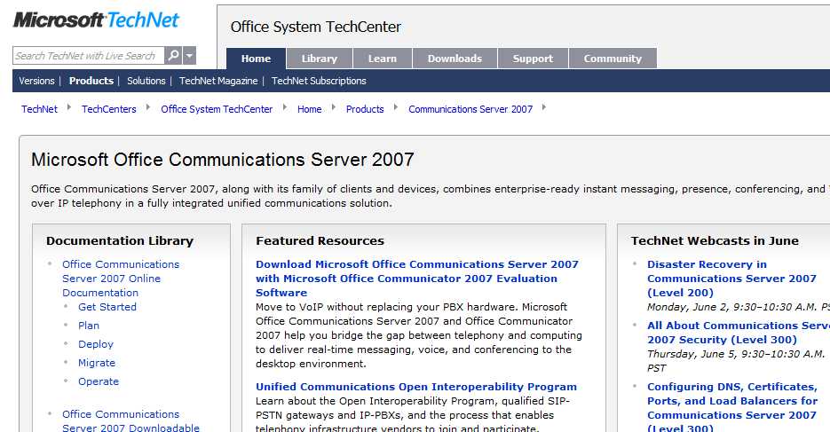
Want To Be An Expert?
Get in depth and up to date technical resources from TechNet
  Leverage the variety
  of Webcasts and
  Virtual Labs available
  Be part of the OCS
  Product Dialogue
  Join the OCS Community
http://technet.microsoft.com/office/ocs/

Slide 31

© 2008 Microsoft Corporation. All rights reserved. Microsoft, Windows, Windows Vista and other product names are or may be registered trademarks and/or trademarks in the U.S. and/or other countries.
The information herein is for informational purposes only and represents the current view of Microsoft Corporation as of the date of this presentation. Because Microsoft must respond to changing market conditions, it should not be interpreted to be a commitment on the part of Microsoft, and Microsoft cannot guarantee the accuracy of any information provided after the date of this presentation. MICROSOFT MAKES NO WARRANTIES, EXPRESS, IMPLIED OR STATUTORY, AS TO THE INFORMATION IN THIS PRESENTATION.

