Slide 1
Microsoft Office Communications Server 2007 Interoperability With PBX Systems
Jamie Stark
Senior Technical Product Manager
Microsoft Corporation

Slide 2
Agenda
Voice Interoperability in UC
OCS Voice Components
Deployment Scenarios
Qualification of PBXs and Gateways
Advanced interoperability topics

Slide 3
Microsoft UC Interoperability Goals
Make it simple to add UC capabilities to any existing customer deployment
Enable trialing and deployment of software powered VoIP interoperating with an existing telephony deployment
Prepare for a future migration to a software based world
End goal: Open software platform based integration (versus interoperability)

Slide 4
UC Interoperability Efforts
Microsoft Open Protocol Specifications
Open release of protocols to high-volume products
~30 protocol documents describing OC and OCS
SIP Forum
Full membership in SIP Forum
SIP Connect 1.1 participation to refine SIP Trunking
Building a robust Ecosystem
Defining scenarios and releasing specs for Interop
Create a program for vendors to qualify solutions

Slide 5
UC Open Interoperability Program http://technet.microsoft.com/ucoip
Enable Partners to develop Industry-Class Telephony Infrastructure that work seamlessly with OCS and Exchange UM
Encourage a wide breadth of solutions and integrations to enter the market
Ensure Customers have positive experiences with Setup, Support, and Use
Allows for scalable qualification of vendors

Slide 6



Software Powered Voice
Today
Future
Legacy PBX interoperability
Pilot today to prepare for the future
Focus on the user experience
OCS and OC replace legacy telephony infrastructure
Integrated user experience across all communication channels
Build Foundation
Single identity with Microsoft Active Directory
Instant Messaging and Presence with OCS 2007
Unified Messaging with Exchange Server 2007
Notes:
7/31/2008 9:41 AM
© 2004 Microsoft Corporation. All rights reserved.
This presentation is for informational purposes only. Microsoft makes no warranties, express or implied, in this summary.
6

Slide 7













Software Powered Voice
UC endpoints
Public IM Clouds
QOE Monitoring
Archiving
CDR
DMZ
AOL
MSN
Yahoo
Data
Audio/Video
Inbound
Routing
SIP
Outbound
Routing
Remote
Users
Voice Mail
Routing
Active Directory
Front-End Server(s)
(IM, Presence)
Conferencing
Server(s)
Backend
SQL server
Access
Server
Mediation
Server
Exchange
2007 Server UM
Federated
Businesses
SIP-PSTN GW
PRI
PBX
Voicemail
PSTN

Slide 8
Software Powered Voice Mediation server
Connects OCS and SIP/PSTN Gateway or IP-PBX
Front-end of the Microsoft OCS voice world
Intermediate signaling and call flow as a B2BUA
Manage innovative elements of the SIP transaction: Inside, TLS and SRTP – Outside, TCP and RTP
Transcode RTP flows from G.711 to RTAudio (8kHz) and SIREN
Act as an ICE Client for PSTN-originated calls
Enables OCS to…
Provide IP telephony
Interconnect with the legacy PSTN

Slide 9





Software Powered Voice SIP/PSTN gateways
Basic Media Gateway
Standalone appliance
Supports TDM features
SIP over TCP
RFC 3261 compliant SIP
G.711
Works with Mediation Server
Hybrid Media Gateway
Media Gateway appliance
Collocated with Mediation Server
Scalability a function of HW utilized for Mediation Server
Basic GW Appliance
UC Mediation Server
Rich GW appliance
Mediation Server

Slide 10
Software Powered Voice Deployment scenarios
Scenario | When to Deploy | Infrastructure Required
OCS Standalone | Pilot the future with specific groups: Highly collaborative employees Mobile employees | PSTN Gateway or existing TDM or Hybrid-IP PBX
OCS Co-Existence | All the features of the existing PBX, plus all features of OC and OCS | Modern PBX that can natively interoperate with OCS
Notes:
7/31/2008 9:41 AM
© 2004 Microsoft Corporation. All rights reserved.
This presentation is for informational purposes only. Microsoft makes no warranties, express or implied, in this summary.
10

Slide 11
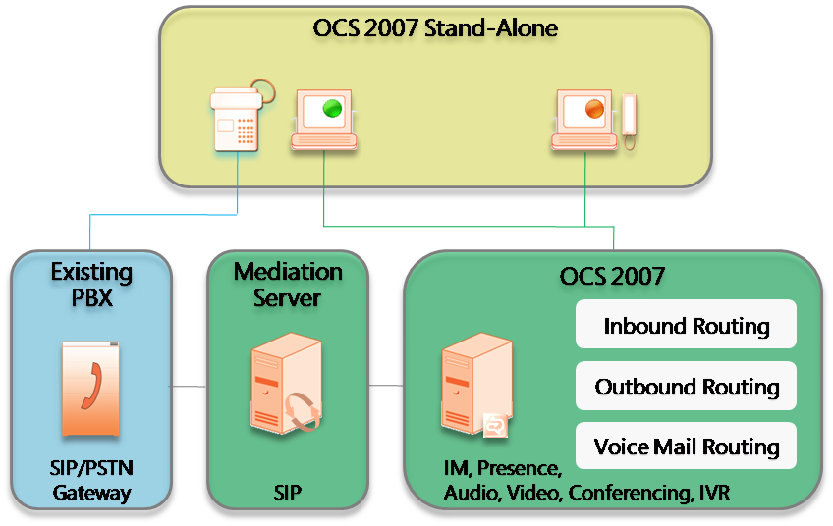
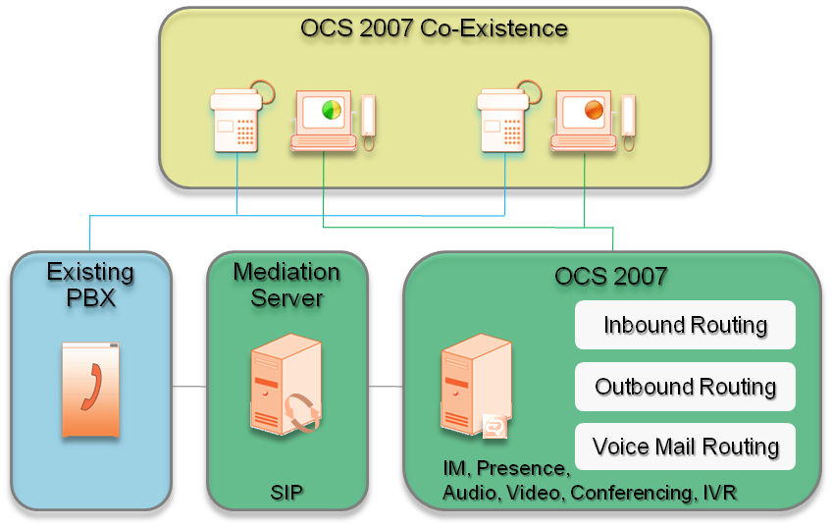
PBX Integration Scenarios
OCS 2007 Standalone
OC “stands alone” on the user’s desktop
OC users homed on OCS only
SIP or TDM connectivity to PBX
Alternate is PBX for users who do not have UC voice
OCS 2007 Co-Existence
OC “co-exists” with a PBX phone on the user’s desktop
OC users also homed on the PBX
SIP Connectivity ONLY to PBX
Based on “Dual Forking” specification

Slide 12
Implementing PBX Integration
OCS 2007 Standalone
SIP-to-PSTN Gateway
Direct SIP Connectivity
OCS 2007 Co-Existence
Dual Forking
Dual Forking with RCC

Slide 13
Implementing PBX Integration
Gateway: Support is a function of the Gateway – OCS is independent of the PBX.
Direct SIP: SIP signaling and media provided by PBX; PBX qualified against MS SIP interop specification
Dual Forking: Direct SIP + PBX is qualified against Microsoft Dual-forking specification
Dual Forking with RCC: PBX supports Dual forking plus Remote Call Control (RCC/CSTA)

Slide 14
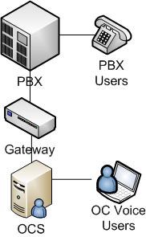
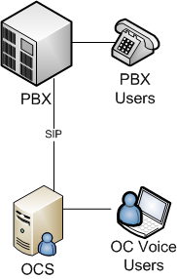
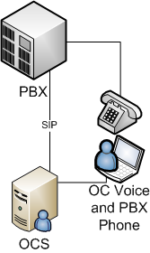

Implementing PBX Integration
Standalone |  | Co-Existence
Gateway | Direct SIP | Dual Forking | Dual Forking with RCC

Slide 15
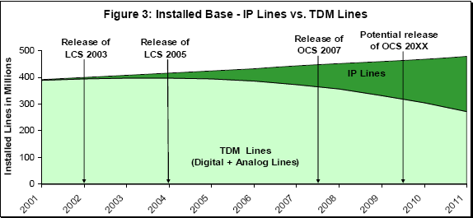
Standalone: Gateway
Customer has a TDM-based PBX that can’t be upgraded to SIP, or a Hybrid-IP PBX and no desire to upgrade
Small impact: appliance device, GW program enforces exceptional end-user experience
Worldwide, still the largest addressable market
Source: Dell’oro Group, Quarterly IP Telephony Enterprise Report, Q2 2007

Slide 16
Standalone: Direct SIP
Integration with a modern SIP-based PBX that is qualified for Direct SIP interop with OCS 2007
Also known in the industry as “SIP Trunking”
“SIP Trunking” = OCS connecting to an IP Telephony Service Provider. On the roadmap for support in a future release
“Direct SIP” = OCS Connecting to an on-premise IP-PBX
No desire for a circuit interface to their PBX
Reduced transcoding of media
Cost often sighted as a concern, but consider PBX licensing
But still a server to server trunk – not client to client due to lack of ICE negotiation, security, etc.

Slide 17
Standalone: Inbound Call Flow

Slide 18
Co-Existence Dual forking and dual forking w/RCC
Integrating with a modern SIP-based PBX
Qualified with the OCS Dual Forking specification
Optionally CSTA for RCC-based presence integration
Leverage investment in PBX infrastructure and station sets
Likely to require a PBX upgrade
PBX needs to suppress forking of a forked call
RCC controls PBX line using Communicator and integrates phone presence with OCS

Slide 19
Co-Existence: Call Flow Example
PBX doesn’t suppress forking

Slide 20
Co-Existence: Call Flow Example
CS1000
MCM/
App Proxy
Med. Server
at BVW
OCS Server
OC Client
(Bob)
Call to DN 5555
INVITE 3438000
UDP
x-nt-ocn:
sip:343-5555
sip-gw-id=
BVW
Ring 5555
Send INVITE to 343-5555 to M.S. associated with BVW
INVITE 343-5555
Ms-call-src= non-ms-rtc
INVITE
Bob@demo.com
(Bob accepts the call)
200 OK
200 OK
200 OK
Cancel (to 5555)
200 OK
Connect to caller
PBX Station calls – OC answers

Slide 21
Remote Call Control aka Third party call control, RCC
Communicator controls a PBX line
Status of PBX line updates OCS’ presence model
Using TR/87 (CSTA over SIP) – may require an RCC gateway
Some RCC features deprecated in OC 2007
Many OCS scenarios lost when using RCC
Media flows through the PBX handset, not OC
Remote user scenarios, Multimedia, Media stack, etc.
RCC does add value to Dual Forking
OIP qualifies Dual Forking + RCC, not RCC only

Slide 22
UCOIP: Current Status
Currently 100+ vendors signed up
Tracking 50+ interoperability engagements
Gateways
Grown to nine vendors with qualified products
Qualified: Five Basic Hybrid, Nine Basic Gateways
PBXs
30 in-process PBX engagements versus 12 GWs
Longer cycles, slower pace of engagement

Slide 23
Gateways: Qualified Products
Vendor | Qualified Product | Configuration | Other Supported Products
Aculab | ApplianX Gateway for OCS 2007 | Basic Hybrid
AudioCodes | Mediant 1000 | Basic Gateway | MediaPack 11x
 | Mediant 2000 | Basic Gateway | MediaPack 11x
 | Mediant 2000 Hybrid | Basic Hybrid | MediaPack 11x, TP-260/SIP
Cisco | 2851 ISR | Basic Gateway | 2800 Series
 | 3845 ISR | Basic Gateway | 3800 Series
Dialogic | 2000 | Basic Gateway | DMG1000 & DMG2000
 | 4000 | Basic Hybrid | DMG4000 Series
NEC | SV70 OCS-GW-A | Basic Gateway
NET | VX1200 | Basic Gateway | VX Series
Nortel | Secure Router 4134 | Basic Hybrid
Quintum | Tenor DX | Basic Gateway | AS, AF, AX, BX, DX, CMS
 | Tenor Hybrid Gateway 60 | Basic Hybrid
VegaStream | Vega 400 | Basic Gateway | Vega50 Europa, Vega 5000

Slide 24
PBXs: Qualified And Pipeline
Vendor | Product | Qualification Level | Firmware | Other Supported
Nortel | CS 1000 | Dual Forking | CS 1000 – 5.0.31 MCM – 3.0.1.77 | CS 1000 Series
Nortel | CS 1000 | Dual Forking w/RCC | CS 1000 – 5.0.31 MCM – 3.0.1.77
Vendor | Product | Version
Aastra / Ericcson | MX-ONE
Alcatel/Lucent | OmniPCX | 9.0
Avaya | Comm Mgr | 4.x
Cisco | CUCM | 7.x
Mitel | 3300 | 8.x
NEC | SV7000
Nortel | CS2100 | 5.2
QubeConnect
Seltatel
ShoreTel | ShoreGear
Swyx | SwyxConnect
IP-PBXs
Expect qualification against new software
Vendors choose the level of qualification
TDM-based PBXs
No native interoperability
Use SIP/PSTN gateway

Slide 25
Interoperability Why can't we all just get along?
Direct SIP Challenges
Proprietary Codecs
SIP over UDP
Session Border Controllers

Slide 26
Direct SIP Challenges Not all so-called SIP solutions are Standard SIP
We overestimated standards compliance of most broadly used solutions
SIP over TCP
Early Media and PRACK
RFC 3966
For optimal customer experience, we released standards-based specifications and test program
Vendors unlikely to fix currently shipping or shipped solutions, more likely to become standard compliant in some future version

Slide 27
RFC 3966
Number structure for geographic area
Country Code | National Destination Code (optional) | Subscriber Number
 | National (significant) number
cc=1–3 digits | maximum 15-cc digits
International public telecommunication number for geographic areas (maximum 15 digits)
OCS uses RFC 3966 numbering
Defines the URI scheme "tel", numbering based on E.164 (above, +44628654321)
Typically need to be converted to dialable numbers for PBX or PSTN
For example, for a gateway based in the UK, country code 44, GW will replace +44 with 0; for all other calls it will replace + with 00
Most IP-PBXs don’t support 3966
Non-standard numbering conventions a relic from the old world
GW provides conversion of to: and from: Fields for interoperability
Microsoft releasing a QFE to break OCS’ RFC 3966 compliance
Addressing cases for E.164 numbers where PBX doesn’t support ‘+’ for number representation in SIP messages as defined in RFC 3966
Dial strings will be used when interacting with the non-compliant PBXs
Targeted for release Fall 2008
Testing on Cisco CUCM; Other PBXs may benefit

Slide 28
SIP Over UDP "OCS needs this for Asterisk support"
UDP for SIP Transport has many issues
Security
Packet Fragmentation
Application layer connection management
Quoting RFC 3261
. ”All SIP elements MUST implement UDP and TCP. SIP elements MAY implement other protocols.
Making TCP mandatory for the UA is a substantial change from RFC 2543. It has arisen out of the need to handle larger messages, which MUST use TCP, as discussed below. Thus, even if an element never sends large messages, it may receive one and needs to be able to handle them.”
OCS nearly always has large messages
There are no plans to support SIP over UDP

Slide 29
SIP Over UDP
Vendor | UDP | TCP | TLS
Acme Packet | Y | Y | Y
Alcatel-Lucent | Y | Y | N
Asterisk | Y | N | N
AudioCodes | Y | Y | Y
Avaya | Y | Y | Y
Cisco | Y | Y | Y
Covergence | Y | Y | Y
IBM | N | Y | Y
Microsoft | N | Y | Y
Nextpoint | Y | Y | Y
Nortel | Y | Y | Y
Siemens | Y | Y | Y

Slide 30
Codecs
“But the Microsoft codec is proprietary, and the only way for other vendors' phones to talk to Microsoft endpoints is via Microsoft's Mediation Server, which transcodes between standard codecs and Microsoft's RT Audio.”
- Nojitter.com, May 26, 2008
True, but misleading
Polycom and Tandberg endpoints call into OCS without Mediation Server

Slide 31
Codecs
OC stack has 9 audio codecs
The real issue is Registration and Security
Most phones can’t support authentication – yet
Codec | Clock rate | P-Time | Usage
RTAudio | 16000 | 20, 40, 60 | Peer to Peer
RTAudio | 8000 | 20, 40, 60 | Mediation Server
SIREN | 16000 | 20, 40, 60, 100, 200 | AVMCU
G.711 μ-Law | 8000 | 20, 40, 60 | Interop
G.711 A-Law | 8000 | 20, 40, 60 | Interop
G.722.1 | 16000 | 20, 40, 60 | Interop
G.723.1 | 8000 | 30, 60, 90 | Interop
G.726 | 8000 | 20, 40, 60 | Interop
GSM 6.10 | 8000 | 20, 40, 60 | Interop

Slide 32
Session Border Controllers
Example Companies
Acme Packet, Nextone, Ingate, Covergence, Newport Networks
Several Gateway vendors also produce SBCs: AudioCodes and NET
Sit in the network edge for security and session mgmt.
Common Value Proposition
Security: Allow remote users and protect against SIP attacks
“Rosetta Stone” Interop: SIP-SIP, SIP Trunking, etc.
Not required nor supported for OCS deployments
The OIP is not accepting SBCs
Not necessary for OCS 2007 Direct SIP or Edge role
Potentially detrimental to media quality, federation, remote

Slide 33
Summary
Interoperability is extremely important for Microsoft, Unified Communications and OCS
The voice components in OCS are designed for open, standards based interop
OCS is being deployed TODAY connecting to a huge variety of existing PBX systems
A scalable program to include any Gateway or PBX vendor is actively qualifying interoperability

Slide 34
Track Resources And References
White Paper: Integrating Telephony with
Office Communications Server 2007
Unified Communications Open Interoperability Program
Office Communications Server 2007 Voice Planning and Deployment Guide
Microsoft Open Protocol Specification
Protocol documentation for OCS & OC
SIP Connect 1.1
RFC 3261
RFC 3966
Nojitter.com Article

Slide 35
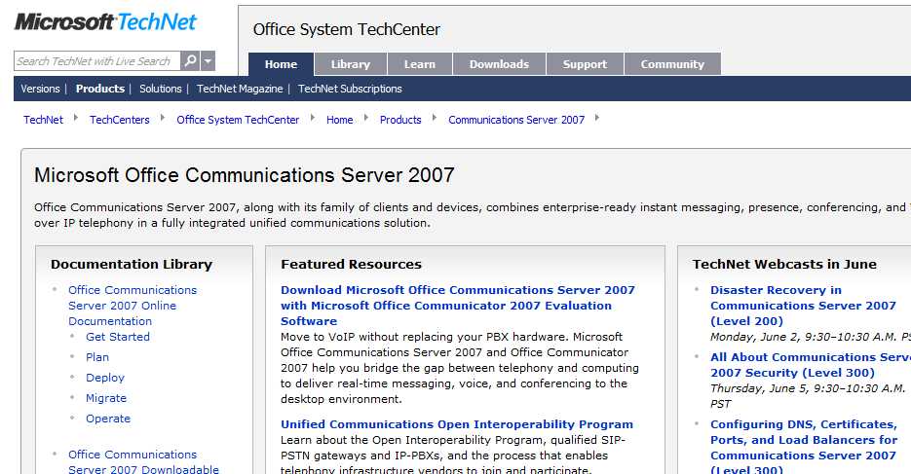
Want To Be An Expert?
Get in depth and up to date technical resources from TechNet
Leverage the variety of Webcasts and Virtual Labs available
Be part of the OCS Product Dialogue
Join the OCS Community
http://technet.microsoft.com/office/ocs/

Slide 36

© 2008 Microsoft Corporation. All rights reserved. Microsoft, Windows, Windows Vista and other product names are or may be registered trademarks and/or trademarks in the U.S. and/or other countries.
The information herein is for informational purposes only and represents the current view of Microsoft Corporation as of the date of this presentation. Because Microsoft must respond to changing market conditions, it should not be interpreted to be a commitment on the part of Microsoft, and Microsoft cannot guarantee the accuracy of any information provided after the date of this presentation. MICROSOFT MAKES NO WARRANTIES, EXPRESS, IMPLIED OR STATUTORY, AS TO THE INFORMATION IN THIS PRESENTATION.

