Slide 1
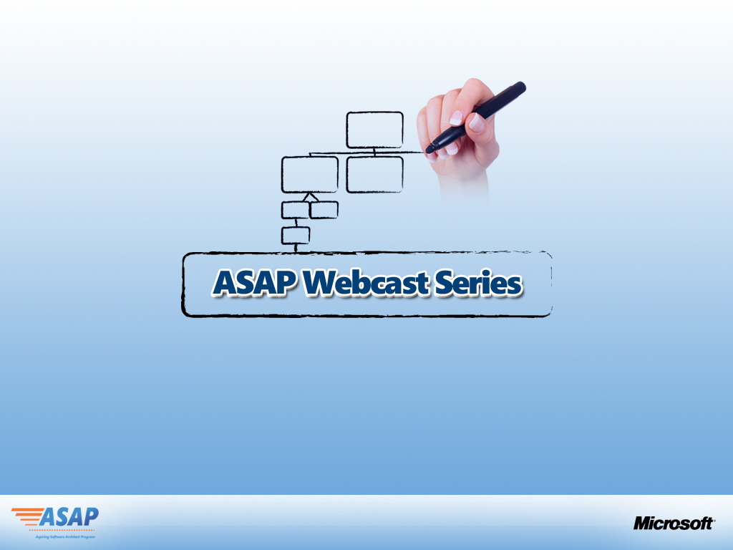
Information Architecture for MOSS Solutions
Presented by:
Girish Phadke, Jaydev Kundurmutt
Senior Architects
Tata Consultancy Services
Hosted by:
Vikram Rajkondawar
Architect Advisor
Microsoft Corporation

Slide 2

What are we going to look at?
Portal Evolution & Governance
Approaching the IA Problem
Case Study
How SharePoint Features Map
The Information Architect
Goals and Considerations
Definitions and Concepts

Slide 3
WHY INFORMATION ARCHITECTURE?
Disparate information sources – the need to consolidate, aggregate
Information overload (or under load)
Dynamic – keeping pace with change - volume, nature of content, business needs
Demands and Interpretation of information within large enterprises can be different and dynamic
Pushing relevant content to users versus pull of information – pro-active and timely informational alerts
Content aggregation, repurposing and branding, interfaces with third parties
Keeping content relevant, current and useful
THE INFORMATION EXPLOSION!!

Slide 4
What is Information Architecture?
Conceptually: the art and science of organizing information so that it is findable, manageable and useful
The design, including organization, labeling, and navigation, of systems that help people share information effectively.

Slide 5
Key Goals
Searchable, Retrievable
Accurate, Current, Consistent
Forum - knowledge sharing, enrichment
Information Push
Information flow
Evolutionary
Uphold information security
One –stop shop
User experience
Brand and culture
Governance and Delegation

Slide 6
Key Terms
Taxonomy
Ontology
Portal
Content Management

Slide 7
Role of the Information Architect
Assess organizational goals, business drivers - Information platform
Envisions, strategizes roadmap, architecture, implementation of the information framework of an enterprise
Business Analyst
Information Worker
Evangelist
Developer
Infrastructure Manager
R O L E S
A GOOD INFORMATION ARCHITECT
Has a strong sense of organization
Communicates effectively posing appropriate questions to a broad stakeholder community – managerial, business and technical
Emphasizes usability

Slide 8
Drivers
Organizational Structure
Line of Business
Organizational culture
Physical distribution and infrastructure
Disparate Information Sources
Content Dynamics
External collaboration
Business processes
Compliance and Regulatory Needs
Information Aggregation and Management Reporting
Social Networking
Information Security

Slide 9
Information Architecture Framework
Information Dissemination
Information Extensibility and Customizability
Information Push and Personalization
Information Integration
Information Discoverability and Taxonomy
Information Accessibility and Availability
Information Portal
Information Branding and Consistency
Information Monitoring and Usage
Information Processes and Workflow
Information Compliance and Regulations
Information Roll-Up and Summarization
Information Security, Policies and Protection
Information Composability, Publishing and Management
Information Management, Governance and Delegation
Information Collaboration and Social Networking

Slide 10
How SharePoint features map?
Information Dissemination
Information Extensibility and Customizability
Information Push and Personalization
Information Integration
Information Discoverability and Taxonomy
Information Accessibility and Availability
Information Portal
Search Center,
Federated Search
Global and Side Navigations,
Breadcrumbs,
Content Types, Site Columns,
Table of Contents Web Part,
Site Directory,
Summary Links Web Part,
Portal Site Connection,
List Views and Folders
Information Branding and Consistency
Information Monitoring and Usage
Information Processes and Workflow
Information Compliance and Regulations
Information Roll-Up and Summarization
Information Security, Policies and Protection
Information Composability, Publishing and Management
Information Management, Governance and Delegation
Information Collaboration and Social Networking

Slide 11
How SharePoint features map?
Information Dissemination
Information Extensibility and Customizability
Information Push and Personalization
Information Integration
Information Discoverability and Taxonomy
Information Accessibility and Availability
Information Portal
Information Branding and Consistency
Information Monitoring and Usage
Dissemination Channels:
Intranet
Extranet
Internet
Mobile
Outlook
Office Applications
Information Processes and Workflow
Information Compliance and Regulations
Information Roll-Up and Summarization
Information Security, Policies and Protection
Information Composability, Publishing and Management
Information Management, Governance and Delegation
Information Collaboration and Social Networking

Slide 12
How SharePoint features map?
Information Dissemination
Information Extensibility and Customizability
Information Push and Personalization
Information Integration
Information Discoverability and Taxonomy
Information Accessibility and Availability
Information Portal
Audiences
Alerts
Personalizable Web Parts
Task Notifications
User Profiles
Information Monitoring and Usage
Information Branding and Consistency
Information Processes and Workflow
Information Compliance and Regulations
Information Roll-Up and Summarization
Information Security, Policies and Protection
Information Composability, Publishing and Management
Information Management, Governance and Delegation
Information Collaboration and Social Networking

Slide 13
How SharePoint features map?
Information Dissemination
Information Extensibility and Customizability
Information Push and Personalization
Information Integration
Information Discoverability and Taxonomy
Information Accessibility and Availability
Information Portal
Single Sign On,
User Profiles,
Enterprise Search,
Business Data Catalog,
Publishing Portal,
Collaboration Portal
Self-Service Site Creation
My Sites
Information Branding and Consistency
Information Monitoring and Usage
Information Processes and Workflow
Information Compliance and Regulations
Information Roll-Up and Summarization
Information Security, Policies and Protection
Information Composability, Publishing and Management
Information Management, Governance and Delegation
Information Collaboration and Social Networking

Slide 14
How SharePoint features map?
Information Dissemination
Information Extensibility and Customizability
Information Push and Personalization
Information Integration
Information Discoverability and Taxonomy
Information Accessibility and Availability
Information Portal
Information Branding and Consistency
Information Monitoring and Usage
Master Pages,
Themes,
Style Sheets,
Page Layouts
Information Processes and Workflow
Information Compliance and Regulations
Information Roll-Up and Summarization
Information Security, Policies and Protection
Information Composability, Publishing and Management
Information Management, Governance and Delegation
Information Collaboration and Social Networking

Slide 15
How SharePoint features map?
Information Dissemination
Information Extensibility and Customizability
Information Push and Personalization
Information Integration
Information Discoverability and Taxonomy
Information Accessibility and Availability
Information Portal
Information Branding and Consistency
Information Monitoring and Usage
InfoPath Forms,
Out of the box workflows
SharePoint Designer Workflow
Visual Studio - Windows Workflow Foundation,
Information Processes and Workflow
Information Compliance and Regulations
Information Roll-Up and Summarization
Information Security, Policies and Protection
Information Composability, Publishing and Management
Information Management, Governance and Delegation
Information Collaboration and Social Networking

Slide 16
How SharePoint features map?
Information Dissemination
Information Extensibility and Customizability
Information Push and Personalization
Information Integration
Information Discoverability and Taxonomy
Information Accessibility and Availability
Information Portal
Content Query Web Part,
Data View Web Part,
RSS Viewer Web Part.
List and Document Library Views,
Sorting, Grouping,
Folders,
Web Part Connections,
Filter Web Parts
Information Branding and Consistency
Information Monitoring and Usage
Information Processes and Workflow
Information Compliance and Regulations
Information Roll-Up and Summarization
Information Security, Policies and Protection
Information Composability, Publishing and Management
Information Management, Governance and Delegation
Information Collaboration and Social Networking

Slide 17
How SharePoint features map?
Information Dissemination
Information Extensibility and Customizability
Information Push and Personalization
Information Integration
Information Discoverability and Taxonomy
Information Accessibility and Availability
Information Portal
Page Layouts,
Web Part Pages and Zones,
Content Publishing,
Site & List templates
Content editor web part,
Image web part,
Document conversion services,
SharePoint Designer based authoring, Variations
Information Monitoring and Usage
Information Branding and Consistency
Information Processes and Workflow
Information Compliance and Regulations
Information Roll-Up and Summarization
Information Security, Policies and Protection
Information Composability, Publishing and Management
Information Management, Governance and Delegation
Information Collaboration and Social Networking

Slide 18
How SharePoint features map?
Information Dissemination
Information Extensibility and Customizability
Information Push and Personalization
Information Integration
Information Discoverability and Taxonomy
Information Accessibility and Availability
Information Portal
Team Sites,
Meeting and Document Workspaces,
Document Libraries,
Blogs, Wikis, Surveys, Forums
Announcements, Calendars,
My Sites, People Search, Colleagues,
Outlook and Office Integration,
Incoming mail
Presence Integration
Information Monitoring and Usage
Information Branding and Consistency
Information Processes and Workflow
Information Compliance and Regulations
Information Roll-Up and Summarization
Information Security, Policies and Protection
Information Composability, Publishing and Management
Information Management, Governance and Delegation
Information Collaboration and Social Networking

Slide 19
How SharePoint features map?
Information Dissemination
Information Extensibility and Customizability
Information Push and Personalization
Information Integration
Information Discoverability and Taxonomy
Information Accessibility and Availability
Information Portal
Central Administration,
Shared Services Administration
Site Collection Admin, Site Owners
Backup/Restore,
Features and Solutions,
Site Provisioning, Managed Paths, Quotas
Self-Service Site Creation,
Information Monitoring and Usage
Information Branding and Consistency
Information Processes and Workflow
Information Compliance and Regulations
Information Roll-Up and Summarization
Information Security, Policies and Protection
Information Composability, Publishing and Management
Information Management, Governance and Delegation
Information Collaboration and Social Networking

Slide 20
How SharePoint features map?
Information Dissemination
Information Extensibility and Customizability
Information Push and Personalization
Information Integration
Information Discoverability and Taxonomy
Information Accessibility and Availability
Information Portal
Users and Groups, Permissions,
Coarse and fine-grained security,
Security-Trimmed UI,
Multiple authentication schemes, Information Rights Management, information policy management,
Recycle Bin, Backup/Restore via Central Admin,
Unused site deletions
Anti-Virus scans and Blocked-File Types
Information Monitoring and Usage
Information Branding and Consistency
Information Processes and Workflow
Information Compliance and Regulations
Information Roll-Up and Summarization
Information Security, Policies and Protection
Information Composability, Publishing and Management
Information Management, Governance and Delegation
Information Collaboration and Social Networking

Slide 21
How SharePoint features map?
Information Dissemination
Information Extensibility and Customizability
Information Push and Personalization
Information Integration
Information Discoverability and Taxonomy
Information Accessibility and Availability
Information Portal
Information Branding and Consistency
Records Center,
Records Management,
Auditing,
Archival
Information Monitoring and Usage
Information Processes and Workflow
Information Compliance and Regulations
Information Roll-Up and Summarization
Information Security, Policies and Protection
Information Composability, Publishing and Management
Information Management, Governance and Delegation
Information Collaboration and Social Networking

Slide 22
How SharePoint features map?
Information Dissemination
Information Extensibility and Customizability
Information Push and Personalization
Information Integration
Information Discoverability and Taxonomy
Information Accessibility and Availability
Information Portal
Site usage and monitoring
Search Queries and Results analysis
Diagnostics and Trace
Audit reports
Information Branding and Consistency
Information Monitoring and Usage
Information Processes and Workflow
Information Compliance and Regulations
Information Roll-Up and Summarization
Information Security, Policies and Protection
Information Composability, Publishing and Management
Information Management, Governance and Delegation
Information Collaboration and Social Networking

Slide 23
How SharePoint features map?
Information Dissemination
Information Extensibility and Customizability
Information Push and Personalization
Information Integration
Information Discoverability and Taxonomy
Information Accessibility and Availability
Information Portal
Offline collaboration/synchronization Outlook Tasks, Calendars,
Office Doc Libraries
InfoPath Forms
Mobile device rendering.
Information Branding and Consistency
Information Monitoring and Usage
Information Processes and Workflow
Information Compliance and Regulations
Information Roll-Up and Summarization
Information Security, Policies and Protection
Information Composability, Publishing and Management
Information Management, Governance and Delegation
Information Collaboration and Social Networking

Slide 24
How SharePoint features map?
Information Dissemination
Information Extensibility and Customizability
Information Push and Personalization
Information Integration
Information Discoverability and Taxonomy
Information Accessibility and Availability
Information Portal
Business Data Catalog,
Enterprise Search
WSRP
Page Viewer Web Part,
RSS,
Information Monitoring and Usage
Information Branding and Consistency
Information Processes and Workflow
Information Compliance and Regulations
Information Roll-Up and Summarization
Information Security, Policies and Protection
Information Composability, Publishing and Management
Information Management, Governance and Delegation
Information Collaboration and Social Networking

Slide 25
How SharePoint features map?
Information Dissemination
Information Extensibility and Customizability
Information Push and Personalization
Information Integration
Information Discoverability and Taxonomy
Information Accessibility and Availability
Information Portal
Site Templates and Definitions,
Master Pages & Layouts, Fields,
Event Handlers,
Workflows
Custom Web Parts
SharePoint Object Model and API
Information Branding and Consistency
Information Monitoring and Usage
Information Processes and Workflow
Information Compliance and Regulations
Information Roll-Up and Summarization
Information Security, Policies and Protection
Information Composability, Publishing and Management
Information Management, Governance and Delegation
Information Collaboration and Social Networking

Slide 26
Typical Problem Statement – A Large IT Company
BestIT
A large, fast-growing multi-national IT organization “BestIT” with 100,000+ associates spread across multiple geographies and continents and servicing several leading customers. The company provides consultancy, systems integration, business process outsourcing, ADM and R&D services.
People are its “bread and butter” Or rather, their Knowledge.
BestIT underwent a major re-organization to provide for an overall agile, scalable model that would help the company better serve its customers and realize its long-term vision and goals to emerge as a leader.
Challenges faced:
Align Information base with changed Organization Structure
Knowledge base and churn overwhelming to manage
Highly dynamic project teams – Knowledge Management
Finding information and networking with people with common interests, goals, skill sets and specialized knowledge

Slide 27
So what is the Information Management Vision
Information Organization, Flow and Dissemination needs to be centralized, efficient, robust, flexible and evolutionary with the end goal of increasing overall workplace productivity
A robust Knowledge Management platform
Generate
People
Knowledge
Use/Reuse
Refine/Evolve
Disseminate To
Harvest
Assets
BestIT

Slide 28
Approaching the Problem
Understand the Overall Portal Information Requirements

Slide 29
Main Inputs Needed
Understand Organizational Structure and Size
Purpose of each Organizational Unit and Nature of Informational Content
Key Stakeholders
High Level Information Requirements for each OU
Taxonomy
Collaboration and Social Networking
Communication
Document and Records Management
Published Content
Workflow
Personalization and Alerts
Line of Business Information
Environments – Intranet, Extranet, Internet
Security
Governance
What is key to discovering inputs and realizing the Information Vision?
Strong Management Commitment and co-operation from Key Stakeholders
How? - Questionnaires, Surveys, White Board Sessions, Interviews….

Slide 30
BestIT’s Requirements
BestIT
Best IT
Corporate Functions
HR
Legal
Industry Verticals
Retail
Infrastructure Functions
Process Excellence
Finance
Other
HealthCare
Other…
Technology Excellence
Other
Project Teams
Project Teams
Individual COEs
Customer Relationships

Slide 31
BestIT Corporate Portal Requirements
BestIT
Corporate Intranet Portal
Corporate Functions
Industry Verticals
Infrastructure Functions
Other

Slide 32
Approach the IA Problem
Determine Portal Structure and Navigation Needs
Plan for Metadata (Taxonomy)
Plan for Collaborative Content
Determine Security Requirements
Plan for Informational Flow (Workflow)
Determine Discoverability (Search) Requirements
Plan for Compliance and Records Management
Plan for Business Data Integration
Plan for Personalization
Design Overall Portal and Hierarchy

Slide 33
Concepts & Decision Points
Design Overall Portal and Hierarchy
Understand SharePoint Site Topology Container Hierarchy
Single or Multiple Farms, SSPs
Web Applications vs Site Collections vs Sites
Web Applications – Zones and Paths

Slide 34
Understand SharePoint Site Topology Container Hierarchy
Farm
Web Application(s) (Zones)
Site Collection(s)
Sites and Sub-Sites
Shared Services
Lists
Document Libraries
Content DB

Slide 35
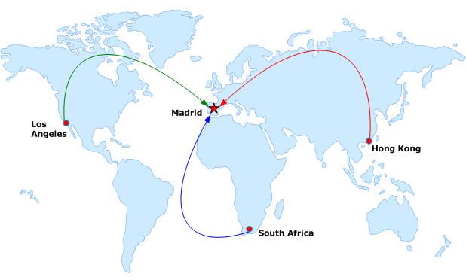
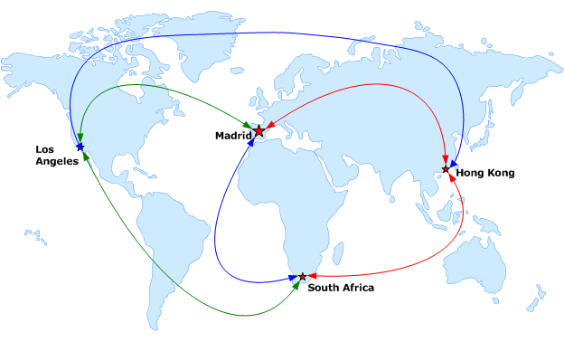
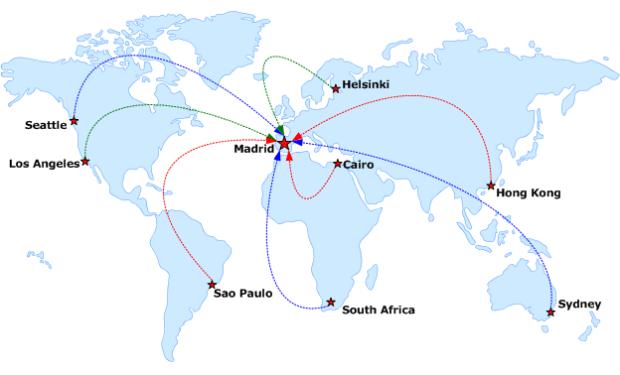
When to go for Multiple Server Farms, SSPs
Why multiple Server Farms
Large Organizations - geographically spread
Industry requirements for physical isolation between sites
Internet/Extranet Publishing Sites that need to be isolated from Intranet Content
Different Performance and Scale Goals
Why multiple SSPs - Isolation of:
User Profiles
Search Scopes and Results
Audiences
Line of Business Data

Slide 36
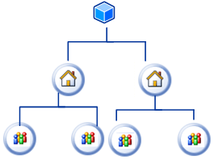
Web Applications vs Site Collections vs Sites
Web Applications vs Site Collections
High level of security isolation needed
Intranet vs Extranet content within a single farm – different content
High level policy overrides needed
Different SLAs for availability
Varying Site Characteristics impact performance (My Sites vs Team Sites)
Secure content authoring environment published to DMZ
Site Collections vs Sites
Commonality of Functionality, Objectives
Size of Content
Separate security and administration models
Commonality required (or not required):
Site Columns and Content Types, Reusable Content
Workflows, Site Quotas, Recycle Bin
SharePoint Security Groups, Policies
Master Pages, Site and List Templates, Themes, Styles ,
Web Part Galleries, (Look and Feel, Branding), Navigation
Search Scope, Best Bets and Keywords,
OOTB Backup and Restore
Feature sets, Usage Reports, Site Locking

Slide 37
Web Applications – Paths & Zones
Paths
Choose unmanaged paths - Web Application to host only one site collection
Choose Managed Paths - Web application to host multiple site collections
Managed Paths can be
Explicit Inclusions
Wild Card Inclusions
Explicit Inclusion Paths - no site collections below
Wild Card Inclusion Paths - auto create a site collection below
Explicit Inclusions limit to 100 site collections in a Web Application
Zones
Default, intranet, extranet, internet , custom
Plan for separate zones when:
Content for multiple partners - authenticated differently
Content accessed by both Intranet as well as Extranet users
Need different/exceptional policy permissions
SSL turned on or off for different zones
Need Alternate Access Mappings
Intranet application requires Forms Based Authentication
Need different caching scenarios
Need to deploy custom HttpModules specific to each zone

Slide 38
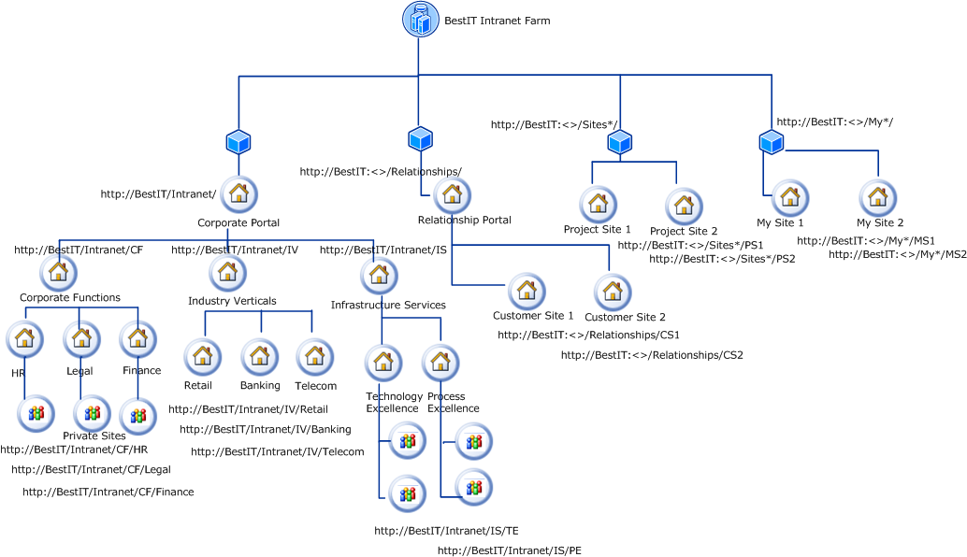
BestIT Proposed Portal Structure
BestIT

Slide 39
Approach the IA Problem
Determine Portal Structure and Navigation Needs
Plan for Metadata (Taxonomy)
Plan for Collaborative Content
Determine Security Requirements
Plan for Informational Flow (Workflow)
Determine Discoverability (Search) Requirements
Plan for Compliance and Records Management
Plan for Business Data Integration
Plan for Personalization
Design Overall Portal and Hierarchy

Slide 40
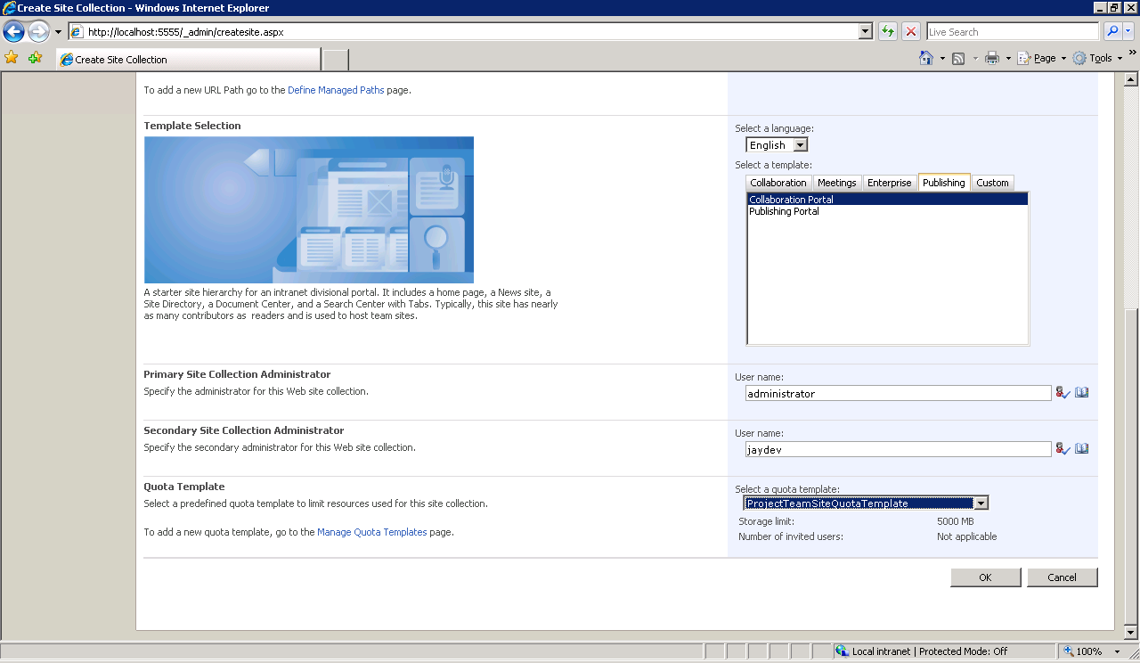
Plan for the following…
Overall Portal and Site Structure
Master Page – Logos and Themes
Global Navigation
Contextual Navigation
Site Map (Directory)
Search Center (Basic and Advanced)
Choice of Site Templates
Collaboration Portal
Publishing Portal
Team Site
Search Center
Site Directory
Document Center
Records Center
Blog, Wiki Templates
Custom Site Templates vs Site Definitions

Slide 41
BestIT opts for following…
BestIT
BestIT determines the following needs for its overall branding, navigation and content organization:
Intranet Portal, Corporate Functions, Infrastructure Functions to follow a common branding with a common top level custom global navigation menu, placeholder for breadcrumb and custom theme
Global menu to reflect each of the above along with Site Map and Help
One level Fly out menu for each top level menu
Search Center to be provided just beneath Global Menu and to be made universally available
Left Navigation Menu to be contextual as per current site and configurable by site owners as per taxonomy/requirement of site
BestIT creates custom site definitions
Relationship Portals to allow flexibility for branding based on specific customer relationships
Team /Project Sites are free to follow their own branding/overall look and feel

Slide 42
Approach the IA Problem
Determine Portal Structure and Navigation Needs
Plan for Metadata (Taxonomy)
Plan for Collaborative Content
Determine Security Requirements
Plan for Informational Flow (Workflow)
Determine Discoverability (Search) Requirements
Plan for Compliance and Records Management
Plan for Business Data Integration
Plan for Personalization
Design Overall Portal and Hierarchy

Slide 43
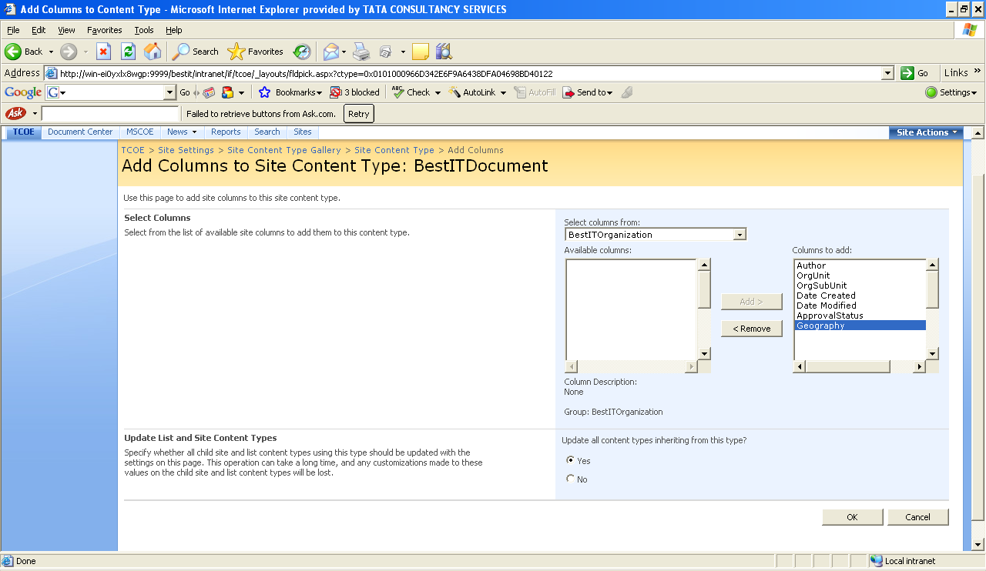
Plan for Meta Data - Site Columns, Content Types
Formal Meta Data Planning Exercise
Understand the organizational vocabulary, content structures
Taxonomy depends on line of business
Abstract meta data for maximum reusability
Common terms/definitions/vocabulary become Site Columns
Exploit lookup lists for site columns
Common Content Structures become Content Types
Content Types are inheritable and extensible
Content Types can be associated with:
Workflows
Information Management Policies
Document Templates
Can apply to Lists and Document Libraries
Available to all Sites in a Site Collection
Can use Site Columns
Are searchable (content query web parts)
Important: Review and Agree on Site Columns and Content Types
Determine what meta data are mandatory and optional

Slide 44
Content Patterns across BestIT – An Example
HR
HR Policies
HR Manuals
Corporate Functions
Policies
Manuals
Any BestIT Asset
Author
Title
Org Unit
Owner
Approved By
Sub Unit
Procedures
HR Procedures
CV Templates
Legal
Legal Policies
Legal Manuals
Corporate Functions
Policies
Manuals
Any BestIT Asset
Author
Title
Org Unit
Owner
Approved By
Sub Unit
Procedures
Legal Procedures
Legal Contracts
Corporate Communications
Newsletters
Brochures
Corporate Functions
Policies
Manuals
Any BestIT Asset
Author
Title
Org Unit
Owner
Approved By
Sub Unit
Procedures
Policies

Slide 45
Technology Center of Excellence
Sample Taxonomy
BestIT
PreSales
Capabilities
Offerings
Proposals
Customer Case Studies
Citations and References
Delivery
Engagement Approach and Methodology
Development Template
Maintenance and Support Template
Migration Template
QA and Testing Template
Risk Management Template
Project Plan Template
Life Cycle Assets
Requirements Template
Design Template
Coding Standards
Test Plan templates
Doc Lib
Technology (Horizontal)
Best Practices
Reference Solution Architecture
Framework
Solution Accelerators
Knowledge Base Articles
Competency
Training Decks
Web Based Training
Certification Guides
eBooks
Training Calendar
Content Type

Slide 46
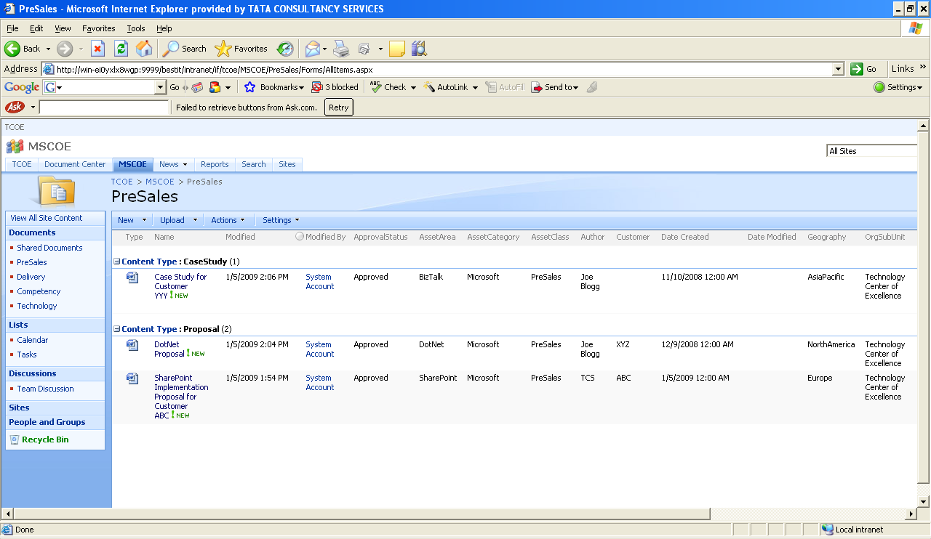
Technology Center of Excellence
Sample Taxonomy
BestIT

Slide 47
Approach the IA Problem
Determine Portal Structure and Navigation Needs
Plan for Metadata (Taxonomy)
Plan for Collaborative Content
Determine Security Requirements
Plan for Informational Flow (Workflow)
Determine Discoverability (Search) Requirements
Plan for Compliance and Records Management
Plan for Business Data Integration
Plan for Personalization
Design Overall Portal and Hierarchy

Slide 48
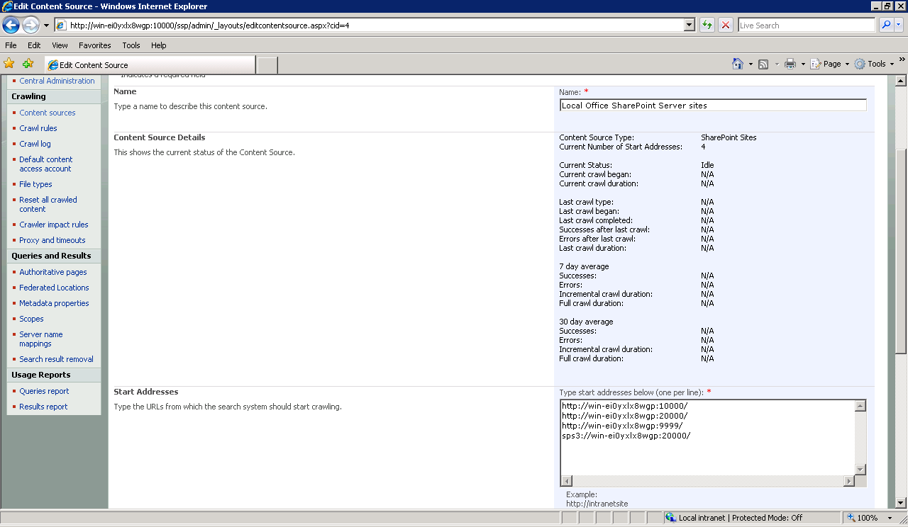
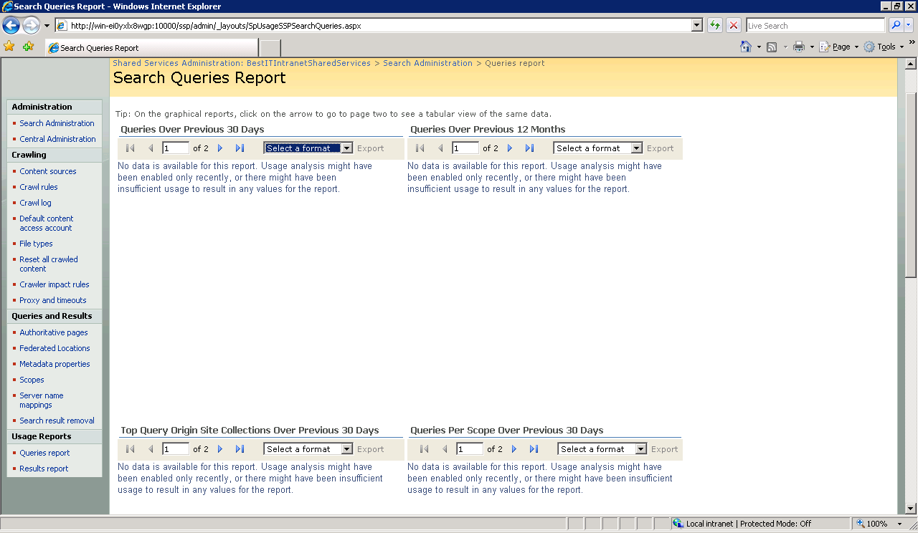
What to consider/plan for?
Basic Search and/or Advanced Search
Content Sources
Search Scopes
Scope Rules
Crawl Rules
File Types
Meta Data property mappings
Server Name Mappings
Key Words, Synonyms, Best Bets
Search-based Alerts
People Search
Review Search Usage

Slide 49
What this means for BestIT?
BestIT
Advanced Search Center - People and Assets
Managed properties - Asset Class, Asset Area and Asset Category
Custom scopes using managed properties for COE sites
Synonyms and Best Bets for some of its key words –
Keyword: SharePoint, Synonyms: SPS 2003, MOSS 2007, Collaboration, Best Bet: SharePoint COE site
BestIT creates custom crawl rules to exclude specific sub sites such as its Legal “Private” Site from its content sources
Separate SSP for its Relationship Portals since a higher level of isolation is required as far as Search is concerned

Slide 50
Approach the IA Problem
Determine Portal Structure and Navigation Needs
Plan for Metadata (Taxonomy)
Plan for Collaborative Content
Determine Security Requirements
Plan for Informational Flow (Workflow)
Determine Discoverability (Search) Requirements
Plan for Compliance and Records Management
Plan for Business Data Integration
Plan for Personalization
Design Overall Portal and Hierarchy

Slide 51
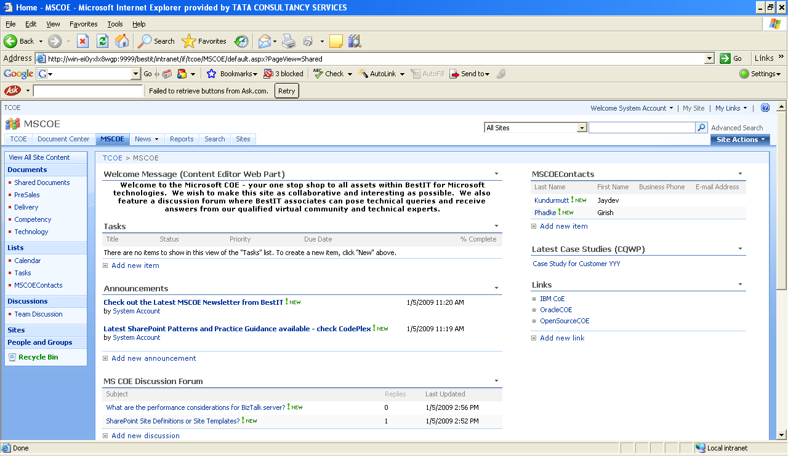
What to Consider/Plan For?
Do your sites require?
Alerts
Announcements
Tasks
Calendar
Document review and approval workflows
RSS
Social networking
Discussion Boards
Surveys
Blogs
Wikis
Choice of Site Templates

Slide 52
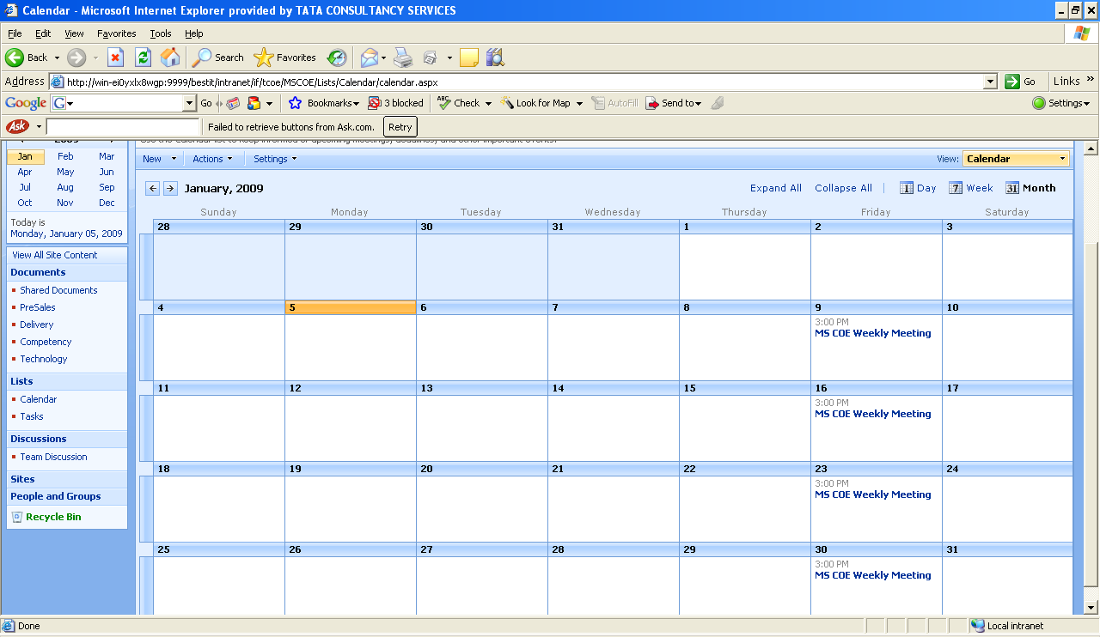
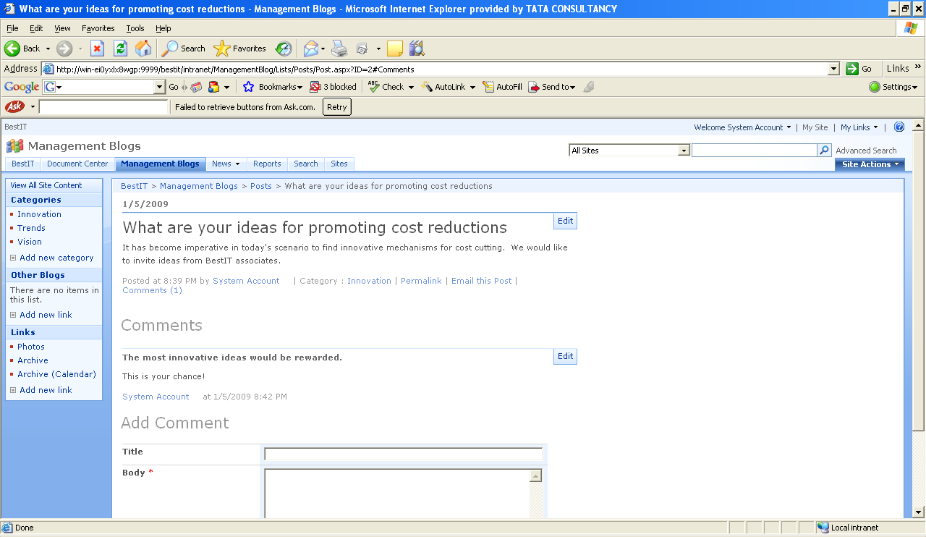
What this means for BestIT?
BestIT
Significant collaborative features throughout Intranet Portal and Project Team Sites
Rating of content and feedback from associates
Senior Management Blogging Site
Enterprise Level Discussion Forum
Discussion Forums for COEs supported by virtual communities
Tasks and Calendar items synchronized with Outlook
Aggregate and surface information from its main portal sites
Wikis on its Team Sites to allow project teams to collaboratively and concurrently work on building project documents
Subscribe alerts on specific lists (announcements, news, discussion forums)

Slide 53
Approach the IA Problem
Determine Portal Structure and Navigation Needs
Plan for Metadata (Taxonomy)
Plan for Collaborative Content
Determine Security Requirements
Plan for Informational Flow (Workflow)
Determine Discoverability (Search) Requirements
Plan for Compliance and Records Management
Plan for Business Data Integration
Plan for Personalization
Design Overall Portal and Hierarchy

Slide 54
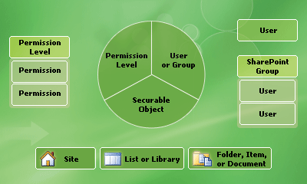
What to consider/plan for?
Site ,List , Folder, Item level security
Permissions & Levels – Full Control, Contribute, Design, Read, Approve, custom?
User permissions for Web applications
SharePoint Site Groups – Visitors, Members, Owners or Custom?
Security Inheritance vs Override s
Web Application Policies
Information Management Policies
SharePoint groups based on AD groups

Slide 55
What this means for BestIT?
BestIT
Each corporate function to avail of default groups.
Security inheritance overrides for Center of Excellence
Specific content given contribute access to specific custom groups
Relationship Portals have extremely limited access even for Read, besides they should not appear in Search Results across the Portal – as they are part of a separate isolated Web Application, a separate SSP can be created for this web application
Team/Collaboration Sites are also private to teams - inter team site access is also to be kept to a minimum – but team sites are large in number – they should also not appear in Search Results across the Portal – custom scopes can be created to exclude the web application containing the team sites from search on the main portal.
Information Management Policies applied for auditing specific assets download on Center of Excellence sites
BestIT wishes to temporarily bar specific individuals from editing any content on any site within its overall portal – it does this via policies at web application level

Slide 56
Approach the IA Problem
Determine Portal Structure and Navigation Needs
Plan for Metadata (Taxonomy)
Plan for Collaborative Content
Determine Security Requirements
Plan for Informational Flow (Workflow)
Determine Discoverability (Search) Requirements
Plan for Compliance and Records Management
Plan for Business Data Integration
Plan for Personalization
Design Overall Portal and Hierarchy

Slide 57
What to consider/plan for?
Information Push
Target audiences
User profiles and attributes
Rules - properties, groups, distribution lists
Controlled by producers of content (rather than consumers of content)
Alerts
What information? What granularity?
Lists, document libraries, Site Links
Item level or List Level or across Lists, Sites
Content Query Web Part, List View Web Parts…
Information Self Service and Composability
Web Part personalization
My Sites
Alerts

Slide 58
What this means for BestIT?
BestIT
BestIT creates the following audiences based on its user profiles inherited from its Corporate Active Directory:
Industry Vertical Leads
Senior Management
Infrastructure Leads
Quality Managers
BestIT targets key announcements that relate to latest trends in the IT industry pertinent to these audiences
BestIT also creates a personalizable web part zone on one of the corporate pages where end users can optionally subscribe to an RSS feed of their choice or create personal links or display a personal view of a Corporate Announcements List .
BestIT provisions My Sites for each of its employees based on a customized template and restricts the site quota to around 5 GB. Employees find it convenient to create their private meeting workspaces with their colleagues to share information, create personal quick links, view their personal tasks/calendars and share any information with the general associate base at large via the public view.

Slide 59
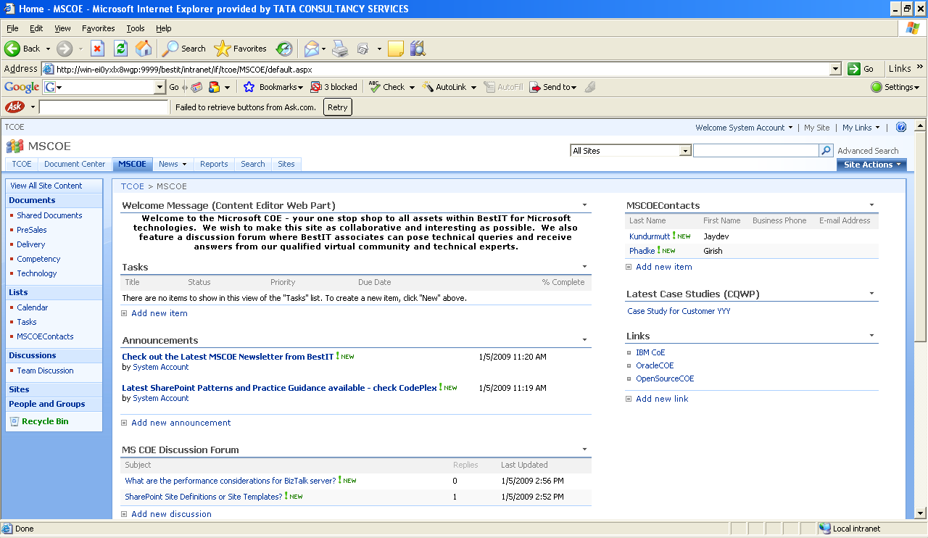
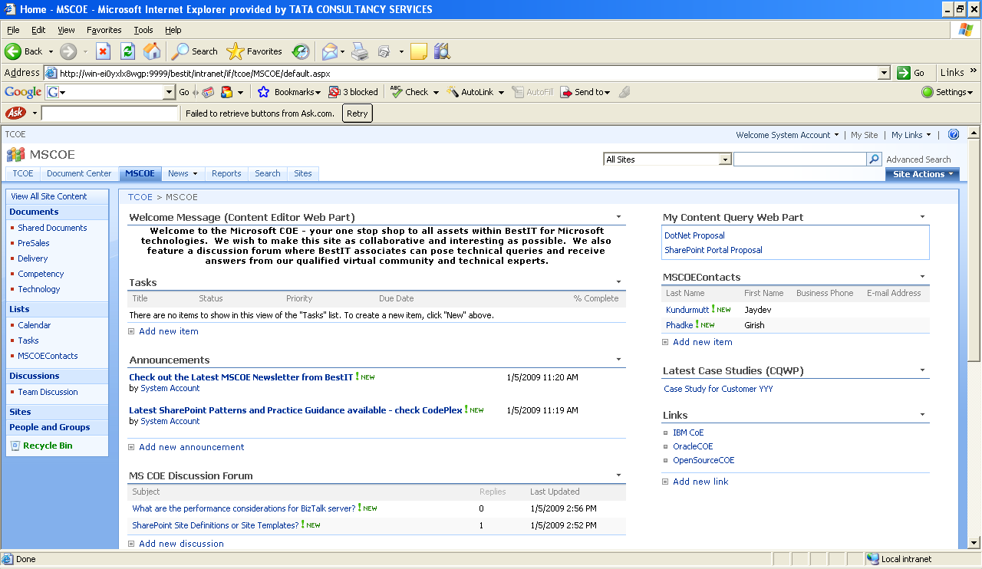
What this means for BestIT?
BestIT
Shared View
Personal View

Slide 60
Approach the IA Problem
Determine Portal Structure and Navigation Needs
Plan for Metadata (Taxonomy)
Plan for Collaborative Content
Determine Security Requirements
Plan for Informational Flow (Workflow)
Determine Discoverability (Search) Requirements
Plan for Compliance and Records Management
Plan for Business Data Integration
Plan for Personalization
Design Overall Portal and Hierarchy

Slide 61
What to consider/plan for
Need to identify, classify and maintain a formal repository of documents as “records” (evidence of activity or transaction) – based on a file plan
Need for formal record retention, expiry and disposal policies
Auditing/monitoring of records, versioning
IRM (Information Rights Management)
Meta data
Workflow and approval processes
Who is responsible/authorized for classifying, maintaining and disposition of records?
Do e-mails also need to be preserved as records?
What processes are in place for “holding” records to serve litigation inquiries?

Slide 62
What this means for BestIT?
BestIT
Analyzes/classifies content - collaboration across various departments
Prepare File plan
Plans Record Center
Document Libraries with content types, site columns
Policies – Retention, Auditing
Record Routing Table
Disposition Approval Workflows
Bar Codes, Labels
Holds
Information Management Policies
Stringent Security and Isolation
Design Mechanisms for routing documents to Record Center

Slide 63
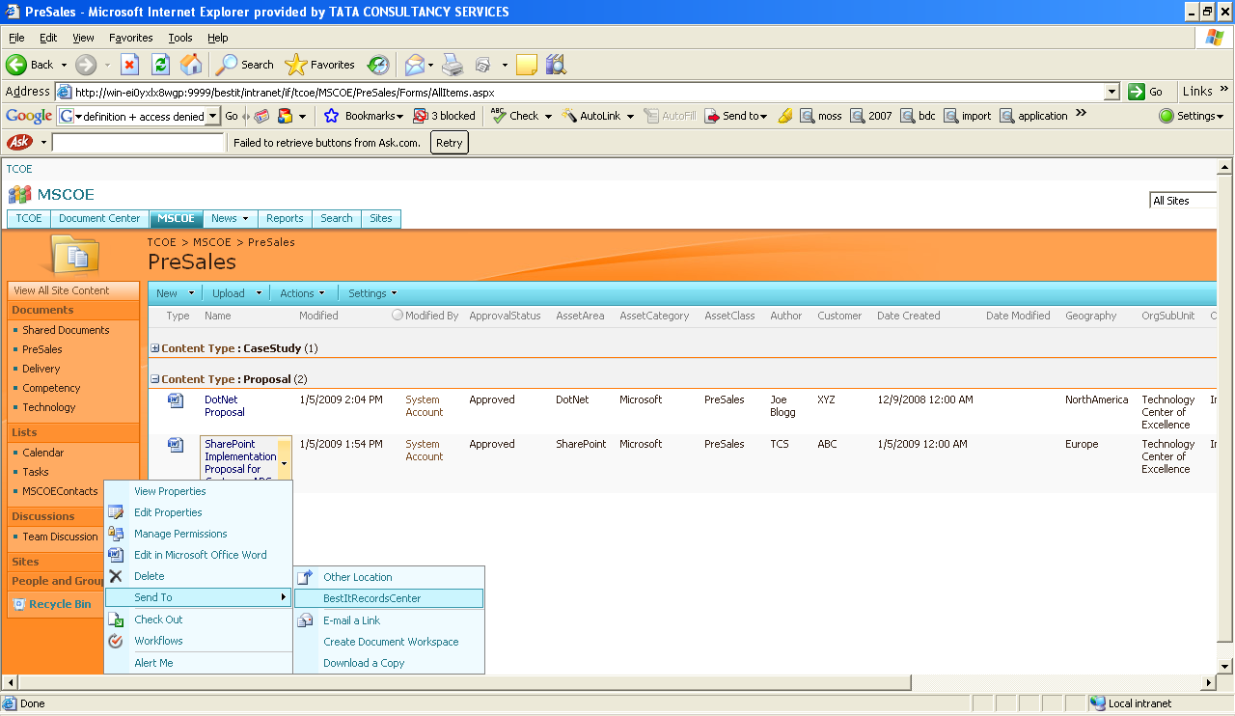
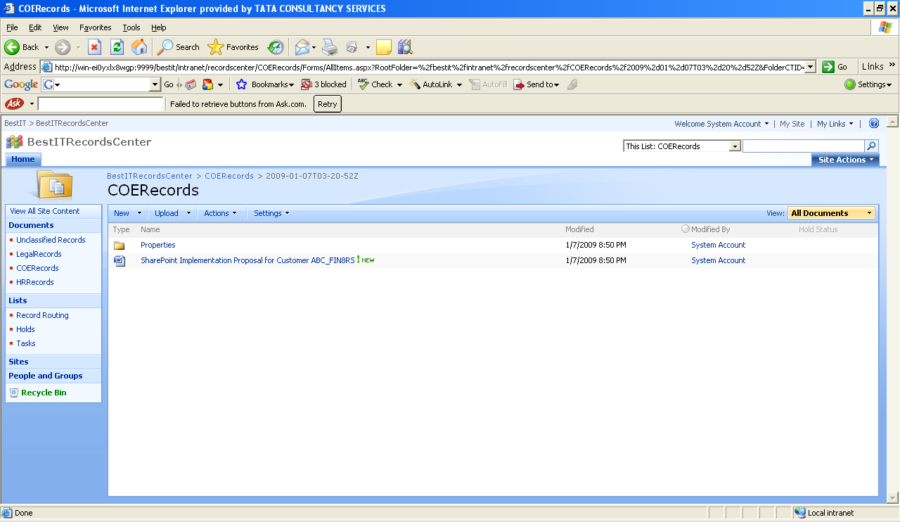
What this means for BestIT?
BestIT
Document sent to Record Center

Slide 64
Approach the IA Problem
Determine Portal Structure and Navigation Needs
Plan for Metadata (Taxonomy)
Plan for Collaborative Content
Determine Security Requirements
Plan for Informational Flow (Workflow)
Determine Discoverability (Search) Requirements
Plan for Compliance and Records Management
Plan for Business Data Integration
Plan for Personalization
Design Overall Portal and Hierarchy

Slide 65
What to consider/plan for
What business processes exist in the organization that follow an information flow, review and approval path – how much of this can be automated?
Leave application
Travel requests
Expense approval
Contracts review and approval
Global IT Helpdesk
How close knit are workflows with common office based tools that employees use such as Word, Excel, Outlook
To what extent are these information flows associated with forms entry and validation
Are there requirements for content authored by specific departments to be published on an ongoing basis on the organization’s web site
Are there requirements for departmental documents to be reviewed and approved prior to publishing them formally to employees
Does the organization need to have processes in place for records disposition/archival?

Slide 66
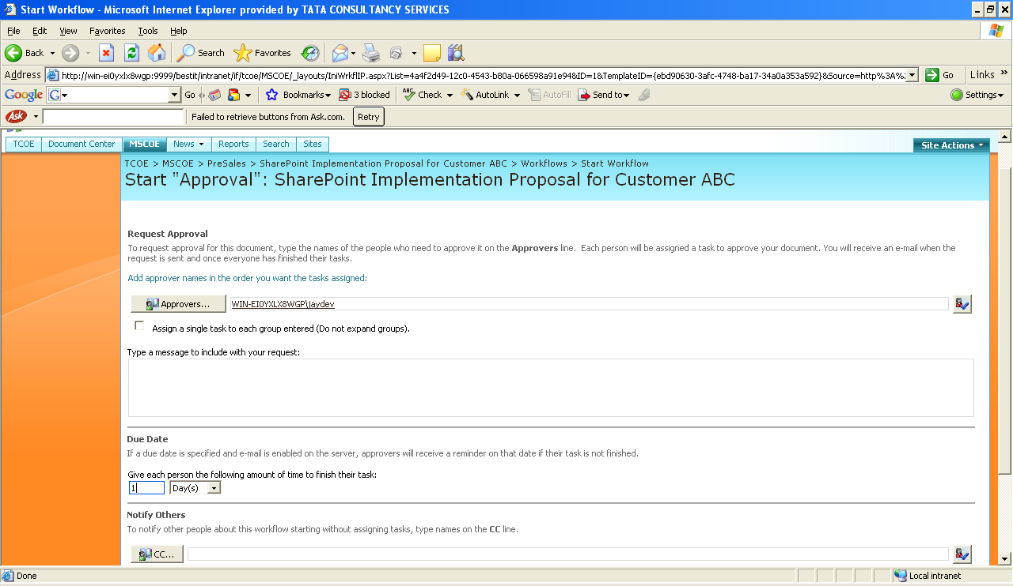
What this means for BestIT?
BestIT
Workflows identified for:
Knowledge Assets
Corporate Content Publication
HR, Legal Policy Documents
Project startup
Quality Audit workflow
How?
Custom Web Parts,
Content Authoring Site
InfoPath Forms & Custom Workflows

Slide 67
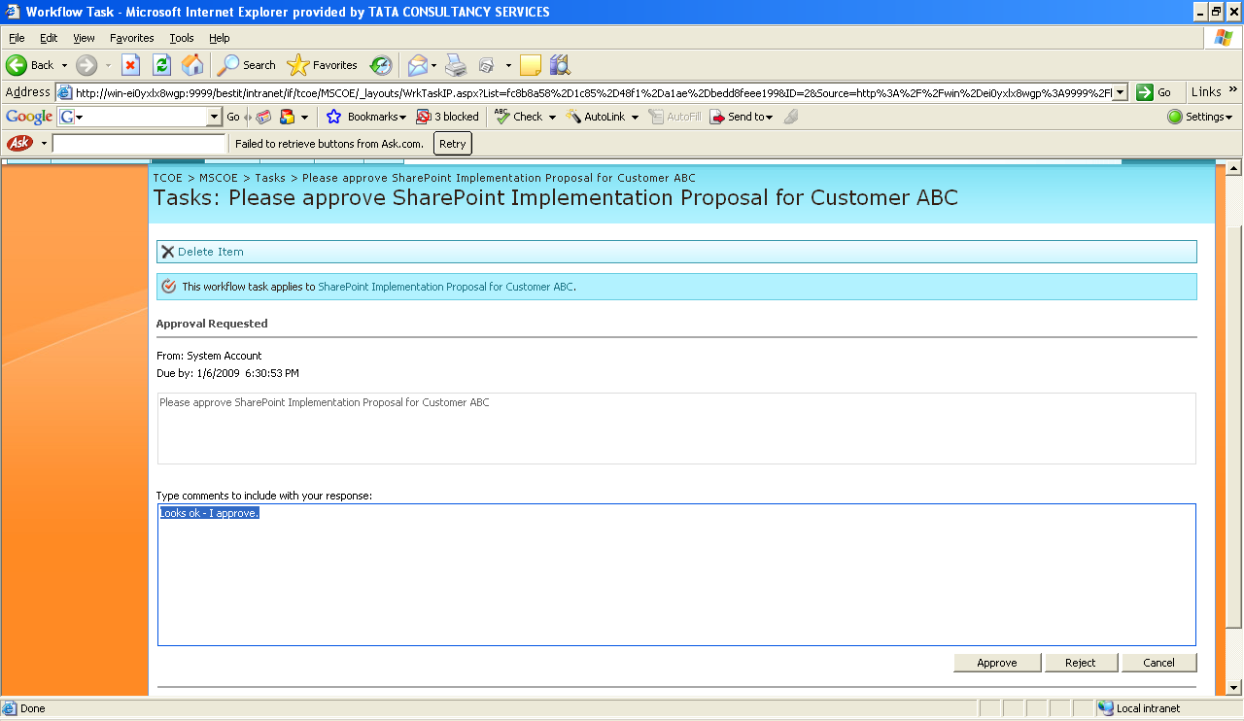
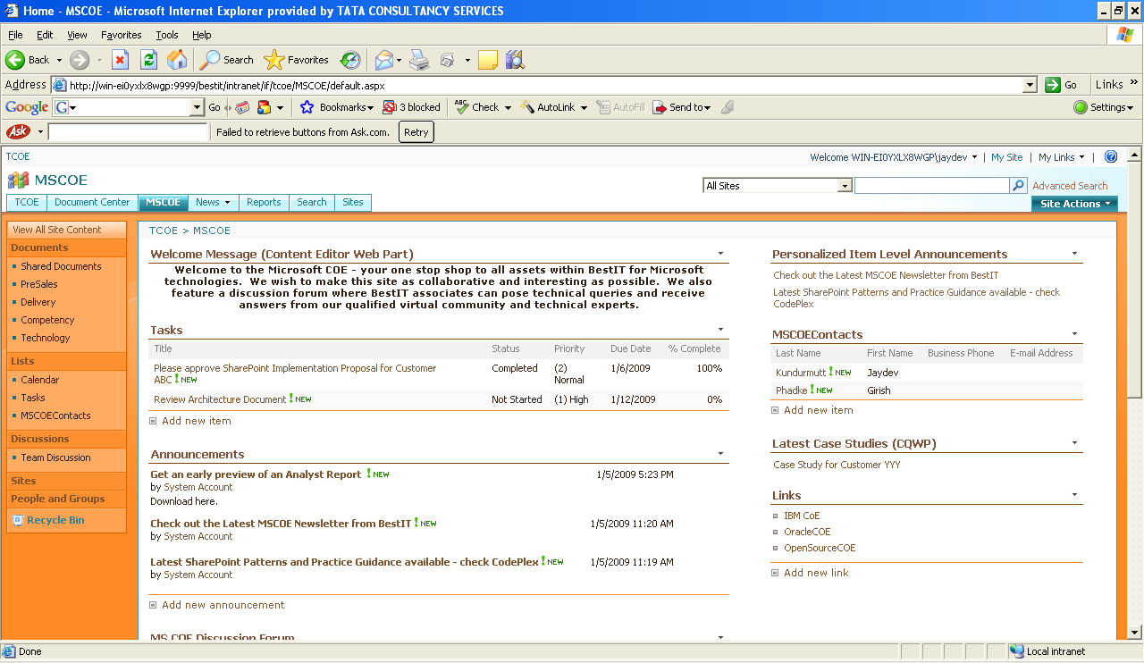
What this means for BestIT?
BestIT
Workflow for Proposal Approval starts
Approver approves
My Tasks shows Complete

Slide 68
Approach the IA Problem
Determine Portal Structure and Navigation Needs
Plan for Metadata (Taxonomy)
Plan for Collaborative Content
Determine Security Requirements
Plan for Informational Flow (Workflow)
Determine Discoverability (Search) Requirements
Plan for Compliance and Records Management
Plan for Business Data Integration
Plan for Personalization
Design Overall Portal and Hierarchy

Slide 69
What to consider/plan for
Are there any business critical application data that needs to be surfaced onto the portal?
Can the business data be indexed and searched on the portal?
What form are the business data available?
Exposed as Web Services
SQL Databases
Packaged applications such as Siebel or PeopleSoft
What are the security restrictions in accessing the business data?
Are all fields in a given record accessible to all users or do different sets of users have different levels of access to fields in a record?
Is there an opportunity for business data to serve as lookups on lists or content types within the main portal?
Is there a requirement to update any data back to the business applications?
Does the organization have a lot of its information embedded in Excel spreadsheets / OLAP sources that can be made available as dashboard information to senior management with the ability to do simple what-if analysis?

Slide 70
What this means for BestIT?
BestIT
BestIT has a global IT helpdesk application that exposes web service API to determine the number of help desk tickets at various statuses on any given day – this information is valuable to Senior Management to keep a tab on the overall health of corporate applications
Management would like to see some of the data attributes included as part of its own lists for computing KPIs that it creates for communicating further information to the organization as a whole
BestIT creates application definition files for the Help Desk application exposing Entities such as Tickets and Methods for retrieving the Ticket Records that are open for more than 1 day, Number of Tickets closed within SLA etc, Applications with the highest and lowest number of tickets etc. Data is exposed via Business Data List Web Parts
Permissions to view the ticket records and status is granted only to Senior Management SharePoint group and displayed in the Management Dashboard Site
A custom scope to search Tickets Data is created and included only on the Management Dashboard site
BestIT Corporate PMO consolidates monthly performance data in excel spreadsheets received from various organizational units – it decides to publish this data via excel services and excel web parts on the management dashboard site and expose certain data attributes as parameters for what-if analysis. Complex macros used to compute analysis data are effectively hidden from public view.

Slide 71
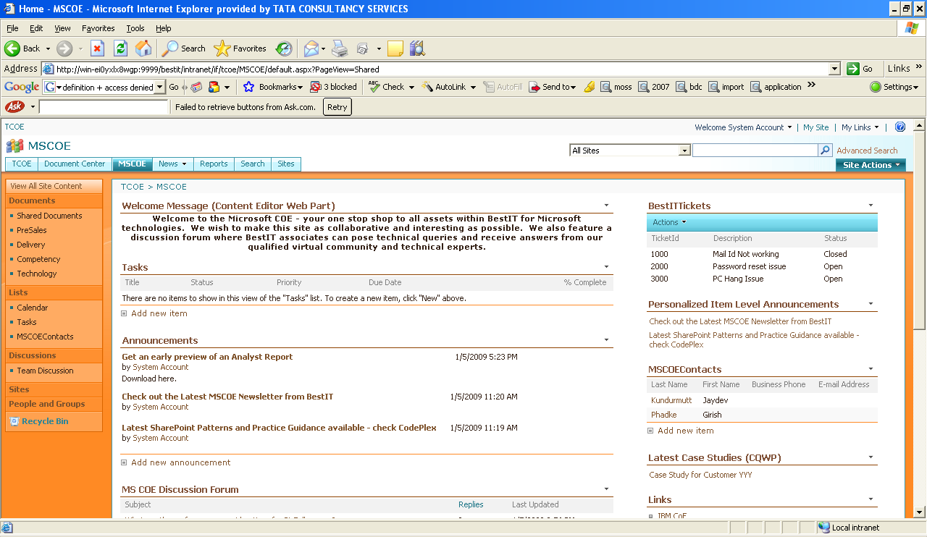
What this means for BestIT?
BestIT
Business Data List

Slide 72
Portal Evolution
Business Data, Apps, Rollup, Personalization
Strong Governance Model & Sponsorship
Deploy – Stage 4
Deploy – Stage 3
Emp Self Service
More Departments
Increase Adoption
Deploy – Stage 2
Document Workflows,
Deploy – Stage 1
Senior Management,
Key Departments
Pre Launch Testing
Portal, Branding, Site Templates, Corp Comm
Quick Wins
Out of Box
Usage Feedback,
POC/Pilot
Engage, Leading Questions
Envision
Basic Doc Mgmt, Collaboration, Search
Ideas, High Level Reqs
Evangelize
Appreciation, Understanding, Ideas

Slide 73
Governance Structure
Program Management, Steering Committee, Executive Sponsorship
Portal / Information Architect
Site Designer
Information Worker
Portal, Site Administrators
Developer
Training , Help Desk
Infrastructure Support

Slide 74
In Conclusion…
Information Architecture involves making a number of key decisions that must carefully weigh pros and cons of following one or the approach
While SharePoint offers a myriad of configurable, out of the box options to create information portals, Information Architecture if not planned carefully and with a strategic rather than tactical approach can lead to significant governance overheads
In general, approach Information Architecture incrementally
Understand that Information Architecture needs an organization-wide perspective requiring complete management and key stakeholder support

Slide 75
Resources
Planning and Architecture for SharePoint
http://technet.microsoft.com/en-us/library/cc261834.aspx
SharePoint Patterns and Practices Guidance
http://www.codeplex.com/spg/
Information Architecture for Fabrikam Industries
http://go.microsoft.com/fwlink/?LinkId=91053
SharePoint Governance Checklist
http://office.microsoft.com/download/afile.aspx?AssetID=AM102552101033
Tag Driven Architecture – New Zealand Ministry of Transport
http://www.sharepointed.com/2008/05/01/how-we-did-it-tag-driven-information-architecture-using-moss-2007-for-the-new-zealand-ministry-of-transport-2/
Overview and several links on MOSS Information Architecture and Governance
http://blogs.msdn.com/joelo/archive/2007/03/16/information-architecture-and-the-information-architect.aspx

Slide 76
Thank You
Take part in our contest and you stand to win an HTC Diamond phone. Go to http://www.microsoftasap.com for more details.

